Slide 1
Programming Skills: more R fun(ctionality)
Modern Techniques in Modelling

Slide 2
What we will introduce in this session
‘control statements' to automate and increase functionality
'functions' in R and how to write your own
'packages' in R to use other people’s code
'sourcing’ other code from different files

Slide 3
Control Statements

Slide 4
Types of Control Statements
‘Loops’ are what they sound like, they repeatedly loop through a bit of code, evaluating it each time. Most programming languages have loops, let’s look at the two popular ones:
‘for’ loops
‘while’ loops
Other helpful control statements are:
‘if-else’ statements
‘break’ / ‘next’ statements

Slide 5
For-loops
Let’s take a look at an example:
square.vector <- c() for (counter in 1:10){ counter.square <- counter^2 square.vector <- c(square.vector, counter.square) }
What is this doing?

Slide 6
A for-loop alternative
‘for-loops’ are often fairly long-winded, and can be slow to evaluate. Are there alternatives? R is a language where code can generally be ‘vectorized’ easily. I.e. operations can be performed on whole vectors all at once (rather than looping through individual elements.
square.vector <- c() for (counter in 1:10){ counter.square <- counter^2 square.vector <- c(square.vector, counter.square) }
Vs.
square.vector <- (1:10)^2

Slide 7
While-loops
Let’s take a look at an example:
x <- 5; # set value of x while (x > 0){ x <- x - 1 # on every loop, minus 1 from x print('x is positive') }

Slide 8
While-loops
Let’s take a look at an example:
x <- 5; # set value of x while (x > 0){ x <- x - 1 # on every loop, minus 1 from x print('x is positive') }
Be careful with ‘while’ loops…
x <- 5; # set value of x while (x > 0){ x <- x + 1 # on every loop, add 1 to x print('x is positive’) }

Slide 9
If-Else statements
Let’s take a look at an example:
if (x < 0){ print('warning: x is negative') } else{ print('x is positive, carry on') }

Slide 10
If-Else statements
Let’s take a look at an example:
if (x < 0){ print('warning: x is negative') } else{ print('x is positive, carry on') }
‘if’ does not need to be followed by ‘else’ and chain multiple statements
if (condition1){
# do something } else if (condition2){ # do something else } else if (condition3){
# do something else entirely }
else {# final option }

Slide 11
Break statement
An example:
square.vector <- c() for (counter in 1:10){ counter.square <- counter^2 if (counter.square > 80){ break } square.vector <- c(square.vector, counter.square) }
What will square.vector equal when we run this?
What will counter equal when we run this?

Slide 12
Nested Statements
You can add as many statements to your code as you like

Slide 13
Nested Statements
An example:
# initialise your variables index.mort <- 0 index.ps <- 0 mortality.rate <- matrix(,nrow=3,ncol=3) # Loop around the possible values for mort for (mort in c(103, 401, 322)){ index.mort <- index.mort + 1 index.ps <- 0 # Loop around the possible values for pop size for (ps in c(1e4, 5e4, 7.5e4)){ index.ps <- index.ps + 1 mortality.rate[index.mort,index.ps] <- 10000 * mort / ps } }

Slide 14
Loop alternatives
Sometimes loops are difficult to read, difficult to write, and take up a lot of lines of code Often there are multiple ways of achieving the same goal in R – without loops.
THINK: what is a) quicker to run, b) easier to read
Let’s rewrite our previous example:
# Define the number of deaths mort <- c(103, 401, 322)
# Define the population size ps <- c(1e4, 5e4, 7.5e4)
# Enumerate all the combinations of mort and ps pop.epi <- expand.grid(mort.val = mort, ps.val = ps) # Calculate the mortality rate per 10,000 mortality.rate <- 10000 * pop.epi$mort.val / pop.epi$ps.val

Slide 15
Functions

Slide 16
What is an R function?
Any set of operations that, when given a set of arguments (or NULL), returns an object AND
where the set of operations are enclosed within the function{} keyword

Slide 17
What is an R function?
# VaccineThreshold function takes two arguments VaccineThreshold <- function(trans.rate, recovery.rate){ # equation for R0 in an SIR model R0 <- trans.rate / recovery.rate # equation for the critical vaccination threshold vaccine.threshold <- 1 - 1/R0 # output of the function return(vaccine.threshold) } VaccineThreshold(1, 0.2)

Slide 18
What is an R function?
Compare this regular R `script’:
#Example of an R script a <- 1; b <- -4; c <- -2 sol <- c(0,0) sol[1] <- (-b + sqrt(b^2 - 4*a*c))/(2*a) sol[2] <- (-b - sqrt(b^2 - 4*a*c))/(2*a) print(sol)
To this function:
#Example of an R function quadratic.soln <- function(a,b,c){ sol <- c(0,0) sol[1] <- (-b + sqrt(b^2 - 4*a*c))/(2*a) sol[2] <- (-b - sqrt(b^2 - 4*a*c))/(2*a) return(sol) } quadratic.soln(1,-4,-2) quadratic.soln(b=-4,c=-2,a=1)

Slide 19
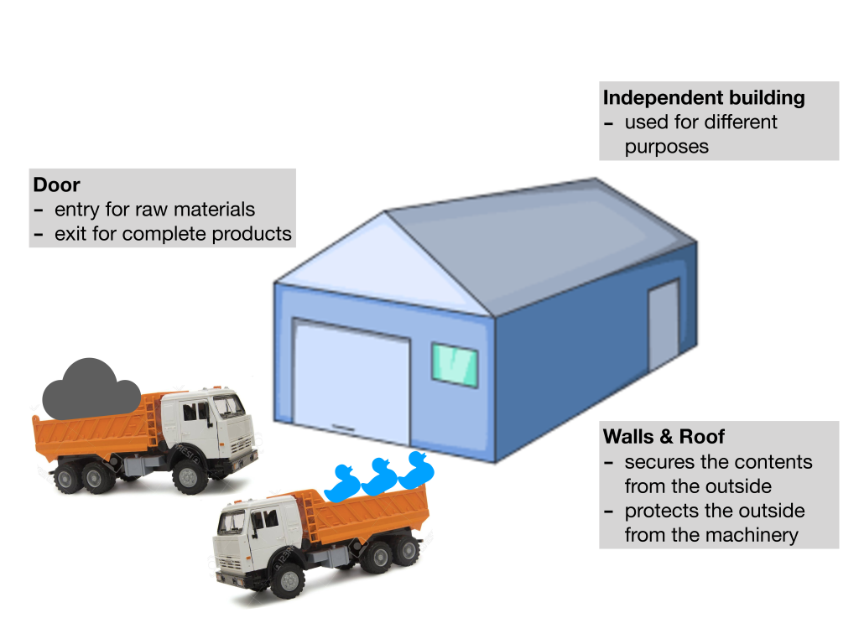
Why do we need to use functions?

Slide 20
An aside on Scoping
Scoping is how R knows where to look for value assignments e.g. print(a) where does R look for a?
R looks for a in its current working environment (e.g. function or top level workspace), if it can’t find it, it looks in the level above, then the next level above etc.
If it can’t find it in any of these environments, R will throw an error

Slide 21
An aside on Scoping
But why does it matter? Let’s look at an example:
Reff.calc <- function(R0){ reff <- R0 * imm.prop }
If we haven’t defined imm.prop, there’s an error (not bad), otherwise it might use a previously defined value that you might not expect, and you’ll never know (very bad)
You can find out what’s in your working environment by typing ls() and remove a variable by rm(imm.prop)

Slide 22
Packages and Sourcing

Slide 23
Packages
A package is a bundle of functions, already written and documented by another R user
Often there is a package with functions already written to save you reinventing the wheel
In Rstudio, either GUI: Tools > Install Packages... or in console type install.packages("myPackage")
Now, when you want to use a package, simply type library(myInstalledPackage)
You can use the functions in the package exactly how you use other base functions but sometimes helpful to use the “::” notation which shows code users where the function is from. E.g. mutate()is the same as dplyr::mutate()

Slide 24
Sourcing code from different files
You may want to split your code between multiple .R files
readibility: too much code for one document
organisation: group different functions into the same thematic files
error reduction: any replication of code writing WILL lead to errors (better to be lazy!)
Simply write source("myfilename.R") into a script / function, and R will read in the contents of myfilename.R at the point where source is called

Slide 25
Over to you
Open up Practical_P02_ProgrammingSkills.R

