Slide 1
Plotting model output with ggplot2
Modern Techniques in Modelling

Slide 2
Introduction

Slide 3
Tidyverse
The tidyverse suite of R packages is designed to make working with data as easy as possible
The relevant packages from tidyverse for us are
ggplot2: for plotting data
dplyr: for manipulating data frames
tidyr: for making data tidy
library(tidyverse)

Slide 4
Long and wide tidy data
Every data set has its own quirks
Tidy data frames consist of a number of observations (rows) of variables (columns), they can be either wide or long
Data needs to be the right shape for the functions being used
ggplot2 usually requires long data

Slide 5
Long and wide tidy data
An example of a wide data frame which we might encounter is the output of an SIR model

Slide 6
Wide data
key: this state at this time
value: proportion
Long data

Slide 7
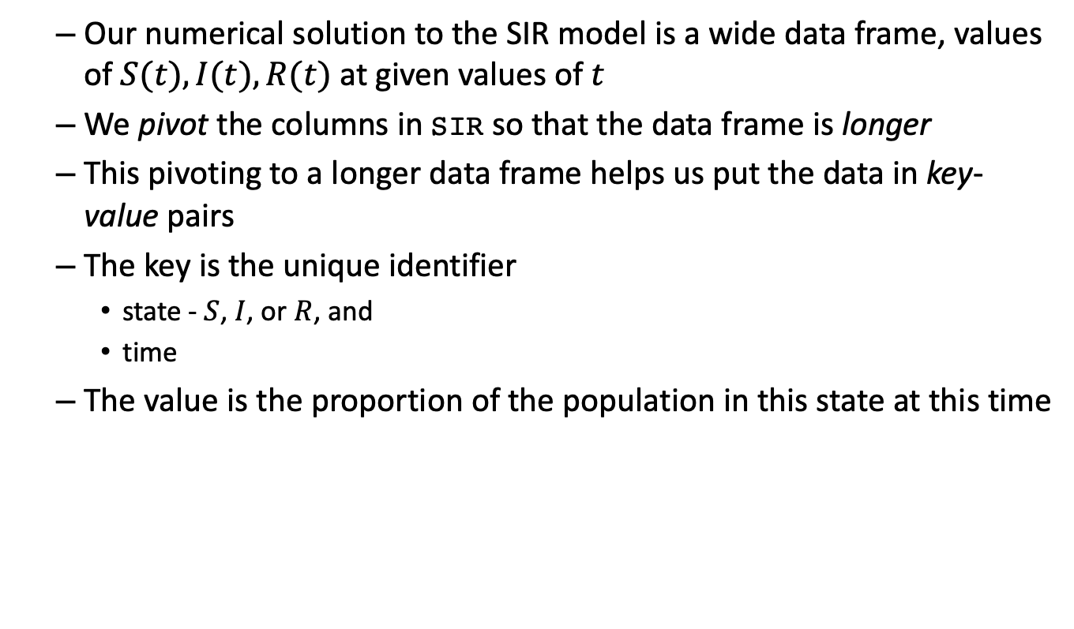
Long and wide tidy data
Our numerical solution to the SIR model is a wide data frame, values of $S(t),I(t),R(t)$ at given values of $t$
We pivot the columns in SIR so that the data frame is longer
This pivoting to a longer data frame helps us put the data in key-value pairs
The key is the unique identifier
state - $S$, $I$, or $R$, and
time
The value is the proportion of the population in this state at this time

Slide 8
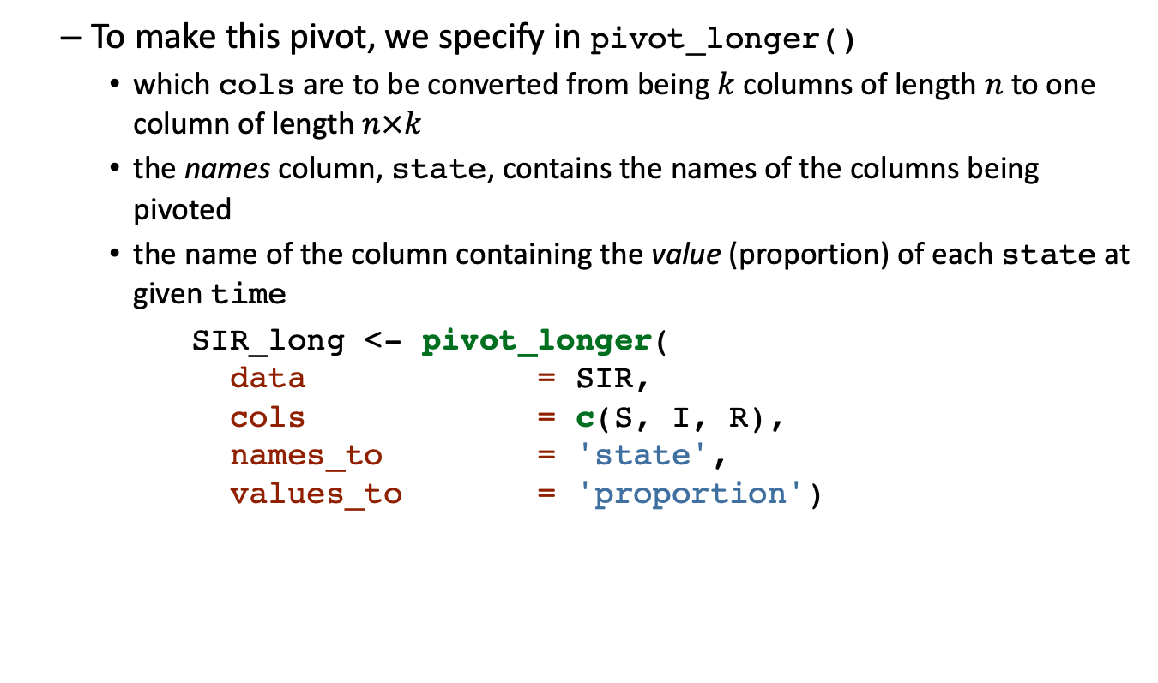
Long and wide tidy data
To make this pivot, we specify in pivot_longer()
which cols are to be converted from being $k$ columns of length $n$ to one column of length $n×k$
the names column, state, contains the names of the columns being pivoted
the name of the column containing the value (proportion) of each state at given time
SIR_long <- pivot_longer( data = SIR, cols = c(S, I, R), names_to = 'state', values_to = 'proportion')

Slide 9
Long and wide tidy data
Wide data
key: this state at this time
value: proportion
Long data

Slide 10
Visualisation with the grammar of graphics

Slide 11
Visualisation with ggplot2
R package ggplot2 uses a grammar of graphics
adding extra commands in a ‘do this, then do this’ manner
assign variables in data frame to aesthetic options in the plot
choose a plotting style for how to display these variables
adjustments to axis scales
adjustments to colors, themes, etc.
additional annotation
Focus is on visual relationships between variables rather than drawing points and lines
Options are properties of the elements of the plot rather than of plot itself

Slide 12
Visualisation with ggplot2
How do we tell the ggplot() function to make a plot?
Load the ggplot2 package, which contains the ggplot() function
Specify a data frame to use, containing the variables we want to plot
library(ggplot2) ggplot(data = my.data.frame)

Slide 13

Visualisation with ggplot2
How do we tell the ggplot() function to make a plot?
Then we set some aesthetic options to tell R which variables from my.data.frame to map to the $x$ and $y$ axes of the plot
ggplot(data = my.data.frame, aes(x = my.x.variable, y = my.y.variable))

Slide 14
Visualisation with ggplot2
How do we tell the ggplot() function to make a plot?
Geometries are the shapes we use to draw plots, e.g. lines, points, polygons, bars, boxplots
We will use the line geometry to build a time series plot
ggplot(data = my.data.frame, aes(x = my.x.variable, y = my.y.variable)) + geom_line()
We can set aesthetics aes(...) inside a geometry to modify the color, fill, alpha transparency, etc. according to a variable in the data frame

Slide 15
Visualisation with ggplot2

Slide 16
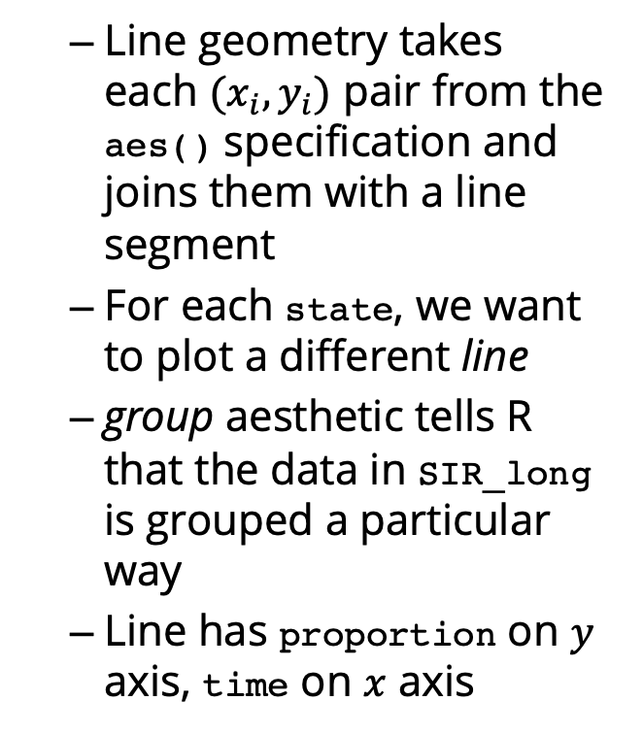
sir_ggplot <- ggplot( data = SIR_long, aes(x = time, y = proportion) ) + geom_line( aes(group = state) )
Line geometry takes each $(x_{i},y_{i})$ pair from the aes() specification and joins them with a line segment
For each state, we want to plot a different line
group aesthetic tells R that the data in SIR_long is grouped a particular way
Line has proportion on $y$ axis, time on $x$ axis

Slide 17
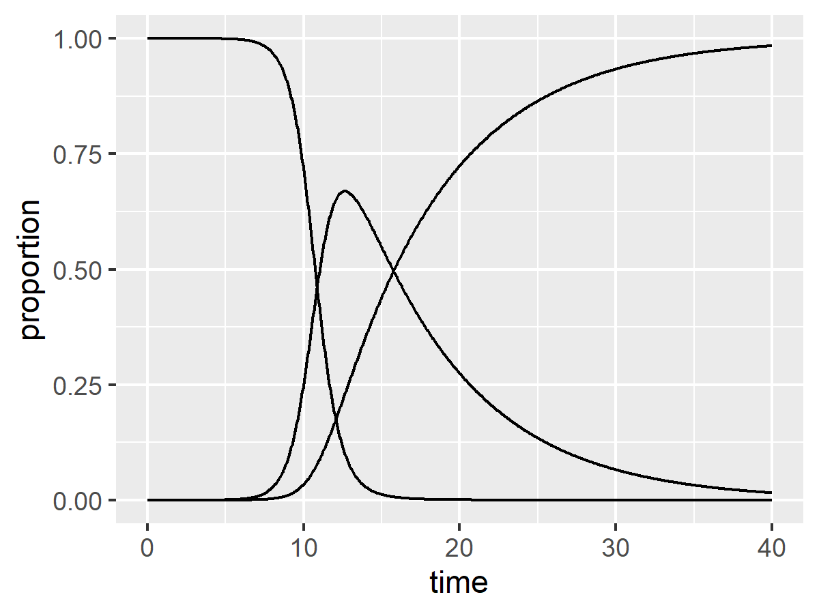
Visualisation with ggplot2

Slide 18
Visualisation with ggplot2
Using our grammar of graphics’ + operator let’s add axis labels to the plot
xlab() and ylab() print their argument as axis labels
sir_ggplot <- sir_ggplot + xlab('Time (days)') + ylab('Proportion of population')
We are sequentially adding functions that modify the plot rather than passing arguments to a plot() to replace default options

Slide 19
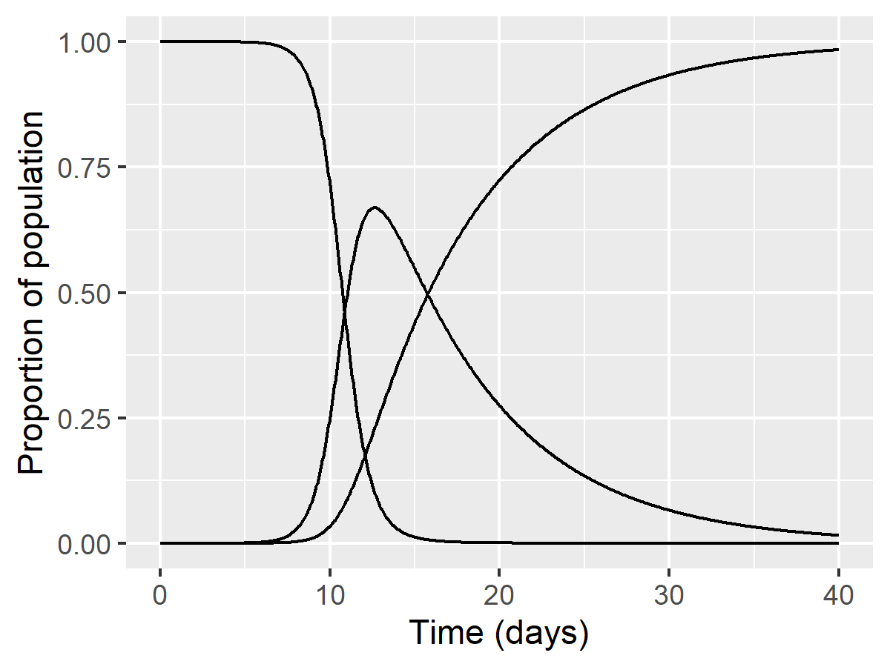
Visualisation with ggplot2

Slide 20
Visualisation with ggplot2
The plot on the previous slide didn’t give us much info on which line is which
Consider a basic plot that we’ll recycle
sir_ggplot_basic <- ggplot(data = SIR_long, # where data lives aes(x = time, # set plot aesthetics... y = proportion)) + # ...specifying x&y vars theme_bw() + # grey grid on white bg xlab('Time (days)') + # replace time as x label ylab('Population proportion') + # replace proportion as y theme(legend.position = 'bottom') # change legend placement
NB no geometry specified
theme_bw() is a collection of options for theme() that specify a white background with a light grey grid and black text
we change the legend placement after we set the default theme, otherwise it will get overwritten

Slide 21
Visualisation with ggplot2
sir_ggplot_color <- sir_ggplot_basic + geom_line( aes(color = state))
Mapping a variable, e.g. state, to part of our plot requires it is inside aes(...)
Here we have colored each line by state
Static options go outside aes(...)

Slide 22
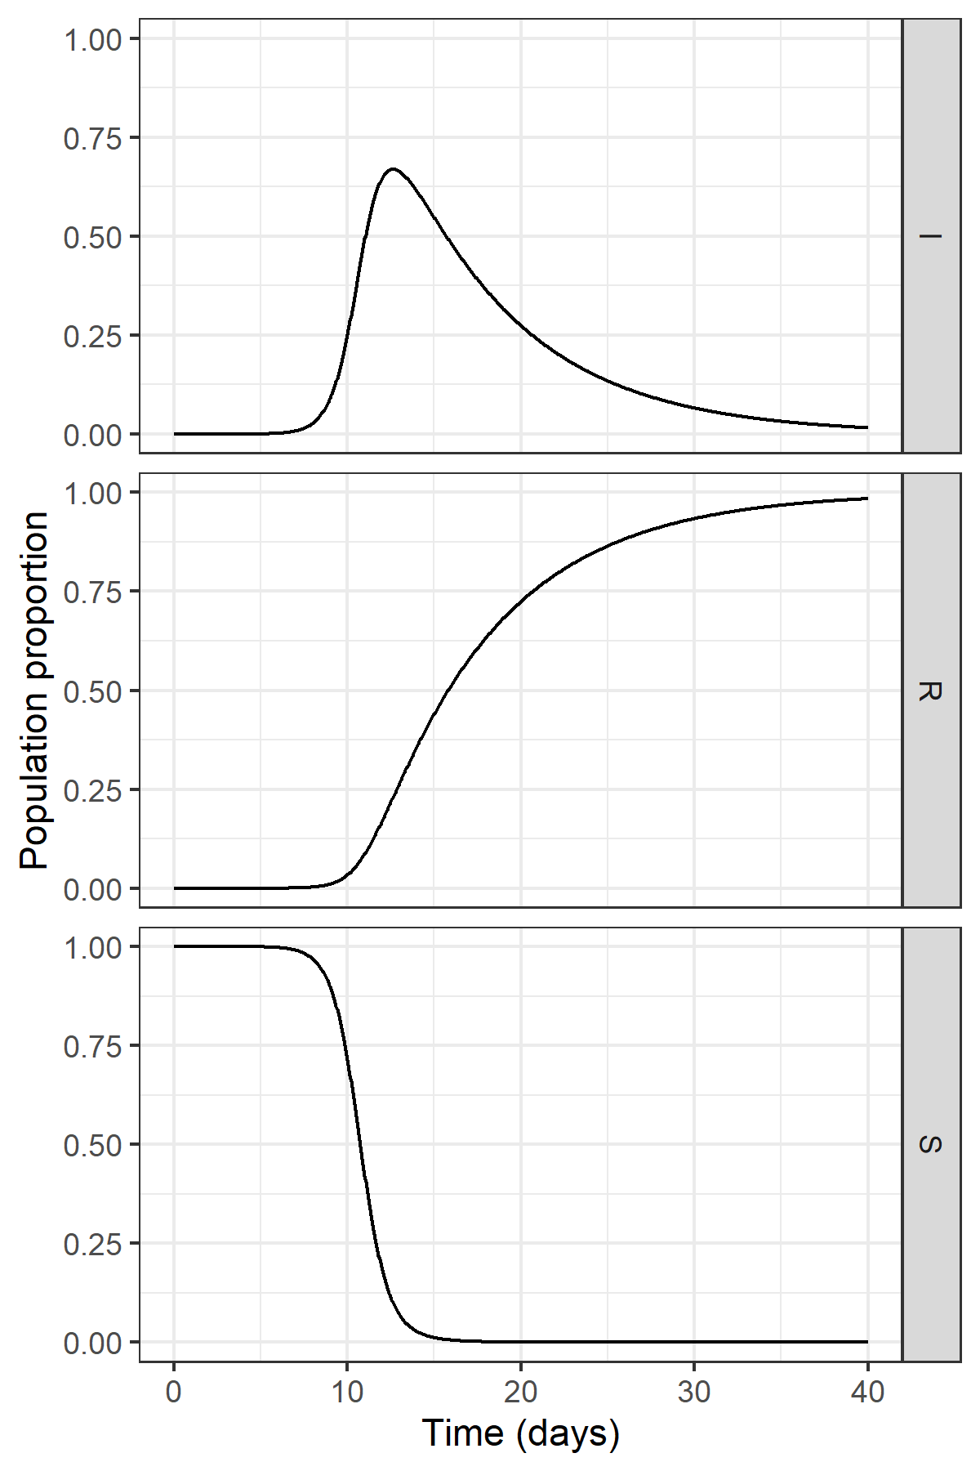
Visualisation with ggplot2
Draw small multiples with facet_grid(), repeating the geometry for each level of the grouping variable on the rows of the grid
sir_ggplot_facet <- sir_ggplot_basic + geom_line() + facet_grid( rows = vars(state) )
where vars() indicates that we are selecting a list of variables

Slide 23
Relevelling factors

Slide 24
Relevelling factors
Default behaviours are:
pivot_longer() respects column order when reshaping
key column is character variable
character variables coerced to alphabetic factors
We can set order of state variable by specifying levels
factor(state, levels = c('S','I','R'))

Slide 25
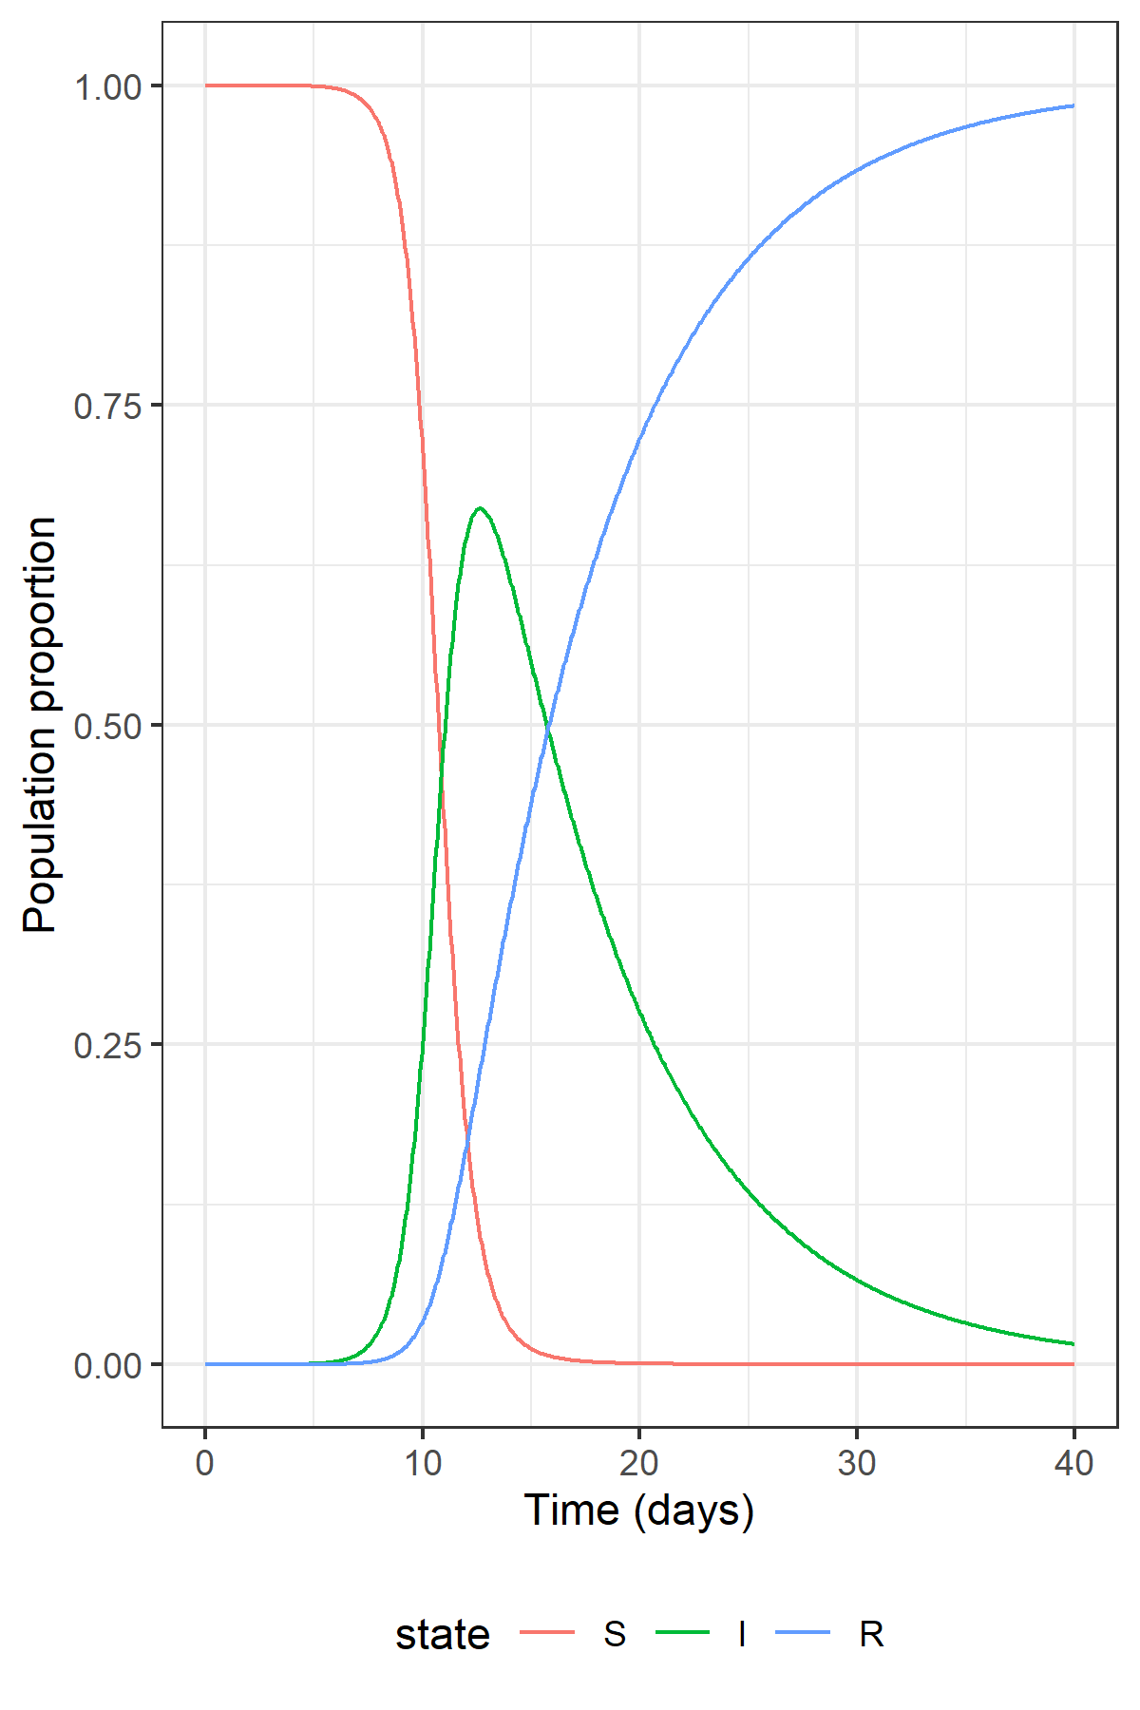
Relevelling factors
SIR_long$state <- factor(SIR_long$state, levels = c('S', 'I', 'R')) sir_ggplot_lines <- ggplot(data = SIR_long, aes(x = time, y = proportion)) + theme_bw() + xlab('Time (days)') + ylab('Population proportion') + theme( legend.position = 'bottom') + geom_line(aes(color = state))

Slide 26
Plotting multiple simulations

Slide 27

Grouping in a factorial design
Consider a factorial design for SIR simulations with each combination of $β=1.42470,1.56756$ and $γ=0.14286,0.36508$

Slide 28
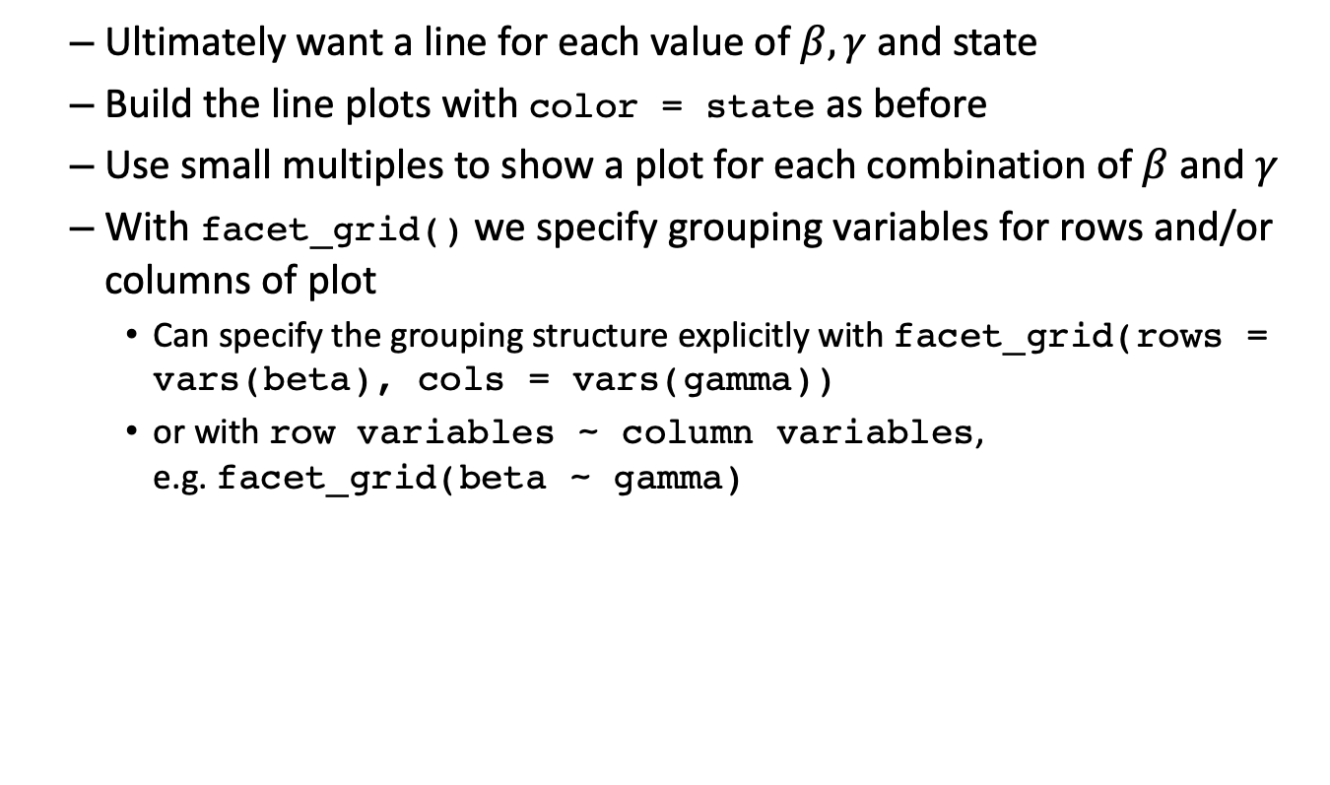
Grouping in a factorial design
Ultimately want a line for each value of $β,γ$ and state
Build the line plots with color = state as before
Use small multiples to show a plot for each combination of $β$ and $γ$
With facet_grid() we specify grouping variables for rows and/or columns of plot
Can specify the grouping structure explicitly with facet_grid(rows = vars(beta), cols = vars(gamma))
or with row variables ~ column variables, e.g. facet_grid(beta ~ gamma)

Slide 29
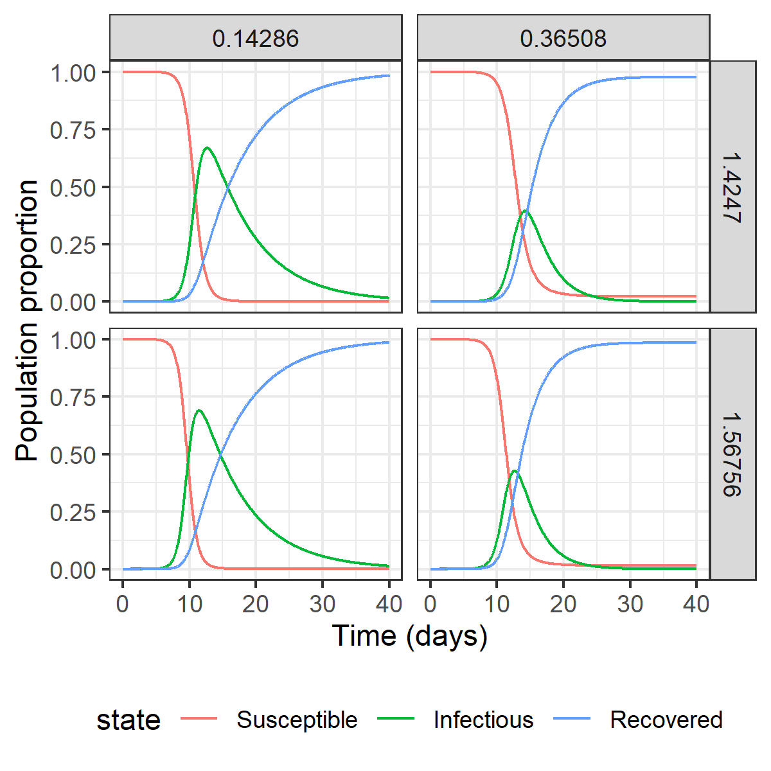
Grouping in a factorial design
SIR_plot_bg_basic <- ggplot(data = factorial_sim, aes(x = time, y = proportion)) + xlab('Time (days)') + ylab('Population proportion') + theme_bw() + theme(legend.position = 'bottom') SIR_plot_bg_grid <- SIR_plot_bg_basic + geom_line(aes(color = state)) + facet_grid(rows = vars(beta), cols = vars(gamma))

Slide 30
Grouping in Monte Carlo simulation
Consider instead of a factorial design for an SIR we have 100 simulations of an SIR model from a Monte Carlo simulation. 12 of the 10100 rows are shown below:

Slide 31
Grouping in Monte Carlo simulation
Pivot the data, as before, and relevel the state variable
sol_sim_long <- pivot_longer( data = sol_sim, cols = c(S, I, R), names_to = 'state', values_to = 'proportion') sol_sim_long$state <- factor(sol_sim_long$state, levels = c('S', 'I', 'R'))

Slide 32
Grouping in Monte Carlo simulation
We can group by simulation index, sim, to show each as a line
Use alpha transparency so we don’t have a giant blob of black
plot_sim <- ggplot(data = sol_sim_long, aes(x = time, y = proportion)) + geom_line(aes(group = sim), alpha = 0.05) + facet_grid(cols = vars(state)) + theme_bw() + xlab('Time(days)') + ylab('Proportion of population')

Slide 33
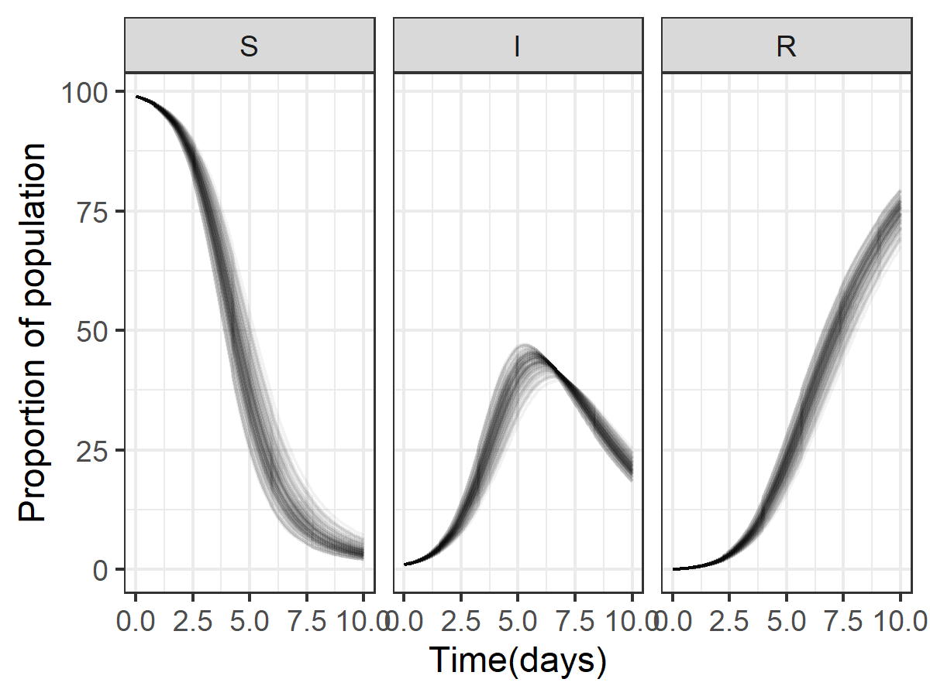
Grouping in Monte Carlo simulation

Slide 34
Grouping in Monte Carlo simulation
To simplify this plot, we could calculate a 95% interval at each time for S, I, R and show these
Use dplyr’s
group_by() to define a grouping structure, and
summarise() to calculate summary statistics for each group (median, upper and lower bounds of a 95% interval)
sol_sim_grouped <- group_by(sol_sim_long, time, state) sol_sim_summarised <- summarise(sol_sim_grouped, q0.025 = quantile(proportion, probs = 0.025), q0.500 = quantile(proportion, probs = 0.5), q0.975 = quantile(proportion, probs = 0.975))

Slide 35
Grouping in Monte Carlo simulation
Can use multiple geometries with different aesthetics
Plot the ribbon and then plot the median line plot_sim_summarised_ribbon <- ggplot(data = sol_sim_summarised, aes(x = time)) + geom_ribbon(aes(ymin = q0.025, # lower edge of ribbon ymax = q0.975), # upper edge of ribbon alpha = 0.5, # make semi-transparent fill = 'skyblue', # fill blue color = NA) + # no border color geom_line(aes(y = q0.500)) + # line for median theme_bw() + # nicer theme facet_grid( cols = vars(state)) + # repeat for each state xlab('Time (days)') + # human friendly axis label ylab('Population') # human friendly axis label

Slide 36
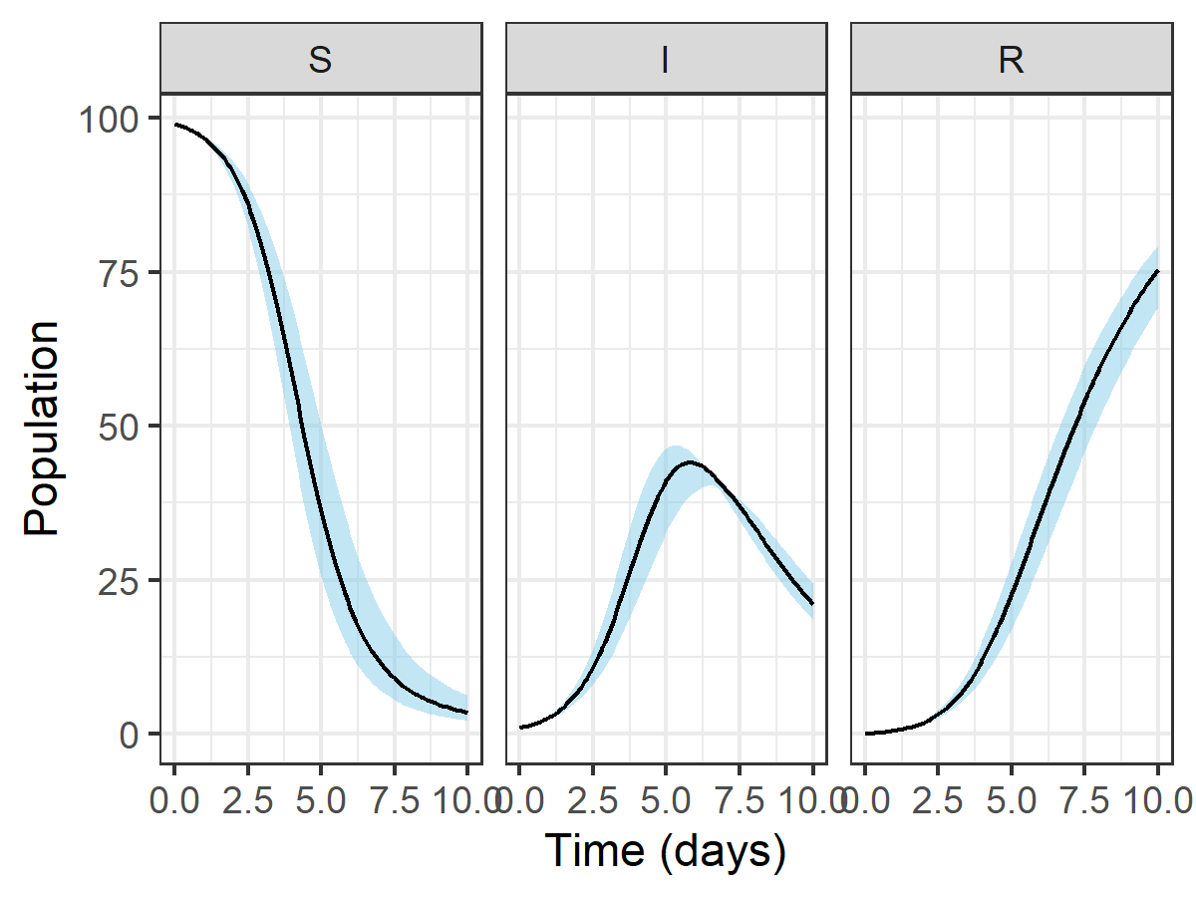
Grouping in Monte Carlo simulation

Slide 37
Summary

Slide 38
Summary
ggplot2 uses aesthetics to map variables in data frame to elements of plot
Plot is sequentially built up by adding elements
geometries (e.g. lines, ribbons)
annotations (e.g. axis labels)
theme options
Data needs to be in key-value pairs for plotting
Data in key-value pairs is easily summarised by key group

Slide 39
Additional Resources
More help on ggplot2 and the tidyverse is available
The #r4ds community have TidyTuesday
Chang (2017) is very useful if a little out of date
Wickham (2010) on philosophy behind ggplot2
Wickham (2014) on what tidy data is
Chang, Winston. 2017. R Graphics Cookbook: Practical Recipes for Visualizing Data. 2nd ed. O’Reilly Media.
Wickham, Hadley. 2010. “A Layered Grammar of Graphics.” Journal of Computational and Graphical Statistics 19 (1):3–28. https://doi.org/10.1198/jcgs.2009.07098.
———. 2014. “Tidy Data.” Journal of Statistical Software 59 (1):1–23. https://doi.org/10.18637/jss.v059.i10.

