Slide 1
Introduction to Git using GitHub
Modern Techniques in Modelling

Slide 2
At this point you should have…
1. Checked if git is installed
Go to a Command Prompt window and type:
git --version
If not, then go to: https://git-scm.com/download/ and run the download.
Accept all default options.
2. Created a GitHub account: github.com/join
3. Downloaded GitHub Desktop: https://desktop.github.com/
Open it, and sign in using your GitHub account
Notes:
Creating github repository in your rproj directory

Slide 3
Objectives for this hour
Introduce the idea of version control – for code
What’s Git? What’s GitHub? What did I just install on my computer?
Familiarise yourselves with some “infrastructure” of Git and GitHub
Introduce some interfaces that can make it easier to use Git and GitHub
Learning by doing!

Slide 4
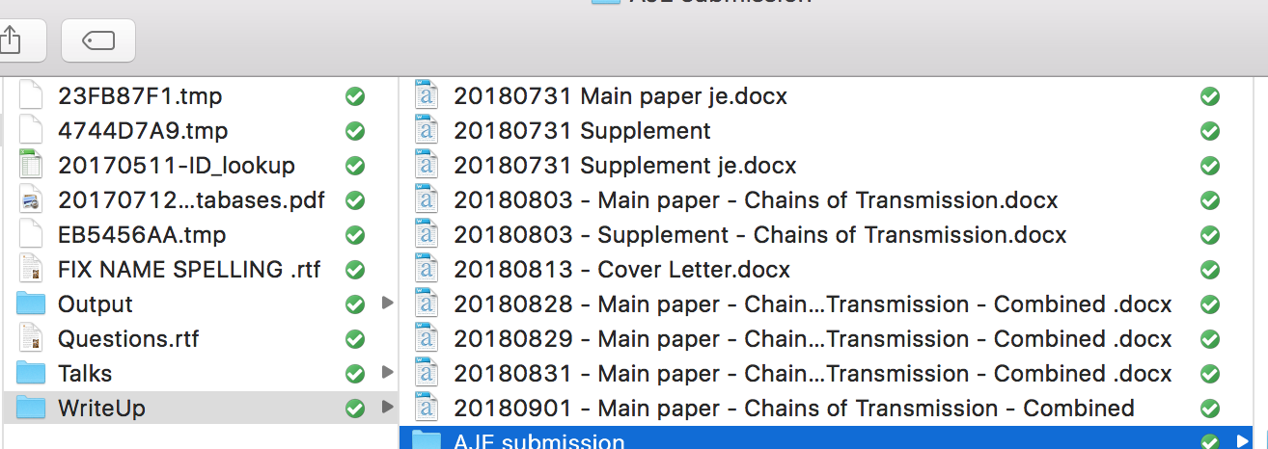
What is version control?
A system that records changes in files
Everybody has used it, even if it’s a system you have made yourself!

Slide 5
Why use version control?
Backup/restore/saving
Synchronisation
Track changes (and ownership)
Seeing your progress
Professional way to create code

Slide 6


The most common version control system is Git
What is git?
What is a repository?
What is a commit?
What is github?

Slide 7
Why?
Git
Flexible
Remembers EVERYTHING
Conserving and preserving
Easy comparison
GitHub
Remember EVERYTHING (online)
Public and private repositories (<- open science!)
Easy collaboration
The “issue board”
Ownership
Showcase your work!

Slide 8
Glossary
There are a lot of new words! It’s just lingo, do not be afraid!
Add
Commit
Push

Slide 9
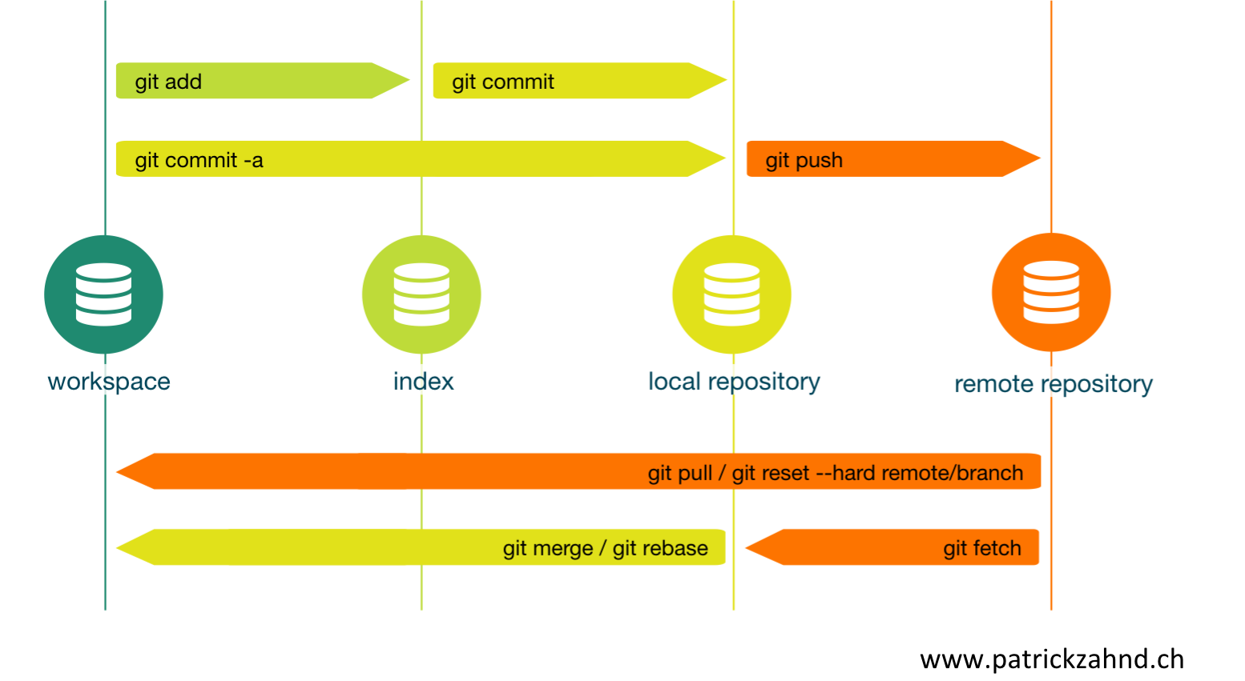
git paradigm

Slide 10
Glossary
There are a lot of new words! It’s just lingo, do not be afraid!
init
clone
Add
Commit
Push
Fetch
Pull
Merge

Slide 11
git paradigm

Slide 12
Using an app to interact with Github
Recommend GitHub Desktop (free, easy-to-use)
There are many others (e.g. inside RStudio)
Benefits: getting started, easy-to-understand, overview
What does it do?
”watches” the repository
Tells you about changes to the files in the folder
Helps you commit the changes

Slide 13
Some key dos and donts
Do:
Commit often
Commit small changes as you go
Write useful commit messages
Don’t:
Commit untested changes
Add data files
Add untrackable files
Add enormous files

Slide 14
Best practices
.gitignore
Add a README
Add a License
Do not put a repo in Dropbox

Slide 15
Further resources
Lots of online tutorials, e.g. https://programminghistorian.org/en/lessons/retired/getting-started-with-github-desktop
Some videos e.g. https://www.youtube.com/watch?v=77W2JSL7-r8
Learn by doing!

