Slide 1
Discrete-time deterministic models
Modern Techniques in Modelling

Slide 2
Introduction

Slide 3
Introduction
Welcome to the lecture on Discrete-time deterministic models
This session’s objectives:
Understand the concept of discrete-time models
Learn about difference equations
Explore the SIR (Susceptible-Infectious-Recovered) model in discrete time
Implement and analyse a discrete-time SIR model in R

Slide 4
Discrete-time deterministic models
Often we may want to model an epidemic in terms of a discrete time step, e.g. from one day to the next:
Susceptible = 99
Susceptible = 98
Susceptible = 97
Infected
= 1
Infected
= 2
Infected
= 2
Recovered
= 0
Recovered
= 0
Recovered
= 1
Day 1
Day 2
Day 3

Slide 5
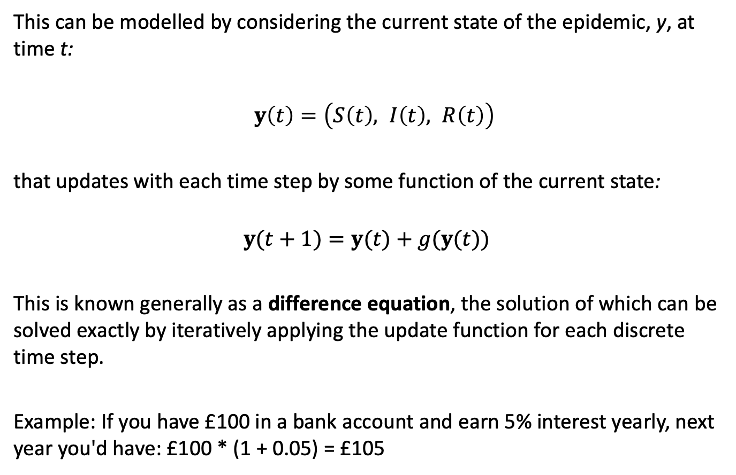
Discrete-time deterministic models
This can be modelled by considering the current state of the epidemic, y, at time t:
$y\left(t\right)=\left(S\left(t\right), I\left(t\right), R\left(t\right)\right)$
that updates with each time step by some function of the current state:
$$y(t+1)=y(t)+g(y(t))$$
This is known generally as a difference equation, the solution of which can be solved exactly by iteratively applying the update function for each discrete time step.
Example: If you have £100 in a bank account and earn 5% interest yearly, next year you'd have: £100 * (1 + 0.05) = £105

Slide 6
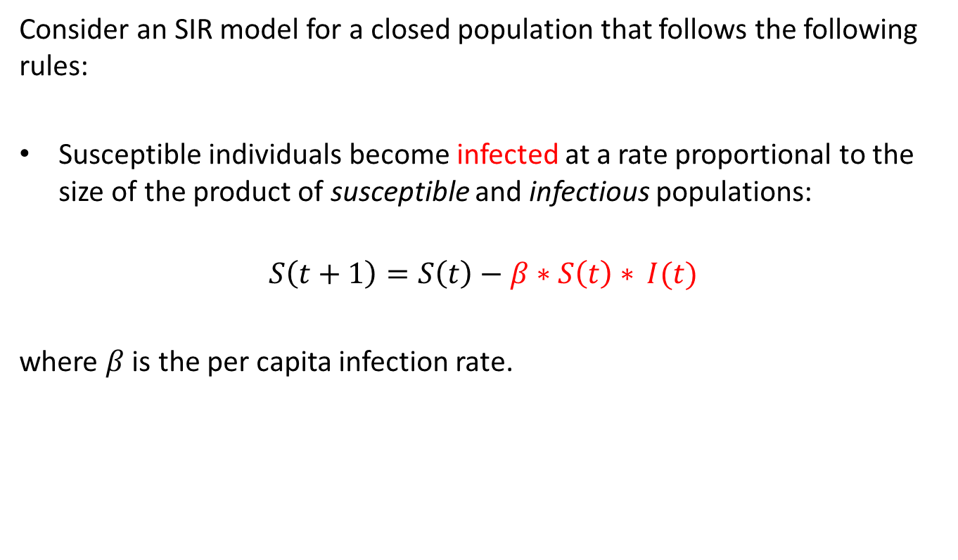
Discrete-time deterministic models
Consider an SIR model for a closed population that follows the following rules:
Susceptible individuals become infected at a rate proportional to the size of the product of susceptible and infectious populations:
$$S\left(t+1\right)=S\left(t\right)−β∗S\left(t\right)∗ I(t)$$
where $β$ is the per capita infection rate.

Slide 7

Discrete-time deterministic models
Recovery from infection grants life-long immunity
$$R\left(t+1\right)=R\left(t\right)+γ∗I(t)$$
Where γ is the recovery rate.
(The mean time spent infectious is then 1/γ (1/rate = duration)).

Slide 8

Discrete-time deterministic models
The only transitions between states in our model are infection and recovery
$$I\left(t+1\right)=I\left(t\right)+β∗S\left(t\right) ∗I\left(t\right)−γ∗I\left(t\right)$$
Which adds those being infected and subtracts those who recover

Slide 9
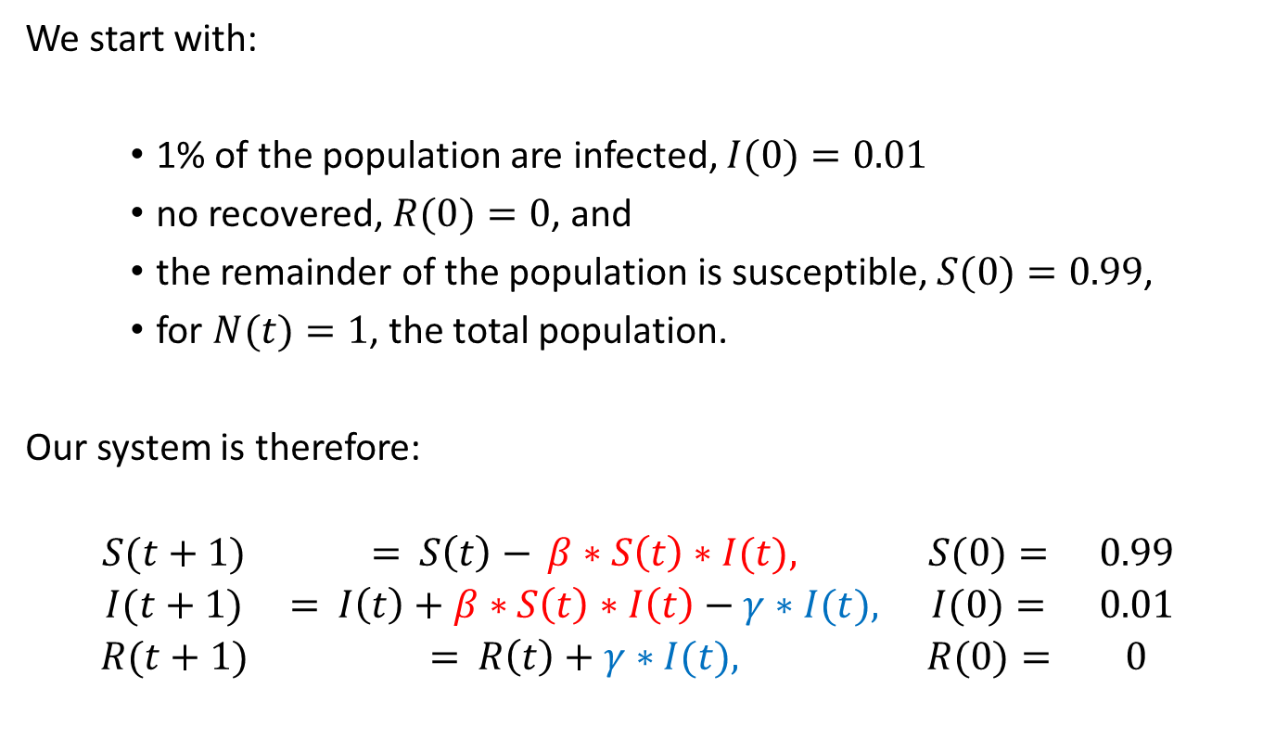
SIR example
We start with:
1% of the population are infected, $I(0)=0.01$
no recovered, $R(0)=0$, and
the remainder of the population is susceptible, $S(0)=0.99$,
for $N(t)=1$, the total population.
Our system is therefore:
$$\begin{matrix}S(t+1) & = S\left(t\right)− β∗S\left(t\right)∗I(t), & S(0)= & 0.99 \\ I(t+1) & = I\left(t\right)+β∗S\left(t\right)∗I\left(t\right)−γ∗I(t), & I(0)= & 0.01 \\ R(t+1) & = R\left(t\right)+γ∗I(t), & R(0)= & 0\end{matrix}$$

Slide 10
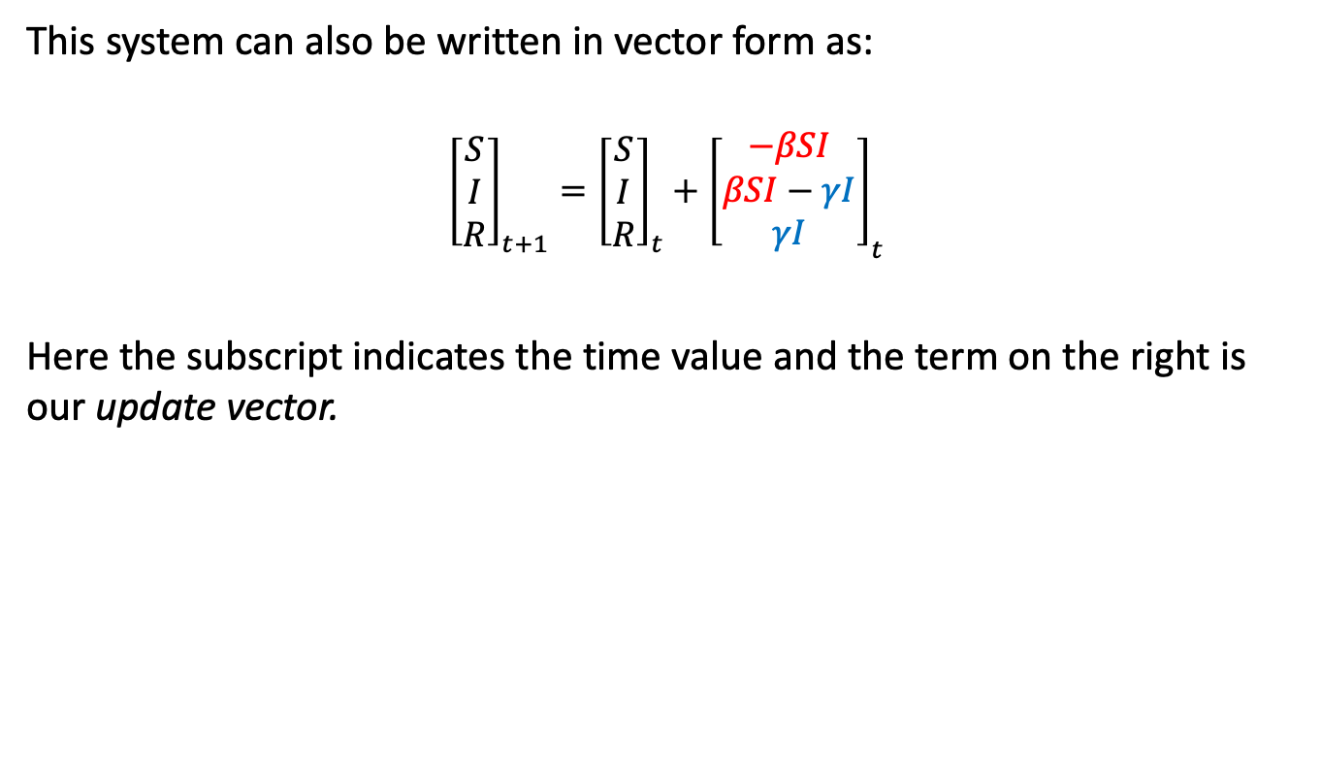
SIR example
This system can also be written in vector form as:
$${\left[\begin{matrix}S \\ I \\ R\end{matrix}\right]}_{t+1}={\left[\begin{matrix}S \\ I \\ R\end{matrix}\right]}_{t}+{\left[\begin{matrix}−βSI \\ βSI−γI \\ γI\end{matrix}\right]}_{t}$$
Here the subscript indicates the time value and the term on the right is our update vector.

Slide 11
SIR example
In R, we can write a function to return our update vector with three elements:
update_sir <- function(t, y, parms){
S <- y[1]
I <- y[2]
R <- y[3]
beta <- parms['beta'] gamma <- parms['gamma'] out <- c(- beta*S*I,
+ beta*S*I - gamma*I,
+ gamma*I) return(out) }

Slide 12
Discrete-time deterministic SIR
parms_sir <- c(beta = 1.3, gamma = 0.23)
time_sir <- seq(0, 20, by = 1)
y_sir <- matrix(data = NA, nrow = length(time_sir), ncol = 3)
# initial values at t=0 y_sir[1, ] <- c(0.99, 0.01, 0) for (i in 1:(nrow(y_sir) - 1)){
y_sir[i + 1,] <- y_sir[i,] + update_sir(t = time_sir[i + 1], y = y_sir[i, ], parms = parms_sir) }

Slide 13
Discrete-time deterministic SIR
y_sir_df <- as.data.frame(y_sir) names(y_sir_df) <- c('Susceptible', 'Infectious', 'Recovered') y_sir_df <- cbind(time = time_sir, y_sir_df) head(y_sir_df)
## time Susceptible Infectious Recovered ## 1 0 0.9900000 0.01000000 0.00000000 ## 2 1 0.9771300 0.02057000 0.00230000 ## 3 2 0.9510006 0.04196833 0.00703110 ## 4 3 0.8991151 0.08420110 0.01668382 ## 5 4 0.8006967 0.16325327 0.03605007 ## 6 5 0.6307654 0.29563626 0.07359832

Slide 14
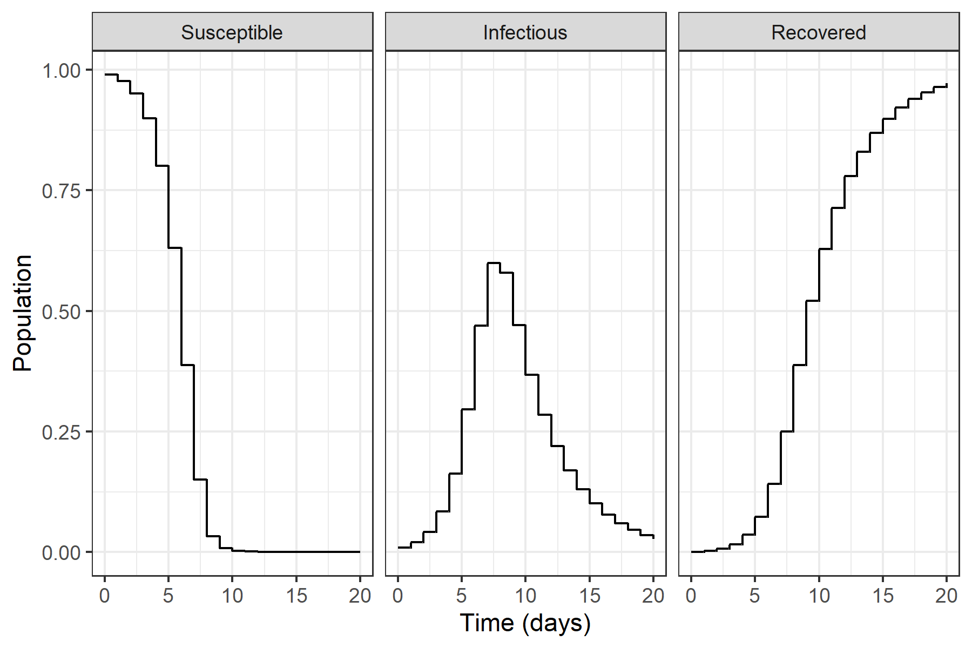
Discrete-time deterministic SIR

Slide 15

Discrete-time deterministic SIR
Our more general form of the update is
$$y(t+1)=f(t,y(t),θ(t))$$
…but parameters may or may not change with time t.

Slide 16
Summary

Slide 17
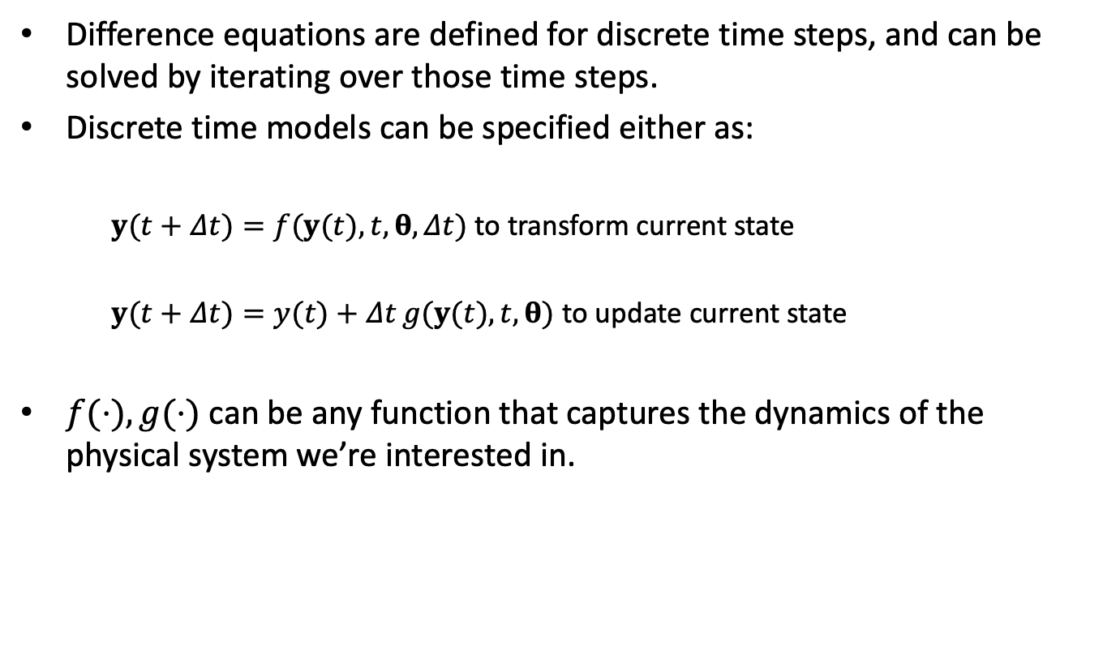
Summary
Difference equations are defined for discrete time steps, and can be solved by iterating over those time steps.
Discrete time models can be specified either as:
$y(t+Δt)=f(y(t),t,θ,Δt)$ to transform current state
$y(t+Δt)=y(t)+Δt g(y(t),t,θ)$ to update current state
$f(⋅),g(⋅)$ can be any function that captures the dynamics of the physical system we’re interested in.

Slide 18
Looking forward
We’ll now look at implementing discrete-time models in R in the practical.
Later today you’ll start to learn about extending to continuous time models with differential equations.
Later in the week you’ll learn about update functions that model infection and recovery as probabilistic events.

Slide 19
Practical

