Slide 1
Continuous-time stochastic models
Modern Techniques in Modelling

Slide 2
Introduction

Slide 3
Overview
Introduce continuous-time stochastic models
Implement Gillespie algorithm and analyse stochastic model output
Implement a stochastic model with the adaptivetau package
Discussion and concluding remarks

Slide 4
Overview
Introduce continuous-time stochastic models
(~20 minutes)
Implement Gillespie algorithm and analyse stochastic model output (~60 minutes)
Implement a stochastic model with the adaptivetau package
(~20 minutes)
Discussion and concluding remarks
(~20 minutes)

Slide 5
Deterministic models
One set of parameters -> one trajectory

Slide 6
Stochastic models
One set of parameters -> many trajectories

Slide 7
Types of model
discrete vs continuous time
discrete vs continuous compartments
deterministic vs stochastic dynamics

Slide 8

Example 1: difference equations
discrete vs continuous time
discrete vs continuous compartments
deterministic vs stochastic dynamics
$$\begin{matrix}S(t+1) & = & S(t)−βS(t)I(t) \\ I(t+1) & = & I(t)+βS(t)I(t)−γI(t) \\ R(t+1) & = & R(t)+γI(t)\end{matrix}$$

Slide 9
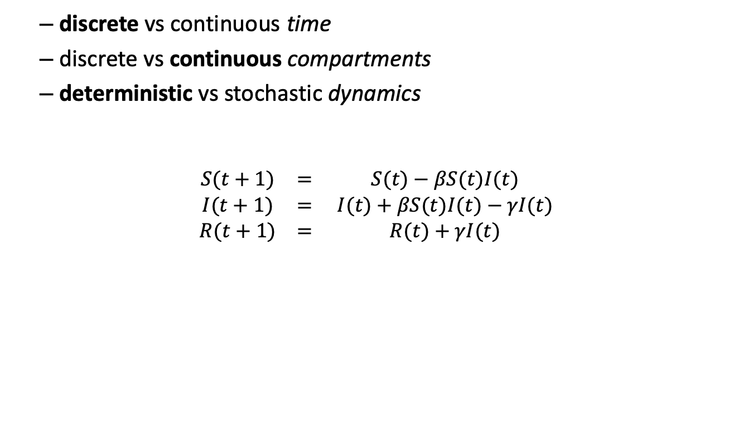
Discrete-time deterministic models
discrete vs continuous time
discrete vs continuous compartments
deterministic vs stochastic dynamics
$$\begin{matrix}S(t+1) & = & S(t)−βS(t)I(t) \\ I(t+1) & = & I(t)+βS(t)I(t)−γI(t) \\ R(t+1) & = & R(t)+γI(t)\end{matrix}$$

Slide 10

Example 2: ODEs
discrete vs continuous time
discrete vs continuous compartments
deterministic vs stochastic dynamics
$$\begin{matrix}\frac{\text{d}S}{\text{d}t} & = & −βSI/N \\ \frac{\text{d}I}{\text{d}t} & = & βSI/N−γI \\ \frac{\text{d}R}{\text{d}t} & = & γI\end{matrix}$$

Slide 11

Continuous-time deterministic models
discrete vs continuous time
discrete vs continuous compartments
deterministic vs stochastic dynamics
$$\begin{matrix}\frac{\text{d}S}{\text{d}t} & = & −βSI/N \\ \frac{\text{d}I}{\text{d}t} & = & βSI/N−γI \\ \frac{\text{d}R}{\text{d}t} & = & γI\end{matrix}$$

Slide 12
Example 3: individual-based model
discrete vs continuous time
discrete vs continuous compartments
deterministic vs stochastic dynamics
For each ts from 1 to T { lambda <- beta * I/N
For each i from 1 to N { If individual i is susceptible: with prob 1-exp(-lambda·∆t) make infected. Else-if individual i is infected: with prob 1-exp(-gamma·∆t) make susceptible. } Record population state }

Slide 13
Example 3: individual-based model
discrete vs continuous time
discrete vs continuous compartments
deterministic vs stochastic dynamics
For each ts from 1 to T { lambda <- beta * I/N
For each i from 1 to N { If individual i is susceptible: with prob 1-exp(-lambda·∆t) make infected. Else-if individual i is infected: with prob 1-exp(-gamma·∆t) make susceptible. } Record population state }

Slide 14
Event-based view
discrete vs continuous time
discrete vs continuous compartments
deterministic vs stochastic dynamics
For each ts from 1 to T { lambda <- beta * I/N
For each i from 1 to N { If individual i is susceptible: with prob 1-exp(-lambda·∆t) make infected. Else-if individual i is infected: with prob 1-exp(-gamma·∆t) make susceptible. } Record population state }

Slide 15
Continuous-time stochastic models

Slide 16
Continuous-time stochastic models
discrete vs continuous time
discrete vs continuous compartments
deterministic vs stochastic dynamics

Slide 17
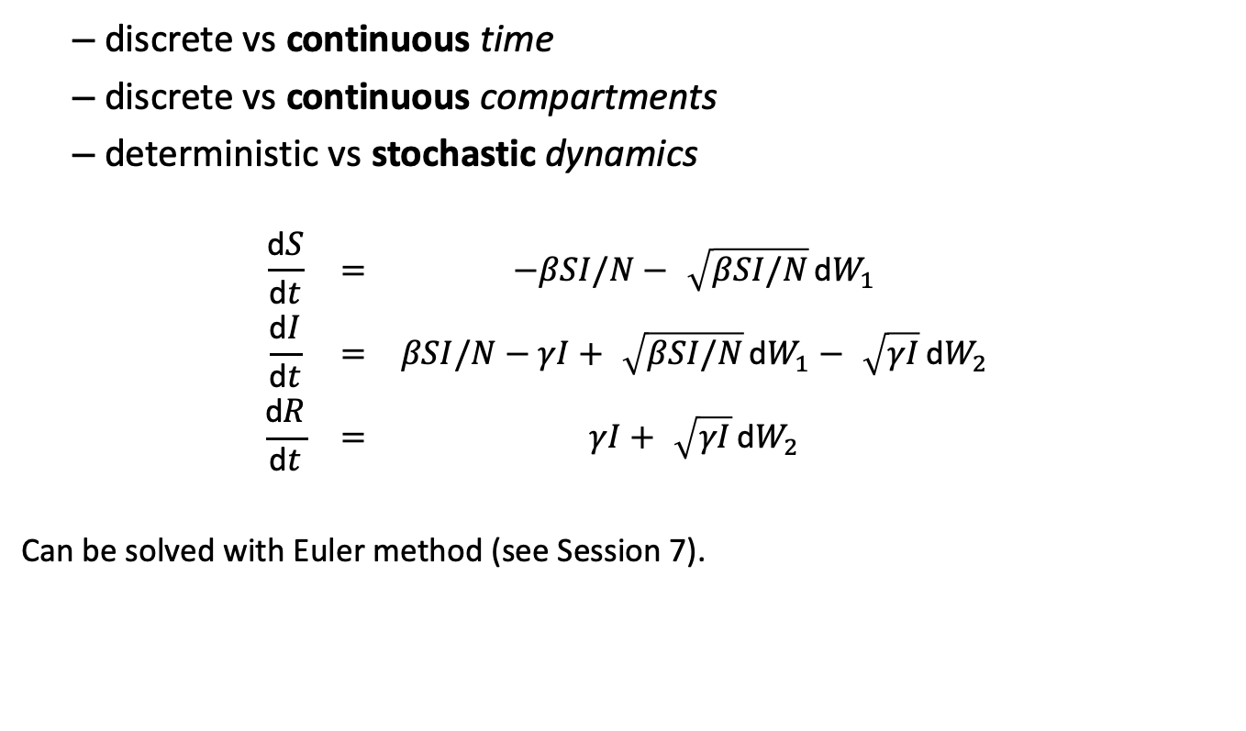
Stochastic differential equations (SDEs)
discrete vs continuous time
discrete vs continuous compartments
deterministic vs stochastic dynamics
$$\begin{matrix}\frac{\text{d}S}{\text{d}t} & = & −βSI/N−\sqrt{βSI/N} \text{d}W_{1} \\ \frac{\text{d}I}{\text{d}t} & = & βSI/N−γI+\sqrt{βSI/N} \text{d}W_{1}−\sqrt{γI} \text{d}W_{2} \\ \frac{\text{d}R}{\text{d}t} & = & γI+\sqrt{γI} \text{d}W_{2}\end{matrix}$$
Can be solved with Euler method (see Session 7).

Slide 18
Continuous-time discrete stochastic models
discrete vs continuous time
discrete vs continuous compartments
deterministic vs stochastic dynamics

Slide 19
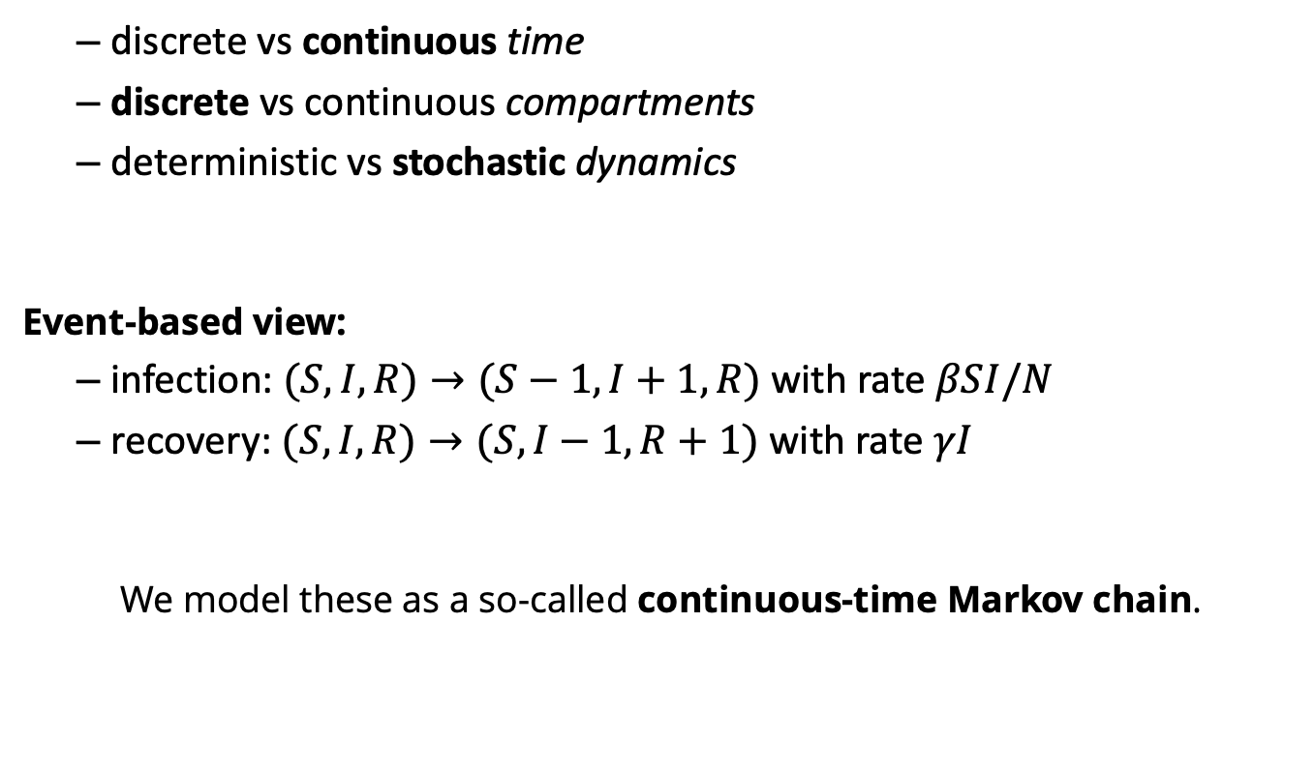
Continuous-time discrete stochastic models
discrete vs continuous time
discrete vs continuous compartments
deterministic vs stochastic dynamics
Event-based view:
infection: $(S,I,R)→(S−1,I+1,R)$ with rate $βSI/N$
recovery: $(S,I,R)→(S,I−1,R+1)$ with rate $γI$
We model these as a so-called continuous-time Markov chain.

Slide 20

Example: Influenza with short and long immunity
$$\begin{matrix}\frac{dS}{dt} & =−βS\frac{I}{N}+(1−α)τT \\ \frac{dE}{dt} & =βS\frac{I}{N}−εE \\ \frac{dI}{dt} & =εE−νI \\ \frac{dT}{dt} & =νI−τT \\ \frac{dL}{dt} & =ατT\end{matrix}$$
QUESTION: Which events can happen, and at what rates?

Slide 21
Time
DISCRETE (session on individual-based models)
for (ts in 1:steps){ … EVENTS … }
CONTINUOUS (here)
while (time < finaltime) { …
time <- time + rexp(n = 1, rate = sum(rates))
if (time <= finaltime) { … EVENTS … }
}
Waiting times between events in a Poisson process are exponentially distributed

Slide 22
Gillespie algorithm
[Gillespie, 1976]
Repeat until end time:
Calculate event rates rates <- c() rates["infection"] <- beta * S * I / N rates["recovery"] <- gamma * I
Choose how long nothing happens rexp(n = 1, rate = sum(rates))
Choose which event happens sample(x = length(rates), size = 1, prob = rates) and update system state according to event.

Slide 23
Now, put it in R!

Slide 24
Practical structure
Part 1: Stochastic simulation using the Gillespie algorithm
Part 2: A faster alternative: the adaptivetau package

Slide 25
Practical part 1
Open the file 10_StochasticContinuousractical/01_Gillespie.R and follow the instructions
Objective: use the Gillespie algorithm to simulate the SIR model; process outputs from stochastic models

Slide 26
adaptive tau-leaping
Algorithm:
Identifies periods during which all rates are not expected to change, and all variables are far from 0
“Leaps” over these periods of time
Adds the net effect of the Poisson-distributed number of transitions that should have occurred in that period
In R, the ssa.adaptivetau package implements this (and generates fast C code).

Slide 27
Practical part 2
Open the file 10_StochasticContinuousractical/02_AdaptiveTau.R and follow the instructions
Objective: use the adaptivetau packages to simulate the SIR and SEITL models

Slide 28
Representing uncertainty

Slide 29
Parameter variation
Total number of cases over a year
X
X
X
X
X
o
X
X
At each of 4 μ values,
5 runs of a model that is:
X
X
X
X
o
X
X
X
X
o
X
Stochastic = o / X ?
Deterministic = o / X ?
o
X
X
X
X
μ
0.1
0.2
0.3
0.4

Slide 30
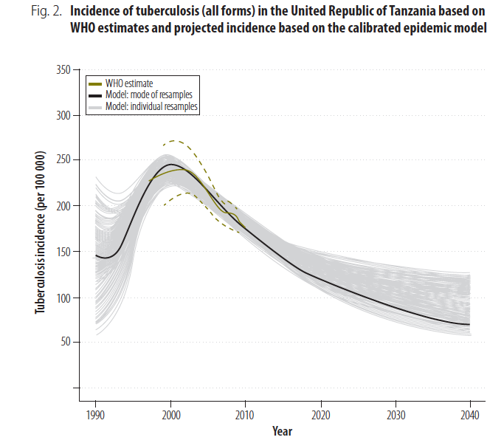
Parameter variation
[Lin, 2012]

Slide 31
Representing uncertainty
LSHTM course: Model fitting and inference for ID dynamics

Slide 32
References
L.J.S. Allen (2017). A primer on stochastic epidemic models: Formulation, numerical simulation, and analysis. Infectious Disease Modelling, 2(2):128–142. https://doi.org/10.1016/j.idm.2017.03.001
M.J. Keeling, P. Rohani (2017). Modeling Infectious Diseases in Humans and Animals. Princeton University Press.
D.T. Gillespie (1976). A general method for numerically simulating the stochastic time evolution of coupled chemical reactions. J Comput Phys, 22(4):403–434, 1976. ISSN 0021-9991. https://doi.org/10.1016/0021-9991(76)90041-3
Y. Cao, D.T. Gillespie, and L.R. Petzold (2007). Adaptive explicit-implicit tau-leaping method with automatic tau selection. J Chem Phys, 126(22):224101 URL https://doi.org/10.1063/1.2745299
A.A. King, M. Domenech de Cellès, F.M.G. Magpantay and Pejman Rohani (2015). Avoidable errors in the modelling of outbreaks of emerging pathogens, with special reference to Ebola. Proc Roy Soc B 282(1806). https://doi.org/10.1098/rspb.2015.0347

