Slide 1
Modern Techniques in Modelling

Slide 2
Who we are
Course organisers
Katherine Atkins, PhD Katherine.Atkins@lshtm.ac.uk
Roz Eggo, PhD r.eggo@lshtm.ac.uk
Nicholas Davies, PhD Nicholas.Davies@lshtm.ac.uk
Yang Liu, PhD Yang.Liu@lshtm.ac.uk
Course administration
Damian Keane Damian.Keane@lshtm.ac.uk
Lecturers and Demonstrators
Johnny Filipe, David Hodgson, Alexis Robert, Alex Richards, Billy Quilty, Sam Abbott, Kaja Abbas, Carl Pearson, Seb Funk, Han Fu (All LSHTM / CMMID-based)

Slide 3
Feedback
Your feedback is important to us!
Please complete the feedback form on Moodle after the course — tell us what we did well and what we could improve.
And please don’t hesitate to ask questions during the course.
Notes:
This is the first iteration of this course
Inevitably some things will not quite go to plan
Please let us know suggested improvements along the way!
no formal evaluation

Slide 4
Resources
Resources
All course information (timetable, links etc) on Moodle https://ble.lshtm.ac.uk/ (shout out now if you haven’t logged-in! Or cannot access wifi)
All exercises completed using Rstudio (shout out now if you haven’t downloaded it!)
Lecture slides on Moodle (and lecture recordings at end of each day)
Practical session exercises and solutions will be downloaded via R package (details to follow in next session)
DISCUSSION BOARD on Moodle for everyone - please feel free to introduce yourself more fully there if you wish
Notes:
I’ll try to finish a few minutes early to give you the opportunity to connect to the wifi and access the moodle documents

Slide 5
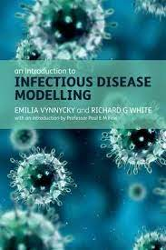
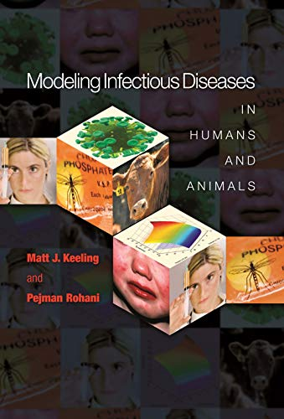
Further resources

Slide 6
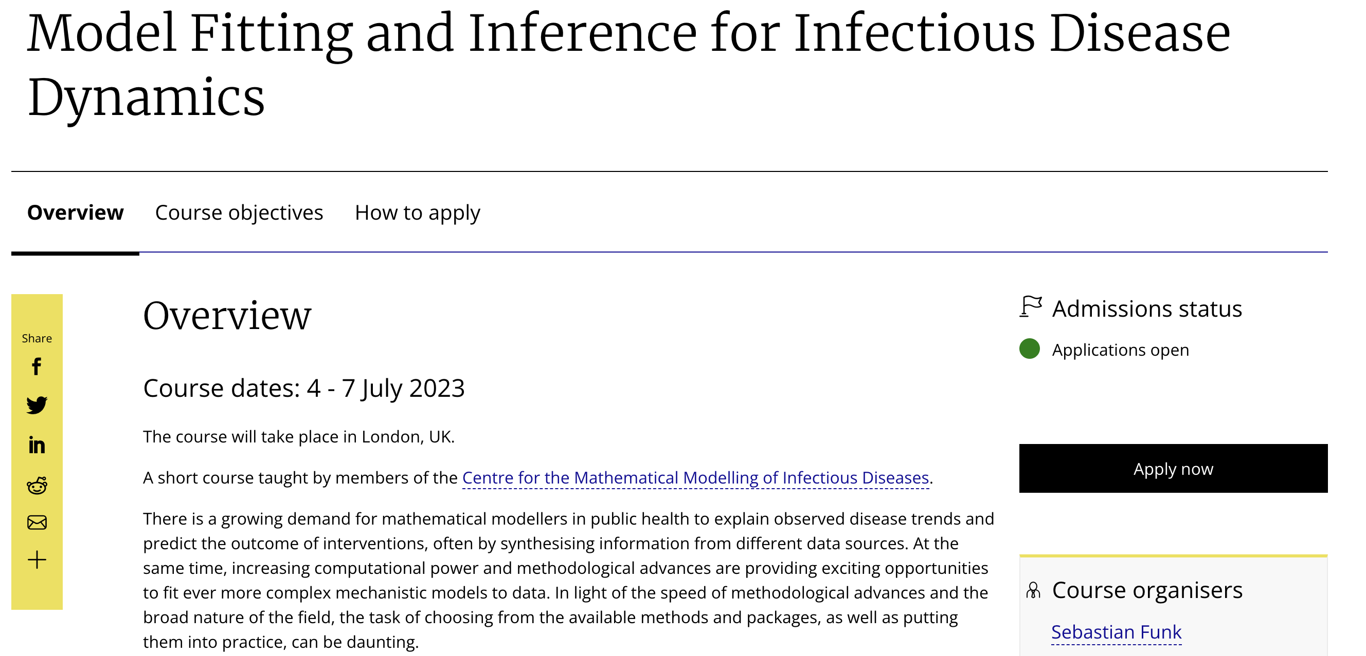
Additional resources

Slide 7
Photo time!

