Slide 1




Modelling problem
We are interested in modelling the 1918 influenza pandemic, specifically what its impact may have been on Greater London at the time. It is estimated that the average person infected will have been infectious from 2 days after exposure, until 6 days after exposure. The basic reproduction number, R₀, was estimated at around 2.4. Individuals who recover have long-lasting immunity.
What is an appropriate model structure?
SEIR
Draw the model structure?
What are the key parameters (by name/symbol)?
What are the key parameters (by value)?
Initial conditions?
$δ$ = 0.5 days^{–1}
$γ$ = 0.25 days^{–1}
$R_{0}=β(1/γ)$
$β=R_{0}γ=2.4×0.25$ days^{–1}
$β=0.6$ days^{–1}
N = 7.3 million
S
$$β(\frac{I}{N})$$
Force of infection
Transmission
Rate = $β$
E
I
R
$$δ$$
Latent
period
=1/$δ$
$$γ$$
Recovery rate
Infectious period
= 1/ $γ$

Slide 2
Metapopulations with ODEs
Modern Techniques in Modelling

Slide 3
Recap

Slide 4

Previously: ODE models in R
We defined a set of ODEs
Then used deSolve to simulate the model output
$$\begin{matrix}\frac{\text{d}S}{\text{d}t} & =−βSI/N \\ \frac{\text{d}I}{\text{d}t} & =βSI/N−γI \\ \frac{\text{d}R}{\text{d}t} & =γI\end{matrix}$$

Slide 5
Example code
SIR_model <- function(times, state, parms){ ## Define variables S <- state["S"] I <- state["I"] R <- state["R"] N <- S + I + R # Extract parameters beta <- parms["beta"] gamma <- parms["gamma"] # Define differential equations dS <- - (beta * S * I) / N dI <- (beta * S * I) / N - gamma * I dR <- gamma * I res <- list(c(dS, dI, dR)) return(res) }

Slide 6
Metapopulations

Slide 7
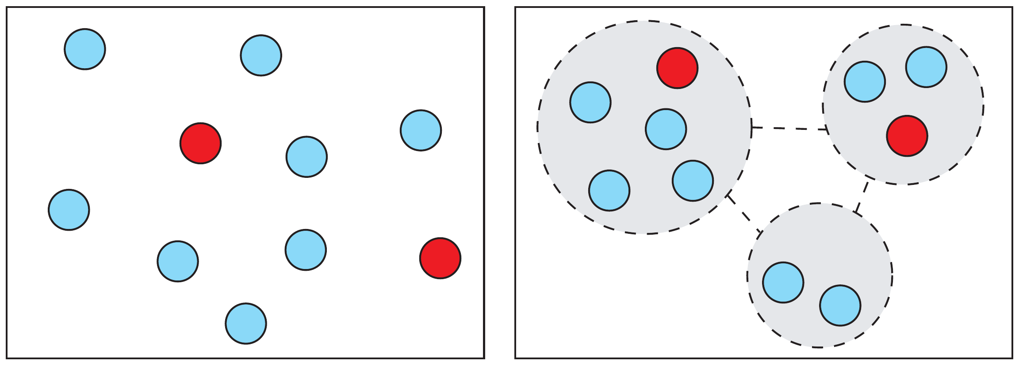
Non-random mixing
So far we’ve assumed everyone mixes together randomly
In reality, people may group together in different locations / settings / groups
If we’re interested in heterogeneity, we need to model multiple populations (‘metapopulations’)
Random mixing vs metapopulations

Slide 8

Metapopulation model
Let’s consider two linked populations.
This means expanding our SIR model:
$$\begin{matrix}\frac{\text{d}S_{1}}{\text{d}t} & =−βS_{1}I_{1}/N_{1} \\ \frac{\text{d}I_{1}}{\text{d}t} & =βS_{1}I_{1}/N_{1}−γI_{1} \\ \frac{\text{d}R_{1}}{\text{d}t} & =γI_{1} \\ \frac{\text{d}S_{2}}{\text{d}t} & =−βS_{2}I_{2}/N_{2} \\ \frac{\text{d}I_{2}}{\text{d}t} & =βS_{2}I_{2}/N_{2}−γI_{2} \\ \frac{\text{d}R_{2}}{\text{d}t} & =γI_{2}\end{matrix}$$

Slide 9

Connecting the populations
Susceptibles in population 1 can have contact with infectives in population 1 and population 2.
But may contact population 2 at a different (lower?) rate:
$$\begin{matrix}\frac{\text{d}S_{1}}{\text{d}t} & =−S_{1}[\overset{\text{from} \text{pop}\text{ 1}}{\overbrace{βI_{1}/N_{1}}}+\overset{\text{from} \text{pop}\text{ 2}}{\overbrace{αβI_{2}/N_{2}}}]\end{matrix}$$

Slide 10
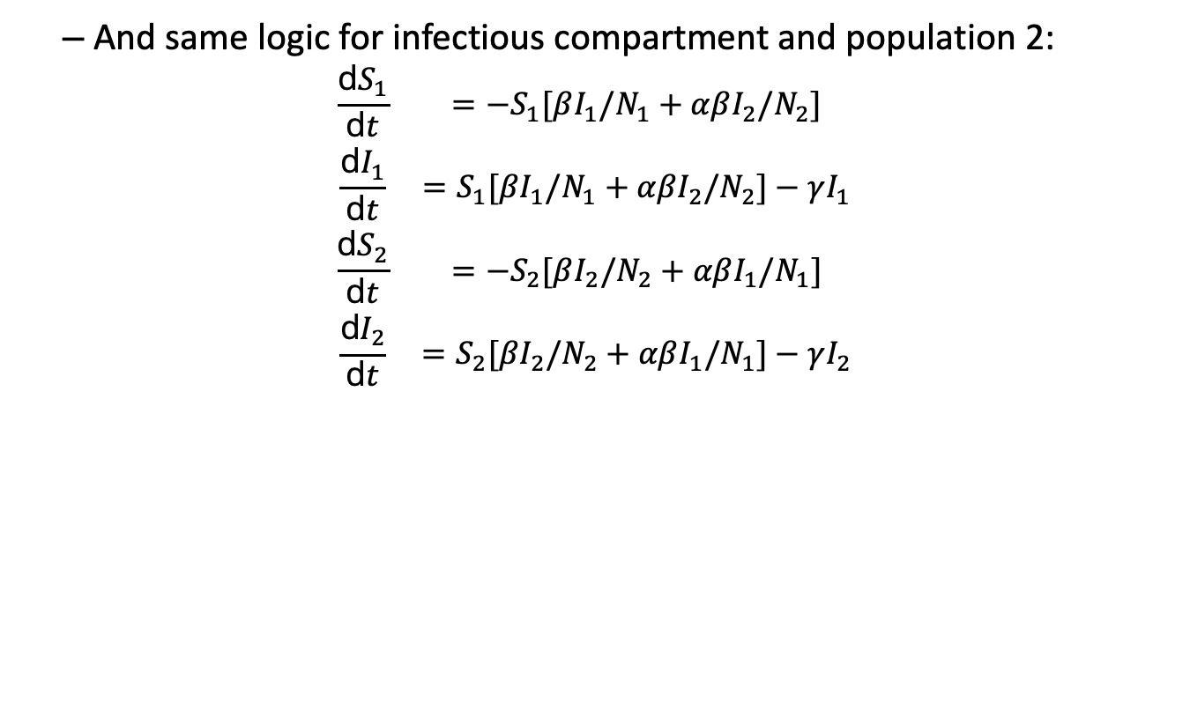
Connecting the populations
And same logic for infectious compartment and population 2:
$$\begin{matrix}\frac{\text{d}S_{1}}{\text{d}t} & =−S_{1}[βI_{1}/N_{1}+αβI_{2}/N_{2}] \\ \frac{\text{d}I_{1}}{\text{d}t} & =S_{1}[βI_{1}/N_{1}+αβI_{2}/N_{2}]−γI_{1} \\ \frac{\text{d}S_{2}}{\text{d}t} & =−S_{2}[βI_{2}/N_{2}+αβI_{1}/N_{1}] \\ \frac{\text{d}I_{2}}{\text{d}t} & =S_{2}[βI_{2}/N_{2}+αβI_{1}/N_{1}]−γI_{2}\end{matrix}$$

Slide 11
Practical
Objective: implement SIR metapopulation model with two populations
Answer questions A-D
Question E is optional
Book by Keeling & Rohani (Princeton, 2007) has more details about metapopulations.

Slide 12
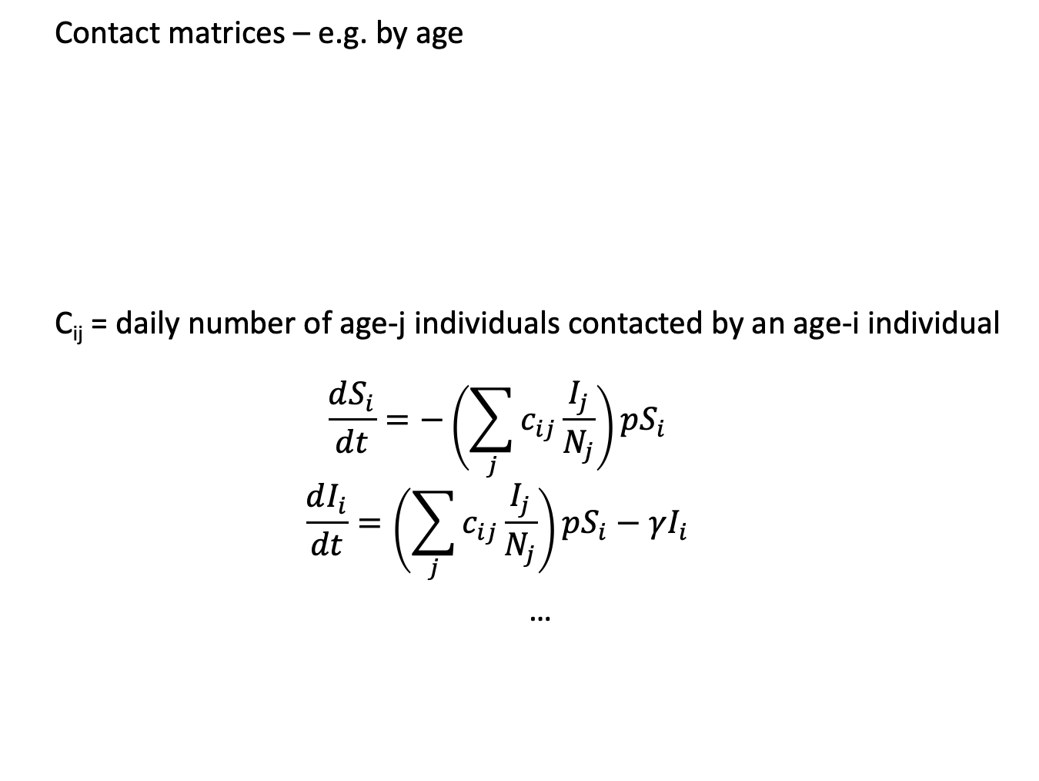
General approach
Contact matrices – e.g. by age
C_{ij} = daily number of age-j individuals contacted by an age-i individual
$$\frac{dS_{i}}{dt}=−\left(\sum_{j}{c_{ij}\frac{I_{j}}{N_{j}}}\right)pS_{i}$$
$$\frac{dI_{i}}{dt}=\left(\sum_{j}{c_{ij}\frac{I_{j}}{N_{j}}}\right)pS_{i}−γI_{i}$$
…
 | 0-4 | 5-9 | 10-14
0-4 | 4.1 | 1.8 | 0.7
5-9 | 1.2 | 5.6 | 1.2
10-14 | 0.8 | 0.9 | 7.8

Slide 13
General approach
Contact matrices – e.g. by age
A question that often comes up… why isn’t this matrix symmetrical about the diagonal? Is it supposed to be?
To see why it doesn’t need to be, consider contact rates among a group of friends with these ages:
(20-29) (20-29) (30-39)
 | 0-4 | 5-9 | 10-14
0-4 | 4.1 | 1.8 | 0.7
5-9 | 1.2 | 5.6 | 1.2
10-14 | 0.8 | 0.9 | 7.8

