Slide 1
Types of Models
Modern Techniques in Modelling
Notes:
…

Slide 2
Many models, so little time
Model is a generic term used to refer to a representation of reality, often (but not always) quantitative in nature.
We use the term mathematical models to refer to a class of (quantitative) models that are mechanistic in nature.
The opposite of mechanistic is phenomenological. Phenomenological models can be called statistical models to differentiate them from mathematical (mechanistic) models.

Slide 3
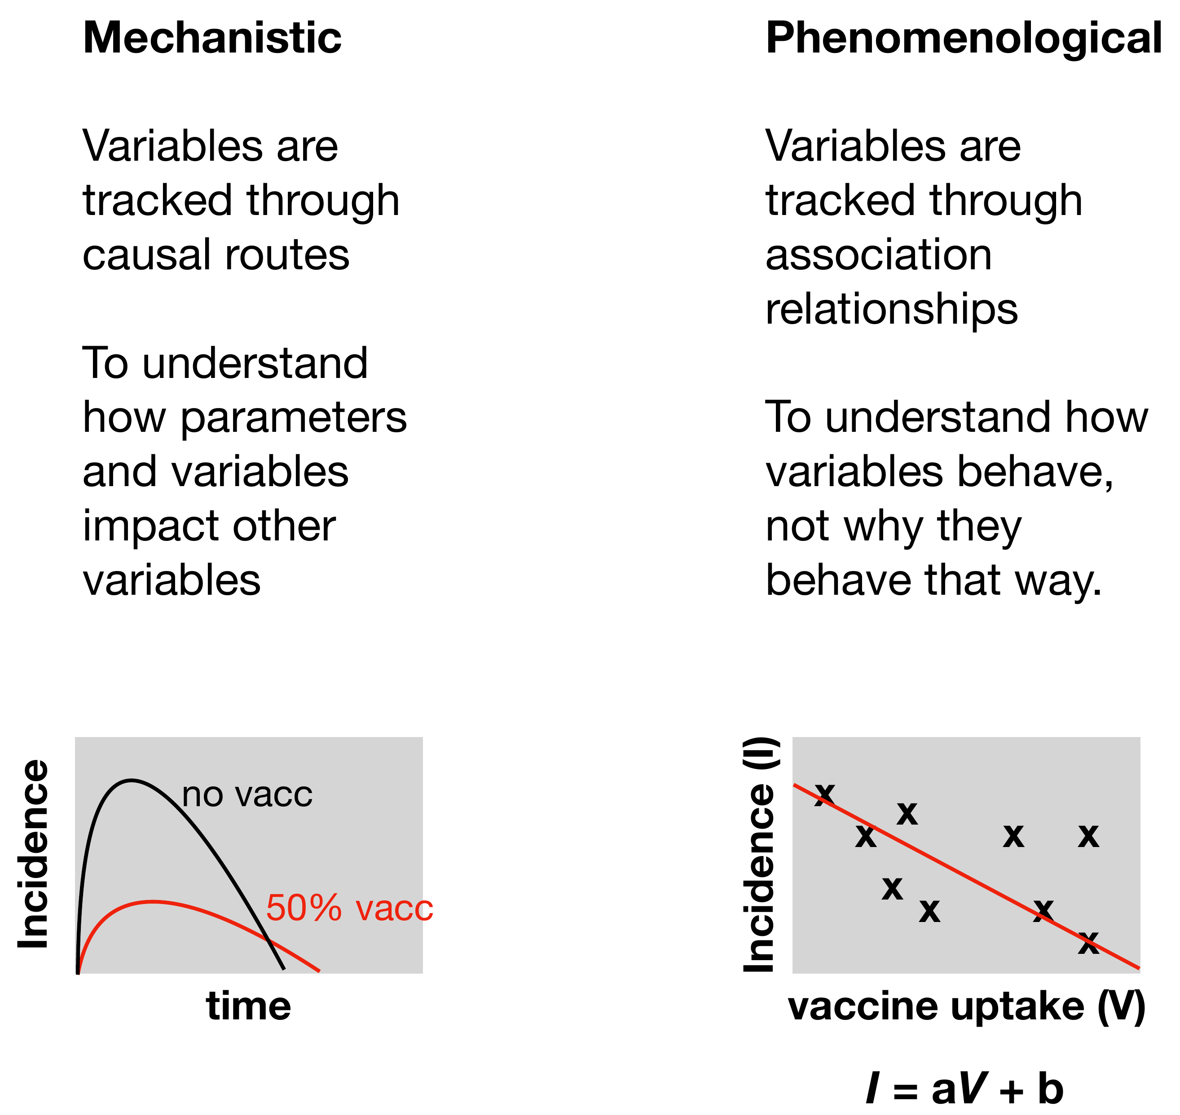
Many models, so little time
Notes:
Herd immunity
Non-linear effects of changing transmission

Slide 4
Which models will we see in the course?
Difference equations
Ordinary differential equations (ODEs)
Metapopulation ODE
Network model
Individual-based model
Stochastic “compartment” model

Slide 5
Which models will we see in the course?
Difference equations Tracks the number of individuals in each epidemiological “compartment” (e.g. Infected or Susceptible) at each e.g. day or week timestep

Slide 6
Which models will we see in the course?
Difference equations Tracks the number of individuals in each epidemiological “compartment” (e.g. Infected or Susceptible) at each e.g. day or week timestep
Susceptible = 99
Susceptible = 98
Susceptible = 96
Infected
= 1
Infected
= 2
Infected
= 3
Recovered
= 0
Recovered
= 0
Recovered
= 1
Day 1
Day 2
Day 3
…

Slide 7
Which models will we see in the course?
Ordinary Differential Equations (ODEs) Same as ‘difference equations’ but instead of calculating at each timestep, we move to continuous time
S
I
R
Defined by change in the number of people in each compartment

Slide 8
Which models will we see in the course?
Metapopulation
Add in structure to ODE model by creating multiple subpopulations that can transmit infections within and between each subpopulation
S
I
R
Subpopulation 1
S
I
R
Subpopulation 2
S
I
R
Subpopulation 3

Slide 9
Which models will we see in the course?
S
I
I
S
I
Network model Elaborates on the idea of structure where each individual is constrained by who they can transmit to. This first introduces idea of “stochastic” dynamics
I
S
R

Slide 10
Which models will we see in the course?
1.
F 48.3y; became infected on day 16; has an incubation period of 5.2 days, will have mild symptoms and lose infectiousness after 8.6 days.
2.
M 15.9y; became infected on day 102; has an incubation period of 3.0 days, will be hospitalized in North London on day 106, discharged on day 108 and lose infectiousness 10.6 days later.
Individual-based model (IBM)
Extends structure by tracking each individual, each with their own spatial and epidemiological characteristics

Slide 11
Which models will we see in the course?
🎲
🎲
S
I
R
Still defined by change in the number of people in each compartment.
But events (e.g. infections, recoveries etc.) happen stochastically. Because we are still tracking total number of people and not individuals, it’s quicker.
Stochastic compartment model
A stochastic implementation of our compartment ODE model but there is randomness in events happening

Slide 12
Which models will we see in the course?
Difference equations Tracks the number of individuals in each epidemiological “compartment” (e.g. Infected or Susceptible) at each e.g. day or week timestep
Ordinary Differential Equations (ODEs) Same as ‘difference equations’ but instead of calculating at each timestep, we move to continuous time
Metapopulation
Add in structure to ODE model by creating multiple subpopulations that can transmit infections within and between each subpopulation
Network model Elaborates on the idea of structure where each individual is constrained by who they can transmit to. This first introduces idea of “stochastic” dynamics
Individual-based model (IBM)
Extends structure by tracking each individual, each with their own spatial and epidemiological characteristics
Stochastic compartment model
A stochastic implementation of our compartment ODE model but there is randomness in events happening

Slide 13
What type of mathematical models should we build?
Main Question: how do we choose a model type and a model structure? Key principle: build with parsimony (“as simple as necessary”)
Notes:
Parsimony as an overarching principle!

Slide 14
What type of mathematical models should we build?
Main Question: how do we choose a model type and a model structure? Key principle: build with parsimony (“as simple as necessary”)
What is the research question?
How big is the population?
Are there stochastic fluctuations in the data that cannot be mechanistically accounted for?
Do we need to track every individual?
What type of events are we modelling and how do we parameterise them?
What type of data do we have?
Notes:
Parsimony as an overarching principle!

Slide 15
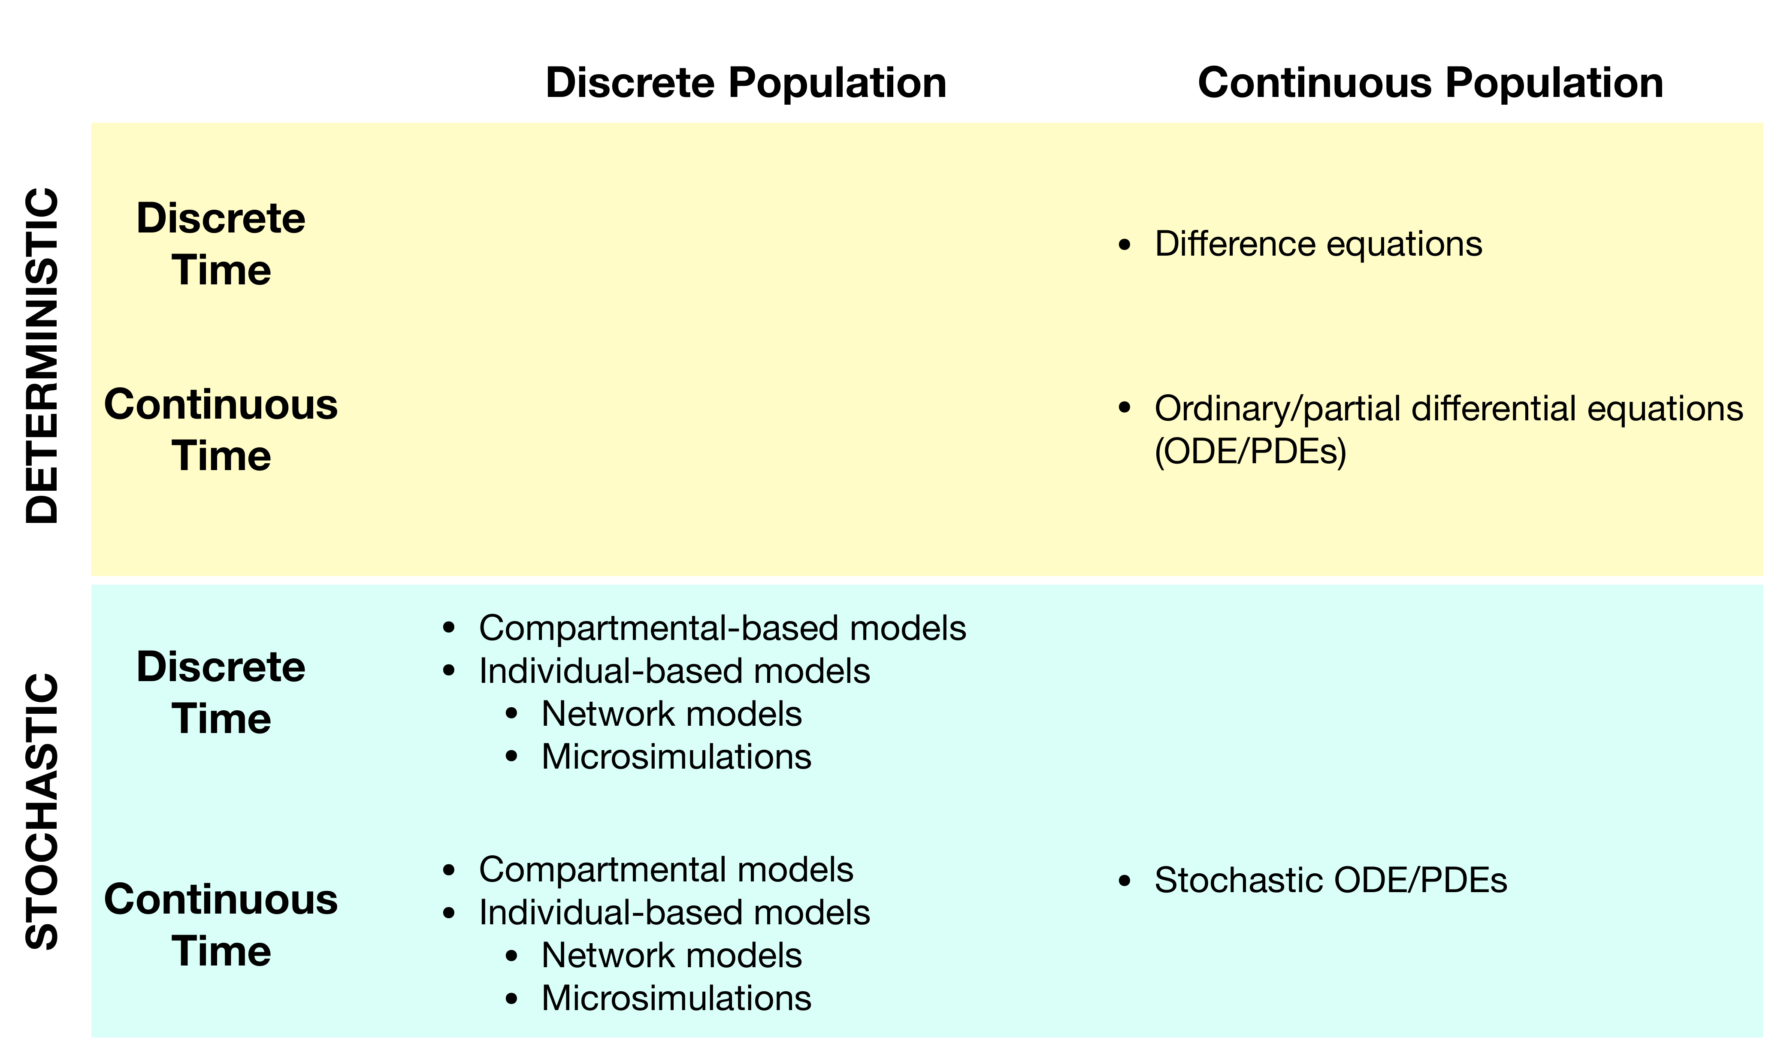
General framework for types of models
Notes:
This slide is confusing – it basically mentions compartmental models 4 time in different categories…
Also stochastic models in continuous time?
Examples:
Want to evaluate probability of CoV outbreak in UK? Stochastic, discrete time -> branching process
Impact of school closures on CoV in the whole of UK? Determinisitc, age stratified (discrete pop), continuous time -> simplest cont time solver is discrete time?

Slide 16
General framework for types of model
On this course, you will encounter a combination of:
Deterministic and Stochastic models
Discrete and continuous time models
Discrete and continuous population models
Simple spatial models

Slide 17
Terminology clarification
Model Variable: A quantity that is tracked through time and changes as a function of the other variables/parameters (e.g. number of infected people)
Model Parameter: Will stay constant through a whole iteration of a model (e.g. vaccine coverage, mortality rate)
Note that in R parameters and variables are both sometimes called "variables”

Slide 18
Download practical exercises
All of the practical exercises will use R scripts that you can download in one go:
Open RStudio
Navigate to https://github.com/cmmid/MTM in your internet browser Follow QuickStart guide in README
To download your files: MTM::scripts(path = “~/Downloads/MTM”,
overwrite = FALSE,
what = “scripts”)
Set path for new folder
Don’t change this if you want to keep any files
Can change to ‘solutions’

Slide 19
Model type examples used in papers
Ordinary differential equations
Hethcote (2000) SIAM 42(2): Review on constructions of SIR-type models
Perelson et al. (1996) Science 271(5255): First description of within-host HIV dynamics spread
Networks
Meyers, LA (2005) J of Theo. Biology 232: Using networks to understand outbreak heterogeneity
Microsimulations
Halloran, ME (2008) PNAS 105(12): Pandemic flu containment in the US
Stochastic ‘event-driven’ model
Legrand et al. (2007) Epi & Infection 135: Modelling Ebola epidemics

