Slide 1
Sensitivity Analysis & Sampling
Modern Techniques in Modelling

Slide 2
Introduction

Slide 3
What we will introduce in this session
Local (or one/multi-way) Analysis
Uncertainty analysis
Sensitivity analysis
Global Analysis
Probabilistic (or Sampling) uncertainty analysis

Slide 4
Uncertainty and Sensitivity
Uncertainty and Sensitivity are often used interchangably (rather confusingly!)
I will used the terminology used in references below:
uncertainty analysis is the evaluation of the uncertainty in model output caused by uncertainty in the model parameter input (most of what we do)
sensitivity analysis is the attribution of this uncertainty to each parameter (either qualitatively or quantitatively)
References recommended:
‘Global Sensitivity Analysis: The Primer’ by Saltelli et al. (2008)
Marino et al. (2008) Journal of Theoretical Biology 254
Blower & Dowlatabadi (1994) International Statistical Review 62

Slide 5
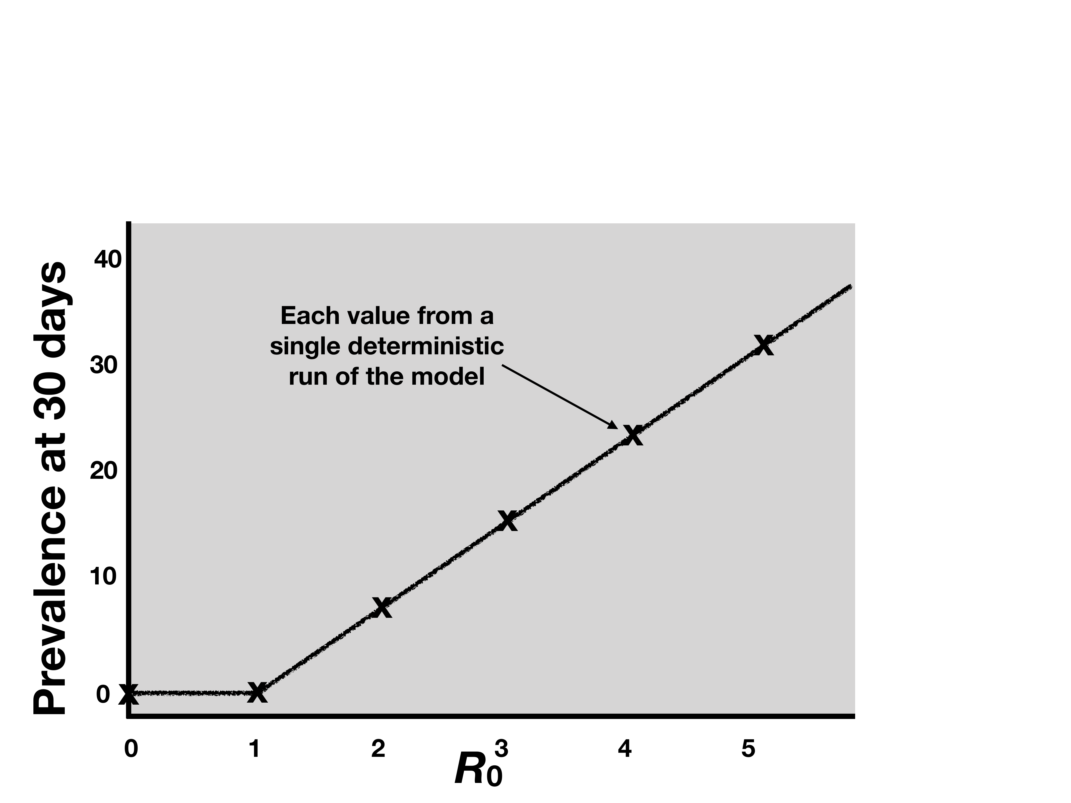
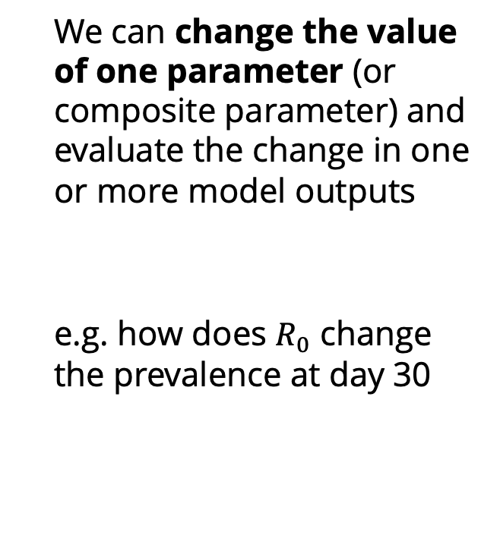
Local (one/multi-way) uncertainty analysis
We can change the value of one parameter (or composite parameter) and evaluate the change in one or more model outputs
e.g. how does $R_{0}$ change the prevalence at day 30

Slide 6
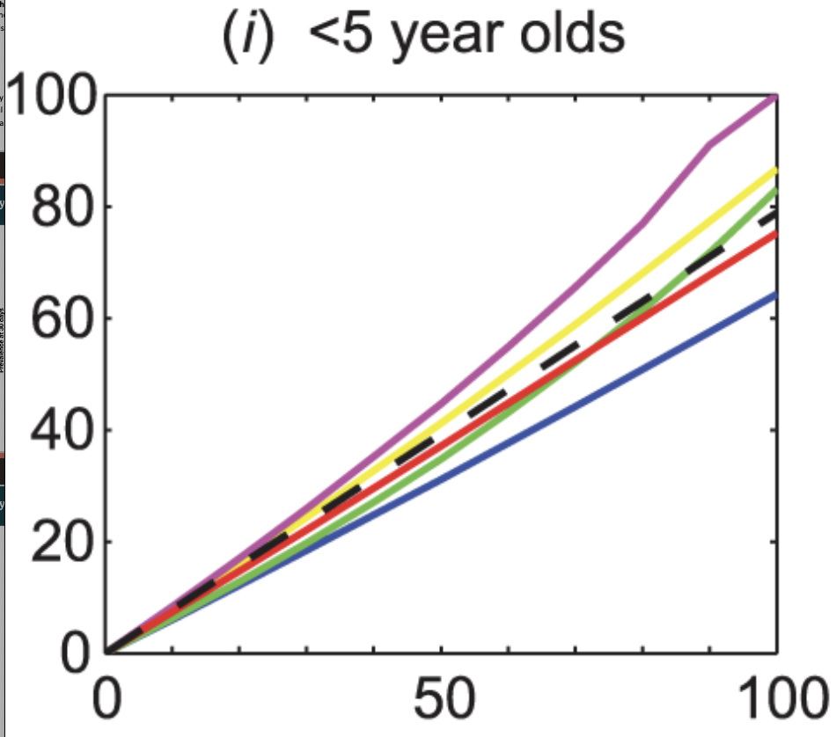


Local (one/multi-way) uncertainty analysis
Instead of changing a parameter across a set of values, we can change the model structure
This is often described as structural uncertainty analysis

Slide 7
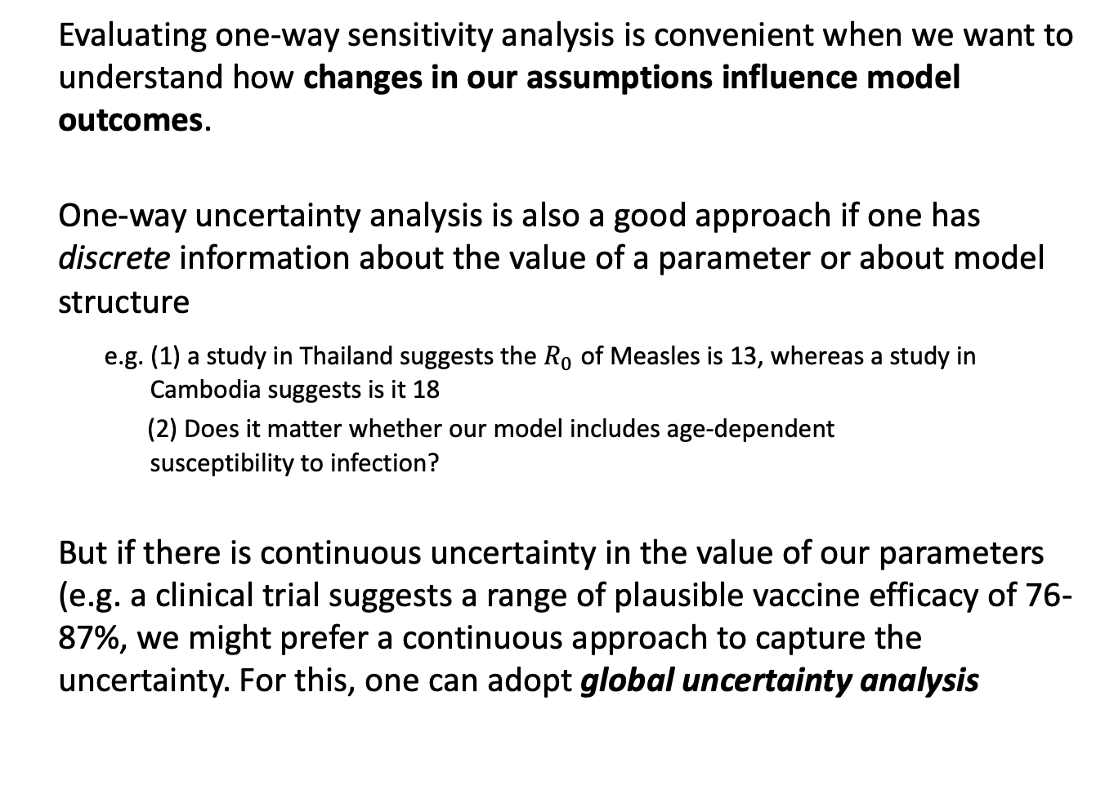
Local (one/multi-way) uncertainty analysis
Evaluating one-way sensitivity analysis is convenient when we want to understand how changes in our assumptions influence model outcomes.
One-way uncertainty analysis is also a good approach if one has discrete information about the value of a parameter or about model structure
e.g. (1) a study in Thailand suggests the $R_{0}$ of Measles is 13, whereas a study in Cambodia suggests is it 18
(2) Does it matter whether our model includes age-dependent susceptibility to infection?
But if there is continuous uncertainty in the value of our parameters (e.g. a clinical trial suggests a range of plausible vaccine efficacy of 76-87%, we might prefer a continuous approach to capture the uncertainty. For this, one can adopt global uncertainty analysis

Slide 8
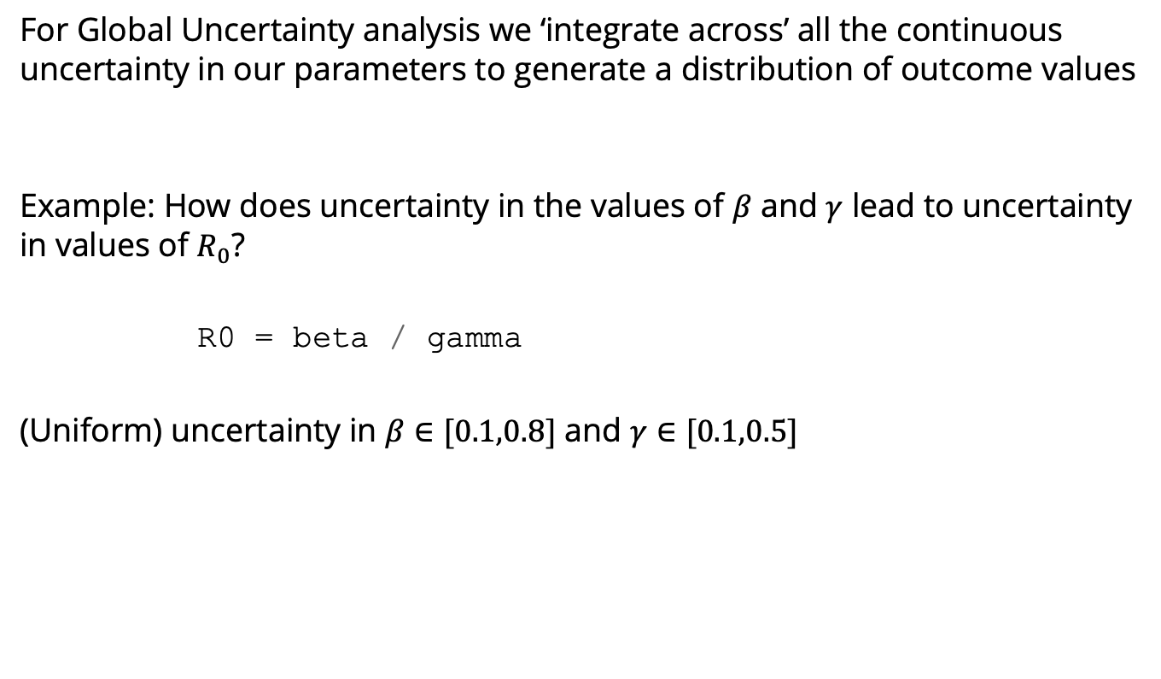
Global uncertainty analysis: Monte Carlo Sampling
For Global Uncertainty analysis we ‘integrate across’ all the continuous uncertainty in our parameters to generate a distribution of outcome values
Example: How does uncertainty in the values of $β$ and $γ$ lead to uncertainty in values of $R_{0}$?
R0 = beta / gamma
(Uniform) uncertainty in $β∈[0.1,0.8]$ and $γ∈[0.1,0.5]$

Slide 9
Global uncertainty analysis: Monte Carlo Sampling
Uniform uncertainty in beta and gamma to $R_{0}$= 1.45 (0.41– 4.43)

Slide 10

Global uncertainty analysis: Monte Carlo Sampling
We assumed that both $β$ and $γ$ were distributed uniformly over their respective intervals, but we can relax this rule and choose any distribution we want

Slide 11
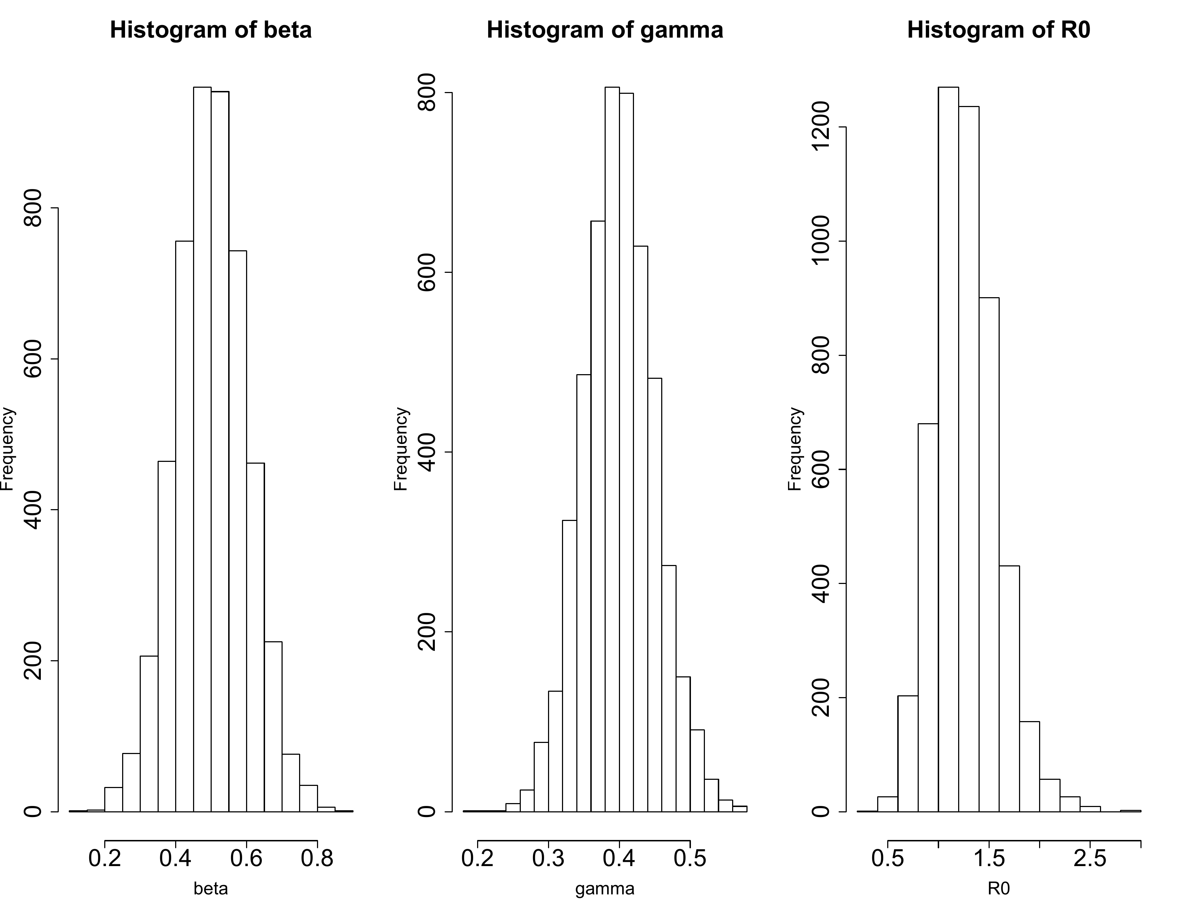
Global uncertainty analysis: Monte Carlo Sampling

Slide 12
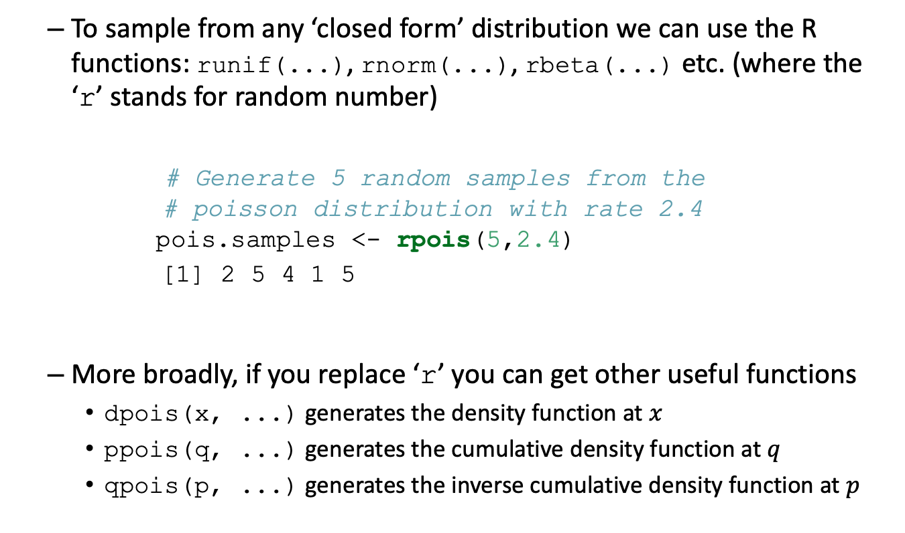
Global uncertainty analysis: Monte Carlo Sampling
To sample from any ‘closed form’ distribution we can use the R functions: runif(...), rnorm(...), rbeta(...) etc. (where the ‘r’ stands for random number)
# Generate 5 random samples from the # poisson distribution with rate 2.4 pois.samples <- rpois(5,2.4)
[1] 2 5 4 1 5
More broadly, if you replace ‘r’ you can get other useful functions
dpois(x, ...) generates the density function at $x$
ppois(q, ...) generates the cumulative density function at $q$
qpois(p, ...) generates the inverse cumulative density function at $p$

Slide 13
Global uncertainty analysis: Monte Carlo Sampling
Every time you ask R to ‘generate random numbers’, you are actually generating pseudorandom numbers from random number generators.
Random number generators (RNGs) are algorithms that produce numbers that look stochastic (random), but are deterministic.
e.g. > runif(1)
[1] 0.9734249
> runif(1)
[1] 0.2389333
If they are deterministic algorithms how do they produce different output every time?

Slide 14
Global uncertainty analysis: Monte Carlo Sampling
….by starting in a different place each time.
To generate a sequence of pseudorandom numbers that are always different, the place (or, ‘seed’), where the algorithm starts must always be different.
This is often achieved by using the current time as the seed.
R will do this automatically for you, but you can set it manually:
E.g. > set.seed(Sys.time()) # use computer’s time to set the seed of the RNG
If you want to create the same sequence of numbers, you can use a fixed seed (if you are wanting to debug your code!)
E.g. > my.seed <- 42
> set.seed(my.seed)
> runif(1)
> [1] 0.914806
> set.seed(my.seed)
> [1] 0.914806

Slide 15
Global uncertainty analysis: Monte Carlo Sampling
Monte Carlo Sampling generates random numbers from an entire distribution. It works because we sample from a parameter distribution (parameter input) that we know to generate samples from the outcome distribution that we don’t know.
However, it can be computationally expensive because the parameter samples are picked from across the entire distribution. If we don’t pick enough samples, the parameter values we assemble might not be a good representation of the distribution

Slide 16
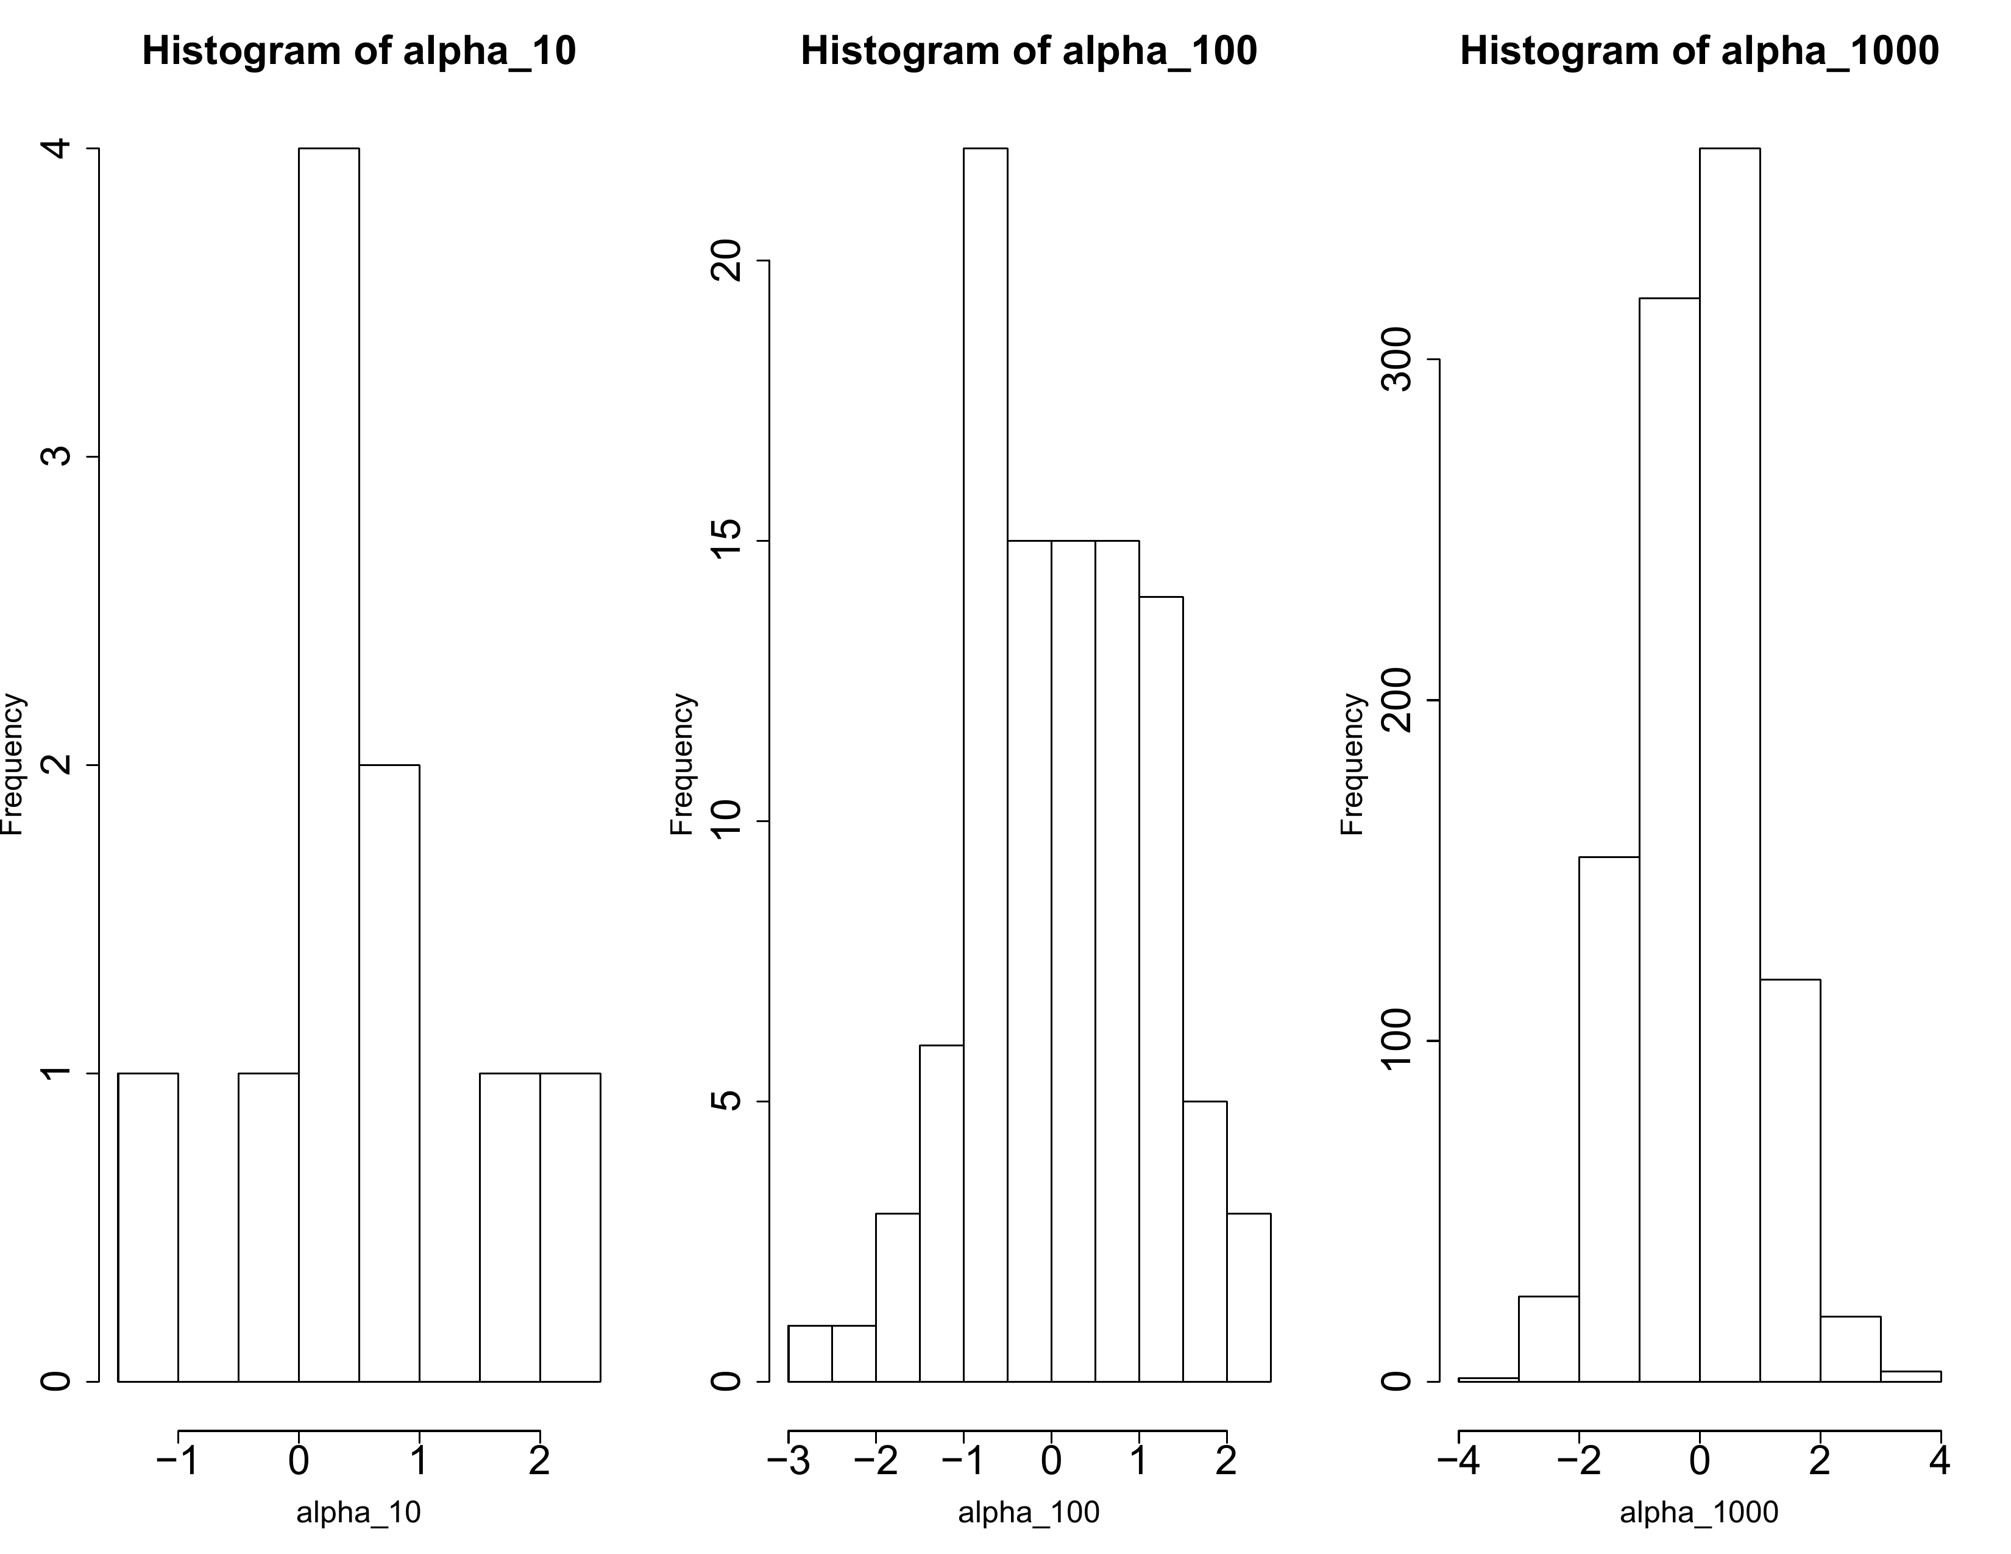
Global uncertainty analysis: Monte Carlo Sampling
10 samples
100 samples
100 samples

Slide 17
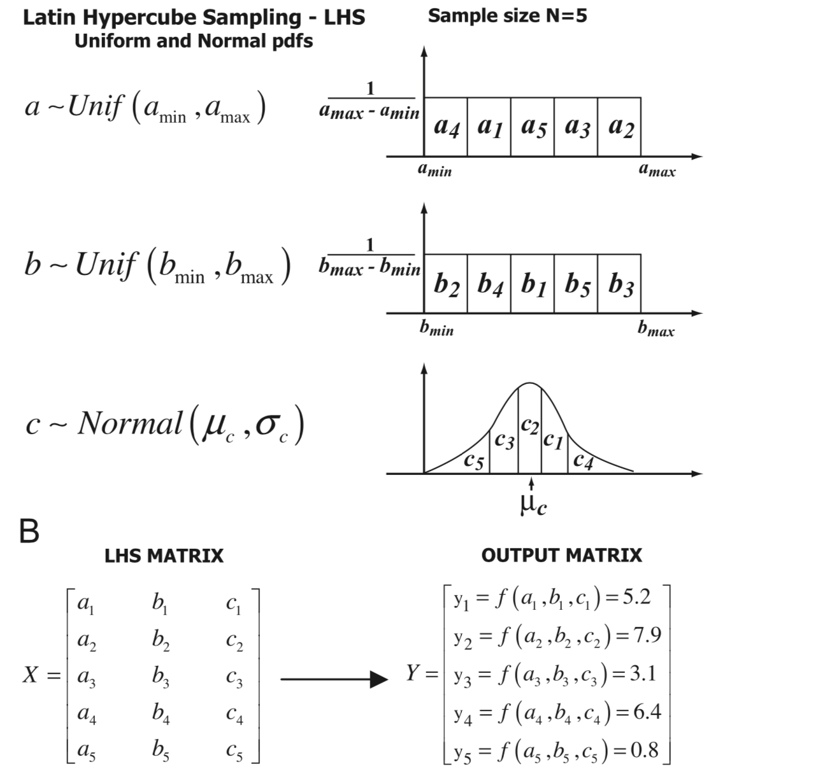
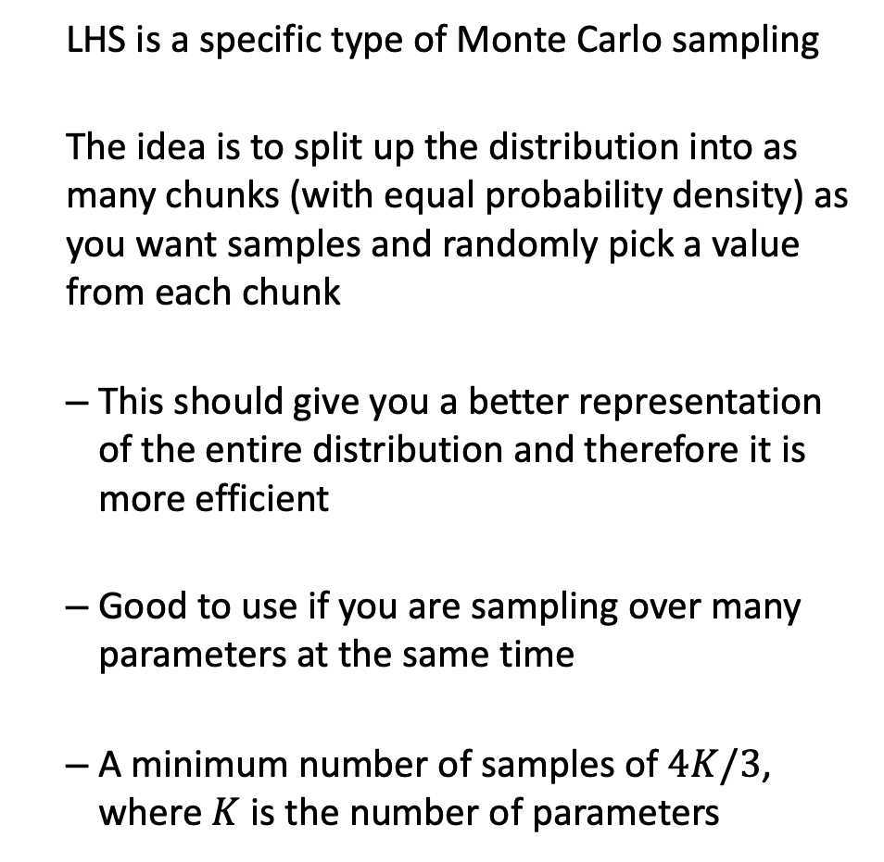
Global uncertainty analysis: Latin Hypercube Sampling
LHS is a specific type of Monte Carlo sampling
The idea is to split up the distribution into as many chunks (with equal probability density) as you want samples and randomly pick a value from each chunk
This should give you a better representation of the entire distribution and therefore it is more efficient
Good to use if you are sampling over many parameters at the same time
A minimum number of samples of $4K/3$, where $K$ is the number of parameters
Marino et al JTB 254(2008)178-196

Slide 18
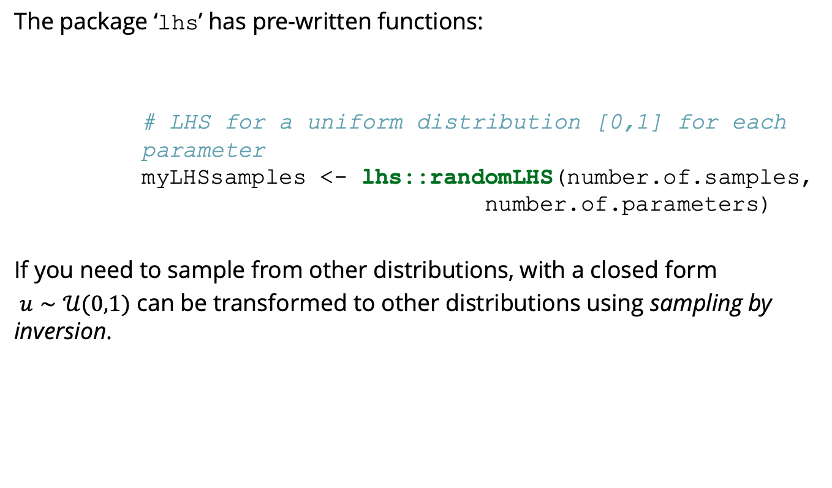
Global uncertainty analysis: Latin Hypercube Sampling
The package ‘lhs’ has pre-written functions:
# LHS for a uniform distribution [0,1] for each parameter myLHSsamples <- lhs::randomLHS(number.of.samples, number.of.parameters)
If you need to sample from other distributions, with a closed form
$u∼𝒰(0,1)$ can be transformed to other distributions using sampling by inversion.

Slide 19
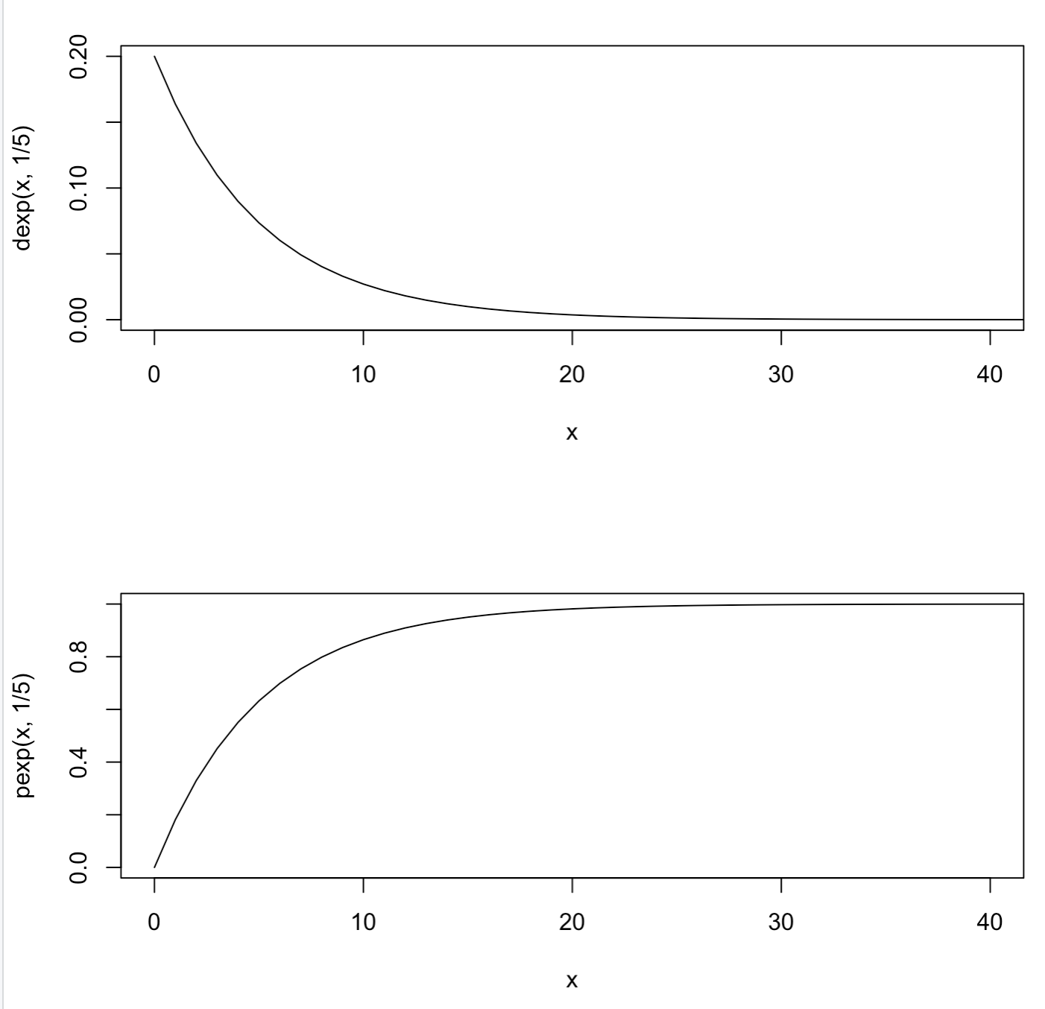
Global uncertainty analysis: Sampling by inversion
Example: Generate samples X₁ ,…, X_{n}
from an Exponential Distribution with rate parameter = 1/5
X_{i}
Sample from U(0,1): R₁ ,…, R_{n}
Calculate a sample from Exp(1/5) using its inverse function F⁻¹(y) = -log(1-y)
X_{i} = -log(1-R_{i})
R_{i}

Slide 20
Local (one/multi-way) sensitivity analysis: measures
The SENSITIVITY (s) of a model with respect to a parameter is:
The increase or decrease in outcome unit per increase in parameter unit
i.e. parameter increase of 0.01 leads to an additive change in the outcome by 0.01s
The ELASTICITY (e) of a model with respect to a parameter is:
The proportional change in the outcome when a parameter is increased
i.e. increasing a parameter by a factor of 1.01 would lead to the scaling of an outcome measure 1.01e
Both measures indicate how much each parameter influences the outcome measure. For more information on Global sensitivity analyses, please consult Saltelli 2008.

Slide 21
Monte carlo sampling vs stochasticity
If you use Monte Carlo sampling, you will generate a distribution of outcomes (e.g. epidemic curves), because you are capturing parameter uncertainty.
However, this sampling does not necessarily mean the underlying model is stochastic (i.e .that it incorporates randomness).
That is, for a fixed parameter draw in your Monte Carlo samples, each model run can be either deterministic (the types of models we have seen so far in the course) or stochastic (there is randomness – we’ll see examples of these tomorrow).

Slide 22
Over to you
Open up Practical_06.R

