Slide 1
Modern Techniques in Modelling

Slide 2
Who we are
Course organisers
Nicholas Davies, PhD Nicholas.Davies@lshtm.ac.uk
Yang Liu, PhD Yang.Liu@lshtm.ac.uk
Oli Brady, PhD Oliver.Brady@lshtm.ac.uk
Course administration
Francesco Grisolia Francesco.Grisolia@lshtm.ac.uk
Lecturers and Demonstrators
Billy Quilty, Kath O’Reilly, Seb Funk, Johnny Filipe, Alexis Robert, Alex Richards, Kaja Abbas (All LSHTM / CMMID-based)

Slide 3
Next steps
A certificate of attendance will be issued automatically by LSHTM’s short courses team (look out for an e-mail next week).
Please complete the feedback form on Moodle after the course — tell us what we did well and what we could improve.
Feel free to contact us if you have any questions on the course material or about your modelling work!
Notes:
This is the first iteration of this course
Inevitably some things will not quite go to plan
Please let us know suggested improvements along the way!
no formal evaluation

Slide 4
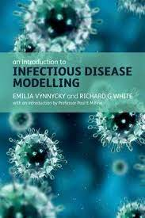
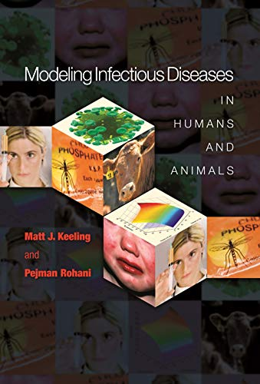
Recommended textbooks

Slide 5
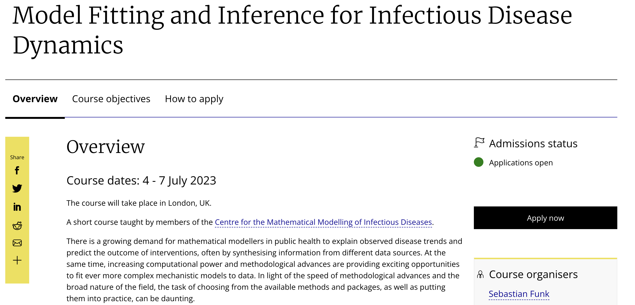
Additional resources
Feb 2025

Slide 6
Which models did we see in the course?
Difference equations Tracks the number of individuals in each epidemiological “compartment” (e.g. Infected or Susceptible) at each e.g. day or week timestep
Ordinary Differential Equations (ODEs) Same as ‘difference equations’ but instead of calculating at each timestep, we move to continuous time
Metapopulation
Add in structure to ODE model by creating multiple subpopulations that can transmit infections within and between each subpopulation
Individual-based model
Tracks each individual, each with their own epidemiological characteristics; this model class also introduces the idea of randomness
Network model Adds structure to the individual-based model, where each individual is constrained by who they can transmit to
Stochastic compartment model
A stochastic implementation of our compartment ODE model but there is randomness in events happening

Slide 7
What type of mathematical models should we build?
Main Question: how do we choose a model type and a model structure? Key principle: build with parsimony (“as simple as necessary”)
What is the research question?
How big is the population?
Are there stochastic fluctuations in the data that cannot be mechanistically accounted for?
Do we need to track every individual?
What type of events are we modelling and how do we parameterise them?
What type of data do we have?
Notes:
Parsimony as an overarching principle!

Slide 8
Wrapping up
Any final questions?
Notes:
Parsimony as an overarching principle!

Slide 9
Photo time!

