Slide 1
Ordinary Differential Equations
Modern Techniques in Modelling

Slide 2
Outline for session 1
What are ordinary differential equations (ODEs)?
How do we use ODEs to model an epidemic?
Using the R package deSolve
Practical: SI, SIR, SEIR models in R

Slide 3
Ordinary differential equations

Slide 4
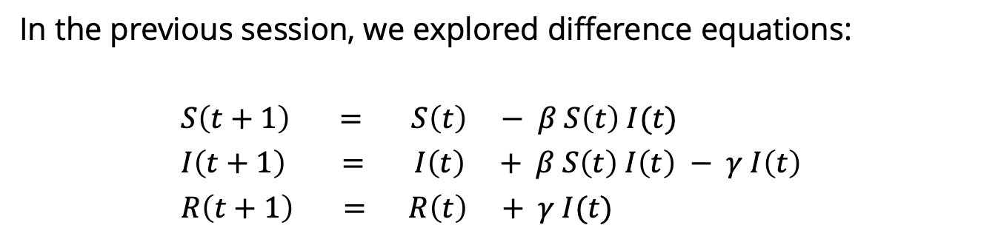
Reminder: Difference equations
In the previous session, we explored difference equations:
$S\left(t+1\right) = S\left(t\right) − β S\left(t\right) I(t)$
$I\left(t+1\right) = I\left(t\right) + β S\left(t\right) I\left(t\right) − γ I\left(t\right)$
$R\left(t+1\right) = R\left(t\right) + γ I(t)$
next
value
current
value
change
in value
=
+
These changes are the interesting part – they are what define the behaviour of the system.

Slide 5
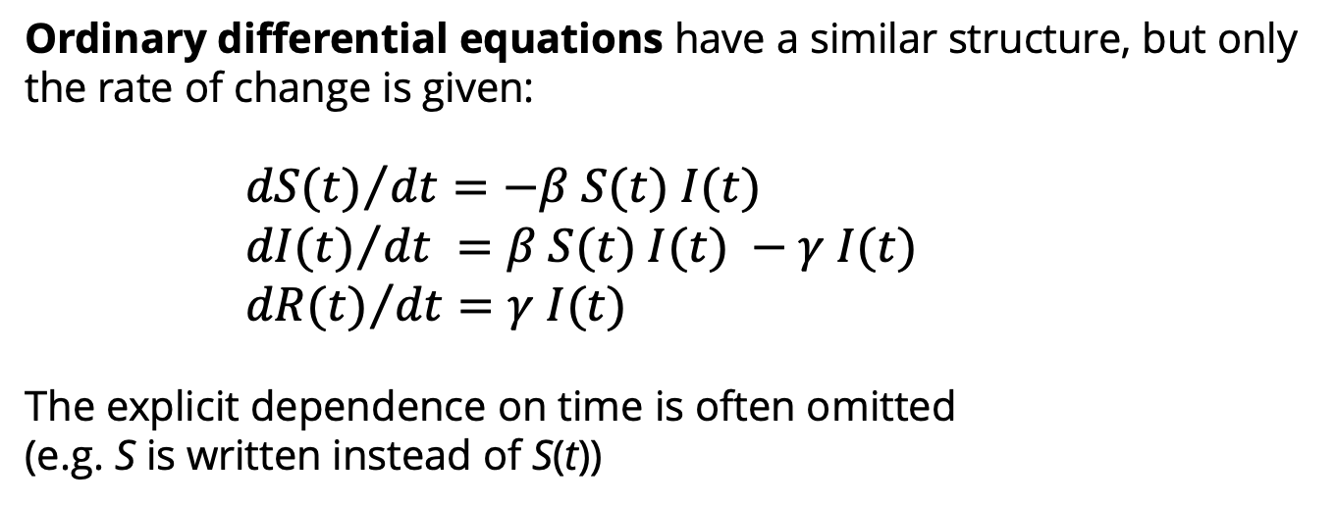
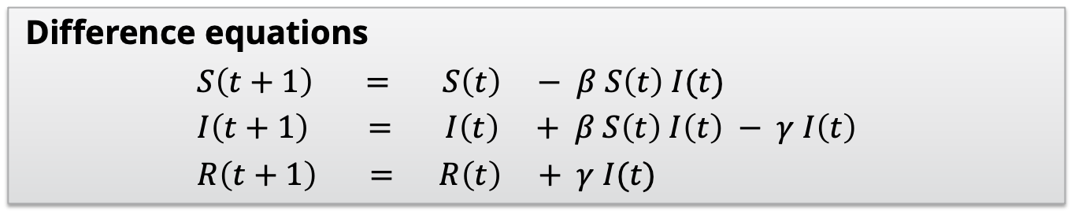
Ordinary differential equations
Difference equations
$S\left(t+1\right) = S\left(t\right) − β S\left(t\right) I(t)$
$I\left(t+1\right) = I\left(t\right) + β S\left(t\right) I\left(t\right) − γ I\left(t\right)$
$R\left(t+1\right) = R\left(t\right) + γ I(t)$
Ordinary differential equations have a similar structure, but only the rate of change is given:
${dS(t)}/{dt}=−β S(t) I(t)$
${dI(t)}/{dt} =β S(t) I(t) −γ I(t)$
${dR(t)}/{dt}=γ I(t)$
The explicit dependence on time is often omitted
(e.g. S is written instead of S(t))

Slide 6
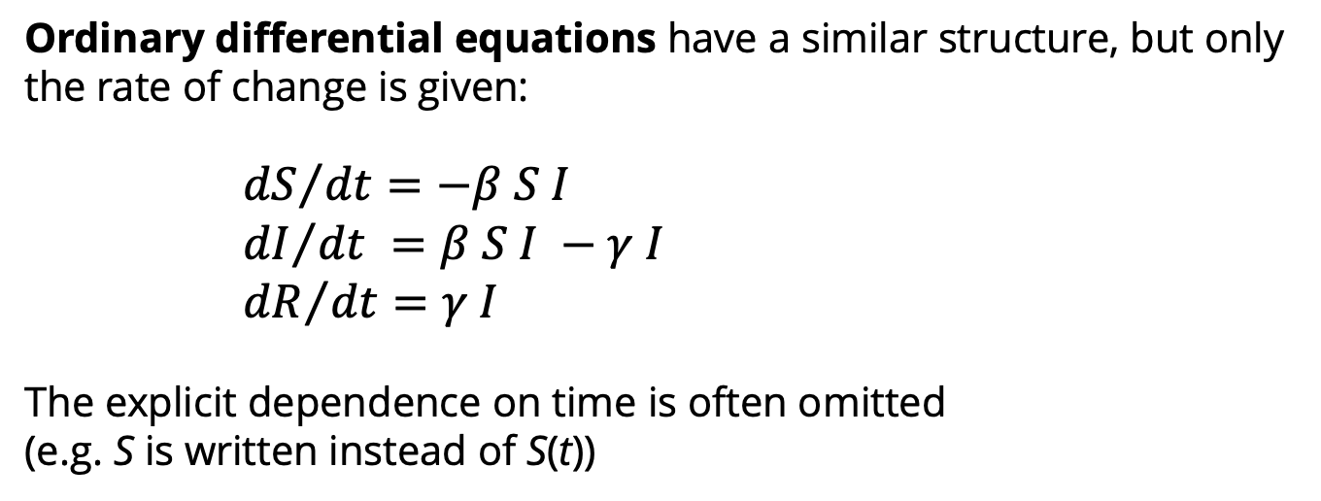
Ordinary differential equations
Difference equations
$S\left(t+1\right) = S\left(t\right) − β S\left(t\right) I(t)$
$I\left(t+1\right) = I\left(t\right) + β S\left(t\right) I\left(t\right) − γ I\left(t\right)$
$R\left(t+1\right) = R\left(t\right) + γ I(t)$
Ordinary differential equations have a similar structure, but only the rate of change is given:
${dS}/{dt}=−β S I$
${dI}/{dt} =β S I −γ I$
${dR}/{dt}=γ I$
The explicit dependence on time is often omitted
(e.g. S is written instead of S(t))

Slide 7
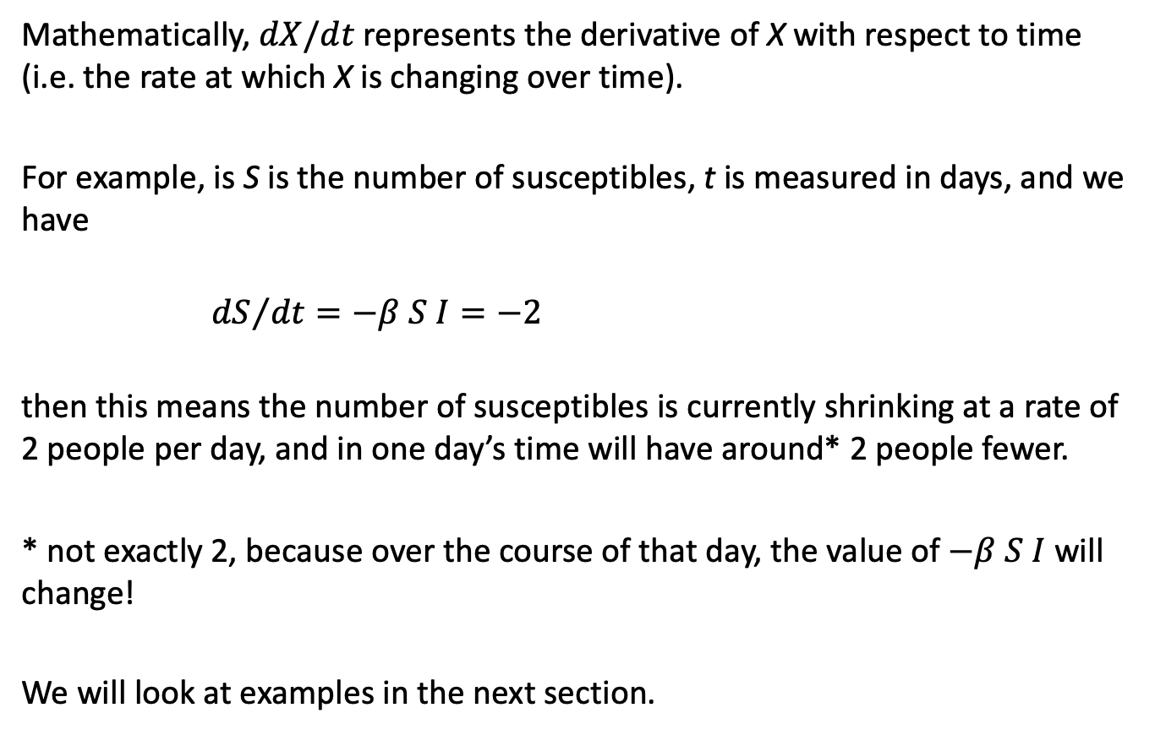
Ordinary differential equations
Mathematically, $dX/dt$ represents the derivative of X with respect to time (i.e. the rate at which X is changing over time).
For example, is S is the number of susceptibles, t is measured in days, and we have
${dS}/{dt}=−β S I=−2$
then this means the number of susceptibles is currently shrinking at a rate of 2 people per day, and in one day’s time will have around* 2 people fewer.
* not exactly 2, because over the course of that day, the value of $−β S I$ will change!
We will look at examples in the next section.

Slide 8
How do we model an infectious disease outbreak using ODEs?

Slide 9
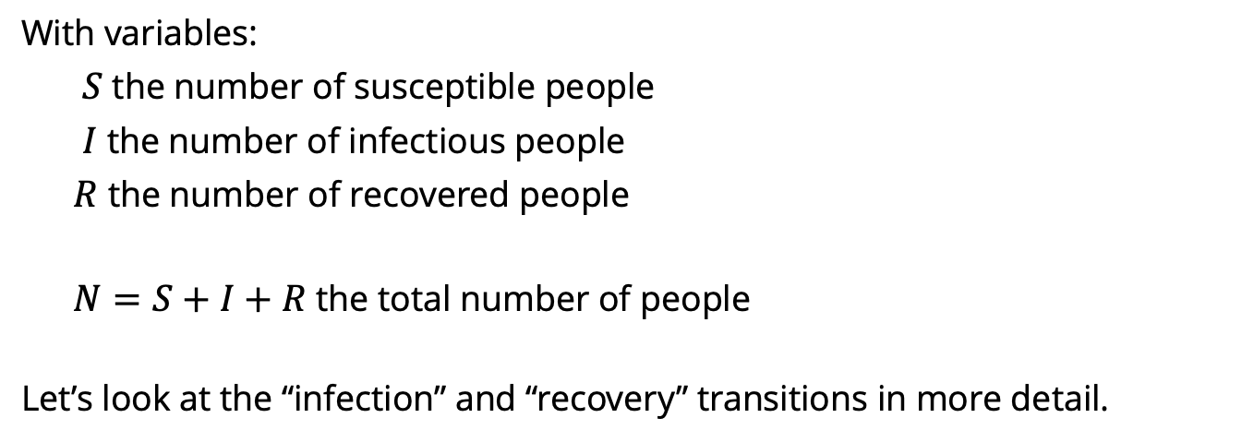
Turning a model diagram into ODEs
S
infection
I
recovery
R
susceptible
infectious
recovered
With variables:
$S$ the number of susceptible people
$I$ the number of infectious people
$R$ the number of recovered people
$N=S+I+R$ the total number of people
Let’s look at the “infection” and “recovery” transitions in more detail.

Slide 10
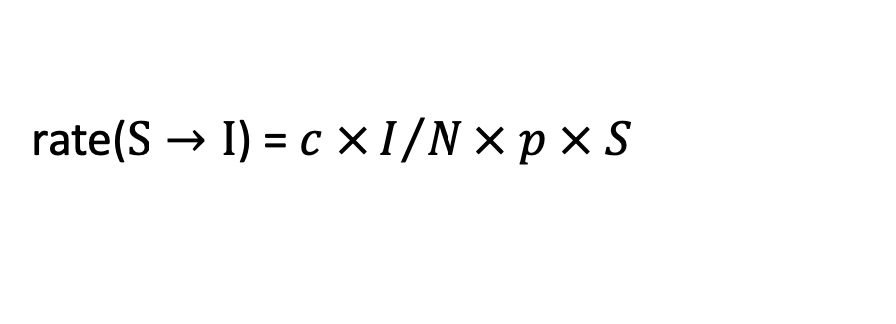
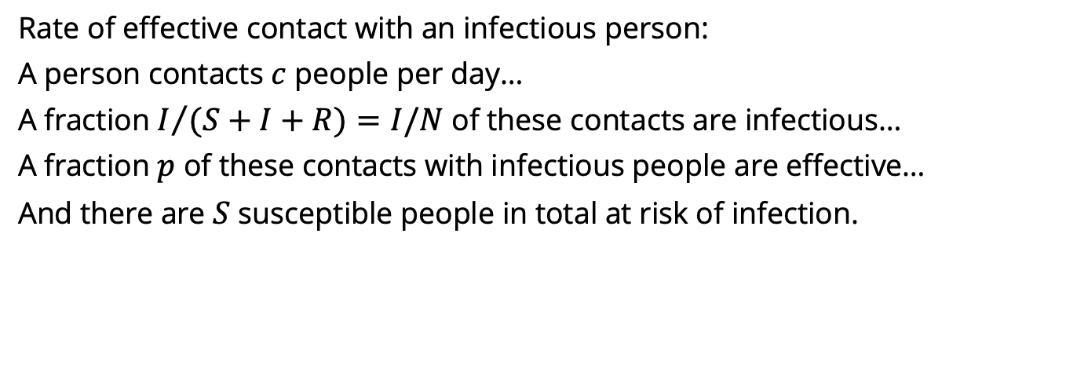
Turning a model diagram into ODEs
S
infection
I
recovery
R
Effective contact with an infectious person
Rate of effective contact with an infectious person:
A person contacts $c$ people per day…
A fraction $I/{(S+I+R)}=I/N$of these contacts are infectious…
A fraction $p$ of these contacts with infectious people are effective…
And there are $S$ susceptible people in total at risk of infection.
rate($S→I$) = $c ×I/N× p × S$

Slide 11
Turning a model diagram into ODEs
S
infection
I
recovery
R
Effective contact with an infectious person
Rate of effective contact with an infectious person:
A person contacts $c$ people per day…
A fraction $I/{(S+I+R)}=I/N$of these contacts are infectious…
A fraction $p$ of these contacts with infectious people are effective…
And there are $S$ susceptible people in total at risk of infection.
rate($S→I$) = $c ×I/N× p × S$

Slide 12
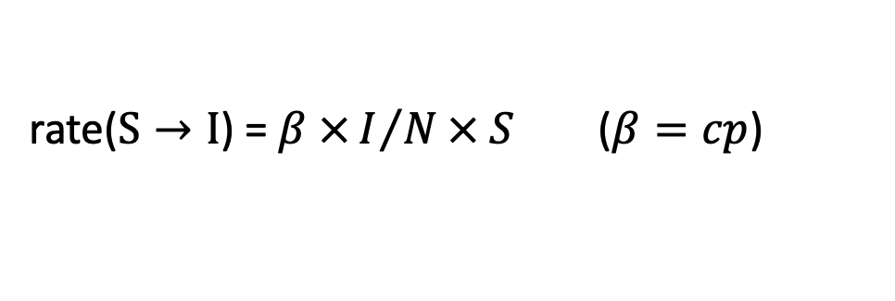
Turning a model diagram into ODEs
S
infection
I
recovery
R
Effective contact with an infectious person
Rate of effective contact with an infectious person:
A person contacts $c$ people per day…
A fraction $I/{(S+I+R)}=I/N$of these contacts are infectious…
A fraction $p$ of these contacts with infectious people are effective…
And there are $S$ susceptible people in total at risk of infection.
rate($S→I$) = $β ×I/N× S$ ($β=cp$)

Slide 13
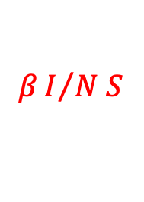
Turning a model diagram into ODEs
S
$$βI/{N S}$$
I
recovery
R
Rate of effective contact with an infectious person:
A person contacts $c$ people per day…
A fraction $I/{(S+I+R)}=I/N$of these contacts are infectious…
A fraction $p$ of these contacts with infectious people are effective…
And there are $S$ susceptible people in total at risk of infection.
rate($S→I$) = $β ×I/N× S$ ($β=cp$)

Slide 14

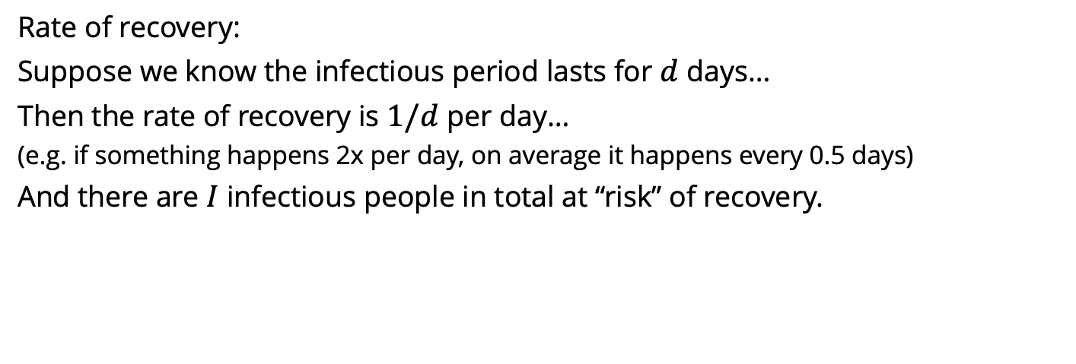
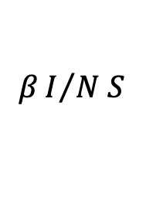
Turning a model diagram into ODEs
S
$$βI/{N S}$$
I
recovery
R
Infectious
period ends
Rate of recovery:
Suppose we know the infectious period lasts for $d$ days…
Then the rate of recovery is $1/d$ per day…
(e.g. if something happens 2x per day, on average it happens every 0.5 days)
And there are $I$ infectious people in total at “risk” of recovery.
rate($I→R$) = $1/d × I$

Slide 15
Turning a model diagram into ODEs
S
$$βI/{N S}$$
I
recovery
R
Infectious
period ends
Rate of recovery:
Suppose we know the infectious period lasts for $d$ days…
Then the rate of recovery is $1/d$ per day…
(e.g. if something happens 2x per day, on average it happens every 0.5 days)
And there are $I$ infectious people in total at “risk” of recovery.
rate($I→R$) = $1/d × I$

Slide 16

Turning a model diagram into ODEs
S
$$βI/{N S}$$
I
recovery
R
Infectious
period ends
Rate of recovery:
Suppose we know the infectious period lasts for $d$ days…
Then the rate of recovery is $1/d$ per day…
(e.g. if something happens 2x per day, on average it happens every 0.5 days)
And there are $I$ infectious people in total at “risk” of recovery.
rate($I→R$) = $γ × I$ ($γ=1/d$)

Slide 17

Turning a model diagram into ODEs
S
$$βI/{N S}$$
I
$$γ I$$
R
Rate of recovery:
Suppose we know the infectious period lasts for $d$ days…
Then the rate of recovery is $1/d$ per day…
(e.g. if something happens 2x per day, on average it happens every 0.5 days)
And there are $I$ infectious people in total at “risk” of recovery.
rate($I→R$) = $γ × I$ ($γ=1/d$)

Slide 18
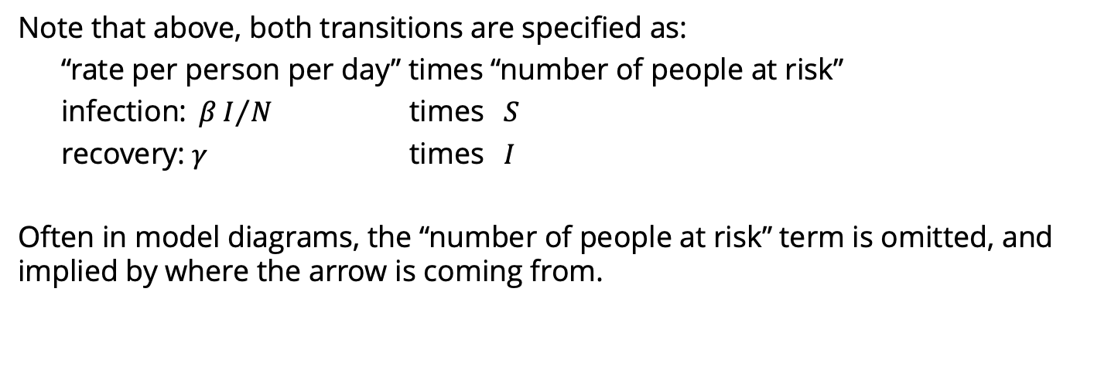

Turning a model diagram into ODEs
S
$$βI/{N S}$$
I
$$γ I$$
R
infection
recovery
Note that above, both transitions are specified as:
“rate per person per day” times “number of people at risk”
infection: $βI/{N }$ times $S$
recovery: $γ$ times $I$
Often in model diagrams, the “number of people at risk” term is omitted, and implied by where the arrow is coming from.

Slide 19
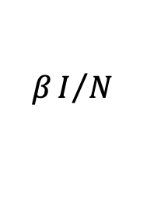

Turning a model diagram into ODEs
S
$$βI/N$$
I
$$γ$$
R
infection
recovery
Note that above, both transitions are specified as:
“rate per person per day” times “number of people at risk”
infection: $βI/{N }$ times $S$
recovery: $γ$ times $I$
Often in model diagrams, the “number of people at risk” term is omitted, and implied by where the arrow is coming from.

Slide 20




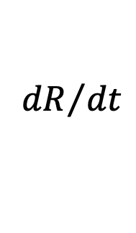
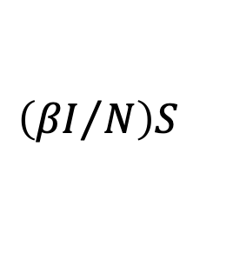
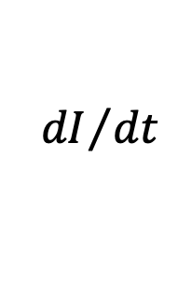
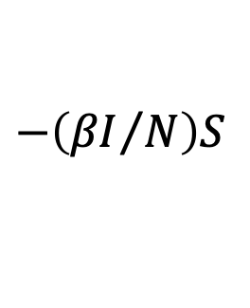
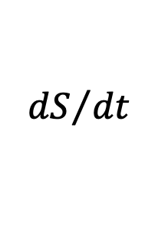

Turning a model diagram into ODEs
S
$$βI/N$$
I
$$γ$$
R
infection
recovery
To turn this into ODEs, we include each rate twice:
once negative for the “leaving” (subtracting from) compartment,
and once positive for the “entering” (adding to) compartment.
$${dS}/{dt}$$
$$=$$
$$−\left({βI}/N\right)S$$
$${dI}/{dt}$$
$$=$$
$$\left({βI}/N\right)S$$
$$− γI$$
$${dR}/{dt}$$
$$=$$
$$γI$$

Slide 21
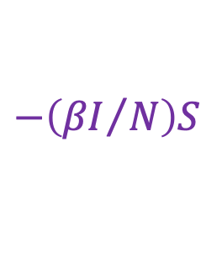
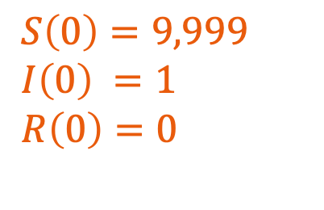


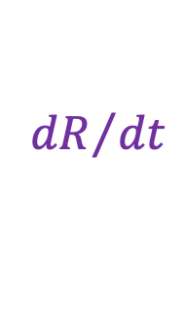

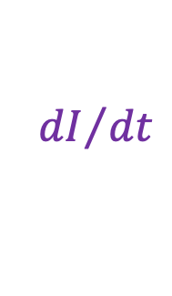
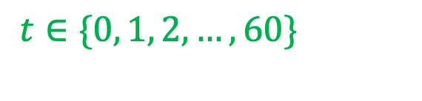

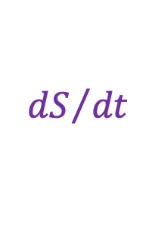
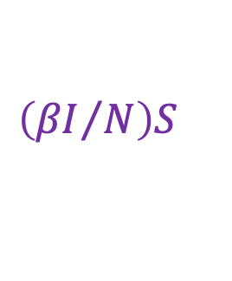

Turning a model diagram into ODEs
S
$$βI/N$$
I
$$γ$$
R
infection
recovery
A full ODE model specification has the following elements:
System of ordinary differential equations
Initial conditions
Parameters
$${dS}/{dt}$$
$$=$$
$$−\left({βI}/N\right)S$$
$S\left(0\right)=9,999$
$I\left(0\right) =1$
$R\left(0\right)=0$
$β=0.8$
$γ=0.4$
$${dI}/{dt}$$
$$=$$
$$\left({βI}/N\right)S$$
$$− γI$$
$${dR}/{dt}$$
$$=$$
$$γI$$
Times to solve system for
$$N=S+I+R$$
$t∈\{0, 1, 2, …, 60\}$

Slide 22
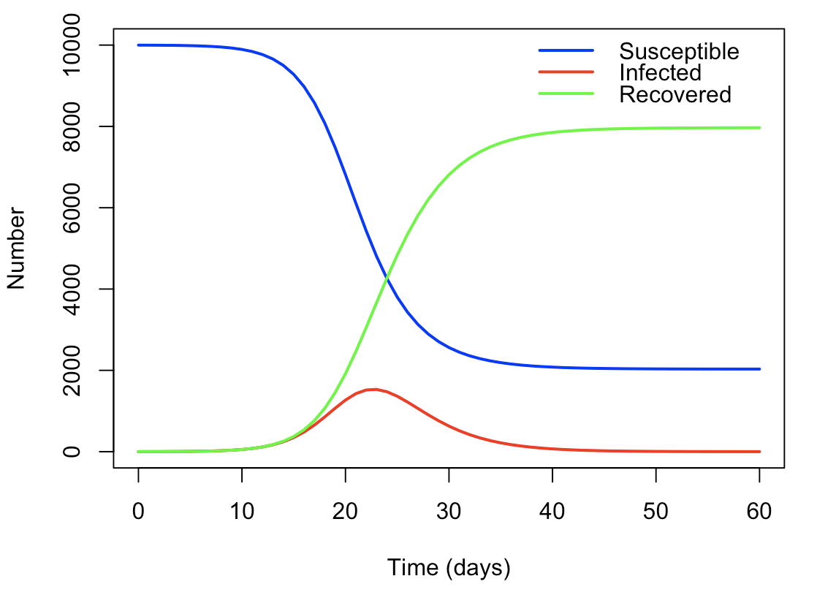
Turning a model diagram into ODEs
S
$$βI/N$$
I
$$γ$$
R
infection
recovery
A full ODE model specification has the following elements:
System of ordinary differential equations
Initial conditions
Parameters
$${dS}/{dt}$$
$$=$$
$$−\left({βI}/N\right)S$$
$S\left(0\right)=9,999$
$I\left(0\right) =1$
$R\left(0\right)=0$
$β=0.8$
$γ=0.4$
$${dI}/{dt}$$
$$=$$
$$\left({βI}/N\right)S$$
$$− γI$$
$${dR}/{dt}$$
$$=$$
$$γI$$
Times to solve system for
$$N=S+I+R$$
$t∈\{0, 1, 2, …, 60\}$

Slide 23
Solving ODE models in R with the deSolve package

Slide 24
Using the R package deSolve
R package which can numerically solve ODEs
Provides the function ode() to solve your model
You provide to ode():
y, initial conditions
times, time points to solve the system for
parms, parameters
func, the system of ODEs as an R function
(optionally, others we will discuss later…)
ode() returns a matrix with numerical solutions to the ODEs and the times

Slide 25

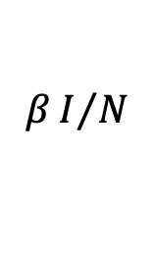




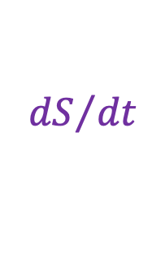
Susceptible Infected (SI) model
Individuals are either susceptible or infected:
Susceptible individuals become infected via transmission rate $β$.
S
$$βI/N$$
I
$${dS}/{dt}$$
$$=$$
$$−\left({βI}/N\right)S$$
$${dI}/{dt}$$
$$=$$
$$\left({βI}/N\right)S$$

Slide 26
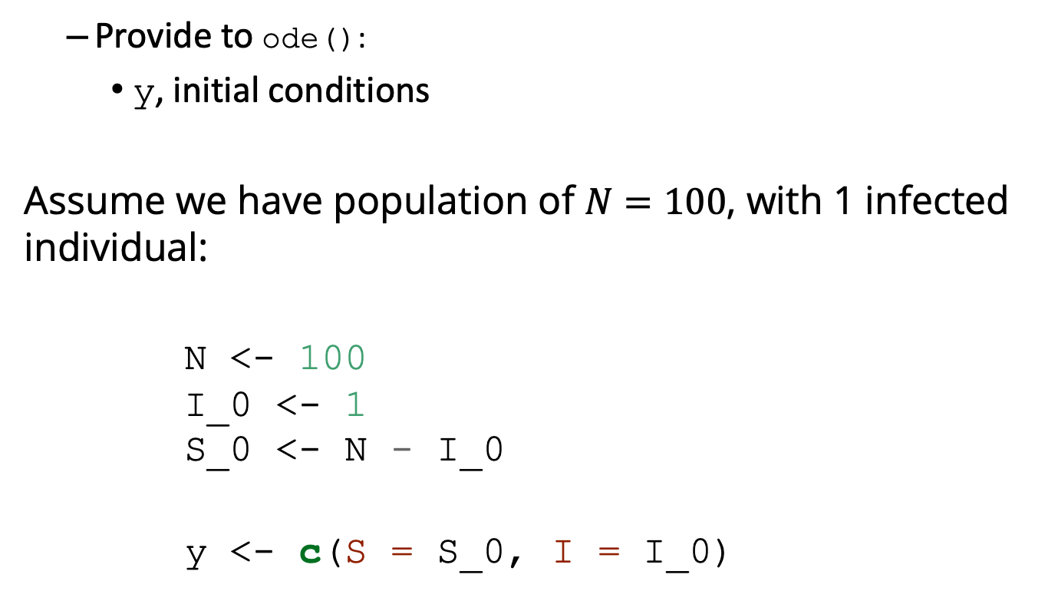
Solving SI model using deSolve
Provide to ode():
y, initial conditions
Assume we have population of $N=100$, with 1 infected individual:
N <- 100 I_0 <- 1 S_0 <- N - I_0
y <- c(S = S_0, I = I_0)

Slide 27
Solving SI model using deSolve
Provide to ode():
times, time points to solve the system for
Let’s solve the equation over a period of 50 days, which we will write inside a vector as follows:
times <- seq(from = 0, to = 50, by = 1)
# or times <- 0:50

Slide 28
Solving SI model using deSolve
Provide to ode():
parms, parameters
We have just one parameter, the transmission rate:
parms <- c(beta = 0.4)

Slide 29
Solving SI model using deSolve
Provide to ode():
func, the system of ODEs as an R function
SI_model <- function(times, state, parms)
{ # Get variables S <- state["S"] I <- state["I"] N <- S + I # Get parameters beta <- parms["beta"] # Define differential equations dS <- -(beta * I / N) * S dI <- (beta * I / N) * S res <- list(c(dS, dI)) return (res) }

Slide 30
Solving SI model using deSolve
# Solve equations output_raw <- ode(y = y, times = times, func = SI_model, parms = parms)
# Convert matrix to data frame for easier manipulation output <- as.data.frame(output_raw) head(output)
## time S I ## 1 0 99.00000 1.000000 ## 2 1 98.60400 1.396000 ## 3 2 98.05340 1.946605 ## 4 3 97.28991 2.710090 ## 5 4 96.23525 3.764747 ## 6 5 94.78605 5.213953

Slide 31
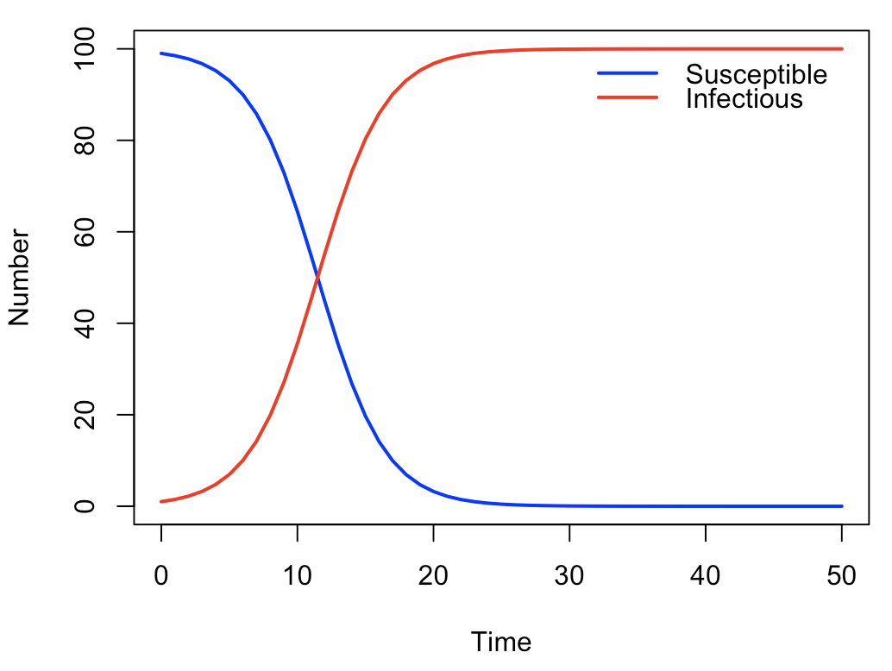
Solving SI model using deSolve

Slide 32
Practical 1 Solving ODEs using deSolve

Slide 33
Practical 1
Objective: Solve SI, SIR, SEIR models using deSolve
Answer questions 1, 2 and 3
Question 4, adding vaccination, is optional.

Slide 34
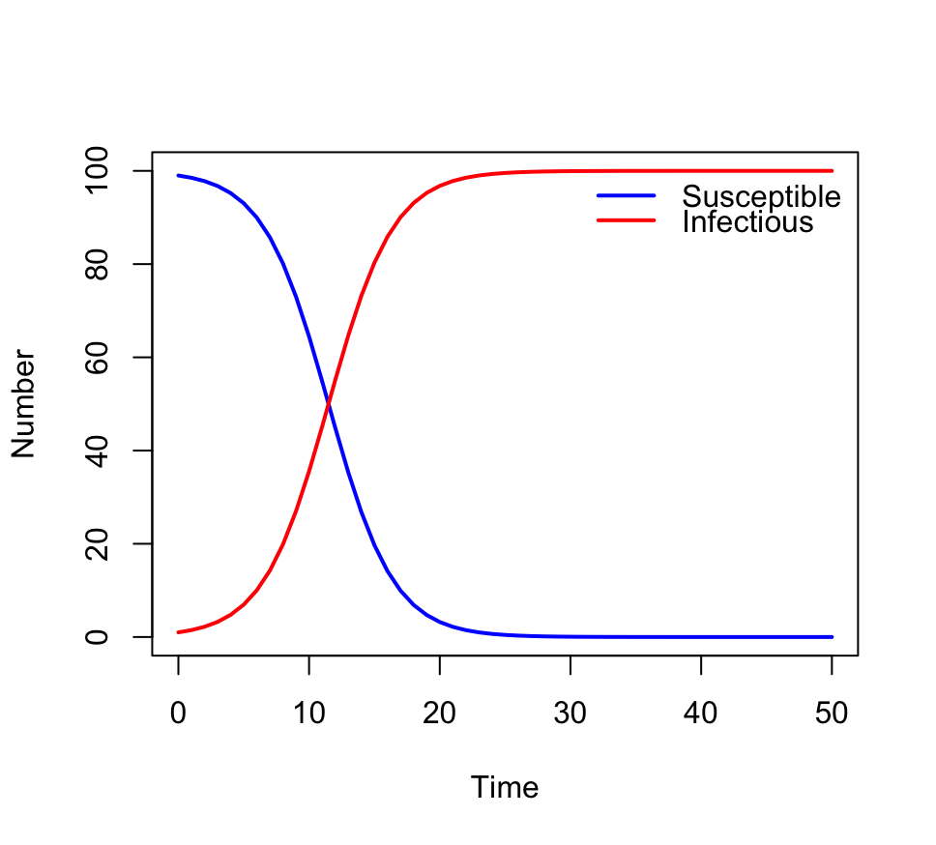
Practical 1: SI model
1a. Increase the initial number of infectious individuals. What happens to the output?

Slide 35
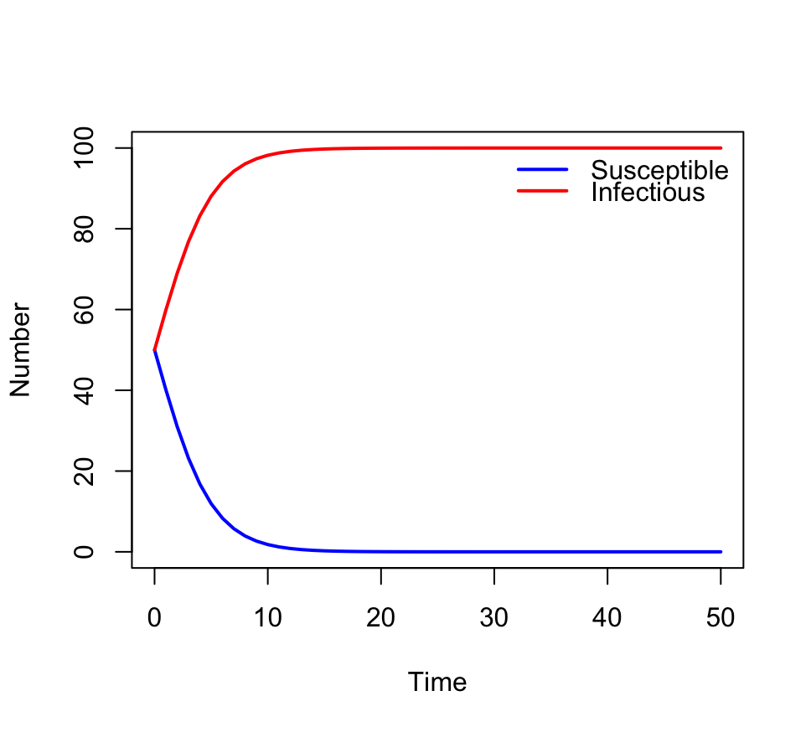
Practical 1: SI model
1a. Increase the initial number of infectious individuals. What happens to the output?
The number of infectious
has a higher starting point,
but the same growth rate
from that level, and the
same endpoint.

Slide 36
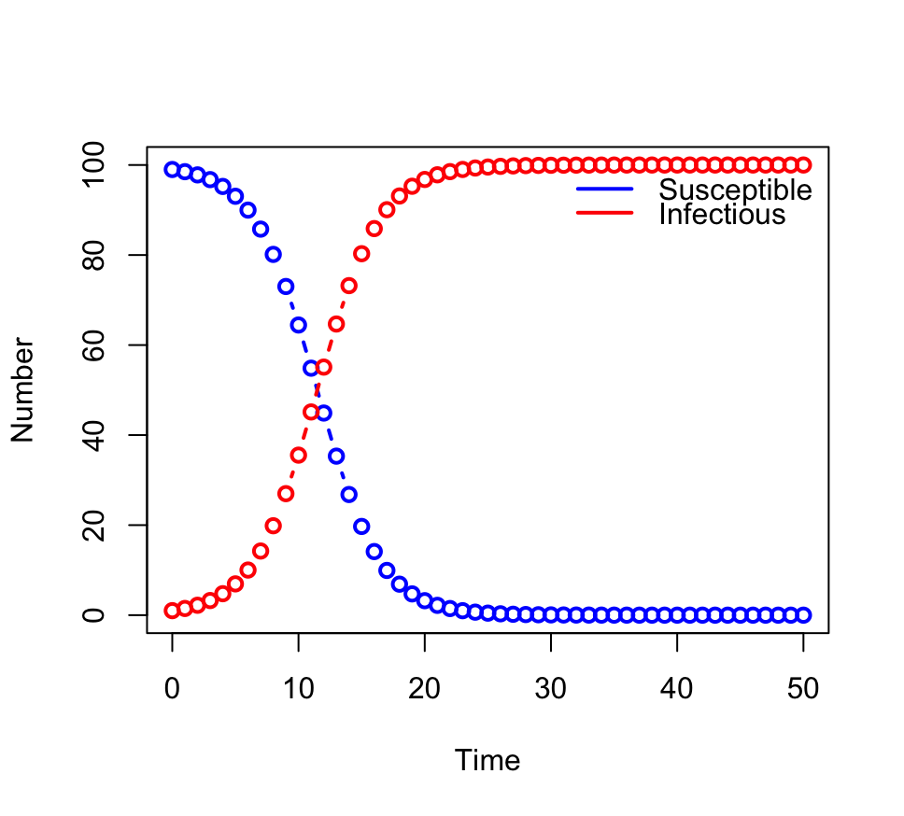
Practical 1: SI model
1c. Increase the value of the by argument (in the times vector). What happens to the output?

Slide 37
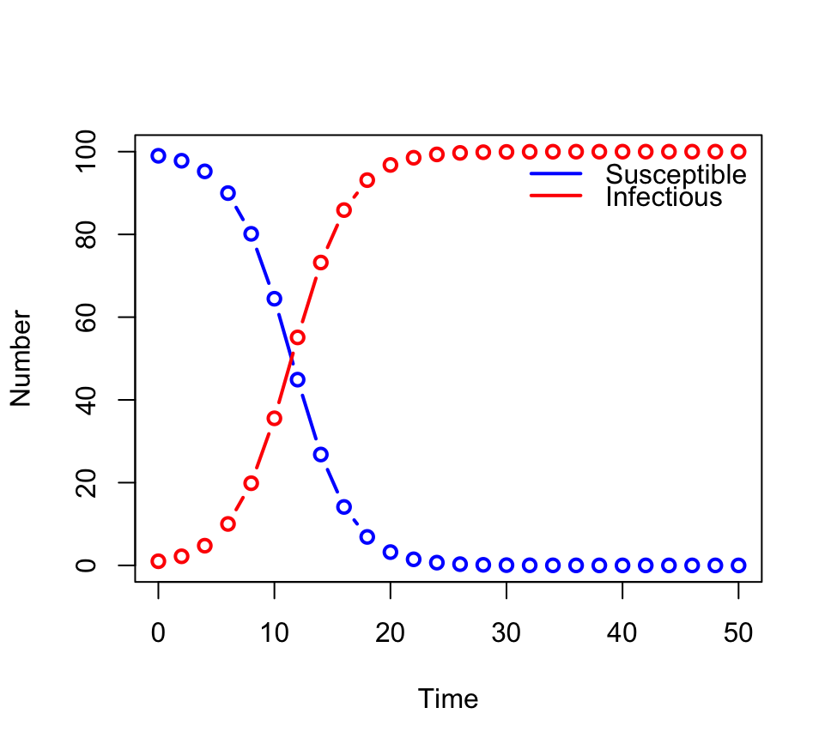
Practical 1: SI model
1c. Increase the value of the by argument (in the times vector). What happens to the output?
The solution points become
more spaced out, but trace
the same underlying curve.

Slide 38
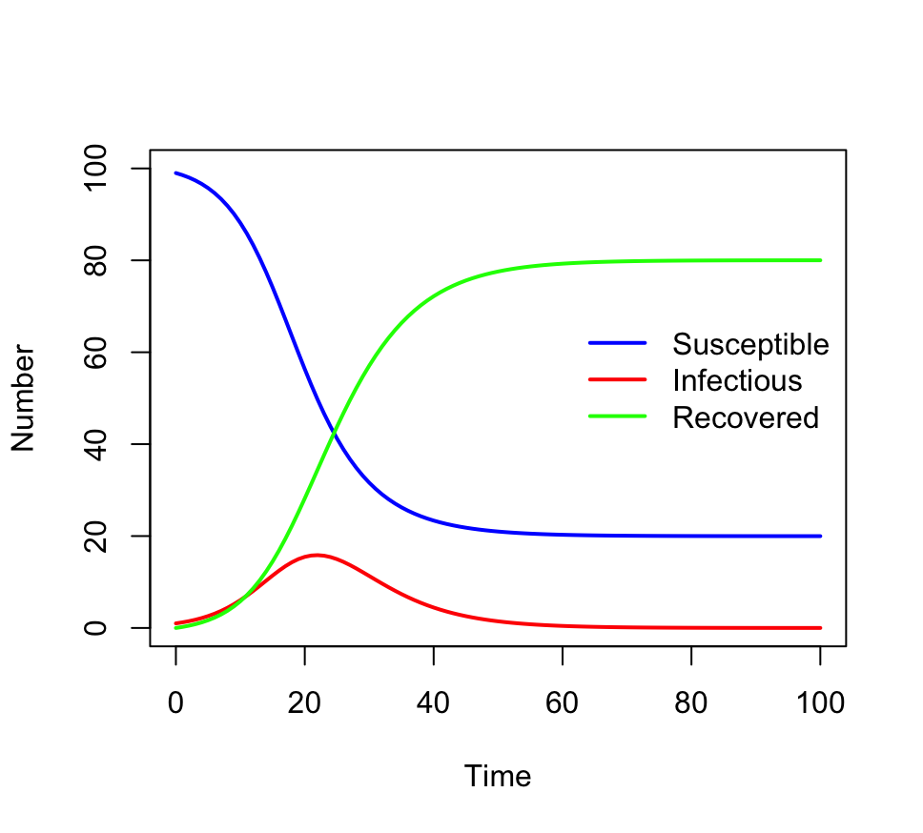
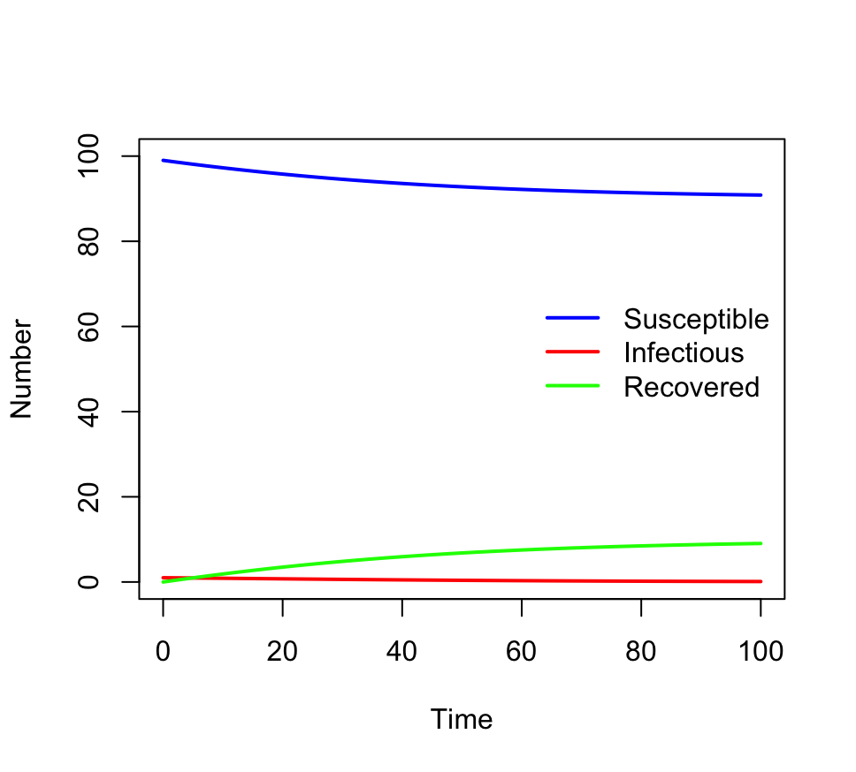
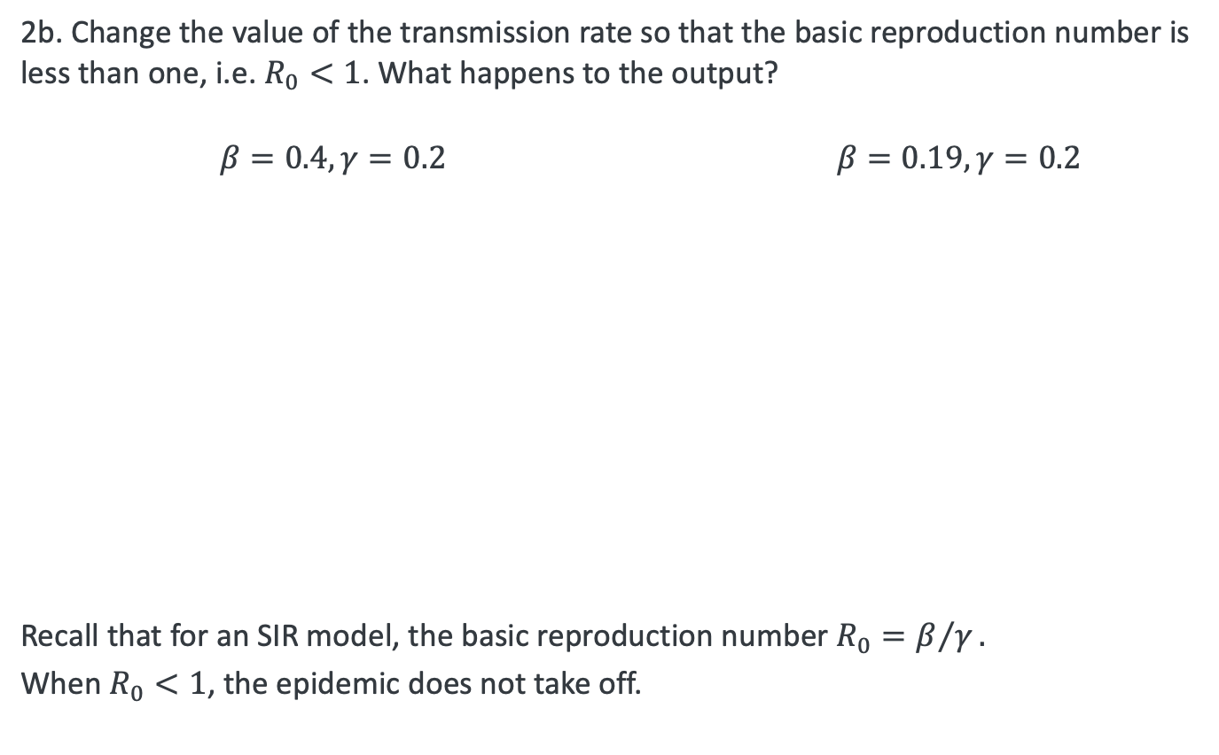
Practical 1: SIR model
2b. Change the value of the transmission rate so that the basic reproduction number is less than one, i.e. $R_{0}<1$. What happens to the output?
$β=0.4, γ=0.2$ $β=0.19, γ=0.2$
Recall that for an SIR model, the basic reproduction number $R_{0}=β/γ.$
When $R_{0}<1$, the epidemic does not take off.

Slide 39
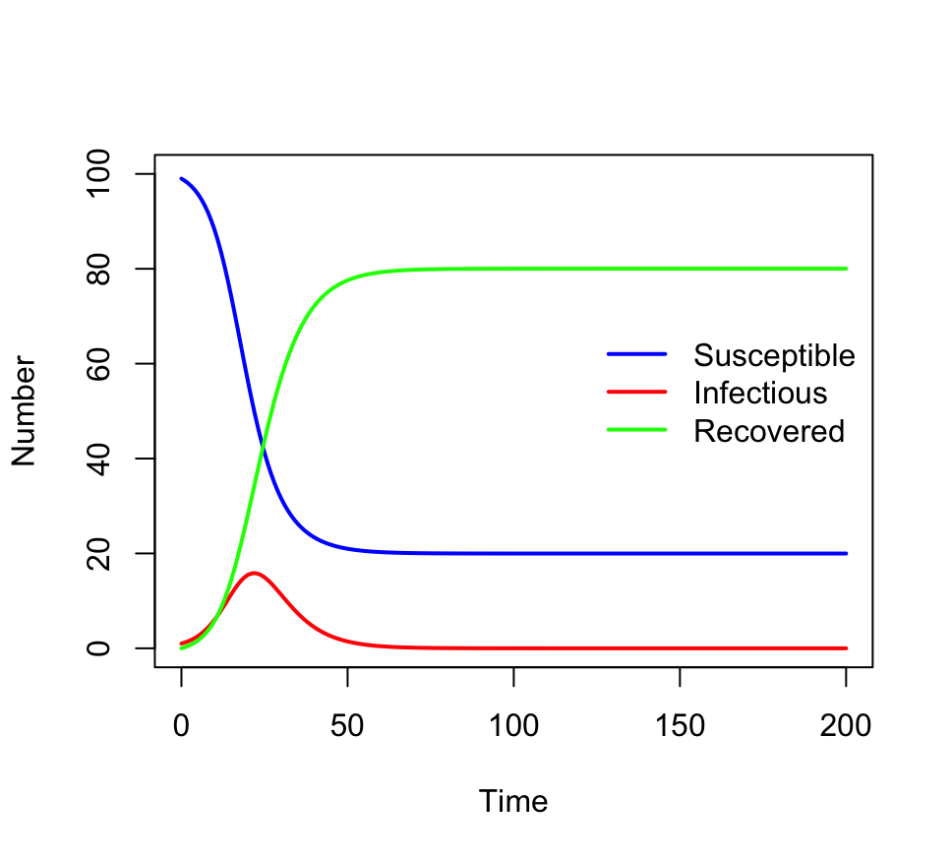
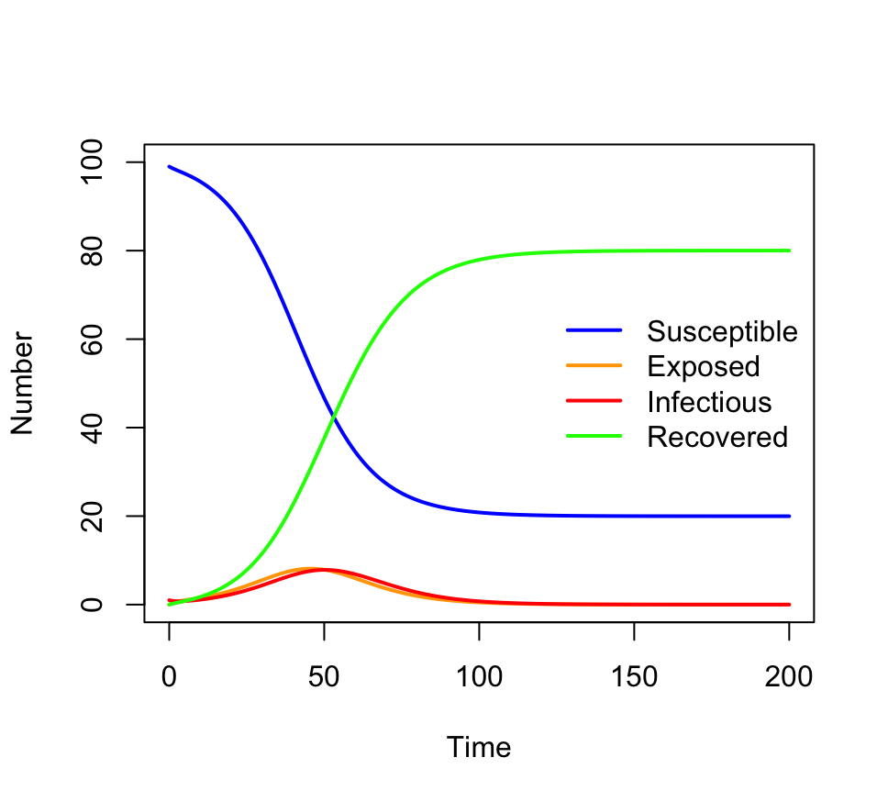
Practical 1: SEIR model
3b. How does the model output differ from the SIR model you coded previously?
Approximately the same number of people get infected, but the epidemic takes approximately twice as long; generation interval is twice as long.
See Wallinga and Lipsitch 2007, especially section 3a, for discussion of the generation interval, the growth rate and the reproduction number in epidemic models.

Slide 40
ODEs session 1 summary
ODE models are specified in terms of state variables and their rates of change
We have seen how to construct ODE systems starting from a flowchart-style model diagram
To solve an ODE model, we need to provide initial conditions for the state variables, parameter values, and times over which to solve the model
We have learned how to use deSolve to solve ODEs in R
Next session: Advanced use of deSolve.

