Slide 1
Ordinary Differential Equations
Modern Techniques in Modelling

Slide 2
Outline for session 1
What are ordinary differential equations (ODEs)?
How do we use ODEs to model an epidemic?
Using the R package deSolve
Practical: SI, SIR, SEIR models in R

Slide 3
Ordinary differential equations

Slide 4
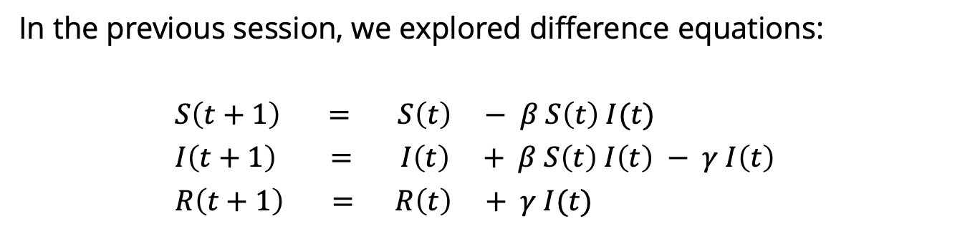
Reminder: Difference equations
In the previous session, we explored difference equations:
$S\left(t+1\right) = S\left(t\right) − β S\left(t\right) I(t)$
$I\left(t+1\right) = I\left(t\right) + β S\left(t\right) I\left(t\right) − γ I\left(t\right)$
$R\left(t+1\right) = R\left(t\right) + γ I(t)$
next
value
current
value
change
in value
=
+
These changes are the interesting part – they are what define the behaviour of the system.

Slide 5
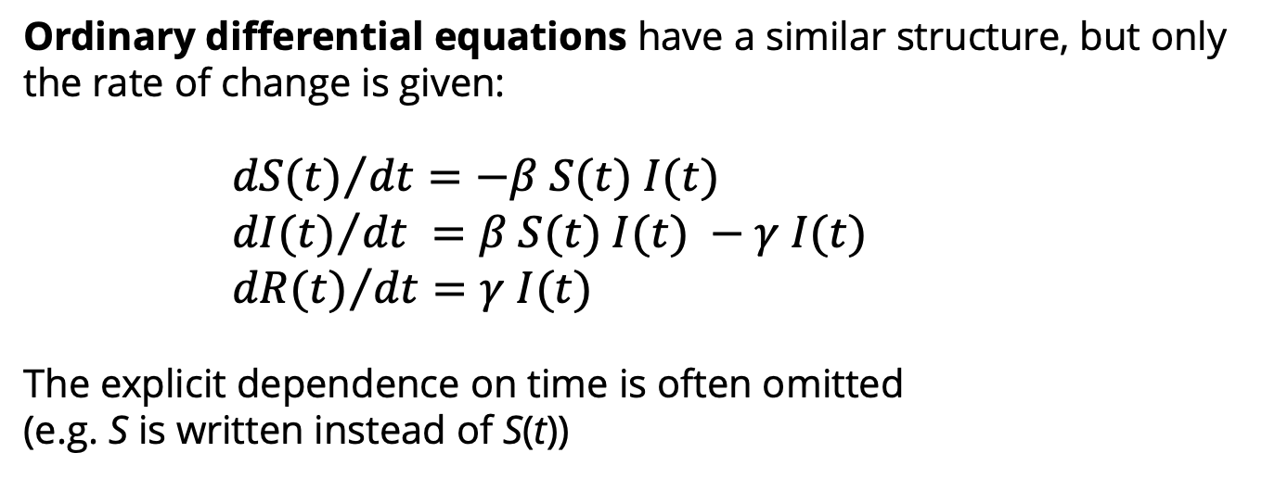
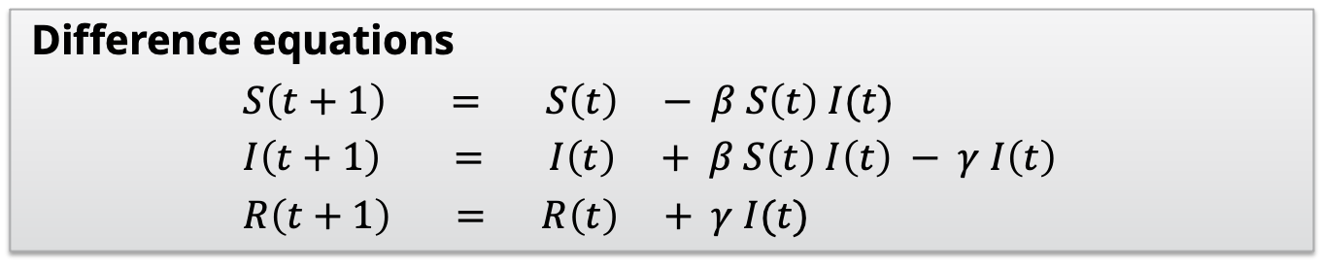
Ordinary differential equations
Difference equations
$S\left(t+1\right) = S\left(t\right) − β S\left(t\right) I(t)$
$I\left(t+1\right) = I\left(t\right) + β S\left(t\right) I\left(t\right) − γ I\left(t\right)$
$R\left(t+1\right) = R\left(t\right) + γ I(t)$
Ordinary differential equations have a similar structure, but only the rate of change is given:
${dS(t)}/{dt}=−β S(t) I(t)$
${dI(t)}/{dt} =β S(t) I(t) −γ I(t)$
${dR(t)}/{dt}=γ I(t)$
The explicit dependence on time is often omitted
(e.g. S is written instead of S(t))

Slide 6
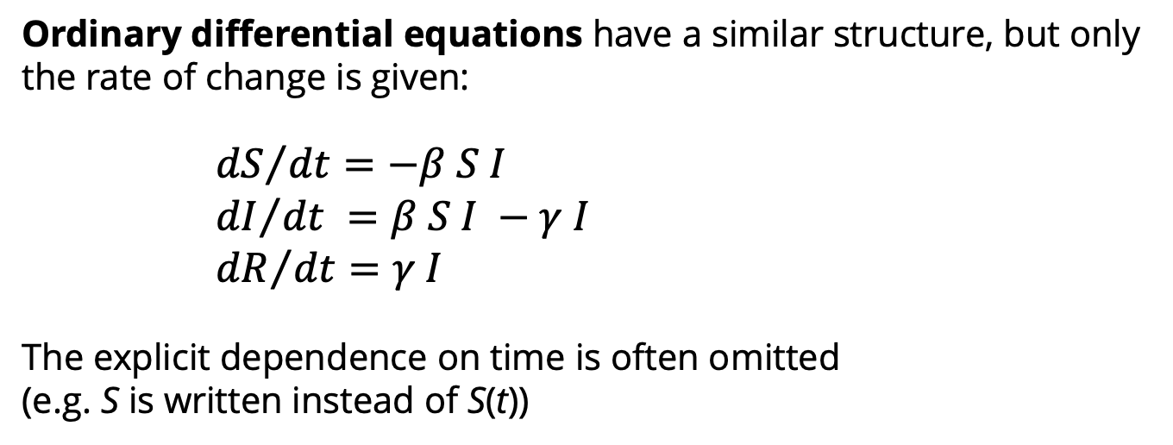
Ordinary differential equations
Difference equations
$S\left(t+1\right) = S\left(t\right) − β S\left(t\right) I(t)$
$I\left(t+1\right) = I\left(t\right) + β S\left(t\right) I\left(t\right) − γ I\left(t\right)$
$R\left(t+1\right) = R\left(t\right) + γ I(t)$
Ordinary differential equations have a similar structure, but only the rate of change is given:
${dS}/{dt}=−β S I$
${dI}/{dt} =β S I −γ I$
${dR}/{dt}=γ I$
The explicit dependence on time is often omitted
(e.g. S is written instead of S(t))

Slide 7
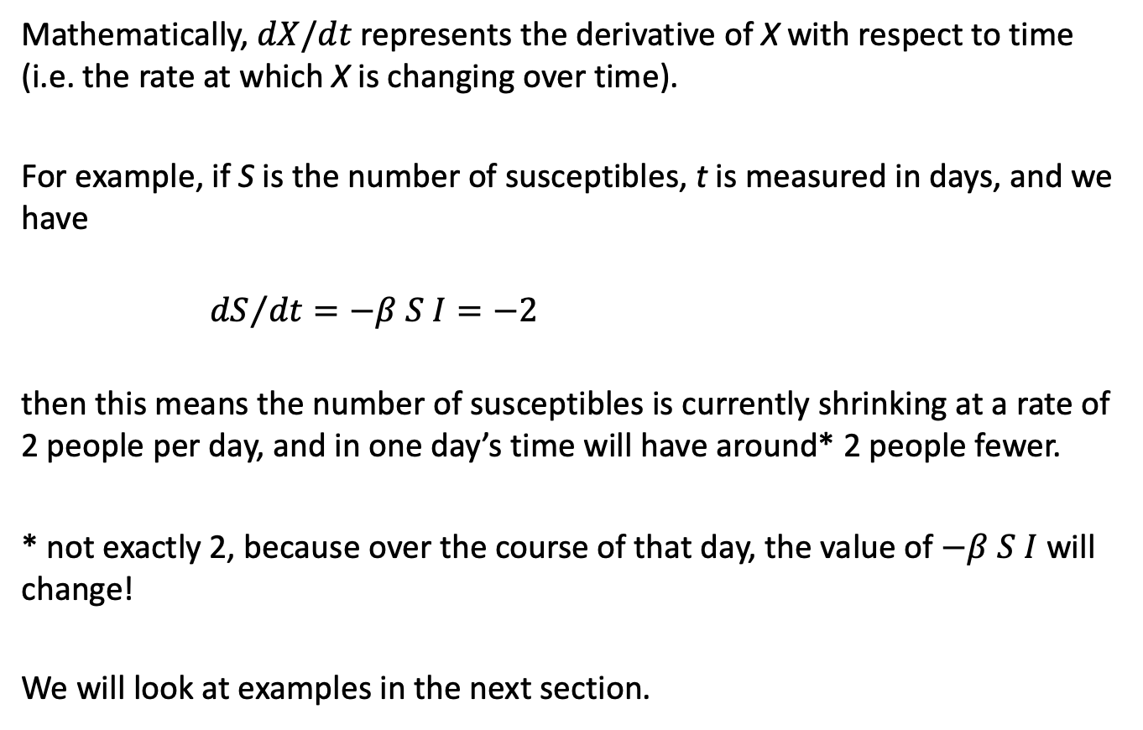
Ordinary differential equations
Mathematically, $dX/dt$ represents the derivative of X with respect to time (i.e. the rate at which X is changing over time).
For example, if S is the number of susceptibles, t is measured in days, and we have
${dS}/{dt}=−β S I=−2$
then this means the number of susceptibles is currently shrinking at a rate of 2 people per day, and in one day’s time will have around* 2 people fewer.
* not exactly 2, because over the course of that day, the value of $−β S I$ will change!
We will look at examples in the next section.

Slide 8
How do we model an infectious disease outbreak using ODEs?

Slide 9
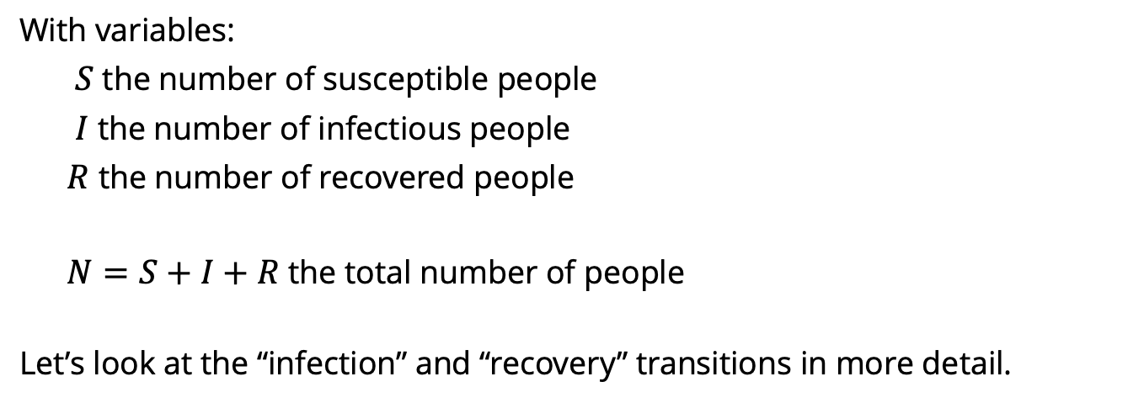
Turning a model diagram into ODEs
S
infection
I
recovery
R
susceptible
infectious
recovered
With variables:
$S$ the number of susceptible people
$I$ the number of infectious people
$R$ the number of recovered people
$N=S+I+R$ the total number of people
Let’s look at the “infection” and “recovery” transitions in more detail.

Slide 10
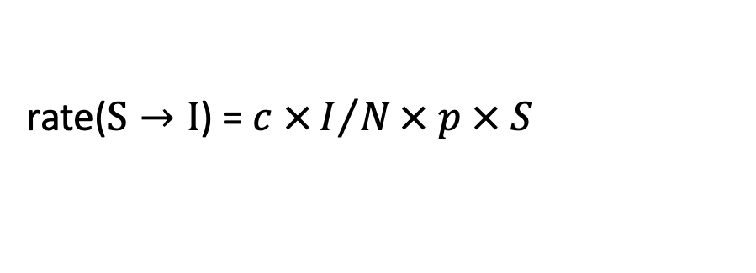
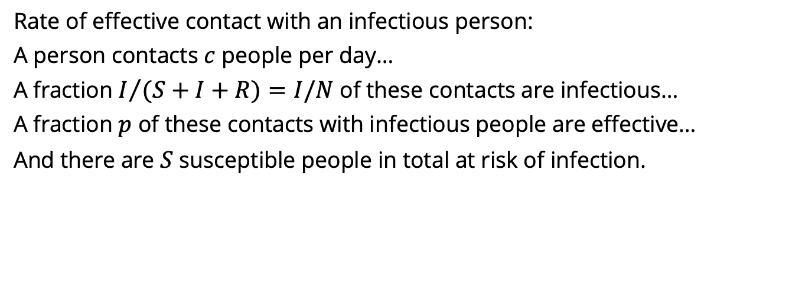
Turning a model diagram into ODEs
S
infection
I
recovery
R
Effective contact with an infectious person
Rate of effective contact with an infectious person:
A person contacts $c$ people per day…
A fraction $I/{(S+I+R)}=I/N$of these contacts are infectious…
A fraction $p$ of these contacts with infectious people are effective…
And there are $S$ susceptible people in total at risk of infection.
rate($S→I$) = $c ×I/N× p × S$

Slide 11
Turning a model diagram into ODEs
S
infection
I
recovery
R
Effective contact with an infectious person
Rate of effective contact with an infectious person:
A person contacts $c$ people per day…
A fraction $I/{(S+I+R)}=I/N$of these contacts are infectious…
A fraction $p$ of these contacts with infectious people are effective…
And there are $S$ susceptible people in total at risk of infection.
rate($S→I$) = $c ×I/N× p × S$

Slide 12
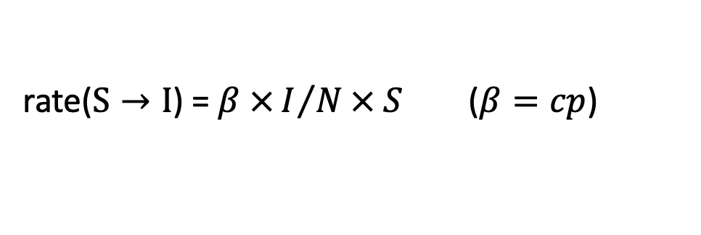
Turning a model diagram into ODEs
S
infection
I
recovery
R
Effective contact with an infectious person
Rate of effective contact with an infectious person:
A person contacts $c$ people per day…
A fraction $I/{(S+I+R)}=I/N$of these contacts are infectious…
A fraction $p$ of these contacts with infectious people are effective…
And there are $S$ susceptible people in total at risk of infection.
rate($S→I$) = $β ×I/N× S$ ($β=cp$)

Slide 13
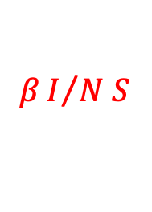
Turning a model diagram into ODEs
S
$$βI/{N S}$$
I
recovery
R
Rate of effective contact with an infectious person:
A person contacts $c$ people per day…
A fraction $I/{(S+I+R)}=I/N$of these contacts are infectious…
A fraction $p$ of these contacts with infectious people are effective…
And there are $S$ susceptible people in total at risk of infection.
rate($S→I$) = $β ×I/N× S$ ($β=cp$)

Slide 14

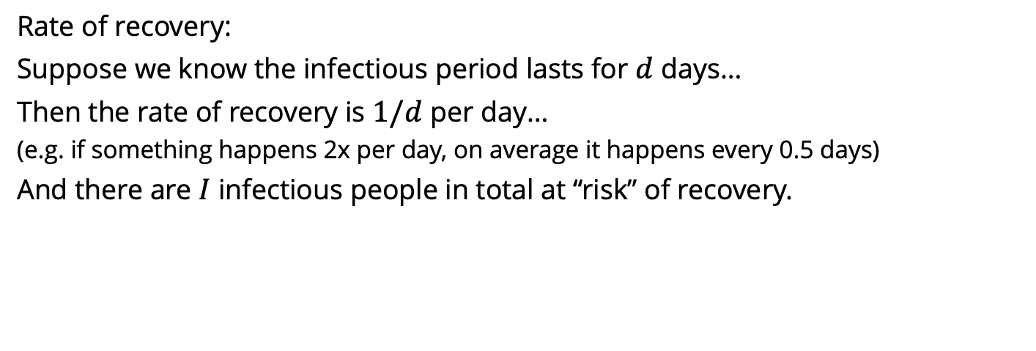
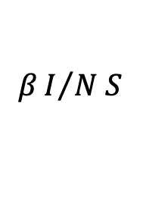
Turning a model diagram into ODEs
S
$$βI/{N S}$$
I
recovery
R
Infectious
period ends
Rate of recovery:
Suppose we know the infectious period lasts for $d$ days…
Then the rate of recovery is $1/d$ per day…
(e.g. if something happens 2x per day, on average it happens every 0.5 days)
And there are $I$ infectious people in total at “risk” of recovery.
rate($I→R$) = $1/d × I$

Slide 15
Turning a model diagram into ODEs
S
$$βI/{N S}$$
I
recovery
R
Infectious
period ends
Rate of recovery:
Suppose we know the infectious period lasts for $d$ days…
Then the rate of recovery is $1/d$ per day…
(e.g. if something happens 2x per day, on average it happens every 0.5 days)
And there are $I$ infectious people in total at “risk” of recovery.
rate($I→R$) = $1/d × I$

Slide 16

Turning a model diagram into ODEs
S
$$βI/{N S}$$
I
recovery
R
Infectious
period ends
Rate of recovery:
Suppose we know the infectious period lasts for $d$ days…
Then the rate of recovery is $1/d$ per day…
(e.g. if something happens 2x per day, on average it happens every 0.5 days)
And there are $I$ infectious people in total at “risk” of recovery.
rate($I→R$) = $γ × I$ ($γ=1/d$)

Slide 17

Turning a model diagram into ODEs
S
$$βI/{N S}$$
I
$$γ I$$
R
Rate of recovery:
Suppose we know the infectious period lasts for $d$ days…
Then the rate of recovery is $1/d$ per day…
(e.g. if something happens 2x per day, on average it happens every 0.5 days)
And there are $I$ infectious people in total at “risk” of recovery.
rate($I→R$) = $γ × I$ ($γ=1/d$)

Slide 18
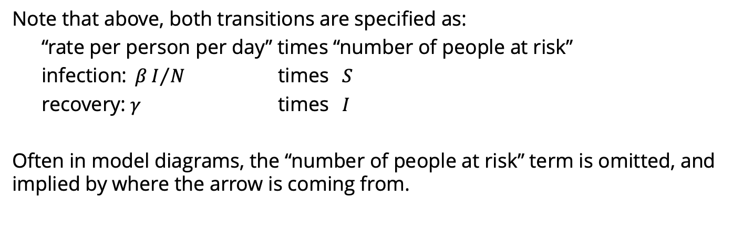

Turning a model diagram into ODEs
S
$$βI/{N S}$$
I
$$γ I$$
R
infection
recovery
Note that above, both transitions are specified as:
“rate per person per day” times “number of people at risk”
infection: $βI/{N }$ times $S$
recovery: $γ$ times $I$
Often in model diagrams, the “number of people at risk” term is omitted, and implied by where the arrow is coming from.

Slide 19
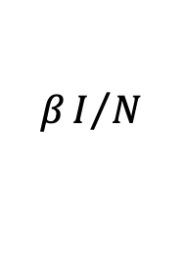

Turning a model diagram into ODEs
S
$$βI/N$$
I
$$γ$$
R
infection
recovery
Note that above, both transitions are specified as:
“rate per person per day” times “number of people at risk”
infection: $βI/{N }$ times $S$
recovery: $γ$ times $I$
Often in model diagrams, the “number of people at risk” term is omitted, and implied by where the arrow is coming from.

Slide 20




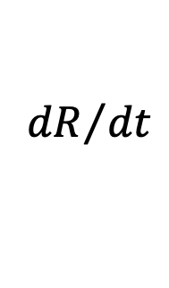
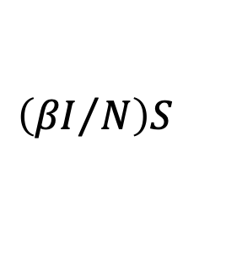
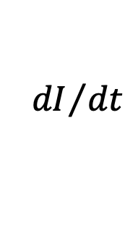
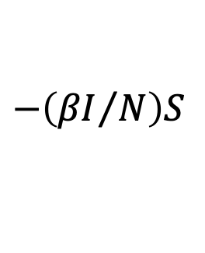
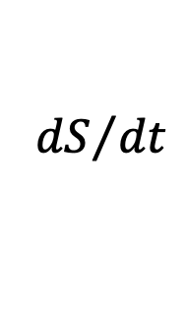

Turning a model diagram into ODEs
S
$$βI/N$$
I
$$γ$$
R
infection
recovery
To turn this into ODEs, we include each rate twice:
once negative for the “leaving” (subtracting from) compartment,
and once positive for the “entering” (adding to) compartment.
$${dS}/{dt}$$
$$=$$
$$−\left({βI}/N\right)S$$
$${dI}/{dt}$$
$$=$$
$$\left({βI}/N\right)S$$
$$− γI$$
$${dR}/{dt}$$
$$=$$
$$γI$$

Slide 21
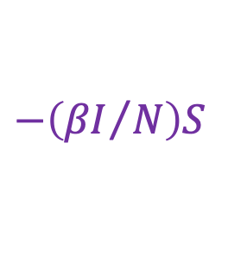
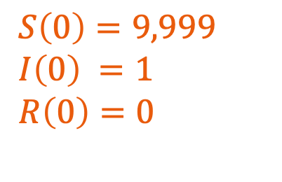


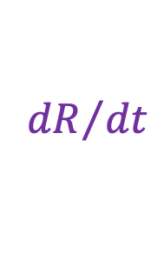

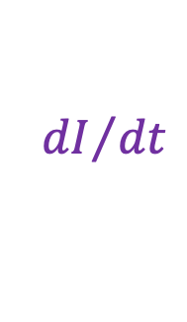
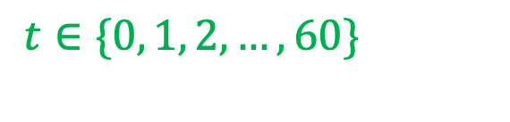

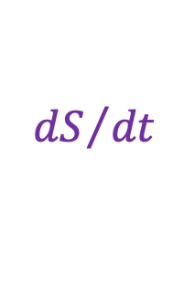
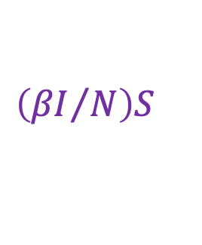

Turning a model diagram into ODEs
S
$$βI/N$$
I
$$γ$$
R
infection
recovery
A full ODE model specification has the following elements:
System of ordinary differential equations
Initial conditions
Parameters
$${dS}/{dt}$$
$$=$$
$$−\left({βI}/N\right)S$$
$S\left(0\right)=9,999$
$I\left(0\right) =1$
$R\left(0\right)=0$
$β=0.8$
$γ=0.4$
$${dI}/{dt}$$
$$=$$
$$\left({βI}/N\right)S$$
$$− γI$$
$${dR}/{dt}$$
$$=$$
$$γI$$
Times to solve system for
$$N=S+I+R$$
$t∈\{0, 1, 2, …, 60\}$

Slide 22
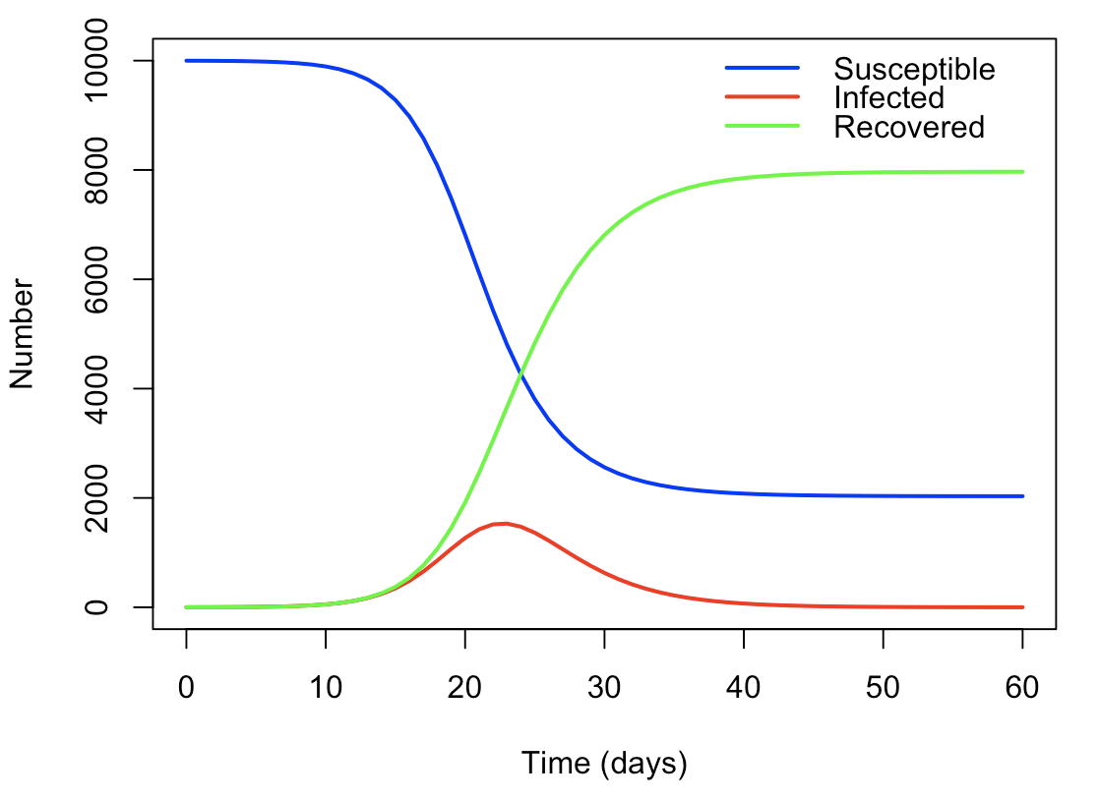
Turning a model diagram into ODEs
S
$$βI/N$$
I
$$γ$$
R
infection
recovery
A full ODE model specification has the following elements:
System of ordinary differential equations
Initial conditions
Parameters
$${dS}/{dt}$$
$$=$$
$$−\left({βI}/N\right)S$$
$S\left(0\right)=9,999$
$I\left(0\right) =1$
$R\left(0\right)=0$
$β=0.8$
$γ=0.4$
$${dI}/{dt}$$
$$=$$
$$\left({βI}/N\right)S$$
$$− γI$$
$${dR}/{dt}$$
$$=$$
$$γI$$
Times to solve system for
$$N=S+I+R$$
$t∈\{0, 1, 2, …, 60\}$

Slide 23
Solving ODE models in R with the deSolve package

Slide 24
Using the R package deSolve
R package which can numerically solve ODEs
Provides the function ode() to solve your model
You provide to ode():
y, initial conditions
times, time points to solve the system for
parms, parameters
func, the system of ODEs as an R function
(optionally, others we will discuss later…)
ode() returns a matrix with numerical solutions to the ODEs and the times

Slide 25

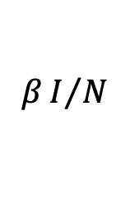




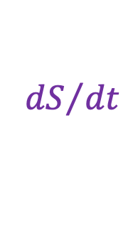
Susceptible Infected (SI) model
Individuals are either susceptible or infected:
Susceptible individuals become infected via transmission rate $β$.
S
$$βI/N$$
I
$${dS}/{dt}$$
$$=$$
$$−\left({βI}/N\right)S$$
$${dI}/{dt}$$
$$=$$
$$\left({βI}/N\right)S$$

Slide 26
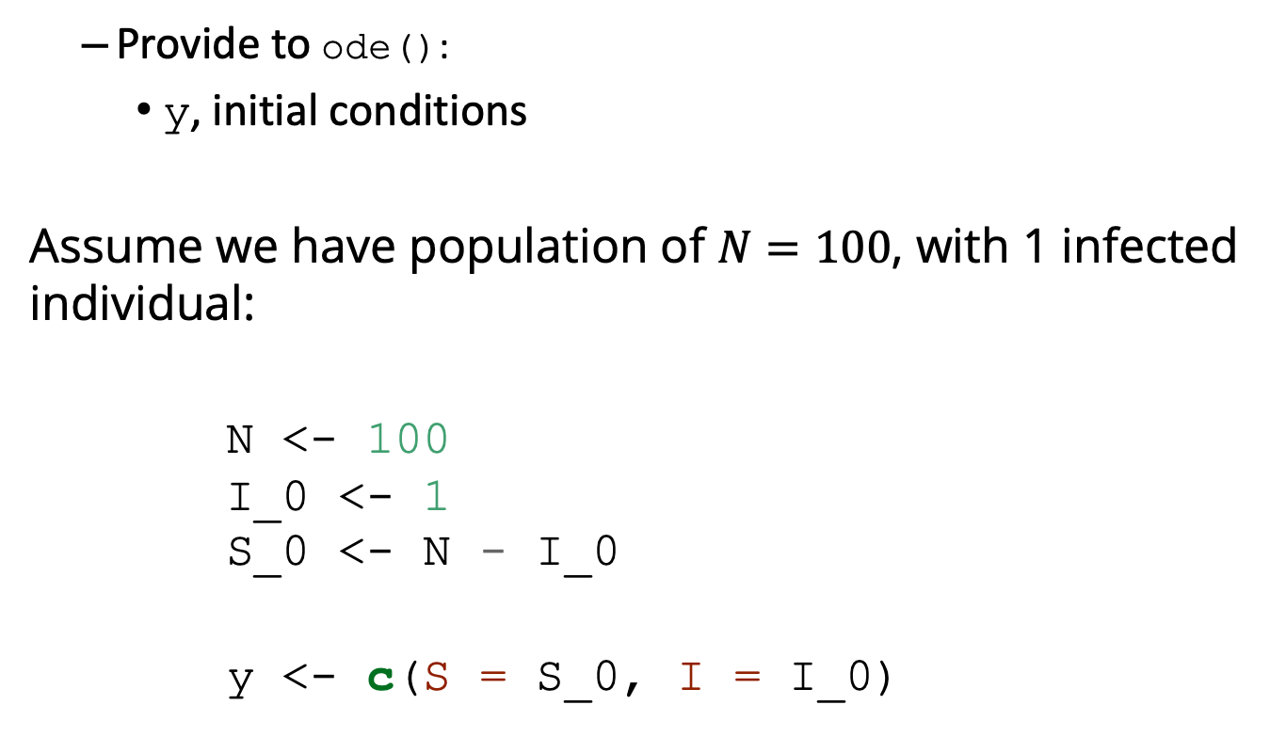
Solving SI model using deSolve
Provide to ode():
y, initial conditions
Assume we have population of $N=100$, with 1 infected individual:
N <- 100 I_0 <- 1 S_0 <- N - I_0
y <- c(S = S_0, I = I_0)

Slide 27
Solving SI model using deSolve
Provide to ode():
times, time points to solve the system for
Let’s solve the equation over a period of 50 days, which we will write inside a vector as follows:
times <- seq(from = 0, to = 50, by = 1)
# or times <- 0:50

Slide 28
Solving SI model using deSolve
Provide to ode():
parms, parameters
We have just one parameter, the transmission rate:
parms <- c(beta = 0.4)

Slide 29
Solving SI model using deSolve
Provide to ode():
func, the system of ODEs as an R function
SI_model <- function(times, state, parms)
{ # Get variables S <- state["S"] I <- state["I"] N <- S + I # Get parameters beta <- parms["beta"] # Define differential equations dS <- -(beta * I / N) * S dI <- (beta * I / N) * S res <- list(c(dS, dI)) return (res) }

Slide 30
Solving SI model using deSolve
# Solve equations output_raw <- ode(y = y, times = times, func = SI_model, parms = parms)
# Convert matrix to data frame for easier manipulation output <- as.data.frame(output_raw) head(output)
## time S I ## 1 0 99.00000 1.000000 ## 2 1 98.60400 1.396000 ## 3 2 98.05340 1.946605 ## 4 3 97.28991 2.710090 ## 5 4 96.23525 3.764747 ## 6 5 94.78605 5.213953

Slide 31
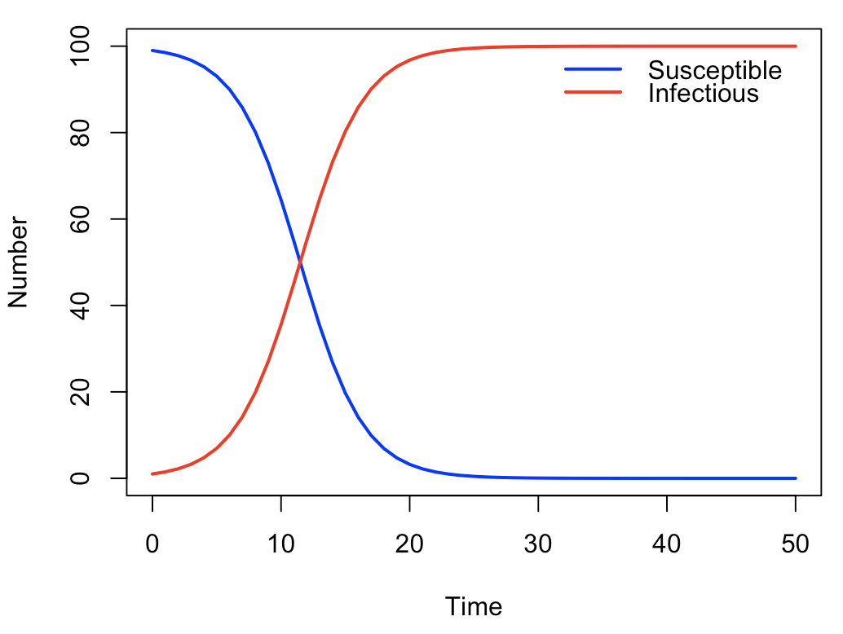
Solving SI model using deSolve

Slide 32
Practical 1 Solving ODEs using deSolve

Slide 33
Practical 1
Objective: Solve SI, SIR, SEIR models using deSolve
Answer questions 1, 2 and 3
Question 4, adding vaccination, is optional.
Note: If you are stuck with a grid of plots in R, use
par(mfrow = c(1,1))
to go back to single-plot mode.

Slide 34
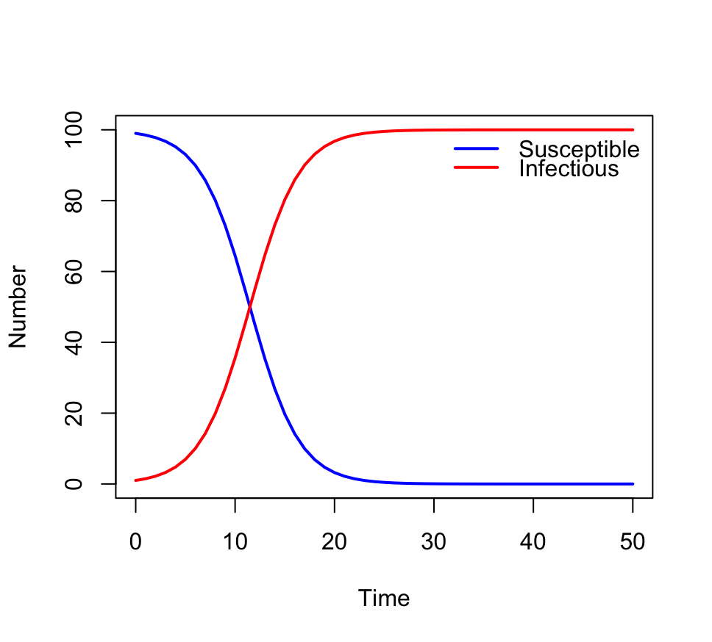
Practical 1: SI model
1a. Increase the initial number of infectious individuals. What happens to the output?

Slide 35
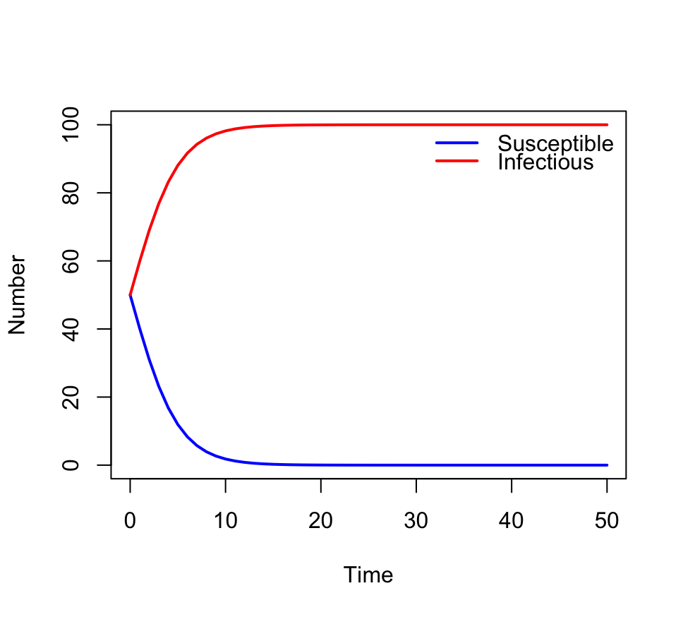
Practical 1: SI model
1a. Increase the initial number of infectious individuals. What happens to the output?
The number of infectious
has a higher starting point,
but the same growth rate
from that level, and the
same endpoint.

Slide 36
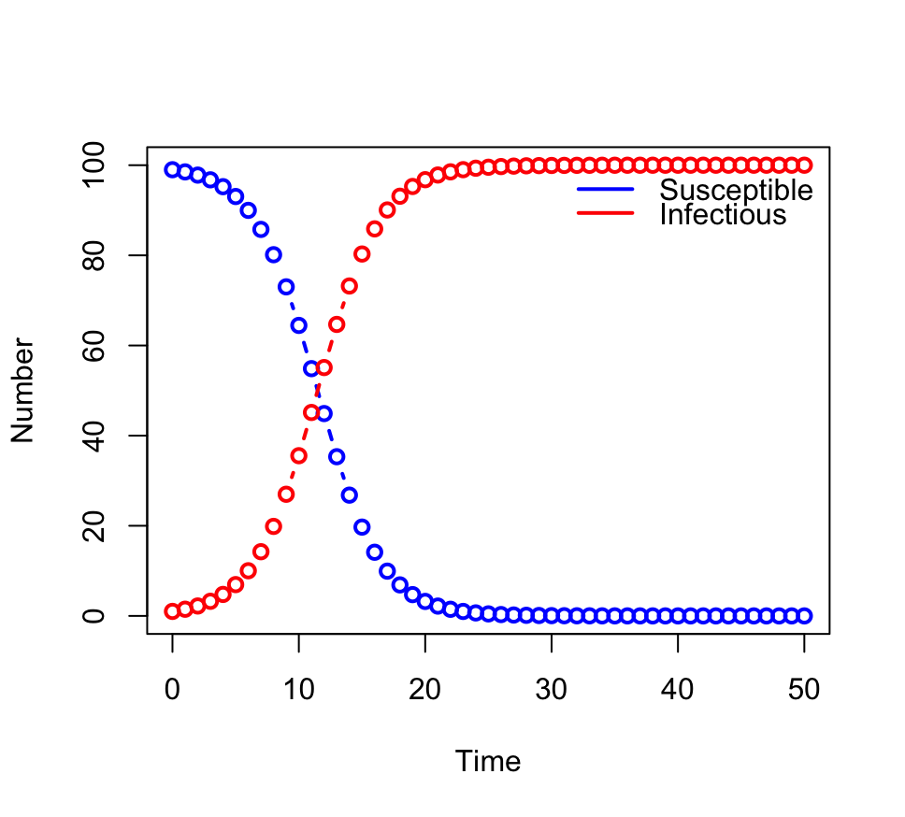
Practical 1: SI model
1c. Increase the value of the by argument (in the times vector). What happens to the output?

Slide 37
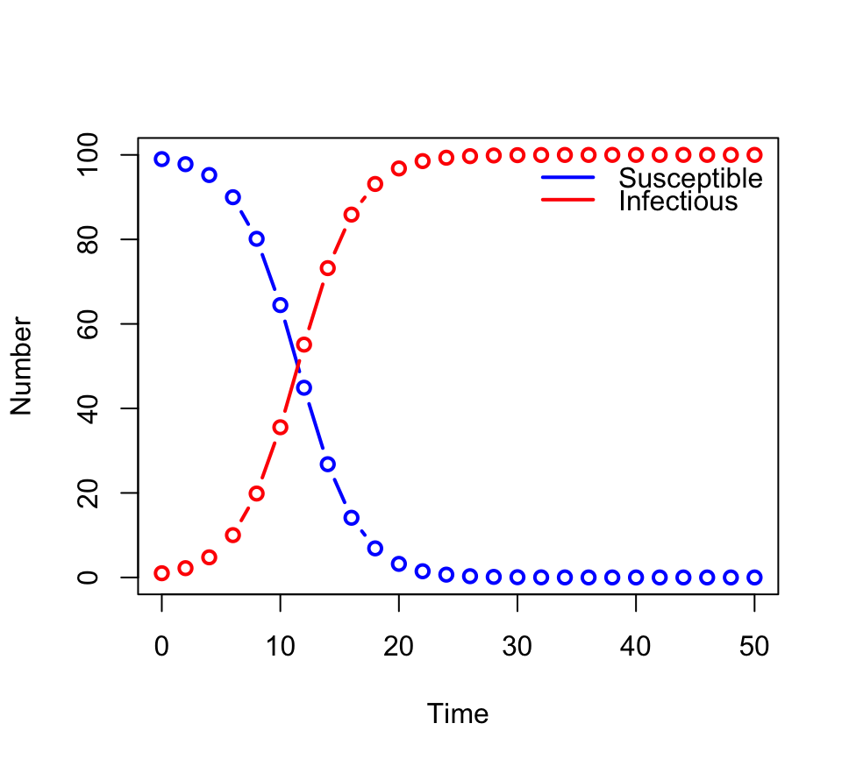
Practical 1: SI model
1c. Increase the value of the by argument (in the times vector). What happens to the output?
The solution points become
more spaced out, but trace
the same underlying curve.

Slide 38
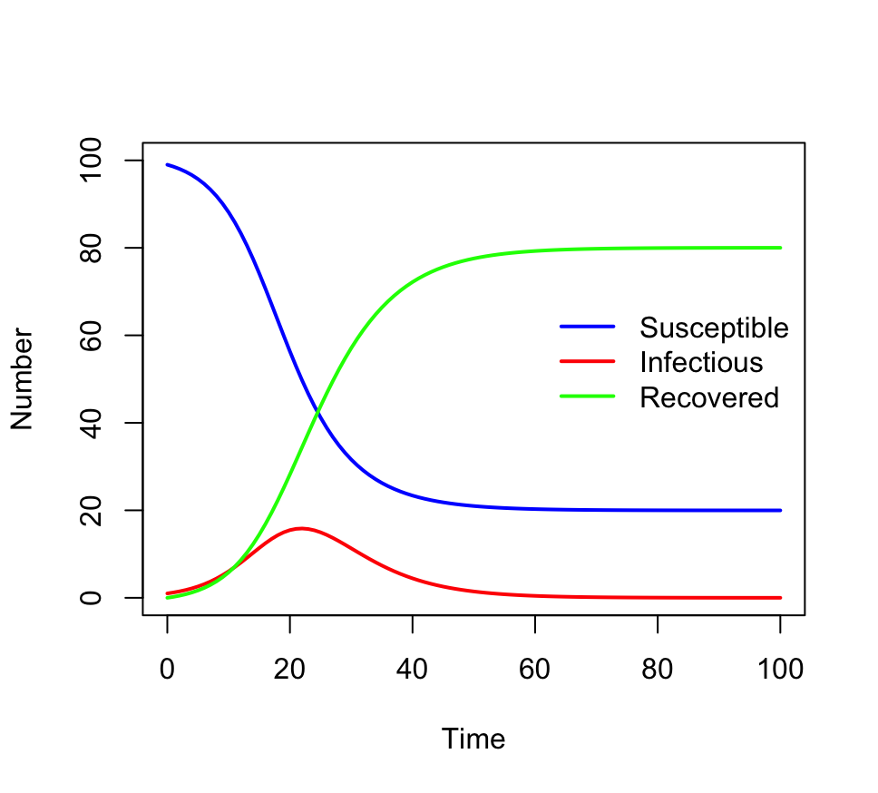
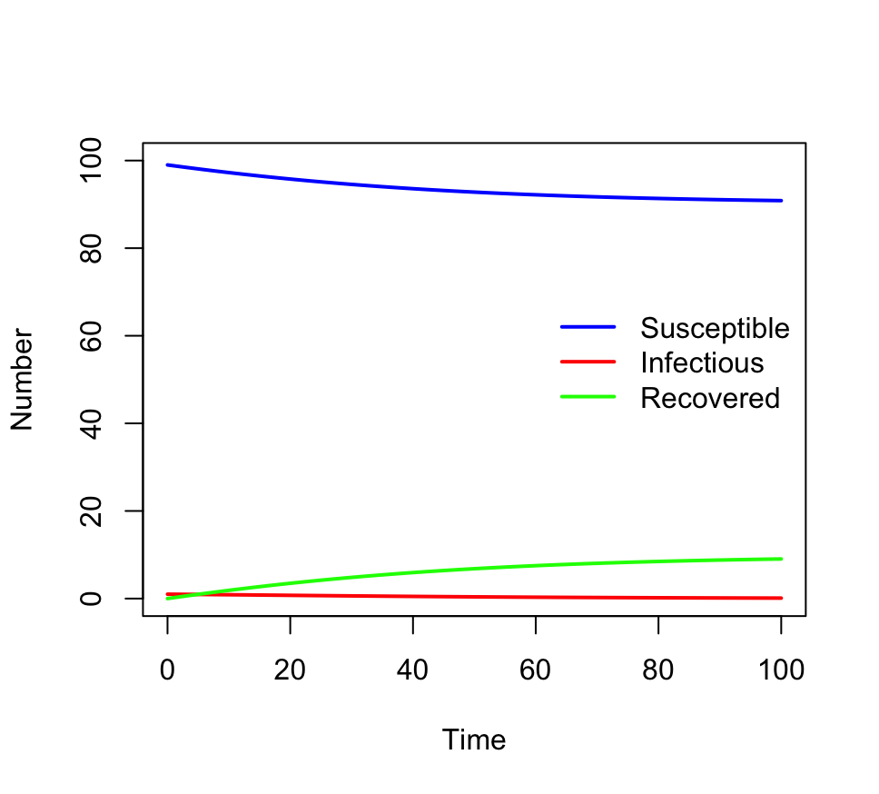
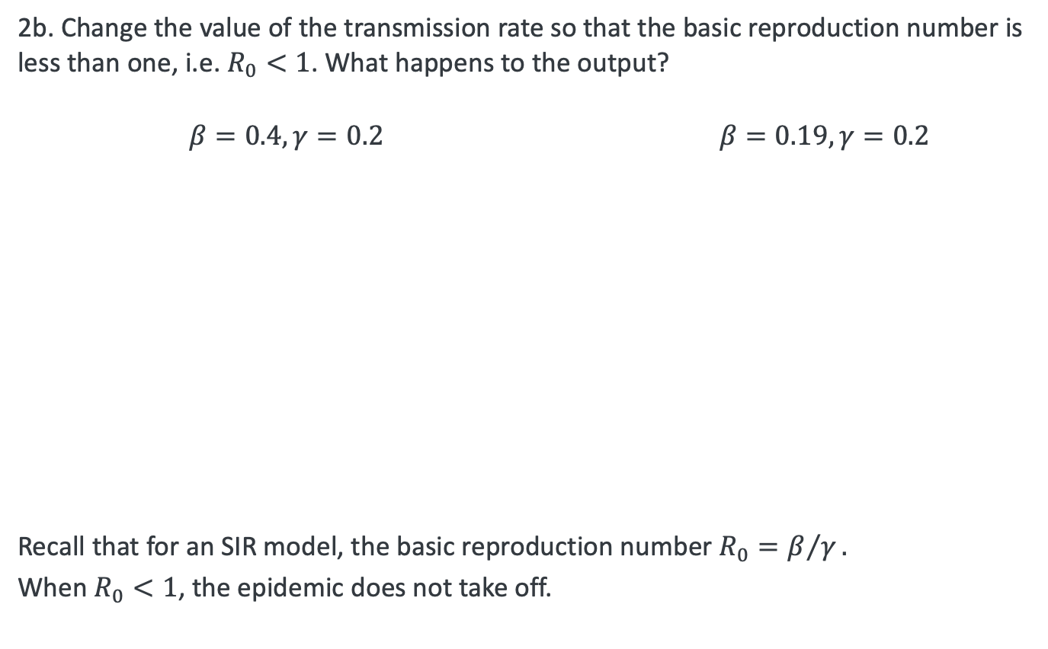
Practical 1: SIR model
2b. Change the value of the transmission rate so that the basic reproduction number is less than one, i.e. $R_{0}<1$. What happens to the output?
$β=0.4, γ=0.2$ $β=0.19, γ=0.2$
Recall that for an SIR model, the basic reproduction number $R_{0}=β/γ.$
When $R_{0}<1$, the epidemic does not take off.

Slide 39
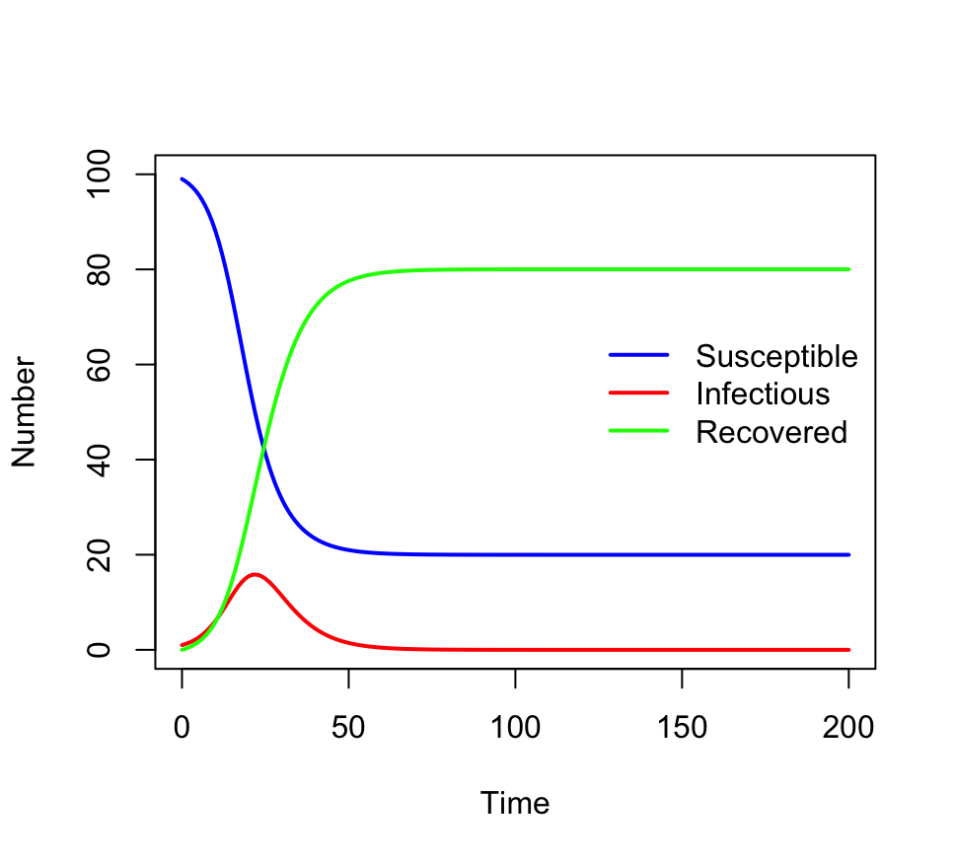
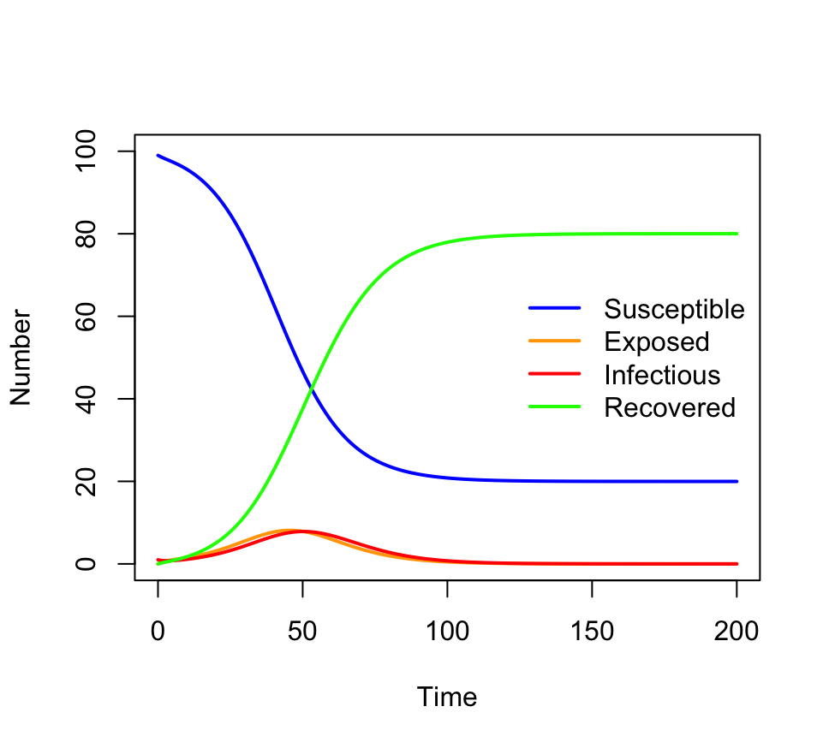
Practical 1: SEIR model
3b. How does the model output differ from the SIR model you coded previously?
Approximately the same number of people get infected, but the epidemic takes approximately twice as long; generation interval is twice as long.
See Wallinga and Lipsitch 2007, especially section 3a, for discussion of the generation interval, the growth rate and the reproduction number in epidemic models.

Slide 40
ODEs session 1 summary
ODE models are specified in terms of state variables and their rates of change
We have seen how to construct ODE systems starting from a flowchart-style model diagram
To solve an ODE model, we need to provide initial conditions for the state variables, parameter values, and times over which to solve the model
We have learned how to use deSolve to solve ODEs in R
Next session: Advanced use of deSolve.

Slide 41
Ordinary Differential Equations, session 2
Modern Techniques in Modelling

Slide 42
Outline for session 2
Recap on ODEs
How does numerical integration work?
Advanced use of deSolve
Practical: time-varying parameters, events, and Rcpp

Slide 43



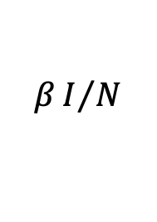


Ordinary differential equations: Recap
S
$$βI/N$$
I
$$γ$$
R
infection
recovery
A full ODE model specification has the following elements:
System of ordinary differential equations
Initial conditions
Parameters
$${dS}/{dt}$$
$$=$$
$$−\left({βI}/N\right)S$$
$S\left(0\right)=9,999$
$I\left(0\right) =1$
$R\left(0\right)=0$
$β=0.8$
$γ=0.4$
$${dI}/{dt}$$
$$=$$
$$\left({βI}/N\right)S$$
$$− γI$$
$${dR}/{dt}$$
$$=$$
$$γI$$
Times to solve system for
$$N=S+I+R$$
$t∈\{0, 1, 2, …, 60\}$
Starting from the initial conditions, we use numerical integration (e.g. with deSolve) to evaluate the variables at times t.

Slide 44
How does numerical integration of ODEs work?

Slide 45
Numerical integration
Systems of ODEs define curves which usually don’t have analytical solutions.
We use numerical integration to approximate these curves.
Usually done using piecewise polynomials.
Recall – examples of polynomials
linear y = ax + b
quadratic y = ax² + bx + c
cubic y = ax³ + bx² + cx + d
Simplest example: piecewise linear approximation (Euler’s method)

Slide 46
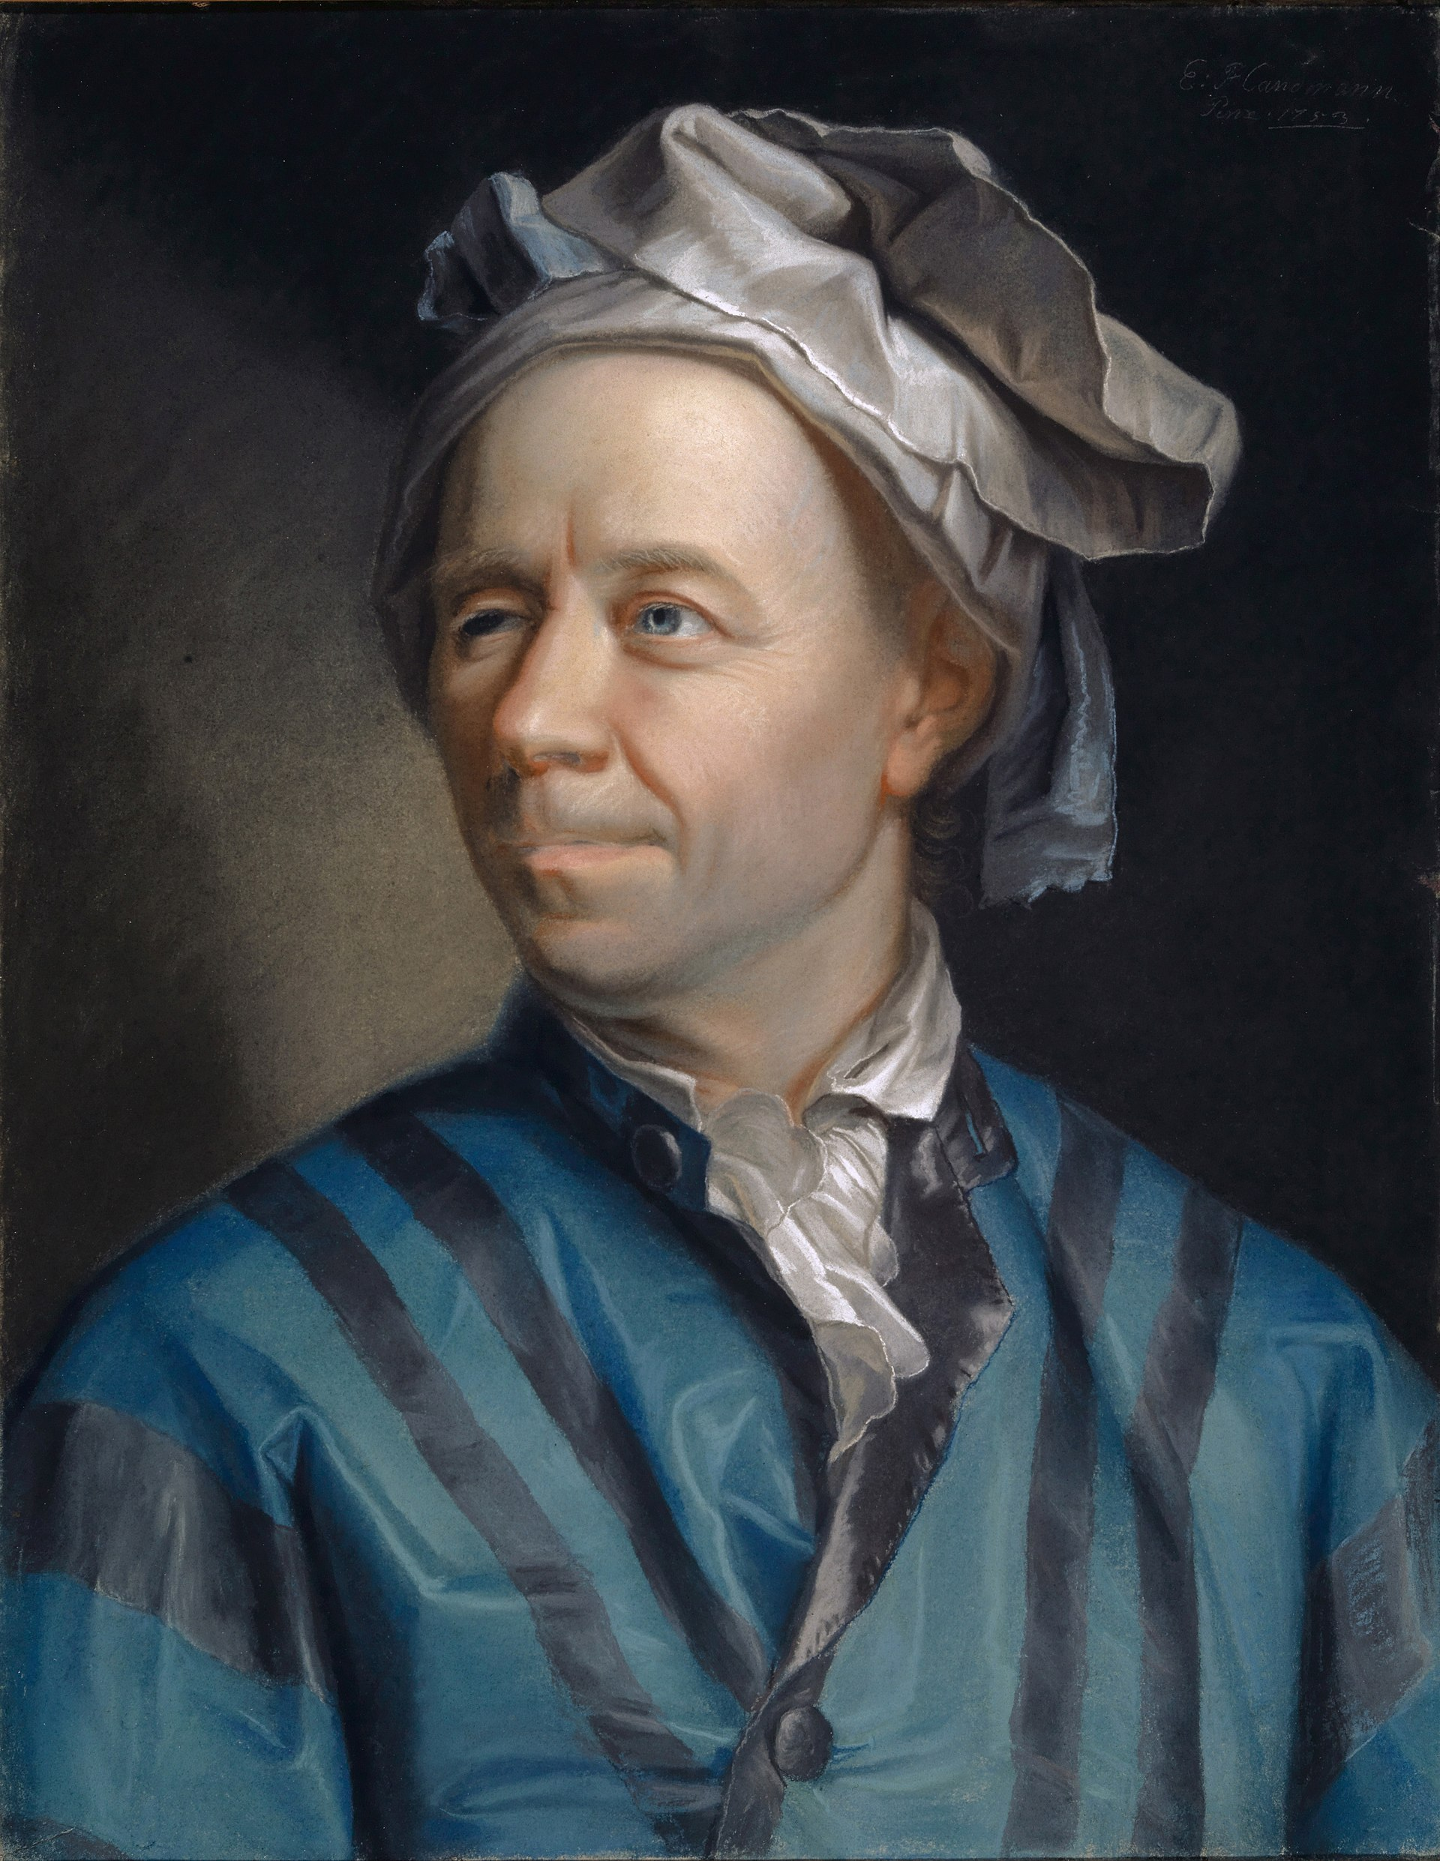
Euler’s method
Choose a time step, ∆t.
Start at initial point y(0).
Use ODEs to get “slope” of function at this point (dy / dt).
Move forward to t’ = t + ∆t along a straight line with this “slope”.
Repeat steps 2 - 3.
∆t

Slide 47
Euler’s method
Choose a time step, ∆t.
Start at initial point y(0).
Use ODEs to get “slope” of function at this point (dy / dt).
Move forward to t’ = t + ∆t along a straight line with this “slope”.
Repeat steps 2 - 3.
∆t

Slide 48
Euler’s method
Choose a time step, ∆t.
Start at initial point y(0).
Use ODEs to get “slope” of function at this point (dy / dt).
Move forward to t’ = t + ∆t along a straight line with this “slope”.
Repeat steps 2 - 3.
Note: This is very much like pretending your ODEs are difference equations!

Slide 49

Quadratic method
Instead of a piecewise linear function, we can use a piecewise quadratic function.

Slide 50

Quadratic method
Instead of a piecewise linear function, we can use a piecewise quadratic function.
Note that for piece 1, we have a slope measurement on the left side and a slope measurement on the right side.

Slide 51
Quadratic method
Instead of a piecewise linear function, we can use a piecewise quadratic function.
Note that for piece 1, we have a slope measurement on the left side and a slope measurement on the right side.
We can use these two slopes to construct a quadratic piece instead of a linear piece.

Slide 52
Quadratic method
Instead of a piecewise linear function, we can use a piecewise quadratic function.
Note that for piece 1, we have a slope measurement on the left side and a slope measurement on the right side.
We can use these two slopes to construct a quadratic piece instead of a linear piece.
And so on…

Slide 53
Quadratic method
Instead of a piecewise linear function, we can use a piecewise quadratic function.
Note that for piece 1, we have a slope measurement on the left side and a slope measurement on the right side.
We can use these two slopes to construct a quadratic piece instead of a linear piece.
And so on…

Slide 54
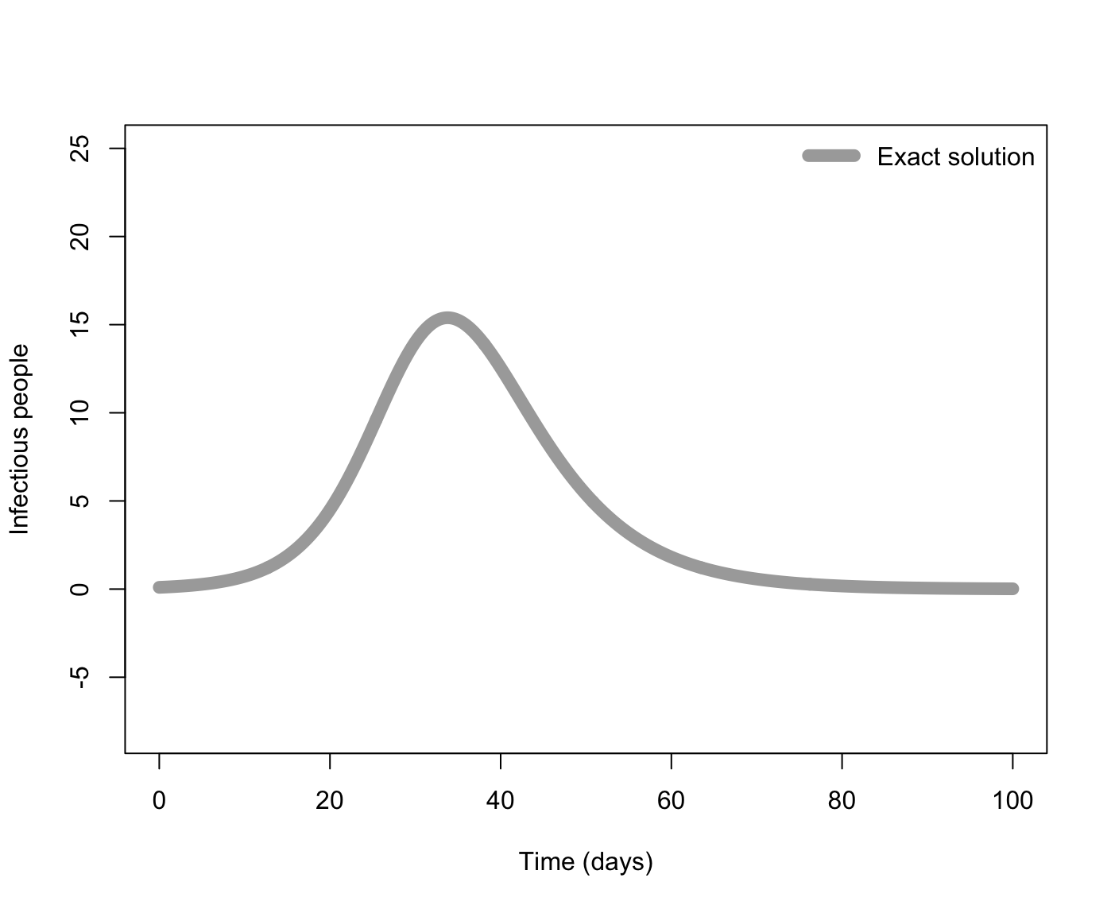
Approximation methods compared
In general, the higher degree polynomials we use, the better our approximation, at a cost of increased computation.
Example: SIR model, I compartment, ∆t = 10

Slide 55
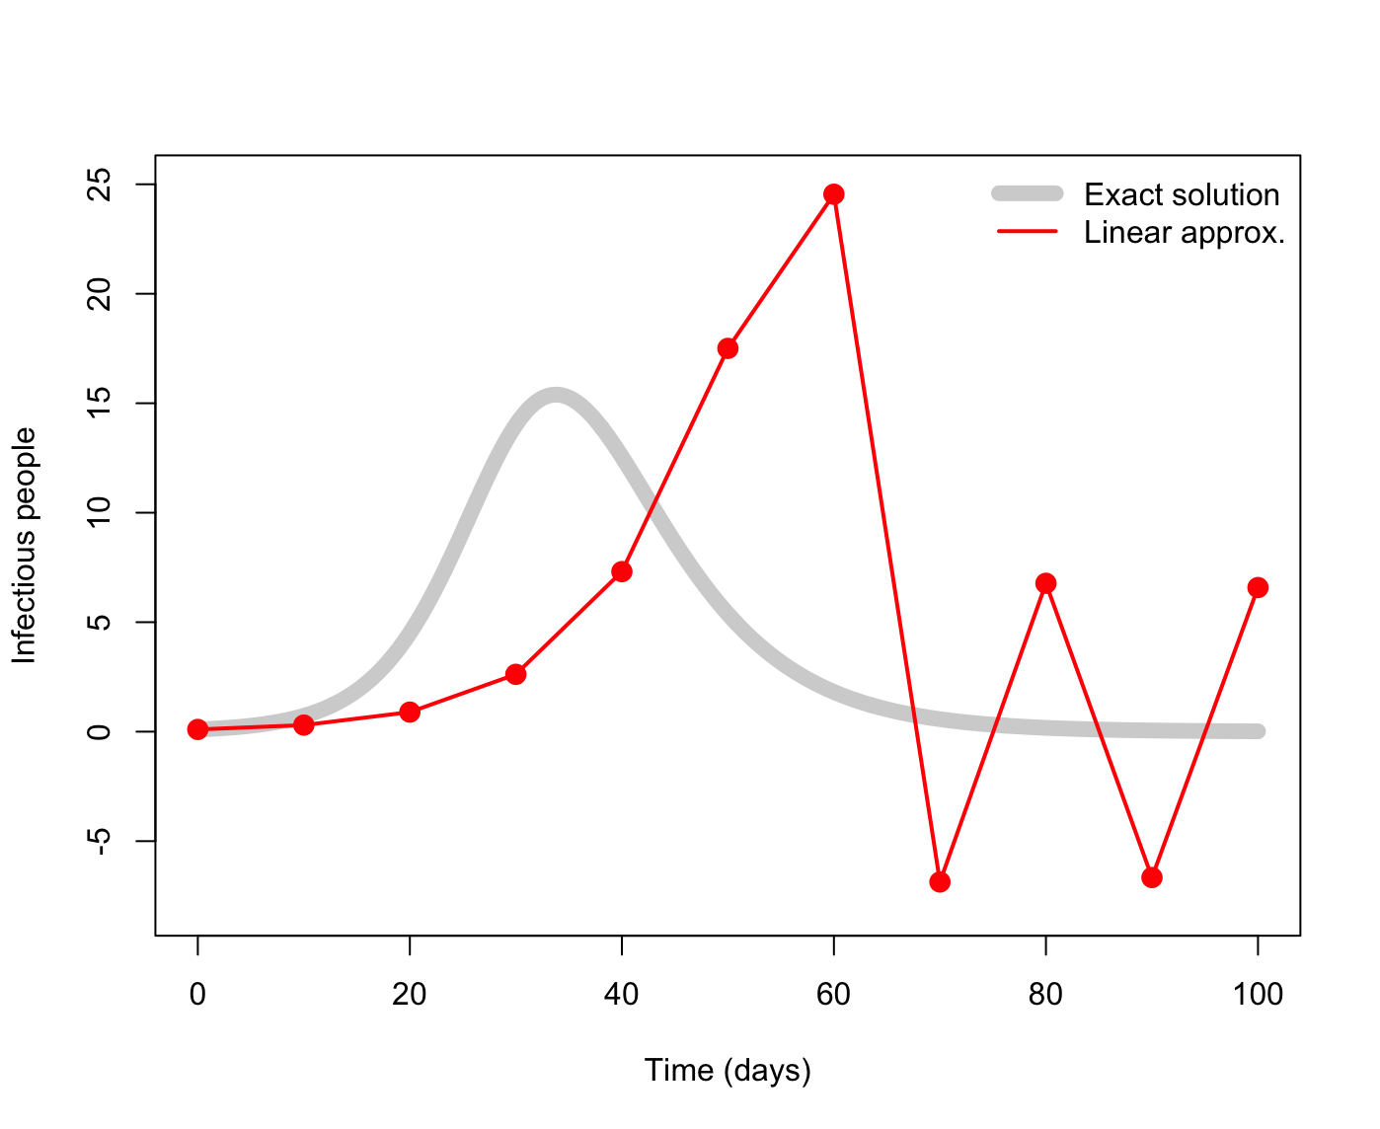
Approximation methods compared
In general, the higher degree polynomials we use, the better our approximation, at a cost of increased computation.
Example: SIR model, I compartment, ∆t = 10

Slide 56
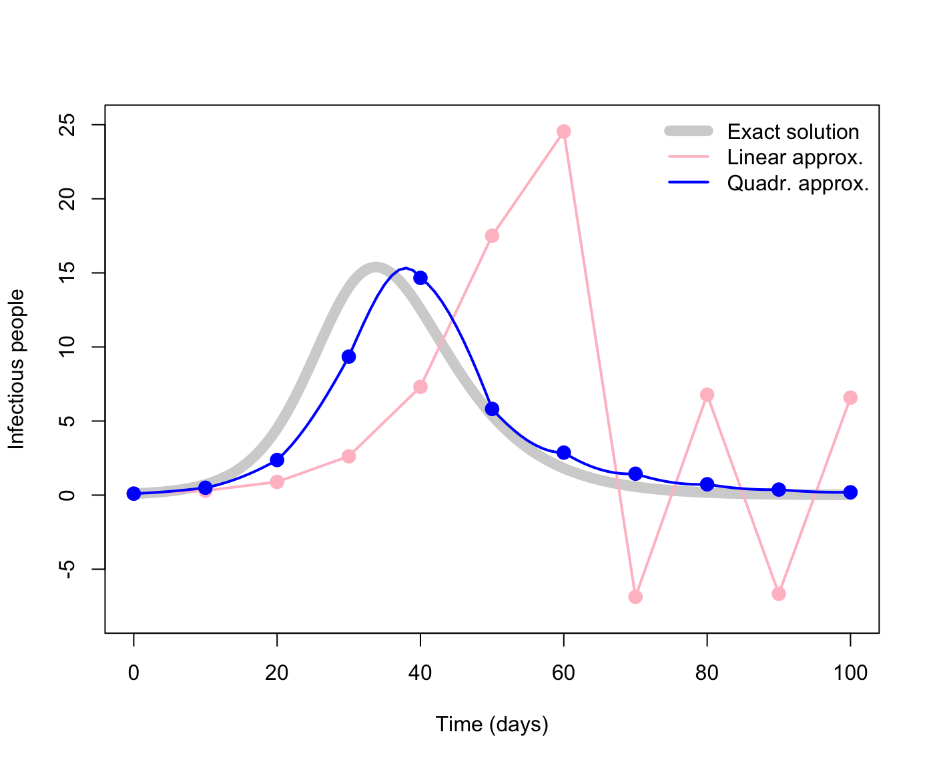
Approximation methods compared
In general, the higher degree polynomials we use, the better our approximation, at a cost of increased computation.
Example: SIR model, I compartment, ∆t = 10

Slide 57
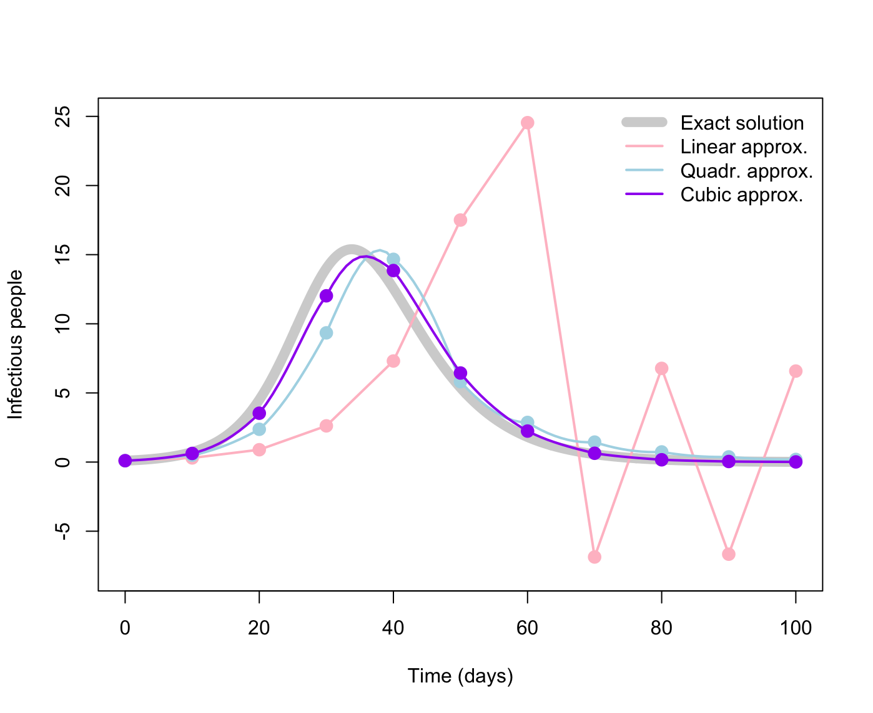
Approximation methods compared
In general, the higher degree polynomials we use, the better our approximation, at a cost of increased computation.
Example: SIR model, I compartment, ∆t = 10

Slide 58
Approximation methods compared
In general, the higher degree polynomials we use, the better our approximation, at a cost of increased computation.
Example: SIR model, I compartment, ∆t = 4

Slide 59
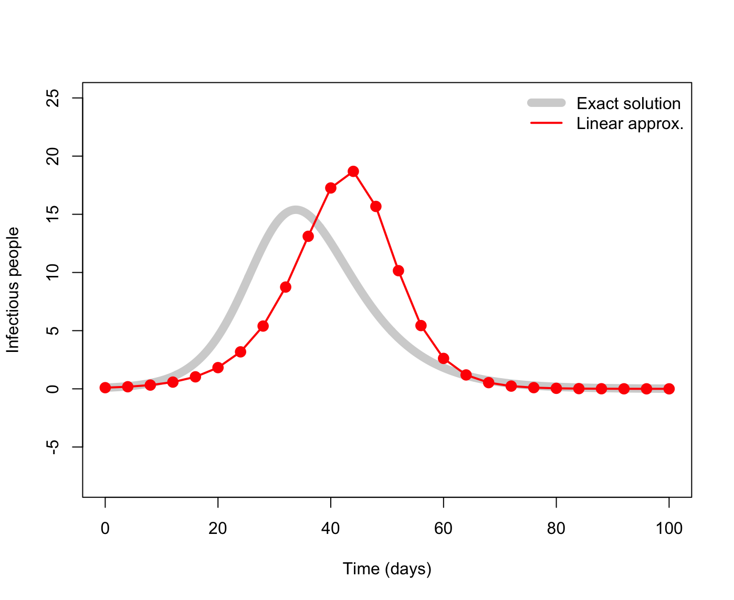
Approximation methods compared
In general, the higher degree polynomials we use, the better our approximation, at a cost of increased computation.
Example: SIR model, I compartment, ∆t = 4

Slide 60

Approximation methods compared
In general, the higher degree polynomials we use, the better our approximation, at a cost of increased computation.
Example: SIR model, I compartment, ∆t = 4

Slide 61

Approximation methods compared
In general, the higher degree polynomials we use, the better our approximation, at a cost of increased computation.
Example: SIR model, I compartment, ∆t = 4

Slide 62

Approximation methods compared
In general, the higher degree polynomials we use, the better our approximation, at a cost of increased computation.
Example: SIR model, I compartment, ∆t = 1

Slide 63
Usage in deSolve
In deSolve, we can specify what approximation method we want to use with the method argument to ode():
# Solve equations output_raw <- ode(y = y, times = times, func = SI_model, parms = parms)

Slide 64
Usage in deSolve
In deSolve, we can specify what approximation method we want to use with the method argument to ode():
# Solve equations output_raw <- ode(y = y, times = times, func = SI_model, parms = parms,
method = "euler")

Slide 65




Usage in deSolve
# Solve equations output_raw <- ode(y = y, times = times, func = SI_model, parms = parms,
method = "euler")
Some common methods:
"euler" Euler’s method Don’t use this!
"rk4" 4th-order Runge-Kutta Commonly used, quite good
"lsoda" Petzold & Hindmarsh Robust (and the default); automatic step size
Leonhard Euler Carl Runge Wilhelm Kutta Linda Petzold Alan Hindmarsh

Slide 66
Advanced use of deSolve

Slide 67
Advanced use of deSolve package
Time-dependent changes to parameters
Events, with or without a “trigger”
Speeding up your model with Rcpp

Slide 68

Time dependent parameters
Parameters, like the transmission rate, are “inputs” into the model.
We have been treating these as constants, but they can also vary with time.
What are some reasons the transmission rate might vary over time?
Seasonality…

Slide 69

Time dependent parameters
Parameters, like the transmission rate, are “inputs” into the model.
We have been treating these as constants, but they can also vary with time.
What are some reasons the transmission rate might vary over time?
Control measures…

Slide 70

Time dependent parameters
Parameters, like the transmission rate, are “inputs” into the model.
We have been treating these as constants, but they can also vary with time.
What are some reasons the transmission rate might vary over time?
Behaviour change…

Slide 71

Events
With ODEs, changes that happen to state variables are fundamentally “smooth” – there are no sudden jumps.

Slide 72

Events
With ODEs, changes that happen to state variables are fundamentally “smooth” – there are no sudden jumps.
What if we need to change the state variables at an instant?
e.g. a new strain of the virus gets introduced on November 20…

Slide 73
Time dependent parameters
Time-dependent parameters can be brought directly into the ODE function.
SI_model <- function(t, state, parms) { # Get variables S <- state["S"] I <- state["I"] N <- S + I # Get parameters beta <- parms["beta"] # Define differential equations dS <- -(beta * S * I) / N dI <- (beta * S * I) / N res <- list(c(dS, dI)) return(res) }

Slide 74
Time dependent parameters
Time-dependent parameters can be brought directly into the ODE function.
SI_seasonal_model <- function(t, state, parms) { # Get variables S <- state["S"] I <- state["I"] N <- S + I # Get parameters beta_max <- parms["beta_max"] period <- parms["period"] beta <- beta_max / 2 * (1 + sin(2*pi*t / period)) # Define differential equations dS <- -(beta * S * I) / N dI <- (beta * S * I) / N res <- list(c(dS, dI)) return(res) }

Slide 75
Using ‘events’ in deSolve
deSolve has the capability to include ‘events’
This can be used when you want to change the value of a state variable based on some condition
Events can be specified as a data.frame, or in a function.
Events can also be triggered by a root function.
use a data.frame to specify times at which events occur
use root function to trigger an event based on some condition

Slide 76

Using ‘events’ in deSolve
Let’s look at an example of using a root function
We want to predict infection in a livestock population
managed births, i.e. birth rate is a function of some target farm size $K$
assume that death occurs at longer time scale than infection, so we don’t include it
$$\begin{matrix}\frac{\text{d}S}{\text{d}t} & =bN(K−N)/K−βSI/N \\ \frac{\text{d}I}{\text{d}t} & =βSI/N\end{matrix}$$
where $N=S+I$.

Slide 77
Using ‘events’ in deSolve
We have our model function,
SI_open_model <- function(times, state, parms){ ## Define variables S <- state["S"] I <- state["I"] N <- S + I # Extract parameters beta <- parms["beta"] K <- parms["K"] b <- parms["b"] # Define differential equations dS <- b * N * (K - N) / K - ( beta * S * I) / N dI <- (beta * S * I) / N res <- list(c(dS, dI)) return(res) }

Slide 78

Using ‘events’ in deSolve
Our event is going to be a herd cull, removing a fraction $τ$.
Firstly, we need to write a function which changes the appropriate state variables
event_I_cull <- function(times, state, parms) { ## Define variables I <- state["I"] # Extract parameters tau <- parms["tau"] I <- I * (1 - tau) # cull the infected population state["I"] <- I return(state) }

Slide 79
Using ‘events’ in deSolve
Secondly, we need to write a function which triggers the event
root <- function(times, state, parms){ ## Define variables S <- state["S"] I <- state["I"] N <- S + I # Extract parameters K <- parms["K"] # Our condition is if more than half of the # target herd size becomes infected; we want # our indicator to cross zero when this happens indicator <- I - K * 0.5 return(indicator) }

Slide 80
Using ‘events’ in deSolve
output_raw <- ode(y = state, times = times, func = SI_open_model, parms = parameters, method = "lsoda", events = list(func = event_I_cull, root = TRUE), rootfun = root)
What does the output look like?

Slide 81
Using Rcpp
Rcpp is an R package that provides an interface between R and C++
The func input in ode can be written in C++
Overcomes some of R’s speed issues

Slide 82
Using Rcpp
#include <Rcpp.h> using namespace Rcpp; // [[Rcpp::export]] List SIR_cpp_model(NumericVector t, NumericVector state, NumericVector parms)
{ // Get variables double S = state["S"]; double I = state["I"]; double R = state["R"]; double N = S + I + R; // Get parameters double beta = parms["beta"]; double gamma = parms["gamma"]; // Define differential equations double dS = -(beta * S * I) / N; double dI = (beta * S * I) / N - gamma * I; double dR = gamma * I; NumericVector res_vec = NumericVector::create(dS, dI, dR ); List res = List::create(res_vec); return(res); }

Slide 83
Practical part 2

Slide 84
Practical part 2
Objective: implement SIR with time dependent transmission and use the events function in deSolve
Answer parts I, II
Part III is optional

