Slide 1
Stochastic individual-based models
Modern Techniques in Modelling

Slide 2
Introduction

Slide 3
Previously
We have explored discrete time-step compartmental models, and continuous ODE-based compartmental models, both of which are deterministic and track groups of individuals.
Now we’ll be exploring another kind of model, stochastic individual-based models (also called: agent-based models, microsimulations).
To understand this type of model, we’ll discuss what individual-based means and what stochastic means in this context.

Slide 4
Stochastic individual-based models
Individual-based logic:
Different kind of logic to a compartmental model.
Instead of thinking about and tracking groups of individuals:
There are 634 infected individuals and 366 uninfected individuals.
What happens next to each group?
We are thinking about and tracking individuals:
Individual 1 is infected.
Individual 2 is not infected.
Individual 3 is infected.
…
What happens next to each individual?

Slide 5
Stochastic individual-based models
Probabilistic rules:
Models are specified in terms of probabilistic “rules” for each individual.
Usually, these rules are evaluated in discrete time steps ∆t, often 1 day.
For example, for an SIS model (Susceptible-Infectious-Susceptible), each individual might follow these rules once each day:
If susceptible,
then with probability X become infectious
If infectious,
then with probability Y become susceptible
Typically, X would be higher or lower depending on the force of infection, and Y would be chosen to reflect the duration of infectiousness (we’ll see more on the next few slides).
Later we’ll discuss more complex kinds of rules.
How do we choose
these probabilities?

Slide 6
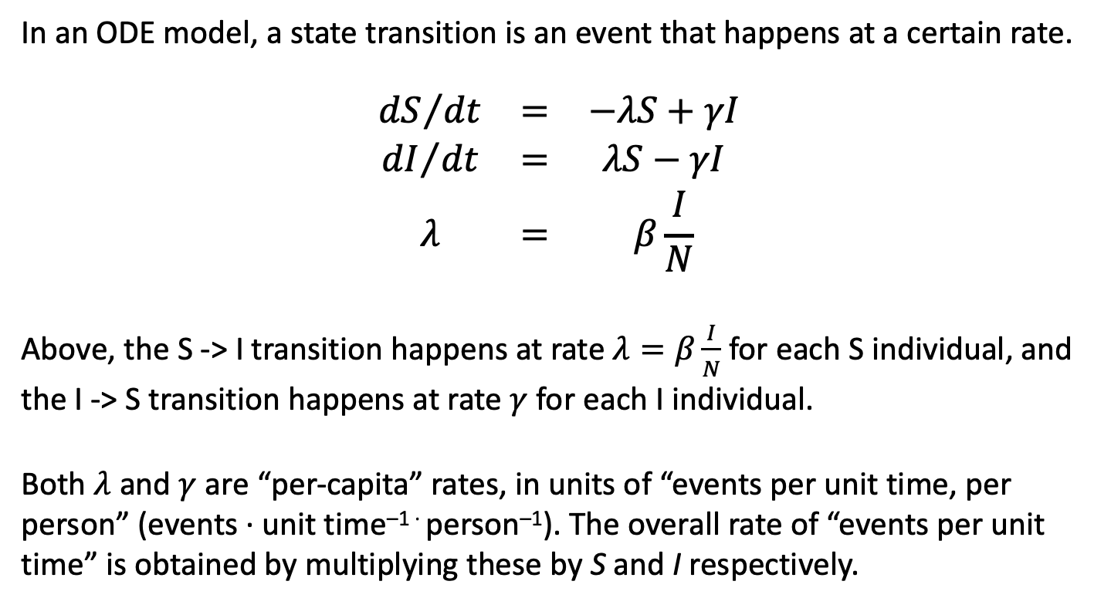
Turning event rates into probabilities
In an ODE model, a state transition is an event that happens at a certain rate.
$$\begin{matrix}{dS}/{dt} & = & −λS+γI \\ {dI}/{dt} & = & λS−γI \\ λ & = & β\frac{I}{N}\end{matrix}$$
Above, the S -> I transition happens at rate $λ=β\frac{I}{N}$ for each S individual, and the I -> S transition happens at rate $γ$ for each I individual.
Both $λ$ and $γ$ are “per-capita” rates, in units of “events per unit time, per person” (events · unit time^{–1 ·} person^{–1}). The overall rate of “events per unit time” is obtained by multiplying these by S and I respectively.

Slide 7
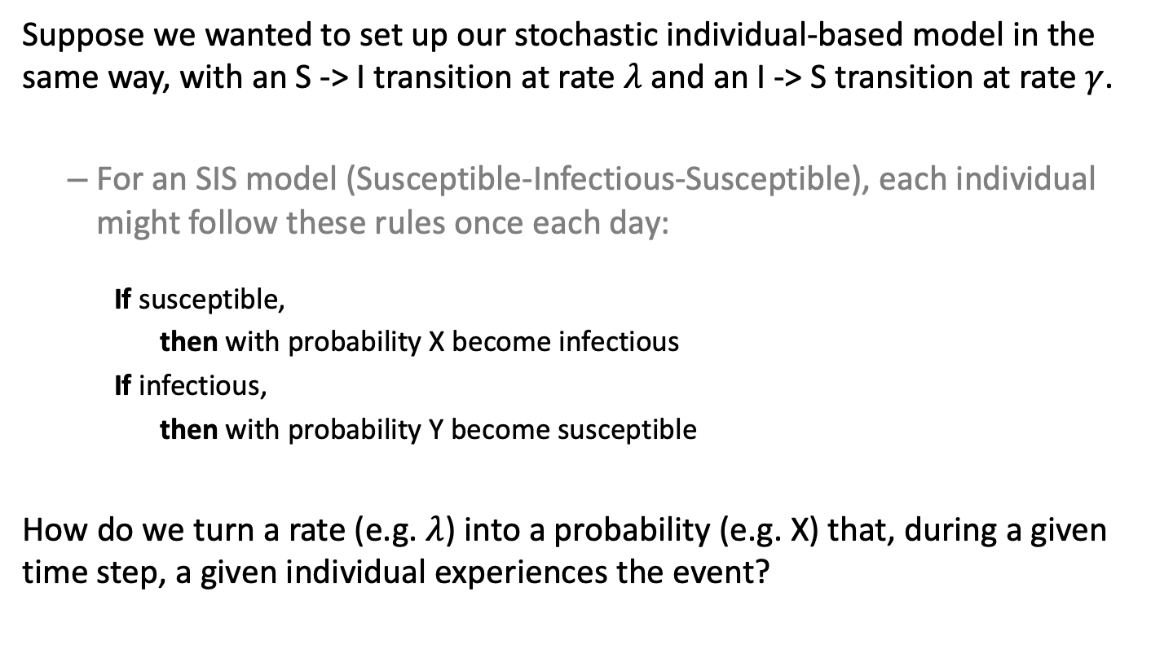
Turning event rates into probabilities
Suppose we wanted to set up our stochastic individual-based model in the same way, with an S -> I transition at rate $λ$ and an I -> S transition at rate $γ$.
For an SIS model (Susceptible-Infectious-Susceptible), each individual might follow these rules once each day:
If susceptible,
then with probability X become infectious
If infectious,
then with probability Y become susceptible
How do we turn a rate (e.g. $λ$) into a probability (e.g. X) that, during a given time step, a given individual experiences the event?

Slide 8


Turning event rates into probabilities
If some event happens at per-individual rate $λ$, the probability of it happening at least once to a given individual in a given time step of duration $Δt$ is
$$\begin{matrix}P\left(≥1 events\right) & = & 1−e^{−λΔt}\end{matrix}$$
$$P\left(≥1 events\right)$$

Slide 9
Turning event rates into probabilities
We might think:
probability = rate × ∆t
e.g.
rate = 0.1 events/day
∆t = 1 day
probability = 0.1 × 1 = 0.1
However, this starts to break down for higher rates:
e.g.
rate = 1.2 events/day
∆t = 1 day
probability = 1.2 × 1 = 1.2???
Problems:
Not clear what to do with this probability that is > 1.
Even when an event happens, on average, once per day, there can be days where the event doesn’t happen at all and days when it happens multiple times. We want to preserve this property of random events.

Slide 10
Turning event rates into probabilities
Consider a length of time, which is divided into time steps ∆t, “scattered” randomly with events.
∆t
Some time steps have 0 events, some have 1, some have >1. How do we account for this mathematically?
The difficulty here is that some time steps contain >1 events. So let’s take our time step and break it down even further into pieces that are so small, it’s safe to assume that no more than one event can happen in each tiny piece.

Slide 11
Turning event rates into probabilities
Consider a length of time, which is divided into time steps ∆t, “scattered” randomly with events.
∆t
Some time steps have 0 events, some have 1, some have >1. How do we account for this mathematically?
The difficulty here is that some time steps contain >1 events. So let’s take our time step and break it down even further into pieces that are so small, it’s safe to assume that no more than one event can happen in each tiny piece.

Slide 12
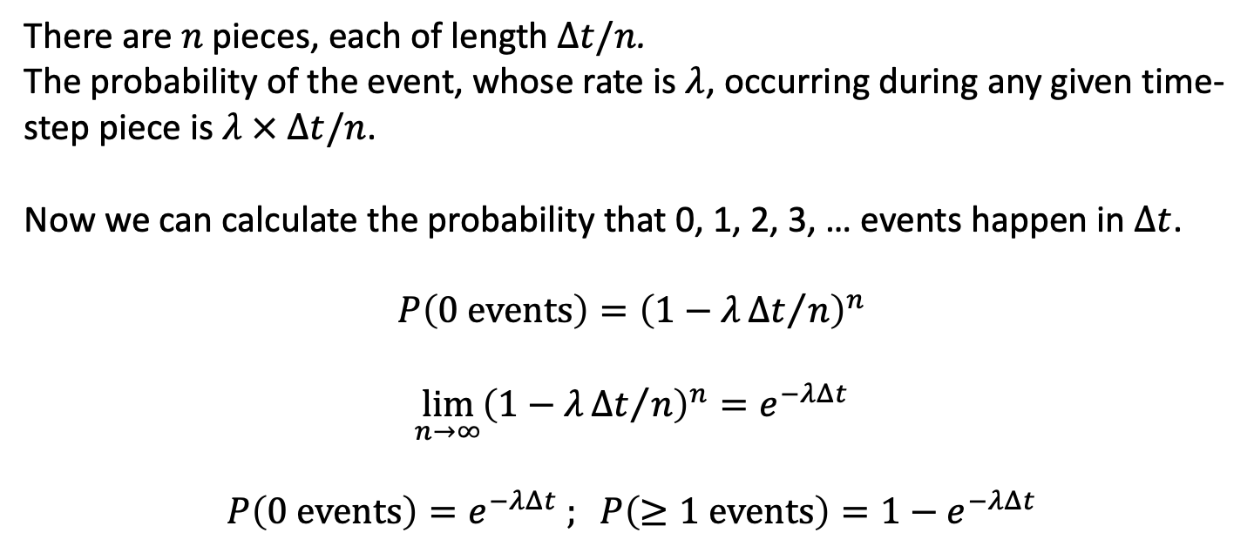
Turning event rates into probabilities
…
n pieces
∆t/n
There are $n$ pieces, each of length $Δt/n$.
The probability of the event, whose rate is $λ$, occurring during any given time-step piece is $λ × Δt/n$.
Now we can calculate the probability that 0, 1, 2, 3, … events happen in $Δt$.
$$P\left(0 events\right)={\left(1−λ{Δt}/n\right)}^{n}$$
$$\lim_{n→∞}{{\left(1−λ{Δt}/n\right)}^{n}=e^{−λΔt}}$$
$$P\left(0 events\right)=e^{−λΔt} ; P\left(≥1 events\right)=1−e^{−λΔt}$$

Slide 13
Turning event rates into probabilities
If some event happens at per-individual rate $λ$, the probability of it happening at least once to a given individual in a given time step of duration $Δt$ is
$$\begin{matrix}P\left(≥1 events\right) & = & 1−e^{−λΔt}\end{matrix}$$
$$P\left(≥1 events\right)$$

Slide 14
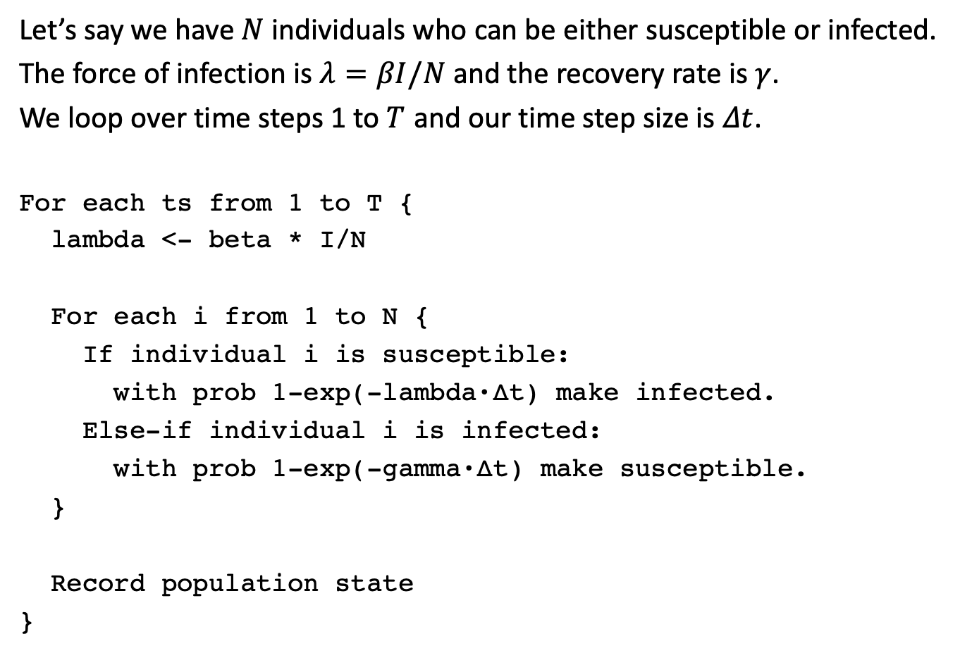
An example stochastic individual-based model
Let’s say we have $N$ individuals who can be either susceptible or infected.
The force of infection is $λ=βI/N$ and the recovery rate is $γ$.
We loop over time steps 1 to $T$ and our time step size is $Δt$.
For each ts from 1 to T { lambda <- beta * I/N
For each i from 1 to N { If individual i is susceptible: with prob 1-exp(-lambda·∆t) make infected. Else-if individual i is infected: with prob 1-exp(-gamma·∆t) make susceptible. }
Record population state }

Slide 15
An example stochastic individual-based model
Pseudocode
Initialize state
For each ts from 1 to T {
lambda <- beta * I/N
For each i from 1 to N { If individual i is susceptible: with prob 1-exp(-lambda·∆t),
make infected.
Else-if individual i is infected: with prob 1-exp(-gamma·∆t),
make susceptible. }
Record population state }
R code
state <- rep("S", n)
state[1:10] <- "I"
for (ts in 1:steps) {
lambda <- beta * sum(state == "I") / n
for (i in 1:n) {
if (state[i] == "S") {
if (runif(1) < 1 - exp(-lambda * dt)) {
state[i] <- "I"
}
} else if (state[i] == "I") {
if (runif(1) < 1 - exp(-gamma * dt)) {
state[i] <- "S"
}
}
}
# Record population state . . .
}

Slide 16
Outline of the practical
An individual-based SEIR model of SARS-CoV-2 transmission.
Adding more complex dynamics to the SEIR model.
Optimizing the model to run faster.

Slide 17
Practical 1. An individual-based SEIR model of SARS-CoV-2 transmission

Slide 18

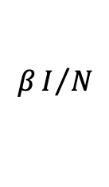


Practical 1: Individual-based SEIR model
In the first practical, you will be implementing an SEIR model with waning immunity as a stochastic individual-based model.
S
$$βI/N$$
E
$$δ$$
I
$$γ$$
R
$$ω$$

Slide 19
Practical 1: Individual-based SEIR model

Slide 20
Practical 1: Individual-based SEIR model
6. What happens if you use set.seed(123456) instead of 12345?

Slide 21
Practical 1: Individual-based SEIR model
6. What happens if you use set.seed(123456) instead of 12345?

Slide 22
Advantages of individual-based models
Each individual can have properties (age, sex, physical location, network of contacts…) that do not need to be “grouped” as in a compartmental model, and which can change in precisely specified ways over time.
Can be easier to think about.
Can allow for more complex dynamics.
Because rules are probabilistic, allows consideration of stochastic effects.

Slide 23
Disadvantages of individual-based models
Usually hard to “prove” results. (i.e. not analytically tractable)
Can be more complex to implement than compartmental models.
Slower to run than compartmental models, especially in R, especially if not coded carefully.
Stochastic effects introduce complications:
Results may depend upon population size, time step size
You have to average over multiple “runs” to have confidence in results

Slide 24
Practical 2. Adding more complex dynamics to the model

Slide 25
More complex dynamics
Up until now, in our model we have only kept track of one “piece of information” for each individual, their state (S, E, I, or R).
In an individual-based model, we can track as many different properties for each individual as we can think of – such as their age, viral load, antibody level, geographical location, household, etc…
These properties are not limited to discrete states (such as S/E/I/R, old/young, etc) but can be values such as real numbers (1.234) or character strings (AGTAGCTAGGC…)
We will now explore a few such examples.

Slide 26
Example 1. Age
We can give each individual an age (in years) in addition to their state:
state <- rep("S", n)
state[1:10] <- "E"
age <- runif(n, 0, 80)
Using this, we can make other properties of the simulation depend upon a person’s age, such as making infectiousness depend on age:
# before
lambda <- beta * sum(state == "I") / n
# after
lambda <- beta * sum(infectiousness(state, age)) / n
infectiousness <- function(state, age) {
ifelse(state == "I", 1.25 – age/160, 0)
}

Slide 27
Example 1. Age
We can also simulate aging in the model:
for (i in 1:n) {
age[i] <- age[i] + dt / 365
# . . .
}
But this may not make a difference if we are only simulating short outbreaks.

Slide 28
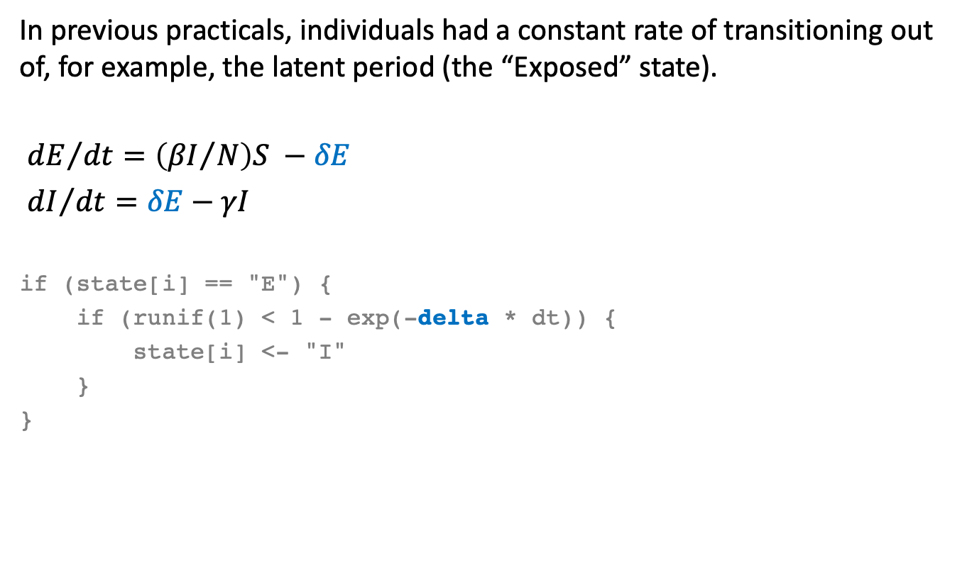
Example 2. Arbitrary delays
In previous practicals, individuals had a constant rate of transitioning out of, for example, the latent period (the “Exposed” state).
${dE}/{dt}=\left({βI}/N\right)S −δE$
${dI}/{dt}=δE−γI$
if (state[i] == "E") {
if (runif(1) < 1 - exp(-delta * dt)) {
state[i] <- "I"
}
}

Slide 29
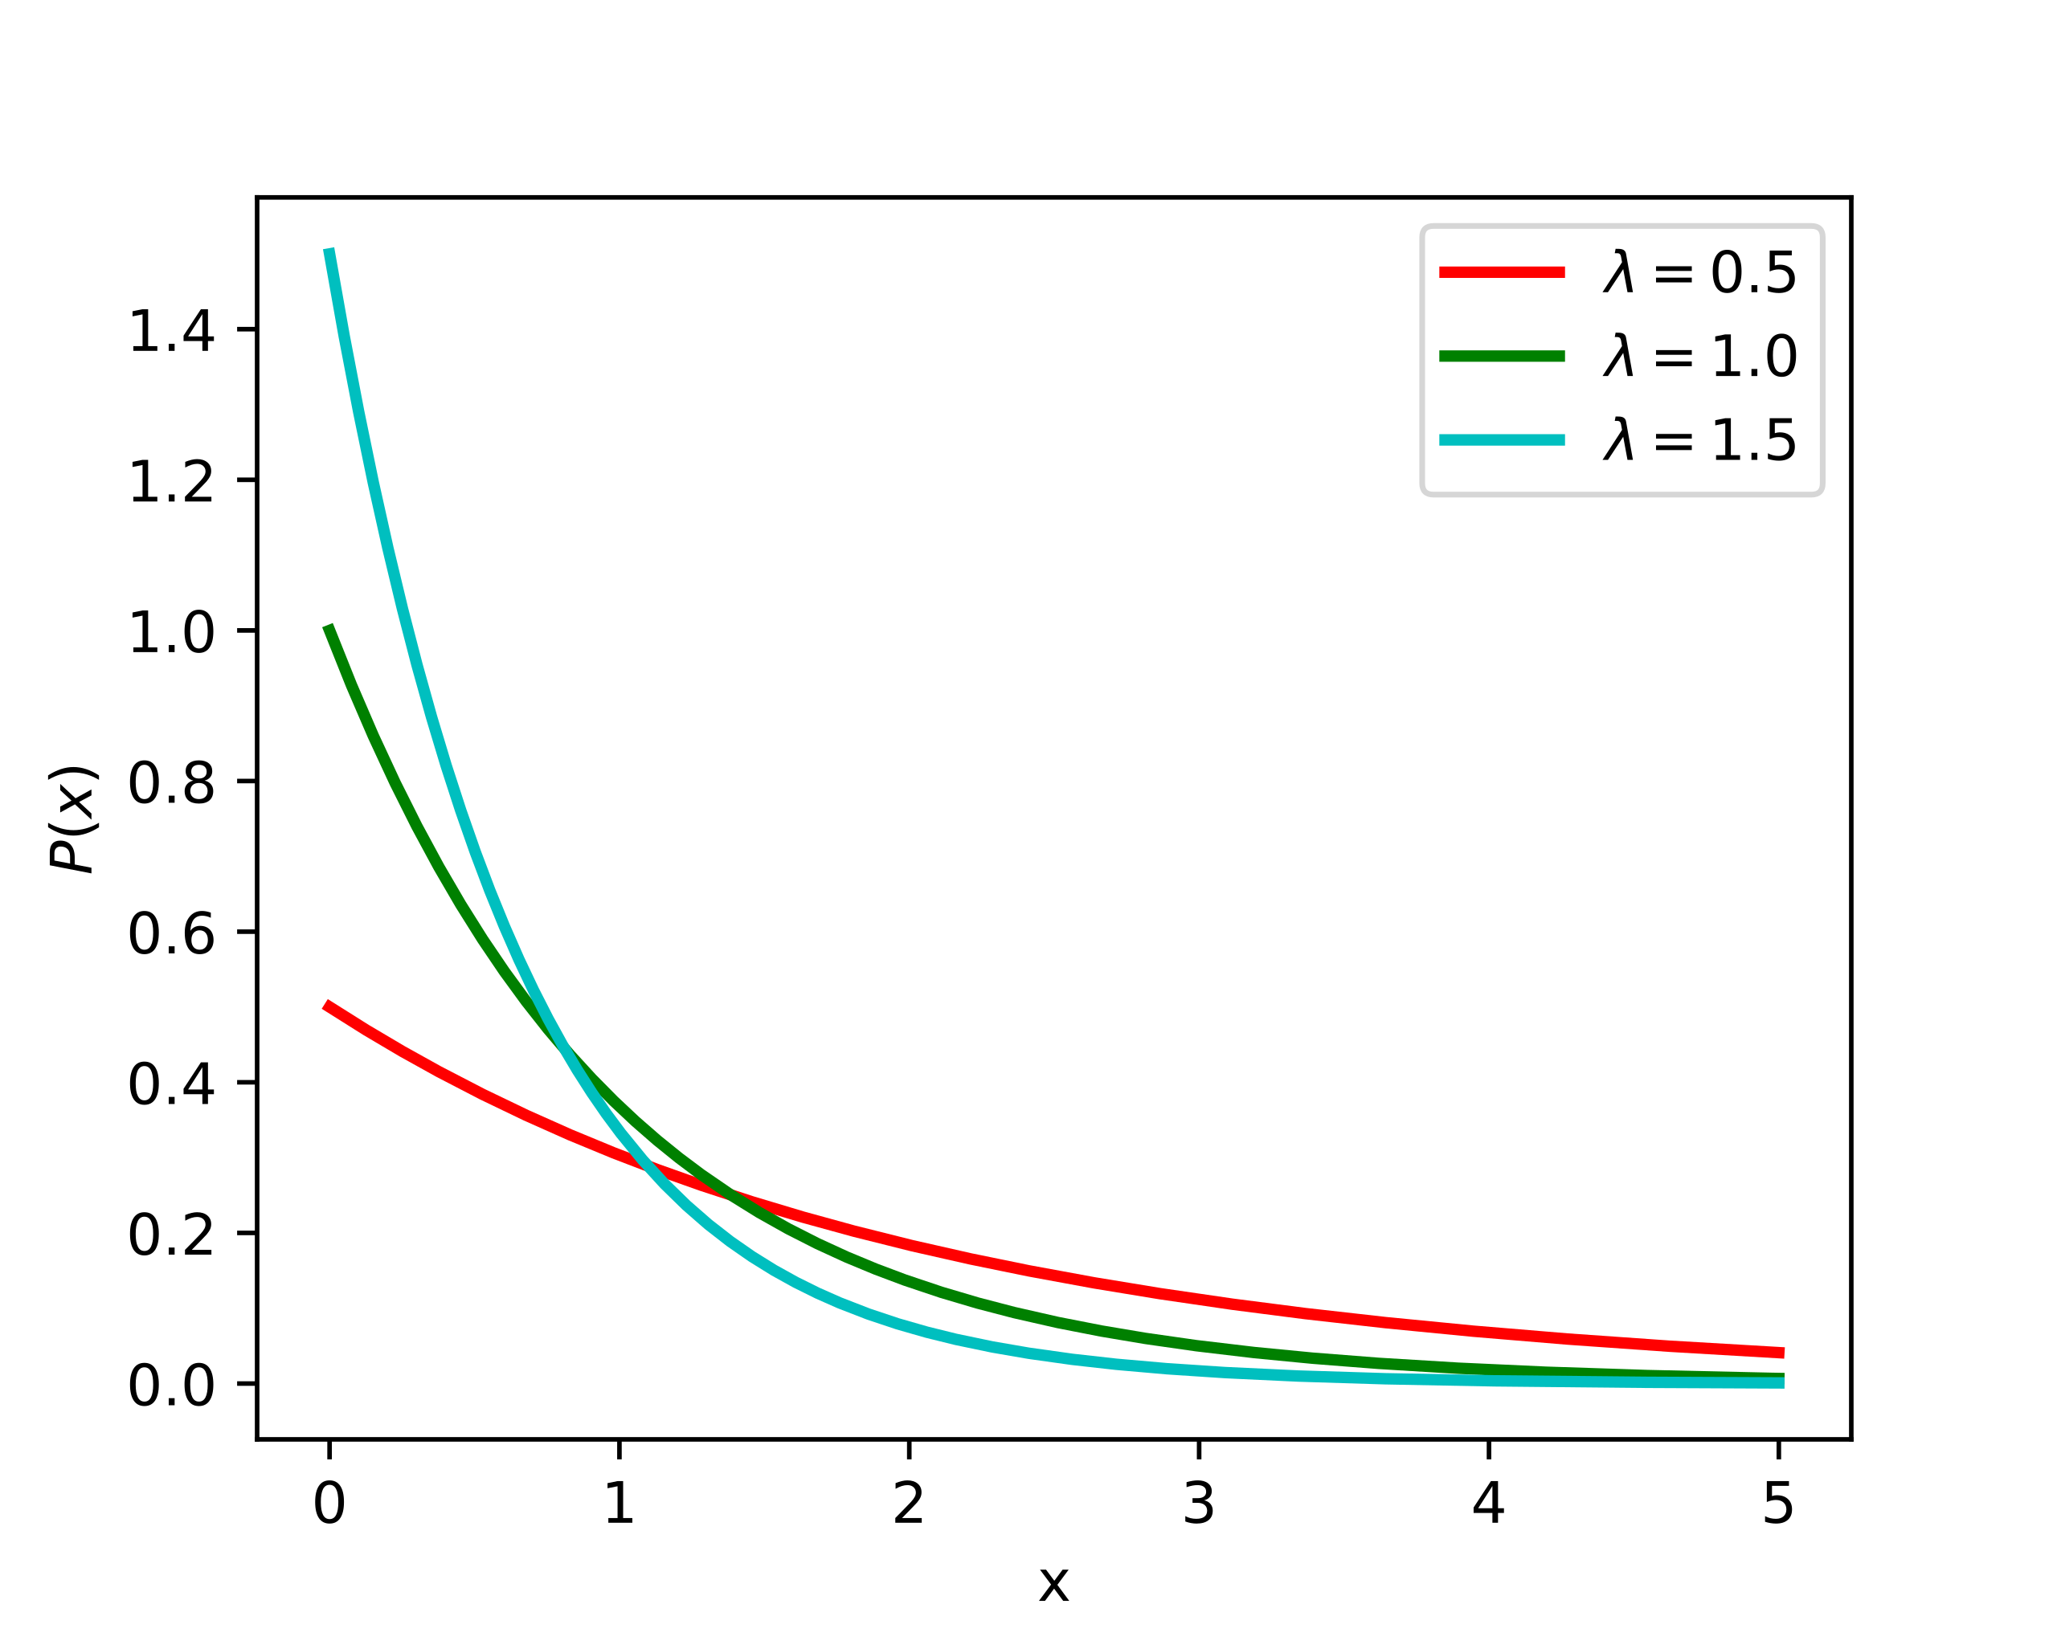
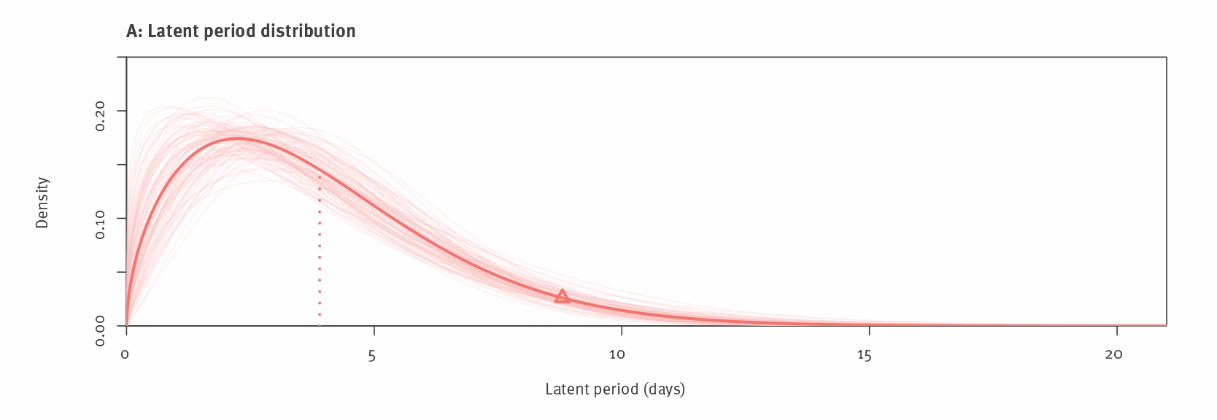
Example 2. Arbitrary delays
When individuals leave a compartment at a constant per-capita rate, the amount of time each individual spends in the compartment is exponentially distributed.
(image: Wikipedia)
However, measured durations of latent / incubation / infectious period are usually more “clumped” than an exponential distribution, such as this estimate of the latent period for the Delta variant. (Kang et al. 2022, Eurosurveillance 27: 2100815)

Slide 30
Example 2. Arbitrary delays

Slide 31
Example 2. Arbitrary delays
We can give each individual a “delay” property:
delay <- rep(0, n)
When individual i enters the Exposed state, we can assign a value to delay[i] representing how much time they have left:
if (state[i] == "S") {
# Transition S -> E (infection) at rate lambda
if (runif(1) < 1 - exp(-lambda * dt)) {
state[i] <- "E"
delay[i] <- rlnorm(1, meanlog = 0.5, sdlog = 0.6)
}
}

Slide 32
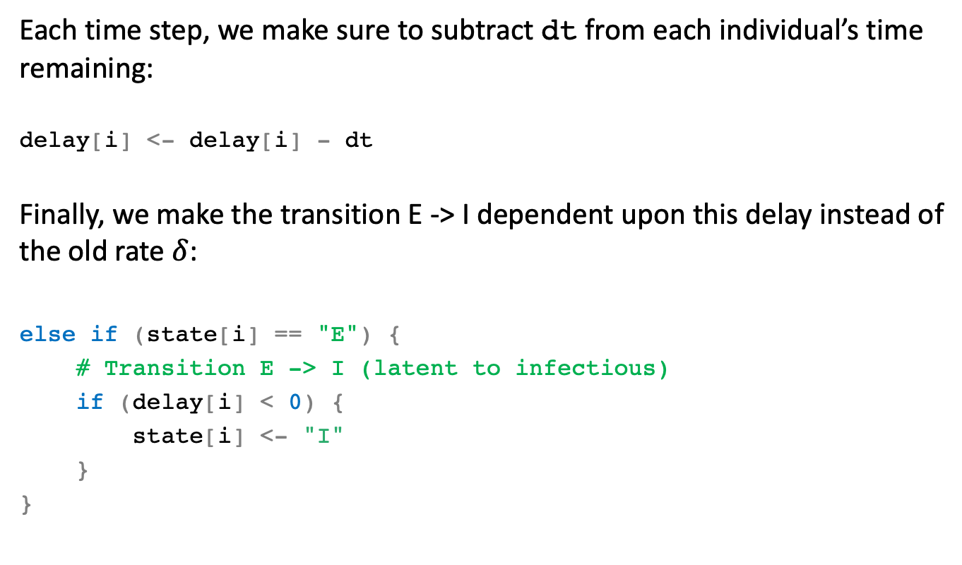
Example 2. Arbitrary delays
Each time step, we make sure to subtract dt from each individual’s time remaining:
delay[i] <- delay[i] - dt
Finally, we make the transition E -> I dependent upon this delay instead of the old rate $δ$:
else if (state[i] == "E") {
# Transition E -> I (latent to infectious)
if (delay[i] < 0) {
state[i] <- "I"
}
}

Slide 33
Practical 2. More complex dynamics
The instructions online will guide you through adding:
delay distributions for the latent and infectious period,
age and age-dependent infectiousness,
immunity based upon antibody levels and
vaccination
to the model from Practical 1.

Slide 34
Practical 2. More complex dynamics

Slide 35
Practical 2. More complex dynamics

Slide 36
Practical 3. Optimizing the model to run faster

Slide 37
Practical 3. Optimizing the model
In R, code that loops over each individual in an individual-based model can be quite slow to run.
This code can be optimized significantly by vectorizing it—that is, by applying events all at once rather than to each individual in turn.

Slide 38
Vectorizing R code
Compare this code:
for (i in 1:n) {
if (state[i] == "S") { if (runif(1) < 1 - exp(-lambda * dt)) { state[i] <- "E" }
} }
With this code:
trE <- (state == "S") & (runif(n) < 1 - exp(-lambda * dt))
state[trE] <- "E"

Slide 39
Summary
Stochastic individual-based models track individual members of a population and assume that events happen probabilistically, which means that they incorporate random chance.
Individual-based models allow you to do things that compartmental models don’t.
But they are more complex to implement and slower to run, so only use them if you need that added complexity.
Stochasticity also means we will need to run the model multiple times to get a good summary of what the model is doing.
The run time of an individual-based model in R can be improved by “vectorizing” the code (but an individual-based model will usually still be slower than a deterministic, ODE model equivalent, if one exists).

