Slide 1
Network Modelling
Modern Techniques in Modelling

Slide 2
Overview
Discuss network modelling concepts (~20 min)
Practical 1: Introduction to the igraph package (~40 min)
BREAK (~30 min)
Reed-Frost SIR Model (~10 min)
Practical 2: A network model of mpox transmission (~40 min)
Closing discussion (~10 min)
Notes:
1-2 mins

Slide 3
Part 1:
What are Network Models?
Why Use Networks?
Notes:
For the first part, I want to motivate your thinking with two questions: namely what are network models? and why use them?

Slide 4
What are Network Models?
Network = set of vertices V and edges E
e₁₂
e₃₄
v₂
v₁
v₄
v₃
e₁₃
e₂₃
Notes:
We’ve already talked earlier in the course about “what is a model”, so let’s start with what is a network before we join those two ideas.
A network is a collection of relationships between two kinds of things: vertices and edges.

Slide 5
What are Network Models?
Network = set of vertices V and edges E
an edge e_{ij} in E connects two vertices v_{i}, v_{j} in V
e₁₂
v₂
v₁
e₃₄
v₄
e₂₃
e₁₃
v₃
Notes:
A network is about relationships, so rather than just floating around separately, vertices and edges are connected. Specifically, edges connect vertices.
A vocabulary note: Often graph is used instead of network, node instead of vertex, and link instead of edge.

Slide 6
What are Network Models?
Modelling: representing real phenomena by abstractions
How might networks represent infectious disease?
e₁₂
v₂
v₁
e₃₄
v₄
e₂₃
e₁₃
v₃
Notes:
question to the class – can get into small groups for 3-5 min elicitation

Slide 7
Some possible answers:
Generally: represent process over the network (e.g., transmission) + vertex state (e.g., SIR)
Useful to think about contacts:
when transmission depends on specific contacts (e.g., STIs)
if there is heterogeneity / structure to contacts (e.g., influenza in schools vs workplaces vs households)
Spatial relationships:
mosquitoes moving between adjacent households
people migrating from one region to another
Notes:
Review answers from class, add some examples

Slide 8
Why use networks?
Shared features of those examples:
“realism” aspect of the model (e.g. vs homogeneous mixing)
clear translation between observations and model
generalisation: e.g., why does R₀ vary between contexts? same pathogen & host - but different transmission networks
Notes:
3-5 minutes; prompt shared features w/ Q to class first
realism - the network explicitly represents more details of the system
because more realism, can match observations between real-world and model more closely (if sufficient meta-data in real data)
because more realism + easier data match, possible to take same model + “fundamental” constants (e.g. given pathogen exposure, probability of infection) and port across circumstances (e.g. flu in school vs flu in workplace). The ability to use the “same” model (albeit with different inputs based on measurements) make conclusions from one setting potentially portable to others

Slide 9
Practical 1
Introduction to the igraph package
Notes:
We’re going to take a bit of time to learn how to use a particular R package, igraph.
igraph allows you to make graph objects w/ edges + vertices, and conveniently manipulate them.
in this practical, you’re introduced to the basics of igraph syntax + some ways to check if you’re using it correctly (e.g., by plotting), as well as a few more advanced functions and where to look for documentation on how to do more complex tasks with the package

Slide 10
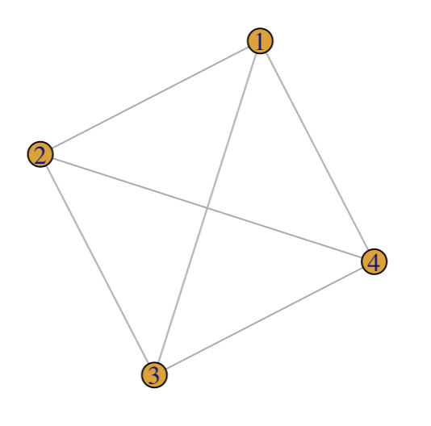
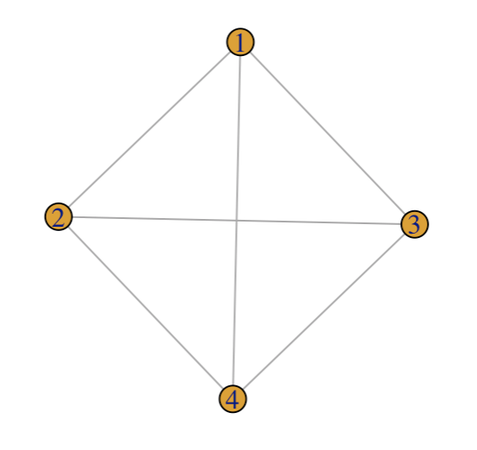
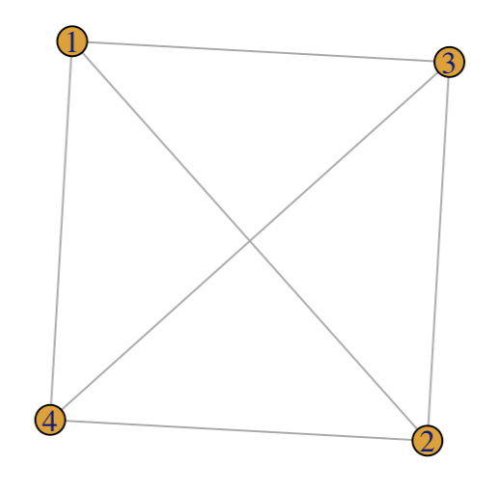
Questions from the practical
1. Run the plot(gr) line multiple times. The plot changes. Does the graph change?
Notes:
To discuss: the position of the vertices changes, but which vertices are connected to which other vertices does not change, and only the latter property is important.

Slide 11
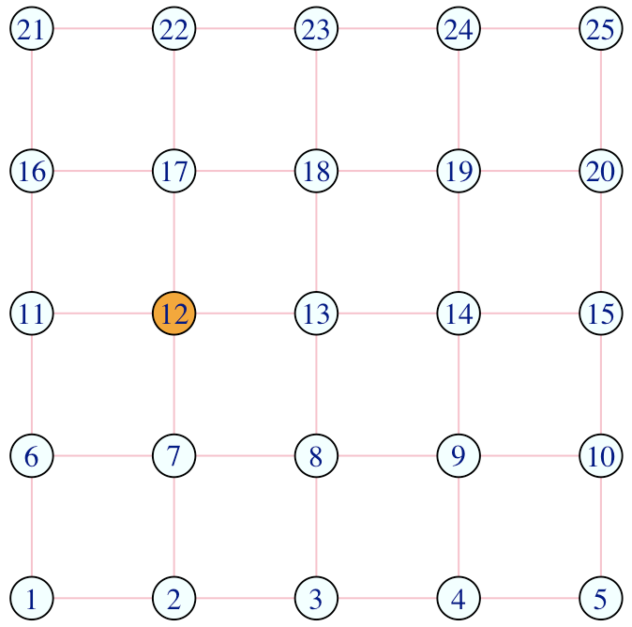
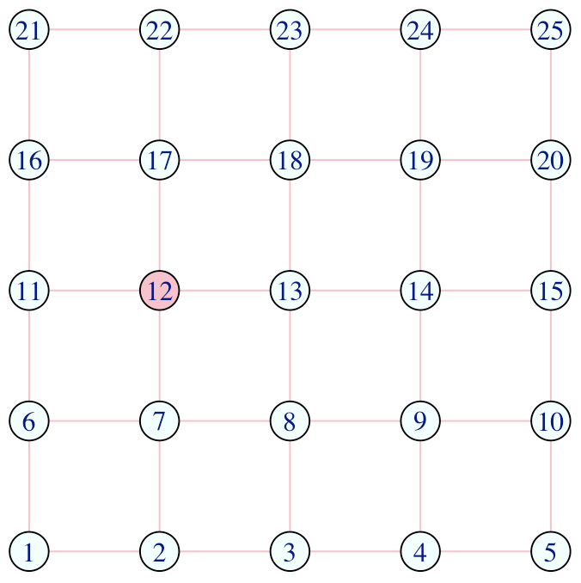
Questions from the practical
V(network)[12]$color <- "orange"
V(network)[color == "orange"]$color <- "pink”
2. What do the above lines do?
While the first line selects a specific vertex (#12), the second line selects all vertices that have
color == "orange”
— this will be useful when we use vertex properties to represent states (e.g. S, I, R).
Notes:
Click to show plot
Key thing here is that we can use the V(network)[ … ] notation to select all vertices with some property in the `…`.

Slide 12
Questions from the practical
V(network)[.nei(color == "pink")]$color <- "pink”
plot(network)
3. What is the code above doing? What happens if you re-run the two lines above several times?
Notes:
Click to show plot

Slide 13
Questions from the practical
V(network)[.nei(color == "pink")]$color <- "pink”
plot(network)
3. What is the code above doing? What happens if you re-run the two lines above several times?
What relevance might selecting
neighbours of vertices have for
modelling infectious disease
transmission?
Notes:
To discuss: neighbours of infected nodes are at risk of infection.

Slide 14
Coffee break

Slide 15
Part 2:
A network SIR model for mpox transmission

Slide 16
In this hour…
Describe the “Reed-Frost” model
Describe how this model can be implemented on a network
Practical: Model mpox transmission on a sexual network

Slide 17
The Reed-Frost model
Population, N, of hosts
“Time” in steps (generations): t, t+1, …
Hosts either Susceptible, Infectious, or Removed
When I and S interact at t, probability p that the S becomes I at t+1 (i.e., stochastic infection)
All I hosts at a time step t become R at t+1
This can be implemented on a network…
Notes:
5 minutes
These are the fundamentals of Reed-Frost. This model doesn’t *require* a network model. However, it can be implemented as a network model.

Slide 18
Population, N, of hosts
“Time” in steps: t, t+1, …
Hosts either Susceptible, Infectious, or Removed
Each time step, all hosts interact
When I and S interact at t, probability p that the S becomes I at t+1
All I hosts at a time step t become R at t+1
N = 11
Notes:
5 minutes on this step-through

Slide 19
Population, N, of hosts
“Time” in steps: t, t+1, …
Hosts either Susceptible, Infectious, or Removed
Each time step, all hosts interact
When I and S interact at t, probability p that the S becomes I at t+1
All I hosts at a time step t become R at t+1
at some t,
S = 8
I = 1
R = 2
S
R
S
S
S
I
S
S
R
S
S

Slide 20
Population, N, of hosts
“Time” in steps: t, t+1, …
Hosts either Susceptible, Infectious, or Removed
Each time step, all neighbours interact
When I and S interact at t, probability p that the S becomes I at t+1
All I hosts at a time step t become R at t+1
at some t,
S = 8
I = 1
R = 2

Slide 21
Population, N, of hosts
“Time” in steps: t, t+1, …
Hosts either Susceptible, Infectious, or Removed
Each time step, all neighbours interact
When I and S interact at t, probability p that the S becomes I at t+1
All I hosts at a time step t become R at t+1
at some t,
S = 8
I = 1
R = 2

Slide 22
Population, N, of hosts
“Time” in steps: t, t+1, …
Hosts either Susceptible, Infectious, or Removed
Each time step, all neighbours interact
When I and S interact at t, probability p that the S becomes I at t+1
All I hosts at a time step t become R at t+1
at t + 1,
S = 5
I = 3
R = 3

Slide 23
Mpox
Monkeypox virus, which causes mpox, spreads by close contact
Flu-like symptoms give way to rash especially on hands and feet, anogenital region, throat, trunk
Clade I and Clade II differ in transmission characteristics and severity
The median incubation period for the 2022 Clade IIb outbreak was 9 days (IQR: 5–13 days; McFarland et al., Euro Surveill.¹)
Transmission of Clade II has often been primarily among sexual networks of GBMSM due to close contact
¹ https://doi.org/10.2807/1560-7917.ES.2023.28.27.2200806

Slide 24
Practical 2
A network model of mpox transmission

Slide 25
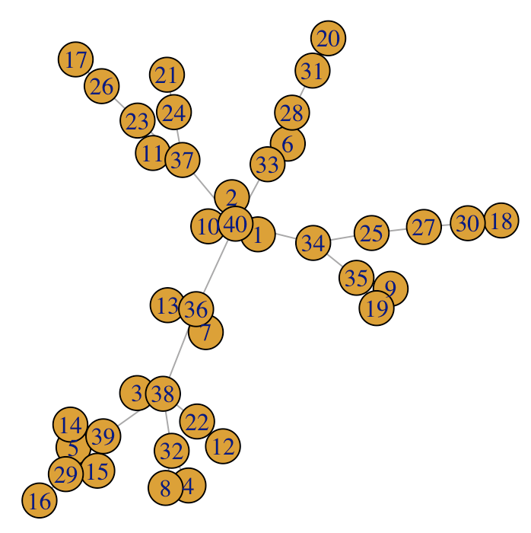
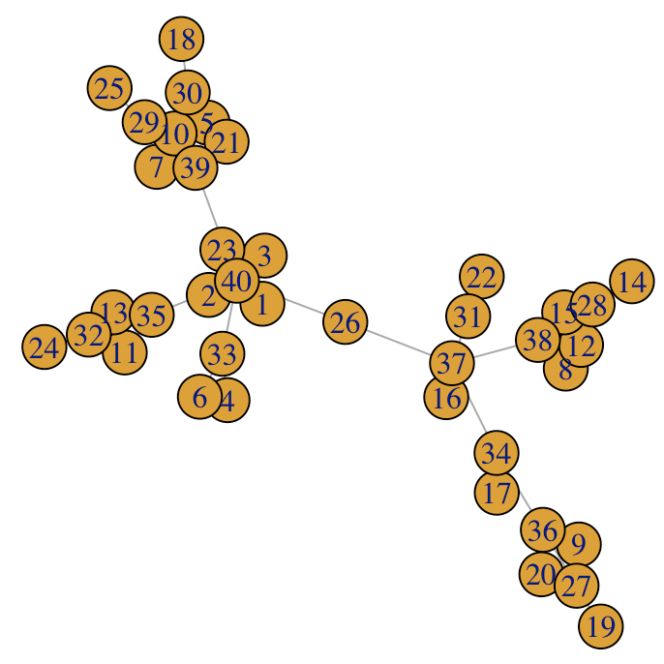
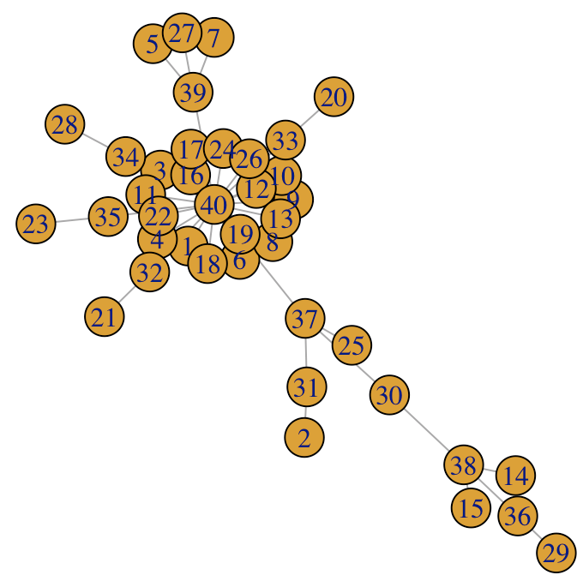
Questions from the practical
1. Try varying the d parameter for create_network() between 0 and 2. What changes about the network?
d = 0
d = 1
d = 2
Notes:
To discuss: As d increases, the distribution of connectedness among vertices becomes more extreme; for d = 2, just a few vertices have a large number of connections and most vertices have only one connection.

Slide 26
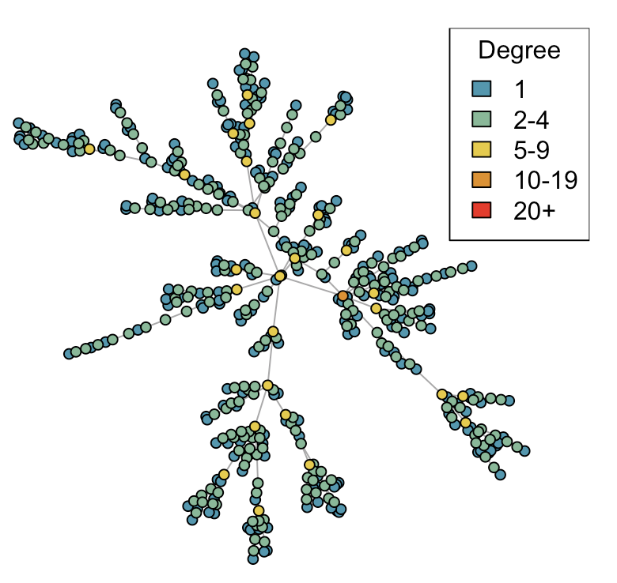
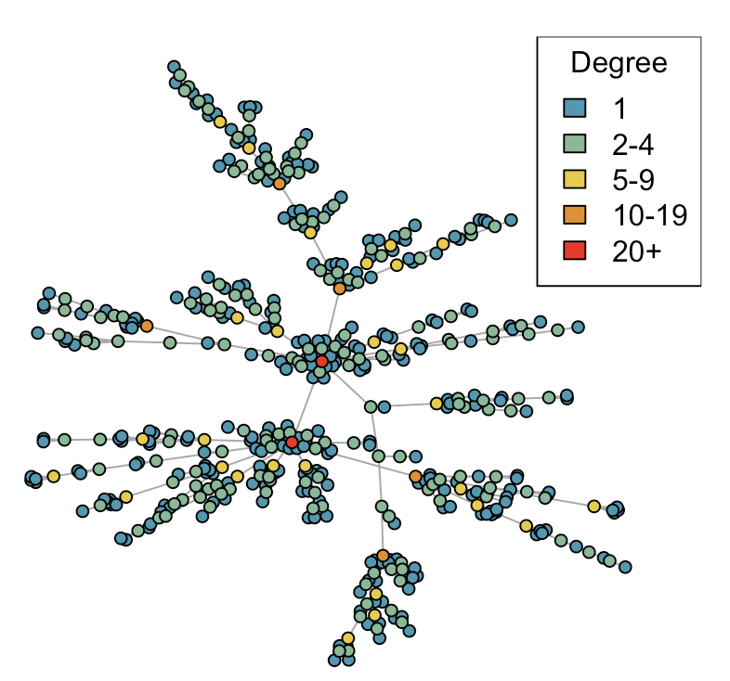
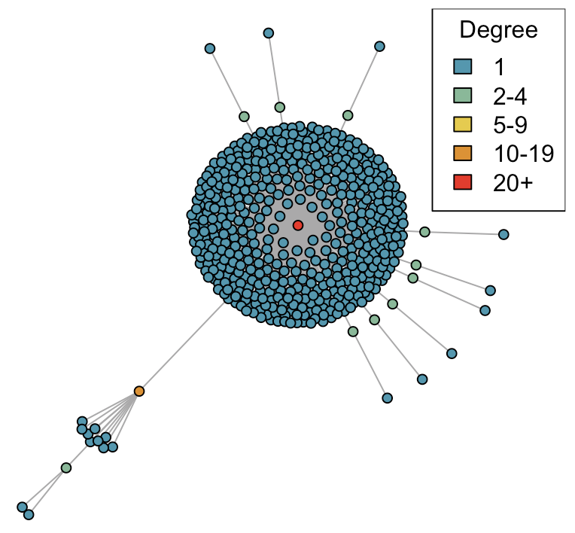
Questions from the practical
2. Plot using plot_degree() for 500 nodes…
d = 0
d = 1
d = 2
Notes:
Same point as previous slide, may be clearer to see with more nodes – e.g. you can see more nodes on the middle plot with degree 20+, and then the right plot is obviously very extreme.
Again, as d increases, the distribution of connectedness among vertices becomes more extreme; for d = 2, just a few vertices have a large number of connections and most vertices have only one connection.

Slide 27
Questions from the practical
net <- create_network(500, 1)
net <- network_step(net, p = 0.8)
plot_state(net)
3. After creating your network with the first line above, run the last two lines repeatedly to watch the network model evolve.

Slide 28
Questions from the practical
net <- create_network(500, 1)
net <- network_step(net, p = 0.8)
plot_state(net)
3. After creating your network with the first line above, run the last two lines repeatedly to watch the network model evolve.
Notes:
Can discuss: importance of the central nodes for spreading infection

Slide 29
Questions from the practical
4. How does the preferential attachment parameter (create_network parameter d) affect the final outbreak size?
Summary of 100 runs
d | Final outbreak size Median (90% CI)
0.0 | 207 (84–308)
1.0 | 261 (131–335)
2.0 | 397 (379–415)
(Tip: quicker to run if you remove the plotting and pausing statements from run_model.)
Notes:
Point to discuss: as the assortativity parameter increases, the final outbreak size tends to be larger. Note that the average degree of the network is always the same across different values of d, since one edge is added for every node that is added. So the “average” amount of mixing is not increasing.

Slide 30
Bonus material
Further “bonus” examples in the practical explore introducing vaccination to the model, and explores the impact of targeting vaccination to the least-connected or to the most-connected individuals.
Notes:
Point to discuss: as the assortativity parameter increases, the final outbreak size tends to be larger. Note that the average degree of the network is always the same across different values of d, since one edge is added for every node that is added. So the “average” amount of mixing is not increasing.

Slide 31
Review
Introduced network modelling concepts
Discussed and implemented Reed-Frost SIR as a network model
Demonstrated strengths of network approach
Closing questions?
For early discussion of Reed-Frost Model, see e.g. An examination of the Reed-Frost theory of epidemics. Abbey H. Hum Biol. 1952 Sep; 24(3):201-33.

