Slide 1
ARM Memory Management Unit
By,
CM Naveen Kumar Reddy.

Slide 2

Overview
Memory Hierarchy
Memory Management Unit
page
Cache
2

Slide 3
Memory Hierarchy
Smaller,
L0:
faster,
registers
and
costlier
L1:
on­chip L1
(per byte)
cache (SRAM)
storage
devices
L2:
off­chip L2
cache (SRAM)
L3:
main memory
Larger,
(DRAM)
slower,
and
cheaper
L4:
local secondary storage
(per byte)
(local disks)
storage
devices
L5:
remote secondary storage
(tapes, distributed file systems, Web servers)
8

Slide 4
Memory Hierarchy (cont..)
DRAM/SRAM is “volatile”: contents lost if power lost.
The primary level is main memory. It includes volatile components like SRAM
and DRAM, and nonvolatile components like flash memory.
The purpose of main memory is to hold programs while they are running
on a system.
Both retain data till the time they are supplied with power.
SRAMs are used in Caches because of higher speed.
DRAMs are used for main memory in a PC because of higher densities.
Disks are “non-volatile”: contents survive power outages.
The next level is secondary storage—large, slow, relatively inexpensive
mass storage devices such as disk drives or removable memory.
9

Slide 5
Memory Management Unit (MMU)
Virtuval Address
CPU
MMU
MEMORY
Physical address
The Memory Management MMU it translates virtual addresses
into physical addresses, and it controls memory access permissions.
Translation Look-aside Buffer (TLB) as part of the MMU hardware.
10

Slide 6
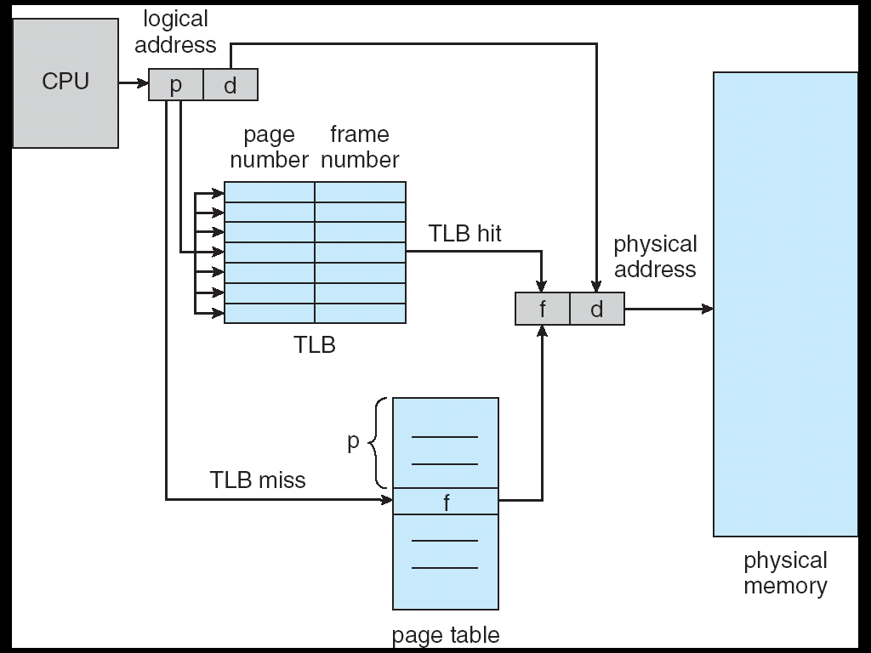
Translation Lookaside Buffer
TLB is consulted by the MMU when the CPU accesses a virtual address
2

Slide 7
Translation Lookaside Buffer
Translation Look-aside Buffer :In order to speed up the translation of virtual to physical addresses.
When an address must be translated, if it is found in the TLB then it can be very quickly mapped to the correct physical address.
On a TLB miss, then the address translation must be done using the full set of page tables stored in the system’s main memory.
If the virtual address is in the TLB,the MMU can look up the physical resource (RAM or hardware).
If the virtual address is not in the TLB,the MMU will generate a page fault exception and interrupt the CPU.
If the address is in the TLB, but the permissions are insufficient,the MMU will generate a page fault.
2

Slide 8
Page
Paging: divide Memory into fixed sized Pages for both Virtual and
physical memory
•Another terminology
–A Virtual Page: page
– A physical page: frame
The ARM MMU supports four page sizes. The largest sizes are
called sections and the smaller sizes are called pages:
Supersections: 16 MB memory blocks (24-bit offsets)
Sections: 1 MB memory blocks (20-bit offsets)
Large pages: 64 KB pages (16-bit offsets)
Small pages: 4 KB pages (12-bit offsets)
3

Slide 9
Paging and Translation addresses
Paging:-
Paging solves the external fragmention problem by using fixed sized
units in both physical and virtual memory.
Translation addresses:-
–Virtual address has two parts: Virtual page number and offset
–Virtual page number (VPN) is an index into a page table
–Page table determines page frame number (PFN)
–Physical address is PFN: :offset
5

Slide 10
Page fault
page table entry(PTE) tells the memory management unit whether a specific
page is mapped into physical memory ("valid") or is not ("invalid"). An attempt
to access an invalid page will cause the MMU to generate a page fault.
The virtual address is not mapped for the process requesting it.
The processes has insufficient permissions for the address.
The virtual address is valid, but swapped out.
5

Slide 11
Page Faults
■
Example: An instruction references a word contained in VP 3, a miss that triggers
a page fault exception
Physical page
Physical memory
Virtual address
(DRAM)
number or
Valid
disk address
VP 1
PP 0
PTE 0
0
null
VP 2
VP 7
1
VP 4
PP 3
1
0
1
0
null
Virtual memory
0
(disk)
PTE 7
1
VP 1
Memory resident
VP 2
page table
VP 3
(DRAM)
VP 4
VP 6
VP 7
4

Slide 12
Demand paging
The operating system copies a disk page into physical memory only if an attempt
is made to access it and that page is not already in memory (if a page fault occurs).
when a process starts executing and tries to load its first instruction, the
operating system will get a page fault because the required page has not been
loaded and mapped onto a page frame.
Bring a page into memory only when it is needed"
- Less I/O needed"
- Less memory needed "
- Faster response"
- More users"
Page is needed ⇒ reference to it"
- invalid reference ⇒ abort"
- not-in-memory ⇒ bring to memory
7

Slide 13
Caches
●
Caches
- Non-cached system
- cached system
- write buffer
11

Slide 14
Why Caches?
A cache holds this information to decrease the time required
to access both instructions and data.
- To increase system performance.
- To hide the slower main memory.
- To handle large amounts of code and data at a faster and
more efficient way.
13

Slide 15
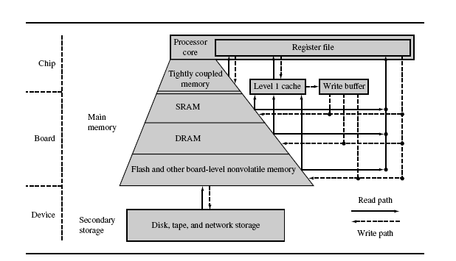
Caches
Cache is the array of high speed, very small memory
sitting between processor(ARM) core and the main
memory
12

Slide 16
Non-Cached system
●
Main memory is accessed directly by the processor core
using the data types supported by the processor core.
Process core
Word, byte access
Main memory
Slow
NonCached system
14

Slide 17
Cached system
●
Small memory placed between processor and main memory
to store recently accessed transactions and make memory
access faster.
Word, byte
Block
access
transfer
Fast
cache
Slow
Main memory
Process core
Word, byte access
Slow
Cached system
15

Slide 18
Write Buffer
●
The write buffer acts as a temporary buffer that frees available space in
the cache memory.
●
The cache transfers a cache line to the write buffer at high speed and
then the write buffer drains it to main memory at slow speed.
Word, byte
Block
access
transfer
Fast
cache
Slow
Write
Main memory
Fast
Process core
buffer
Slow
Word, byte access
Slow
Cached system
17

Slide 19
Cache Architecture
- ARM uses two bus architectures in its cached cores, the Von-Neumann
and the Harvard.
- In processor cores using the Von Neumann architecture,there is a
single cache used for instruction and data.
- This type of cache is known as a unified cache. A unified cache memory
contains both instruction and data values.
- The Harvard architecture has separate instruction and data buses to
improve overall system performance, but supporting the two buses
requires two caches
- instruction cache (I-cache) and data cache (D-cache). This type of
cache is known as a split cache.
18

Slide 20
Cache Elements
Cache memory
Cache memory holds the data frequently requested by CPU
Cache controller
The cache controller is hardware that copies code or data from
main memory to cache memory automatically.
20

Slide 21
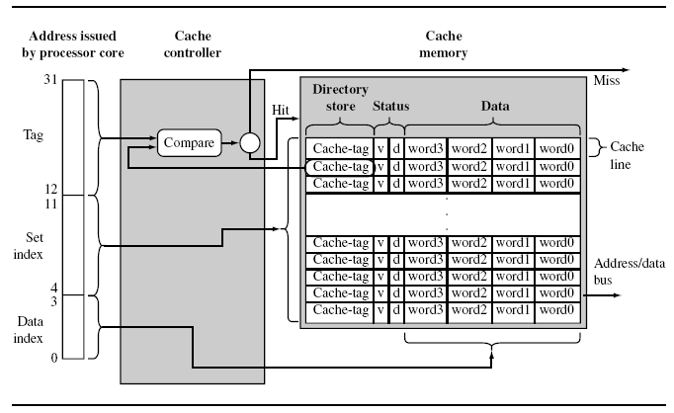
Cache Memory
The cache memory is a dedicated memory array
accessed in units called cache lines.
Cache memory has three main parts Directory store,
Status information, and Data section.
All three parts of the cache memory are present for each
cache line.
21

Slide 22
About Cache Line
Cache tag is a directory store which holds the address,
identifying where the cache line was copied from main
memory. In this way it keeps track of information from main
memory being stored in cache line of cache memory.
Data section holds the data read from main memory.
Status bits maintain state information. Two common status
bits are the valid bit and dirty bit.
A valid bit marks a cache line as active, meaning it
contains live data originally taken from main memory and is
currently available to the processor core on demand.
A dirty bit defines whether or not a cache line contains
data that is different from the value it represents in main
memory.
22

Slide 23
Cache operation
CPU requests contents of memory location
Check cache for this data
If present, get from cache (fast)
If not present, read required block from main memory to cache
Then deliver from cache to CPU
Cache includes tags to identify which block of main memory is in each cache slot
19

Slide 24
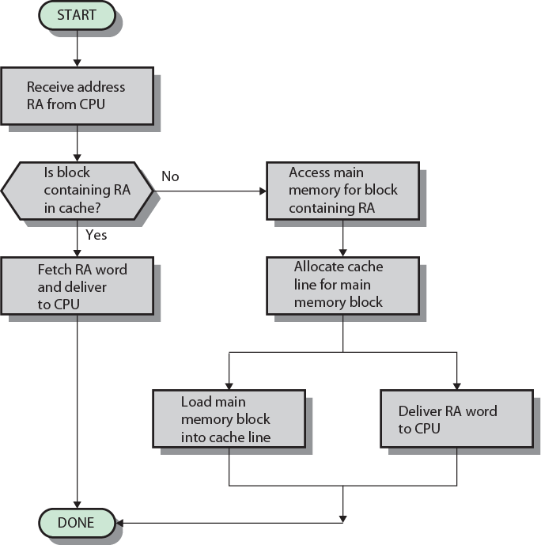
Cache Read Operation - Flowchart
19

Slide 25
Cache hit and cache miss
The cache controller divides the address of the request from
processor core into three fields i.e . the tag field, the set index field,
and the data index field.
The controller then checks the valid bit to determine if the cache line
is active, and compares the cache-tag to the tag field of the requested
address.
If both the status comparison succeed, it is a cache hit. If either the
status comparison fails, it is a cache miss.
23

Slide 26
The instruction and data cache
IDC operation:-
The MMU must never be disabled when the cache is on.
However, you can enable the two devices simultaneously with a
single write to the “Control Register”.
24

Slide 27
Control Register
31
14 13 12 11 10 9 8 7 6 5 4 3 2 1 0
V
UNP
R
S
B
L
D
P
W
C
A
M
UNP/SBZ
/SBZ
The C bit determines if data being read can be placed in the IDC and used for
subsequent read operations. Typically, main memory is marked as cachable to
improve system performance,and I/O space is marked as noncachable to stop the
data being stored in the ARM720T cache.
Cachable reads (C=1)
A line fetch of eight words is performed when a cache miss occurs in a cachable
area of memory, and it is randomly placed in a cache bank.
Note:- Memory aborts are not supported on cache line fetches and are ignored.
Uncachable reads (C=0)
An external memory access is performed and the cache is not written.
25

Slide 28
Control Register
31
14 13 12 11 10 9 8 7 6 5 4 3 2 1 0
31
14 13 12 11 10 9 8 7 6 5 4 3 2 1 0
UNP/SBZ
V
UNP
R
S
B
L
D
P
W
C
A
M
V
UNP
RSBL
DPWCAM
UNP/SBZ
/SBZ
/SBZ
M Bit :-MMU enable/disable: 0 = MMU disabled 1 = MMU enabled.
A Bit :- Alignment fault enable/disable:
0 = Address Alignment Fault Checking disabled
1 = Address Alignment Fault Checking enabled.
C Bit :-Cache enable/disable:
0 = Instruction and/or Data Cache (IDC) disabled
1 = Instruction and/or Data Cache (IDC) enabled.
W Bit :-Write buffer enable/disable:
0 = Write Buffer disabled
1 = Write Buffer enabled.
P Bit :- When read, returns 1. When written, is ignored.
28

Slide 29
Control Register
31
14 13 12 11 10 9 8 7 6 5 4 3 2 1 0
31
14 13 12 11 10 9 8 7 6 5 4 3 2 1 0
UNP/SBZ
V
UNP
R
S
B
L
D
P
W
C
A
M
V
UNP
RSBL
DPWCAM
UNP/SBZ
/SBZ
/SBZ
D Bit :- When read, returns 1. When written, is ignored.
L Bit :- When read, returns 1. When written, is ignored.
B Bit :- Big-endian/little-endian:
0 = Little-endian operation
1 = Big-endian operation.
S Bit :- System protection: Modifies the MMU protection system.
R Bit :- ROM protection: Modifies the MMU protection system.
UNP/SBZ Bits :- When read, this returns an Unpredictable value. When written, it
Should Be Zero, or a value read from these bits on the same processor.
V Bit :-Location of exception vectors:
0 = low addresses 1 = high addresses.
The value of the V bit reflects the state of the VINITHI external input, sampled while HRESETn is LOW.
28

Slide 30
Any Questions ?

