Slide 1
Linux device driver
By,
CM Naveen Kumar Reddy.

Slide 2
content
Data Types in the Kernel
USB Drivers
The Linux Device Model
DMA
Block Drivers

Slide 3
Data Types in the Kernel
Most of the programmers are accustomed to freely using standard types like int and long , writing device drivers requires some care to avoid typing conflicts and bugs
64-bit platforms have different data type representations
arch Size: char short int long ptr long-long u8 u16 u32 u64
i386 1 2 4 4 4 8 1 2 4 8
alpha 1 2 4 8 8 8 1 2 4 8
armv4l 1 2 4 4 4 8 1 2 4 8
ia64 1 2 4 8 8 8 1 2 4 8
m68k 1 2 4 4 4 8 1 2 4 8
mips 1 2 4 4 4 8 1 2 4 8
ppc 1 2 4 4 4 8 1 2 4 8
sparc 1 2 4 4 4 8 1 2 4 8
sparc64 1 2 4 4 4 8 1 2 4 8
x86_64 1 2 4 8 8 8 1 2 4 8

Slide 4
Assigning an Explicit Size to Data Items
See <asm/types.h>
  u8; /* unsigned byte (8-bits) */
  u16; /* unsigned word (16-bits) */
  u32; /* unsigned 32-bit value */
  u64; /* unsigned 64-bit value */
If a user-space program needs to use these types, use __ prefix (e.g., __u8)

Slide 5
Interface-Specific Types
Some of the commonly used data types in the kernel have their own typedef statements, thus preventing any portability problems.
For example,a process identifier (pid) is usually pid_t instead of int .
Using pid_t masks any possible difference in the actual data typing.

Slide 6
Time Intervals
Whenever you calculate time intervals using jiffies, scale your times using HZ (the number of timer interrupts per second)
The number of jiffies corresponding to msec milliseconds is always msec*HZ/1000 .

Slide 7
Byte Order
Big endian is the byte order where the most significant byte, is stored first (at the lowest storage address).
Little endian is the byte order where the least significant byte, is stored first.
The Linux kernel can be either big endian or little endian depending upon which architecture it is compiled for.
Big Endian | Little Endian | Either
AVR32 FR-V H8300 PA-RISC S390 Motorola 680x0 PowerPC SPARC | Alpha CRIS Blackfin Intel 64 IA-32 (x86) MN10300 | ARM SuperH (sh) M32R MIPS Xtensa

Slide 8
Conversion Macros
There are many macros for converting between the byte order used by the current processor and either the big or little endian byte order. In addition, for each type of conversion, there are different macros for 16-bit, 32-bit and 64-bit values.
#include <linux/kernel.h>
__u16 leXX_to_cpu(const __leXX); // XX is 16 or 32 or 64 bit
__le16 cpu_to_leXX(const __uXX);
__u16 beXX_to_cpu(const __beXX);
__be16 cpu_to_beXX(const __uXX);
These macros to convert to or from the target byte order, even if you know it is not necessary for the processor you are using.

Slide 9
USB Drivers
Linux kernel supports two main types of USB drivers:-
1.Drivers on a host system:-
The USB drivers for a host system control the USB devices that are plugged into it, from the host’s point of view (PC).
2.Drivers on a device:-
The USB drivers in a device, control how that single device looks to the host computer as a USB device.
Structure of USB device driver is similar to character device driver.
usb_register , usb_deregister
Basic command:
lsusb –v command you will get the information about USB device.
D= Devices, C= configuration, I= Interface. E=endpoint.

Slide 10
We can create Device Table to detect devices automatically. We have passed device ID so that once we connect the device driver, it will automatically get started.
For USB device we have to pass first parameter as usb in device table. Then we have to pass name of device ID table.
Plug the device probe function runs and on removing the device disconnect
function runs.
Insmod ,rmmod this commands used to inserting and removing the module into the kernel.

Slide 11
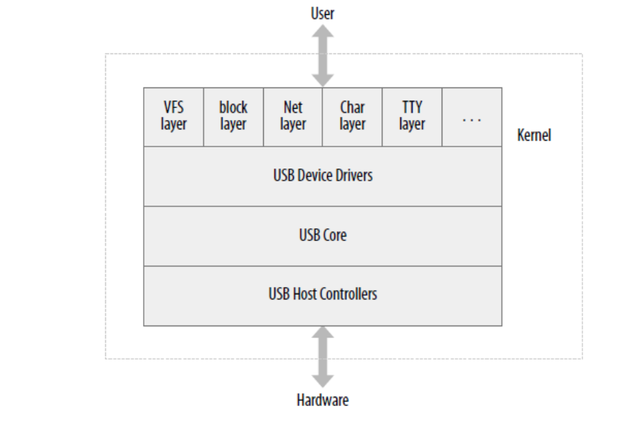
Structure of USB Device Driver
USB core gets utilized to provide hardware access to USB driver.

Slide 12
Four parts of USB end points:
USB devices gets connected to USB driver using USB Interface.
USB endpoints are useful to transfer data inside [IN endpoint] or outside [out endpoint]. The data is transferred in one direction only with the help of data pipe.
Control: It is used to configure device, to get information about device and to check status of device by passing commands. (Endpoint 0 , bidirectional).
Interrupt: This Endpoint is used to transfer fewer amount of data after some gap of
duration. Devices like mouse, keyboard gets Controlled by this endpoint by passing
command data.
Bulk: This Endpoint is utilized for transfer of large amount of data.
This is used for printer, network card like devices.
Isochronous: This endpoint is useful for transferring large amount of audio and video
data. Here important thing is continuous flow of data;

Slide 13
USB Urbs and how it's work?
USB Urbs : Kernel talks with USB devices using USB request block.
USB urbs are useful for data exchange with the endpoint.
URB works:-
- USB device driver creates URB.
- Endpoint gets assigned to USB device.
- URB uses device driver to register it in USB core.
- Then USB core register this in USB host controller driver.
- USB host controller processes and transfers USB data.
- Once URB controller gets completed;Acknowledges to USB USB host device driver.

Slide 14
Important code snippets of USB device driver:
#include <linux/pci.h> | This header supports for all USB related information and functions
struct usb_driver | This structure indicates USB devices.
struct pci_driver; | This structure indicates PCI device driver
struct usb_device_id; | Gives Information of USB devices supported by driver
Int usb_register(struct usb_driver *d) | Register USB device to USB core.
struct usb_class_driver; | For usb devices which perform communication using major number
struct urb; | Structure used to send USB data
Struct urb *usb_alloc_urb(int iso_packets, int mem_flags); Void usb_free_urb(struct urb *urb); | To create or remove USB or URB structure.
int usb_submit_urb(struct urb *urb, int mem_flags); | To start or stop USB data transmission.

Slide 15
Important code snippets of USB device driver (cont..)
Int usb_kill_urb(struct urb *urb); | stop USB data transmission.
usb_buffer_alloc() | Create buffer to perform direct memory transfer.
usb_buffer_free() | Free the buffer once wok will be done.
usb_gadget_register_driver() | Register gadget device.

Slide 16
Gadget Driver:
When embedded system gets connected to computer at that time Linux runs on both
computer and on device.
In such cases Computer works as Host and Embedded Device works on Gadget Driver.
Gadget Devices: [Storage,Network] gives answer to request sent by Host.
drivers/usb/gadget/zero.c at this location we can find basic code for gadget driver.

Slide 17
The Linux Device Model
Used to track all drivers and models
Enables the driver core to match driver with new device
The components that play a major role in building and maintaining the model are:
  Bus
  Device
  Device Drivers
  Class

Slide 18
Bus
A channel between processor and one or more devices
  Can be virtual or physical
All devices are connected to a bus
A bus can be plugged into another bus
  E.g., USB controller is usually a PCI device
Device model represents actual connections between buses and devices they control

Slide 19
Device Driver
Used to represent kernel drivers that can handle specific devices
When a device is registered that can be handled by a particular driver, the probe function instantiates the driver for that particular device

Slide 20
Memory Mapping
the mmap system call, which allows the mapping of device memory directly into a user process’s address space.
get_user_pages:-
- it is used to map user-space memory into the kernel (with get_user_pages) .
Address Types:-
User virtual addresses:- These are the regular addresses seen by user-space programs.
Physical addresses:- The addresses used between the processor and the system’s memory.
Bus addresses:- The addresses used between peripheral buses and memory.
Kernel logical addresses:- These make up the normal address space of the kernel. These addresses map some portion (perhaps all) of main memory and are often treated as if they were physical addresses.

Slide 21
DMA
With DMA, the driver can avoid the time Consuming process of transferring data between memory and device registers.
A DMA device driver has a more complex structure because it must deal with such factors as
- Programming a device to store into a page buffer in physical memory
- Scheduling operations, such as blocking a user process and waking it up when the operation is complete
- Asynchronous interrupts from the device
- The possibility that requests from other processes can occur while the device is operating
-The possibility that a device interrupt can occur while the driver is handling a request

Slide 22
Data transfer can be triggered in two ways:
Either the software asks for data or the hardware asynchronously pushes data to the
System.
In first case:-
1.When a process calls read,the driver method allocates a DMA buffer and instructs
the hardware to transfer its data into that buffer. The process is put to sleep.
2. The hardware writes data to the DMA buffer and raises an interrupt when it's done.
3. The interrupt handler gets the input data, acknowledges the interrupt, and awakens
the process, which is now able to read data.
second case:-
when DMA is used asynchronously. Driver should maintain a buffer so that a subsequent read call will return all the accumulated data to user space.
1. The hardware raises an interrupt to announce that new data has arrived.
2.The interrupt handler allocates a buffer and tells the hardware where to transfer its
data.
3. The peripheral device writes the data to the buffer and raises another interrupt when it's done.
4. The handler dispatches the new data, wakes any relevant process, and takes care of housekeeping.

Slide 23
Block drivers
Registration
Block device operations
Request processing
Other details

Slide 24
BLOCK DRIVERS
Provides access to devices that transfer randomly accessible data in blocks, or fixed size chunks of data (e.g., 4KB)
Note that underlying HW uses sectors (e.g., 512B)
Bridge core memory and secondary storage
Performance is essential Or the system cannot perform well.
sbd (Simple Block Device)
A ramdisk

Slide 25
BLOCK DRIVER REGISTRATION
To register a block device, call
int register_blkdev(unsigned int major,
const char *name);
major: major device number
If 0, kernel will allocate and return a new major number
name: as displayed in /proc/devices
To unregister, call
int unregister_blkdev(unsigned int major,
const char *name);

Slide 26
BLOCK DEVICE OPERATIONS
struct block_device_operations is similar to file_operations
Important fields
/* may need to lock the door for removal media; unlock in the release method; may need to spin the disk up or down */
int (*open) (struct block_device *dev,fmode_t mode);
int (*release) (struct gendisk *gd,fmode_t mode);

