Slide 1


A
presentation on
Educazione- An online education system
Pranav Waikar
Rohan Patel
Pratik Deshmukh
Prof. P. S. Dhotre
Prof M.A. Arkadi
SITS, Computer Engg
Department of Computer Engineering
Sinhgad Institute of Technology and Science, Narhe, Pune
Notes:
1

Slide 2
Agenda
Introduction
Motivation
Problem statement and objectives
Proposed Architecture /Methodology
Conclusion
References.
28/08/17
SITS, BE Computer, Project Presentation 2017
2

Slide 3
Introduction
With the advent of internet, better means of data-sharing and relaying of information, it can be effectively used in the sector of education.
Our project aims to do the same.
It enables teachers and students to better manage and utilize learning tools. It eliminates the need of sitting in a classroom to gain education
28/08/17
SITS, BE Computer, Project Presentation 2017
3

Slide 4
Motivation
We believe that education should be available to everyone who want to learn.
In this digital realm, Educazione , a platform where teacher can teach and student can learn.
Educazione provides platform for all kind of people to learn anything at their convienient time,location with ease and have fun.
28/08/17
SITS, BE Computer, Project Presentation 2017
4

Slide 5
Domain
Web development
Database
Information system
28/08/17
SITS, BE Computer, Project Presentation 2017
5

Slide 6
Hardware and Software requirements
Hardware – Server
Software –
HTML with CSS
PHP
Javascript
Accessibility: Any device with internet browser.
28/08/17
SITS, BE Computer, Project Presentation 2017
6

Slide 7
Requirements
Functional requirements-
User authentication and enrolment
Course enrolment
Content access
Profile creation and updation
Non-functional requirements-
Security
Accessibility
Reliability
28/08/17
SITS, BE Computer, Project Presentation 2017
7

Slide 8
Problem Statement and Objectives
How to help teachers teach and students learn via online system?
Objectives
To help teachers teach courses easily and manage students on online platform.
To help students choose ,enroll ,learn courses of choice.
Notes:
8

Slide 9
Proposed Architecture
User will sign-up
Choose and enrol for any course/(s)
User will complete the designed modules.
Upon passing user will get a certificate and Rank points.
User will take examination.
The profile of user will show the earned Rank points.
28/08/17
SITS, BE Computer, Project Presentation 2017
9

Slide 10
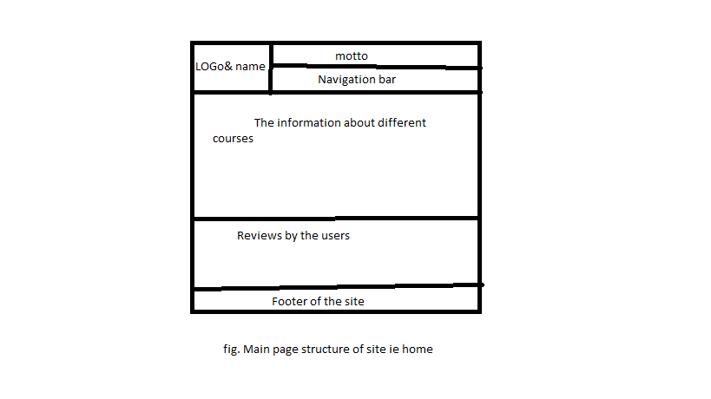
UI Designs
28/08/17
SITS, BE Computer, Project Presentation 2017
10

Slide 11
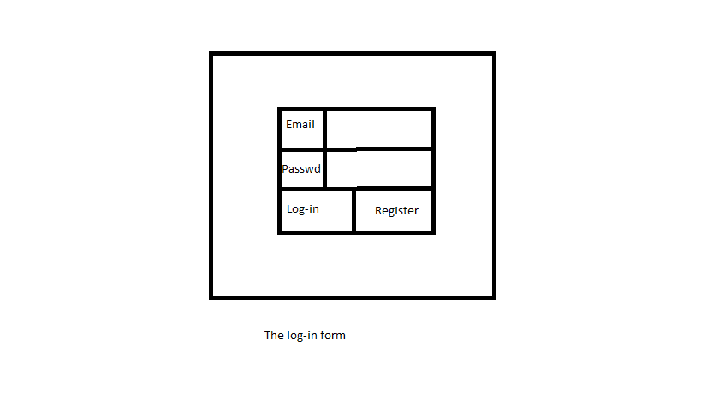
UI Designs
28/08/17
SITS, BE Computer, Project Presentation 2017
11

Slide 12
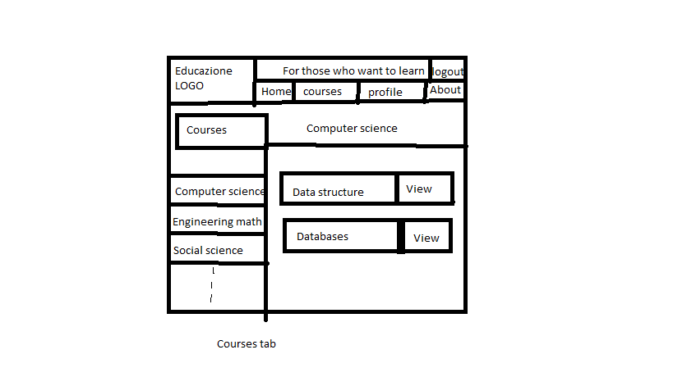
UI Designs
28/08/17
SITS, BE Computer, Project Presentation 2017
12

Slide 13
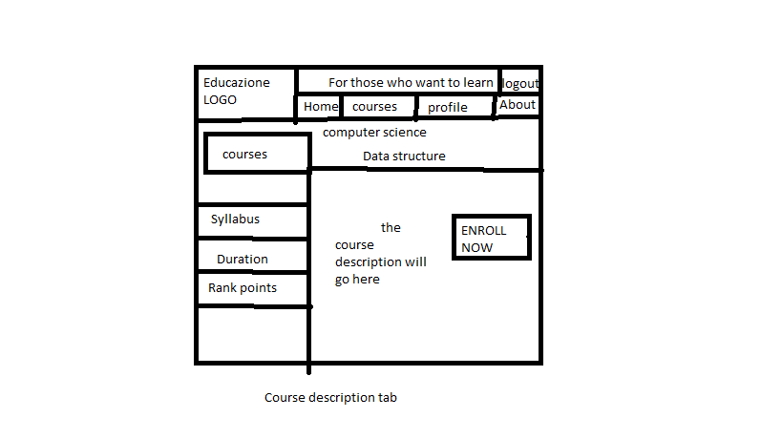
UI Designs
28/08/17
SITS, BE Computer, Project Presentation 2017
13

Slide 14
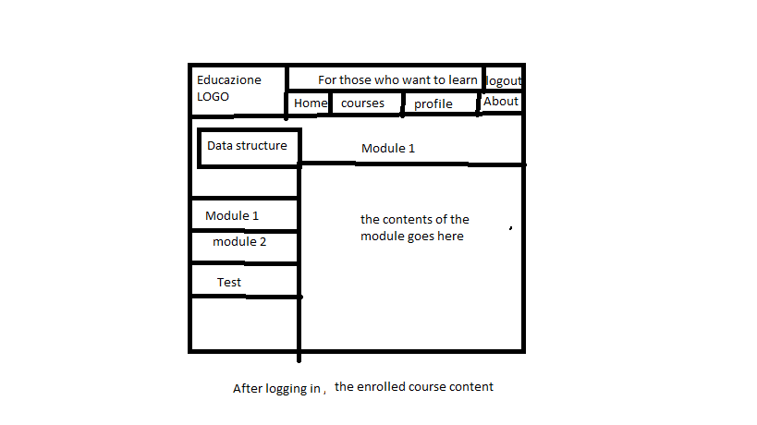
UI Designs
28/08/17
SITS, BE Computer, Project Presentation 2017
14

Slide 15
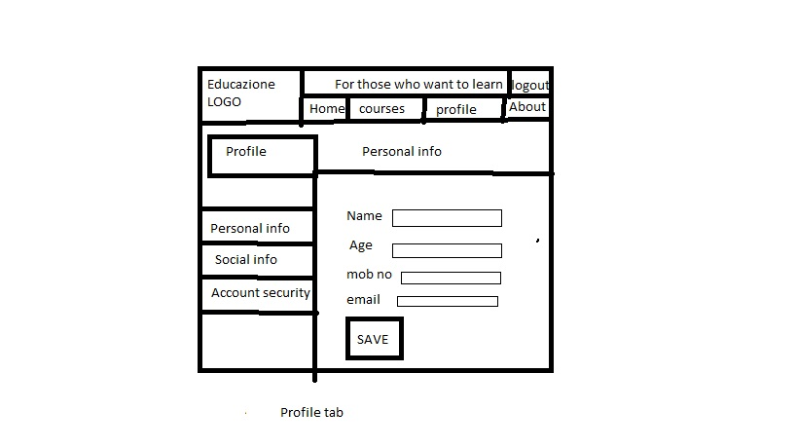
UI Designs
28/08/17
SITS, BE Computer, Project Presentation 2017
15

Slide 16
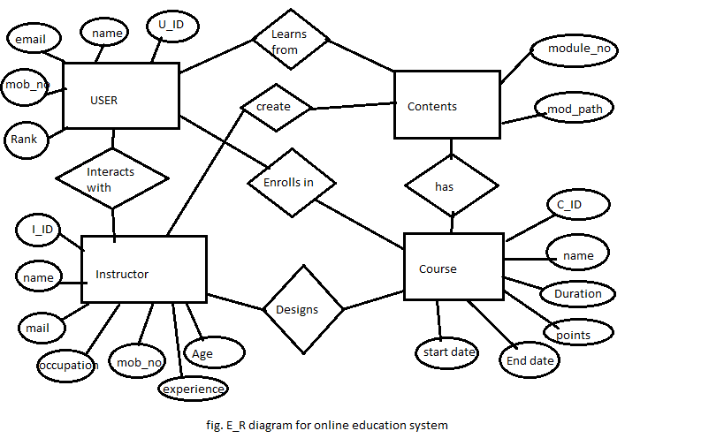
ER Model
28/08/17
SITS, BE Computer, Project Presentation 2017
16

Slide 17
Application
The system can be used as personal or professional online learning and teaching platform.
28/08/17
SITS, BE Computer, Project Presentation 2017
17

Slide 18
Conclusion
In this way we can use the internet to facilitate course material, help teachers and students to connect with each other easily using this online platform.
28/08/17
SITS, BE Computer, Project Presentation 2017
18

Slide 19
Reference
IEEE A Cost-Effective Computer Supported Collaborative Learning for Online Education
e-Learning On the uptake of modern technologies for online education
Effective Online Education System for First Year Students at the University
28/08/17
SITS, BE Computer, Project Presentation 2017
19

Slide 20
Thank you!
28/08/17
SITS, BE Computer, Project Presentation 2017
20

