Slide 1
NETCONF / YANG
Overview
a

Slide 2
Session Objectives
At the end of this presentation, you will be able to:
Identify the major problems/issues facing network administrators
Describe the NETCONF/YANG protocol and modeling language
Describe how the features of NETCONF/YANG address major problems in network administration
Describe a use case for NETCONF/YANG

Slide 3
Outline
NETCONF/YANG
Definition
Distinction between Protocol and Modeling language
NETCONF Protocol Layers
NETCONF Operations
Base
Capabilities
Solutions for Network Managers
Problems for Network Managers
Summary

Slide 4
Network Management Problems Needing Solutions
I must configure everything manually from the CLI. I need a programmatic interface!
All devices have a different syntax or operations!
I can’t tell the difference between configuration and operational data!
I need to be able to configure services on the network and not just individual devices!
If I hit an error while configuring one of several devices, I must go back and reconfigure all devices back to the way they were!
I cannot test a configuration before committing it!
You will learn to overcome these problems in this training using NETCONF/YANG

Slide 5

NETCONF and YANG
NETCONF
Protocol to install, manipulate, and delete the configuration of network devices
RPC-based with XML-based data encoding
YANG
Data modeling language to model configuration, state data and operations
Mappings to NETCONF and RESTCONF (draft)

Slide 6
A Data Model and a Protocol
YANG: A Data Model
Explicitly and precisely determines the structure, syntax and semantics of the data…
…that is externally visible
Consistent and complete
NETCONF: A Protocol
Provides primitives to view and manipulate data
Encoding of the data as defined by the data model
Protocol
Data
Model
Instance
Data

Slide 7

Terminology
YANG
Modules
Management
Applications
Yang
Models
Client
Server
Session
Datastore
Configuration Data
State Data
NETCONF
Manager
NETCONF
YANG Modules
YANG Modules
YANG Modules

Slide 8
NETCONF Layering Model
Layer
NETCONF
Example
Content
Configuration
data
Notification
data
<rpc xmlns="urn:ietf:params:xml:ns:netconf:base:1.0">
<get-config>
<source>
<running/>
</source>
</get-config>
</rpc>
Operations
<get>
<get-config>
Messages
<rpc>
<notification>
Secure
Transport
ssh

Slide 9
NETCONF and YANG Architecture
Client
NETCONF
NETCONF
Server
Content
Content
Operations
Operations
RPC
RPC
Transport
Transport
Modeled in YANG
Configuration
Data Storage

Slide 10
NETCONF Operations
Content
Base Operations
Additional Operations (Capabilities)
Operations
<rpc message-id="101"
xmlns="urn:ietf:params:xml:ns:netconf:base:1.0">
<get-config>
<source>
<running/>
</source>
</get-config>
</rpc>
RPC
Transport

Slide 11
Base Operations
Base NETCONF specification provides restricted set of operations
Data Manipulation
<get>
<get-config>
<edit-config>
<copy-config>
<delete-config>
Locking
<lock>
<unlock>
Session Management
<close-session>
<kill-session>
Additional operations are defined as capabilities

Slide 12
NETCONF Capabilities
Additional operations and content supported on a device
Example:
:candidate,
:writable-running,
:startup
Capabilities supporting multiple configuration datastores
Running
Candidate
<copy>
Startup
<copy>
<commit>
Working copy to manipulate with no impact on current configuration
Complete and active configuration
Configuration loaded by the device at startup

Slide 13
Advertising Capabilities
Capabilities are advertised by server and client at start of session
<hello xmlns="urn:ietf:params:xml:ns:netconf:base:1.0">
<capabilities>
<capability>urn:ietf:params:netconf:base:1.1</capability>
<capability>urn:ietf:params:netconf:capability:startup:1.0</capability>
</capabilities>
<session-id>4</session-id>
</hello>
Client
Server

Slide 14
Network Management Problems Needing Solutions
I must configure everything manually from the CLI. I need a programmatic interface!
All devices have a different syntax or configuration file!
I can’t tell the difference between config and state data!
I need to be able to configure a service on the network and not individual devices!
If I hit an error while configuring one of several devices, I must go back and reconfigure all devices back to the way they were!
I cannot test a configuration before committing it!
Notes:
Everything must be configured manually from CLI
Manually configuring from Excel, Word or printed doc
All devices have a different syntax or configuration file
No common database schema
It is Hard to figure out what I can manage
No distinction between config and state data
I need to configure a service on the network not individual devices
Unable to configure multiple devices concurrently
If I find an error while configuring several devices, I must go back and reconfigure all devices back to the way they were
No automantic rollback if something fails
I cannot test a configuration before implementing it
There is no sandbox to test or validate

Slide 15


I must configure everything manually from the CLI. I need a programmatic interface!
NETCONF provides the fundamental programming features for comfortable and robust automation of network services
Scripting can be done via Python or PERL
<rpc message-id="101“ xmlns="urn:ietf:params:xml:ns:netconf:base:1.0">
<copy-config>
<target>
<stamrtup/>
</target>
<source>
<running/>
</source>
</copy-config>
</rpc>

Slide 16
All devices seem to have a different syntax or configuration file!
There is a single standard IETF XML configuration schema to upload/download regardless of device.
Modeled in YANG
Human readable, easy to learn
Hierarchical configuration data models
Reusable types and groupings (structured types)
Extensibility through augmentation
Formal constraints validation
Modular (modules and sub-modules)
Well defined versioning rules

Slide 17
I can’t tell the difference between config and state data!
YANG Models clearly divided into Configuration and State Datastores
Complete bank of configurable elements downloadable in a single transaction
Base Operations:
<get-config> Retrieve all configuration data*
<get> Retrieve all configuration +state data*
* Can be filtered to retrieve a subset

Slide 18
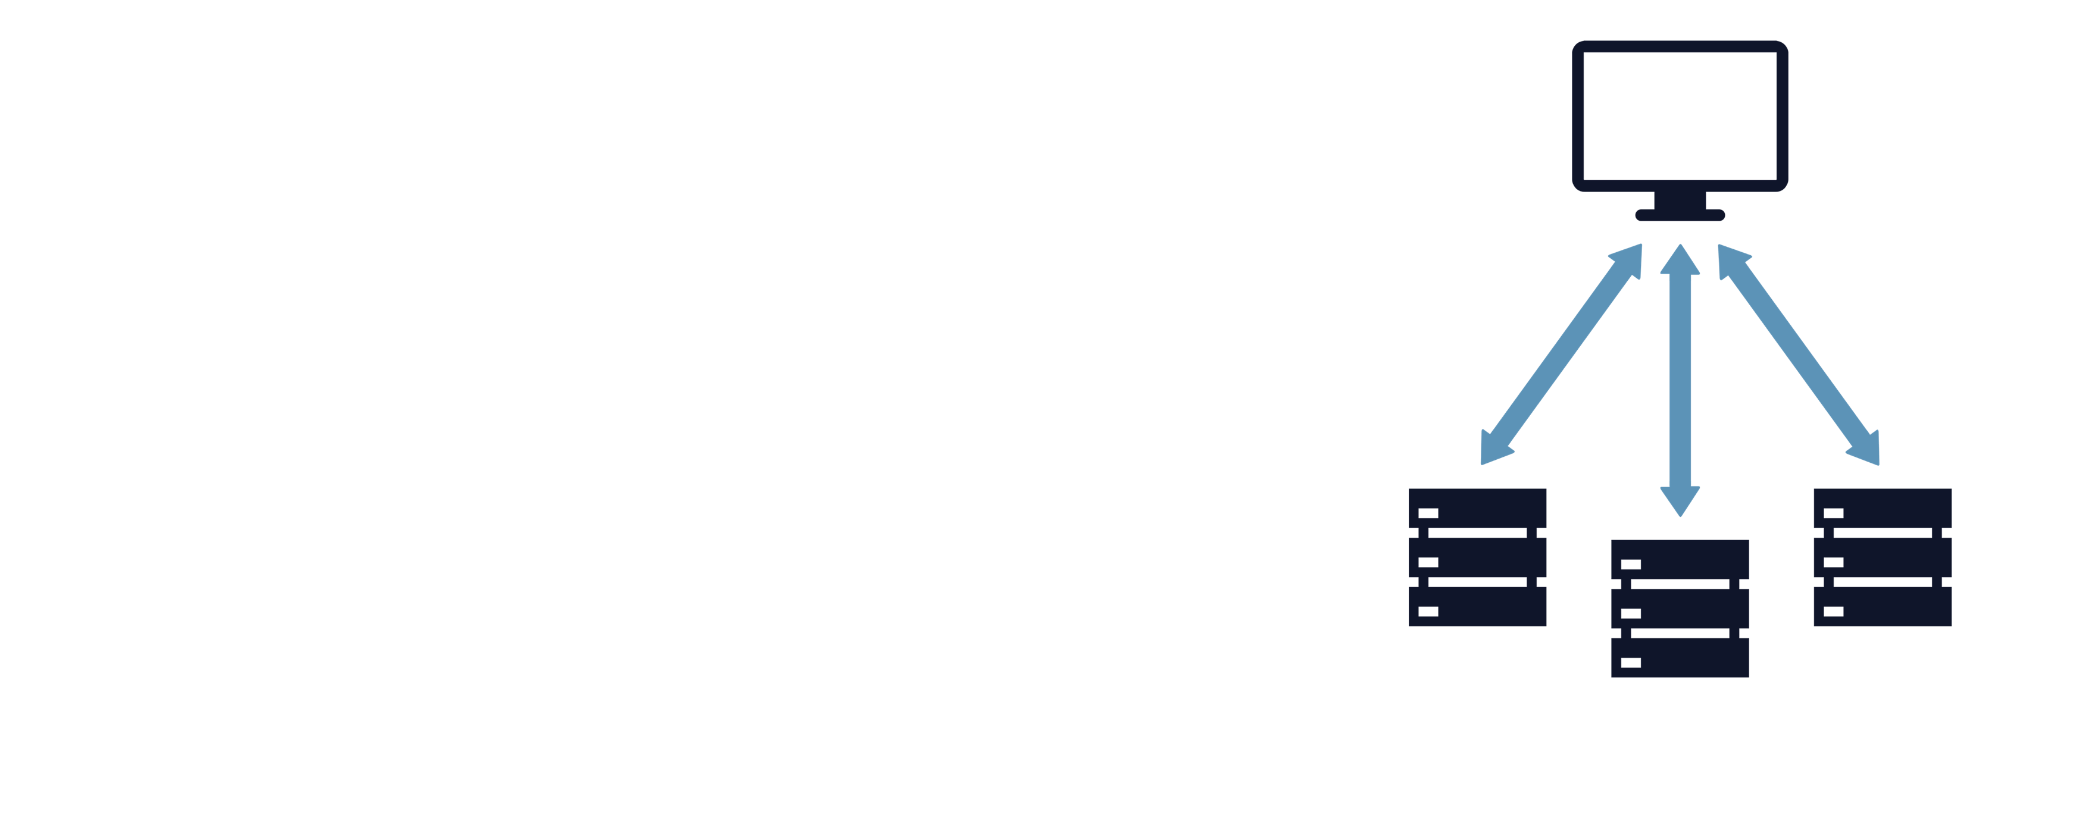
I need to be able to configure a service on the network and not individual devices!
NETCONF provides primitives to:
In parallel:
Acquire locks on multiple devices
Upload configuration changes
Change running configuration and test
Make changes permanent
Release locks

Slide 19
If I hit an error while configuring one of several devices, I must go back and reconfigure all devices back to the way they were!
Transactions can be atomic – either it completely succeeds or there is no change!
This gives you the ability to “UNDO”
Capability Operation
:confirmed-commit <cancel-commit>

Slide 20
I cannot test a configuration before implementing it!
validate
You can check a complete configuration for syntactical and semantic errors before applying the configuration to the device
Candidate
<validate>
<source>
<candidate/>
</source>
</validate>
Capability Operation
:confirmed-commit <cancel-commit>

Slide 21
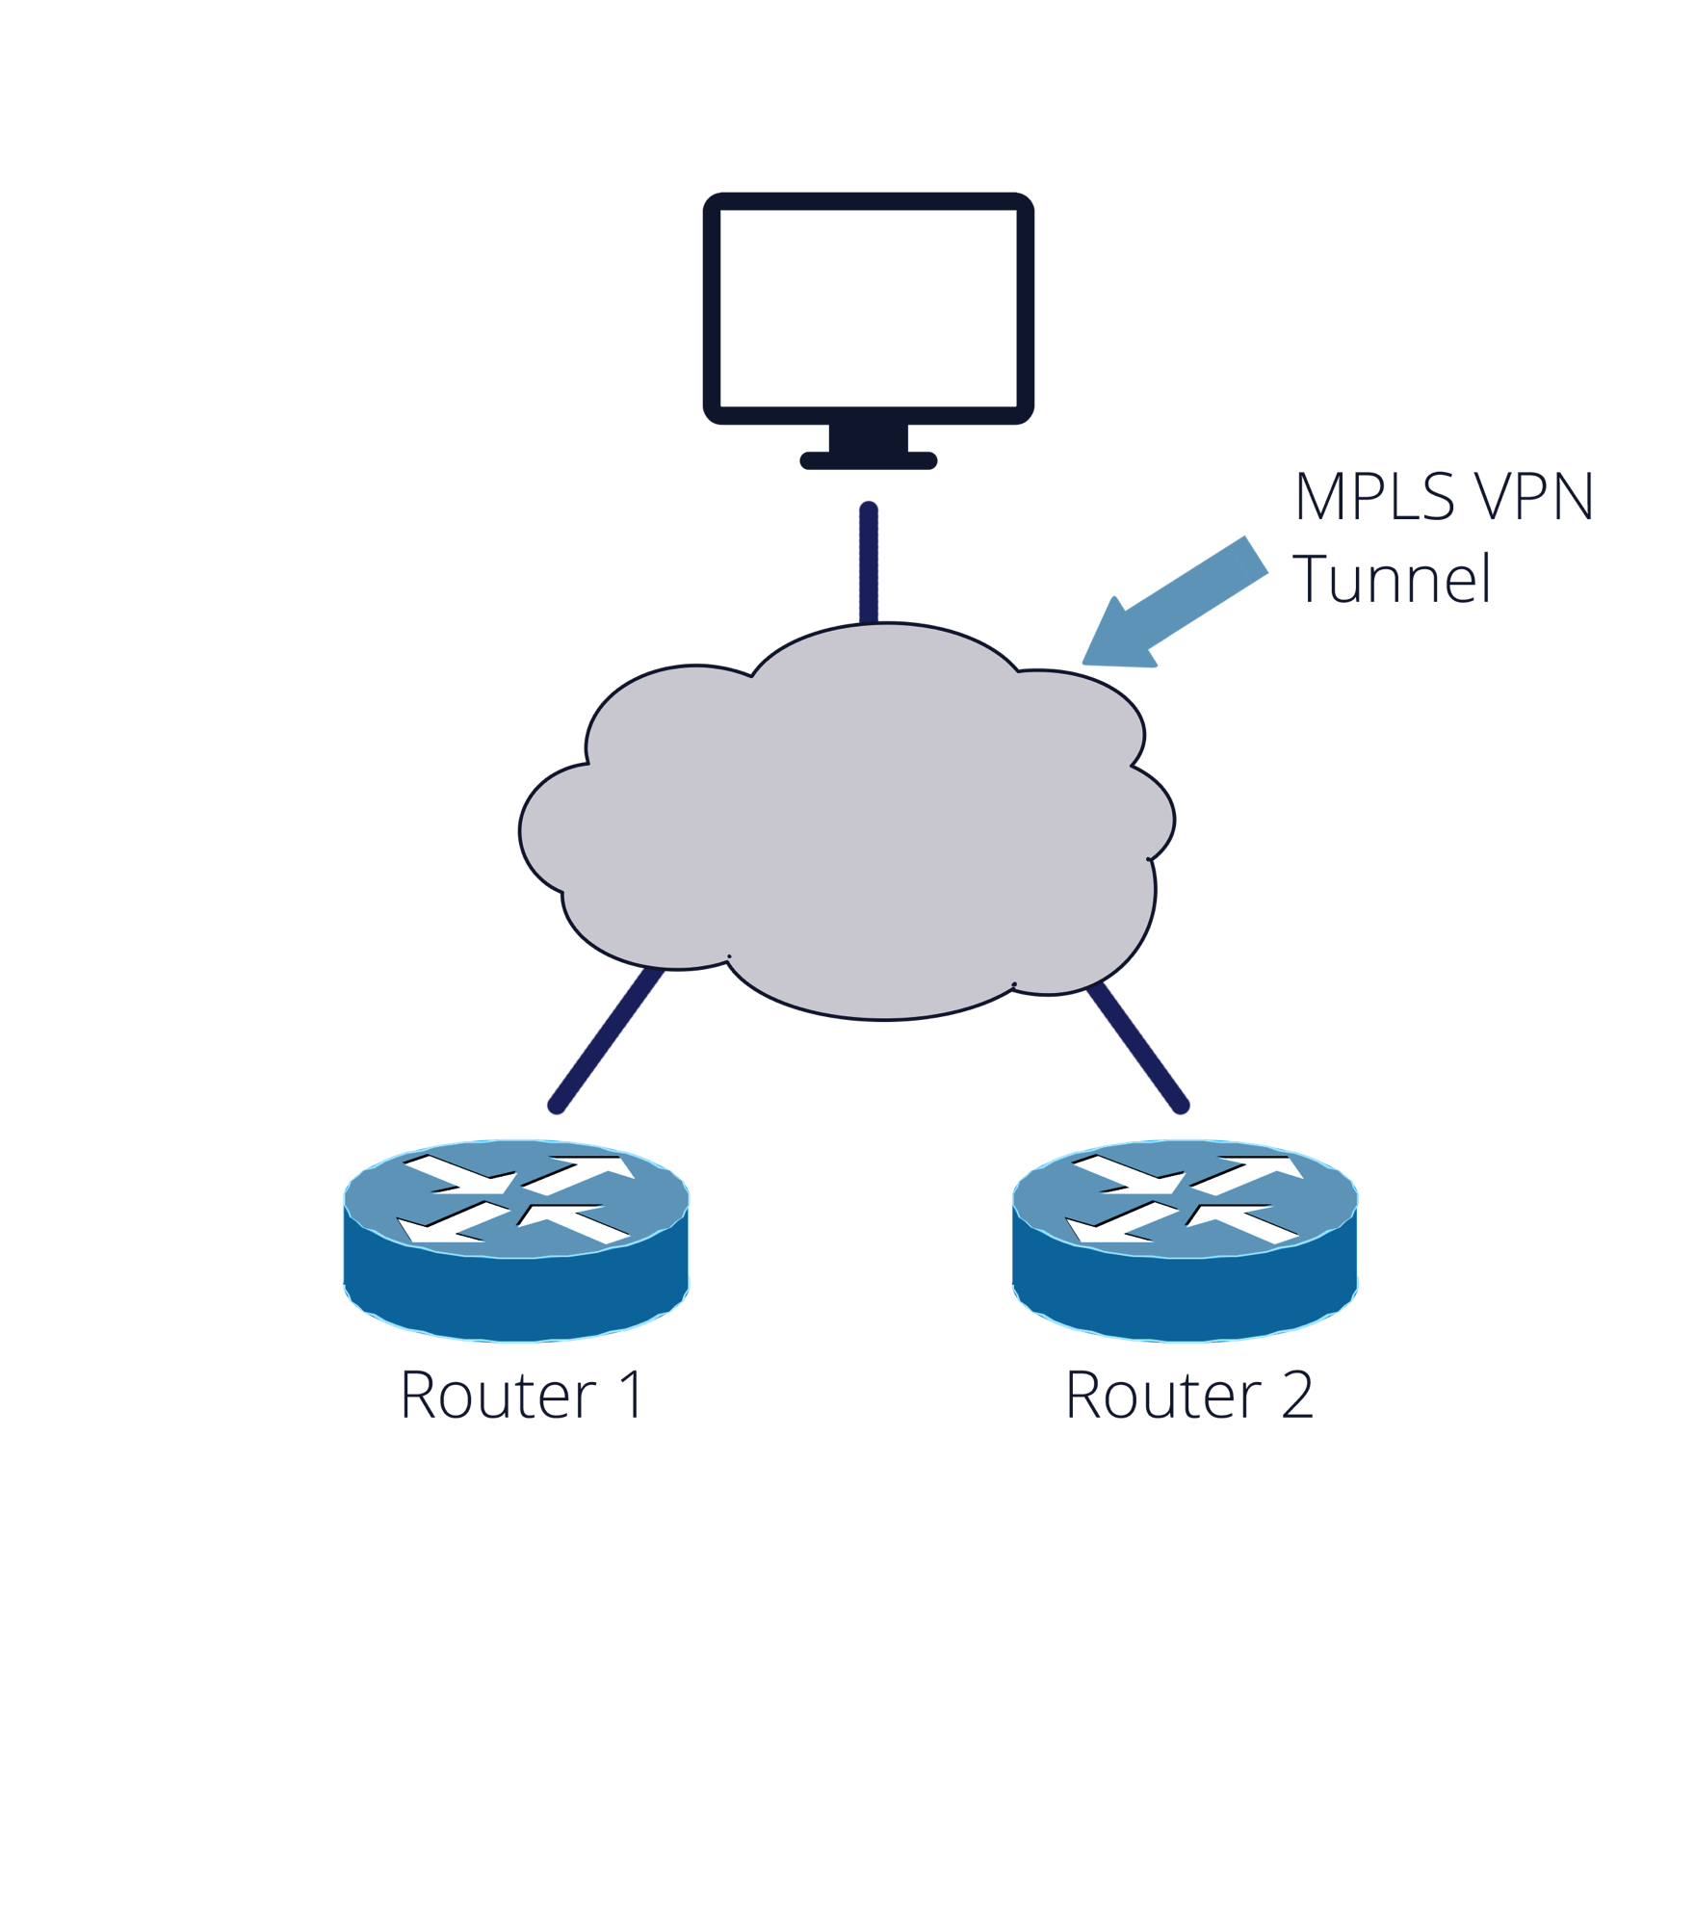
Use Case:
Need to program:
Task 1: Activate interface on group of devices
Task 2: Assign addresses to interfaces
Task 3: Configure MPLS VPN Tunnel
Router 1:
FastEth0: 2001:db8:c18:1::3/128
Router 2:
FastEth0: 2001:db8:c18:1::2/128

Slide 22
Summary
NETCONF provides the fundamental programming features for comfortable and robust automation of network services
YANG is a full, formal contract language with rich syntax and semantics to build applications on

