Slide 1
SYSC-3110 Object-Oriented Programming and Design Laboratory
Persistence to a Database:
Object-Relational Mapping

Slide 2
Object-Relational Mapping (ORM)
A popular pattern best described in Martin Fowler's Patterns of Enterprise Application Architecture
  allows OO-style use of a relational database
  forces:
    writing SQL in code is error-prone (no compile-checking)
    code becomes independent of database SQL dialect
      makes it easier to switch databases
      makes it possible to have different DBs in different environments
    not good practice to mix different languages (see also view templating: JSP, etc.)
    but adds another layer with its own complexities and inefficiencies
      for example, you may not realize that you are querying the database multiple times needlessly

Slide 3
The Patterns
An ORM tool typically implements a Data Mapper and/or ActiveRecord
  some way to abstract away the database connection
It also helps with behavioral issues such as transactional operations on multiple dependent objects
And it helps bridge the impedance mismatch between an OO and a relational representation of data

Slide 4
Active Record
The simpler ORM pattern, simple enough that you can implement it yourself
The idea:
  one-to-one mapping of each model class to a database table
    and a one-to-one mapping of each model instance to a row in that table
  provide supporting CRUD methods
Supported extensively in frameworks such as Rails or Play
  dynamic languages (such as Ruby) can do more for you here
    e.g., use reflection to dynamically generate those CRUD methods

Slide 5
Data Mapper
The more complex pattern
You likely will never have to implement one yourself, but rather use an ORM provider
The idea: the mapper sits between the domain objects and the database, in a way that they stay decoupled from one another
  this way they domain objects and the database can evolve independently from one another
  the mapping between the domain object attributes and the table columns is specified programmatically or in a configuration file

Slide 6
Impedance mismatch
references vs foreign keys
has-many relationship: collection (multi-valued attribute!) vs normalized tables with foreign keys
many-to-many relationships: in a relational database they require an intermediate join table
inheritance
for these issues, Fowler has captured a number of Structural Mapping Patterns
  Identity Field
  Association Table Mapping
  Single Table Inheritance

Slide 7

Structural Mapping Patterns: Identity Field
In OO, you use can identify an object by its reference
In a relational database, you identify a row by its primary key
In ORM, specify an existing attribute as the primary key, or just add a variable for that purpose

Slide 8
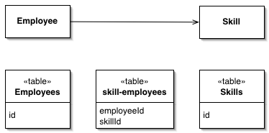
Structural Mapping Patterns: Association Table Mapping
In OO, a has-many relationship is captured by a collection
In a relational database, this corresponds to a multivalued attribute, but would not comply to the First Normal Form
  create as many rows as values, and possibly use a foreign key

Slide 9
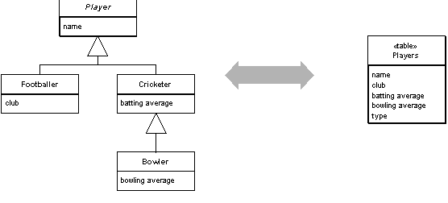
Structural Mapping Patterns: Single Table Inheritance
In OO, a subclass inherits instance variables of the superclass
in relational databases, no inheritance. Having separate tables for the superclass and the subclass would work, but would often involve making expensive join operations
  one possibility is to consolidate the hierarchy into a single table, and use a type column to differentiate
  some waste of space but usually worth it.

Slide 10
ORM support
ORM is supported in many languages by many libraries and frameworks:
  Hibernate in Java, ActiveRecord in Ruby/Rails, etc.
  in Java there is now a standard called Java Persistence API (JPA)
    Hibernate is one of many vendors implementing JPA
    JPA is a layer on top of JDBC, the traditional driver API for databases

Slide 11
JPA Howto
To persist data to a database using JPA you need:
  a database (duh!), e.g. SQLite, MySQL, PostgreSQL…
  a JDBC driver for that database
  a JPA implementation: Hibernate, Eclipse's, etc.
  to annotate the class of the objects you want to persist
  to write a configuration file called persistence.xml, specifying the above

Slide 12
JPA Howto 1: A database
SQLite vs full-fledged databases

Slide 13
JPA Howto 2: JDBC
JDBC is the low-level API to connect Java to a database
  you can use it to connect to a DB, and to query it using SQL
  each database provider will have to provide a driver that implements JDBC
  as a result, your Java queries can be fairly database-neutral

Slide 14
JPA Howto 3: A JPA implementation
JPA is a JSR (Java Specification Request) that builds on top of JDBC
allows more seamless and transparent interaction with the DB. It is the Data Mapper.
but it’s just a standard! Need actual implementation
  recall how SAX was just a standard for XML parsing
Hibernate was an early ORM provider, and is one of the JPA providers
EclipseLink, etc.

Slide 15
JPA Howto 4: Annotate your classes
Full details here
@Entity to annotate the class to be persisted
@Id to annotate the primary key to be used
Associations: @OnetoOne, @OneToMany, @ManyToOne, @ManyToMany
  use them to navigate from one entity to another
  annotate the method that allows you this navigation
  remember from Association Table Mapping that the foreign key lives on the other end of the one-to-many relationship
best done with an example (scroll down to Player and Team classes)

Slide 16
JPA Howto 5: persistence.xml
The important elements are:
  persistence-unit
  provider
  class
  property
best done with an example (scroll down to fig. 2)
in newer JPA providers, this step has become unnecessary!

Slide 17
JPA Howto 6: querying your objects
you first need an entity manager
  this may be injected for you (more on this next week!)
you can use this entity manager to create, read, update, delete records in the database
  operations that write to the database must be enclosed in a transaction
  for more complex queries you can use a Java variant of SQL called JPQL
  but many ORMs can provide a more OO-friendly way of retrieving objects
  also don’t forget about cascading operations
best done with an example

