Slide 1
SYSC 4806 Software Engineering Laboratory
Dependency Injection and the Spring Framework

Slide 2
Java Components, a.k.a JavaBeans
JavaBeans are basically Plain Old Java Objects (POJOs)
  they just follow a few conventions, so they can be easily initialized and assembled by 3rd party tools:
    provide an empty constructor
    getter/setter method naming
As standalone components they could be assembled in a “BeanBox”, although the original BeanBox implementation didn’t last long…
  GUI design tools perpetuate the idea (most Swing classes are JavaBeans)
Enterprise JavaBeans (EJBs) extended the idea for web app development (with support for threading, transactions, data access, etc.), but got too complex:
  introduced many constraints and dependencies
  backlash against EJBs led to a return to the POJO model

Slide 3
Dependency Injection
Another term and pattern coined by Martin Fowler
  see the blog post where it came from
  also described in PEAA as the Plugin pattern
It’s about decoupling pushed to the extreme, to help with “componentization” and ease of unit testing
  components and services are supposed to be even more reusable than typical classes
  this means the component shouldn’t be dependent on the implementations of other classes unless they are part of the service that it is supposed to provide
  the component can be tested in isolation, using stubs when appropriate

Slide 4
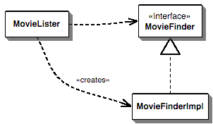
The dependency problem by example
(from Fowler’s blog post)

Slide 5
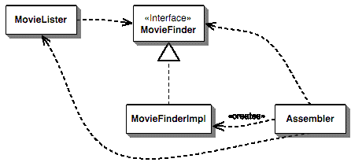
Solving the dependency problem
(from Fowler’s blog post)

Slide 6
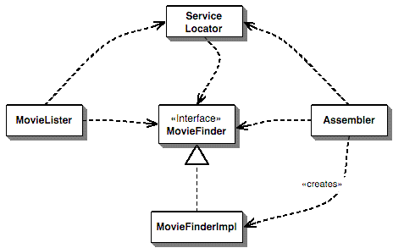
An alternative: Dependency Lookup using a Service Locator
Used by EJBs via JNDI
(fig. from Fowler’s blog post)

Slide 7
Benefits of Dependency Injection
Ease of unit testing: the dependency can be mocked by the container, no change to the unit required
No boilerplate code to hook up components together
No dependency on a framework on the container. It calls you.

Slide 8
Bean Configuration in Spring
three possibilities: XML, Java annotations, Java code
XML is the old way, Java annotations are probably the best way now
the beans we want to configure are the ones whose dependencies we don’t want to hard code: data mapper, various services, etc.

Slide 9
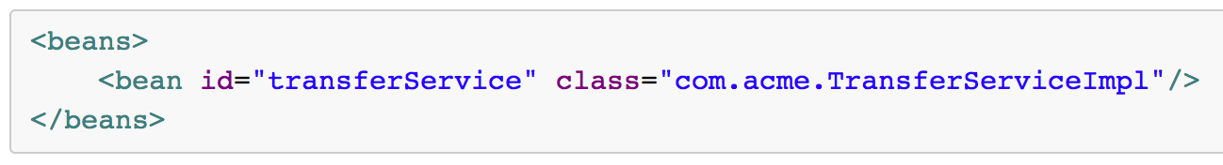
XML-based Configuration
<beans>, <bean> tags

Slide 10
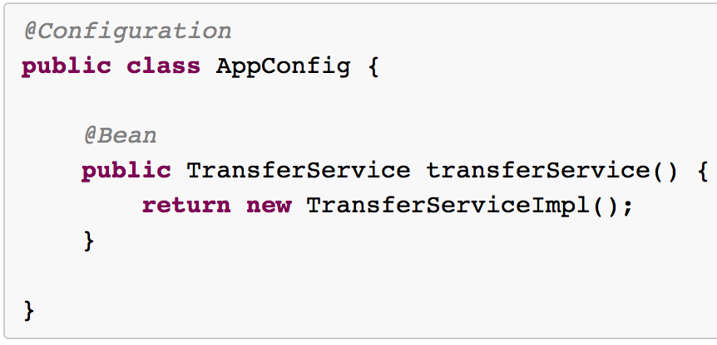
Annotation-based Configuration
@Configuration, @Bean, @Component tags
@Autowired, @ComponentScan

Slide 11
Spring MVC annotations
@Controller, @RestController, @Service
@Repository, @CRUDRepository: for DAO and Models
@Resource

