Slide 1
SYSC 4806 Software Engineering Laboratory
Spring MVC Controllers

Slide 2
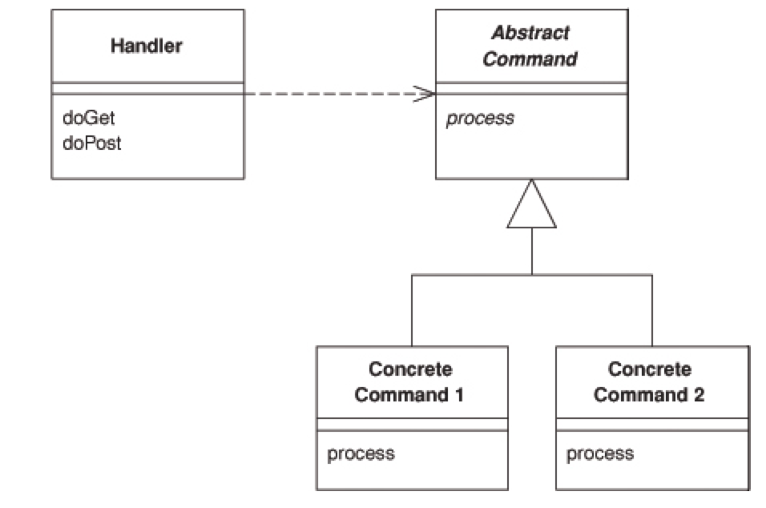
The FrontController Pattern
A controller that handles all requests for a web site
(from PEAA)

Slide 3
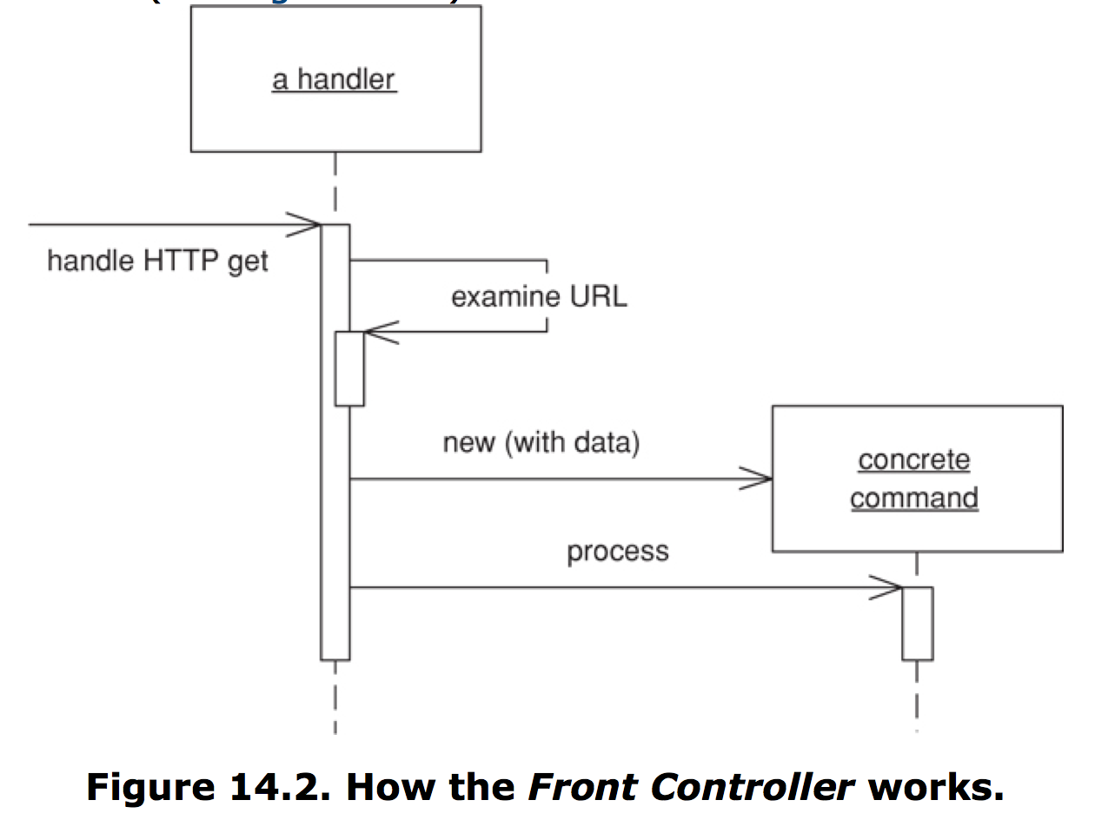
The FrontController Pattern
(from PEAA)

Slide 4
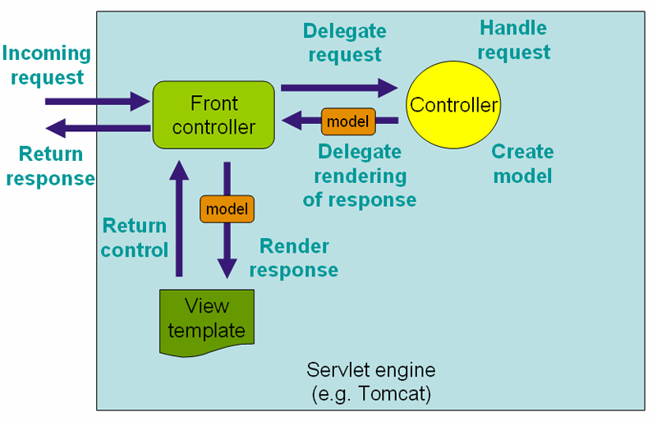
The DispatcherServlet
(from Spring MVC online documentation)
(from Spring MVC online documentation)

Slide 5
Spring MVC annotations
@Controller, @RestController, @Service
@Repository, @CRUDRepository: for DAO and Models
@RequestMapping: to match routes
@RequestParam: to extract request parameters into variables to be used in the controller
@ModelAttribute: to map form data (POST) into an object
@CookieValue: same but for cookies
  to set a cookie, check out HttpServletResponse.addCookie
Best done via example: scroll down to HomeController

Slide 6
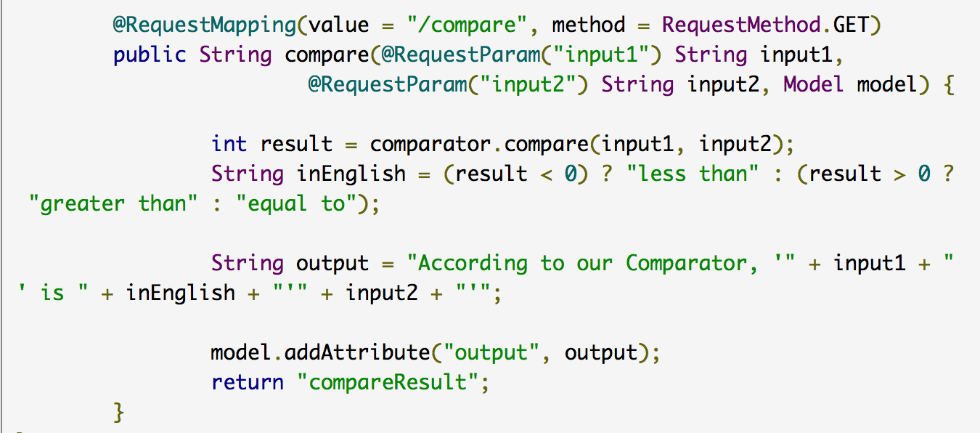
Writing a Spring MVC Controller: an example
(from the link in previous page)

Slide 7
Writing a Spring MVC Controller: an example
Important elements in the code in the previous slide:
@RequestMapping to match /compare path
  and restriction to GET method (could also use @GetMapping annotation instead)
mapping of request parameters “input1” and “input2” to variables using @RequestParam
use of model object passed as parameter to populate variables in the template to return
use of template view (defined elsewhere)
  a view resolver takes the name and maps it to a view
    typically by adding a prefix and/or an extension

Slide 8
Spring MVC using Spring Boot
Spring Boot will auto-configure everything, so no need to worry about XML stuff as long as you’re happy with the defaults
It can package things in a JAR by including Servlet container (Tomcat or other)
  this leads to one important limitation: JSPs can’t be used this way
    either create WAR and deploy to Tomcat manually,
    or use a different template engine (Thymeleaf seems to be the preferred option these days)

Slide 9
REST Support in Spring MVC
Spring MVC also allows easy publishing of your CRUDRepository as REST endpoints
It provides seamless rendering of JSON views using serialization
best learned via a tutorial
(sorry, this reads like an ad!)

