Slide 1
SYSC 4806 Software Engineering Laboratory
Advanced Topics: SaaS Non Functional Requirements

Slide 2
Non Functional Requirements
They are requirements that help judge the quality of the system, rather than its specific behavior
  The “-ilities”
Example: NFRs for an ATM
Example: what are common NFRs for SaaS?

Slide 3
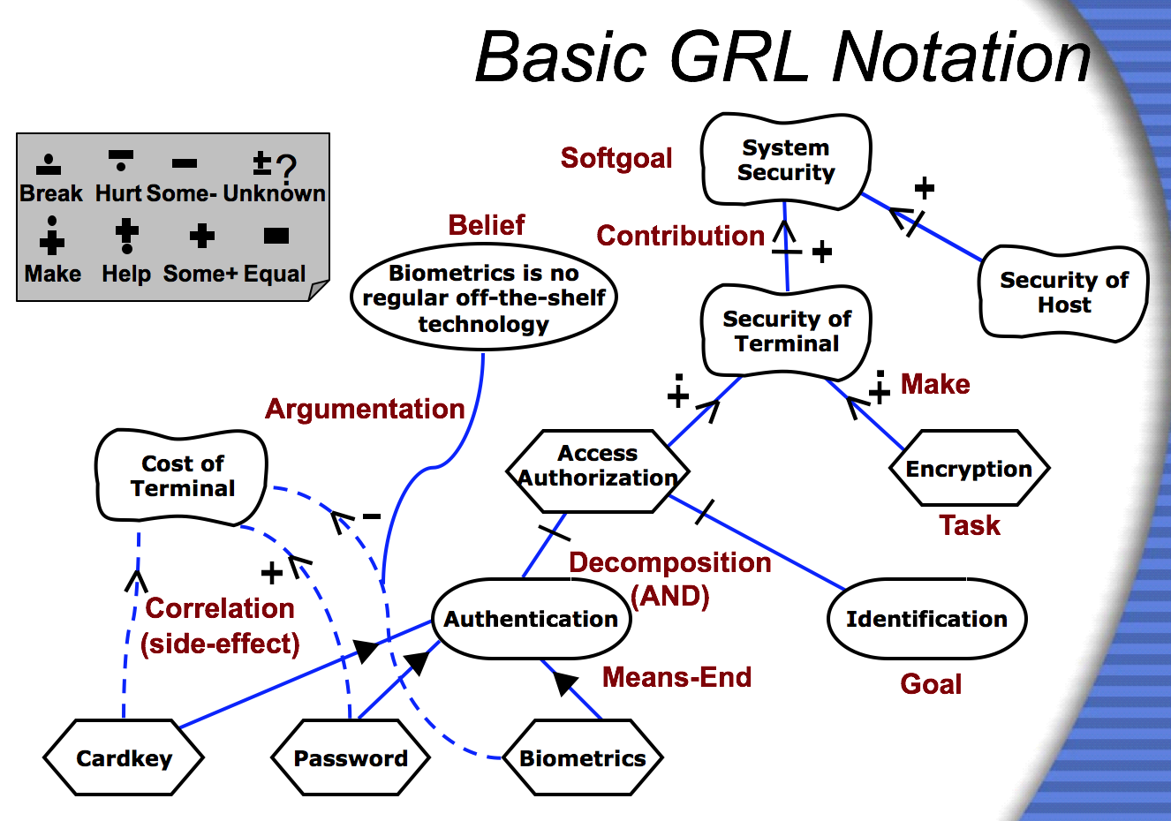
A Notation: GRL [Amyot]

Slide 4
Common Non Functional Requirements in SaaS
(some of the soft goals)
Availability/maintainability (can change on the fly without disruption to the user)
Resiliency (can recover from crashes)
Robustness
Scalability
Responsiveness
Security
here’s a blog post that expands on this list

Slide 5
Common Non Functional Requirements in SaaS
(some of the goals)
Avail./maint. (can change on the fly without disruption to the user)
Resiliency (can recover from crashes)
Robustness
  validation
Scalability
  load balancing
Responsiveness
  caching
Security
  authentication
  authorization
  attack prevention (a whole guest lecture on this soon!)

Slide 6
The tasks: addressing NFRs the DRY way
Notice how many of the goals and approaches to address NFRs (validation, caching, authentication, logging) are cross-cutting concerns
  handling them at the level of each controller would be a maintainability nightmare:
    your controllers would end up doing too many things, that’s a lack of cohesion
    it’s not DRY at all
    this is why most web frameworks provide specific support for them

Slide 7

Validation in Spring MVC
  Handling all errors in the controllers is smelly:
    overreaches into model’s responsibility (Fat Controller antipattern)
    might have to duplicate error checking in multiple controllers that deal with the same model
  Spring supports JSR-303 annotations for validation.
    use those annotations in your models
    check for errors in the controller
    return error page
    for more complex validations, implement Validator interface
    best explained with an example

Slide 8
Logging
  Spring Boot includes support for logging out of the box
    you’ve already seen it in action when running your Spring application and checking console output
      uses the LogBack library
    can customize (in application.properties):
      the level to be logged: FATAL, ERROR, WARN, INFO, DEBUG, TRACE
      where to output the log
    add your own log messages
      example in next slide

Slide 9
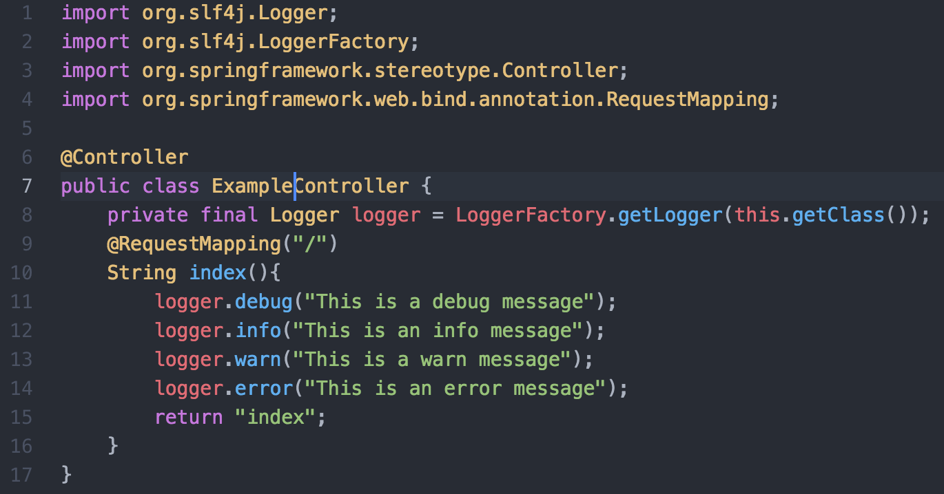
Logging

Slide 10
Authentication
  Best explained by this video from the textbook:

Slide 11
General Purpose Technique for Implementing Cross-Cutting Concerns: AOP
  Now how to check for whether the user is logged in, or enable monitoring/logging in more than one controller in a DRY manner?
  Aspect-Oriented Programming to the rescue!
  Terminology
    An Aspect is the module where you can deal with the cross-cutting concern
    An Advice is what you want to do about the concern
    A Join Point is when you want the execution to happen
    A Pointcut is a predicate that can match one or many Join Points

Slide 12
AOP Implementation Patterns
  Weaving: the AspectJ approach
    some sort of compilation process injects the advice into the join points
  Proxies: Spring’s approach
    calls to the join points are intercepted by proxy objects (a GoF pattern!) that contain the advice
      might lack the full power of AspectJ
      but can be done in pure Java and without any additional compilation process
      makes sense in SaaS, since can have proxies sitting in front of controllers

Slide 13
AOP Support in Spring
  The annotations (link for the gory details)
    @EnableAspectJAutoProxy to enable AspectJ style annotations
    @Aspect to use regular Java class as an aspect
    @Before, @After, etc. combined with point cut expression to annotate the method to be injected
  Some useful annotations for built-in Spring aspects (you can use these in your controllers when applicable):
    @Transactional
    @Cacheable

