Slide 1
Shopee Case Study
By Christopher mok

Slide 2
Search & Recommendation objectives
Users should be able to find the product they are looking for with least amount of clicks
Users should be recommended products that they are interested in
Address any issue that hinders the above 2 objectives

Slide 3
Assumptions
Assume that total_users refer to the sum of all unique users who have loaded the Shopee’s App home screen
Assume that impression & clicks include the items featured on home screen and items on cart
Assume that the data is clean and no misreporting
23-24 Jan 2021 anomaly is not due to database error
Decimals in clicks is correct

Slide 4
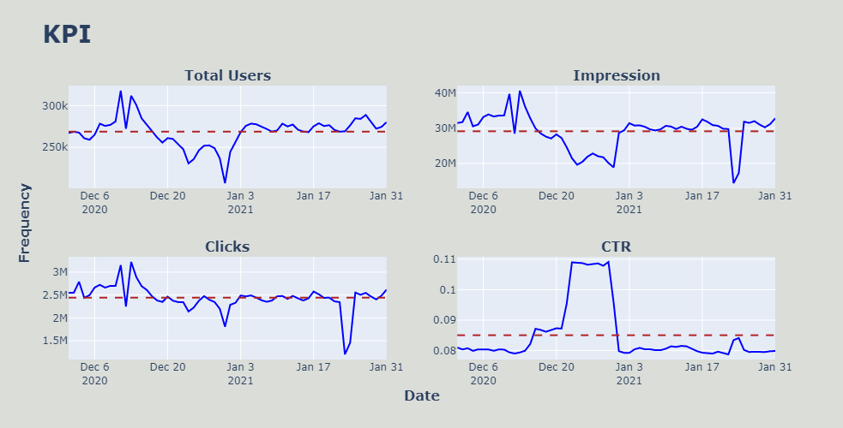
Visualization of KPI
23-24 Jan 2021
23-30 Dec 2020
31 Dec 2020
23-24 Jan 2021

Slide 5
Observation
Sudden dip in impression and clicks on 23-24 Jan 2021
CTR slightly increases on 23-24 Jan 2021
Sudden dip in clicks and total users on 31 Dec 2020
Sustained increase in CTR from 23 Dec 2020 – 30 Dec 2020 corresponding to a fall in impression, perhaps due to users already adding items to cart beforehand to do their last minute shopping for the new year
With the exception of 23-24 Jan 2021, the total users and impression are generally highly correlated.
Both fluctuate greatly in Dec with higher than average on the first 2 weeks of Dec and lower than average on the last 2 weeks of Dec. Both metrics remain fairly constant in Jan
Total Users, Clicks & Impressions all dipped on Public Holidays (25, 31 Dec 2020)

Slide 6
Hypotheses
The dip in impression and clicks can be explained by the fall in total number of users
The surge of total users in the first 2 weeks of December is due to Shopee 12.12 Birthday Sale
High CTR is due to high volume of clicks and low volume of impressions
Technical issues relating to the dip in impression and clicks on 23-24 Jan 2021

Slide 7
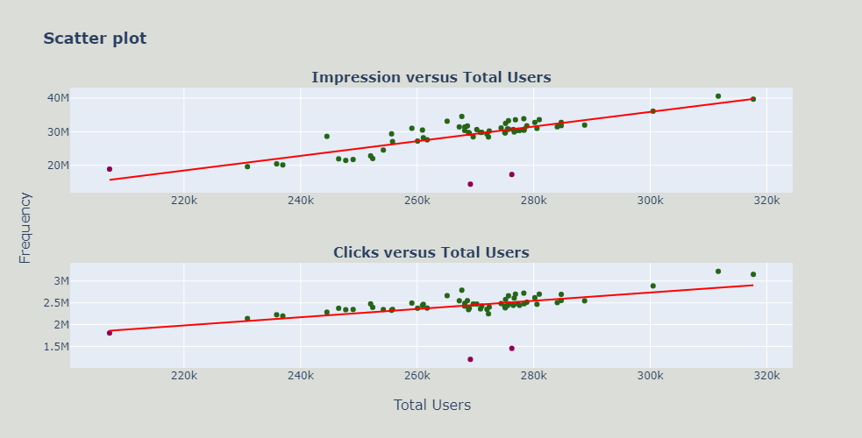


Impressions & Clicks
The dip in impressions and clicks on 31 Dec 2020 can be explained due to a lower number of users
The dip in numbers of impressions and clicks in 23-24 Jan 2021 cannot be explained by the numbers of total users
$R^{2}$ = 0.577
$R^{2}$ = 0.317

Slide 8
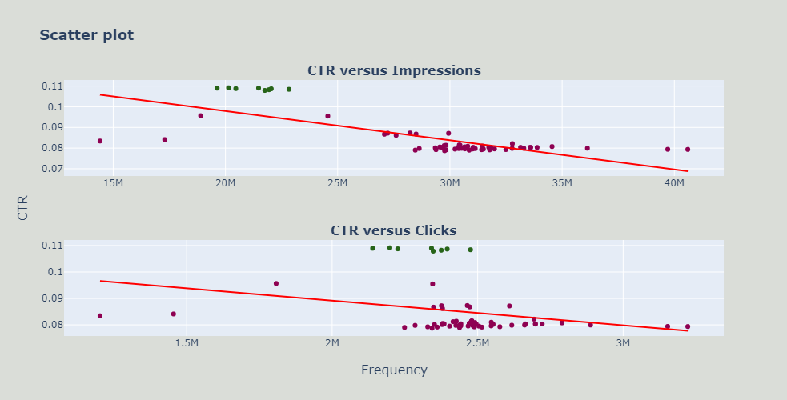


CTR
High CTR can be due to high volume of clicks or low volume of impression
However, the data shows that the high CTR is explained more by a lower impression. In fact, the number of clicks is not statistically significant in explaining the CTR.
$R^{2}$ = 0.526
$R^{2}$ = 0.078

Slide 9
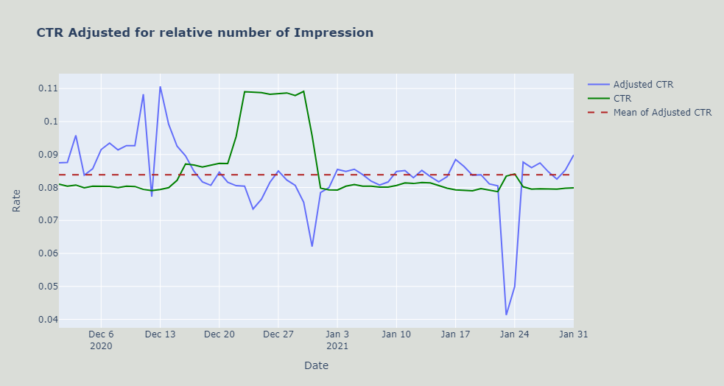

Impression Adjusted CTR
CTR alone can be misleading as higher CTR can imply lower impression -> Not effective to detect anomalies in search performance
Only high CTR during high volumes of impression generate high volumes of sales
Impression Adjusted CTR = $CTR ∗ \frac{Impressions}{{Impressions}_{mean}}$
1 – 12 Dec :
Higher than average adjusted CTR in line with Shopee 12.12 Birthday Sale from 26Nov – 12Dec
23-24 Jan : Especially Low CTR after adjusting for its low impression

Slide 10
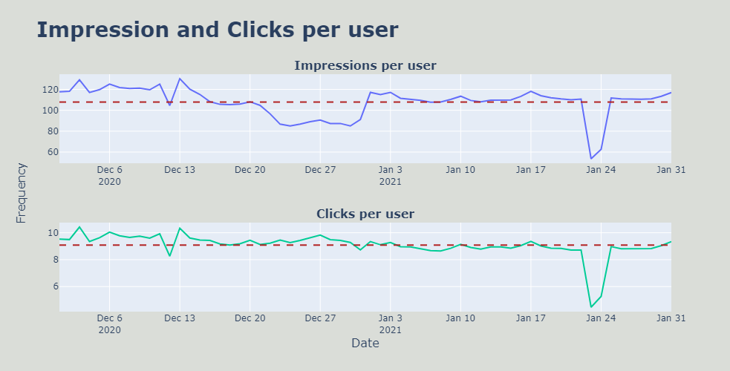
Per user
With the exception of 23-24 Jan 2021, the number of impressions each user sees are relatively more volatile as compared to the number of clicks per user
23-24 Jan : Especially low user activity

Slide 11
23-24 Jan 2021
Total users remain normal but numbers of impression and clicks are abnormally low
Possible reasons
App-related bugs (search-bar, next-page-button, loading time, etc)
Mass-scale out-of-stock products
External promotional event from competitors
Regional events (internet shutdown, public holidays)

Slide 12
Verification method
Track key metrics
Number of users - To track traffic flow
Number of Impressions – To track users’ search activities
Number of Clicks – To track users’ s search activities
CTR – To track success of search capabilities
Impression Adjusted CTR – To track success of search capabilities
Number of clicks per user – To track users’ search activities
Number of impressions per user – To track users’ search activities
Investigate key metrics by date/month, region, product categories & access type (additional data)
Design dashboard to improve the efficiency of investigation
Prototype based on randomly generated values for additional data

Slide 13
Dashboard Design
Objective
Design a dashboard for stakeholders to efficiently investigate the causes of search performance within the Shopee App
Stakeholders
Product Managers : Popularity of product & represent sellers’ interests (by products)
Sales Executives : CTR directly correlated with sales
Marketing Department : Success of marketing campaign (search by keywords/categories upon launch date)
Data Science : To identify and evaluate the search features that require areas of improvement (clicks for products)
IT Department : To understand traffic and to mitigate any app-related technical issues (total users by access type)
Success Metrics
Usage rate (overall + by stakeholders)
Effectiveness of dashboard to aid in decision making
Loading time
Reporting lag (real-time? 1day, 1week, 1month lag?)

Slide 14
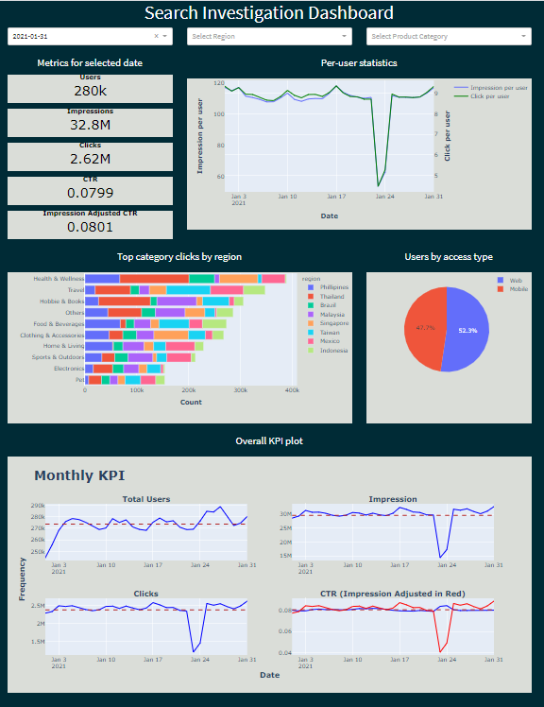
Dashboard Prototype
Drill down by filtering according to Date, Region & Product Category
Display of metrics according to dropdown selection
Dual-axis graph to compare trend of impression and clicks per each user to detect any anomaly in individuals’ search pattern
Display number of clicks for each product category based on keyword by region
Sudden shift in proportion of mobile-web users suggest technical fault of the app. Hover data to show the numbers of each group
Snapshot of KPI metrics of the selected month
The month is selected from the selected date for graphs that has date in the horizontal axis

Slide 15
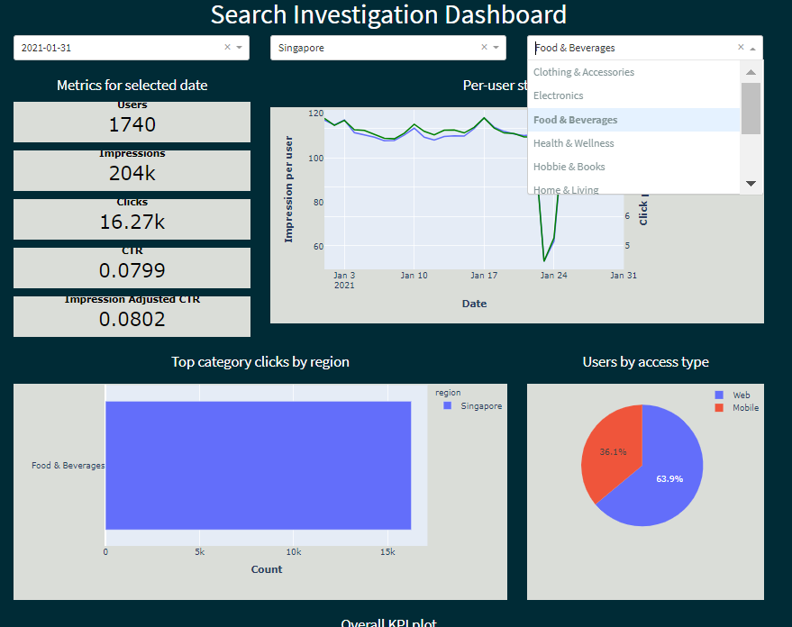
Interactivity
To consider different regional trends and specific events for Marketing
Investigate search performance by products to get domain knowledge inputs from Product Manager
Daily Snapshot for Sales Executive to get quick market sensing
Highlight Data Science Team to finetune their search algorithm if clicks of certain products are found to be unusually low
Highlights login issues from users to alert IT department for management of traffic
Designed for specific business use case

Slide 16
Implementation Phase
Phase 1 : Understanding business use case of stakeholders through collaboration
Phase 2 : Data Collection and Warehousing to centralize the data for efficient retrieval
Phase 3 : Development of MVP / Prototype to get feedback from stakeholders
Prioritize anomaly detection and inputs from IT department as any unwarranted technical issues could negatively impact sales and customer experience
Phase 4 : Deployment in the cloud for easy accessibility to stakeholders
Phase 5 : Iteratively improve dashboard design through continuous feedback loop and evaluation of success metrics

Slide 17
README
- To run the dashboard locally,
1. Go to the root of folder and install the dependencies
pip install –r requirements.txt
2. Run python app.py on local terminal
3. Copy and paste the provided link to browser to load the dashboard on local computer

