Slide 1
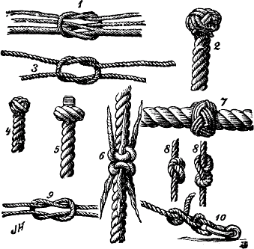
Why "to REBIND or NOT to REBIND" is STILL a QUESTION?
Created by:
Cristian Molaro, Belgium
Independent consultant
IBM GOLD Consultant
IBM Champion IM
Notes:
Why to REBIND or not to REBIND is STILL a question? REBIND is a topic that has already been discussed often. In DB2 9 and DB2 10, there are many issues in terms of (RE) BIND added but there are also options changed. The new options also reflect the many new questions, such as "what are the pros and cons of RELEASE DEALLOCATE with High Performance DBATs DDF?" In this presentation Cristian put everything another list in a row. Plan Stability / m APREUSE, and APCOMPARE. Time for a new (RE) BIND strategy?

Slide 2
- DISCLAIMER
Please be aware that the actual programming techniques, algorithms and all numerical parameters used in examples given in this presentation are subject to change at some future date either by a new version of DB2, a new release, a Small Programming Enhancement (SPE) or a Programming Temporary Fix (PTF).
The information contained in this presentation has not been submitted to any formal review and is distributed on an “as is” basis without any warranty either express or implied. The use of this information or the implementation of any of these techniques is a customer responsibility and depends on the customer’s ability to evaluate and integrate them into the customer’s operational environment. While each item may have been reviewed for accuracy in a specific situation, there is no guarantee that the same or similar results will be obtained elsewhere. Customers attempting to adapt these techniques to their own environments do so at their own risk.
DB2 is a trademark of International Business Machine corporation. This presentation uses many terms that are trademarks. Wherever we are aware of trademarks the name has been spelled in capitals.

Slide 3
- Agenda
The need for REBIND
Case study
PLAN MANAGEMENT
DB2 10 High Performance DBATS
Summary and conclusions

Slide 4


- To REBIND or NOT to REBIND? That is the question..
The ubiquitous DB2 discussion…
GETTING THE REBIND BENEFITS AT THE LOWER RISKS
Performance
Scalability
Access paths
…
Performance degradation
Concurrency issues
…
DYNAMIC SQL is out of SCOPE → implicit REBIND at least at first execution
TIP:
IMPORTANT:
IBM recommends REBIND at each new release

Slide 5

- The DB2 10 “Performance” migration path
DB2 10 CM
DB2 10 CM + REBIND
DB2 10 NFM
DB2 10 NFM + Changes
New in DB2 10: Savings out of the box
Conversion Mode + REBIND
_{Savings out of}
_{the box}
_{Maximum saving potential}
NOT = TRANSPARENT
IMPORTANT: REBIND is not required for migrating to DB2 10
BUT: REBIND is strongly recommended

Slide 6
- DB2 10 Performance Enhancements CM + REBIND
Most access path enhancements
SQL paging performance enhancements
Single index access for complex OR predicates
IN list performance
Optimized Stage1 processing (single or multiple IN lists)
Matching index scan on multiple IN lists
Query parallelism improvements
More stage 2 predicates can be pushed down to stage 1
More aggressive merge of views and table expressions
Avoid materialization of views
REBIND enables further SQL runtime improvements
TIP:
Some performance query performance benefits do not require REBIND
IMPORTANT:
No REBIND required for moving from CM to NFM

Slide 7
- DB2 10 Catalog changes
Size
Partition-by-growth (PBG) catalog / directory table spaces
Allow packages to grow beyond 64GB using LOBs
V8/DB2 9 APAR PK80375 adds zparm for SPT01 compression
BUT no compression in DB2 10
New LOB columns to the catalog
In-line lob enhancement with PM27811 (next slide)
Improved concurrency and reduced contention
Change to row-level locking
Indexes instead of links
DSN1CHKR is no longer required
IMPORTANT:
DB2 10 NFM reduces catalog contention dramatically → Concurrent DDL processing and BIND operations

Slide 8

- APAR PM27811: adds partial compression SPT01
Adds support for inline LOB and compression for SPT01
In DB2 V10 NFM the package information is stored in a LOB table space with an inline length of 0
All the package information is stored in the LOB table space
This can not be compressed → more DASD requirements
Package information is stored in the LOB → the base row and the LOB row must be read → can affect performance
ZPARMS:
SPT01_INLINE_LENGTH → NOINLINE or 1-32138
COMPRESS_SPT01 → Compress SPT01 base table
Valid settings are NO and YES. The default is NO
When DB2 is started with PM27811 on for the first time
in-line length of DSNDB01.SPT01 is changed from 0 to 32138
DSNDB01.SPT01 is put in AREOR

Slide 9
- DB2 Catalog changes and Performance
Indexes for the catalog instead of links improves concurrency and makes catalog health checking easier
BUT: operations that access the DB2 catalog are expected to show a higher CPU utilization
Single thread BIND/REBIND shows degraded CPU and elapsed time performance on entry CM
BIND will take longer but has less contention
You may change existing procedures to go parallel
BUT cannot do this until post ENFM
The dynamic SQL full PREPARE increase in class 2 CPU and elapsed time ranges from 20% to 30% (comparing DB2 9 to DB2 10)
Extra cost is largely attributed to the utilization of indexes instead of links in the DB2 catalog
IMPORTANT:
Catalog indexes are introduced when you migrate to CM but there is no increased concurrency in this mode

Slide 10

- DB2 10 Literal replacement
DB2 10: The dynamic SQL full PREPARE increase in class 2 CPU and elapsed time ranges from 20% to 30% when comparing DB2 9 to DB2 10
Extra cost is largely attributed to the utilization of indexes instead of links in the DB2 catalog
Dynamic SQL with literals can be re-used in the DSC
Literals replaced with &
EXAMPLE:
WHERE ACCOUNT_NUMBER = 123
Becomes:
WHERE ACCOUNT_NUMBER = &

Slide 11

- DB2 10 Literal replacement
How to enable:
CONCENTRATE STATEMENTS WITH LITERALS in PREPARE ATTRIBUTES clause
Or set LITERALREPLACEMENT in the ODBC initialization file
Or set the keyword enableLiteralReplacement=’YES’ in the JCC Driver
Accounting report:
Performance
Biggest performance gain for repeated SQL with different literals
Using parameter marker still provides best performance
DYNAMIC SQL STMT TOTAL
-------------------- --------
REOPTIMIZATION 0
NOT FOUND IN CACHE 4
FOUND IN CACHE 1
IMPLICIT PREPARES 0
PREPARES AVOIDED 0
CACHE_LIMIT_EXCEEDED 0
PREP_STMT_PURGED 0
CSWL - STMTS PARSED 5
CSWL - LITS REPLACED 3
CSWL - MATCHES FOUND 1
CSWL - DUPLS CRETED 0

Slide 12

- DB2 10 and virtual storage
DBM1 below 2GB
75-90% less usage in DB2 10 compared to DB2 9
Larger number of threads
Possible data sharing member consolidation
Improve CPU with storage
More RELEASE(DEALLOCATE)
Larger MAXKEEPD values for KEEPDYNAMIC=YES
Should I still monitor virtual storage?
xxxxDBM1
2GB
75-90% less usage
DBM1 BTB
Notes:
Laboratory measurements and early customer experience have shown substantial savings in the primary constrained address space, DBM1. Most measurements have shown 75% to 90% savings for the virtual storage in that address space below the 2 GB bar. Some EDMPOOL and some working storage remains below the bar.
This storage relief allows many more threads or concurrent users in a DB2 subsystem, allowing new possibilities for optimization.
Some customers will be able to consolidate data sharing members, saving on memory, CPU and administration time.
Other customers will be able to use the storage to improve service or to reduce CPU time more. Some common examples are expected to be use of RELEASE(DEALLOCATE) and larger amounts of dynamic statement cache.

Slide 13

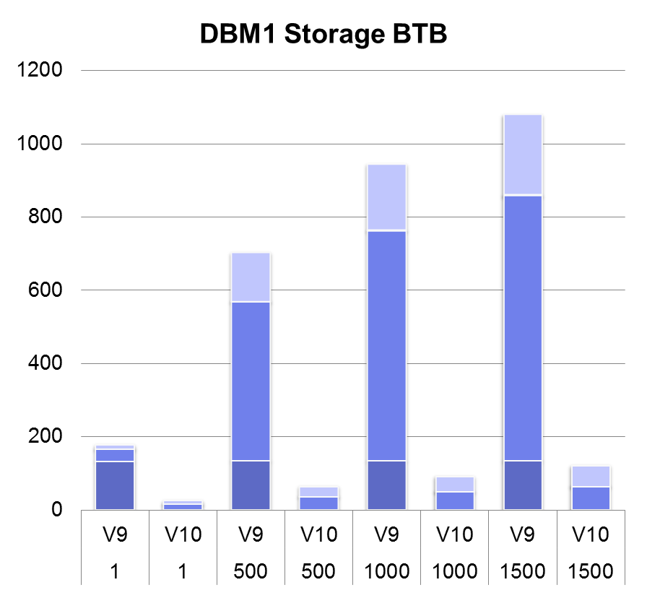
- Distributed workload: DBM1 Storage Below 2GB
DBM1: 90% reduction
Real storage increases between 3% to 12%
→ MB
# concurrent threads →

Slide 14
- DB2 10 and Virtual Storage
Sample SQL workloads and DBM1 BTB

Slide 15
- The “obligation” to REBIND
Some considerations when migrating to DB2 10:
Packages or plans last bound prior to DB2 Version 6
Must be rebound for use on DB2 Version 10
If the ABIND subsystem parameter is set to YES or COEXIST → DB2 will automatically rebind the package or plan
Otherwise →REBIND manually to prevent SQLCODE -908
Plans containing DBRMs are not supported
Use the COLLID option of REBIND
Otherwise → implicit DBRM to package conversion
Default collection: DSN_DEFAULT_COLLID_<plan name>
DISALLOW_DEFAULT_COLLID = NO / YES [PM37816]
Private Protocol is not supported → REBIND required for DRDA
IMPORTANT: A next release of DB2 could impose more severe restrictions

Slide 16
DB2 PP DOES NOT WORK in DB2 10!
You MUST convert plans and packages from PP to DRDA protocol, if any, before migrating to V10 from V8 or V9
See APAR PK64045: PREPARATION FOR ELIMINATION OF PRIVATE PROTOCOL IN DB2 10 FOR Z/OS
It has an impact on existing BIND/REBIND processes
Creation of ALIASES may be required, unless DRDA_RESOLVE_ALIAS is active

Slide 17
- Alias resolution processing
PRIVATE PROTOCOL
LOC2
LOC1
CREATE ALIAS NL.EMP FOR LOC2.PRD.EMP
PKG1
DRDA
BIND COPY
DEFAULT V8 V9
SELECT *
FROM
NL.EMP;
CREATE ALIAS NL.EMP FOR PRD.EMP
PKG1
SELECT *
FROM
NL.EMP;
PKG1
PRD.EMP
DRDA
BIND COPY
DRDA_RESOLVE_ALIAS
SELECT *
FROM
PRD.EMP;
APAR PK64045: PREPARATION FOR ELIMINATION OF PRIVATE PROTOCOL IN DB2 10 FOR Z/OS

Slide 18
- Controlling the use of PP
It could be good to de-activate PP before migrating to V10
After all packages and plans are migrated to DRDA, it would be nice to avoid ANY future introduction of PP
To configure a subsystem to evaluate the effects of private protocol capabilities being no longer available
PK92339: NEW PRIVATE_PROTOCOL SUBSYSTEM PARAMETER (V8 & V9)
PP capabilities can be enabled or disabled in a subsystem
PRIVATE_PROTOCOL=NO
Reject any inbound private protocol requests
Fail any outbound private protocol request
Fail any BIND or REBIND with DBPROTOCOL(PRIVATE)
AUTOBIND will leave plans or packages invalid if previously bound with DBPROTOCOL(PRIVATE)

Slide 19

Important to know about PP → DRDA
TIP: Keep up to date and informed on PP to DRDA related maintenance
PM17665: CHANGE AUTHORIZATION CHECKS AT SERVER FOR DB2/Z WHEN PRIVATE PROTOCOL IS DISABLED
PP security rules are different than DRDA security rules
Execute privilege is required on remote pkgs under DRDA
PP security inheritance is not longer supported
DB2 for z/OS server authorization processing has been changed to behave consistently with non DB2 for z clients
PM37300: CHANGE AUTHORIZATION CHECKS TO RECOGNIZE SECONDARY IDS AT SERVER FOR DB2/Z WHEN PRIVATE PROTOCOL IS DISABLED
PRIVATE_PROTOCOL=AUTH
WARNING: After applying this APAR, access from remote DB2 for z/OS client applications MAY now fail with SQLCODE -551

Slide 20

Case study

Slide 21


- To REBIND or NOT To REBIND? Case study
Case study: OLTP environment of a financial institution, DB2 9
Use the DB2 Catalog to report package release bound status
PROBLEM: Often, users avoid or delay REBIND
SELECT
RELBOUND, COUNT(*)
FROM SYSIBM.SYSPACKAGE
WHERE VALID <> 'N'
AND OPERATIVE <> 'N'
-- DB2 10:
-- WHERE LASTUSED >=
-- (CURRENT_DATE - 1 MONTH)
GROUP BY RELBOUND
WITH UR
;
SYSIBM.SYSPACKAGE

Slide 22
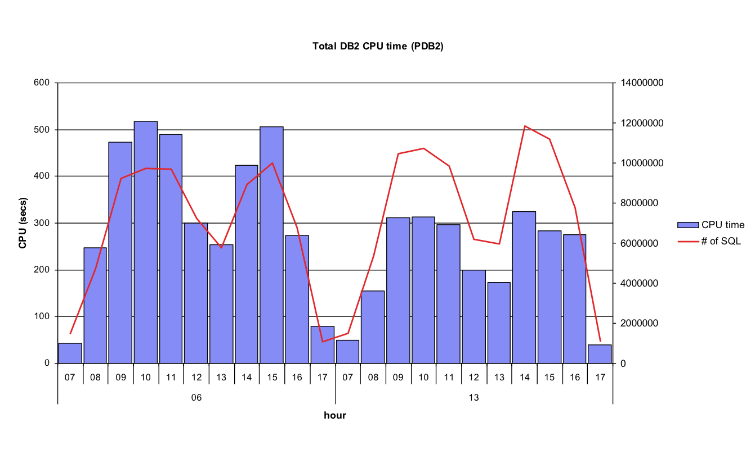
- Effects of mass REBIND: Case study
CPU changes after mass REBIND > 2000 packages
BEFORE

Slide 23
- Effects of mass REBIND: Case study
CPU changes after mass REBIND > 2000 packages
2 important packages went wrong
MIX access path creating RID failures at run time
Operations protected by PLAN STABILITY
AFTER

Slide 24

- RID List processing failures
RID overflow scenarios
Concurrent queries each consuming shared RID pool
Single query requesting > 25% of table or hitting RID pool limit
DB2 9 will fallback to Tablespace Scan
DB2 10 will continue by writing new RIDs to workfile
Avoid the disaster of falling back to TS-Scan
Has no effect on access path selection
PROBLEM: In most cases, a RID list failure becomes a Table Space Scan
PERFORMANCE: Impact on short running SQL in the 10-20% CPU increase range
A lot better than TS scan!
IMPORTANT:
You must REBIND to obtain RID overflow to WF in DB2 10

Slide 25

Db2 plan management

Slide 26

- DB2 PLAN MANAGEMENT
PLAN MANAGEMENT:
Provides protection from access path regression
Also known as Access Path Stability
At REBIND PACKAGE, DB2 saves old PACKAGE copies
Old copies kept in DB2 SPT01 and Catalog tables
Plan management policies:
OFF: DB2 does not save access path information
BASIC: Keep information about the current and one additional access paths know as the previous access path
EXTENDED: DB2 saves information about the current and two additional access paths: known as previous and original copies
DB2 10 default = EXTENDED
Controlling the plan management scope
PLANMGMT subsystem parameter
PLANMGMT REBIND option

Slide 27


- DB2 PLAN MANAGEMENT
REBIND … PLANMGMT(BASIC)
REBIND … PLANMGMT(EXTENDED)
New Copy
Current Copy
Previous Copy
Previous Copy
New Copy
Current Copy
If no Original Copy available
Original Copy

Slide 28
- DB2 PLAN MANAGEMENT
Rebind a package using PLANMGMT(EXTENDED) for the first time
Current (“known safe”) package becomes Previous and Original
EXAMPLE:
REBIND PACKAGE(PDB2PK.PCKGCE0) -
OWNER(PDB2) -
QUALIFIER(PDB2) -
EXPLAIN(YES) -
REOPT(NONE) -
PLANMGMT(EXTENDED)
Previous Copy
New Copy
Current Copy
Using PLANMGMT for the first time
Original Copy

Slide 29

- DB2 PLAN MANAGEMENT: Case study
Performance degradation due to access path change:
SWITCH(ORIGINAL) vs. SWITCH(PREVIOUS)
END TIME PLAN AUTHID CORRID ELAPSED CPU # STMTS GETPAGE REASON
----------- -------- -------- -------- -------- -------- ------- ------- ------
13:58:46 PDB2PLN1 CRIS CRISLRXX 7,254 ms 2,025 ms 19,211 13,497 OK
Previous Copy
Previous Copy
Current Copy
Current Copy
Original Copy
Original Copy
SWITCH(ORIGINAL)
SWITCH(PREVIOUS)

Slide 30
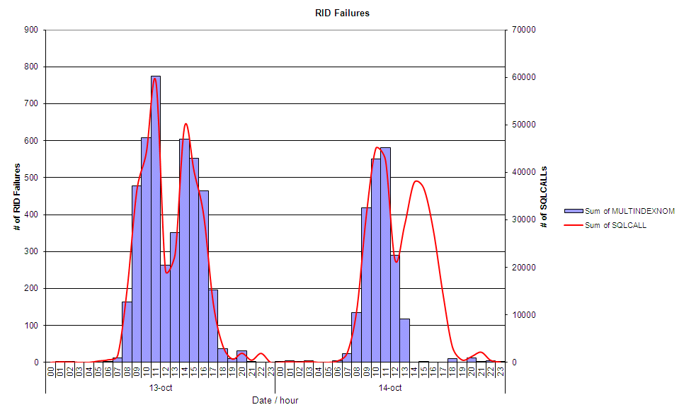
- PLAN MANAGEMENT: Case study
EXAMPLE:
REBIND PACKAGE(PDB2PK.PCKGCE0) -
SWITCH(ORIGINAL)
Notes:
http://publib.boulder.ibm.com/infocenter/dzichelp/v2r2/topic/com.ibm.db2z10.doc.perf/src/tpc/db2z_revertsavedaccesspath.htm

Slide 31
- Some PLAN MANAGEMENT considerations
With EXTENDED → Monitor SPT01 space utilization!
DB2 9 → compress SPT01
APRETAINDUP(NO) DB2 10 REBIND option
Saves Old copies only when they differ from the Active copy
There is no performance impact at runtime
PLAN MANAGEMENT can be used during migration to DB2 10
Provides safer mass-REBIND strategies
TIP:
DB2 10 for z/OS and SPT01 compression:
PM27073: Preconditioning for in-line length of DSNDB01.SPT01
PM27811: DB2 code has been enhanced to allow the in-line length of DSNDB01.SPT01 to be changed. Support for subsystem parameters
SPT01_INLINE_LENGTH
COMPRESS_SPT01

Slide 32
- Getting details about PLAN MANAGEMENT usage
DB2 10
SYSIBM.SYSPACKCOPY contains a row for every package
SYSPACKAGE like for previous and original package copies
No need to SWITCH to see information on inactive copies (V9)
COPYID: 1=PREVIOUS copy, 2=ORIGINAL copy, 0=CURRENT
SELECT
SUBSTR(COLLID,1,10) AS COLLID ,SUBSTR(NAME,1,10) AS NAME ,LASTUSED
,VALID ,OPERATIVE ,COPYID ,PLANMGMT ,APRETAINDUP
FROM SYSIBM.SYSPACKAGE
WHERE COLLID = 'CRISCOLL' AND NAME = 'DSN8CLTC'
UNION ALL
SELECT
SUBSTR(COLLID,1,10) AS COLLID ,SUBSTR(NAME,1,10) AS NAME ,LASTUSED
,VALID ,OPERATIVE ,COPYID ,PLANMGMT ,APRETAINDUP
FROM SYSIBM.SYSPACKCOPY
WHERE COLLID = 'CRISCOLL' AND NAME = 'DSN8CLTC'
WITH UR;
---------+---------+---------+---------+---------+---------+---------+---------+---------+
COLLID NAME LASTUSED VALID OPERATIVE COPYID PLANMGMT APRETAINDUP
---------+---------+---------+---------+---------+---------+---------+---------+---------+
CRISCOLL DSN8CLTC 2012-12-28 Y Y 0 E Y
CRISCOLL DSN8CLTC 2012-07-27 Y Y 1 E Y
CRISCOLL DSN8CLTC 2012-03-01 Y Y 2 E Y
DSNE610I NUMBER OF ROWS DISPLAYED IS 3

Slide 33
- DB2 10 Plan Management Enhancements
EXPLAIN PACKAGE
Extracts in use PLAN_TABLE information for packages
COPY-ID can be CURRENT - PREVIOUS - ORIGINAL
>>-EXPLAIN----PACKAGE----------->
>>-----COLLECTION--collection-name--PACKAGE--package-name--------->
>----+--------------------------+----+-------------------+-------->
| | | |
+---VERSION-version-name---+ +---COPY--copy-id---+
SELECT
SUBSTR(PROGNAME,1,10) AS PROGNAME ,ACCESSTYPE ,MATCHCOLS
,SUBSTR(ACCESSNAME,1,10) AS ACCESSNAME ,INDEXONLY ,PREFETCH
,SUBSTR(HINT_USED,1,25) AS HINT_USED
FROM PLAN_TABLE WHERE PROGNAME = 'DSN8CLTC';
---------+---------+---------+---------+---------+---------+---------+---------+---------+---
PROGNAME ACCESSTYPE MATCHCOLS ACCESSNAME INDEXONLY PREFETCH HINT_USED
---------+---------+---------+---------+---------+---------+---------+---------+---------+---
DSN8CLTC I 1 XEMP_PHOTO N EXPLAIN PACKAGE: COPY 0
DSN8CLTC I 1 XEMP_PHOTO N EXPLAIN PACKAGE: COPY 1
DSN8CLTC R 0 N S EXPLAIN PACKAGE: COPY 2
DSNE610I NUMBER OF ROWS DISPLAYED IS 3
IMPORTANT:
Only works for packages bound in DB2 9 or later.
Uses information in the Explain Data Block (EDB)

Slide 34
- DB2 10 Plan Management Enhancements
BIND/REBIND EXPLAIN(ONLY)
Populates EXPLAIN tables but does not create a package
The existing package is not dropped or replaced
Even if ACTION(REPLACE) is specified
PLAN_TABLE.BIND_EXPLAIN_ONLY = ‘Y’
---------+---------+---------+---------+---------+---------+---------+---------+-----
PROGNAME ACCESSTYPE MATCHCOLS ACCESSNAME INDEXONLY PREFETCH BIND_EXPLAIN_ONLY
---------+---------+---------+---------+---------+---------+---------+---------+-----
DSN8CLTC I 1 XEMP_PHOTO N N
DSN8CLTC I 1 XEMP_PHOTO N N
DSN8CLTC I 1 XEMP_PHOTO N N
DSN8CLTC I 1 XEMP_PHOTO N N
DSN8CLTC I 1 XEMP_PHOTO N Y
DSN8CLTC I 1 XEMP_PHOTO N N
DSN8CLTC I 1 XEMP_PHOTO N N
IMPORTANT:
BIND/REBIND EXPLAIN(ONLY) requires the same level of locking and concurrency than traditional BIND/REBIND

Slide 35
- DB2 EXPLAIN survival Guide
BIND/REBIND with EXPLAIN(YES)
Generates a new access path
Populates PLAN_TABLE
Creates new package
BIND/REBIND with EXPLAIN(ONLY)
Generates a new access path
Populates PLAN_TABLE
Does NOT create a new package
EXPLAIN PLAN (i.e. SPUFI)
Generates a new access path and populates PLAN_TABLE
EXPLAIN PACKAGE
Does NOT generate new access path.
Extracts existing access path from package and populates PLAN_TABLE

Slide 36
- DB2 10 Plan Management Enhancements
PM25679: ACCESS PATH ENHANCEMENT
PM25679 July 2011, late addition to DB2 10
New BIND/REBIND option APCOMPARE
Access path comparison across BIND/REBIND
New BIND/REBIND option APREUSE
“Freeze” access path across BIND/REBIND
Example:
REBIND with PLANMGMT(EXTENDED) APREUSE(ERROR)
..then…
REBIND EXPLAIN(ONLY) failing packages and check access path changes
Can be combined with PLANMGMT
IMPORTANT:

Slide 37

- APCOMPARE
Determines if new access path is different
Optionally STOP BIND/REBIND
APCOMPARE(NO) → Default
APCOMPARE(WARN)
RC=4
Package processing continues
APCOMPARE(ERROR)
RC=8
Package processing ends
DB2 provides results via messages and PLAN_TABLE information
PLAN_TABLE.REMARKS populated to indicate a failure
PLAN_TABLE.HINT_USED = ‘APREUSE’ if ended OK
IMPORTANT:
Only works for packages bound in DB2 9 or later.
Uses information in the Explain Data Block (EDB)

Slide 38

- APREUSE
Allows a package to reuse access paths for static SQL
APREUSE(NO) → Default
APREUSE(ERROR)
RC=8
Package processing ends
There is no APREUSE(WARN) option ☹
Some limitations applies
Consider the feature as being using HINTS
Will not work always: reported 1% to 5% “failure” ratio
A single failed query will fail the whole package
IMPORTANT:
Allows to obtain DB2 10 updated runtime structures without changing access path
IMPORTANT:
Only works for packages bound in DB2 9 or later.
Uses information in the Explain Data Block (EDB)

Slide 39
- Some example scenarios
Example 1: Mass REBIND after maintenance application:
Retain the existing access paths and rebuild the runtime structures:
REBIND PACKAGE with:
PLANMGMT(EXTENDED) save existing access paths
APREUSE(ERROR) accept only unchanged access paths
Use EXPLAIN(ONLY) to investigate rejected access paths
Alternatively: use APCOMPARE(WARN) instead of APREUSE to get alerted on access paths changes at REBIND
Use REBIND SWITCH to restore access paths with problems
Example 2: Skip migration DB2 V8 to DB2 10:
REBIND in DB2 10CM using PLANMGMT(EXTENDED)
Allows you to REBIND SWITCH in case of performance issues
APREUSE will not be available on this scenario, but you can still use HINTS if the PLAN_TABLE information is available
More details here :http://publib.boulder.ibm.com/infocenter/dzichelp/v2r2/topic/com.ibm.db2z10.doc.perf/src/tpc/db2z_managepathsmaint.htm

Slide 40
- Tracing Dynamic STMT Cache
IFCID 316: reports on the contents of the prepared SQL in the Global Dynamic STMT cache
IFCID 317: provides the SQL statement text from the DSC
DSN_STATEMENT_CACHE_TABLE
A row for each SQL statements in the global DSC
STMT_TEXT is a CLOB(2M) → table can grow quickly!
hlq.SDSNSAMP(DSNTESC)
Use SQL for performance investigation:
TIP: use EXPLAIN STMTCACHE ALL to explain ALL the STMTs in the DSC
EXAMPLE:
SELECT STMT_ID, STAT_CPU, STAT_EXEC, STAT_GPAG, STAT_TS
FROM DSN_STATEMENT_CACHE_TABLE
ORDER BY EXPLAIN_TS DESC, STAT_CPU DESC
FETCH FIRST 5 ROWS ONLY;

Slide 41
- Tracing Dynamic STMT Cache
PLAN_TABLE: access path as in the Global DSC; QUERYNO
DSN_STATEMNT_TABLE; QUERYNO
DSN_FUNCTION_TABLE; QUERYNO
Extended explain tables are not populated (there is no EXPLAIN)
---------+---------+---------+---------+---------+---------+---------+---------+---------+
STMT_ID STAT_CPU STAT_EXEC STAT_GPAG STAT_TS
---------+---------+---------+---------+---------+---------+---------+---------+---------+
56 +0.8689610673493030E+02 1843 16587 2011-04-27-08.36.38.697014
50 +0.5469929887360217E+02 1157 10404 2011-04-27-08.36.38.697014
54 +0.1787785722321155E+02 1848 14942 2011-04-27-08.36.38.697014
55 +0.1724589921539905E+02 9343 27555 2011-04-27-08.36.38.697014
51 +0.1501635670755424E+02 3682 11046 2011-04-27-08.36.38.697014
DSNE610I NUMBER OF ROWS DISPLAYED IS 5
DSNE616I STATEMENT EXECUTION WAS SUCCESSFUL, SQLCODE IS 100
---------+---------+---------+---------+---------+---------+---------+---------+---------+
TIP: use EXPLAIN STMTCACHE STMTID # to explain a single STMT in the DSC
EXAMPLE:
EXPLAIN STMTCACHE STMTID 56;

Slide 42

Db2 high performance dbats

Slide 43
- Benefits of HP DBAT + RELEASE(DEALLOCATE)
DB2 10 High Performance DBAT reduces CPU consumption by:
Supporting RELEASE(DEALLOCATE)
Avoid repeated package allocation/de-allocation
Avoids acquiring and releasing parent (IS, IX) locks frequently
Avoids the processing necessary to go INACTIVE and then back to ACTIVE
More noticeable CPU reduction for short transactions
Behavior
DBAT will stay associated with connection at UOW boundaries if there is at least one RELEASE(DEALLOCATE) package allocated
DBAT will be terminated after 200 uses
Normal idle thread time-out IDTHTOIN detection will be applied to these DBATs
TIP:
No benefit and not support for ACTIVE threads (CMSTATS=ACTIVE)
TIP:
No benefit for KEEPDYNAMIC YES

Slide 44
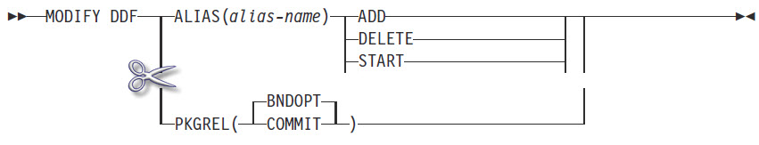
- DIS DDF DETAIL in DB2 10
DSNL080I -DB0A DSNLTDDF DISPLAY DDF REPORT FOLLOWS:
DSNL081I STATUS=STARTD
DSNL082I LOCATION LUNAME GENERICLU
DSNL083I DB0A USIBMSC.SCPDB0A -NONE
DSNL084I TCPPORT=12345 SECPORT=12346 RESPORT=12347 IPNAME=-NONE
DSNL085I IPADDR=::10.50.1.1
DSNL086I SQL DOMAIN=wtsc63.itso.ibm.com
DSNL087I ALIAS PORT SECPORT STATUS
DSNL088I ABC 0 0 STOPD
DSNL088I TEST 0 0 STOPD
DSNL088I TEST2 0 0 STOPD
DSNL090I DT=I CONDBAT= 10000 MDBAT= 200
DSNL092I ADBAT= 0 QUEDBAT= 0 INADBAT= 0 CONQUED= 0
DSNL093I DSCDBAT= 0 INACONN= 1
DSNL105I CURRENT DDF OPTIONS ARE:
DSNL106I PKGREL = COMMIT
DSNL099I DSNLTDDF DISPLAY DDF REPORT COMPLETE

Slide 45
- Exploiting High Performance DBATs
To enable:
To disable:
To monitor:
Statistics GLOBAL DDF activity report
REBIND with RELEASE(DEALLOCATE)
-MODIFY DDF PKGREL (BNDOPT)
STC12396 DSNL300I -DB0A DSNLTMDF MODIFY DDF REPORT FOLLOWS:
DSNL302I PKGREL IS SET TO BNDOPT
DSNL301I DSNLTMDF MODIFY DDF REPORT COMPLETE
-MODIFY DDF PKGREL (COMMIT) to overlaid BNDOPT option
GLOBAL DDF ACTIVITY QUANTITY
-------------------------- ---------
CUR ACTIVE DBATS-BND DEALLC 5.39
HWM ACTIVE DBATS-BND DEALLC 10.00

Slide 46
- Implement gradually or selectively
BIND a new set of packages with RELEASE(DEALLOCATE)
SYSSHxyy
S: Represents a small package (65 sections)
H: Represents WITH HOLD
x: Indicates the isolation level
1=UR, 2=CS, 3=RS, 4=RR
yy: The package iteration 00 through FF
BIND PACKAGE(DRDADEALLOC)
QUAL(DB2R1)
OWNER(DB2R1)
COPY(NULLID.SYSSH200)
SQLERROR(NOPACKAGE)
ISOL(CS)
REL(D)
CURRENTD(N)
ACTION(REPLACE)
KEEPDYNAMIC(N)
V I V O Quali- R E D
S Collection Name Owner Bind Timestamp D S A P fier L X R
-- ------------------ -------- -------- ---------------- - - - - -------- - - -
DRDADEALLOC SYSSH200 DB2R1 2011-02-25-15.01 R S Y Y DB2R1 D N R
NULLID SYSSH200 DB2R1 2011-02-22-20.35 R S Y Y DB2R1 C N R
******************************* END OF DB2 DATA *******************************

Slide 47
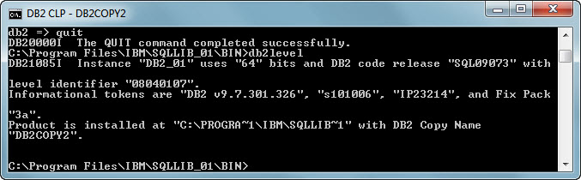
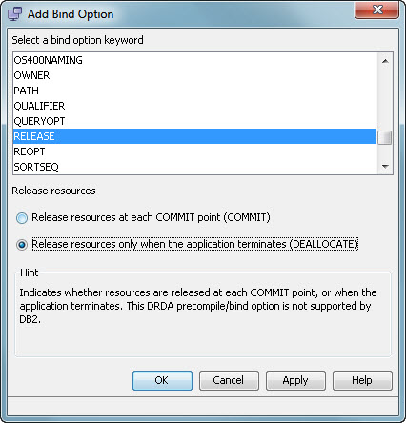
- DB2 Client and DB2 10
DB2 10 requires DB2 Client 9.7 Fixpack 3a
RELEASE(DEALLOCATE) → default

Slide 48
- RELEASE(COMMIT) vs RELEASE(DEALLOCATE)
Total CPU per txn = System Services Address Space + Database Services Address Space + IRLM + DDF Address Space CPU
CPU time in microseconds.
Total CPU per transaction | V9 | V10 PKREL(COMMIT) | Delta (%) | V10 PKREL(BNDOPT) | Delta (%)
SQCL | 2114 | 1997 | -5.5 | 1918 | -9.3
SPCB | 1221 | 1124 | -7.9 | 1056 | -13.5
JDBC | 2152 | 2017 | -6.3 | 1855 | -13.8
SQLJ | 1999 | 1761 | -11.9 | 1689 | -15.5
SPSJ | 1759 | 1642 | -6.7 | 1550 | -11.9
SPNS | 1472 | 1304 | -11.4 | 1180 | -19.8

Slide 49
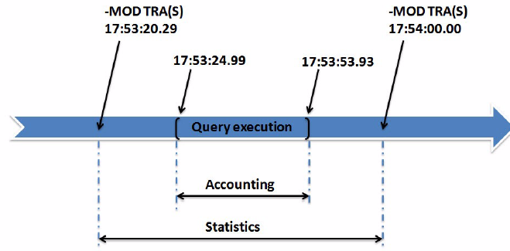
- Do not forget the DB2 Address Spaces
A complete benchmark must consider CPU in DB2 AS
Follow these steps
Issue a MODIFY TRACE command to produce a new statistics record before starting your testing
As the single user of the DB2 subsystem, perform the tests
Issue again a MODIFY TRACE command

Slide 50
Summary and conclusions

Slide 51
- This was our agenda today
The need for REBIND
Case study
PLAN MANAGEMENT
DB2 10 High Performance DBATS
Summary and conclusions

Slide 52

- More to investigate and to explore
Production modeling using profiles
New zparms
SIMULATED_CPU_SPEED
SIMULATED_COUNT
Cloning RUNSTATS from production to test environments
Migrating soon?
Review PLAN_TABLE requirements
Prepare a REBIND strategy
Investigate new DB2 messages
DSNT292I: DB2 WAS UNABLE TO FIND A PRE-EXISTING PACKAGE TO OBTAIN PRIOR ACCESS PATHS. APCOMPARE AND/OR APREUSE OPTIONS WERE IGNORED
Statement level HINTS + DSN_USERQUERY_TABLE
Package RE/BIND or dynamic prepare

Slide 53

- Time for a new (RE) BIND strategy?
Getting the most of DB2 requires BIND / REBIND
New tools and techniques help to reduce risks
No strategy at all is the worst strategy
Please be kind and REBIND, but do it safely…

Slide 54
- A classic of the DB2 literature
To REBIND or not to REBIND, “When?” is the question:
Whether 'tis nobler in the mind to suffer the slings and
arrows of outrageous access paths, Or to take arms against a sea of troubles, And by rebinding, end them?
To die: to sleep;
No more; and by a sleep to say we end
the heart-ache and the thousand natural shocks that old
plans are heir to. ‘tis a consummation devoutly to be wished.
To die, to sleep.
To sleep: perchance to dream: aye, there’s the rub;
For in that sleep of death what dreams may come when plans have shuffled off this mortal coil,
must give us pause: There’s the respect that makes calamity
of so long life for old plans and packages;
[Apologies to the Bard and to Hamlet act 3 scene 1.]
GREAT EXPECTATIONS: DB2 10 PERFORMANCE
Roger Miller, IDUG Solutions Journal - Spring 2011
Notes:
To rebind or not to rebind, “When?” is the question: Whether 'tis nobler in the mind to suffer the slings and
arrows of outrageous access paths, Or to take arms against a sea of troubles, And by rebinding, end them? To
die: to sleep; No more; and by a sleep to say we end the heart-ache and the thousand natural shocks that old
plans are heir to. ‘tis a consummation devoutly to be wished. To die, to sleep. To sleep: perchance to dream: aye,
there’s the rub; For in that sleep of death what dreams may come when plans have shuffled off this mortal coil,
must give us pause: There’s the respect that makes calamity of so long life for old plans and packages; *Apologies
to the Bard and to Hamlet act 3 scene 1.]

