Slide 1
Scale | K=7 | K=9 | K=9 (Adj 1)
2 | 0.7101375670699078 | 0.7110013579741475 | 0.7237004327996567
3 | 0.4346850329159785 | 0.4331253015602313 | 0.43505821563495195
4 | 0.34473398252048015 | 0.41107447055793794 | 0.3732456163796626
5 | 0.36757373907140656 | 0.36937936872741456 | 0.3708393801497519
10 | 0.1594092701611137 | 0.16584241530720034 | 0.17592345230450118
100 | 0.007835667649324184 | 0.008315838325366053 | 0.008008158848788752
 | 32635 | 274 | 7658 | 8960 | 8540 | 99 | 672 | 1282 | 492 | 1648 | 1705 | 607 | 698
 |  | 'Subject Focus' | 'Eyes' | 'Face' | 'Near' | 'Action' | 'Accessory' | 'Group' | 'Collage' | 'Human' | 'Occlusion' | 'Info' | 'Blur'
Adj 1 | 1 | 0.008395894 | 0.234656044 | 0.274551861 | 0.261682243 | 0.003033553 | 0.02059139 | 0.039282978 | 0.015075839 | 0.050497932 | 0.052244523 | 0.018599663 | 0.02138808

Slide 2
F1_Score (472 Features Used)
Model (Using New Features) | Scale 2 | Scale 3 | Scale 4 | Scale 5 | Scale 10
KNN (k=9) | 0.7221585931034439 | 0.46732568463220353 | 0.4153729470835422 | 0.3994351176424011 | 0.20369004599023197
BernoulliNB | 0.6995545093109174 | 0.3827375466059408 | 0.38699328665978183 | 0.35943531532049455 | 0.1782627716170566
MultinomialNB | 0.7294884256670239 | 0.46101479549555274 | 0.40550711838991416 | 0.385131432883749 | 0.19889422709580085
GaussianNB | 0.7431560778585475 | 0.43076387104512126 | 0.26452264399061476 | 0.24256135770726184 | 0.08451262997683431
Logistic Regression | 0.7456156571237389 | 0.4750788815080421 | 0.4321313059958879 | 0.40265310769678164 | 0.21717970100742184
DecisionTreeClassifier | 0.7267112713227708 | 0.48352625634697727 | 0.4207882841443314 | 0.37905883678646185 | 0.20542761982611238
RandomForestClassifier | 0.7497312362849147 | 0.506979781511527 | 0.4199766541053637 | 0.4026626758499844 | 0.21678623330678393
AdaBoostClassifier | 0.7077878806353369 | 0.4957521851173089 | 0.38010071822142255 | 0.35943531532049455 | 0.18296979657549253
svm.LinearSVC | 0.7462301287477798 | 0.47030606207176834 | 0.43232262540021227 | 0.40457248462530865 | 0.21695743276149096
svm.SVC(kernel="poly“) | 0.7390464635317013 | 0.47757634251282627 | 0.44041971287556086 | 0.41231877674610873 | 0.2106748389607841
svm.SVC(kernel="rbf“) | 0.7279773519630485 | 0.4728385233257737 | 0.4315765100207354 | 0.40813321445890766 | 0.21637658508249327
svm.SVC(kernel="linear" | 0.7305975574407493 | 0.462882004304889 | 0.40434414117230033 | 0.388175835249604 | 0.2017562101613773
MLPClassifier (NN) (20,20,20) | 0.7120088816414571 | 0.46798273577790606 | 0.4323870864493302 | 0.4037645002218544 | 0.20175751235647402
MLPClassifier (NN) (100,100,100) | 0.7224232639086609 | 0.4748147981457058 | 0.41206468064734486 | 0.3870277645660342 | 0.21290383032800658

Slide 3
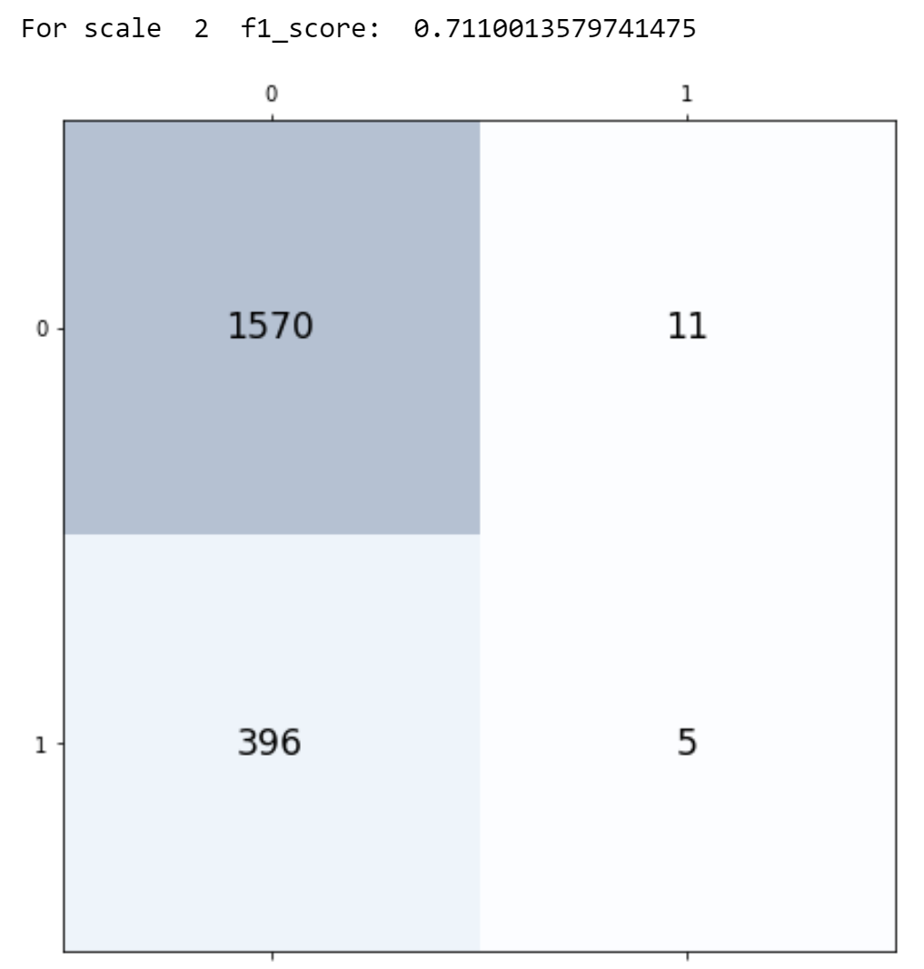
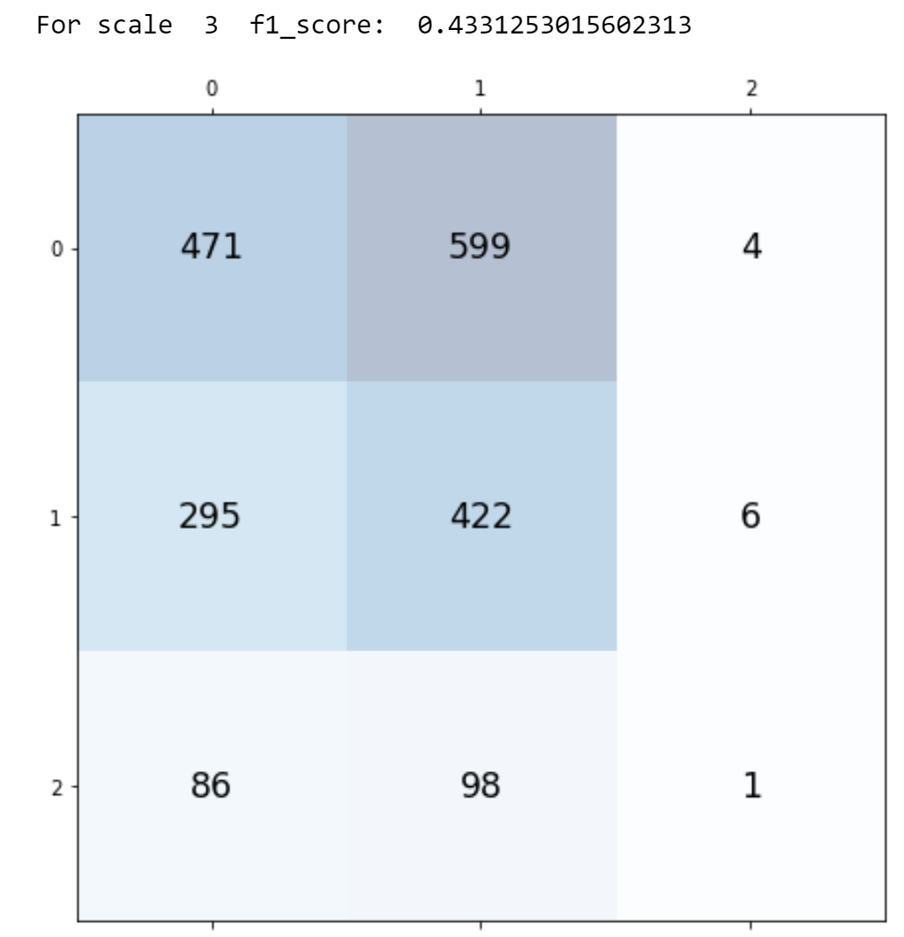
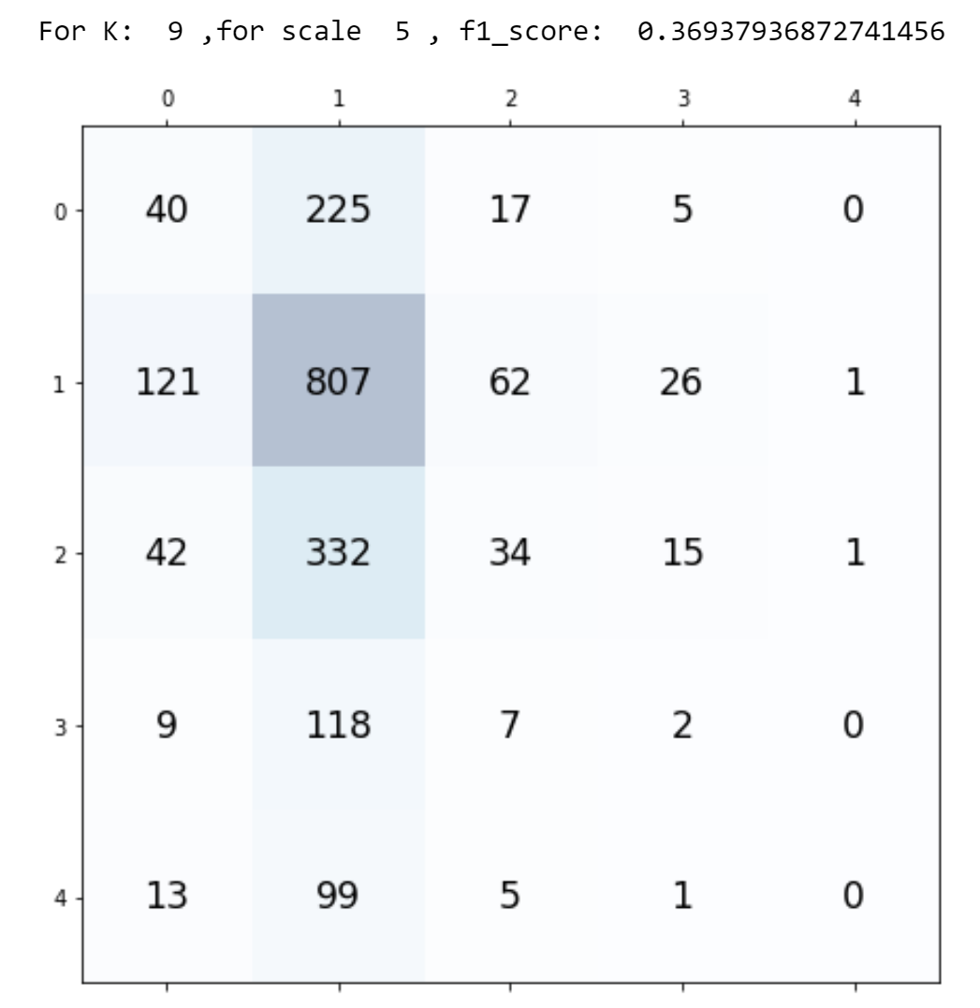
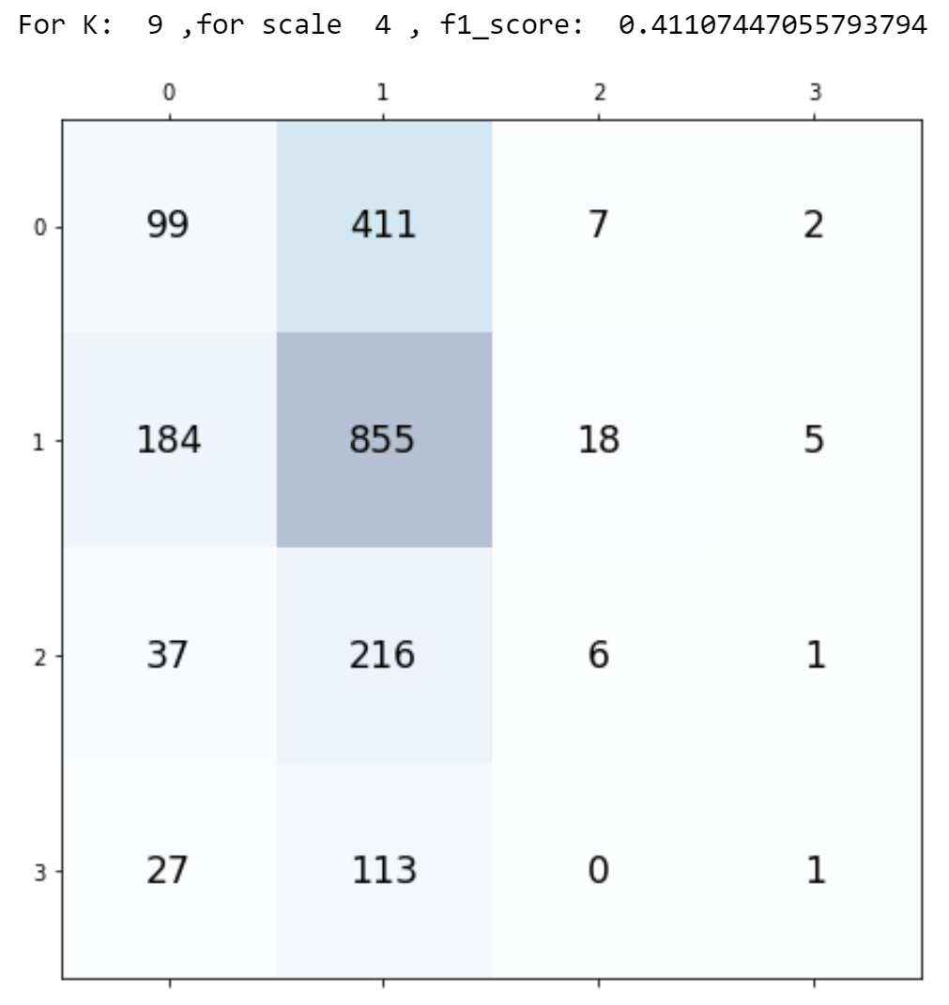

Slide 4
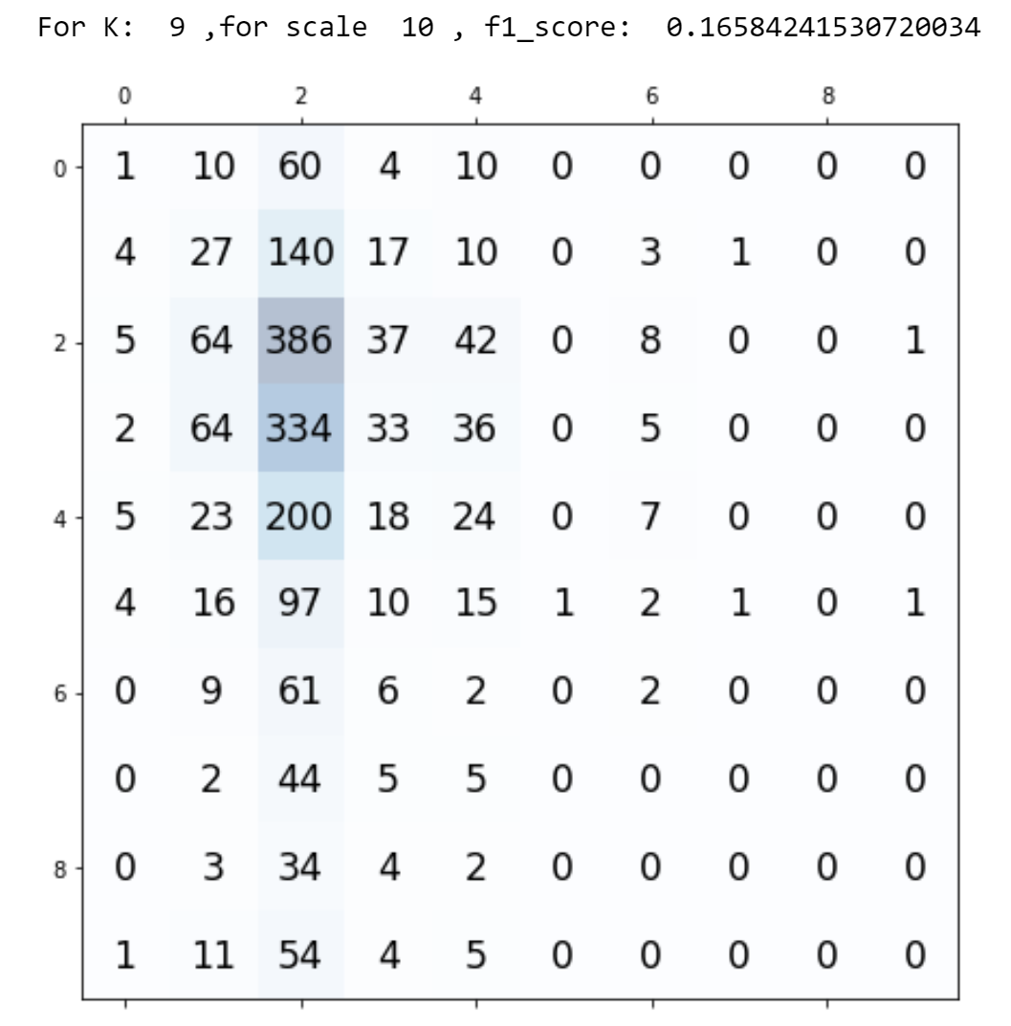

Slide 5
OLD SLIDES

Slide 6
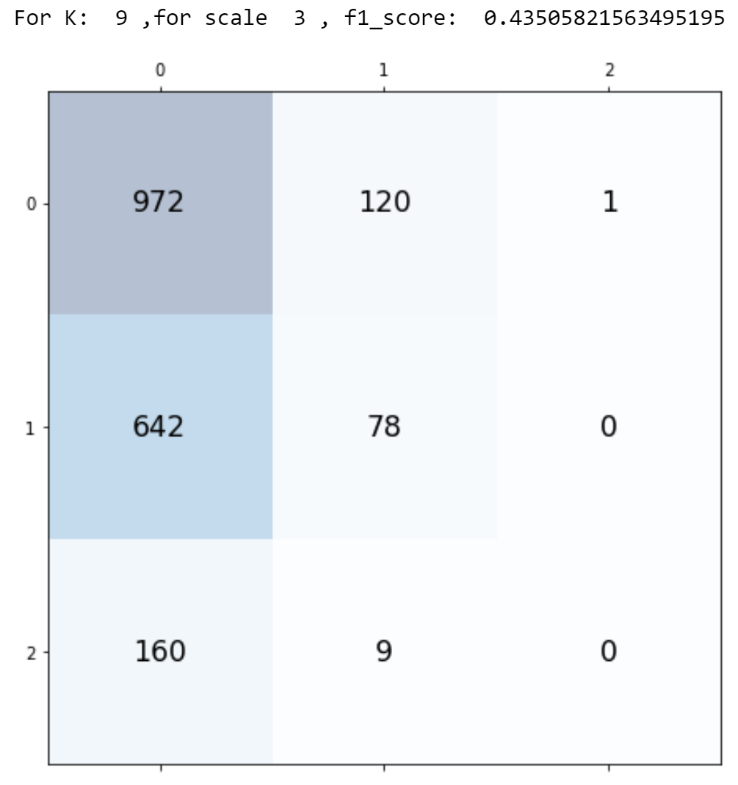
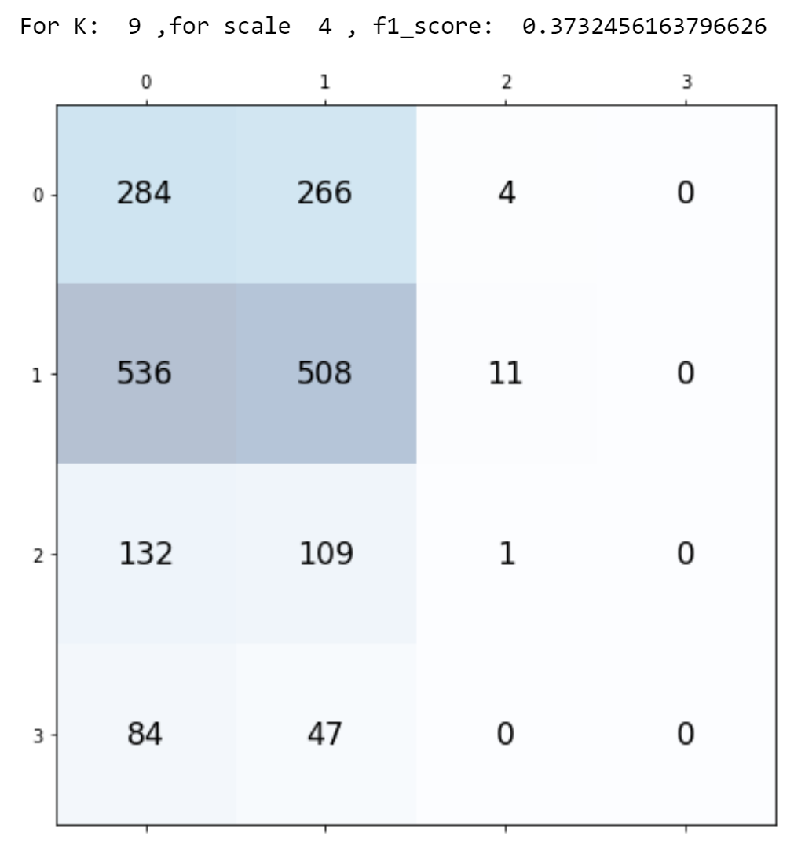
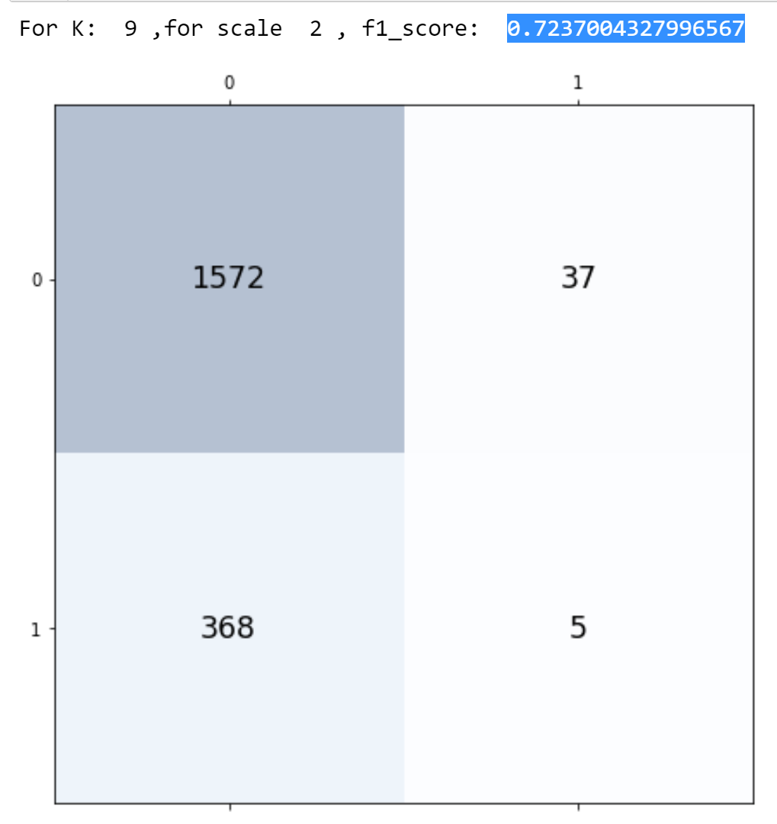
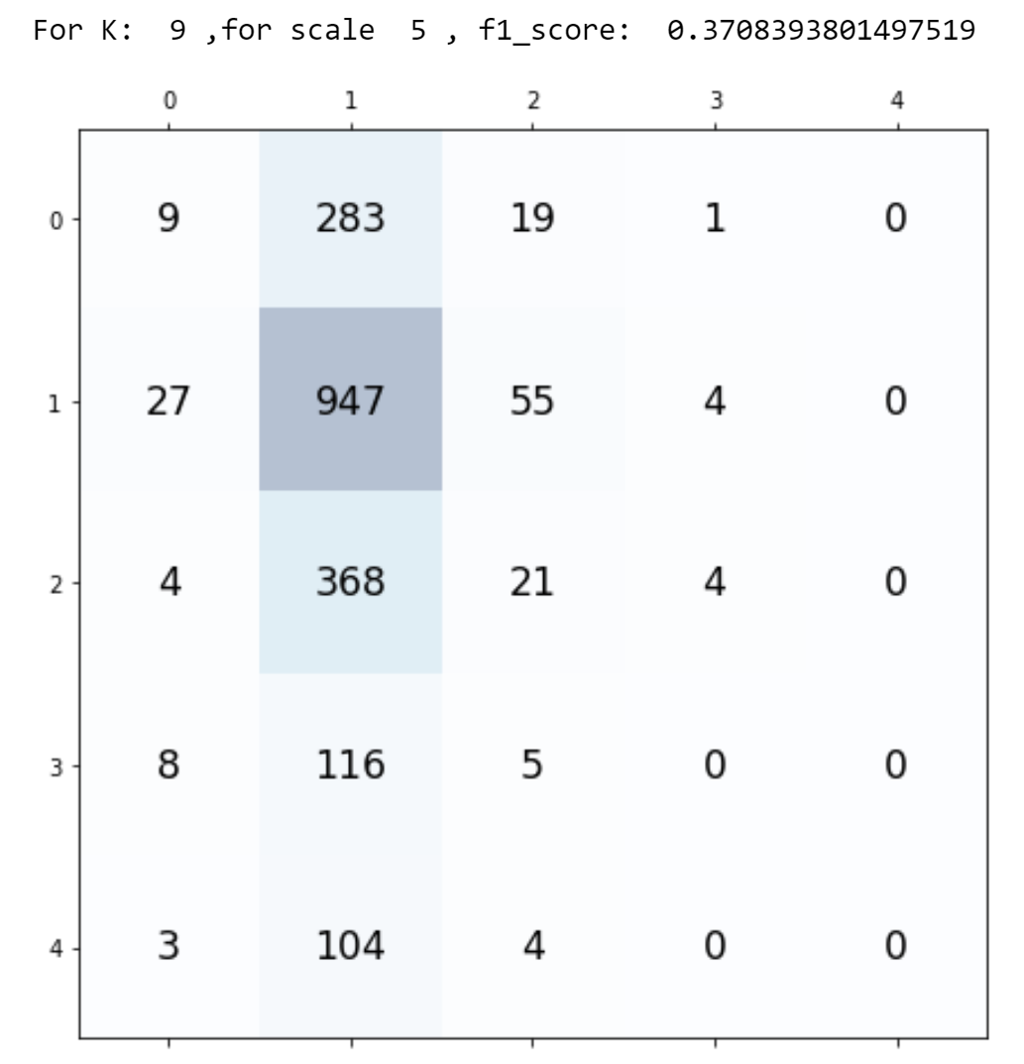

Slide 7
