Slide 1
MyMenu
CMPUT 401

Slide 2
Product Overview
MyMenu is an App that is meant for users with food limitations that want to have an easy way to find out foods they can eat. The App has the Restaurants sign up and upload their menus to the online database. Users will be able to log in to their account, which holds their food preferences and restrictions. They will be able to see Restaurants near them, select them and then look at the menu for whatever restaurant they choose. The menu will show only the items that the user can eat based on the profile. Users will also be able to see specials that restaurants will advertise. The App will be available for iOS and Android.

Slide 3
Example User Scenarios
A user that has a peanut allergy will be able to see food a restaurant offers that will cause an allergic reaction.
If the user still wants an item, they can check to see if the item can be altered to fit their dietary needs.

Slide 4
Chosen Architecture
We used Objective-C and Java to make two separate native tablet applications.
We used MVC in both projects
We used the clients existing server and database schema
The clients database uses MYSQL

Slide 5
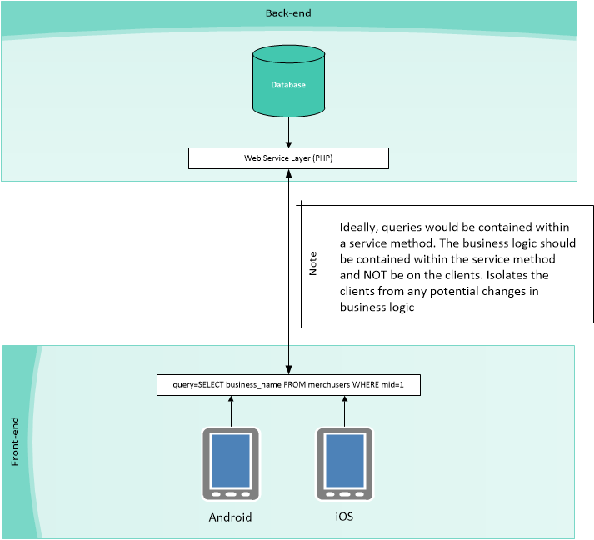

Slide 6
Implementation Challenges
Creating views in a set orientation then trying to change over. i.e) landscape to portrait
Trying to create consistency between our design implementation on a tablet and the clients existing phone design.

Slide 7
Management Challenges
We did not have any true management problems.
We took turns addressing, creating and assigning issues.
We met 3-4 times a week so communication between members was not a problem
Client responded to questions in a quick and efficient manner

Slide 8
What we thought worked
Pair Programming
Meeting often and communicating on a regular basis
Having a single client contact to funnel information

Slide 9
What we learned
All of the members learned Objective-C and iOS.
MySQL Trigger Syntax
Members learnt proper software engineering techniques
Proper Github source control

Slide 10
Open Source
 | iOS | Android
Networking | AFNetworking | OkHttp, Retrofit
Serialization | RaptureXML | SimpleXML
Calendar | TimesSquare | TimesSquare
Concurrency | ReactiveCocoa, ReactiveViewModel | RxJava
Image Loading | SDWebImageView | Picasso
Testing | OMock | Retrofit-Mock, Spoon, Esspreso

Slide 11
What we would do differently
Develop an iOS project in both orientations as you go.
Develop both applications simultaneously.
Better separation of concerns with respect to business logic.

Slide 12
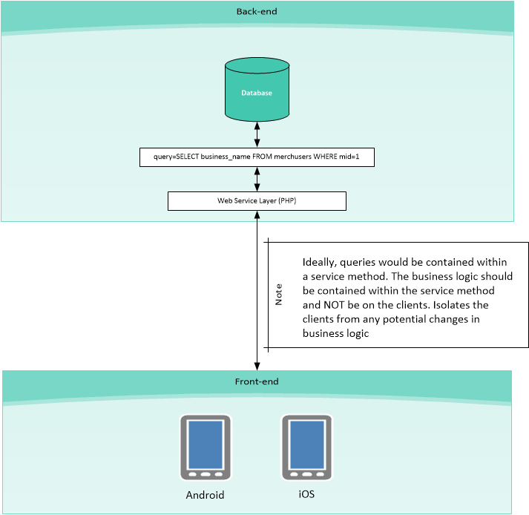

Slide 13
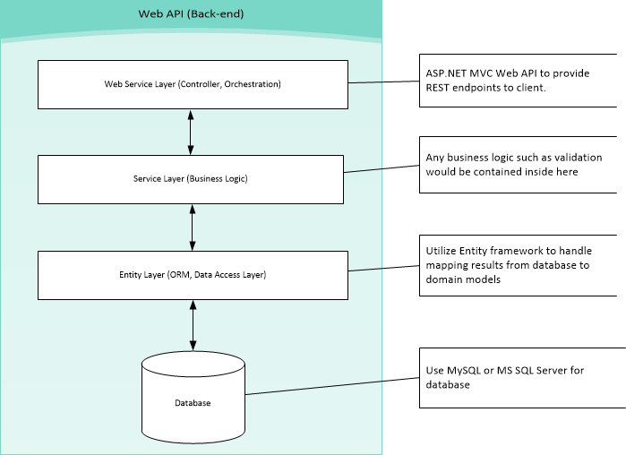

Slide 14
Questions?

