Slide 1
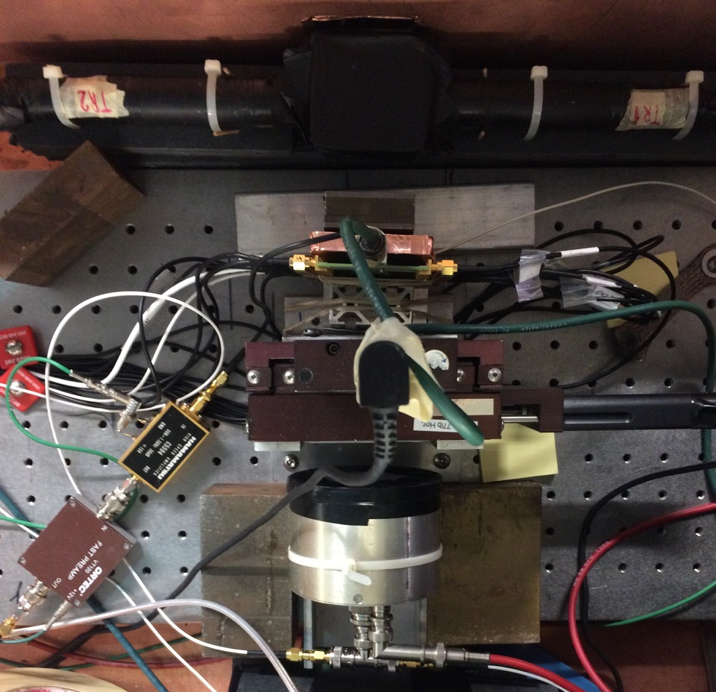
Tungsten Absorber
Beam Direction
Photek 240 MCP-PMT
Silicon Pad Sensor

