Slide 1
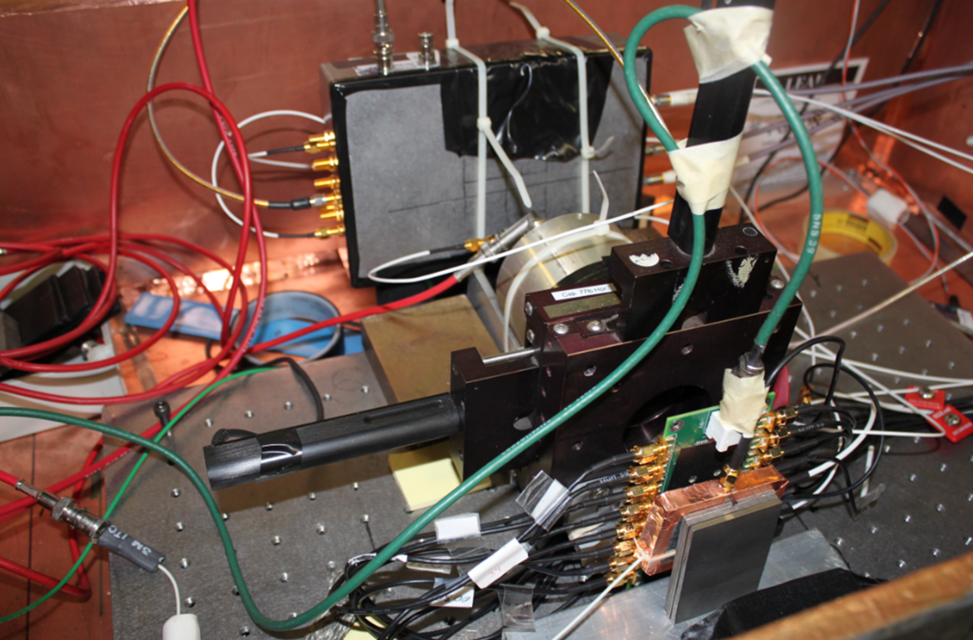
Photek 240 MCP-PMT
Tungsten Absorber
Silicon Pad Sensor
Beam Direction

