Slide 1
Machine Learning Workshop: Model Evaluation

Slide 2
Selecting data for model evaluation
Training
Validation
Test

Slide 3
Selecting data for model evaluation
Training
Validation
Test
Use the majority of the data to train/fit the model, providing many examples to “learn” from.
Never use these examples to evaluate model performance!
Reason: Observations used to train the model will have higher model performance simply because the model has already seen this data.

Slide 4
Selecting data for model evaluation
Training
Validation
Test
Leave out a proportion of the data to adjust or ”tune” model parameter settings (e.g., the number of nearest neighbors).
Note: We only use this to evaluate the effect of adjusting these parameters, and performances based on these points.
Similar to training data, by continuously adjusting the model for the best results, we indirectly provide the model the validation labels. The model parameters are become biased toward the validation set.

Slide 5
Selecting data for model evaluation
Training
Validation
Test
The left out test set informs us how well the models perform.
This data has not been seen by the models (either directly or indirectly) and therefore will be a fair assessment of how well the model can perform for the classification task.

Slide 6
K-Fold Cross-Validation
Training
Test
Round 1
1
2
…
K-1
K
Round 2
1
2
…
K-1
K
Take the average performance across all rounds of training to evaluate model parameters
...
1
2
…
K-1
K
Round K-1
1
2
…
K-1
K
Round K
1
2
…
K-1
K
Validation Set for Round K

Slide 7
Scikit Function for Applying K-Fold
import numpy as np
from sklearn.model_selection import KFold
X = np.array([[0, 11],
[1, 22],
[2, 33],
[3, 44]])
kf = KFold(n_splits=4, shuffle=True)
for X_train, X_test in kf.split(X):
#Train the model (i.e., model.fit(X[X_train])
#Test the model (i.e., model.predict(X[X_test])
#Try print(X[X_Train]) and print(X[X_test])!

Slide 8
Stratifying Class Labels
Training
Test
Validation
Classes not represented in validation or test data selection
Data stratified by class labels
Class A
Class B

Slide 9
Stratified K-Fold Function in Scikit
import numpy as np
from sklearn.model_selection import StratifiedKFold
X = np.array([[0, 11],
[1, 22],
[2, 33],
[3, 44]])
y = np.array([0, 0, 1, 1])
skf = StratifiedKFold(n_splits=2, shuffle=True)
for X_train, X_test in skf.split(X,y):
#Train the model (i.e., model.fit(X[X_train])
#Test the model (i.e., model.predict(X[X_test])
#Try print(X[X_Train]) and print(X[X_test])!

Slide 10
Train Test Split Function
import numpy as np
from sklearn.model_selection import train_test_split
X = np.array([[0, 11],
[1, 22],
[2, 33],
[3, 44]])
y = np.array([0, 0, 1, 1])
X_train, X_test, y_train, y_test = train_test_split( X, y, test_size=0.5, stratify=y)
print(X_train)

Slide 11
Parameter Tuning
Machine learning models have parameters which can change classification results.
Example: K-Nearest Neighbor (sklearn.neighbors.KNeighborsClassifier)
n_neighbors: The number of neighbors used by the classifier to make a decision.
weights: Parameter for applying weights to the nearest neighbors.
p: The power parameter for the distance metric.

Slide 12
Grid Search
Number of Neighbors
3
5
7
11
13
15
17
1
2
p
3
4
5
Basic Idea: Run all model parameter combinations (i.e., brute force) and choose the best one.

Slide 13
Grid Search with Scikit
from sklearn.model_selection import GridSearchCV
from sklearn.neighbors import KNeighborsClassifier
parameters = {'p’:[1,2,3,4,5],
'n_neighbors’:[3,5,7,11,13,15,17]}
knn = KNeighborsClassifier()
gsc = GridSearchCV(knn, parameters)
gsc.fit(gs_data, gs_target)
gsc.cv_results_['mean_test_score']
gsc.cv_results_['params']

Slide 14
Confusion Matrix
Class A
80
20
True Label
Class B
40
60
Class A
Class B
Predicted Label
Accuracy = 80+60/(80+20+40+60) = 140/200 = 0.70 = 70%

Slide 15
Accuracy Can Be Misleading
Class A
90
0
True Label
Class B
10
0
Class A
Class B
Predicted Label
Accuracy = 90+0/(90+0+10+0) = 90/100 = 0.90 = 90%

Slide 16
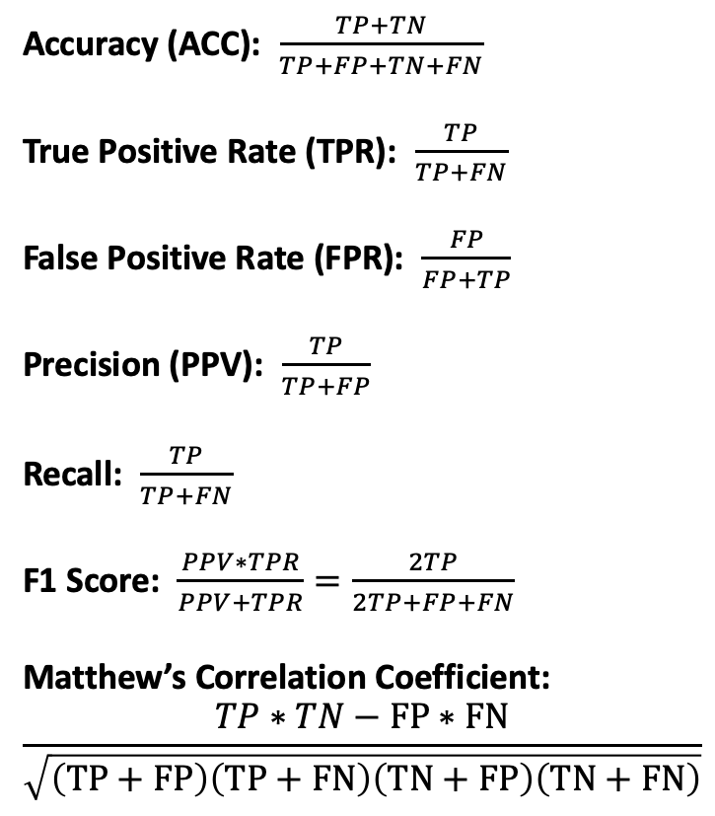
Other Metrics
Accuracy (ACC): $\frac{TP+TN}{TP+FP+TN+FN}$
True Positive Rate (TPR): $\frac{TP}{TP+FN}$
False Positive Rate (FPR): $\frac{FP}{FP+TP}$
Precision (PPV): $\frac{TP}{TP+FP}$
Recall: $\frac{TP}{TP+FN}$
F1 Score: $\frac{PPV∗TPR}{PPV+TPR}=\frac{2TP}{2TP+FP+FN}$
Matthew’s Correlation Coefficient:
$$\frac{TP∗TN−FP∗FN}{\sqrt{\left(TP+FP\right)\left(TP+FN\right)\left(TN+FP\right)\left(TN+FN\right)}}$$
True
Positive
(TP)
False Negative
(FN)
Class A
True Label
False Positive
(FP)
True Negative
(TN)
Class B
Class A
Class B
Predicted Label

Slide 17
Metrics with Scikit
y_pred = [0, 1, 0, 1]
y_true = [0, 1, 0, 0]
from sklearn.metrics import accuracy_score
acc = accuracy_score(y_true, y_pred)
acc
from sklearn.metrics import f1_score
f1 = f1_score(y_true, y_pred)
f1
from sklearn.metrics import matthews_corrcoef
mcc = matthews_corrcoef(y_true, y_pred)
mcc

Slide 18
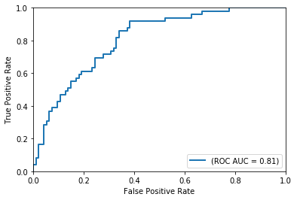
Receiver Operating Characteristic (ROC) Curve

Slide 19
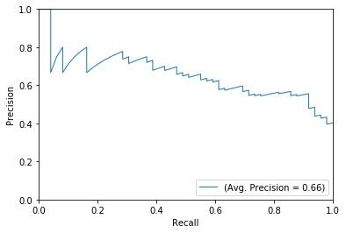
Precision Recall (PRC) Curve

Slide 20
Exercise
Using the mouse protein dataset (MiceProtein_2f2c.csv):
Split the data into training and testing sets, stratifying by class labels
Run grid search cross validation on the training set using KNN classifier for n_neighbors and p
Plot ROC and PRC curves using a KNN classifier with the best parameters on the test dataset
Hint: Use one KNN classifier to fit a grid search model to find the best parameters, then create a new KNN classifier setting the best parameters observed, fit the training data, and predict the probabilities from the test data

Slide 21
Context Specific Data Selection: Splitting Data by Chromosome
Example: Consider training a machine learning model that classifies transcription start sites (TSS) using DNA sequence as features.
ACTCGGTGCGAGGTGACGATTCCGAGATGGACCAGTAGAGCAGATCCTG
TSS Selected for Training
Alternative TSS Selected for Testing
Overlapping DNA Sequence
(Half of the same DNA sequence was provided to the model previously!)
To avoid these cases, we might consider alternative data selection strategies such as: Chr2 for validation, Chr3 for testing, and remaining chromosomes for model training.

