Slide 1
COVID-19 Vaccination Effectiveness
by
Geoffrey Pang
John Porretta
Cayley Morrow
7-Sep-2023

Slide 2
Project Overview
Objective:
In this project, we will look at how effective the COVID-19 vaccinations were on factors such as hospitalisations, confirmed cases and mortality rates.
Data Sources:
One World In Data – third party website with collation of data from WHO, John Hopkins etc
World Bank to get GDP per capita
Key Questions to Answer:
1. How have COVID-19 vaccines affected? (world comparison)?
2. Does a difference in healthcare expenditure affect COVID-19 cases (using WorldBank API)?
3. Was lockdown effective?
4. Was the Covid19 vaccinations effective in Australia?
5. How effective was using different vaccines?

Slide 3
Data Processing
1. One World In Data
- Selected the columns of interest
- output to CSV file
- Dataset are given daily and use groupby Month to answer research questions
2. World Bank to get GDP per capita
- Get GDP per capita

Slide 4
COVID-19: ICU Patient Admissions, Confirmed Cases and Mortality Rates
Question 1: How have COVID-19 vaccines affected ICU patient admissions, confirmed cases and mortality rates?

Slide 5
COVID-19: Healthcare Expenditures vs COVID-19 Cases
Question 2: Does a difference in healthcare expenditure affect COVID-19 cases?

Slide 6
COVID-19: Lockdown
Question 3: Was lockdown effective?

Slide 7
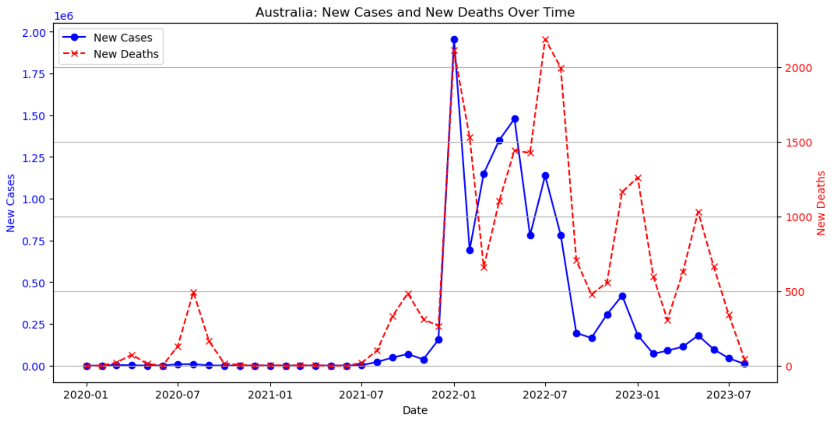
Australia: New Cases vs New Deaths (Monthly Sum)
Question 4a. Australia: Understanding Covid19 New Cases and New Deaths
Omnicron
BA.4.5 & BA.5
Key Messages:
7th Waves identified
Each Wave is associated with Peak New Deaths
BA.2 & BA.5
XBB.1.5, XBB, XBB.1.16
Beta
Delta
Alpha

Slide 8
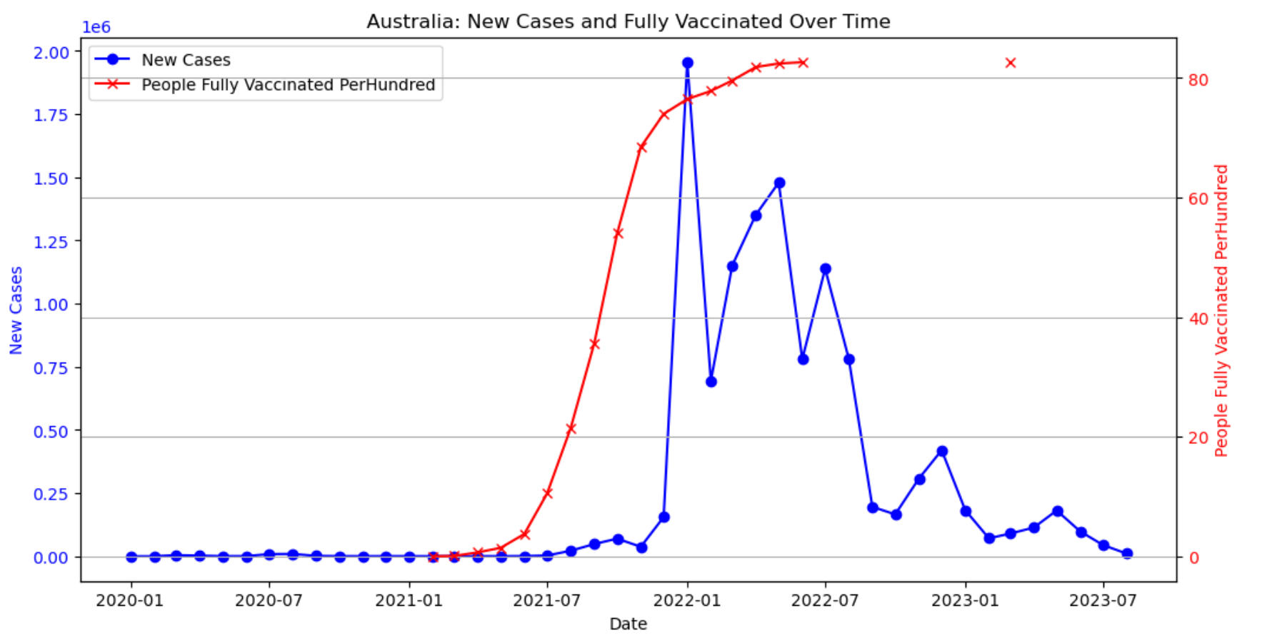
Australia: New Cases vs People Fully Vaccinated Per Hundred (Monthly Sum)
Question 4b: Was the Covid19 Vaccinations effective in Australia?
Key Messages:
Vaccination Works: Drastic drop in New Cases after 2300 People Fully Vaccinated Per Hundred. Meaning people have 23 times vaccines shots.
Vaccination Stopped Administering: Vaccination peak by mid-2022 and dramatically drop to zero.

Slide 9
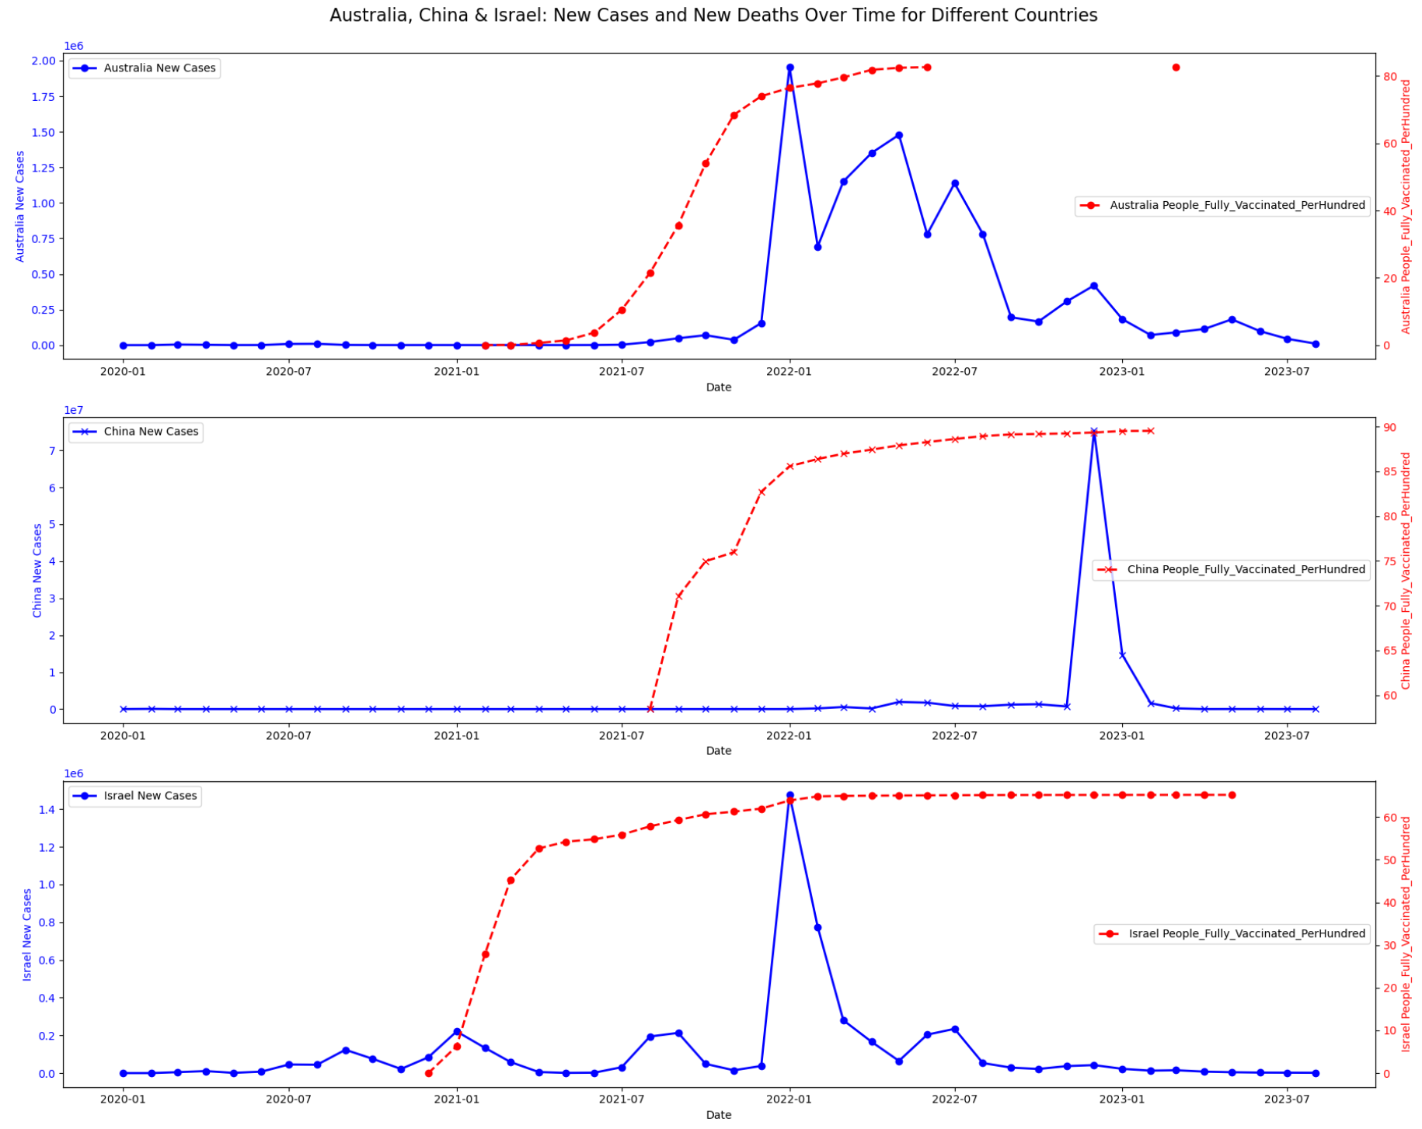
Compare Australia, China and Israel Vaccination Effectiveness
Question 5: How effective was using different Vaccines?
Key Messages:
Different Vaccines are Used (from News Media):
Australia (AstraZ, Moderna, Pfizer)
China (SinoVac & SinoPharm)
Israel (Pfizer)
Different Doses Program.
Australia: Ramp up vaccination for over 1 year with upto 25 shots average per person.
China: Two waves of shots over 1.5 years. Upto 5 shots average per person
Israel: Maintain a relatively high shots (17.5 times per person) over 2.5 years.
Result:
Australia: Vacciantion program was effective
China: Works initially but they had a spike in end 2022 with Omnicron
Israel: Mixed. Huge spike in beginning 2022 despite high doses.
Australia
China
Israel

Slide 10
Final Conclusions
Key Questions to Answer:
How have COVID-19 vaccines affected? (world comparison)?
-
2. Does a difference in healthcare expenditure affect COVID-19 cases (using WorldBank API)?
-
3. Was lockdown effective?
-
4. Was the Covid19 vaccinations effective in Australia?
-
5. How effective was using different vaccines?
-

