Slide 1
COVID-19 Vaccination Effectiveness
By Geoffrey Pang, Cayley Morrow, and John Porretta

Slide 2
Background
COVID-19 is a viral respiratory illness caused by the coronavirus (SARA-CoV-2)
Transmission
COVID-19 mainly spreads from person to person through respiratory droplets of an infected person and can also spread by touching contaminated surfaces. Symptoms can vary widely and can appear 2 – 14 days after exposure to the virus.
Severity
COVID-19 can range from mild to severe, with some individuals remaining asymptomatic. Severe cases can lead to pneumonia, acute respiratory distress syndrome (ARDS), organ failure, and death, particularly in older adults and those with underlying health conditions.
Vaccination
Several COVID-19 vaccines have been developed and authorized for emergency use around the world. Vaccination efforts aim to achieve herd immunity and reduce the spread of the virus.
Variants
Variants of the SARS-CoV-2 virus have emerged, some of which may have different transmission rates or resistance to immunity generated by vaccination or previous.

Slide 3
Project Overview
Objective:
In this project, we will look at how effective the COVID-19 vaccinations were on factors such as hospitalisations, confirmed cases and mortality rates.
Data Sources:
Our World In Data – third-party website with a collation of data from WHO, John Hopkins, etc.
World Bank – GDP Per Capita
Key Questions to Answer:
1. How have COVID-19 vaccines affected? (world comparison)?
2. Does a difference in Gross Domestic Product (GDP) Per Capita affect COVID-19 cases (using World Bank API)?
3. Did lockdowns have an effect?
4. Were the COVID-19 vaccinations effective in Australia?
5. How effective were the different types of vaccinations?

Slide 4

Data Sources
COVID-19 Dataset by Our World in Data
Using owid-covid-data.csv
Selected the columns of interest for our questions
Created output as a CSV file
The dataset is presented by day
We used the ‘groupby’ function to make the data manageable

Slide 5
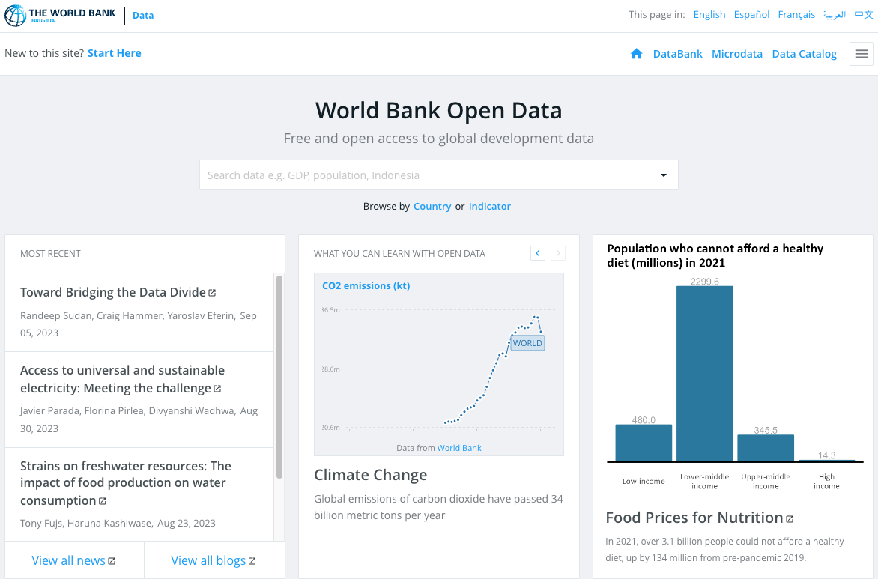
Data Sources
World Bank Open Data
Using API requests to access GDP Per Capita for specific countries

Slide 6
How have COVID-19 vaccinations affected ICU patient admissions, confirmed cases and mortality rates?

Slide 7
Does a difference in Gross Domestic Product (GDP) Per Capita affect COVID-19 cases (using World Bank API)?

Slide 8
Does a difference in Gross Domestic Product (GDP) Per Capita affect COVID-19 cases (using World Bank API)?

Slide 9
Did lockdowns have an effect?

Slide 10
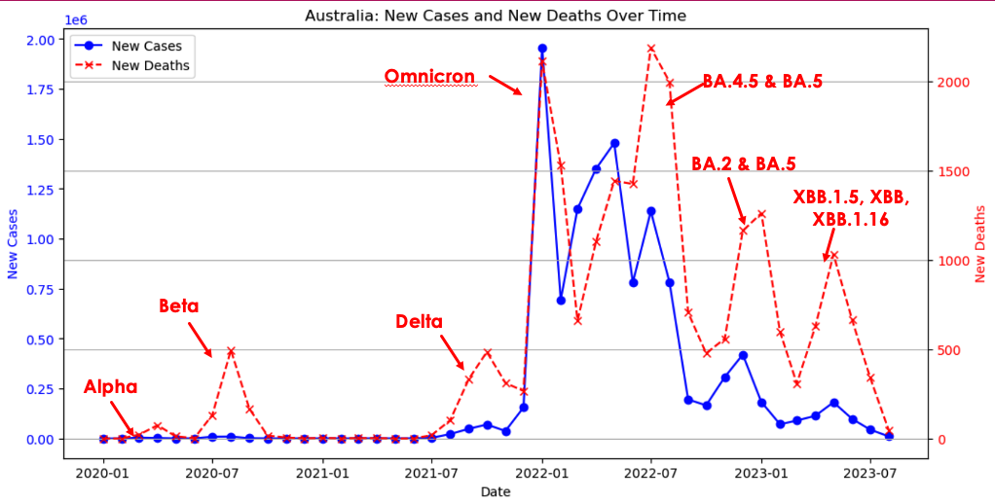
Were the COVID-19 vaccinations effective in Australia?
Key Messages
7 waves identified
Each wave is associated with Peak New Deaths

Slide 11
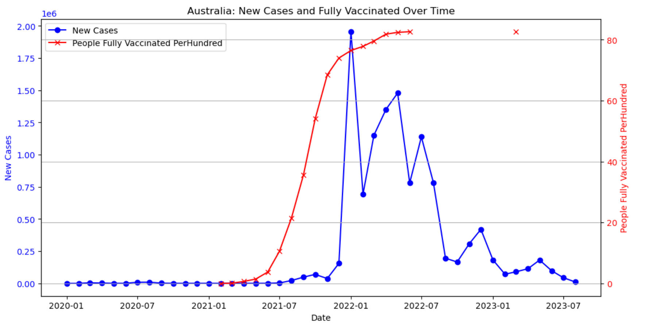
Were the COVID-19 vaccinations effective in Australia?
Key Messages:
Vaccination works: Drastic drop in New Cases after 2300 People Fully Vaccinated Per Hundred. This means people have 23x vaccinations.
Vaccination stopped being administered: Vaccination peaked by mid-2022 and dramatically dropped to zero.

Slide 12
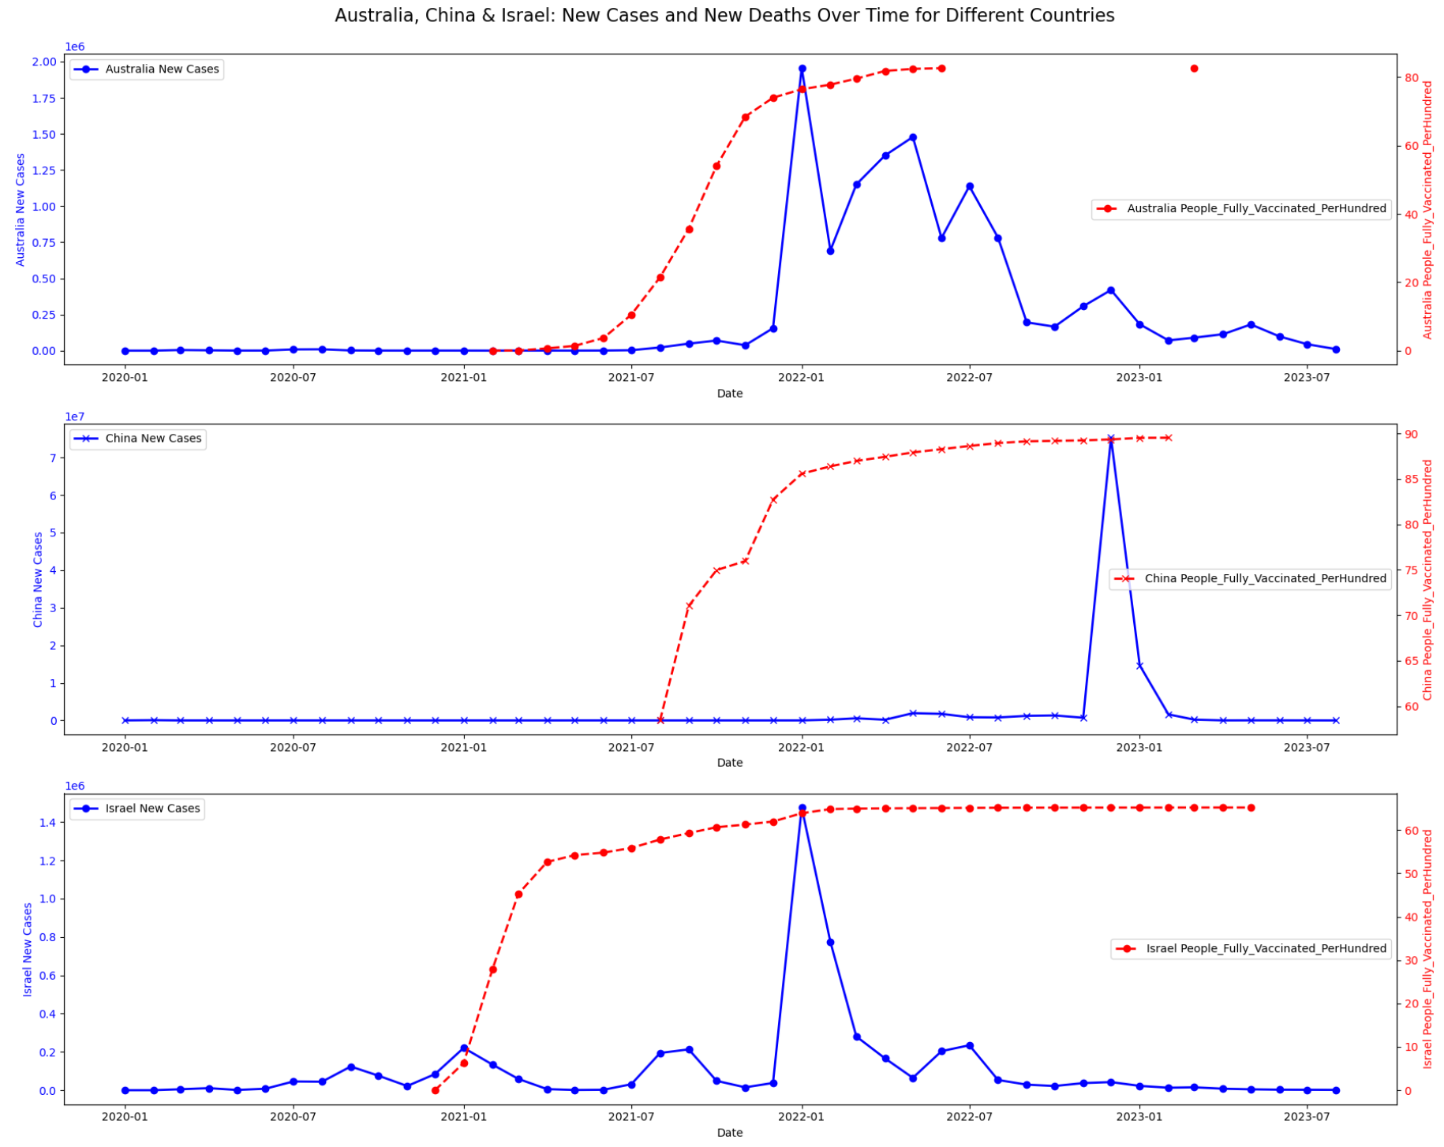
How effective were the different types of vaccinations?
Key Messages:
Different vaccinations being used(from news media):
Australia (AstraZ, Moderna, Pfizer)
China (SinoVac & SinoPharm)
Israel (Pfizer)
Different Doses Program.
Australia: ramped up vaccination for over one year with up to 25 shots on average per person.
China: two waves of vaccinations over 1.5 years. Up to five shots on average per person
Israel: maintained relatively high vaccination rates (17.5 times per person) over 2.5 years.
Result:
Australia: the vaccination program was effective
China: worked initially but had a spike at the end of 2022 with Omnicron
Israel: inconclusive. Huge spike in the beginning of 2022 despite high doses.

Slide 13
How effective was having multiple vaccinations?

Slide 14
Conclusions
Is the vaccination effective?

