Slide 1
Controller
Web Service WISEBED API
send() only
Testbed Service
Software Component

Slide 2
Controller
Federator
Testbed Service A
Testbed Service B

Slide 3
Controller
send() only
Testbed Service A
Testbed Service B

Slide 4
Controller
Testbed Service A
Testbed Service B
send() only
send() only
Custom Filter
Component

Slide 5

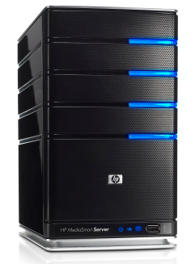
TARWIS
Testbed Service

Slide 6
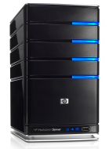

TARWIS
Testbed Service
Federator
Testbed Service 1
Testbed Service 2

Slide 7
TARWIS
Testbed Service
Federator
Testbed Service 1
Testbed Service 2

Slide 8

MyController
Shawn
(incl.Testbed Service)

Slide 9

MyController
Testbed Service

