Slide 1

Virtual Worlds
Group: An Update
Virtual Worlds Group
Microsoft Research

Slide 2
Agenda
Demo
Related Work
Requirements
Architecture
Lessons Learned
Summary
Notes:
Intro to group:
Virtual Worlds Group mission statement
To research and develop social, multi-user, multimedia technologies that enhance Microsoft Internet products and services.
Past experiments/products? V-CHAT, ComicChat.
Current emphasis on a platform that enables social interaction and mutli-person communication.
Demo

Slide 3
The Virtual Worlds Group
To research and develop social, multi-user, multimedia technologies that enhance Microsoft Internet products and services

Slide 4
Demo
POV
Navigation
Multi-user physical consistency
Non-literal spaces
2D vs. 3D user interfaces (HTML popups)
User profiles and levels of privacy
User to user communication (whispering, gesturing, etc.)
Accessories
Drag and drop
Simulated behaviors for training
Notes:
Polyopolis?
Hutch Space
Social Support
General navigation and customizability
Profiles, etc.
Trading Space
Education/simulation/training
Ice World
Collaborative entertainment
Education
CD World?
Flatland:
Non-3D use of platform
Collaborative presentations w/ feedback

Slide 5
Related Work
MOOs, Smalltalk
Distributed COM
Graphical Worlds (VRML, DIS/SIMNET, SPLINE, Sony)
Distributed VR Systems
NetShow
Notes:
DIS/SIMNET,
VRML-based worlds (MERL, SONY)
Distributed VR systems (DIVE)
Distributed databases, operating systems
DCOM

Slide 6
Requirements
Distributed
Persistent
End-user extensible
Live-editable
Secure

Slide 7
V-Worlds Approach
Build on COM
Add:
  Dynamic properties and methods
  Single-inheritance
  Persistence
  Automatic replication
Use HTML and ActiveScripting to build applications

Slide 8
Bystander Updating
World A
Room
Room
1
2
Server
Client
✶
User.Description = "Tall"
Client 1
Client 2
Clients...
Client 3

Slide 9
Bystander Updating
World A
Room
Room
1
2
Server
✴
Setprop
Client
Message
✶
User.Description = "Tall"
Client 1
Client 2
Clients...
Client 3

Slide 10
Bystander Updating
World A
World
→
Log
Log record
File
Room
Room
1
2
Server
✴
Setprop
Client
Message
✶
User.Description = "Tall"
Client 1
Client 2
Clients...
Client 3

Slide 11
Bystander Updating
World A
World
→
Log
Log record
File
Room
Room
1
2
Server
✴
Setprop
✵
Client
Setprop
Message
Message
✶
User.Description = "Tall"
Client 1
Client 2
Clients...
Client 3

Slide 12
Bystander Updating
World A
World
→
Log
Log record
File
Room
Room
1
2
Server
✴
Setprop
✵
Client
Setprop
Message
Message
✶
User.Description = "Tall"
Client 1
Client 2
Clients...
Client 3

Slide 13
Component Based Client
Web Page
VWSYSTEM
Control
Event and
Method Calls
Events
VWRENDER
Control
VWSOUND
Control
...
Other UI
Controls
DHTML/
JavaScript
VBScript
Direct 3D
DirectDraw
DirectSound
DirectMusic
Notes:
Well suited to trying out different controls.
Interested in graphics:
Different renderers into the system
Different representations for characters (articulated figures)
Different interface ideas:
Navigation in the environment.
Multimodal and gestural input.
Speech input and output.
Incorporating autonomous characters.
Collaborative decision making.

Slide 14
Using the VWorlds Platform
Add an existing ActiveX control to the web page (text to speech)
Create a new control (new renderer)
Use DHTML and ActiveScripting to control UI (Flatland)
Implement behaviors in world (in script or COM)

Slide 15
Flatland
Non-3D Uses for the VWG Platform

Slide 16
Why Flatland?
Push the Platform
Business Uses
Collaboration Research
  Working with Anoop Gupta

Slide 17
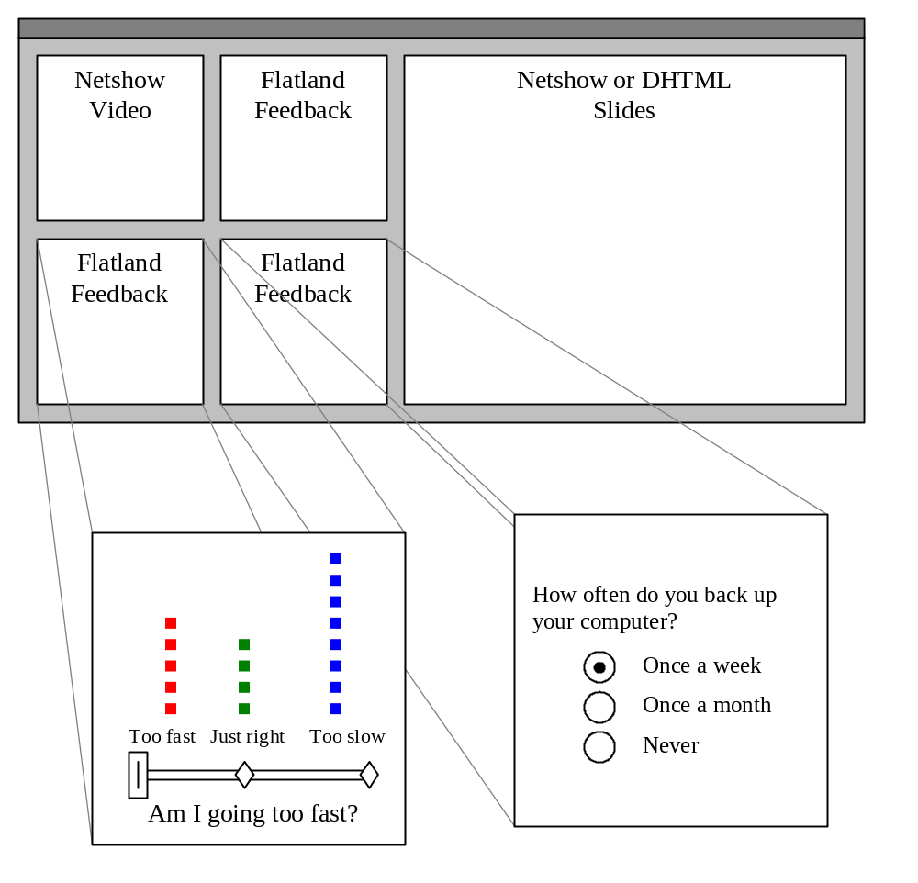

Slide 18
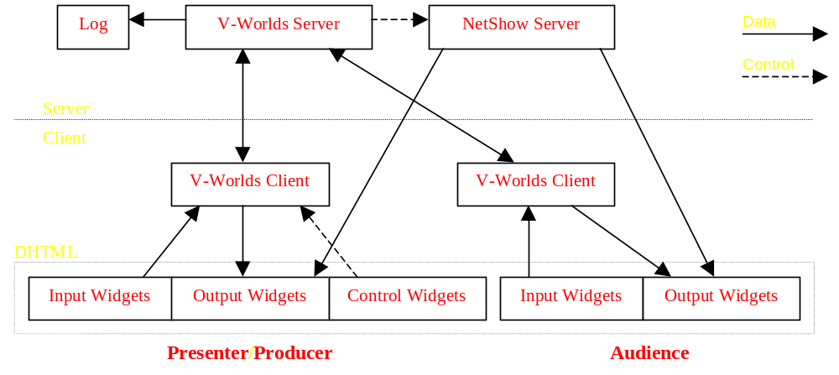
Architecture

Slide 19
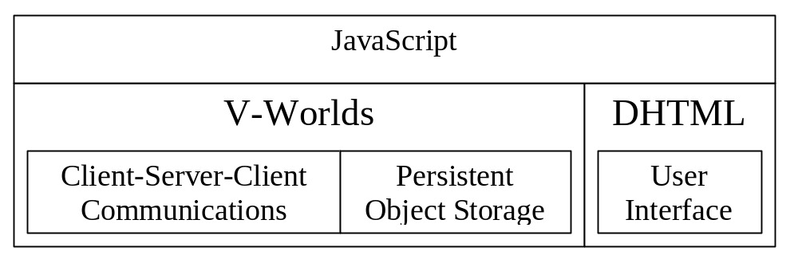
Rapid Prototyping Environment

Slide 20
Phase 1
Presentation
Remote Learning
V-Worlds/NetShow integration
Audience feedback
Calendar Q1 1998

Slide 21
Future
Extend & refine
Customers
Users
Collaboration

Slide 22
Flatland
New uses for the VWG platform in presentation feedback, remote learning & collaboration

Slide 23
Status
Working with a small number of outside sites to develop a variety of applications
Limited internal beta in Q3
Developing sociological user tests
Working internally to incorporate interesting research on top of platform
  Graphics group: Camera Control/Conference Room
  Collaboration Group
  Others?
Notes:
Working with a small number of outside sites to develop a variety of worlds.

Slide 24
Summary
Platform for exploring social interaction with multimedia
Experimenting with different technologies on top of platform
Mail alias for questions and discussion
Future work
  Improve platform functionality
  Build new research on top of platform
  Basic sociological research for cyberspace

Slide 25
Backup Slides

Slide 26
Lessons Learned
Pros/cons of being a browser-based application
Pros/cons of 3D graphics
Difficulties of writing multi-user applications
Social interaction issues

Slide 27
Browser-Based Applications
Using HTML and script to glue together applications has great benefits (productivity, flexibility)
There are lots of problems that remain to be solved: dealing with focus, keyboard accelerators, security, performance, etc.

Slide 28
3D Graphics
Pros:
  Gives users of virtual worlds a spatial context for interaction.
  Good for organizing loosely associated information.
  3D is cool.

Slide 29
3D Graphics
Cons:
  First-person POV is not intuitive to everyone.
  Navigation can be difficult.
  Implementing user interfaces in 3D poses some difficult problems. Implementing them “out of world” poses others.
  Building appealing, workable, 3D spaces and avatars is difficult.

Slide 30
Social Interaction Issues
Dealing with bad behavior.
Censoring and punishing constructively.
Providing building blocks for personal and group investment.

