Slide 1



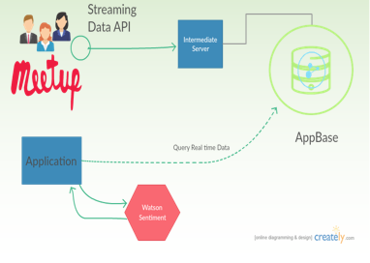
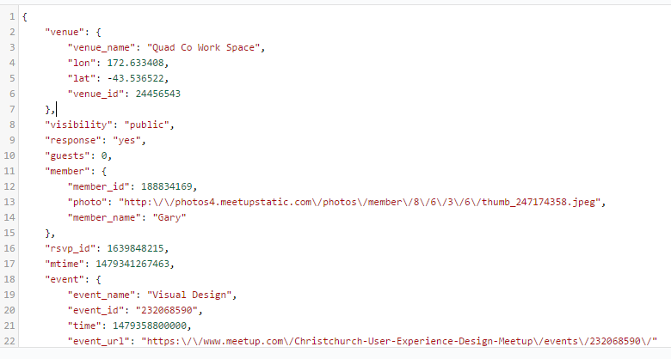
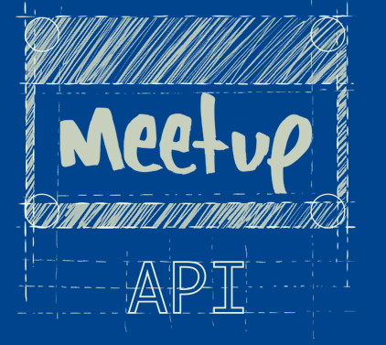
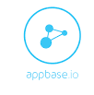
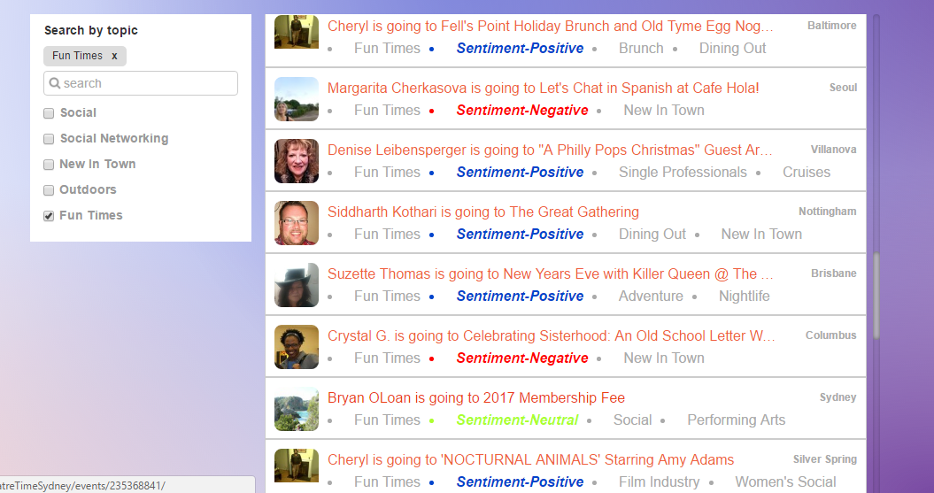

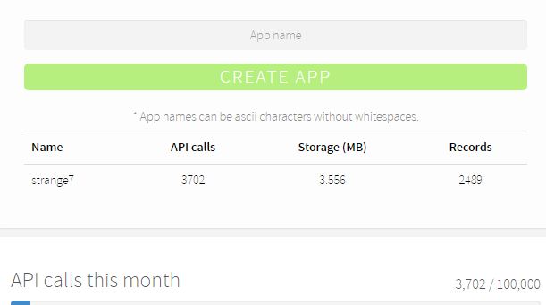


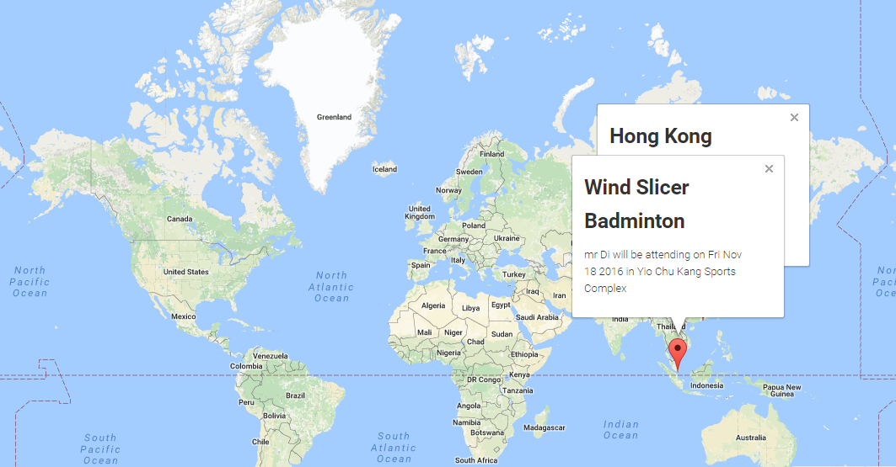
Events Manager
Doodle Kit Sentiment Engine Use Case @ Hackathon Fall 2016
Moulika Chadalavada, Pruthvi Raj Reddy Chukkannagari, Santhosh Gattu, Bhargav Velagapudi
INTRODUCTION
APPROACH
Sentiment Engine Use Case is about developing a web application for analyzing sentiment across public information using any machine learning tools. Our application aims at fetching real-time feeds using Meetup's RSVPs with appbase.io which is a hosted data streams API. Then sentiment analysis for the streaming events helps users to join.
On the backend, we use a NodeJS worker to fetch Meetup's RSVP API and insert them into an appbase.io app. On the frontend, we use jQuery to create the feed UI and query appbase.io in real-time with different keyword filters.
Based on the data fetched from Meetup, Sentiment Analysis is done using IBM Bluemix Alchemy API for the comments done for events. Also the event locations at different places are displayed on Google Maps.
SYSTEM ARCHITECTURE
RSVPS Data from MEET UP Streaming API gives event
notifications of every user.
Event Id’s from streaming data are retrieved to query
the event comments API of Meet Up.
Assumption: Sentiment Analysis using the comments is
the best source of event/group’s activities and review.
FEATURES
Recommends user to browse events based on topics
and helps make decisions depending on the sentiment
and believe it or not all in real-time.
Projects the locations obtained through streaming data
on to the google maps API.
Elastic search based querying and execution in
Appbase.io app.
TOOLS & API’s USED
RESULTS

