Slide 1


UMKC Hackathon Fall 2016 SENTIMENT ENGINE
Presented By Strange7
Moulika Chadalavada
Pruthvi Raj Reddy
Santhosh Kumar
Bhargav Krishna

Slide 2
Sentiment Engine - Use Case
“Use a cloud based machine learning tool such as IBM Watson or Wolfram Language to analyze sentiment across public information such as Twitter or a public database. Create an application that uses this in a novel and useful way. “

Slide 3
Sentiment Engine-Introduction
This application aims at fetching real-time feeds using Meetup's RSVPs with appbase.io which is a hosted data streams API.
On the backend, we use a Node.JS worker to fetch Meetup's RSVP API and insert them into an appbase.io app.
On the frontend, we use jQuery to create the feed UI and query appbase.io in real-time with different keyword filters.
Based on the data fetched from Meetup Sentiment Analysis is done using IBM Bluemix Alchemy API for the comments done for events.
The Meetup API provides simple Restful HTTP and streaming interfaces for extending community using the Meetup platform from our own apps.
Also the event locations at different places are displayed on Google Maps.

Slide 4
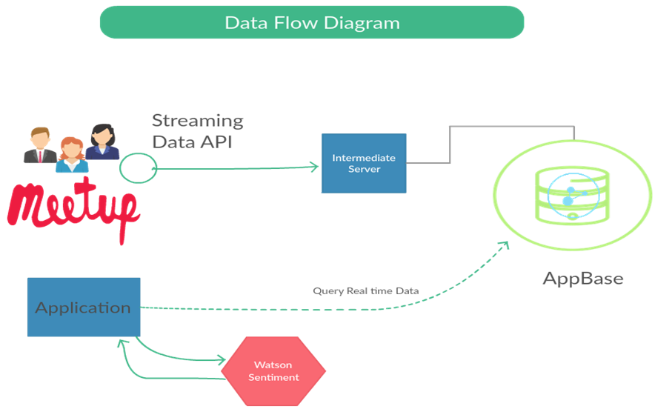
System Architecture

Slide 5
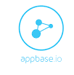

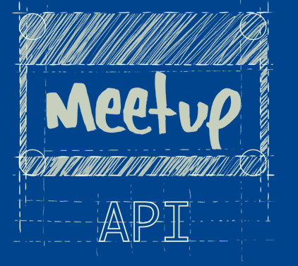


API and Software's Used

Slide 6
Sentiment Engine- Key Ingredients
Backend Worker
We use the Meetup's long-polling RSVP Stream Endpoint to get realtime RSVPs.
We then store this data in appbasio.io, easy to query both historical data and real-time feeds
User Interface
Querying appbase.io for Meetup RSVP feeds by topics.
The UI / UX logic maintained with a jQuery frontend.
And we use typeahead for displaying the search interface.

Slide 7
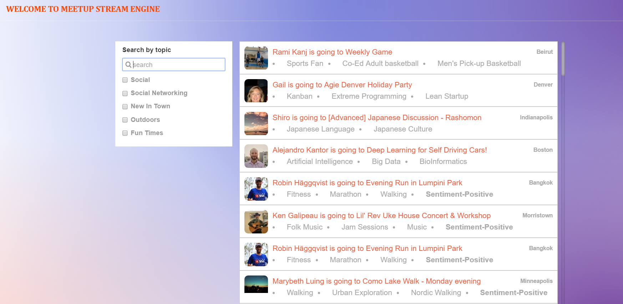
Youtube Link: https://www.youtube.com/watch?v=qwG1SFimuyo

