Slide 1

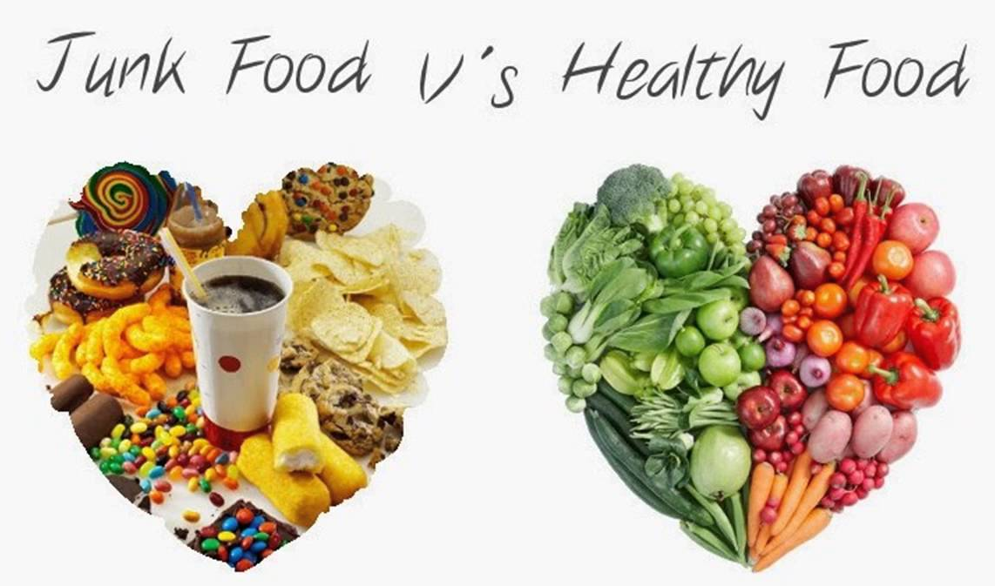
Food Game: Junk or Healthy?
UMKC Spring-2017 Hackathon
Presented By Griffondors
Lakshmi Nikitha Kona
Pruthvi Suggula
Malineni Anusha
Moulika Chadalavada

Slide 2
About Use-Case
We have used food-101 dataset ,and we have selected 25 classes to train our model
We have used inception model to train the last layer which is a type of transfer learning
We have achieved 75% accuracy
The saved graph and the labels are saved and it is used in the web application for predictions
The web application identifies a given image.
It also identifies the calorie count for which we used edaman API
For sentimental analysis we used IBM Watson API
Also it classifies if the given image is healthy or junk food

Slide 3
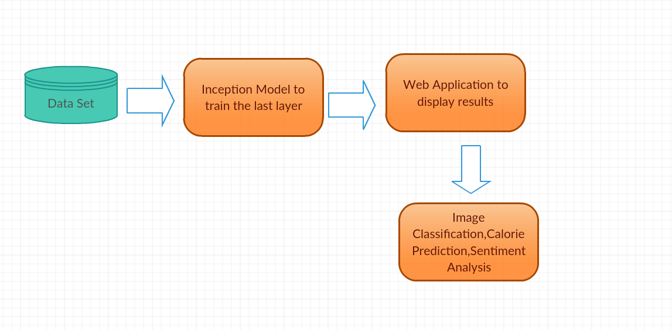
Architecture

Slide 4





Tools Used

Slide 5
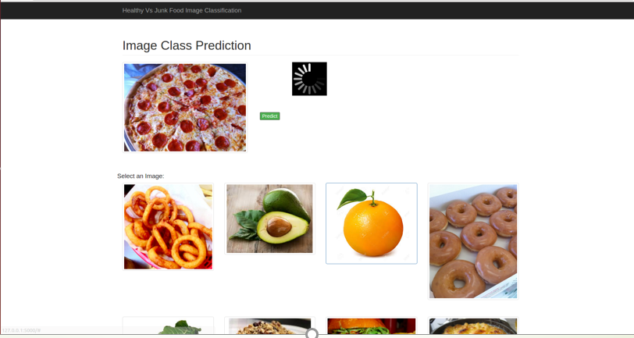
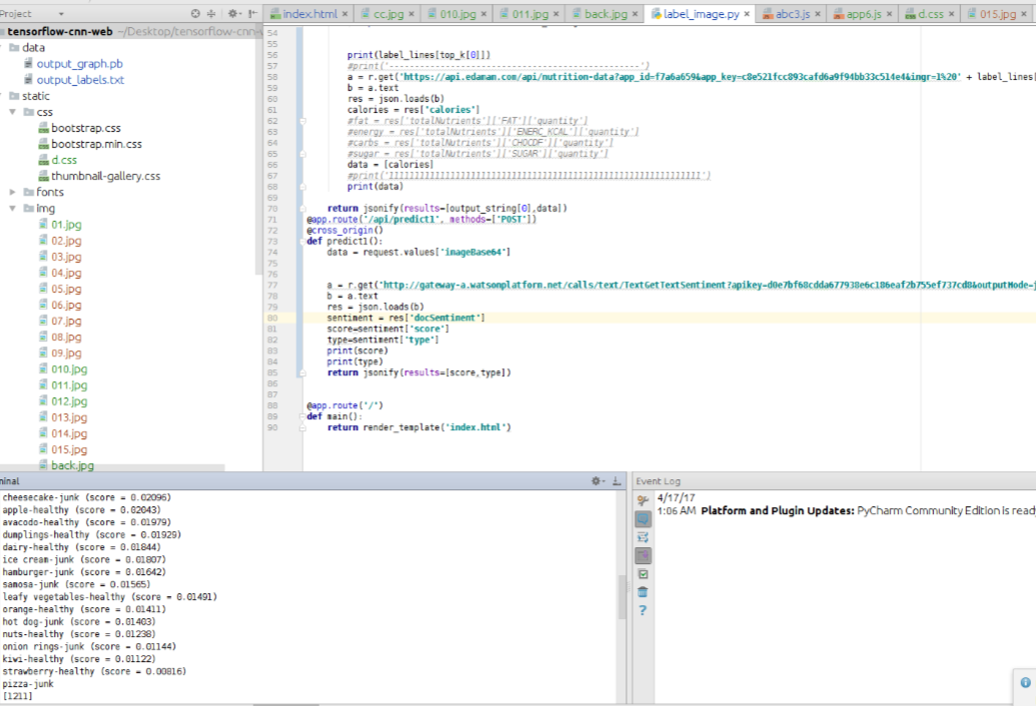
Results & Outputs

Slide 6
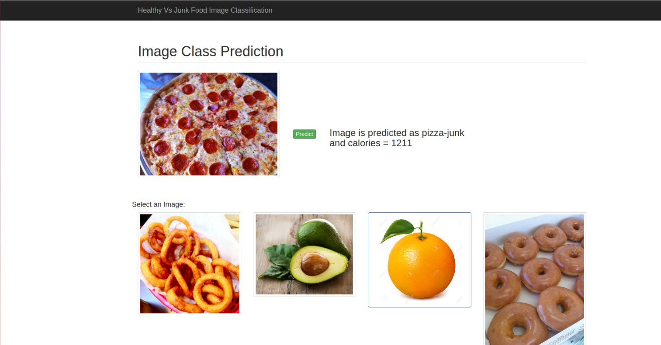
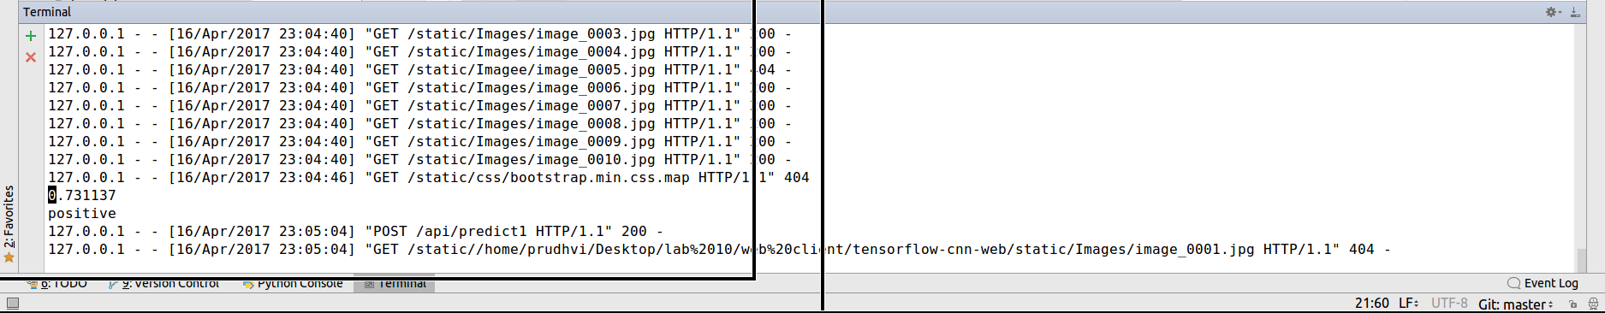
Results & Outputs

Slide 7

YouTube Link: https://www.youtube.com/watch?v=ix7ALJjknow

