Slide 1
Improving Cuckoo Hashing with Perfect Hashing
Moulika Chadalavada
Yijie Han
School of Computing and Engineering
University of Missouri at Kansas City
Kansas City, MO 64110, USA

Slide 2
Agenda
Introduction
Cuckoo Hashing
Cuckoo Hashing Implementations
Perfect Hashing
Our Approach
Allocating Keys to Memory
Adding New Key to Memory
Advantages
Conclusion
References

Slide 3
Introduction
Data Structure is a systematic way of organizing data such that it can be used efficiently.
Time Complexity of Binary Search : O(logN)
Hashing is used to improve search time, generally used in dictionaries
Hashing used for storing and indexing a large amount of data using keys.
Hashing perform dictionary operations in O(1) time.
Hash Table uses a hash function to compute and store data in array format.
Using Hash Table data access is very fast.

Slide 4
Introduction
Hash Tables maps multiple keys to the same index which results collision in hashing.
There are many hashing techniques introduced to avoid collisions.
Some of the main strategies used in collision resolution are:
Buckets
Chaining
Open Addressing
Cuckoo Hashing is one of the hashing technique which provide high memory utilization in constant access time.
Cuckoo Hashing aims at reducing collisions and optimizes throughput

Slide 5
Introduction
Perfect Hashing maps distinct elements to set of integers without any collision.
In Perfect Hashing set of keys to be hashed must be provided to create hash function.
By considering frequency of keys during key lookup memory utilization can be efficient.
To Improve Cuckoo Hashing we chose Perfect Hashing because it doesn't require any collision resolution mechanism.

Slide 6
Cuckoo Hashing
Cuckoo Hashing is one of the hash table schemas.
Provides high memory utilization and constant access time.
Every non-empty cell contains a key-value pair. (Open-Addressing)
Mainly aims at reducing collisions which might occur when more than one key is mapped to the same cell.
To avoid collision instead using one hash function Cuckoo Hashing mechanism uses two hash functions.

Slide 7
Cuckoo Hashing
Key Inserting Mechanism:
For each key two locations are provided in the hash table.
In Cuckoo Hashing mechanism inserting a new key first looks if one of its two cells are empty or full.
If empty then the key will be placed in the available cell.
When both the cells are full, the other keys will be moved to their respective second locations to insert the new key.

Slide 8
Different Cuckoo Hashing Implementations
Serial Implementation:
Tables are accessed serially.
Inserts element into first table that is free starting from Table-1.
Worst case occurs when element not stored or found in last table
Parallel Implementation:
Tables is selected in random.
Insertion is done in first free table that is accessed randomly.
Every table stored in different memory, search operation done in parallel.

Slide 9
Different Cuckoo Hashing Implementations
Pipeline Implementation:
Search operation is pipelined and access memory sequentially.
Number of memory accesses is reduced.
Performance is same as parallel.
But in pipeline architecture once search operation successful rest of memories need not be accessed.

Slide 10
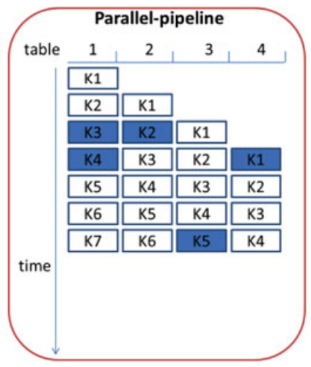
Parallel Pipeline Implementation

Slide 11
Different Cuckoo Hashing Implementations
Parallel-d-Pipeline Implementation:
Each pipeline has different entry point.
Allows the user to insert an element to any table idle in that cycle.
Parallel-d-Pipeline approach throughput depends on various factors.
One among them is matching operations percentage that is successful.
Several elements can leave the pipelines and sent to output in one cycle.

Slide 12
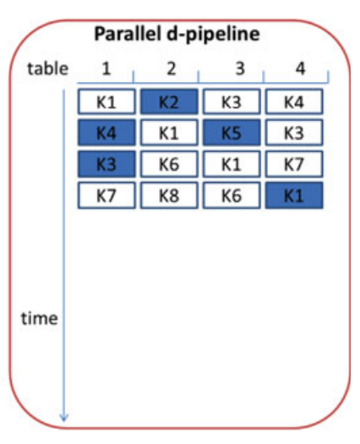
Parallel-d-Pipeline Implementation

Slide 13
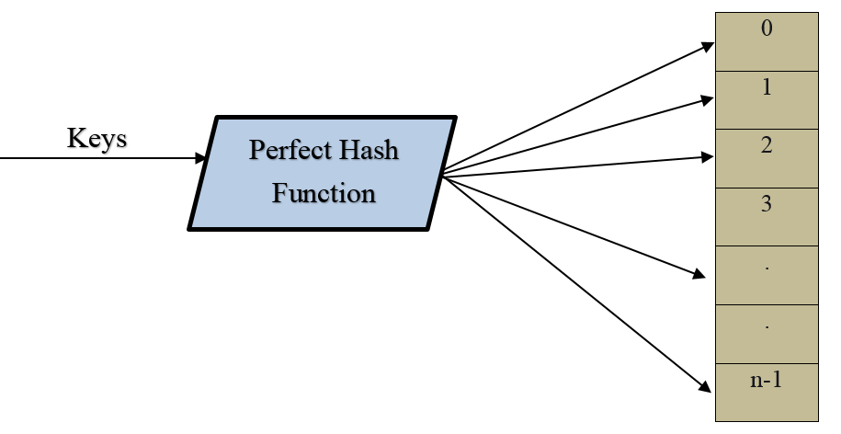
Perfect Hashing
In Perfect Hashing, hash function maps distinct elements of set S to a set of integers, without collisions.
Perfect Hashing is one of the strategies for resolving collisions in hashing.

Slide 14
Perfect Hashing
In chained hash table expected cost of lookup is O(1+α).
In linear probing, the expected cost is O(1).
But the expected cost of lookup is not same as expected worst-case cost of lookup.
Perfect Hashing lookups take worst case time O(1).
A minimal perfect hash function maps each key to n consecutive integers in hash table there exist one entry for each key without any empty slots.
Minimal Perfect Hash Functions used for efficient memory usage and for speed retrieval of elements from static data sets.

Slide 15
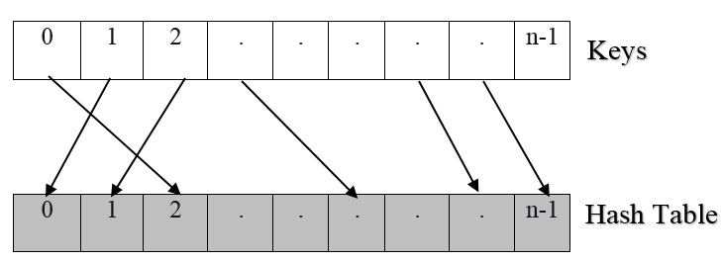
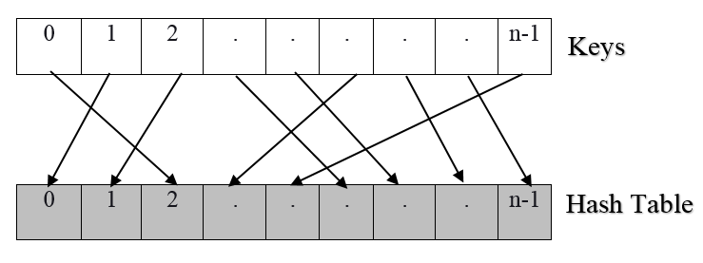
Perfect & Minimal Perfect Hashing
Perfect Hashing
Minimal Perfect Hashing

Slide 16
Inserting Key using Perfect Hashing
To insert keys to slots two hash functions are used:
H(key), this function hashes the key which returns a position in the intermediate array.
F(x, key), is used to find the position of key which is unique, where x = H(key).
This process only returns a value if the key we are looking for is present in the table.

Slide 17
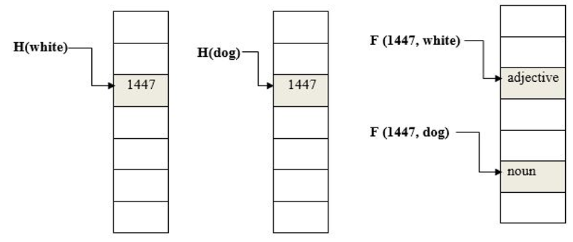
Example of Perfect Hash Key Lookup

Slide 18
Our Approach (Combining Cuckoo Hashing with Perfect Hashing)
Cuckoo Hashing requires two hash functions.
Insertions may run into cycle, which might require multiple rehashes to succeed.
Cycles only arise if we revisit the same slot with the same element to insert.
There might be a possibility that algorithms may enter an infinite loop and may result in the collision.
The memory usage is high, as we are storing in alternate locations.

Slide 19
Our Approach (Combining Cuckoo Hashing with Perfect Hashing)
Solution:
Perfect Hashing doesn't contain collisions.
It maps distinct elements of set S to a set of integers.
We chose to improve Cuckoo Hashing with Perfect Hashing mechanism to improve the keys hit ratio and memory utilization.
We used Perfect hashing because it doesn't require any collision resolution mechanism.
Perfect Hashing doesn't result in the collision while inserting elements into the hash table.

Slide 20
Allocating Keys to Memory
It’s difficult to anticipate all possible keys as set is huge.
Here we can put known frequently encountered keys into a set S.
Map the keys in S to memory modules by using a perfect hashing function.
Perfect hashing function can be obtained in O(|S|² b) time.
Analyze set S of frequently encountered keys and store high frequency keys together in memory module.

Slide 21
Architecture for Allocating Keys to Memory
Step 1: For an input key x, first compute its perfect hash value f(x).
Step 2: f(x) value is indexed to the table to get the Memory module in which f(x) is present.
Step 3: If x is in S then we find the correct memory module that stores x.
For example, the memory module that store x is Ma, then T[f(x)] =a. We use a hash function h for Ma to find the location h(x) of x in Ma.
Step 4: If x is not in S. Then we will first use f(x)=a to find memory module Ma. We then use h(x) to locate x in Ma.

Slide 22
Architecture for Allocating Keys to Memory
Step 5: Three situations can happen here while allocating memory to the element.
The first situation is that h(x)=h(y) for a y in S, thus h(x) and h(y) collides.
The second situation is that no key is at position h(x) or x is stored at h(x) position of Ma.
The third situation is when h(x)=h(y) for a y not in S while y has already been in the position h(y) in Ma.

Slide 23
Architecture for Allocating Keys to Memory
f(x) has |S|² values and only |S| values correspond to keys in S.
The other |S|² - |S| values don’t correspond to any key x in S, so |S|² - |S| are less frequent keys.
For these keys T[f(x)] set to memory for storing less frequency keys.
Thus frequently occurred keys in S will be identified in constant time.
For keys, not in S their hash value may have collision with the keys in S.
Since these keys occur less frequently we can afford more hashing and rehashing time for these keys.

Slide 24
Adding New Key to Memory
Once the memory allocation is completed any key can be looked up in memory based on frequency.
If a new key which is unknown has to be stored in memory, first hashing is performed.
If the key has the highest frequency, then it is looked up in memory that stores keys with high frequencies.
If it has less frequency then it will be looked up in memory with low frequencies.

Slide 25
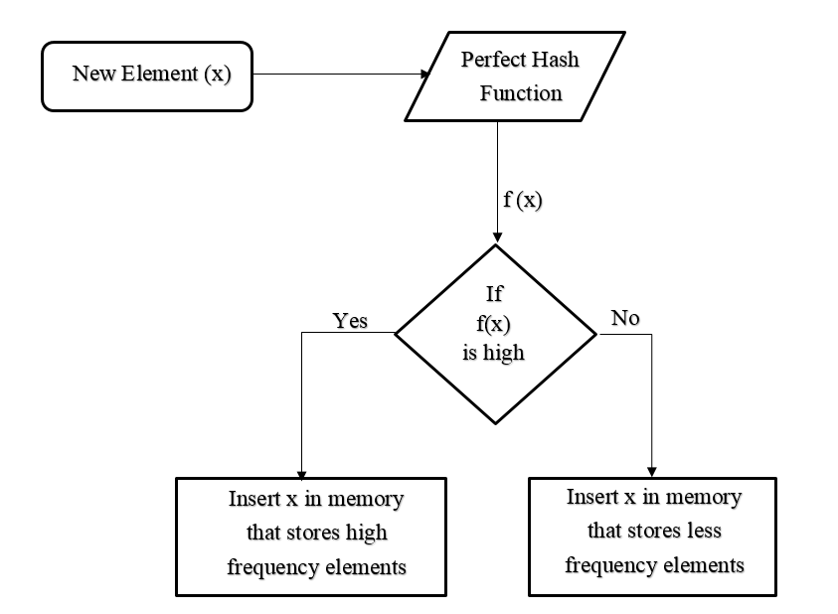
Adding New Key to Memory

Slide 26
Adding New Key to Memory - Example
Character | Hashed Frequency | Memory
A | 0.1% | Memory-2
B | 0.4% | Memory-2
C | 4% | Memory-1
D | 5% | Memory-1
E | 0.3% | Memory-2

Slide 27
Advantages
With this mechanism key storage, memory utilization and key lookup is performed very efficiently.
When compared to Cuckoo Hashing this mechanism is more efficient as hashing is performed fast and cleverly follows memory utilization.
No collision resolution mechanism is required as Perfect Hashing is used.
Key lookup is fast as it is based on frequency, and new key insertion is also easy with this mechanism.

Slide 28
Conclusion
As part of this thesis we studied about Cuckoo hashing and Perfect hashing.
We introduced new mechanism by combining perfect hashing with cuckoo hashing.
This mechanism is used to increase keys hit-ratio and reduce memory utilization.
Key lookup is based on frequency.
New key insertion also becomes easy with this mechanism.

Slide 29
References
M. Dietzfelbinger, A. Karlin, K. Mehlhorn, F. M. auf der Heide, H. Rohnert, and R. E. Tarjan, "Dynamic Perfect Hashing: Upper and Lower Bounds," 29th Annual Symposium on Foundations of Computer Science, White Plains, NY, vol. 23, no. 4, pp. 524-531, 1988.
A. Kirsch, M. Mitzenmacher, and G. Varghese, "Hash-Based Techniques for High-Speed Packet Processing", In: Cormode G., Thottan M. (eds) Algorithms for Next Generation Networks. Computer Communications and Networks. Springer, London, pp 181-218,2010.
D. Belazzougui, F.C. Botelho, and M. Dietzfelbinger, "Hash, Displace, and Compress", In: Fiat A., Sanders P. (eds) Algorithms - ESA 2009. ESA 2009. Lecture Notes in Computer Science, vol. 5757. Springer, Berlin, Heidelberg, 2009.
G. Levy, S. Pontarelli and P. Reviriego, "Flexible Packet Matching with Single Double Cuckoo Hash," in IEEE Communications Magazine, vol. 55, no. 6, pp. 212-217, doi: 10.1109 /MCOM.2017.1700132, 2017.
P. Gupta and N. McKeown, "Algorithms for Packet Classification," in IEEE Network, vol. 15, no. 2, pp. 24-32, doi: 10.1109/65.912717, Mar/Apr 2001.
R. Pagh, and F.F. Rodler. "Cuckoo Hashing". Algorithms — ESA 2001. ESA 2001. Lecture Notes in Computer Science, Springer, Berlin, Heidelberg, vol. 2161, pp. 121–133. ISBN 978-3-540-42493-2,2001.
R. Raman, "The Power of Collision: Randomized Parallel Algorithms for Chaining and Integer Sorting", Proceedings of the Tenth Conference on Foundations of Software Technology and Theoretical Computer Science, Springer, Berlin, Heidelberg, vol. 472, pp. 9-11,1990.
R. Raman, "Priority Queues: Small, Monotone and Trans-dichotomous", Proc. 1996 European Symp. on Algorithms, Lecture Notes in Computer Science, vol. 1136, pp. 121-137,1996.

Slide 30
References
S. Pontarelli, P. Reviriego and J. A. Maestro, "Parallel d-Pipeline: A Cuckoo Hashing Implementation for Increased Throughput," in IEEE Transactions on Computers, vol. 65, no. 1, pp. 326-331, Jan. 1 2016.
F. P. J. Brooks, "No Silver Bullet Essence and Accidents of Software Engineering," in Computer, vol. 20, no. 4, pp. 10-19, April 1987.
T.H. Cormen, C.E. Leiserson, R.L. Rivest, and C. Stein, "Introduction to Algorithms" (3rd ed.). Massachusetts Institute of Technology. pp. 253–280. ISBN 978-0-262-03384,2009.
M. Mitzenmacher, "Some Open Questions Related to Cuckoo Hashing", In: Fiat A., Sanders P. (eds) Algorithms - ESA 2009. ESA 2009. Lecture Notes in Computer Science, vol 5757, Springer, Berlin, Heidelberg, 2009.
D. Fotakis, R. Pagh, P. Sanders, and P. Spirakis, "Space Efficient Hash Tables with Worst Case Constant Access Time", Theory of Computing Systems, vol. 38, no. 2, pp. 229-248, 2005.
B. Jenkins, "Order-preserving Minimal Perfect Hashing", in Dictionary of Algorithms and Data Structures [online], V. Pieterse and P.E. Black, eds. 14 April 2009. Available from: https://www.nist.gov/dads/HTML/orderPreservMinPerfectHash.html
E.A. Fox, Q. Chen, and A. M. Daoud, "Order-preserving Minimal Perfect Hash Functions and Information Retrieval", ACM Transactions on Information Systems, New York, NY, USA: ACM, pp. 281–308,1991.
D. C. Schmidt, "GPERF: A Perfect Hash Function Generator", C++ Report, SIGS, Vol. 10, No. 10, December 1998. Available from: http://www.cs.wustl.edu/~schmidt/PDF/gperf.pdf

Slide 31


