Slide 1
Integration in the cloud - IPaaS with Fuse technology
Charles Moulliard

Slide 2
Agenda
Introduction & Key concepts
JClouds
CloudStack/OpenStack
Fuse
Conclusion

Slide 3

Speaker : Charles Moulliard
Engineer in Agronomy & Master in Zoology
Solution Architect & Consultant @RedHat
Committer → Karaf (PMC), Camel (PMC), ServiceMix, DeltaSpike
Twitter : @cmoulliard
LinkedIn : http://www.linkedin.com/in/charlesmoulliard
Blog : http://cmoulliard.blogspot.com
Slideshare : http://www.slideshare.net/cmoulliard

Slide 4
Introduction

Slide 5
Introduction
Cloud computing is the use of computing resources (hardware and software) that are delivered as a service over a network (typically the Internet).
Characteristics : Agility, Virtualization, Security, Performance, Reliability, Maintenance, Multitenancy

Slide 6
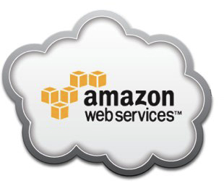

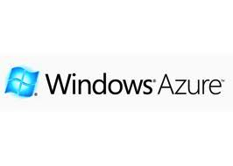

IaaS
IaaS : Provide computers/virtual machines or resources
Virtual machines uses hypervisor (Xen, KVM)

Slide 7




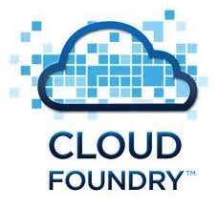
PaaS
Deliver a computing platform typically including operating system, programming language execution environment, database, and web server

Slide 8

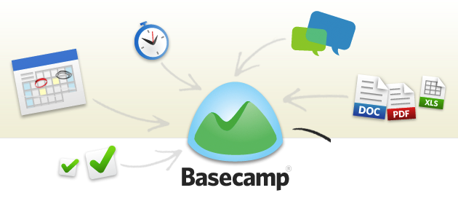

SaaS
Install and operate application software in the cloud and cloud users access the software from cloud clients.

Slide 9
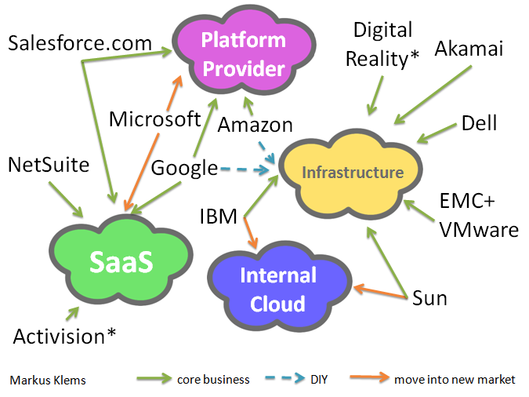
All together
Resume

Slide 10
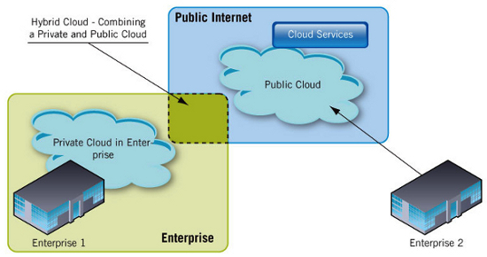
Deployment models
Public / Hybrid / Private
Is it different from Extranet/Intranet ...

Slide 11
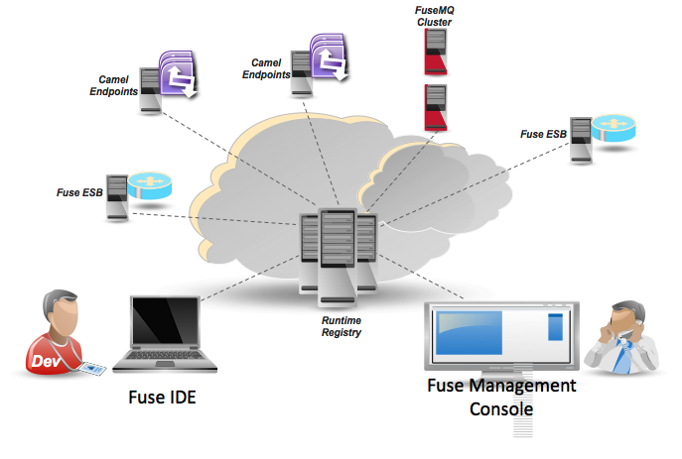
iPaas
What is Integration Platform as a Service ?
Combination of Iaas and Paas

Slide 12
iPaas - More
Provide Fabric runtimes top of clouding machines for public, private or hybrid clouds
Fabric : Agent working closely with Apache Zookeeper (registry of config and deployment)
Karaf : Lightweight containers running top of OSGI runtime

Slide 13
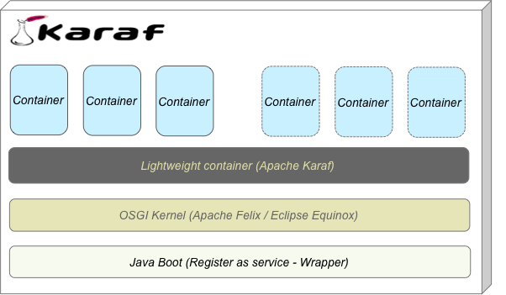
Apache Karaf

Slide 14
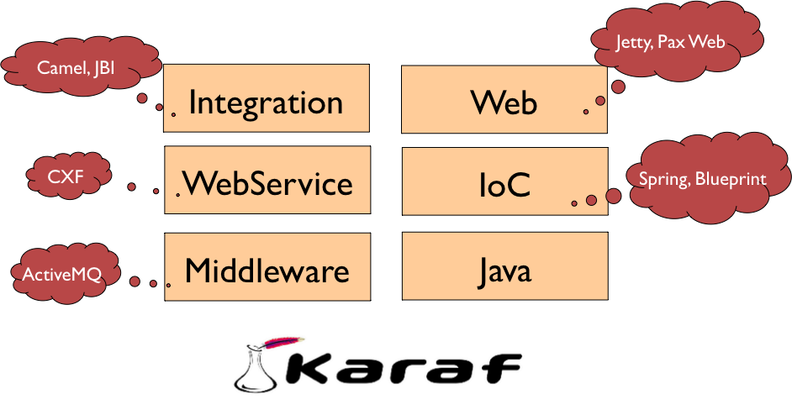
Apache Karaf

Slide 15
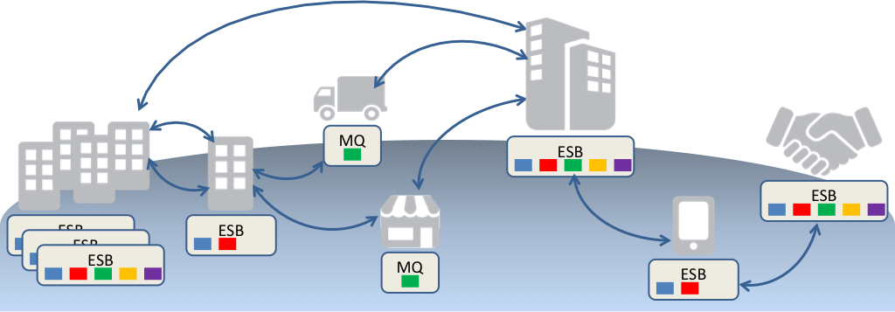
Fuse Fabric
Integration everywhere

Slide 16
jclouds a Cloud provider, Tooling framework

Slide 17


jclouds
Umbrella project
jclouds : open source library that helps you get started in the cloud.
API gives you the freedom to use portable abstractions or cloud-specific features.

Slide 18
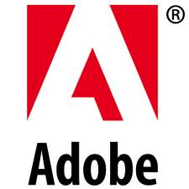


Who uses
RedHat - OpenShift to deploy applications to Terremark, RackSpace & EC2
Twitter, Adobe
GigaSpace, SalesForces
General Electric
Camel, Karaf, Cellar, ….

Slide 19
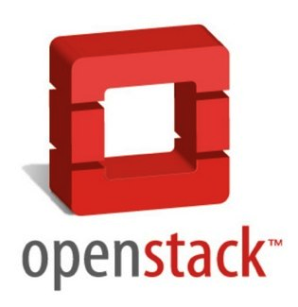

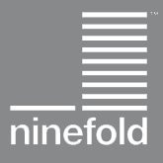


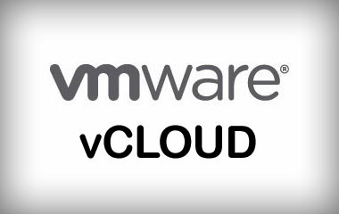

JClouds
30 cloud providers & cloud software stacks including Amazon, GoGrid, Ninefold, vCloud, OpenStack, and Azure.

Slide 20
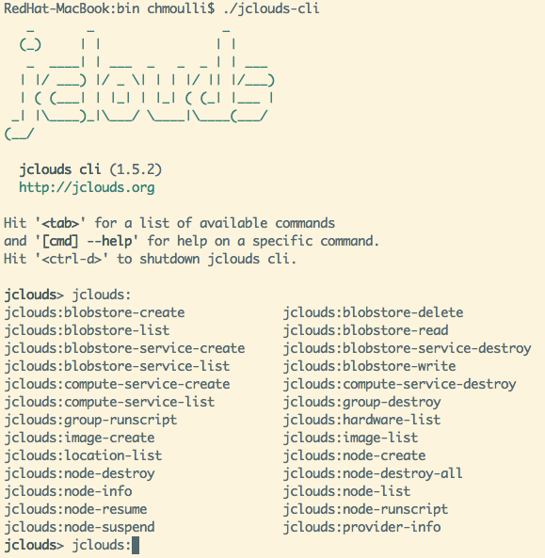
jclouds
BlobStore api
= simplify storage management (S3, ...)
Compute Api
= manage nodes in
the cloud
Tools = Karaf client

Slide 21
CloudStack

Slide 22

CloudStack
Apache project
Based on Citrix work (> April 2011)
Software designed to deploy and manage large networks of virtual machines, as a highly available, highly scalable Infrastructure as a Service (IaaS) cloud computing platform.
Supports the most popular hypervisors: VMware, Oracle VM, KVM, XenServer and Xen Cloud Platform

Slide 23
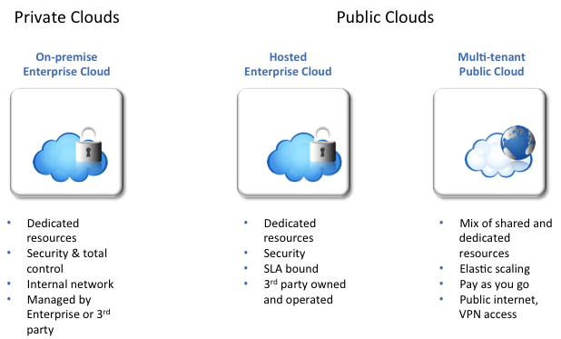
CloudStack – Infrastructure

Slide 24
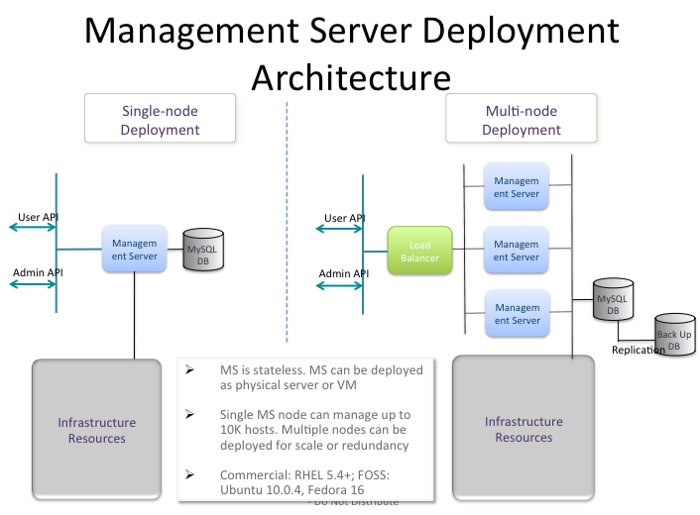

Slide 25
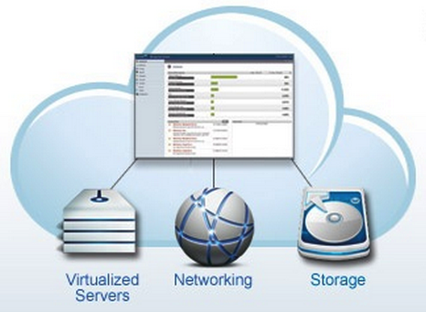
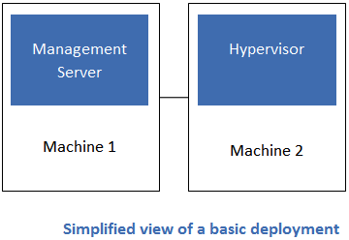
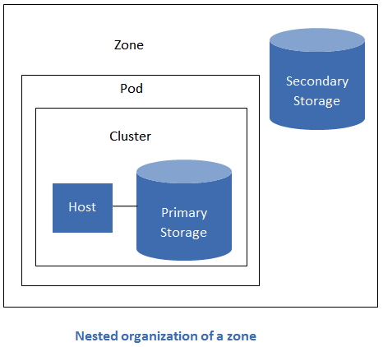
CloudStack

Slide 26
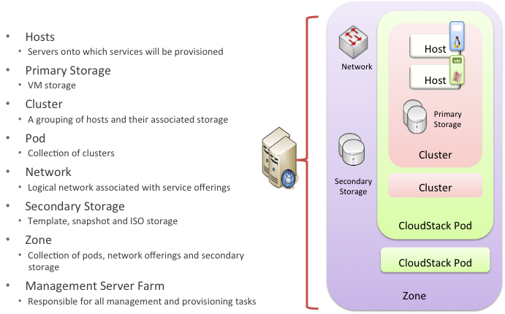
CloudStack – Core Components

Slide 27
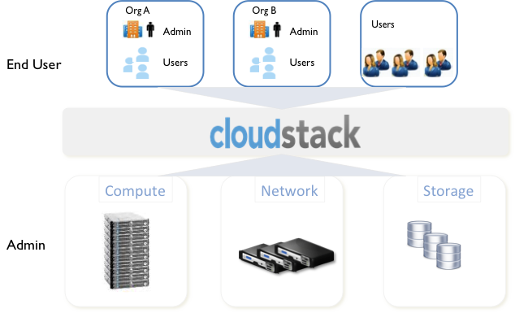
CloudStack – Self Service Portal

Slide 28
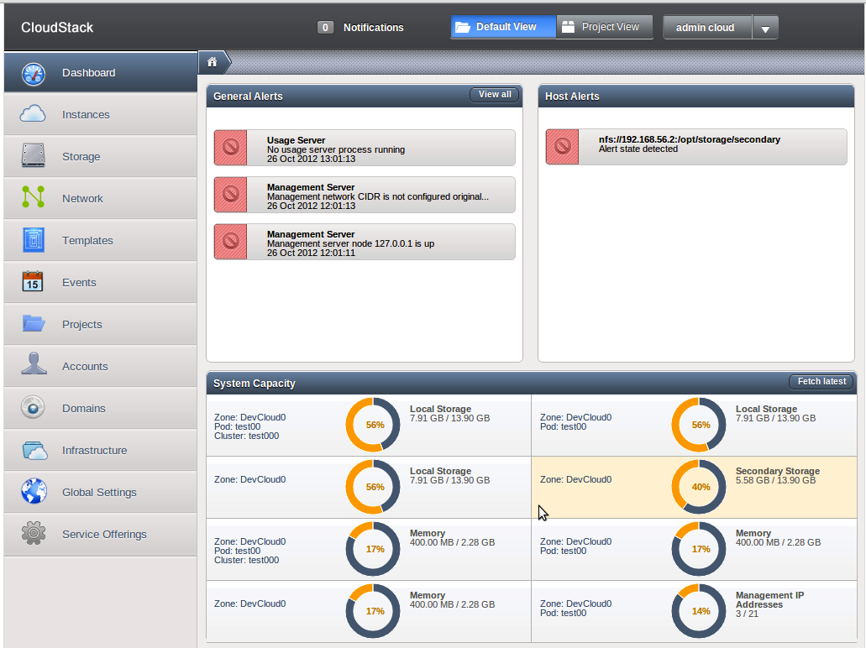
CloudStack
Web console :

Slide 29
CloudStack
Supported by jclouds
???

Slide 30
Fuse Fabric

Slide 31
Fuse Fabric
Integration everywhere

Slide 32
Fuse Fabric
“Integration” projects are really hard to install, configure and run
Distribution of workload/process is not an easy task
We want to make it easy!

Slide 33
Fuse Fabric
http://fabric.fusesource.org/
Open Source Software for “configuring, provisioning & running Fuse and Apache software on any machines” physical, virtual, private, public, private+public cloud
Keeps you DRY from those rainy clouds :)
Weave your containers into an easy to manage
fabric

Slide 34
Fuse Fabric
Allows to create instances and administrate them
locally or remotely
BUT
Instances not “cloned”
Configurations updated manually
Process is error prone
No deployment platform
Machine A
admin:create
Karaf
“root”
Karaf
“toto”
Karaf
“nestor”
Copy instance
Machine B
Karaf
“nestor”

Slide 35
Fuse Fabric in the cloud
Machine A
Fabric will create instanc &manage them
• Locally
• Remotely (ssh)
• In the cloud
Deploy artifacts
Cloud instance created
using jclouds api
fabric:create
Fabric
“master”
Fabric
“toto”
Fabric
“nestor”
fabric:create ….
Cloud Infra
Fabric
“aws-ec2”

Slide 36
What is Fabric
Storage engine = Configurations & registry
Agents = Spy !
Profiles = Artifacts to be deployed

Slide 37
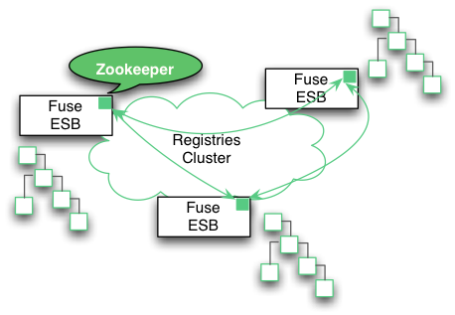
Storage engine
Based on Apache ZooKeeper
  Is a Centralized Coordination Service, distributed and highly reliable
  Uses a directory
  & file based
  structure
  Part of Fuse
  “Ensemble”

Slide 38
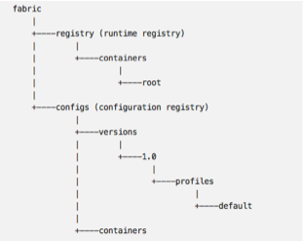
Storage engine
2 kinds of “registry” → one for the containers and the other for artifacts
Artifacts = jars, properties files, system, env properties to be deployed

Slide 39
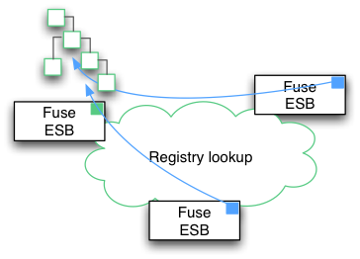
Agent
Fabric-agent deployed per Karaf container
Contains a Zookeeper client
Agent listens to the registry to configures, provisions features & services
Send info(s) to
registry (RMI, SSH)

Slide 40
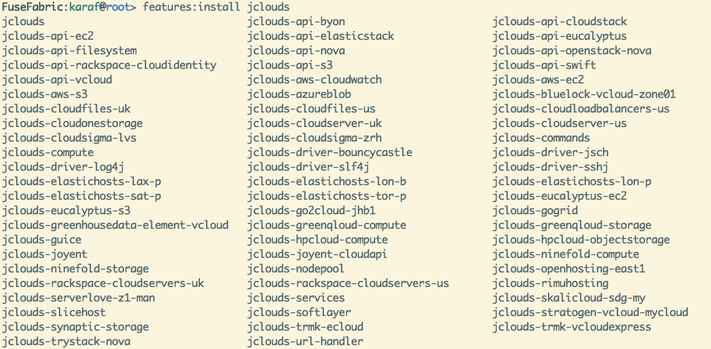
Fuse Fabric : Cloud providers
Amazon EC2
Cloustack
Openstack

Slide 41

Fuse Fabric - Installation
Deploy features (= artifacts required)
Will install commands, libraries required to
communicate with Cloud Provider and
manage instances

Slide 42
Fuse Fabric - Setup
A. Create “ensemble” (optional)
B. Add a provider
A = Api of the jclouds provider
B = Public key
C = Password
A
B
C

Slide 43
Fuse Fabric - Join
A. Create a container in the cloud
B. Join the container
C. Connect

Slide 44
Fuse Fabric : What happen
A Karaf fabric container is created
Fabric agent is registered with Zookeeper
“Artifacts” to be deployed are loaded from Profile(s)
Maven proxy is used
Fabric “Master”
Zookeeper
JClouds
Cloud Machine
Shell script
Fabric
“Instance”

Slide 45
IPaaS Architectures

Slide 46
IPaaS Architectures

Slide 47
Architecture - “On an Island”
Cloud A
Container
1
Container
2
Container
3
Cloud B
Container
1
Container
2
Fabric Ensemble
Fabric Ensemble

Slide 48
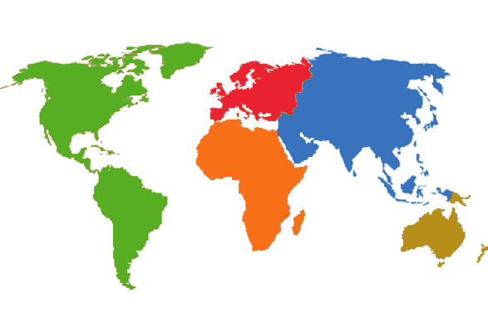
Architecture - “Interconnected”
Cloud A
Cloud B
Container
1
Container
2
Container
3
Container
4
Fabric Ensemble

Slide 49

Architecture - “Integrated”
Cloud A
Container
3
Container
4
Intranet
Container
1
Container
2
Fabric Ensemble

Slide 50
Conclusion

Slide 51
Conclusion
Fuse Fabric technology is ready and mature to allow to deploy iPaas projects
Use best of Java api (jclouds) and support all Cloud providers
Support Public, Private and Hybrid infrastructure
Designed to deploy Camel, CXF, ActiveMQ

Slide 52
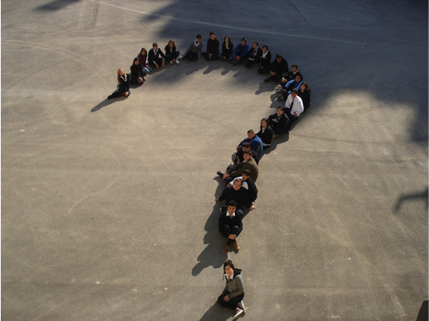

Questions
@cmoulliard
cmoulliard@apache.org
Fuse Fabric : http://fabric.fusesource.com

