Slide 1
Karaf - When OSGI modularity meets Java EE world
Charles Moulliard
&
Romain Manni-Bucau

Slide 2
Agenda
Modularity
OSGI EE
Java EE
All together
Conclusion

Slide 3

Speaker : Charles Moulliard
Engineer in Agronomy & Master in Zoology
Project Manager & Architect for banking sector
Solution Architect & Consultant @RedHat
Committer → Karaf (PMC), Camel (PMC), ServiceMix, DeltaSpike, Fabric
@cmoulliard
http://www.linkedin.com/in/charlesmoulliard
http://cmoulliard.blogspot.com
http://www.slideshare.net/cmoulliard

Slide 4

Speaker : Romain Manni-Bucau
Java and JavaEE developer
Participates to Apache OpenEJB & TomEE since 2011
His professional area is particularly linked to banks and insurances
His development environment mainly consists of Open Source & Apache projects (TomEE, Karaf, ...)

Slide 5
Introduction to Modularity

Slide 6
What does modularity means ?
Open Standard Gateway Initiative exists since 1999
Initially conceived to create dynamic environments for the “home gateway”
Lead by Telco, IT vendor
Class-loading isolation
Dependency control, versioning

Slide 7

What does modularity means ?
Function → Class
Class → Interface
Classes → Jar
Jar → Bundle (a Module)
Bundle has a lifecycle !

Slide 8
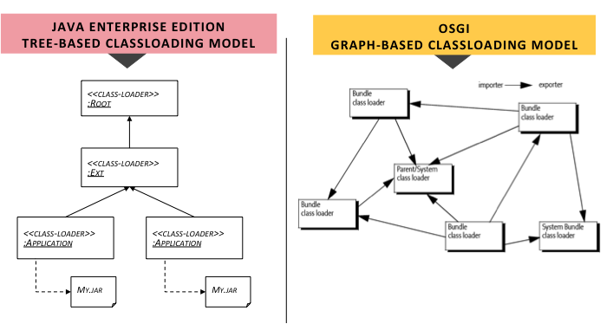
What does modularity means ?

Slide 9
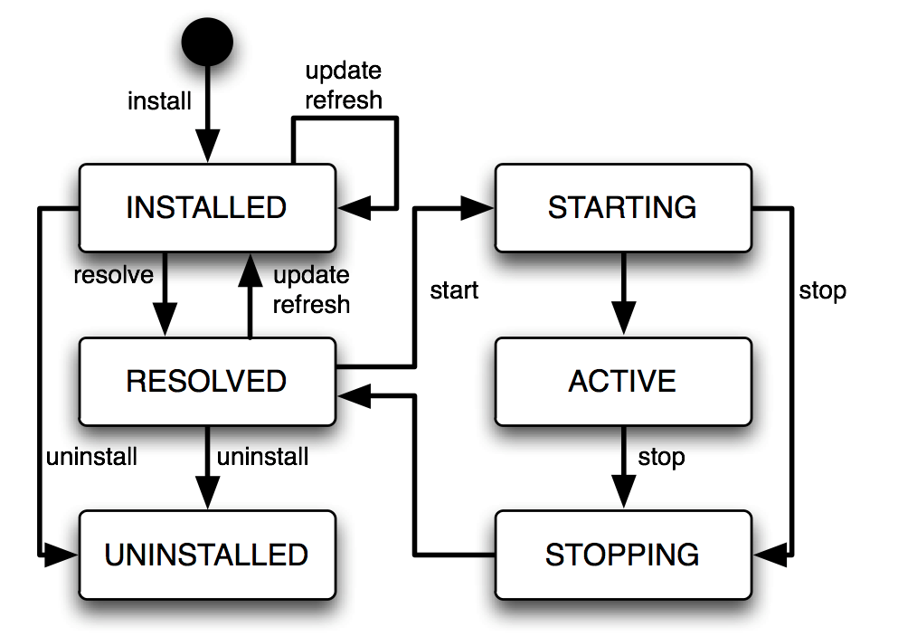
What does modularity means ?
Replace bundle by a new
Dependencies
& versions
checked
BundleActivator,
Blueprint, SpringDM
iPOJO

Slide 10
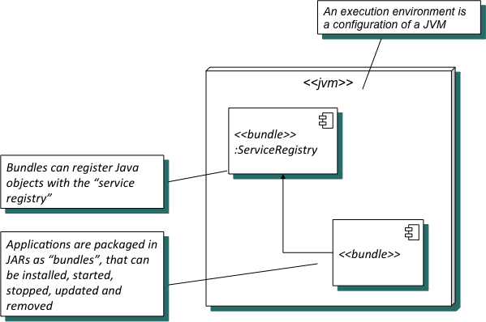
What does modularity means ?
OSGI Architecture introduces core concepts:
  Execution Environment
  Modules (bundles) & lifecycle
  Services & Service Registry

Slide 11
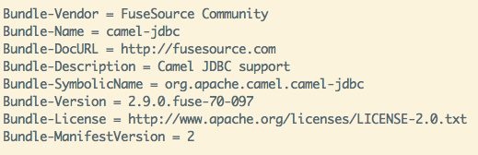
What does modularity means ?
How modularity is expressed
→ METADATA added in MANIFEST.mf file

Slide 12
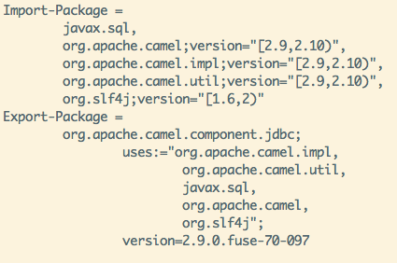
What does modularity means ?
And of course : Import & Export Package

Slide 13
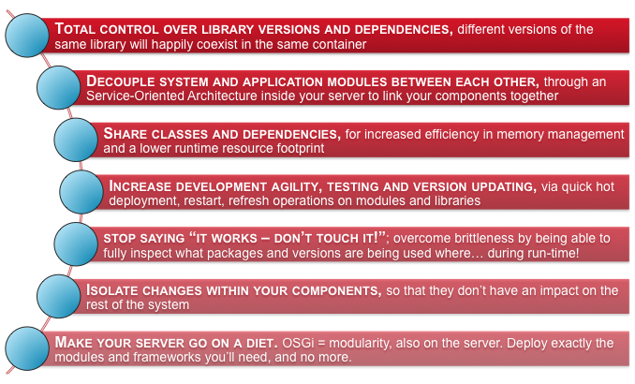
What does modularity means ?

Slide 14

Apache Karaf
Birthdate - 16th of June 2010
Platform running on OSGI (Apache Felix, Eclipse Equinox)
Provides a lightweight container where
Applications, Integration projects
Web Service, JMS Brokers
Java applications
can be deployed
Used by ServiceMix, Geronimo projects

Slide 15
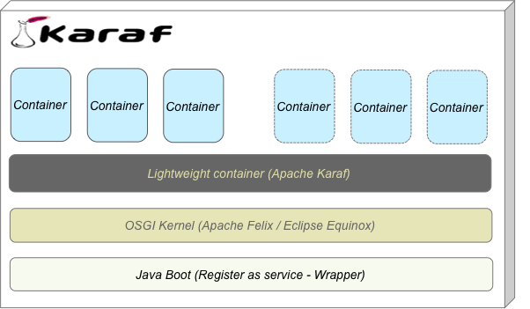
Apache Karaf

Slide 16
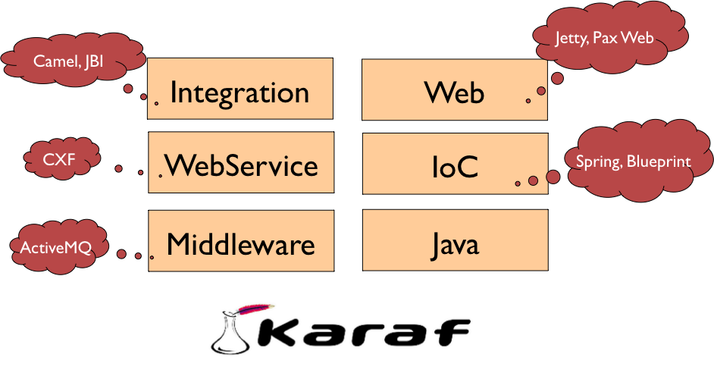
Enterprise Service Bus
Java OSGI

Slide 17
Apache Karaf
Administration console (locale, remote, ssh, web, jmx)
Provisioning system (features)
Hot deployment and configuration management (properties)
Instances management
Security integration (JAAS → ldap, jdbc, file)
Logging unification (log4j, logger, commons logging, ….)

Slide 18
Quick Apache Karaf demo

Slide 19
Is there an alternative ?

Slide 20


Java Jigsaw vision
Jigsaw project seems like
Loch Ness Monster
Announced since Java SE 7
& now -> Java SE 9
in 2015
Faced to issues
(backward compatibility)

Slide 21
Java Jigsaw vision
CLASSPATH death
New Class format
Static linkage (<= Java card – 1996)
Byte code verification step moved to speed process
JDK will have a system module library in which the platform modules are installed

Slide 22
Java Jigsaw vision
Dependency defined --> module-info.java file
module com.greetings @ 0.1 {
requires jdk.base;
requires org.astro @ 1.2;
class com.greetings.Hello;
}

Slide 23
Java Jigsaw vision
Managed using specific commands
jmod -L mlib create # this creates module lib "mlib"
jmod -L mlib install modules org.astro com.greetings
rm -rf mlib/com.greetings
java -L mlib -m com.greetings

Slide 24
OSGI EE
Extend Modularity with enterprise features

Slide 25
OSGI EE
OSGI is not only a specification defining a “modular” architecture
Embrace EE world
Provide support for Java standards :
  JPA, JNDI, Web (HTTP), JTA, JDBC
  Soon CDI, EJB

Slide 26


OSGI EE
Implemented by Apache Aries
But also OPS4J - Pax

Slide 27
What is OSGI EE ?
OSGI services (Java Interfaces)
JPA, JTA OSGI containers
Web OSGI container
Blueprint (IoC) to configure services, beans and access services
But also
  JNDI (wrapper)
  SpiFly (Java ServiceLoader – static/dynamic)
  Applications isolation (EBA)

Slide 28
Enterprise Service Bus
Java OSGI EE
OSGI EE
JPA, JTA, JNDI, JDBC

Slide 29
What is OSGI EE ?
A typical architecture
Apache Karaf
Java Service
Java DAO
Blueprint
Blueprint
OSGI Services
JPA
Tx
DB
<bean id="conferenceService" class="org.apache.conf2012.service.impl.ConferenceService">
<property name="conferenceDAO">
<reference interface="org.apache.conf2012.service.ConferenceDAO"/>
</property>
</bean>

Slide 30
What is OSGI EE ?
Architecture enriched with Web layer
Apache Karaf
Java DAO
Java Service
Web
Blueprint
Blueprint
Blueprint
OSGI Services
JPA
Tx
DB
Simply HTML artifacts,
web framework

Slide 31
What is OSGI EE ?
Using Camel for Integration
Apache Karaf
File, WS, Rest, JMS
Java DAO
Java Service
Java Service
Camel
Blueprint
Blueprint
OSGI Services
JPA
Tx
Bean
DB
from(“file://apacheCon2012”)
.unmarshall(“csv”)
.beanRef(“insertConference”);

Slide 32
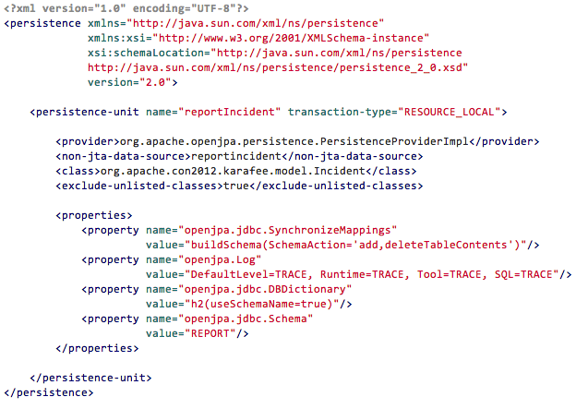
What is OSGI EE ?
Persistence

Slide 33
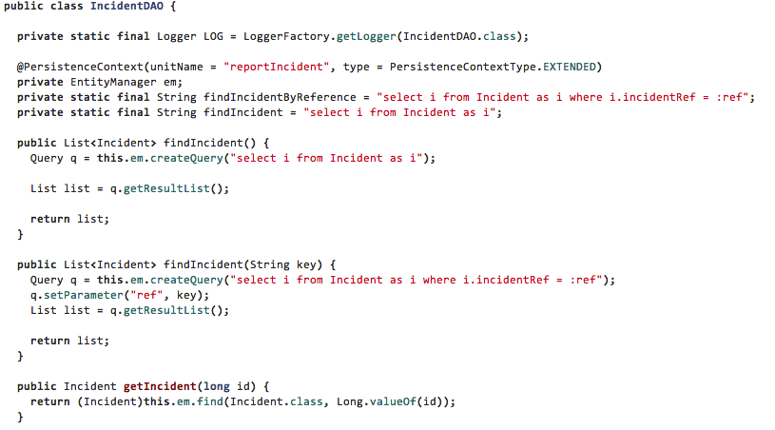
What is OSGI EE ?
DAO

Slide 34
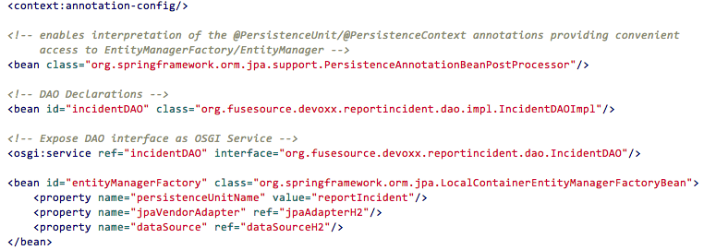
What is OSGI EE ?
DAO (Spring/Blueprint) using JPA/Hibernate

Slide 35
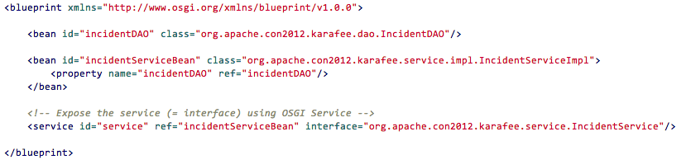
What is OSGI EE ?
Service

Slide 36
Java EE

Slide 37

Java EE - Specs
JSR 907 (JTA)
JSR 196 (JAAS)
JSR 115 (JACC)
JavaMail
JSR 338 (JPA)
JSR 303 (Bean Validation)
JSR 299 + 330 (CDI)
JSR 318 (EJB)

Slide 38





Java EE – Specs (next)
JSR 315 (servlet)
JSR 245 (JSP)
JSR 344 (JSF)
JSR 914 (JMS)
JSR 339 (JAX-RS)
JSR 224 (JAX-WS)
Connector

Slide 39



Java EE & Apache
Supported by Apache foundation projects
OpenJPA
OpenEJB
OpenWebbeans
DeltaSpike
ActiveMQ
CXF, Camel
Tomcat, MyFaces

Slide 40

Java EE - Concepts
@EntityManager
Transactions
JAX-WS
@Resource
JAX-REST
JAAS
Pooling
@Inject
Endpoint
PersistenceUnit

Slide 41
When Java EE meets OSGI

Slide 42
Java EE on Karaf
What is required
  A Karaf runtime
  Features (= provisioning)
  New Karaf command (optional)
Follow Java EE specs & development guidelines

Slide 43
Karaf plus EE
Features →
Java EE api + OpenEJB + OpenWebbeans + OpenJPA
Turn on your Karaf into Java EE world :
CDI + EJB3 + JPA + JTA + ...

Slide 44
Enterprise Service Bus
Java EE world
EE
CDI, EJB, JPA, JTA

Slide 45
Karaf EE Architecture
Architecture (JPA, EJB, CDI)
Apache Karaf
Java Service
Java DAO
Web Framework
CDI
CDI
HTTP
OSGI Services
OpenJPA
OpenEJB
JTA
…
@Inject
@Startup
@Singleton
Conference DAO MyConferenceDAO
….
DB

Slide 46
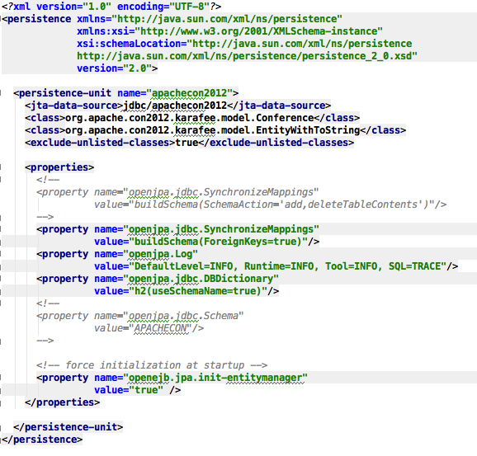
Karaf with EE - Example
Pers
istence

Slide 47
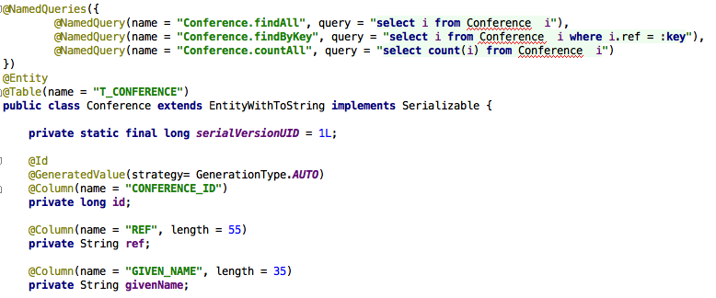
Karaf with EE - Example
Entity

Slide 48
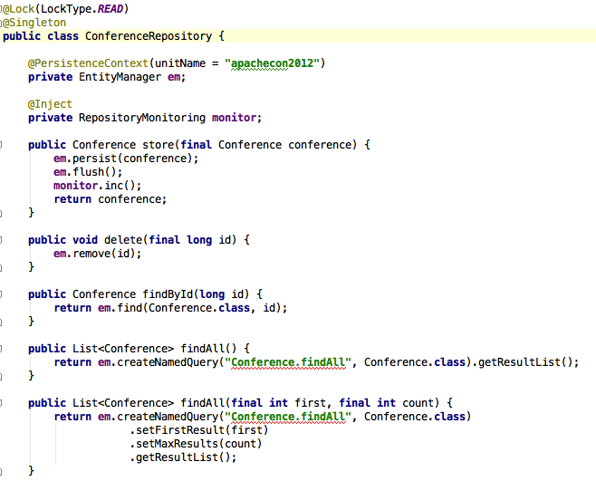
Karaf with EE - Example
DAO

Slide 49
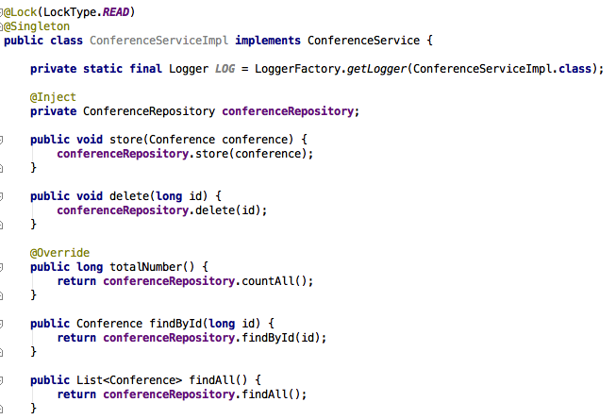
Karaf with EE - Example
Service

Slide 50
DEMO & Conclusion

Slide 51
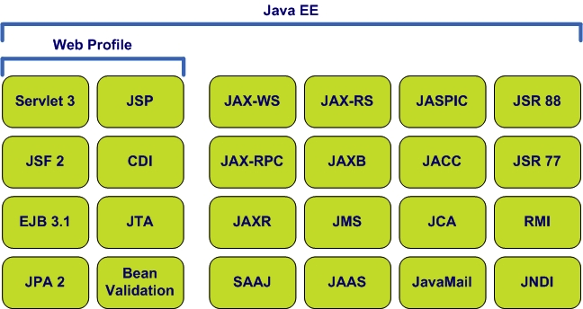
Karaf EE = Combine lightweight containers with Java EE
Allow to develop modular projects
Capitalize your Java EE knowledge
Convergence between, best of both technologies OSGI & Java EE

Slide 52



Questions
@cmoulliard
@rmannibucau
Karaf with EE –
http://repo1.maven.org/maven2/org/apache/openejb/apache-karafee/

