Slide 1
Flux: Practical Job Scheduling
Dong H. Ahn, Ned Bass, Al Chu, Jim Garlick, Mark Grondona,
Stephen Herbein, Tapasya Patki, Tom Scogland, Becky Springmeyer
August 15, 2018

Slide 2
What is Flux?
New Resource and Job Management Software (RJMS) developed here at LLNL
A way to manage remote resources and execute tasks on them

Slide 3


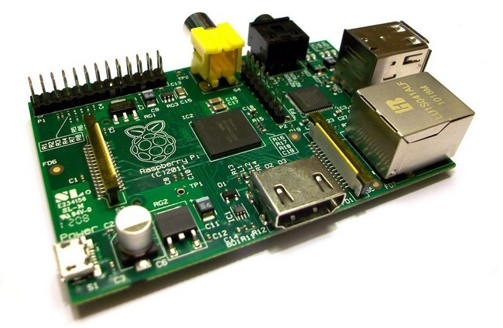

What is Flux?
New Resource and Job Management Software (RJMS) developed here at LLNL
A way to manage remote resources and execute tasks on them
flickr: dannychamoro

Slide 4





What is Flux?
New Resource and Job Management Software (RJMS) developed here at LLNL
A way to manage remote resources and execute tasks on them

Slide 5






What about …?

Slide 6


What about …?
Closed-source

Slide 7


What about …?
Not designed for HPC

Slide 8


What about …?
Limited Scalability, Usability, and Portability

Slide 9
Why Flux?
Extensibility
Open source
Modular design with support for user plugins
Scalability
Designed from the ground up for exascale and beyond
Already tested at 1000s of nodes & millions of jobs
Usability
C, Lua, and Python bindings that expose 100% of Flux’s functionality
Can be used as a single-user tool or a system scheduler
Portability
Optimized for HPC and runs in Cloud and Grid settings too
Runs on any set of Linux machines: only requires a list of IP addresses or PMI
Flux is designed to make hard scheduling problems easy

Slide 10
Portability: Running Flux
Already installed on LC systems (including Sierra)
spack install flux-sched for everywhere else
Flux can run anywhere that MPI can run, (via PMI – Process Management Interface)
Inside a resource allocation from: itself (hierarchical Flux), Slurm, Moab, PBS, LSF, etc
flux start OR srun flux start
Flux can run anywhere that supports TCP and you have the IP addresses
flux broker -Sboot.method=config -Sboot.config_file=boot.conf
boot.conf:
session-id = "mycluster"
tbon-endpoints = [
"tcp://192.168.1.1:8020",
"tcp://192.168.1.2:8020",
"tcp://192.168.1.3:8020"]

Slide 11
Why Flux?
Extensibility
Open source
Modular design with support for user plugins
Scalability
Designed from the ground up for exascale and beyond
Already tested at 1000s of nodes & millions of jobs
Usability
C, Lua, and Python bindings that expose 100% of Flux’s functionality
Can be used as a single-user tool or a system scheduler
Portability
Optimized for HPC and runs in Cloud and Grid settings too
Runs on any set of Linux machines: only requires a list of IP addresses or PMI

Slide 12
Usability: Submitting a Batch Job
Slurm
sbatch –N2 –n4 –t 2:00 sleep 120
Flux CLI
flux submit –N2 –n4 –t 2m sleep 120
Flux API:
import json, flux
jobreq = {
'nnodes' : 2,
'ntasks' : 4,
'walltime' : 120,
'cmdline' : ["sleep", "120"]}
f = flux.Flux ()
resp = f.rpc_send ("job.submit", json.dumps(jobreq))

Slide 13
Usability: Running an Interactive Job
Slurm
srun –N2 –n4 –t 2:00 sleep 120
Flux CLI
flux wreckrun –N2 –n4 –t 2m sleep 120
Flux API:
import sys
from flux import kz
resp = f.rpc_send ("job.submit", json.dumps(jobreq))
kvs_dir = resp['kvs_dir']
for task_id in range(jobreq['ntasks']):
kz.attach (f, "{}.{}.stdout".format(kvs_dir, task_id), sys.stdout)
f.reactor_run (f.get_reactor (), 0)

Slide 14
Usability: Tracking Job Status
CLI: slow, non-programmatic, inconvenient to parse
watch squeue –j JOBID
watch flux wreck ls JOBID
Tracking via the filesystem
date > $JOBID.start; srun myApp; date > $JOBID.stop
Push notification via Flux’s Job Status and Control (JSC):
def jsc_cb (jcbstr, arg, errnum):
jcb = json.loads (jcbstr)
jobid = jcb['jobid']
state = jsc.job_num2state (jcb[jsc.JSC_STATE_PAIR][jsc.JSC_STATE_PAIR_NSTATE])
print "flux.jsc: job", jobid, "changed its state to ", state
jsc.notify_status (f, jsc_cb, None)
Non-I/O
→ quota -vf ~/quota.conf
Disk quotas for herbein1:
Filesystem used quota limit files
/p/lscratchrza 760.3G n/a n/a 8.6M
I/O
Runtime Stages
I/O

Slide 15
Why Flux?
Extensibility
Open source
Modular design with support for user plugins
Scalability
Designed from the ground up for exascale and beyond
Already tested at 1000s of nodes & millions of jobs
Usability
C, Lua, and Python bindings that expose 100% of Flux’s functionality
Can be used as a single-user tool or a system scheduler
Portability
Optimized for HPC and runs in Cloud and Grid settings too
Runs on any set of Linux machines: only requires a list of IP addresses or PMI

Slide 16
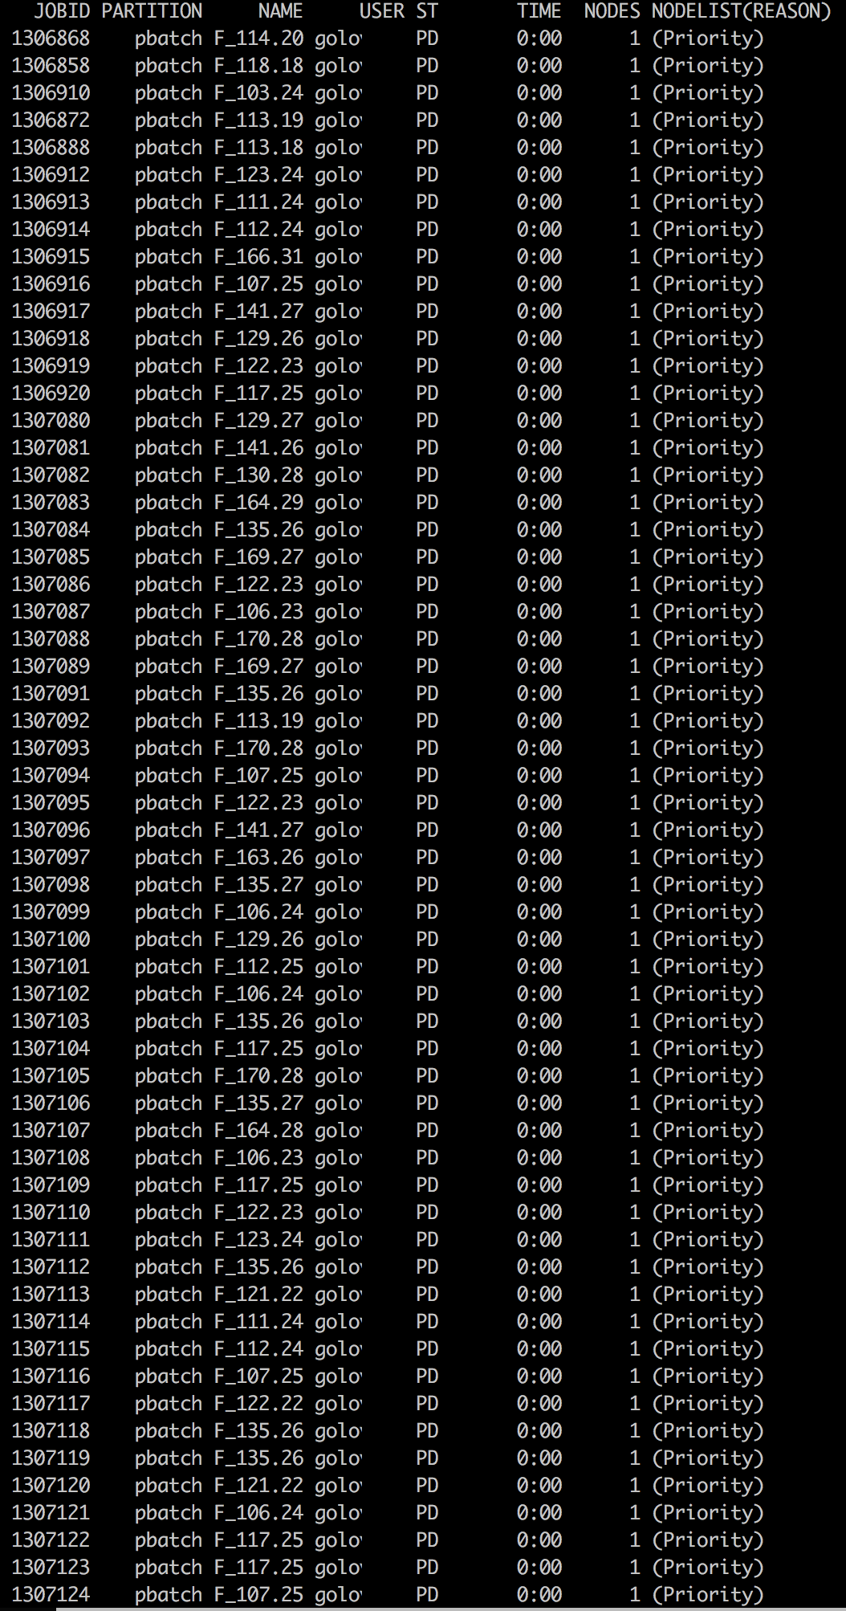
Scalability: Running Many Jobs
Slurm
find ./ -exec sbatch –N1 tar –cf {}.tgz {}\;
Slow: requires acquiring a lock in Slurm, can timeout causing failures
Inefficient: uses 1 node for each task
find ./ -exec srun –n1 tar –cf {}.tgz {}\;
Slow: spawns a process for every submission
Inefficient: is not a true scheduler – can overlap tasks on cores
Flux Capacitor
find ./ -printf -n1 tar –cf %p.tgz %p | flux-capacitor
flux-capacitor --command_file my_command_file
-n1 tar -cf dirA.tgz ./dirA
-n1 tar -cf dirB.tgz ./dirB
-n1 tar -cf dirC.tgz ./dirC
Flux API:
for f in os.listdir(‘.’):
payload[‘command’] = [“tar”, “-cf”, ”{}.tgz”.format(f), f]
resp = f.rpc_send ("job.submit", payload)
Subject: Good Neighbor Policy You currently have 271 jobs in the batch system on lamoab. The good neighbor policy is that users keep their maximum submitted job count at a maximum of 200 or less. Please try to restrict yourself to this limit in the future. Thank you.
Capacitor
Scheduler
Variable Input Job Stream
Constant Output Job Stream

Slide 17
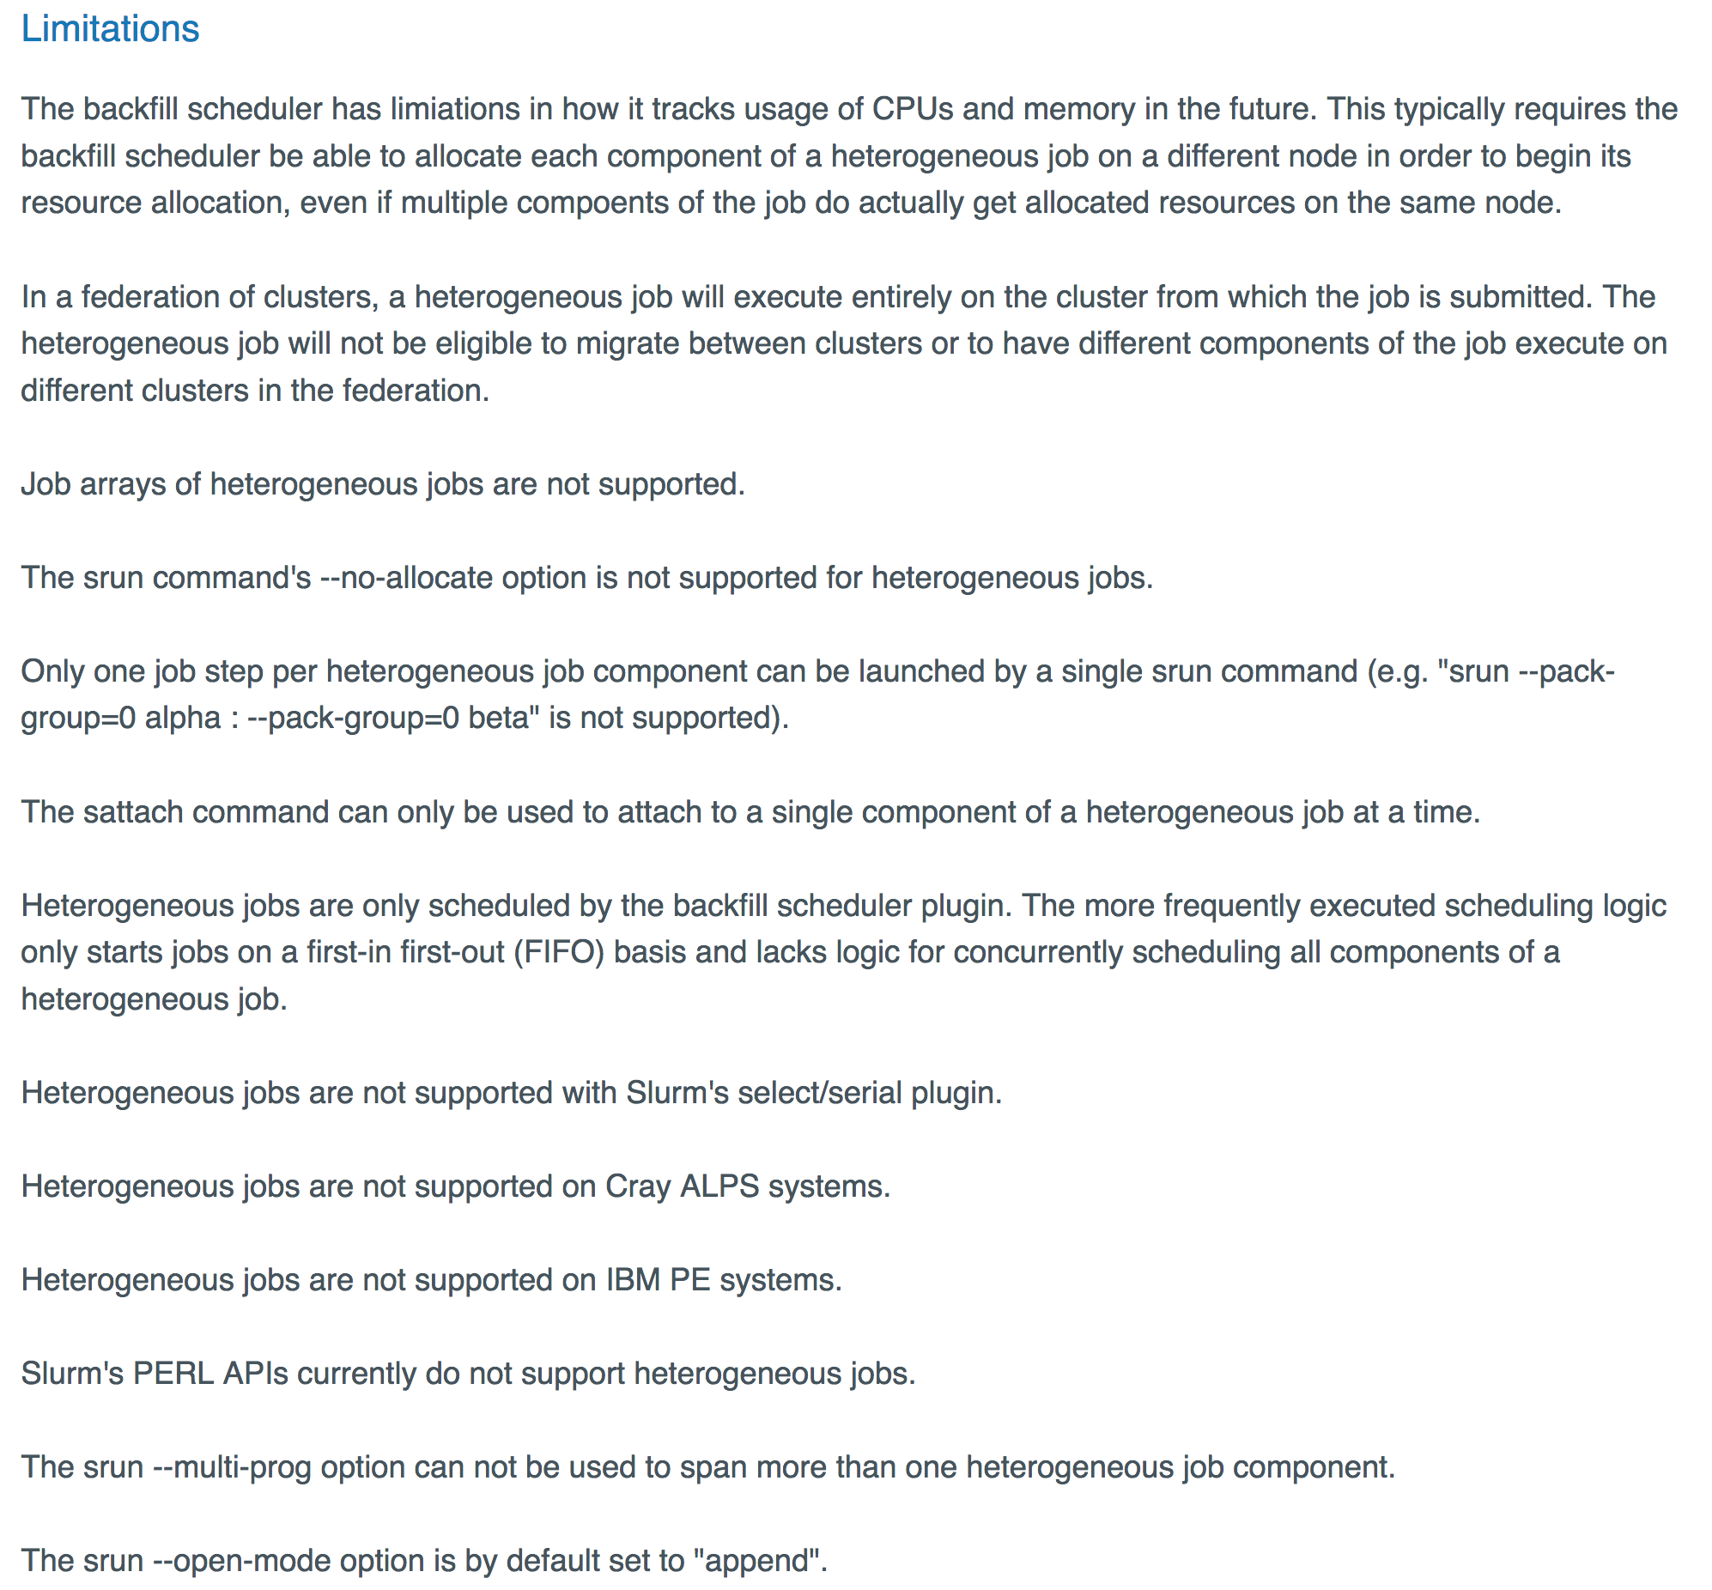
Scalability: Running Many Heterogeneous Jobs
Slurm
No support for heterogeneous job steps in versions before 17.11
Limited support in versions after 17.11
Flux Capacitor
flux-capacitor --command_file my_command_file
-n1 tar -cf dirA.tgz ./dirA
-n32 make –j 32
-N4 my_mpi_app
...
https://slurm.schedmd.com/heterogeneous_jobs.html#limitations

Slide 18
Scalability: Running Millions of Jobs
Flux Capacitor (Depth-1)
flux-capacitor --command_file my_command_file
Hierarchical Flux Capacitor (Depth-2)
for x in ./*.commands; do flux submit -N1 flux start \ flux-capacitor --command_file $x done
Flux Hierarchy (Depth-3+)
flux-hierarchy --config=config.json --command_file my_command_file
Capacitor
Capacitor

Slide 19
Why Flux?
Extensibility
Open source
Modular design with support for user plugins
Scalability
Designed from the ground up for exascale and beyond
Already tested at 1000s of nodes & millions of jobs
Usability
C, Lua, and Python bindings that expose 100% of Flux’s functionality
Can be used as a single-user tool or a system scheduler
Portability
Optimized for HPC and runs in Cloud and Grid settings too
Runs on any set of Linux machines: only requires a list of IP addresses or PMI

Slide 20

Extensibility: Modular Design
At the core of Flux is an overlay network
Built on top of ZeroMQ
Supports RPCs, Pub/Sub, Push/Pull, etc
Modules provide extended functionality (i.e., services)
User-built modules are loadable too
Some modules also support plugins
External tools and commands can access services
User authentication and roles supported
Flux Instance
Service Modules
Heartbeat
Key-Value Store
Overlay Networks & Routing
Resource
Remote Execution
Msg Idioms (RPC/Pub-Sub)
Sched Framework
Comms Message Broker
Policy
Plugin A
Commands
flux submit
flux-capacitor

Slide 21
Extensibility: Creating Your Own Module
Register a new service “pymod.new_job” that ingests jobs and responds with a Job ID
Load using flux module load pymod --module=path/to/file.py
import itertools, json, flux
def handle_new_job(f, typemask, message, arg):
job_queue, job_ids = arg
job_queue.append(message.payload)
response = {‘jobid’ : job_ids.next()}
f.respond(message, 0, json.dumps(response))
def mod_main(f, *argv):
f.msg_watcher_create(flux.FLUX_MSGTYPE_REQUEST,
handle_new_job,"pymod.new_job", args=([], itertools.count(0))).start()
f.reactor_run(f.get_reactor(), 0)

Slide 22
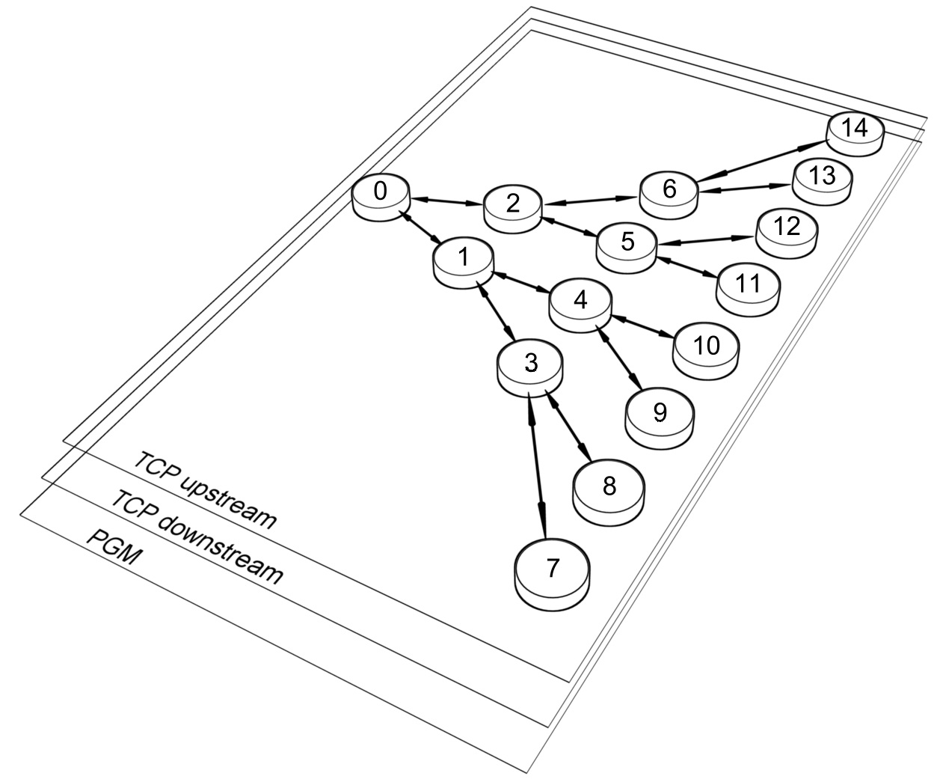
Extensibility: Flux’s Communication Overlay
Connect to a running flux instance
f = flux.Flux()
Send an RPC to a service and receive a response
resp = f.rpc_send (”pymod.new_job", payload) jobid = json.loads(resp)[‘jobid’]
Subscribe to and publish an event
f.event_subscribe(“node_down”) f.msg_watcher_create(node_down_cb, raw.FLUX_MSGTYPE_EVENT, “node_down”).start()
f.event_send(“node_down”)

Slide 23
Extensibility: Scheduler Plugins
Common, built-in scheduler plugins:
First-come First-Served (FCFS)
Backfilling
Conservative
EASY
Hybrid
Various, advanced scheduler plugins:
I/O-aware
CPU performance variability aware
Network-aware
Create your own!
Loading the plugins
flux module load sched.io-aware
FLUX_SCHED_OPTS="plugin=sched.fcfs" flux start

Slide 24

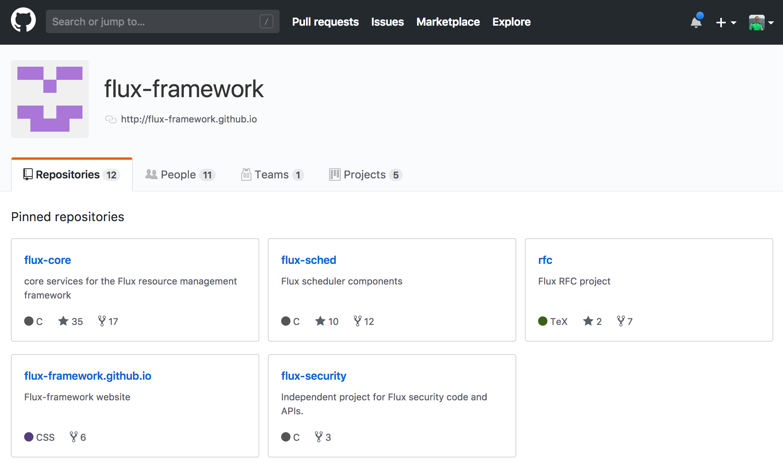
Extensibility: Open Source
Flux-Framework code is available on GitHub
Most project discussions happen in GitHub issues
PRs and collaboration welcome!
Thank You!

Slide 25
Disclaimer
This document was prepared as an account of work sponsored by an agency of the United States government. Neither the United States government nor Lawrence Livermore National Security, LLC, nor any of their employees makes any warranty, expressed or implied, or assumes any legal liability or responsibility for the accuracy, completeness, or usefulness of any information, apparatus, product, or process disclosed, or represents that its use would not infringe privately owned rights. Reference herein to any specific commercial product, process, or service by trade name, trademark, manufacturer, or otherwise does not necessarily constitute or imply its endorsement, recommendation, or favoring by the United States government or Lawrence Livermore National Security, LLC. The views and opinions of authors expressed herein do not necessarily state or reflect those of the United States government or Lawrence Livermore National Security, LLC, and shall not be used for advertising or product endorsement purposes.

