Slide 1
Wannabe Programmers
Hackathon Serres 2019

Slide 2
Data Mining
SQL Injection ()
XSS ()
Local File Inclusion ()
Detect certain chars in the request.

Slide 3
Parse Data
Using the Data Mining we labeled each request as:
OK
SQLI
XSS
LFI

Slide 4


SQL DataBase

Slide 5
Answer to Questions
Most dangerous ip in our opinion:
We used a function to evaluate the dangerousness of an ip, based on the number of each type of request.

Slide 6
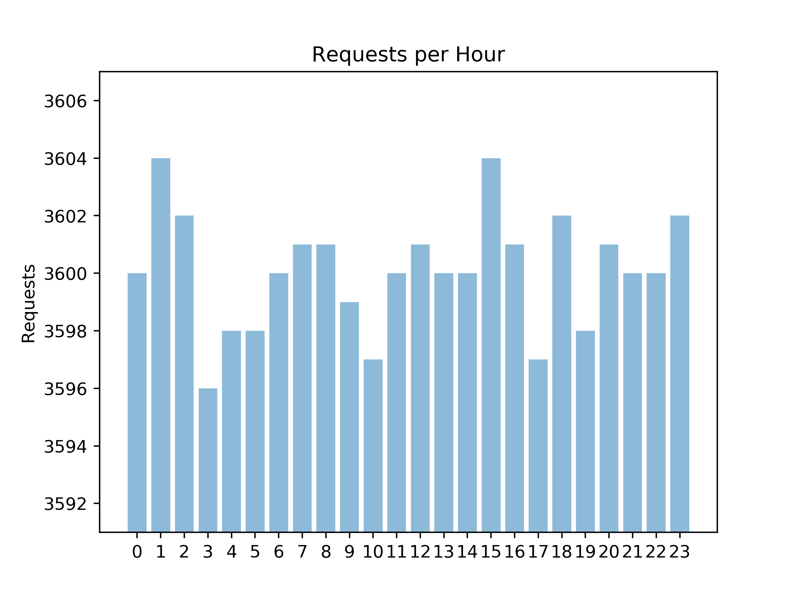
Visualization
Requests per hour

Slide 7
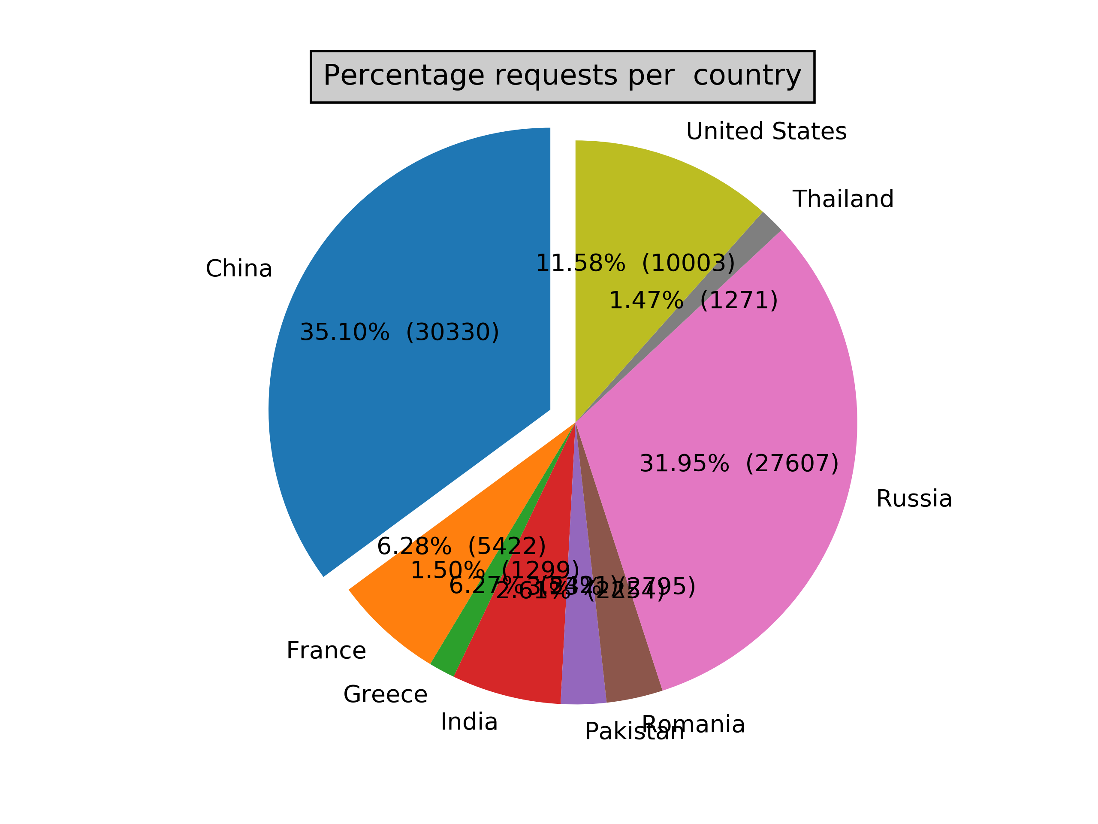
Visualization

Slide 8
Visualization Word
Site : https://bit.ly/2Js7Q4H

Slide 9
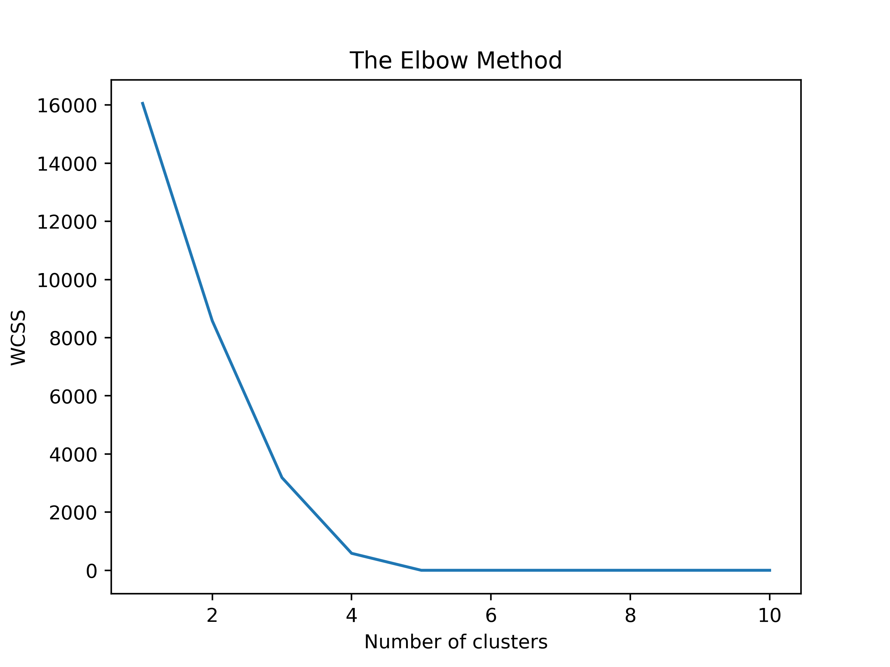
Machine Learning
Kmeans Clustering
Strings→ 1,0 arrays based on some specific characters
Sum of Squares

Slide 10
Machine Learning
Random Forest Classifier
Request → array of integers (unicode of chars)
Used 5-Fold cross validation:
  Accuracy 99%

