Slide 1

Agile Development
Celeste Pauna

Slide 2
The various Agile Roles
Product Owner
Scrum Master
Developers
Testers

Slide 3
Scrum Master
The role of scrum master can be thought of as the “servant leader.” Their responsibility is to ensure that all team members adhere to Agile practices. Agile development should be “self-organizing”. The scrum master is very important in keeping all team members organized in this type of environment.
“Accountability means to
say what you do,
do what you say.”
― Pearl Zhu
Responsibilities
Facilitates scrum events.
Supports the product owner
Coaches the development team.
Hosts sprint reviews and retrospectives.

Slide 4
Product Owner
Manages and creates the product backlog.
Represents the customers and the stakeholders.
Collaborates closely with the development team and scrum master.
Relays the information from the sprint reviews and retrospectives to the clients and stakeholders.
The product owner acts as a bridge between
the development team and the clients. They are responsible for maximizing the value
of the product by managing the
product backlog. The product owner is also
responsible for writing the user stories based
on the clients wants and needs.

Slide 5

Developers and Testers
The development team are the “workforce” of the Scum team. Here is where you find the coders and programmers. They transform the product owners' vision into the working product. The testers are the “quality assurance” of the scrum team. They test valid and invalid user actions and record how the product responds.
Responsibility's
Utilize user stories
Follow industry standard best practices
Openly communicate with the rest of the scrum team
Testers collaborate with developers and vice versa
Create test cases from the user stories

Slide 6
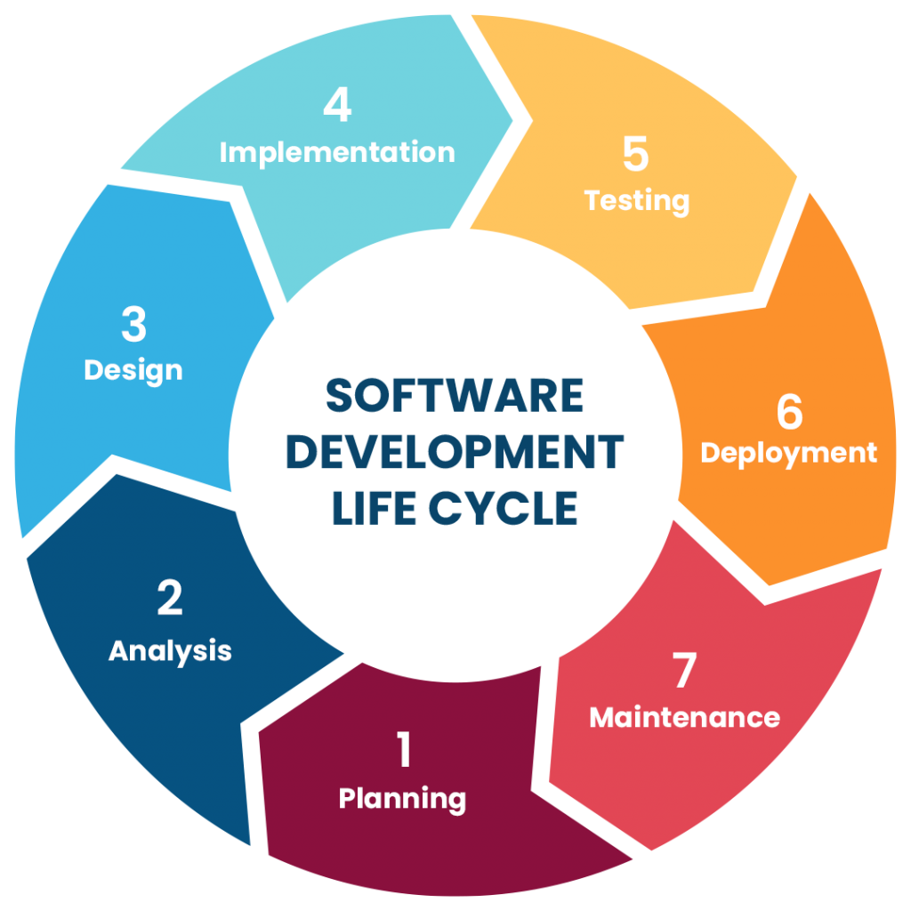
The SDLC Software Development Lifecycle
Planning
Design/Analysis
Development/Implementation
Testing
Deployment
Maintenance/Review
The important thing is not your process.
The important thing is your process for improving your process.
-Henrik Kniberg
6

Slide 7
Planning Design
1
2
This is the initial phase in the project.
Understand what the customer needs and define the initial vision.
Identify high-level requirements
Create the initial product backlog
Decide how the team will build the solution.
Design should be just enough to start development
Create the acceptance criteria
The design evolves with the project
7

Slide 8
Development
Testing
Turn user stories into working software.
Developers construct and write code.
Construct the features outlined in the user stories.
Collaborate with testers to define test cases.
Ensure the increment works,
meets requirements and is high quality.
Run test cases
Check for bugs and edge cases
Automate tests where possible
8

Slide 9
Deployment Review
Deliver a potentially shippable
product increment.
Inspect the product and the process.
At the end of each sprint the increment is demonstrated in the sprint review.
Documentation is updated as needed
If it is the final sprint, it may be released (depending on the organization)
Stakeholders give feedback on the increment
Iteration success and delays are analyzed by the team
Ideas for the next faze are considered
9

Slide 10
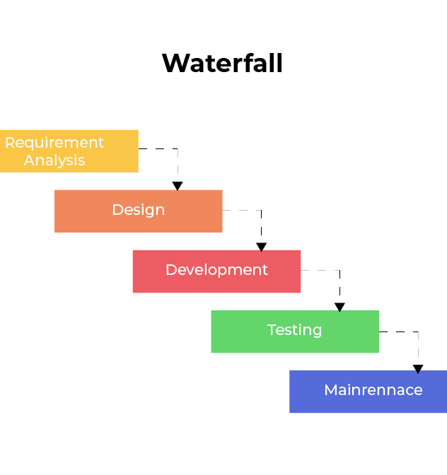
Waterfall methodology
Requirements
Design
Development
Testing
Maintenance

Slide 11

Facts to consider when choosing development style

Slide 12
Waterfall vs Agile
Requirements are pinpointed form the start
The approach is linear and sequential
Flexibility is very low
Once a phase is complete there is no going back
Documentation is heavily detailed
Team can adapt to changes in requirements
Approach is iterative and incremental
Flexibility is high and welcomes change
Phases are repeated every sprint
Documentation is lightweight and evolving

Slide 13
Fin
References
Charles G. Cobb. (2015). The Project Manager’s Guide to Mastering Agile : Principles and Practices for an Adaptive Approach. Wiley.
Clean Agile: Back to Basics
By Robert C. Martin
Agile Methodology
-Geeks for geeks

