Slide 1
Rock-Paper-Scissors AI with Image Recognition
By: Weifeng Ma
SJSU CMPE 260

Slide 2
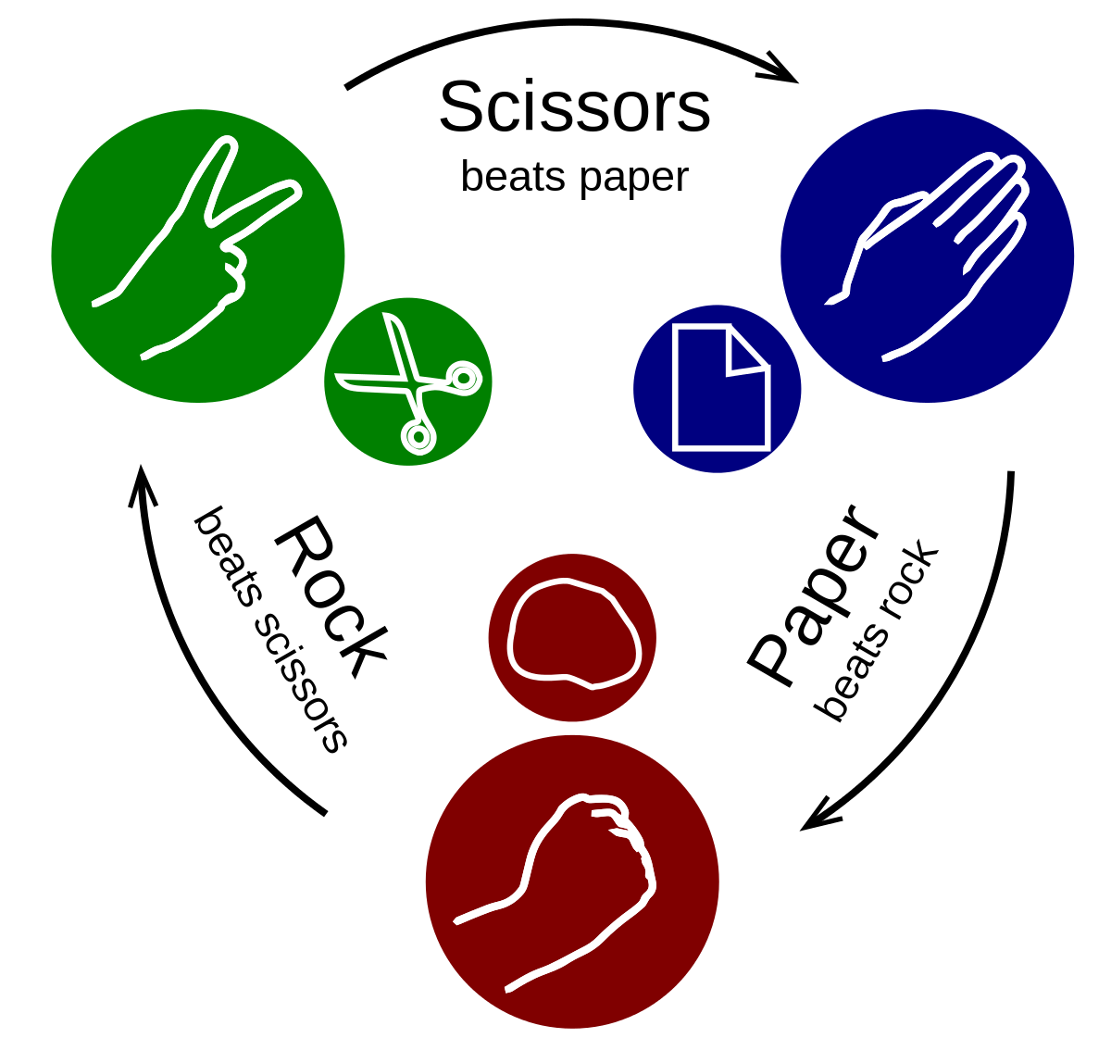
INTRODUCTION
The Rock-Paper-Scissor AI that implemented with a reinforcement mechanism. In this project, I will make the Rock-Paper-Scissors that apply the concept of reinforcement learning I learned from this class. I’ll implement the AI by using a reinforcement learning approach. To get better understanding of deep learning, I also implement image recognition that uses an image of rock/paper/scissors as input. The game itself will keep track of human choices and produce the choice with the highest chance to win humans.
Notes:
Image From: https://en.wikipedia.org/wiki/Rock_paper_scissors

Slide 3
markov chain process

Slide 4
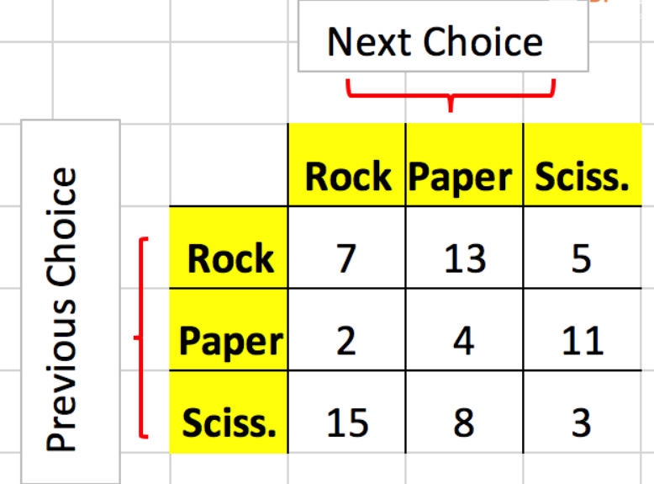
Keep track of payer choices
Last choice R -> 7 times would pick R
Last choice S -> 3 times would pick S
Notes:
Image From: https://en.wikipedia.org/wiki/Rock_paper_scissors

Slide 5
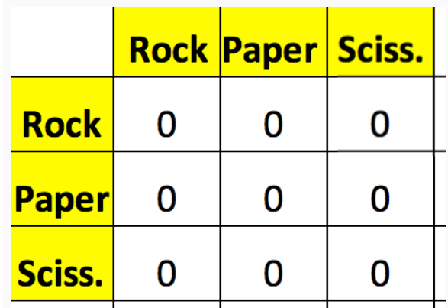
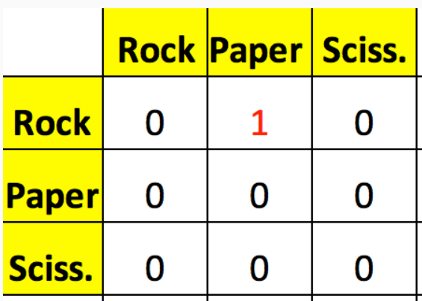
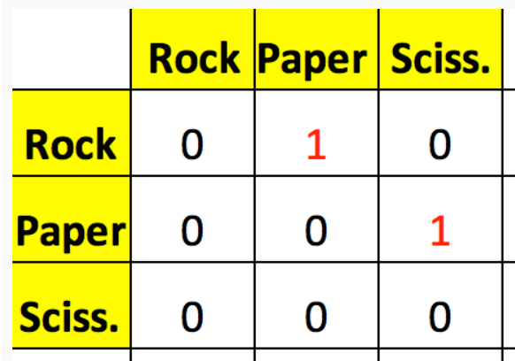
If the player select R (previous), and then select P (current); we would have:
And then if the player select S, we will have:

Slide 6
In practice:
If (SR is the highest)
Pick R
If (SR > 8 times)
Pick the choice > 8
According to the record, the AI knew that scissors came out as R 15 times, P 8 times, and S only 3 times, so the user is most likely to come out with a R.

Slide 7

Sum up rows
Calculate R = R/Sum = rating
Highest wining rate value -> best choice

Slide 8
Image Recognition

Slide 9
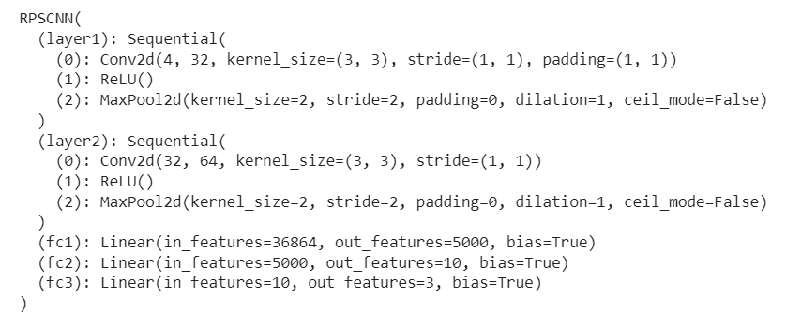
CNN
https://colab.research.google.com/drive/1E1M5WPv21g3-lJhO-yHzDMWUKWsV9f_e#scrollTo=ZPzrLb355Ss_

Slide 10
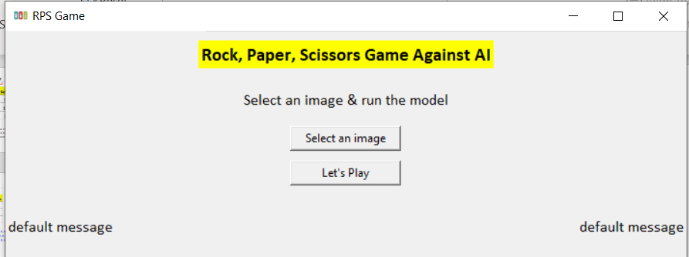
UI
Python Tkinter

Slide 11
Demo

