Slide 1
Trust in recommender system to solve cold start problem
By: Weifeng Ma
CMPE 297
Short Story Assignment

Slide 2

Recommender/Recommendation Systems (RSs)
Recommendation systems are complex artificial intelligence systems that are designed to provide a prediction to users based on a preference. Many popular e-commerce sites, such as Amazon, have adopted personalized recommendation systems for their users, suggesting items they can buy based on their past behavior.

Slide 3
Collaborative Filtering
Collaborative filtering, which filters information by using data from other users, is heavily used in practice. The recommendation process uses feedback, comments and opinions to filter through a large amount of information and filter out information that may be of interest to the target user.
Most websites like Amazon, YouTube, and Netflix use collaborative filtering.

Slide 4
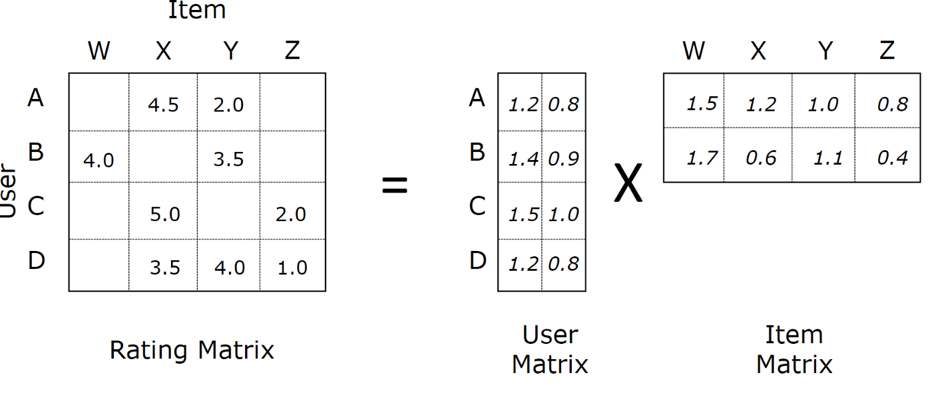
Matrix Factorization
Matrix factorization is a collaborative filtering algorithm to find the relationship between items and users’ entities.
Notes:
Image from: https://medium.com/@connectwithghosh/simple-matrix-factorization-example-on-the-movielens-dataset-using-pyspark-9b7e3f567536

Slide 5
Cold Start Problem
How to make the most effective recommendations without knowing anything about the user?
Cold start can be three types: user cold start, item cold start, and system cold start
Solution:
Get more data! Gain more information!

Slide 6
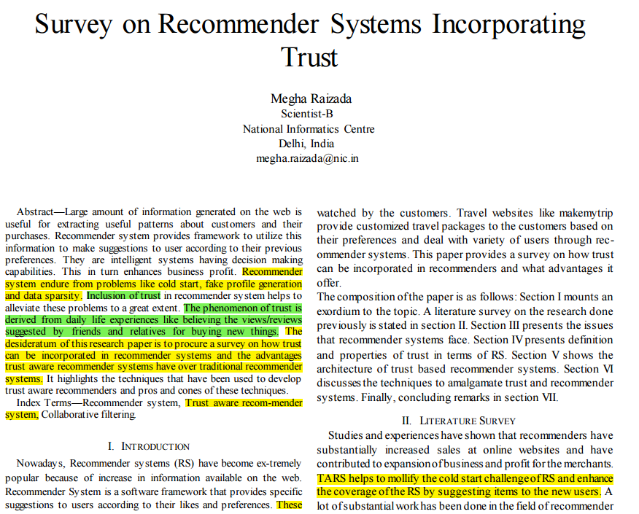
Trust-Aware Recommender Systems
Notes:
Article Link: https://ieeexplore.ieee.org/document/9792731

Slide 7
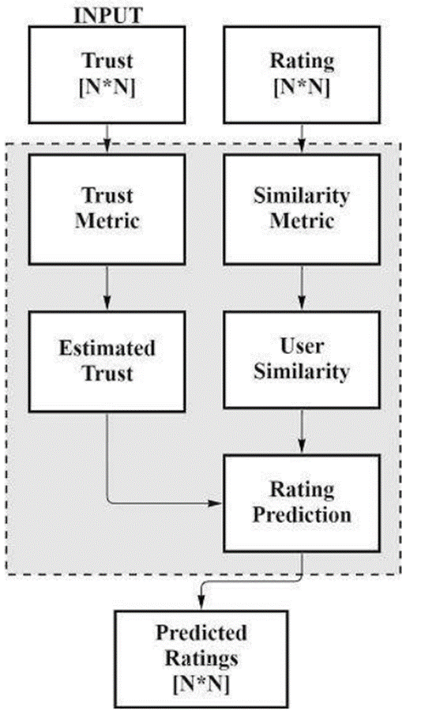
Basic Structure of TARS

Slide 8
Conclusion
Trust-aware recommender systems are used to incorporate trust in recommender systems so that shilling attacks couldn’t bias the suggestions of the recommender systems.
We can also use trust-aware to remove the cold start problem so that new users could get suggestions from the users they trust in the system.

Slide 9
Reference
Raizada, M. (2022). Survey on Recommender Systems Incorporating Trust. 2022 International Conference on Applied Artificial Intelligence and Computing (ICAAIC). https://doi.org/10.1109/icaaic53929.2022.9792731

