Slide 1
last.fm content dashboards Bhushan Deo | Gaurav Bhardwaj | Prabhu Siddharth Raveendran | Krishna Chaitanya Dwarapudi
CmpE 273 Project

Slide 2
Project Demo
What is last.fm?
Last.fm data sets: 1000 users data set: listening history for each user 360,000 users data set: top 50 artists for each user Source: http://www.dtic.upf.edu/~ocelma/MusicRecommendationDataset/
Business case: to create a web application which queries a data set and creates a visually pleasing dashboard.
http://mysterious-wave-7118.herokuapp.com/
Code at https://github.com/cmpe273project/lastfmcontentdashboards

Slide 3
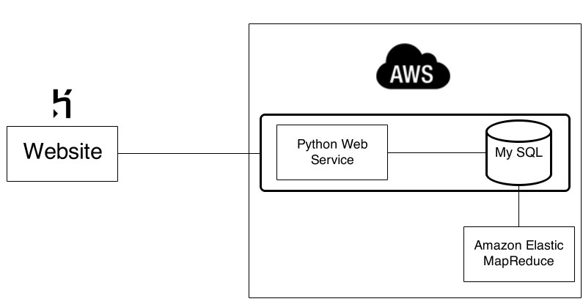
Basic Architecture

Slide 4
Web Services
Built using Python and Bottle Web Framework
MySQL connector for Python
Endpoints:
/1K → Track Analysis
/360K → Album Analysis
/usersimilarity → User Similarity
/networkanalysis → Network Analysis

Slide 5
Database Design
Schema: main_1k : 19150868 tuples
profile_1k : 992 tuples
main_360k : 17559530 tuples
profile_360k : 359347 tuples
userid | timestamp | artid | artname | traid | traname
userid | gender | age | country | registered
usersha1 | artmbid | artname | plays
usersha1 | gender | age | country | registered

Slide 6
Database Design
Started off in the wrong direction with MongoDB.
main_360k : 17559530 tuples
profile_360k : 359347 tuples
Thus, due to structure of the data set, we needed joins, but in MongoDB we have to do “joins” programmatically which is inefficient compared to RDBMS.
Ex: If for an artist “the beatles”, we get 40,000 users from the first table, we have to make 40,000 queries to the other table to get the gender, age and country.
usersha1 | artmbid | artname | plays
usersha1 | gender | age | country | registered

Slide 7
Database Design

Slide 8
Database Design
MySQL: With proper indexes on the fields which we are querying, query time comes down to 30 seconds.

Slide 9
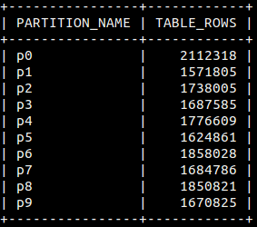
Database Design
MySQL: To improve performance further, we used partitioning. (based on KEY – MySQL’s own internal hashing function.

Slide 10
Database Design
MySQL: With partitioning, query time comes down to 7-8 seconds in the worst case.

Slide 11
User Similarity
Music compatibility between two users based on their common artists, and number of plays for those artists
Cosine Similarity to calculate the music compatibility between users
usersha1 | artmbid | artname | plays

Slide 12
Entire Network Analysis
Using Hadoop to come up with trends from the entire network: - Top 10 artists in the network - Top 10 artists by year - Count for usage (scrobbling by users), by hour, day and month.

Slide 13
Entire Network Analysis
Used Amazon Elastic MapReduce(EMR) minimize the job time.
Can be used to easily change the number of nodes as per requirement.

Slide 14
Front End
Website hosted on Heroku platform.
Foundation front-end framework, JQuery for UI.
Canvas JS and HERE Maps API for visualizing data.

