Slide 1


3 Neural Networks: Advanced Architectures
Leon Herrmann
Stefan Kollmannsberger
Chair of Data Engineering in Construction
Bauhaus-Universität Weimar
Deep Learning in Computational Mechanics – an introductory course,
Herrmann et al. 2025
website
book
Notes:
generated with https://www.the-qrcode-generator.com/

Slide 2
Contents
3.1 Fully Connected Neural Network
3.2 Forward Propagation
3.3 Differentiation
3.4 Backpropagation
3.5 Activation Function
3.6 Learning Algorithm
3.7 Regularization of Neural Networks
3.8 Approximating the Sine Function
3.9.1 Convolutional Neural Networks
3.9.2 Graph Neural Networks
3.9.6 Recurrent Neural Networks
3.9.8 Physics-Inspired Architectures for Dynamics (Hamiltonian & Lagrangian Neural Networks)
4 Introduction to Physics-Informed Neural Networks

Slide 3
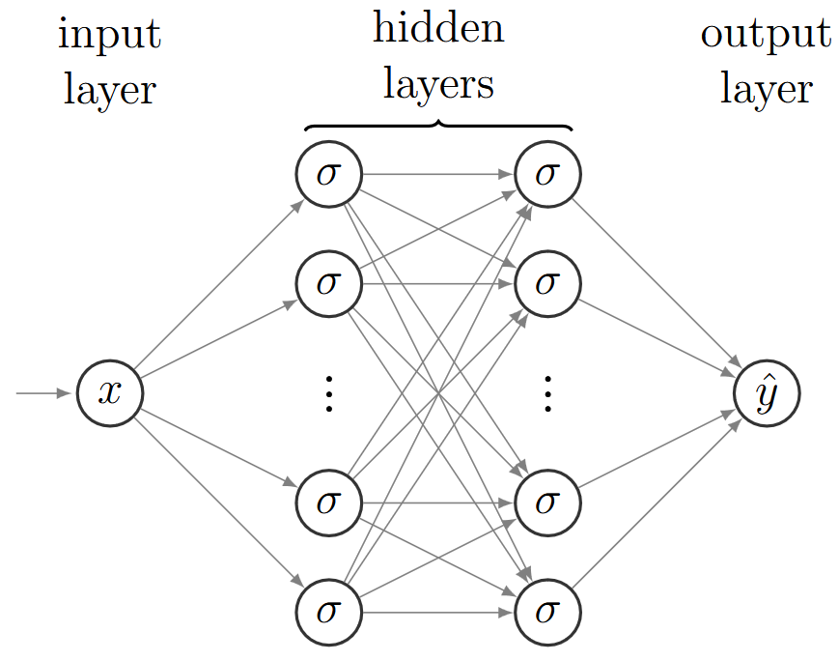
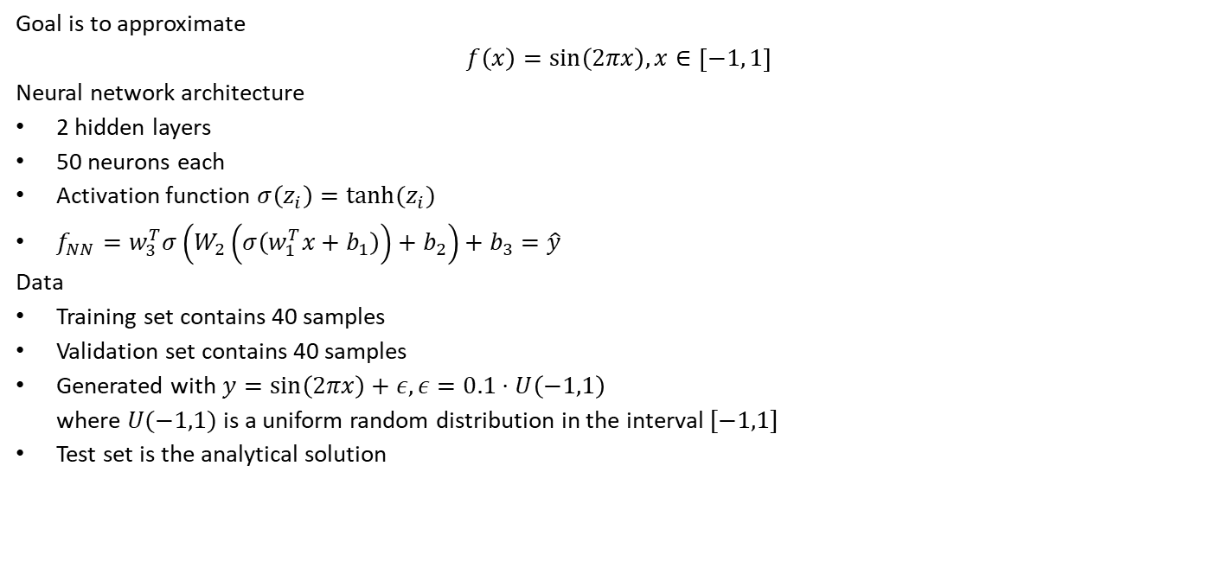
3.8 Approximating the Sine Function
Goal is to approximate
$$f\left(x\right)=sin\left(2πx\right), x∈\left[−1, 1\right]$$
Neural network architecture
2 hidden layers
50 neurons each
Activation function $σ\left(z_{i}\right)=tanh(z_{i})$
$f_{NN}=w_{3}^{T}σ\left(W_{2}\left(σ\left(w_{1}^{T}x+b_{1}\right)\right)+b_{2}\right)+b_{3}=\hat{y}$
Data
Training set contains 40 samples
Validation set contains 40 samples
Generated with $y=sin\left(2πx\right)+ε, ε=0.1⋅U\left(−1,1\right)$
where $U(−1,1)$ is a uniform random distribution in the interval $[−1,1]$
Test set is the analytical solution

Slide 4

3.8 Approximating the Sine Function
Goal is to approximate
$$f\left(x\right)=sin\left(2πx\right), x∈\left[−1, 1\right]$$
Network architecture
$$f_{NN}=w_{3}^{T}σ\left(W_{2}\left(σ\left(w_{1}^{T}x+b_{1}\right)\right)+b_{2}\right)+b_{3}=\hat{y}$$
Cost function used for training
$$C=ℒ_{D}^{\left(train\right)}=\frac{1}{m_{D}^{\left(train\right)}}\sum_{i=1}^{m_{D}^{\left(train\right)}}{{\left({\tilde{y}}_{i}^{\left(train\right)}−{\hat{y}}_{i}^{\left(train\right)}\right)}^{2}}$$
Neural network parameter initialization with a uniform distribution with special bounds
Optimization with Adam for 10’000 epochs

Slide 5
3.8 Approximating the Sine Function – PyTorch
Neural network definition
modules = []
modules.append(torch.nn.Linear(1, 50))
modules.append(torch.nn.Tanh())
modules.append(torch.nn.Linear(50, 50))
modules.append(torch.nn.Tanh())
modules.append(torch.nn.Linear(50, 1))
model = torch.nn.Sequential(*modules)
Training data
x = torch.rand((40, 1)) * 2 – 1
noise = torch.rand(x.shape) * 0.2 – 0.1
y = torch.sin(2 * torch.pi * x) + noise
Notes:
sequential is a container that can execute serveral modules

Slide 6
3.8 Approximating the Sine Function – PyTorch
Cost function definition
def costFunction(y, yPred):
return torch.mean((y – yPred) ** 2)
Prediction and cost function evaluation
yPred = model(x)
cost = costFunction(y, yPred)
cost.backward() #computes the gradient
Optimizer definition
epochs = 10000
optimizer = torch.optim.Adam(model.parameters(), lr=0.001)
Training loop
for epoch in range(epochs):
optimizer.zero_grad() #resetting the gradients (not accumulating them)
yPred = model(x)
cost = costFunction(y, yPred)
cost.backward()
optimizer.step()
Notes:
Model has parameters because torch.nn.Linear() created previously is a nn.module()
https://docs.pytorch.org/docs/stable/generated/torch.nn.Module.html
That has parameters (
any by the way also has a forward() function

Slide 7
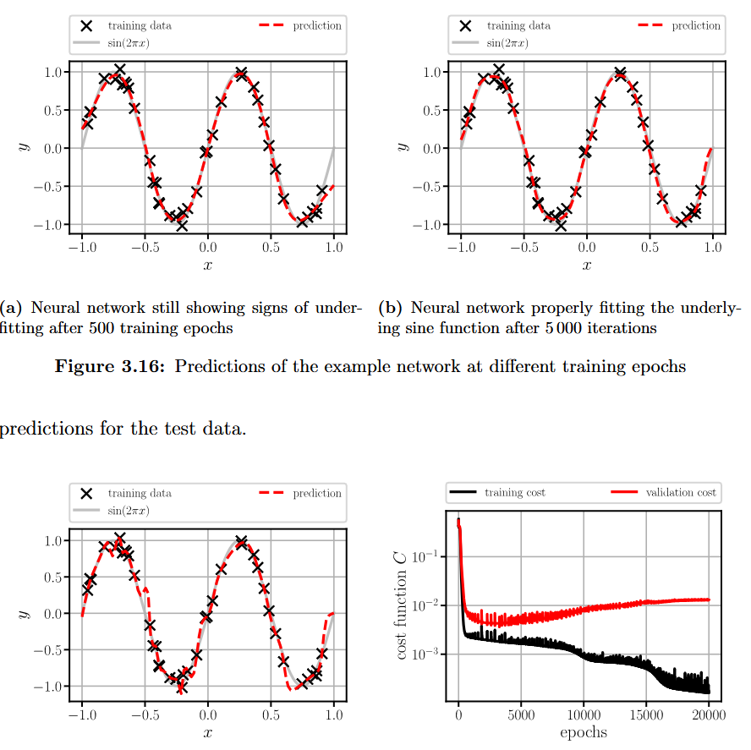
3.8 Approximating the Sine Function – Results
500 epochs
5‘000 epochs
20‘000 epochs
Learning history

Slide 8
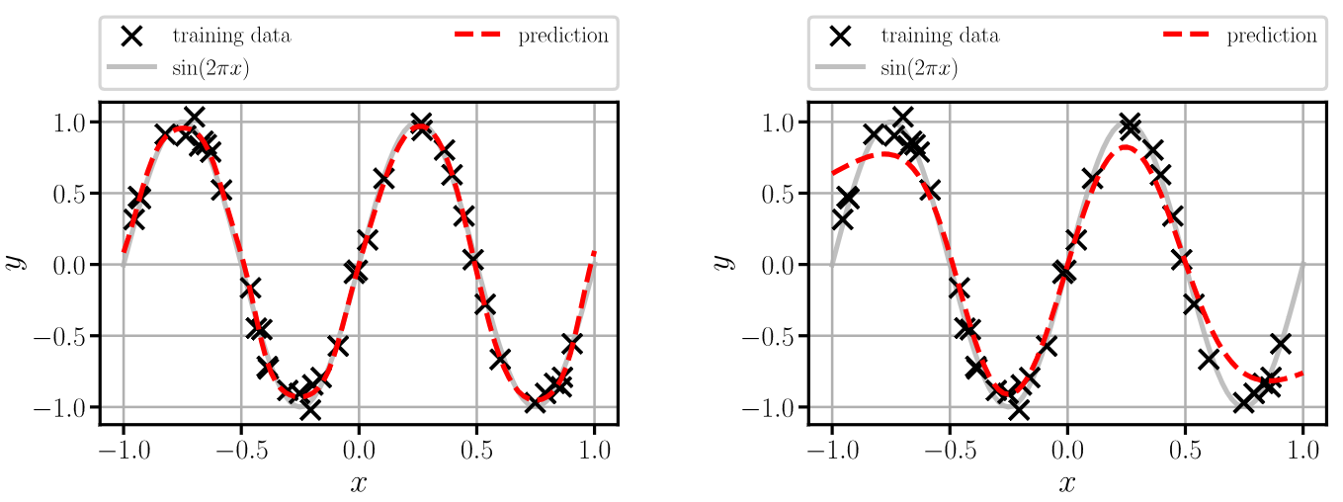
3.8 Approximating the Sine Function – Results
20‘000 epochs with regularization
20‘000 epochs too much regularization

Slide 9
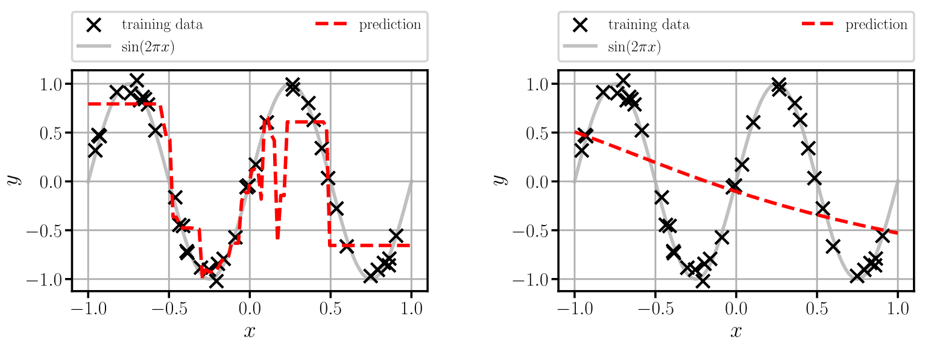

3.8 Approximating the Sine Function – Results
5‘000 epochs with Adam at $α=0.1$
5‘000 epochs with SGD
Notes:
Rechts: nur stochastic gradient decent: Hauptpunkt: Nur gradient Decient ist zu einfach.
Hauptpunkt ist auch, dass die Sensitivität gegenüber Hyperparmetern groß ist,
Daher muss viel getuende werden.

Slide 10
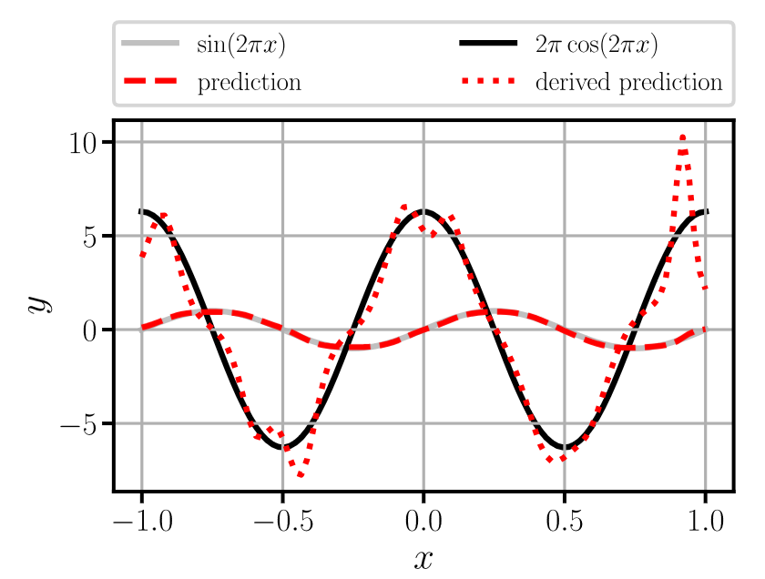
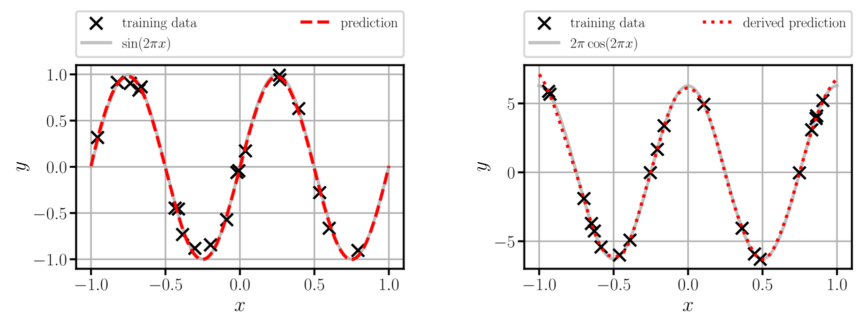
3.8 Approximating the Sine Function – Sobolev
Derivatives of predictions are typically inaccurate
Sobolev training increases accuracy by incorporating derivatives in training
data (higher order derivatives also improve)
def costFunction(y, yPred, dy, dyPred):
lossy = torch.mean((y – yPred) ** 2)
lossdy = torch.mean((dy – dyPred) ** 2)
return lossy + lossdy
Prediction
Derivative of prediction

Slide 11
Exercises
E.7 Approximating the Sine Function (C)
In PyTorch, build a fully connected neural network, that approximates the sine function.

Slide 12
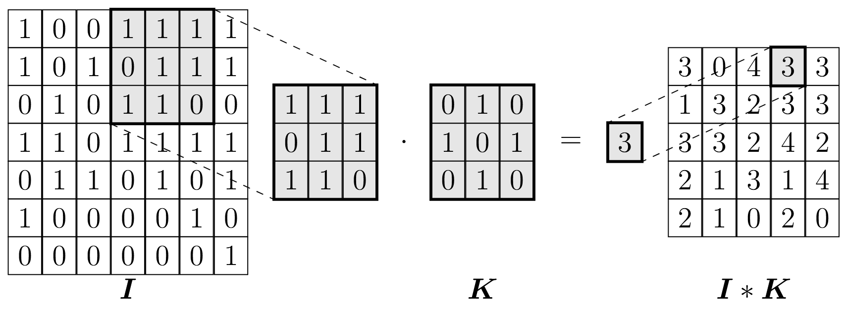
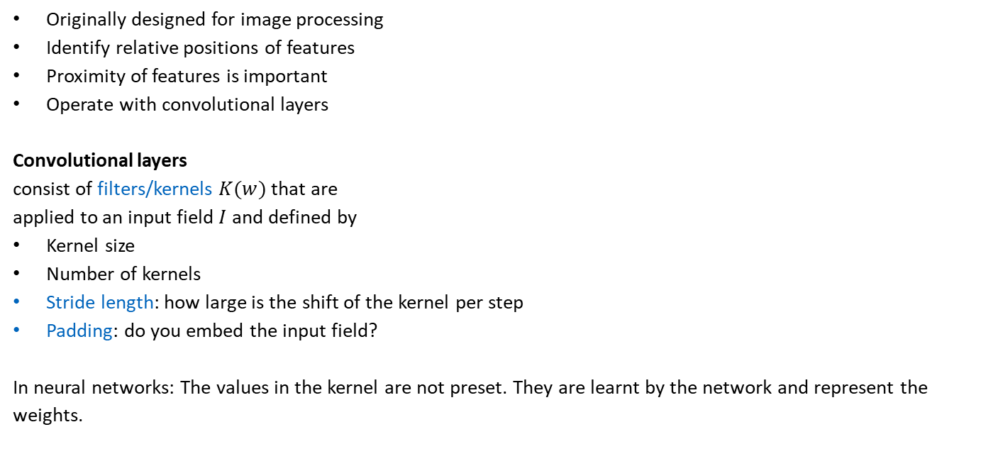
3.9.1 Convolutional Neural Networks
Originally designed for image processing
Identify relative positions of features
Proximity of features is important
Operate with convolutional layers
Convolutional layers
consist of filters/kernels $K(w)$ that are
applied to an input field $I$ and defined by
Kernel size
Number of kernels
Stride length: how large is the shift of the kernel per step
Padding: do you embed the input field?
In neural networks: The values in the kernel are not preset. They are learnt by the network and represent the weights.
local receptive
field
Kernel
Notes:
locality and translational invariance are exploited
Like an ordinary neural network, a convolutional neural network consists of neurons that have learnable weights and biases. What differs is the arrangement of the processed data and the mathematical operations employed in the hidden layers, which are separated into convolutional and pooling operations.
The input layer is no longer a vector but has the shape of a matrix to account for the grid-like structure of pixels in an image. For instance, a convolutional neural network is processing a square image of 7\times7pixels where each pixel corresponds to a gray-scale value 7 × 7

Slide 13




3.9.1 Convolutional Neural Networks
The convolution $∗$ is computed as a combination of the multidimensional dot product, also known as tensordot product:
$$o=V_{ij}⋅K_{ij}$$
Example (2D convolutional filter applied with a stride length of $s=1$ and no padding)
$$1⋅0+1⋅1+1⋅0+0⋅1+1⋅0+1⋅1+1⋅0+1⋅1+0⋅0=3$$
This operation is then repeated by shifting the view $V_{ij}$ with the stride $s$
$$O_{kl}=\sum_{i,j}{V_{(i+k)(j+l)}⋅K_{ij}}=V∗K$$
$$V_{ij}$$
$$K_{ij}$$
$$O_{kl}$$

Slide 14
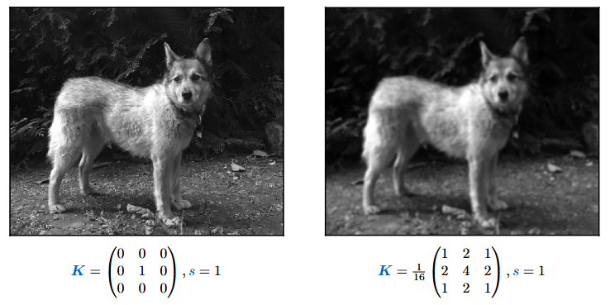
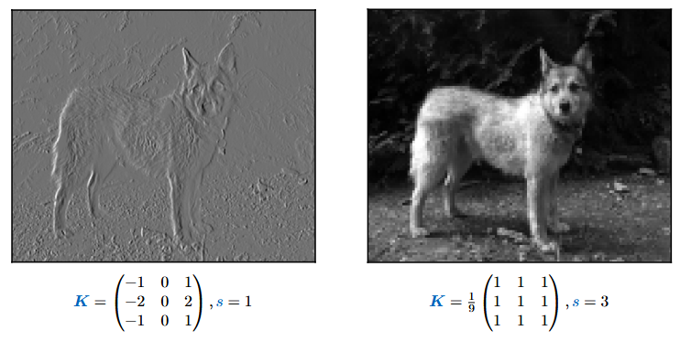
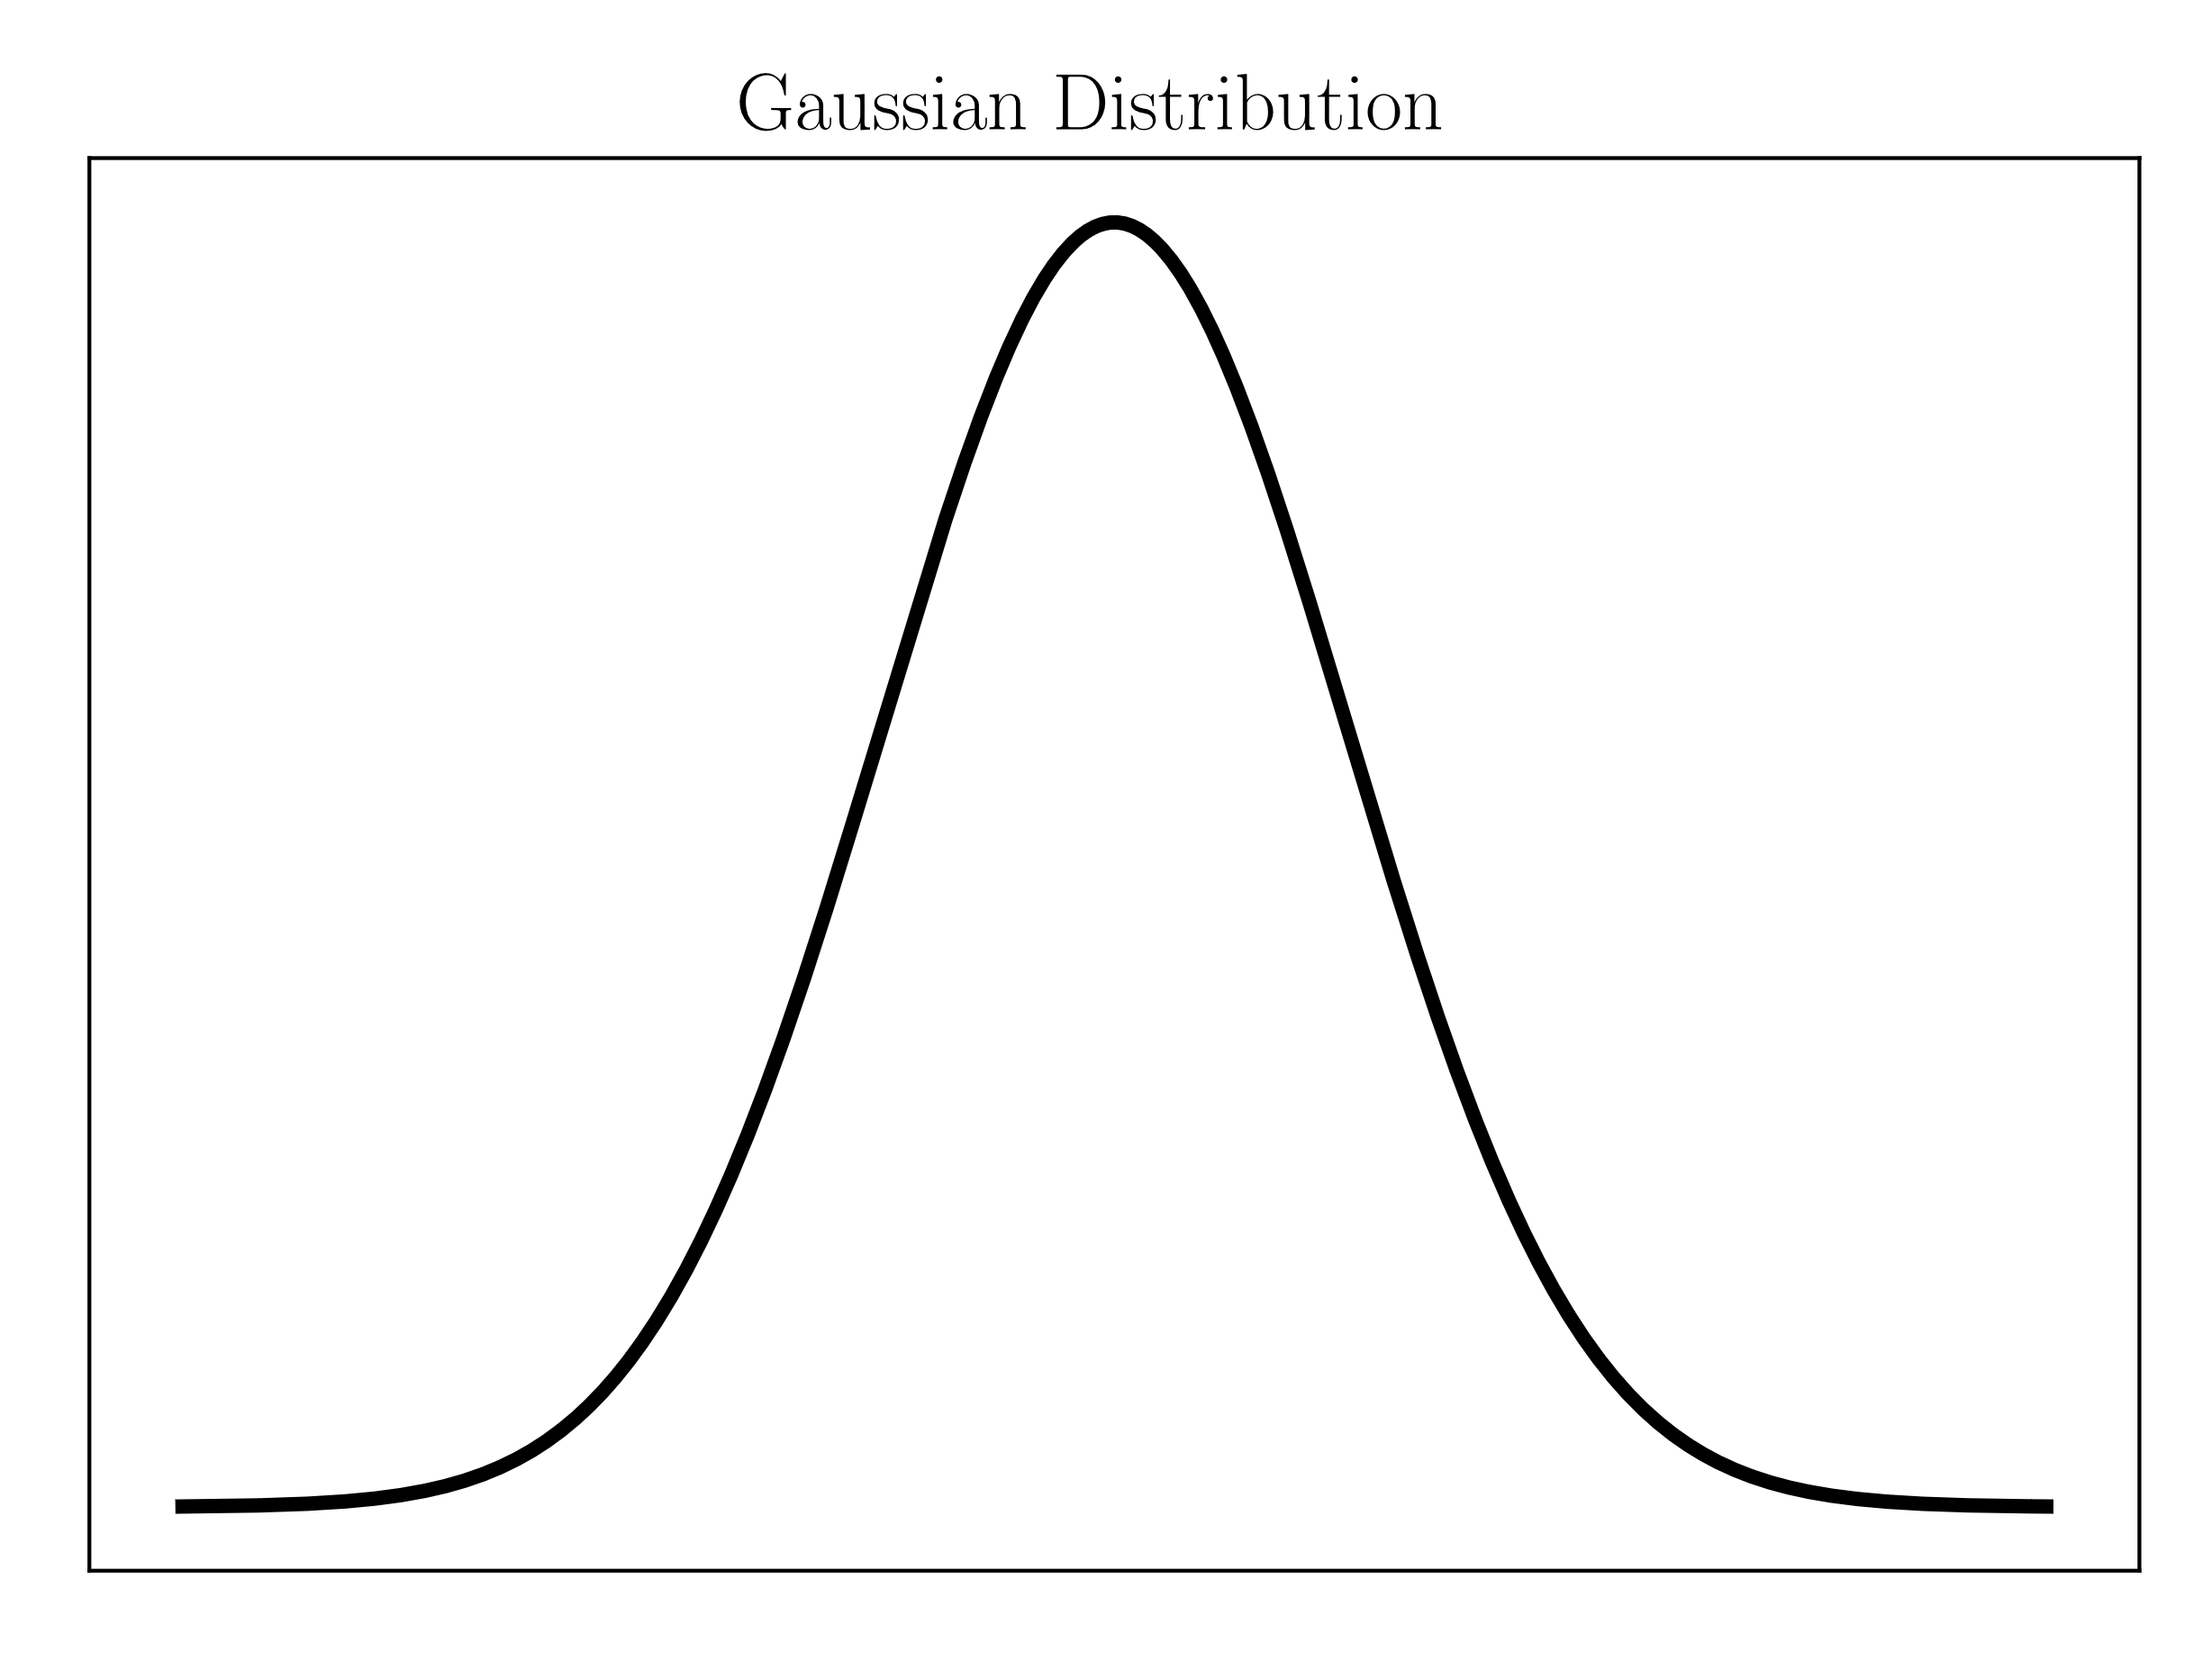
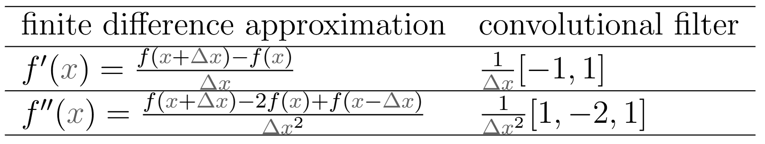

3.9.1 Convolutional Neural Networks – Filters
Example filters
Identity filter
Gaussian filter
Sobel filter in $x$-direction
Averaging filter
For other filters for gradient computation, see Chapter 9.

Slide 15
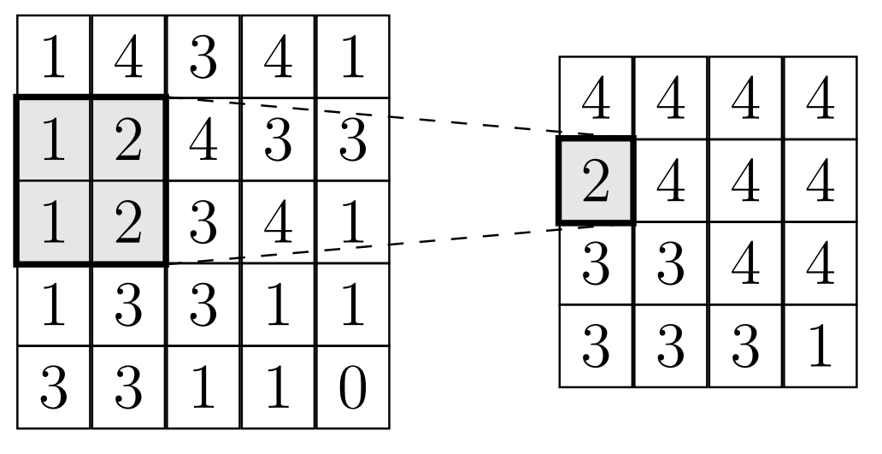

3.9.1 Convolutional Neural Networks – Pooling
Pooling layers reduce the spatial size by extracting relevant features (filtering!)
Pooling types
  Max Pooling
  Average Pooling
Pooling layers are defined by
  Kernel size
  Stride length
  Padding
Example “max pooling”(2D convolutional filter applied with a stride length of $s=1$ and no padding)
$$\max\left\{1, 2, 1, 2\right\}=2$$

Slide 16
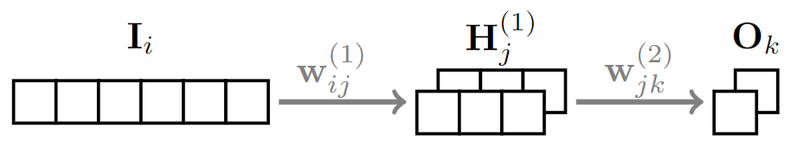
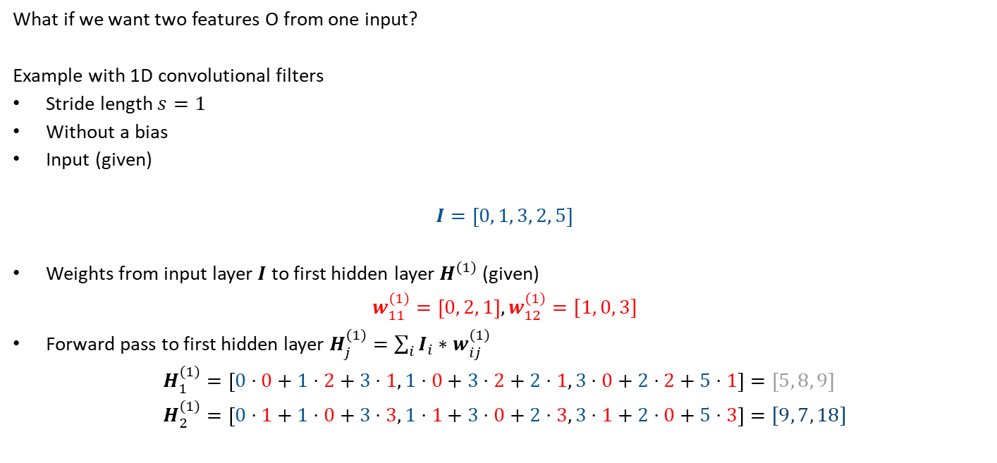
3.9.1 Convolutional Neural Networks – Example
What if we want two features O from one input?
Example with 1D convolutional filters
Stride length $s=1$
Without a bias
Input (given)
$$I=\left[0, 1, 3, 2, 5\right]$$
Weights from input layer $I$ to first hidden layer $H^{\left(1\right)}$ (given)
$$w_{11}^{\left(1\right)}=\left[0, 2, 1\right], w_{12}^{\left(1\right)}=[1, 0, 3]$$
Forward pass to first hidden layer $H_{j}^{\left(1\right)}=\sum_{i}{I_{i}}∗w_{ij}^{\left(1\right)}$
$$H_{1}^{\left(1\right)}=\left[0⋅0+1⋅2+3⋅1, 1⋅0+3⋅2+2⋅1, 3⋅0+2⋅2+5⋅1\right]=\left[5, 8, 9\right] \\ H_{2}^{\left(1\right)}=\left[0⋅1+1⋅0+3⋅3, 1⋅1+3⋅0+2⋅3, 3⋅1+2⋅0+5⋅3\right]=[9, 7, 18]$$
2 channels
Notes:
Remark: This example is without a pooing layer. Its only convolutions!

Slide 17
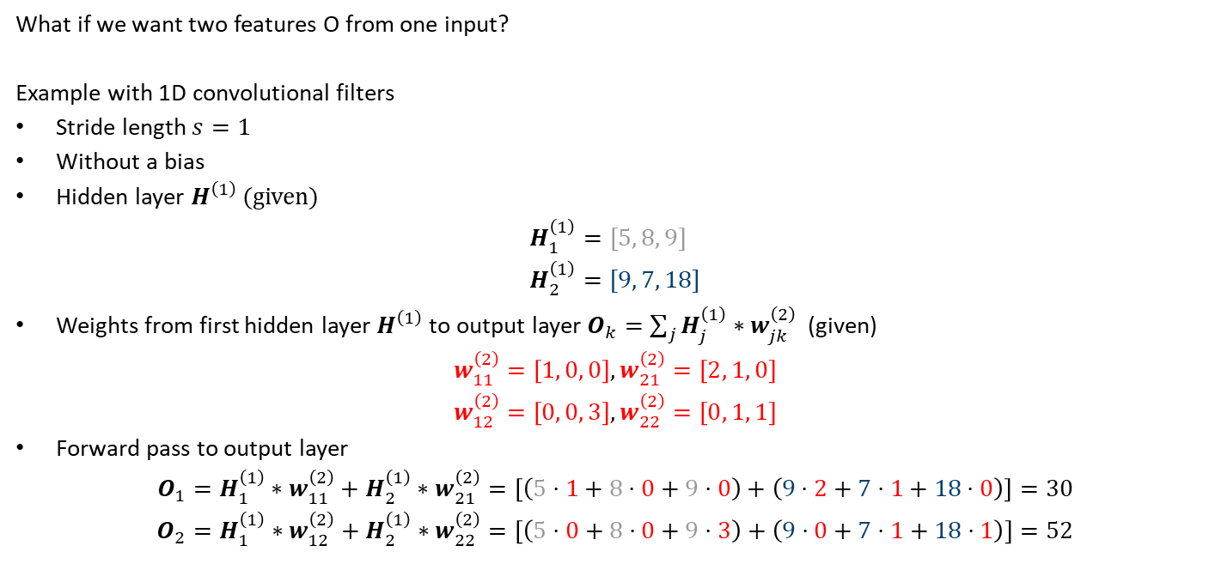
3.9.1 Convolutional Neural Networks – Example
What if we want two features O from one input?
Example with 1D convolutional filters
Stride length $s=1$
Without a bias
Hidden layer $H^{\left(1\right)}$ (given)
$$H_{1}^{\left(1\right)}=\left[5, 8, 9\right] \\ H_{2}^{\left(1\right)}=[9, 7, 18]$$
Weights from first hidden layer $H^{\left(1\right)}$to output layer $O_{k}=$ $\sum_{j}{H_{j}^{\left(1\right)}∗w_{jk}^{\left(2\right)}}$ (given)
$$w_{11}^{\left(2\right)}=\left[1, 0, 0\right], w_{21}^{\left(2\right)}=\left[2, 1, 0\right]$$
$$w_{12}^{\left(2\right)}=\left[0, 0, 3\right], w_{22}^{\left(2\right)}=\left[0, 1, 1\right]$$
Forward pass to output layer
$$O_{1}=H_{1}^{\left(1\right)}∗w_{11}^{\left(2\right)}+H_{2}^{\left(1\right)}∗w_{21}^{\left(2\right)}=\left[\left(5⋅1+8⋅0+9⋅0\right)+\left(9⋅2+7⋅1+18⋅0\right)\right]=30$$
$$O_{2}=H_{1}^{\left(1\right)}∗w_{12}^{\left(2\right)}+H_{2}^{\left(1\right)}∗w_{22}^{\left(2\right)}=\left[\left(5⋅0+8⋅0+9⋅3\right)+\left(9⋅0+7⋅1+18⋅1\right)\right]=52$$
2 channels

Slide 18
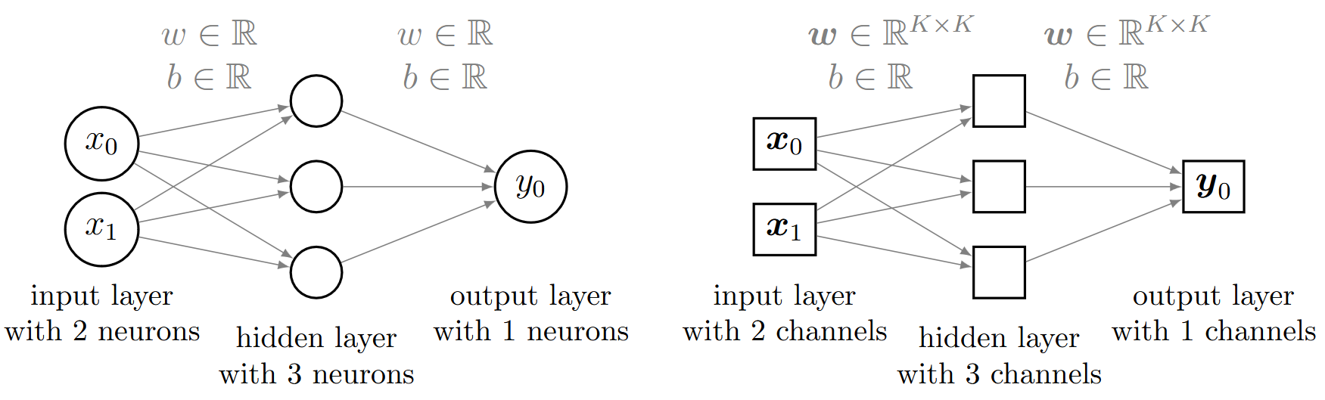


3.9.1 Convolutional Neural Networks – Depth
ImageNet Classification with Deep Convolutional Neural Networks, (Alex) Krizhevsky et al. 2012
Comparison to fully connected neural network
Channels are analogous to neurons
Filters are analogous to linear transformations (connections)
Number of parameters in fully connected neural network:
Number of parameters in convolutional neural network:
Number of parameters per weight/kernel
Number of connections (weights) +
Number of biases
$1⋅\left(2⋅3+3⋅1\right)+\left(3+1\right)$
$$\left(K^{d}\right)⋅\left(2⋅3+3⋅1\right)+(3+1)$$
Fully connected neural network
Convolutional neural network
Notes:
A key difference between the fully connected neural network and convolutional neural networks is the data being processed:
matrices in the case of convolutional networks <->scalars for fully connected networks.
Consequently, there is a distinction in terminology
the layer depth is denoted in neurons for the fully connected network
in channels for the convolutional network.
The second key difference is the convolutional operation, which can be viewed as a method of weight sharing.
Sharing weights and biases in combination with the pooling operation reduces the amount of trainable parameters significantly.
Thus, convolutional networks learn much faster than fully connected neural networks with comparable expressive power.

Slide 19
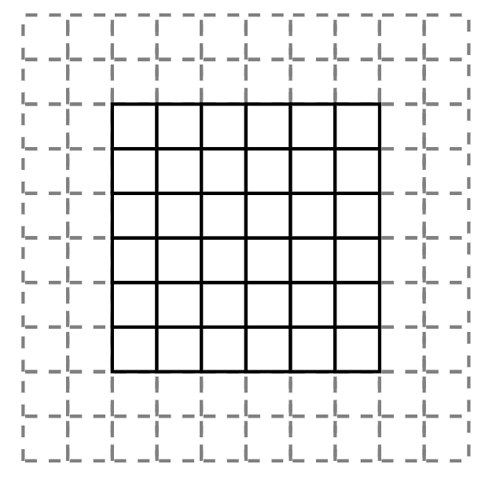



3.9.1 Convolutional Neural Networks – Padding
Padding counteracts the shrinking of the output, padding can be used
Padding types
  Valid padding (No padding)
  Zero padding
  Reflection padding
The output dimension $O$ after a convolutional layer
$$O=\left\lfloor \frac{I−K+2P}{s}\right\rfloor +1$$
Input dimension $I$
Kernel size $K$
Padding size $P$
Stride length $s$
$$O=\left\lfloor \frac{5−3+2⋅0}{1}\right\rfloor +1=3$$
$$O=\left\lfloor \frac{3−3+2⋅0}{1}\right\rfloor +1=1$$

Slide 20
3.9.1 Convolutional Neural Networks – PyTorch
class CNN(torch.nn.Module):
def __init__(self, inputImages, hiddenImages, outputImages):
super(CNN, self).__init__()
self.cnn1 = torch.nn.Conv2d(inputImages, hiddenImages, kernel_size=3,
stride=1, padding=1)
self.cnn2 = torch.nn.Conv2d(hiddenImages, outputImages, kernel_size=3,
stride=1, padding=1)
self.activation = torch.nn.ReLU()
def forward(self, x):
y = self.activation(self.cnn1(x))
y = self.cnn2(y)
return y
model = CNN(2, 3, 1) # input has size
(1, 2, imageSize, imageSize)

Slide 21
Exercises
E.11 Convolutional Neural Network (P & C)
Familiarize yourself with convolutional neural networks through pen-and-paper forward propagation and through the application of different convolutional filters to images (using PyTorch).

Slide 22
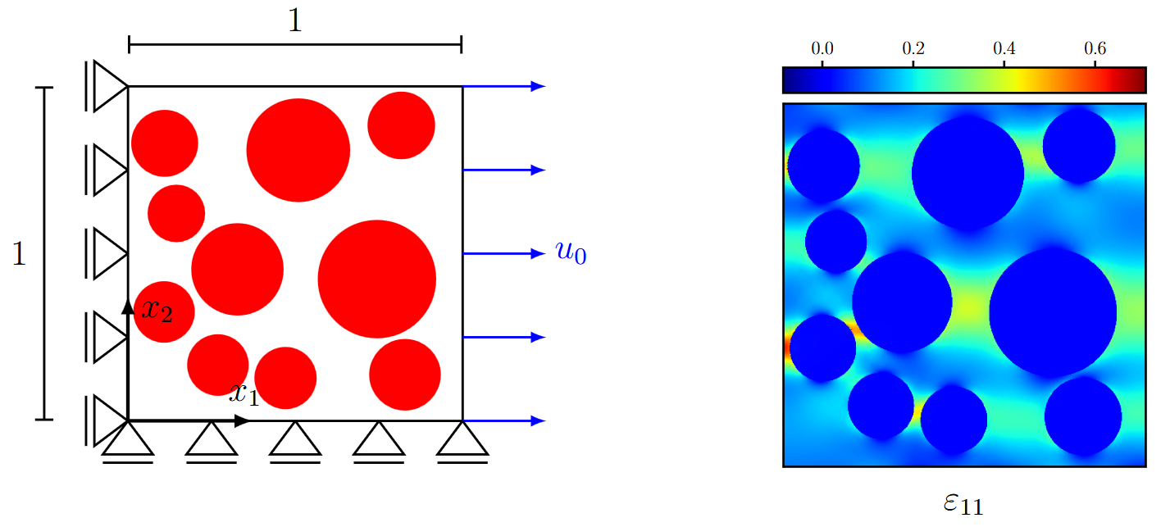

3.9.1 Convolutional Neural Networks – Example
Learning strain distributions from data
Goal is to make the neural network predict the strain of a 2D domain under a uni-axial load
Domain is defined by fiber material (red) and matrix material (white) with the elastic properties
$$E_{f}={85}^{′}000, ν_{f}=0.22 \\ E_{m}=3^{′}000, ν_{m}=0.4$$

Slide 23
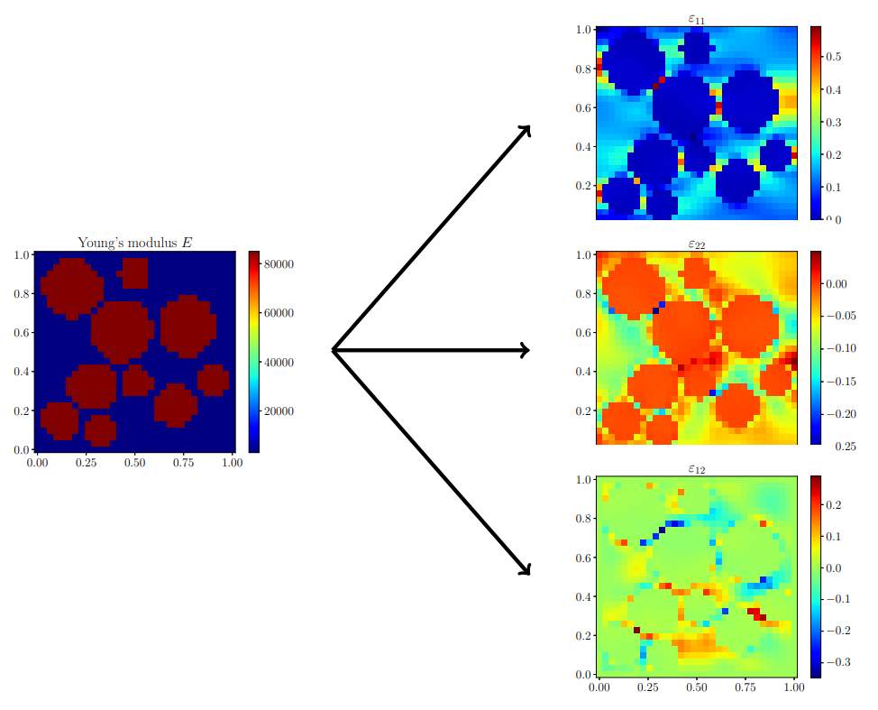
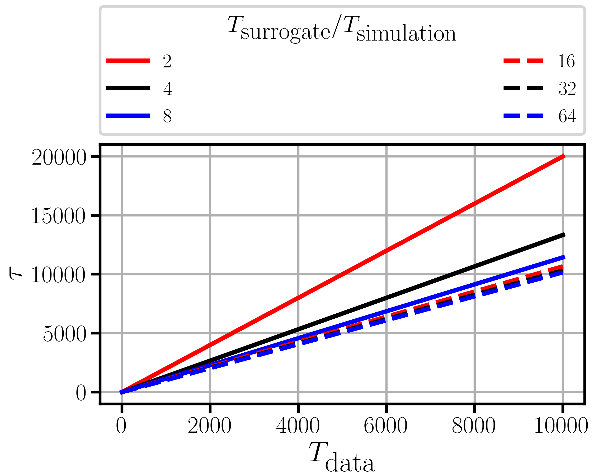


3.9.1 Convolutional Neural Networks – Example
To reduce the complexity of the task, the domain is discretized in $32×32$ grid
Strain prediction from the underlying material distribution
A U-Net (see Chapter 8) is used as neural network architecture
To estimate the efficiency of the approach,
the breakeven threshold $τ$must be considered
$$τ=\frac{T_{data}+T_{train}}{T_{simulation}+T_{surrogate}}$$
$τ$represents the number of surrogate evaluations to make training worth the effort
    $T$ is the time of
      data collection ($T_{data}$)
      training ($T_{train}$)
      1 simulation ($T_{simulation})$
      1 surrogate evaluation
      ($T_{surrogate}$)
U-Net: Convolutional Networks for Biomedical Image Segmentation, Ronneberger et al. 2015
Assuming $T_{data}=T_{simulation}⋅m$
and $T_{train}≈0$

Slide 24
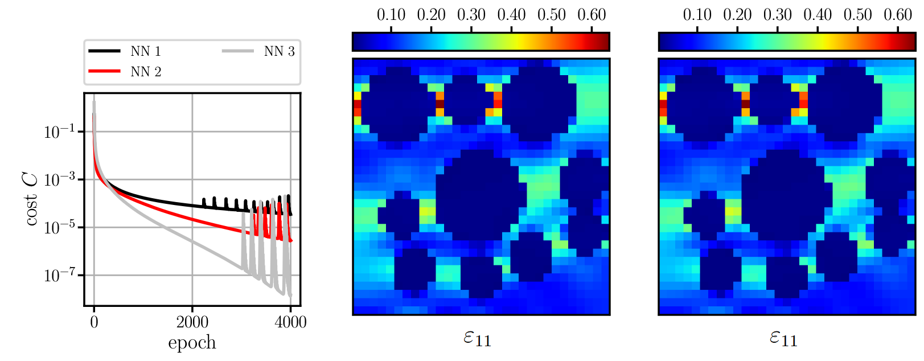
3.9.1 Convolutional Neural Networks – Example
Model selection (make sure that model can learn the training data by heart)
NN 1: U-net with 5 convolutional layers: 94‘978 parameters
NN 2: feed-forward convolutional neural network with 4 layers: 38‘405 parameters
NN 3: U-net followed by 3 convolutional layers: 154‘471 parameters
Training with 1
datapoint
Prediction with NN 2
Ground truth
Notes:
Training on 1 data point (i.e. one specific map geometry to strain)

Slide 25
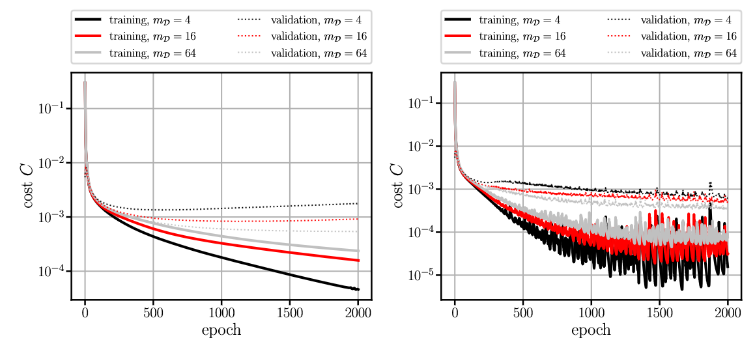
3.9.1 Convolutional Neural Networks – Example
With selected model (NN 3), increase the training data (and potentially tune the architecture & optimizer)
Without regularization
With regularization
Notes:
Next, the number of training samples is increased, and a validation set is employed to determine the generalization error.
A good practice is to slowly and iteratively increase the training set size m_D, e.g., in multiples of two, and adjust the network architecture and hyperparameters in case of convergence issues.
The training error increases for larger training sets, but more importantly, the validation error, i.e., the generalization error, decreases

Slide 26
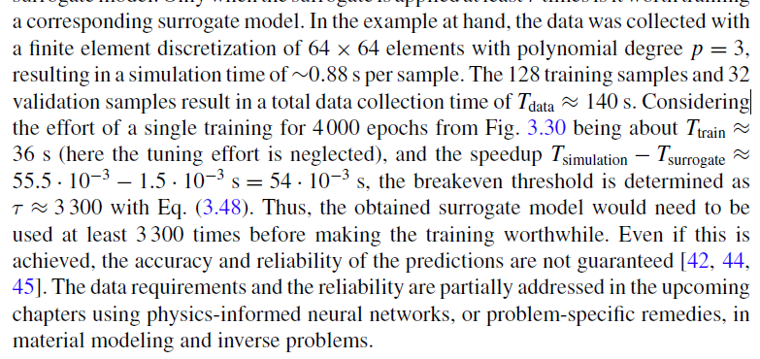
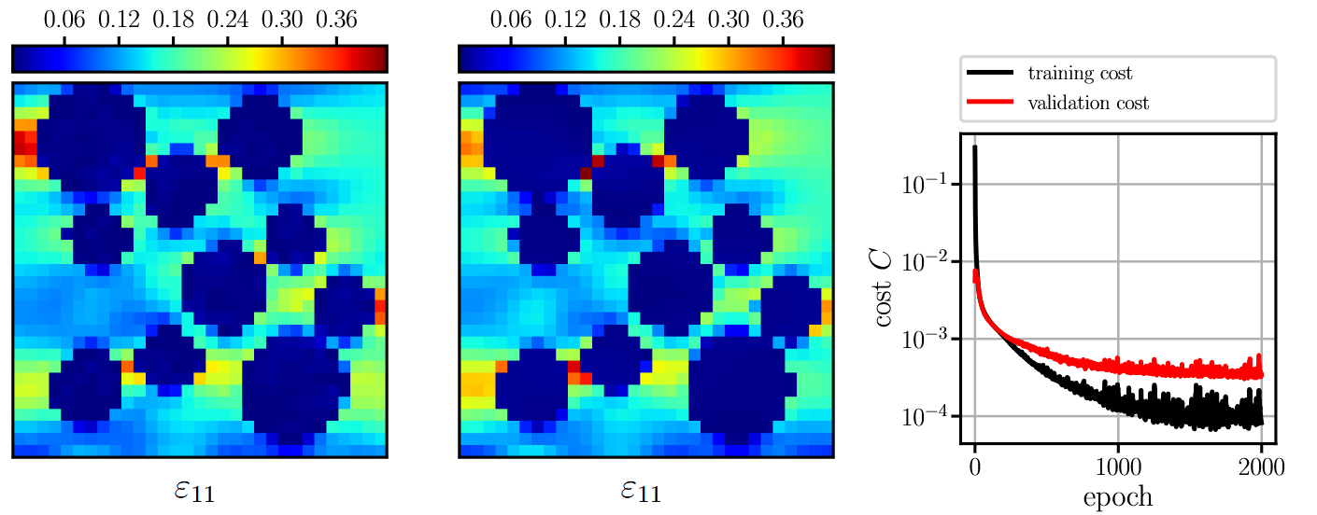
3.9.1 Convolutional Neural Networks – Example
Prediction on unseen data (i.e., validation data)
Prediction
Ground truth
Learning history
Notes:
-Quite a good prediction with only minor differences
-the prediction time for one sample is 37 times faster than computing the solution using FEM
Furthermore, the prediction time stays constant for multiple parallel predictions until the limits of the GPU memory are reached, which is not easily possible for classical methods such as the finite element method.
However, during training about 128 training samples and 32 validation samples were needed. That took 120 seconds.
4000 training epochs were needed, which took 36 seconds
This results in a break even threshold of τ ≈ 3 300
i.e. if less than 3300 predictions are needed ist not worth it. You might as well compute the result using FE (which is more reliable, too!)

Slide 27


3.9.1 Convolutional Neural Networks – TensorBoard
TensorBoard is a visualization tool for TensorFlow (& other machine learning libraries, e.g., PyTorch)
Beneficial for debugging and hyperparameter tuning/model selection
Includes features such as graphs, histograms, output visualization

Slide 28

3.9.1 Convolutional Neural Networks – TensorBoard
Track the progress in prediction quality by comparing outputs with labels

Slide 29
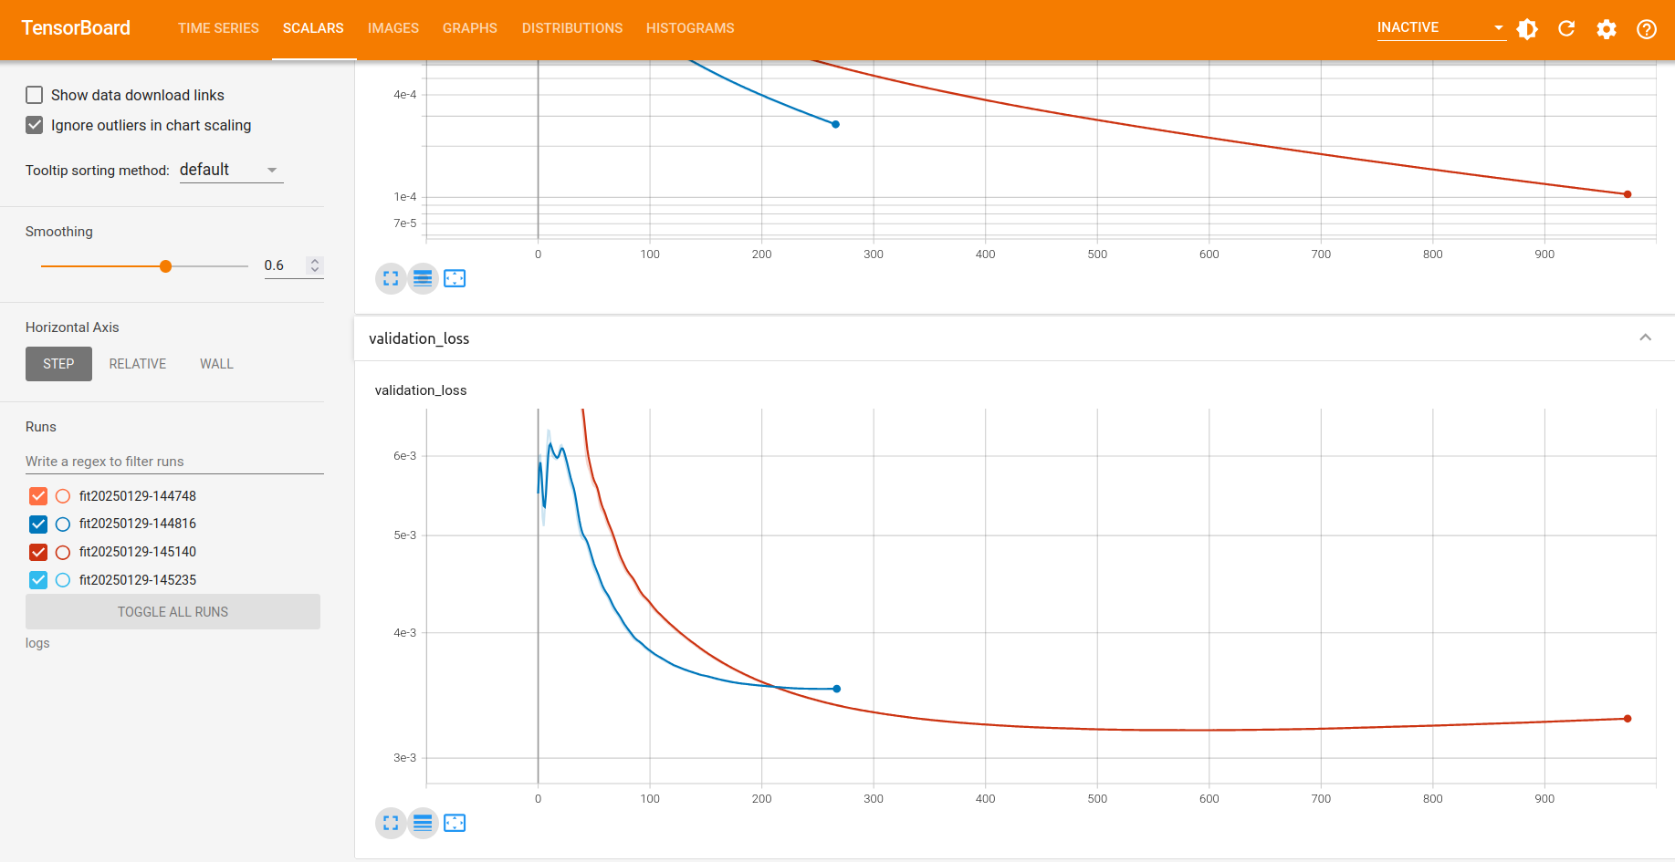
3.9.1 Convolutional Neural Networks – TensorBoard
Compare different architectures and hyperparameters through different training runs

Slide 30
Exercises
E.12 Learning Strain Distributions (C)
Train a convolutional neural network as a surrogate, that maps the Young‘s modulus distribution to strain distributions. Experiment with different hyperparameters and different network architectures. For this, use TensorBoard.

Slide 31
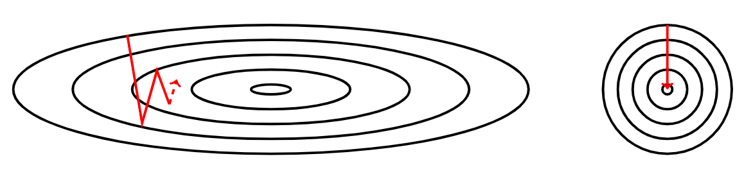

Normalization
Normalization helps the optimization procedure
Ensures, that features have similar scales
Input normalization centering the mean to zero and establishing a unit standard deviation $σ=1$
$$\hat{x_{i}}=\frac{x_{i}−μ}{σ}$$
where $μ$ is the mean of all features $x$ and $σ$ is the standard deviation:
$$μ=\frac{1}{n}\sum_{i=1}^{n}{x_{i}}, σ=\sqrt{\frac{1}{n}\sum_{i=1}^{n}{{\left(x_{i}−μ\right)}^{2}}}$$

Slide 32
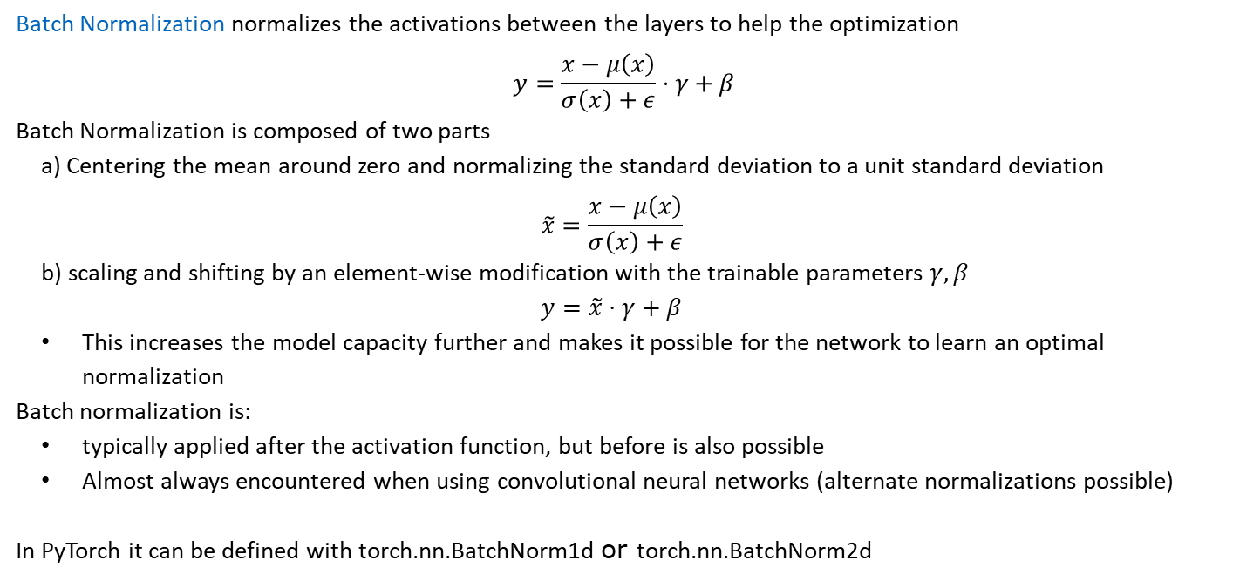
Batch Normalization
Batch Normalization normalizes the activations between the layers to help the optimization
$$y=\frac{x−μ\left(x\right)}{σ\left(x\right)+ε}⋅γ+β$$
Batch Normalization is composed of two parts
  a) Centering the mean around zero and normalizing the standard deviation to a unit standard deviation
  $$\tilde{x}=\frac{x−μ\left(x\right)}{σ\left(x\right)+ε}$$
  b) scaling and shifting by an element-wise modification with the trainable parameters $γ, β$
  $$y=\tilde{x}⋅γ+β$$
  This increases the model capacity further and makes it possible for the network to learn an optimal normalization
  Batch normalization is:
  typically applied after the activation function, but before is also possible
  Almost always encountered when using convolutional neural networks (alternate normalizations possible)
In PyTorch it can be defined with torch.nn.BatchNorm1d or torch.nn.BatchNorm2d

Slide 33
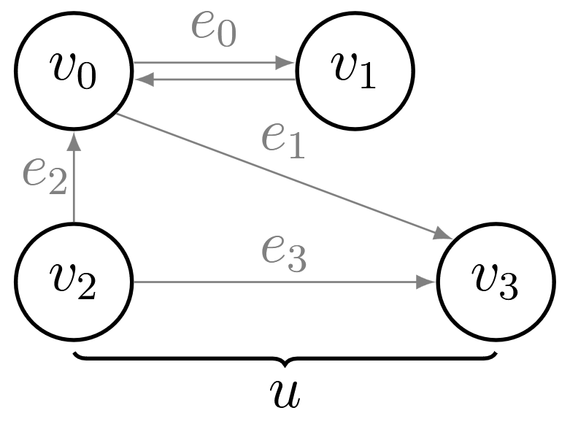
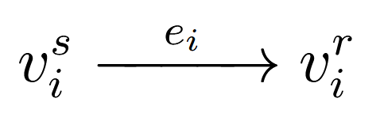
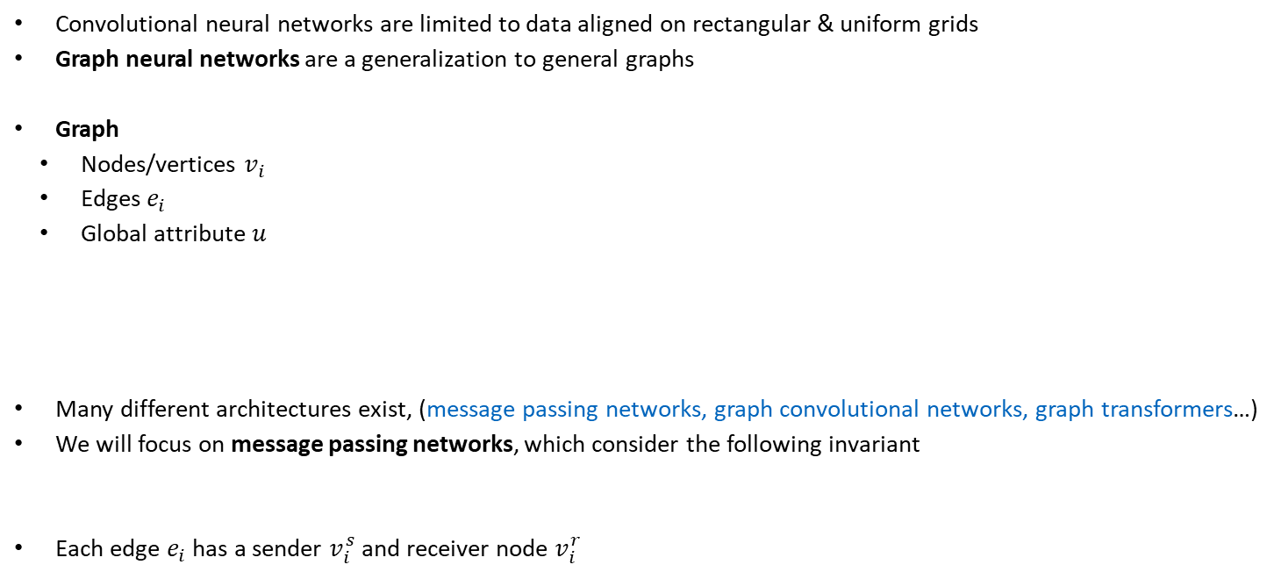
3.9.2 Graph Neural Networks
Convolutional neural networks are limited to data aligned on rectangular & uniform grids
Graph neural networks are a generalization to general graphs
Graph
  Nodes/vertices $v_{i}$
  Edges $e_{i}$
  Global attribute $u$
Many different architectures exist, (message passing networks, graph convolutional networks, graph transformers…)
We will focus on message passing networks, which consider the following invariant
Each edge $e_{i}$ has a sender $v_{i}^{s}$ and receiver node $v_{i}^{r}$
Relational inductive biases, deep learning, and graph networks, Battaglia et al. 2018
Notes:
An example in compuational mechanics is:
https://sites.google.com/view/meshgraphnets
-graph convolutional neural network is a special case of a message passing network

Slide 34
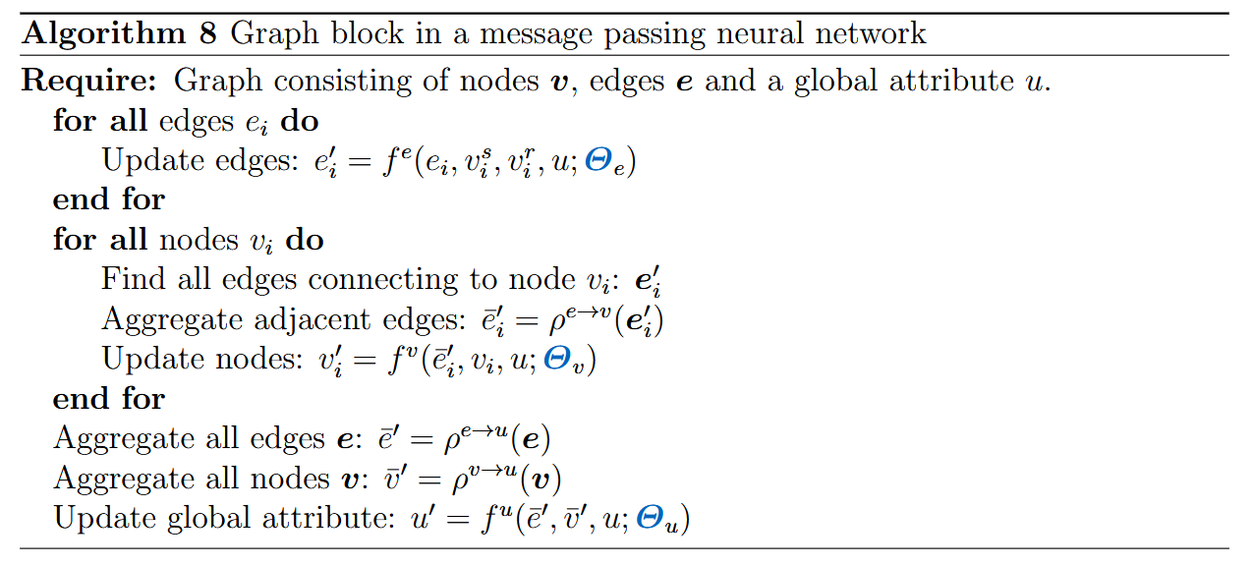

3.9.2 Graph Neural Networks
Edges are updated through the first fully connected neural network ${e_{i}^{′}=f}^{e}(e_{i}, v_{i}^{s}, v_{i}^{r}, u)$
aggregating connecting edges ${\overline{e}}_{i}$ (e.g., max or sum) as ${{\overline{e}}_{i}}^{′}=ρ^{e→v}\left(e_{i}^{′}\right)$
Nodes are updated by second fully connected neural network ${v_{i}^{′}=f}^{v}({{\overline{e}}_{i}}^{′}, v_{i}, u)$
The global attribute is updated by aggregating all edges and nodes: third fully connected neural network ${u^{′}=f}^{u}({\overline{e}}^{′},{\overline{v}}^{′},u)$
Application to mesh-
based simulation
Learning Mesh-Based Simulation with Graph Networks, Pfaff et al. 2020
Notes:
Aggregation is like pooling

Slide 35
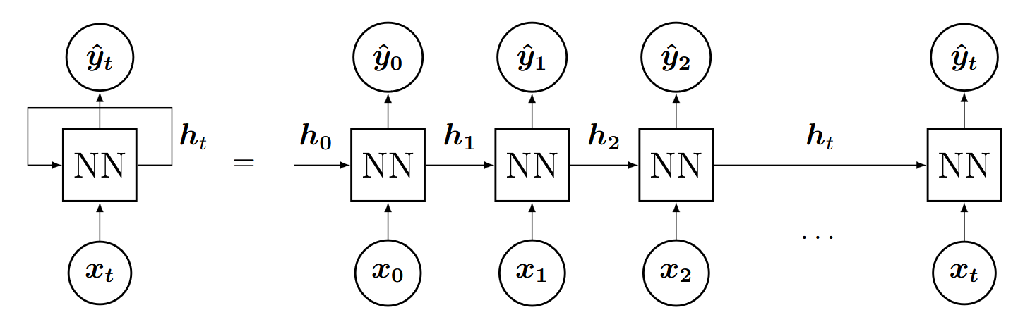
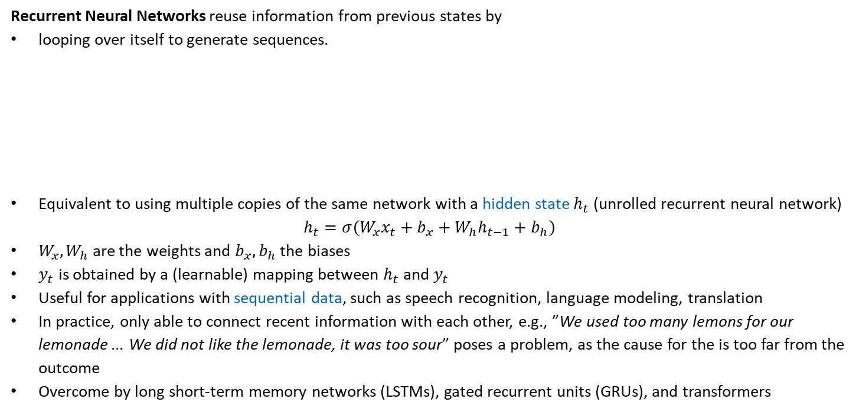
3.9.6 Recurrent Neural Networks
Recurrent Neural Networks reuse information from previous states by
looping over itself to generate sequences.
Equivalent to using multiple copies of the same network with a hidden state $h_{t}$ (unrolled recurrent neural network)
$$h_{t}=σ\left(W_{x}x_{t}+b_{x}+W_{h}h_{t−1}+b_{h}\right)$$
$W_{x}, W_{h}$ are the weights and $b_{x}, b_{h}$ the biases
$y_{t}$ is obtained by a (learnable) mapping between $h_{t}$ and $y_{t}$
Useful for applications with sequential data, such as speech recognition, language modeling, translation
In practice, only able to connect recent information with each other, e.g., ”We used too many lemons for our lemonade ... We did not like the lemonade, it was too sour” poses a problem, as the cause for the is too far from the outcome
Overcome by long short-term memory networks (LSTMs), gated recurrent units (GRUs), and transformers

Slide 36
3.9.6 Recurrent Neural Networks - PyTorch
class RNN(torch.nn.Module):
def __init__(self, inputSize, hiddenStateSize, outputSize):
super(RNN, self).__init__()
self.rnn = torch.nn.RNN(inputSize, hiddenStateSize, nonlinearity=‘relu’, num_layers=2)
self.linear = torch.nn.Linear(hiddenStateSize, outputSize)
def forward(self, x):
h, _ = self.rnn(x) # unrolls the RNN
y = self.linear(h) # transforms hidden layer to output layer
return y
inputSize = 1
hiddenStateSize = 500
outputSize = 1
model = CNN(inputSize, hiddenStateSize, outputSize)
Recurrent neural networks do not only have to be combined with fully connected neural networks, convolutional neural networks are for example also possible

Slide 37
3.9.8 Physics-Inspired Architectures for Dynamics
The previous architecture learn physical behavior only from data
Governing laws can be incorporated into neural networks
  Through training (via penalty terms in the cost function, i.e., weak enforcement/regularization; see Chapters 4 & 5)
  Via the neural network architecture (by constraining the learnable space, i.e., strong enforcement; see Chapter 7)
Strong enforcement of physics
  Dynamics
    Hamiltonian neural networks
    Lagrangian neural networks
  Constitutive modeling
    Input-convex neural networks (see Chapter 7)
  Boundary conditions
    Strong enforcement of boundary conditions (see Chapters 4 & 5)

Slide 38
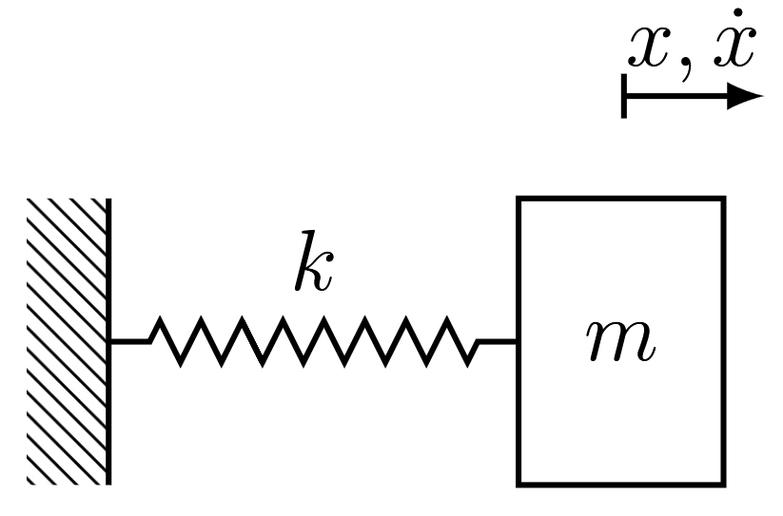

3.9.8 Physics-Inspired Architectures for Dynamics
Consider a one-dimensional mass-spring model
Desribed by the ordinary differential equation
$$m\ddot{x}\left(t\right)+kx\left(t\right)=0$$
And the solution
$$x\left(t\right)=Asin(ωt+φ)$$
Where $ω=\sqrt{k/m}$is the natural frequency and $A, φ$ are determined by the initial conditions $x\left(0\right), \dot{x}(0)$
Alternatively the system can be described by
Hamiltonian Mechanics
Euler-Lagrange Equation

Slide 39
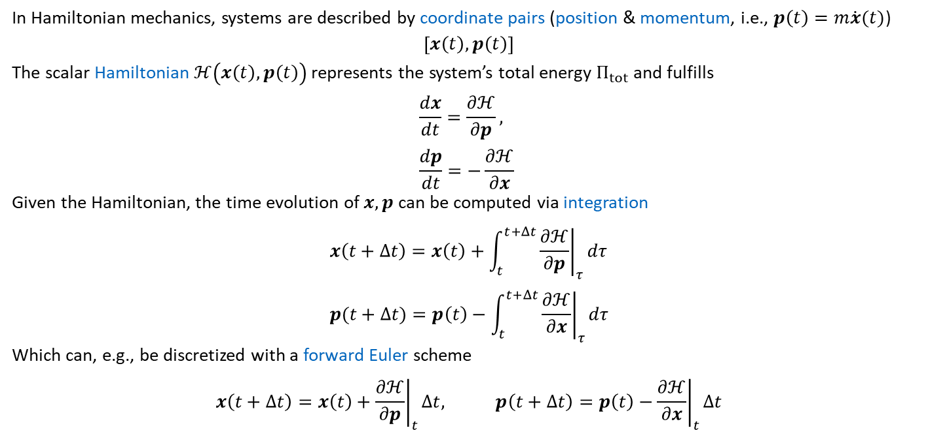
3.9.8.2 Hamiltonian Mechanics
In Hamiltonian mechanics, systems are described by coordinate pairs (position & momentum, i.e., $p\left(t\right)=m\dot{x}(t)$)
$$\left[x\left(t\right), p\left(t\right)\right]$$
The scalar Hamiltonian $ℋ\left(x\left(t\right), p\left(t\right)\right)$ represents the system’s total energy $Π_{tot}$ and fulfills
$$\frac{dx}{dt}=\frac{∂ℋ}{∂p}, \\ \frac{dp}{dt}=−\frac{∂ℋ}{∂x}$$
Given the Hamiltonian, the time evolution of $x, p$ can be computed via integration
$$x\left(t+Δt\right)=x\left(t\right)+\int_{t}^{t+Δt}{{\left.\frac{∂ℋ}{∂p}\right|}_{τ}dτ} \\ p(t+Δt)=p\left(t\right)−\int_{t}^{t+Δt}{{\left.\frac{∂ℋ}{∂x}\right|}_{τ}dτ}$$
Which can, e.g., be discretized with a forward Euler scheme
$$x\left(t+Δt\right)=x\left(t\right)+{\left.\frac{∂ℋ}{∂p}\right|}_{t}Δt, p\left(t+Δt\right)=p\left(t\right)−{\left.\frac{∂ℋ}{∂x}\right|}_{t}Δt$$

Slide 40

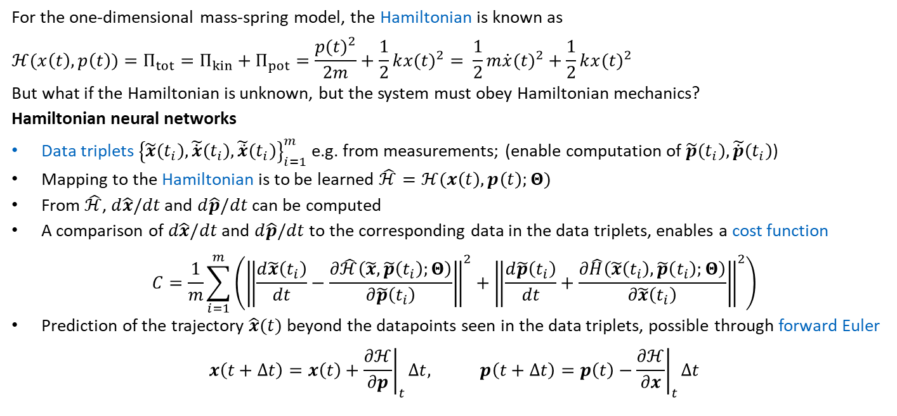
3.9.8.3 Hamiltonian Neural Networks
For the one-dimensional mass-spring model, the Hamiltonian is known as
$$ℋ(x\left(t\right),p\left(t\right))=Π_{tot}=Π_{kin}+Π_{pot}=\frac{{p(t)}^{2}}{2m}+\frac{1}{2}k{x(t)}^{2}= \frac{1}{2}m{\dot{x}(t)}^{2}+\frac{1}{2}k{x(t)}^{2}$$
But what if the Hamiltonian is unknown, but the system must obey Hamiltonian mechanics?
Hamiltonian neural networks
Data triplets ${\left\{\tilde{x}\left(t_{i}\right), \tilde{\dot{x}}\left(t_{i}\right), \tilde{\ddot{x}}\left(t_{i}\right)\right\}}_{i=1}^{m}$ e.g. from measurements; (enable computation of $\tilde{p}\left(t_{i}\right), \tilde{\dot{p}}\left(t_{i}\right)$)
Mapping to the Hamiltonian is to be learned $\hat{ℋ}=ℋ(x\left(t\right), p\left(t\right);Θ)$
From $\hat{ℋ}$, $d\hat{x}/dt$ and $d\hat{p}/dt$ can be computed
A comparison of $d\hat{x}/dt$ and $d\hat{p}/dt$ to the corresponding data in the data triplets, enables a cost function
$$C=\frac{1}{m}\sum_{i=1}^{m}{\left({\left\|\frac{d\tilde{x}\left(t_{i}\right)}{dt}−\frac{∂\hat{ℋ}\left(\tilde{x},\tilde{p}\left(t_{i}\right);Θ\right)}{∂\tilde{p}\left(t_{i}\right)}\right\|}^{2}+{\left\|\frac{d\tilde{p}\left(t_{i}\right)}{dt}+\frac{∂\hat{H}\left(\tilde{x}\left(t_{i}\right),\tilde{p}\left(t_{i}\right);Θ\right)}{∂\tilde{x}\left(t_{i}\right)}\right\|}^{2}\right)}$$
Prediction of the trajectory $\hat{x}(t)$ beyond the datapoints seen in the data triplets, possible through forward Euler
$$x\left(t+Δt\right)=x\left(t\right)+{\left.\frac{∂ℋ}{∂p}\right|}_{t}Δt, p\left(t+Δt\right)=p\left(t\right)−{\left.\frac{∂ℋ}{∂x}\right|}_{t}Δt$$
$$\frac{dx}{dt}=\frac{∂ℋ}{∂p},\frac{dp}{dt}=−\frac{∂ℋ}{∂x}$$
Notes:
P(t)=mdot mal x

Slide 41
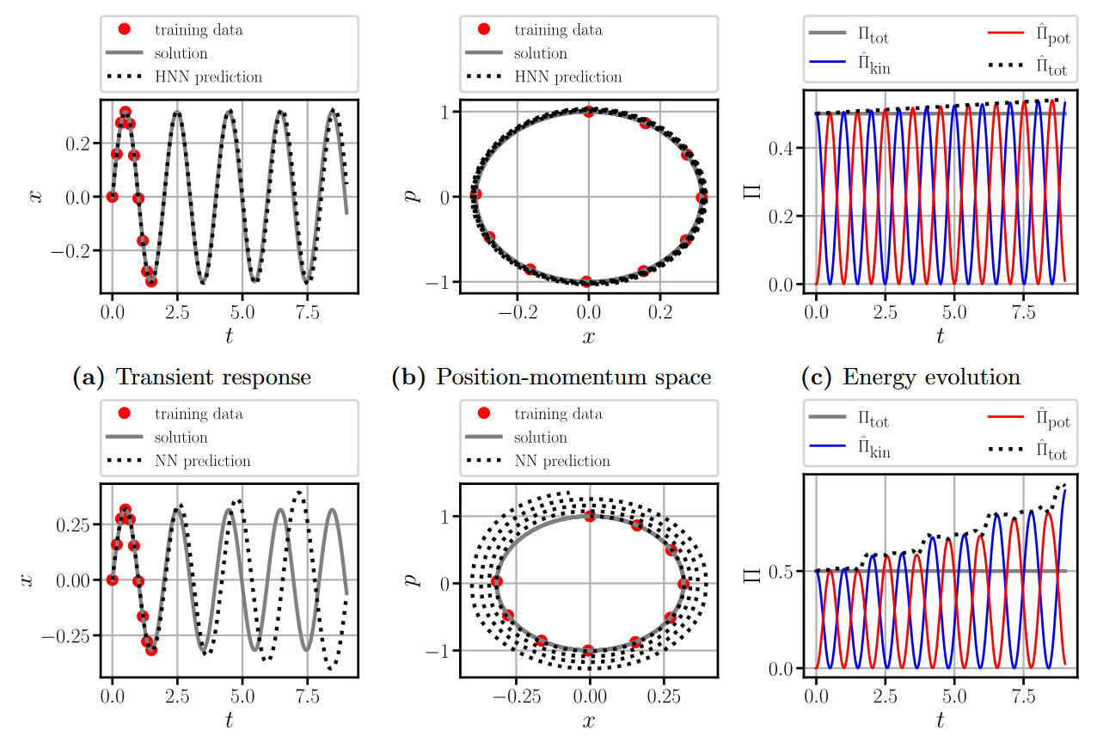

3.9.8.3 Hamiltonian Neural Networks - Results
Hamiltonian neural network
Standard neural network
$$\left({\hat{\dot{x}} \atop \hat{\dot{p}}}\right)=f\left(x,p;Θ\right) \\ C=\frac{1}{m}\sum_{i=1}^{m}{{\left(\tilde{\dot{x}}−\hat{\dot{x}}\right)}^{2}+{\left(\tilde{\dot{p}}−\hat{\dot{p}}\right)}^{2}}$$
Notes:
Approximation is superior using HNN.
But the HNN also does not conserve the total energy
This error stems from the forward Euler integration scheme and can be avoided with energy-conserving time-stepping schemes, such as the trapezoidal rule.
The Hamiltonian neural network generalizes better, because it learns to conserve a scalar quantity (related to the enery) from the observations.

Slide 42
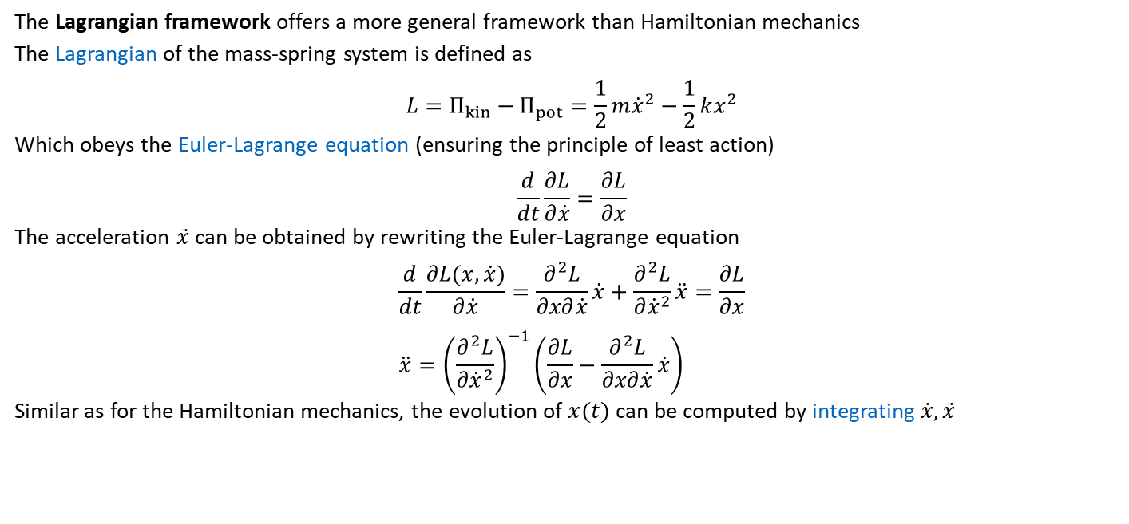
3.9.8.4 Euler-Lagrange Equation
The Lagrangian framework offers a more general framework than Hamiltonian mechanics
The Lagrangian of the mass-spring system is defined as
$$L=Π_{kin}−Π_{pot}=\frac{1}{2}m{\dot{x}}^{2}−\frac{1}{2}kx^{2}$$
Which obeys the Euler-Lagrange equation (ensuring the principle of least action)
$$\frac{d}{dt}\frac{∂L}{∂\dot{x}}=\frac{∂L}{∂x}$$
The acceleration $\ddot{x}$ can be obtained by rewriting the Euler-Lagrange equation
$$\frac{d}{dt}\frac{∂L(x,\dot{x})}{∂\dot{x}}=\frac{∂^{2}L}{∂x∂\dot{x}}\dot{x}+\frac{∂^{2}L}{∂{\dot{x}}^{2}}\ddot{x}=\frac{∂L}{∂x} \\ \ddot{x}={\left(\frac{∂^{2}L}{∂{\dot{x}}^{2}}\right)}^{−1}\left(\frac{∂L}{∂x}−\frac{∂^{2}L}{∂x∂\dot{x}}\dot{x}\right)$$
Similar as for the Hamiltonian mechanics, the evolution of $x(t)$ can be computed by integrating$\dot{x},\ddot{x}$

Slide 43



3.9.8.5 Lagrangian Neural Networks
Data triplets ${\left\{\tilde{x}\left(t_{i}\right), \tilde{\dot{x}}\left(t_{i}\right), \tilde{\ddot{x}}\left(t_{i}\right)\right\}}_{i=1}^{m}$
Mapping to the Lagrangian is to be learned $\hat{L}=L\left(x\left(t\right), \dot{x}\left(t\right);Θ\right)$
The Lagrangian obeys the Euler Lagrange Equation:
and ensures the principle of least action
Lagrangian Networks predict the Lagrangian $L$ and use the Euler Lagrange Equation as a cost function as follows
The acceleration $\hat{\ddot{x}}$ can be computed from
With the predicted acceleration a cost function can be formulated as
$$C=\frac{1}{m}\sum_{i=1}^{m}{{\left\|\tilde{\ddot{x}}\left(t_{i}\right)−\hat{\ddot{x}}\left(\hat{L};\tilde{x}\left(t_{i}\right),\tilde{\dot{x}}\left(t_{i}\right)\right)\right\|}^{2}}$$
$$\frac{d}{dt}\frac{∂L}{∂\dot{x}}=\frac{∂L}{∂x}$$
$$\ddot{x}={\left(\frac{∂^{2}L}{∂{\dot{x}}^{2}}\right)}^{−1}\left(\frac{∂L}{∂x}−\frac{∂^{2}L}{∂x∂\dot{x}}\dot{x}\right)$$
Notes:
https://www.youtube.com/watch?v=HLUIx6FqAvg

Slide 44



3.9.8.5 Lagrangian Neural Networks - Results
Lagrangian neural network
The Lagrangian is not unique
Standard neural network
$$\left({\hat{\dot{x}} \atop \hat{\dot{p}}}\right)=f\left(x,p;Θ\right) \\ C=\frac{1}{m}\sum_{i=1}^{m}{{\left(\tilde{\dot{x}}−\hat{\dot{x}}\right)}^{2}+{\left(\tilde{\dot{p}}−\hat{\dot{p}}\right)}^{2}}$$

Slide 45

Comparison of Hamiltonian and Lagrangian NNs
Notes:
both networks reliably learn the dynamics of the system from only ten data points.
By contrast, the conventional neural network suffers from a severe energy accumulation despite the improved integration scheme.
In conclusion, much more accurate predictions for unseen data, i.e., the generalization gain,
comes from the implicit enforcement of Hamiltonian mechanics and the Lagrangian framework.
A shortcoming of both approaches lies in their sole applicability to dynamical systems through the Lagrangian and the Hamiltonian. A different and more general perspective, using differential equations, is achieved by physics-informed neural networks, which will be discussed in the upcoming Chaps. 4 and 5.6
Or more generally, by enforcing conversation laws.

Slide 46
Exercises
E.13 Hamiltonian & Lagrangian Neural Networks (C)
Implement a Hamiltonian and a Lagrangian neural network and apply it to the mass-spring model. Compare the generalization capabilities to a standard neural network.
Further Material:
Steve Brunton: https://www.youtube.com/watch?v=HLUIx6FqAvg

Slide 47
Contents
3.1 Fully Connected Neural Network
3.2 Forward Propagation
3.3 Differentiation
3.4 Backpropagation
3.5 Activation Function
3.6 Learning Algorithm
3.7 Regularization of Neural Networks
3.8 Approximating the Sine Function
3.9.1 Convolutional Neural Networks
3.9.2 Graph Neural Networks
3.9.6 Recurrent Neural Networks
3.9.8 Physics-Inspired Architectures for Dynamics (Hamiltonian & Lagrangian Neural Networks)
4 Introduction to Physics-Informed Neural Networks

Slide 48
3 Neural Networks: Advanced Architectures
Leon Herrmann
Stefan Kollmannsberger
Chair of Data Engineering in Construction
Bauhaus-Universität Weimar
Deep Learning in Computational Mechanics – an introductory course,
Herrmann et al. 2025
website
book
Notes:
generated with https://www.the-qrcode-generator.com/

