Slide 1


10 Methodological Overview
Leon Herrmann
Stefan Kollmannsberger
Chair of Data Engineering in Construction
Bauhaus-Universität Weimar
Deep Learning in Computational Mechanics – an introductory course, Herrmann et al. 2025
website
book
Notes:
generated with https://www.the-qrcode-generator.com/

Slide 2
Contents
9 Inverse Problems & Deep Learning
10.1 Simulation Substitution
10.1.1 Data-Driven Modeling
10.1.2 Physics-Informed Learning
10.2 Simulation Enhancement
10.2.1 Pre-processing
10.2.2 Physical Modeling
10.2.3 Numerical Methods
10.2.4 Post-Processing
10.3 Discretizations as Neural Networks
10.4 Generative Approaches
10.5 Deep Reinforcement Learning
11 The Future of Deep Learning in Computational Mechanics

Slide 3
10 Methodological Overview
Deep learning in computational mechanics: a review, Herrmann et al. 2024
Simulation substitution
Data-driven modelling
Physics-informed learning
Simulation enhancement
Discretizations as neural networks
Generative approaches
Deep reinforcement learning
Simulation with graph neural networks; DMD; Transfer learning
Hamiltonian/Lagrangian neural networks; SINDy; (PINNs)
Input-convex neural networks for material modeling; EUCLID; Neural networks as ansatz function of inverse quantities; Superresolution; Differentiable physics
Hardware acceleration with GPUs; (HiDeNN)
Generative design; Realistic data generation; Anomaly detection; Transformers for natural language processing
Control engineering tasks: autonomous flight; robots;
Alternative gradient-free optimizer

Slide 4

10.1.1 Data-Driven Modeling
The aim of data-driven modeling is to learn a model in a supervised manner relying on labeled data
$${\{{\tilde{x}}_{i}, {\tilde{y}}_{i}\}}_{i=1}^{m_{𝒟}}$$
Neural network as approximation of function $y=f\left(x\right)$ relating the data
$$\hat{y}=f_{NN}\left(x;Θ\right)$$
The quality of prediction is defined in terms of a data misfit function, e.g., the MSE
$$ℒ_{𝒟}=\frac{1}{2}\sum_{i=1}^{m_{𝒟}}{||\hat{y}\left({\tilde{x}}_{i};Θ\right)−{\tilde{y}}_{i}||^{2}}$$
Covered in depth in Chapter 3

Slide 5
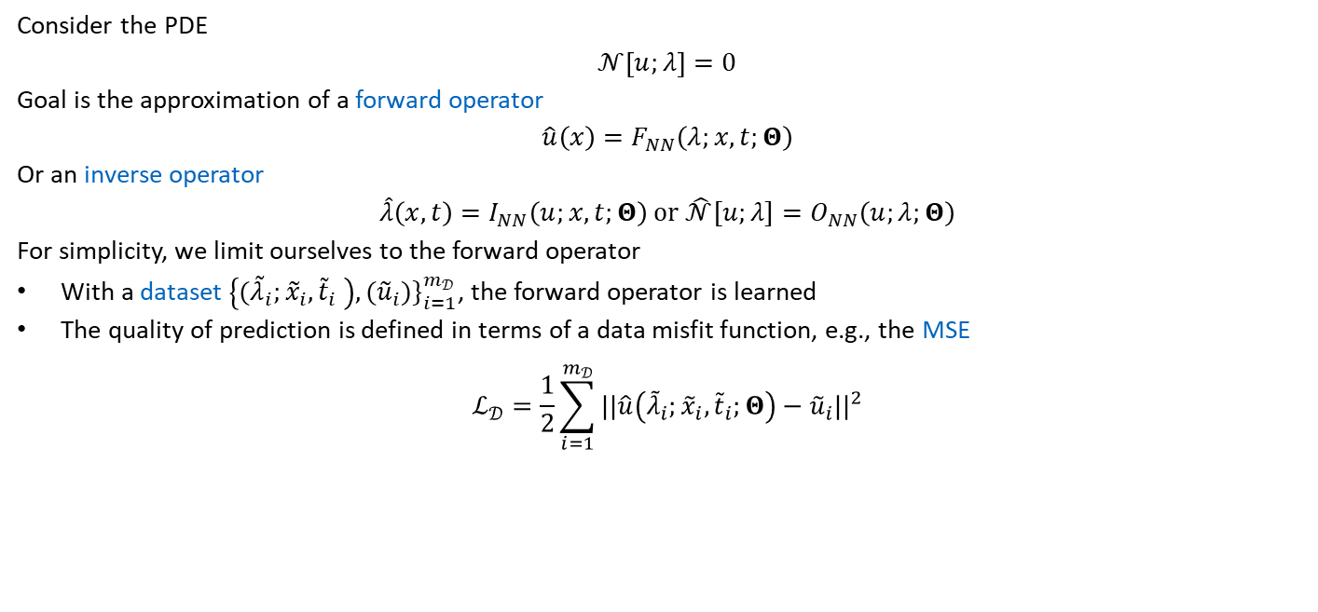
10.1.1 Data-Driven Modeling
Covered in depth in Chapter 3
Consider the PDE
$$𝒩\left[u;λ\right]=0$$
Goal is the approximation of a forward operator
$$\hat{u}\left(x\right)=F_{NN}\left(λ;x,t;Θ\right)$$
Or an inverse operator
$$\hat{λ}\left(x,t\right)=I_{NN}\left(u;x,t;Θ\right) or \hat{𝒩}[u;λ]=O_{NN}\left(u;λ;Θ\right)$$
For simplicity, we limit ourselves to the forward operator
With a dataset $\left\{{(\tilde{λ}}_{i};{\tilde{x}}_{i}, {\tilde{t}}_{i} \right), ({\tilde{u}}_{i})\}_{i=1}^{m_{𝒟}}$, the forward operator is learned
The quality of prediction is defined in terms of a data misfit function, e.g., the MSE
$$ℒ_{𝒟}=\frac{1}{2}\sum_{i=1}^{m_{𝒟}}{||\hat{u}\left({\tilde{λ}}_{i};{\tilde{x}}_{i}, {\tilde{t}}_{i};Θ\right)−{\tilde{u}}_{i}||^{2}}$$

Slide 6

10.1.1 Data-Driven Modeling
10.1.1.1 Space-Time Approaches
Time can simply be treated in the same way, as any other spatial dimensions
In the following, time $t$ is no longer mentioned explicitly, but included in the coordinates $x$
10.1.1.2 Time-Stepping Procedures
Time is treated in a discrete manner using relying on a time-stepping procedure

Slide 7
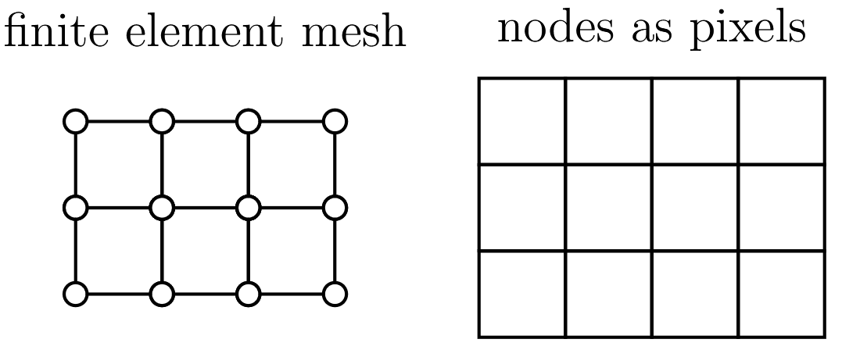
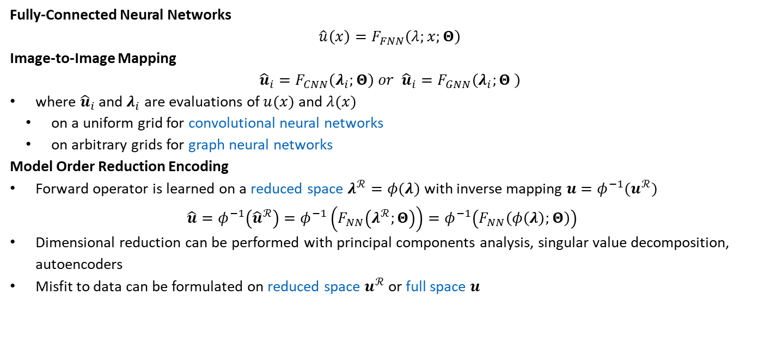
10.1.1 Data-Driven Modeling
Covered in depth in Chapters 3 & 6
Fully-Connected Neural Networks
$$\hat{u}\left(x\right)=F_{FNN}\left(λ;x;Θ\right)$$
Image-to-Image Mapping
$${\hat{u}}_{i}=F_{CNN}\left(λ_{i};Θ\right) or {\hat{u}}_{i}=F_{GNN}\left(λ_{i};Θ \right)$$
where ${\hat{u}}_{i}$ and $λ_{i}$ are evaluations of $u(x)$ and $λ(x)$
on a uniform grid for convolutional neural networks
on arbitrary grids for graph neural networks
Model Order Reduction Encoding
Forward operator is learned on a reduced space $λ^{ℛ}=φ(λ)$ with inverse mapping $u=φ^{−1}(u^{ℛ})$
$$\hat{u}=φ^{−1}\left({\hat{u}}^{ℛ}\right)=φ^{−1}\left(F_{NN}\left(λ^{ℛ};Θ\right)\right)=φ^{−1}\left(F_{NN}\left(φ\left(λ\right);Θ\right)\right)$$
Dimensional reduction can be performed with principal components analysis, singular value decomposition, autoencoders
Misfit to data can be formulated on reduced space $u^{ℛ}$ or full space $u$

Slide 8
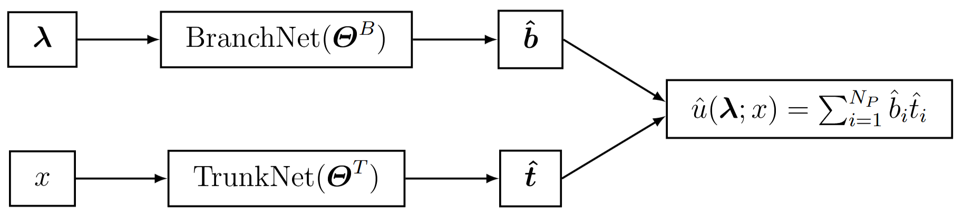

10.1.1.1.4 Neural Operators
DeepONet
Operator prediction is split up into two tasks
Prediction of basis functions ${\hat{t}}_{i}=F_{FNN}^{T}(x_{i};Θ^{T})$
Prediction of coefficients ${\hat{b}}_{j}=F_{FNN}^{B}\left(λ_{j};Θ^{B}\right)$
Prediction of solution ${\hat{u}}_{ij}$ at $x_{i}$ with coefficients $λ_{j}$ with the scalar product
$${\hat{u}}_{ij}={\hat{b}}_{j}⋅{\hat{t}}_{i}$$

Slide 9
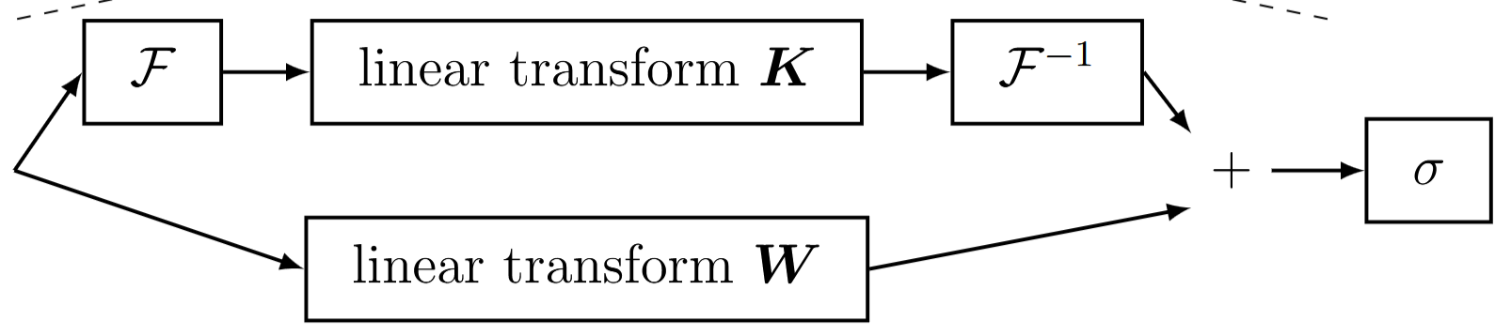

10.1.1.1.4 Neural Operators
Fourier Neural Operators
Mapping of coefficients $λ$ to solution $u$ is learned on a uniform grid
$$\hat{u}\left(λ\right)=F_{FNO}\left(λ;Θ\right)$$
Fourier Neural Operator (FNO) consists of Fourier Layers that operator in Fourier Space (over $x$)
$$a^{\left(j+1\right)}\left(x\right)=σ(Wa^{\left(j\right)}\left(x\right)+b+(ℱ^{−1}\left[Kℱ\left(a^{\left(j\right)}\left(x\right)\right)\right])$$

Slide 10
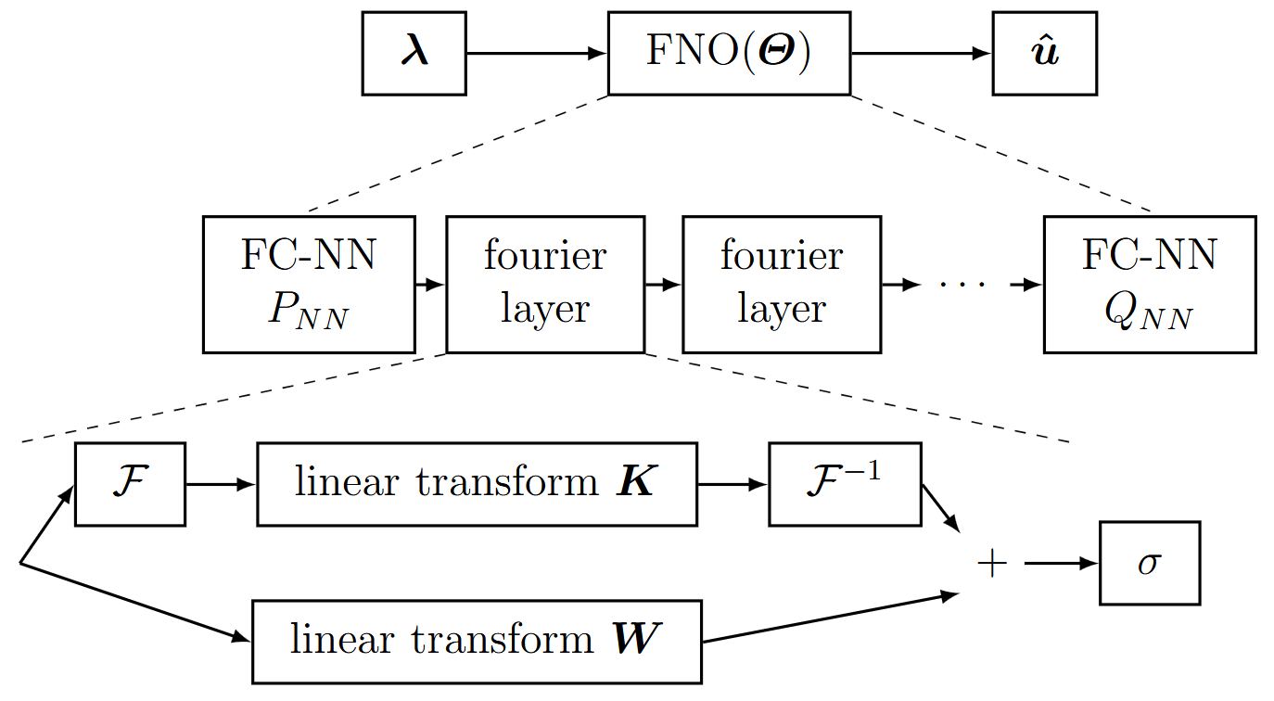
10.1.1.1.4 Neural Operators
Fourier Neural Operators
Expressive and efficient architecture
Enhance the non-local expressivity
Fast Fourier transforms enable computational efficiency

Slide 11
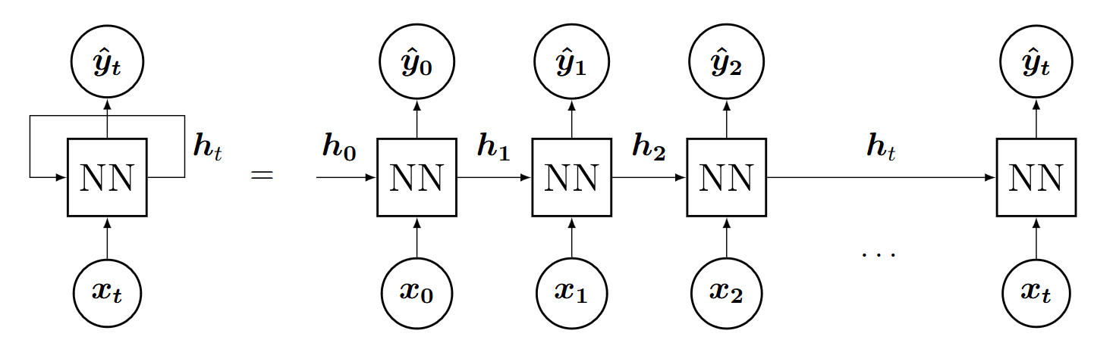

10.1.1.2 Time-Stepping Procedures
Time-Stepping Procedures
Problem is discretized in time with $t_{i+1}=t_{i}+Δt$
Prediction of time-history with fully-connected neural network
$$\hat{u}\left(x, t_{i+1}\right)=F_{FNN}(x, t_{i};Θ)$$
Prediction of time-history with recurrent neural network
$$\left\{{\hat{u}}_{2}, {\hat{u}}_{3},…, {\hat{u}}_{N}\right\}=F_{RNN}(x;u_{1};Θ)$$
or variations, such as LSTM, GRU, transformers
Difference to fully-connected neural network is a hidden/latent state that propagates infromation from prior steps

Slide 12
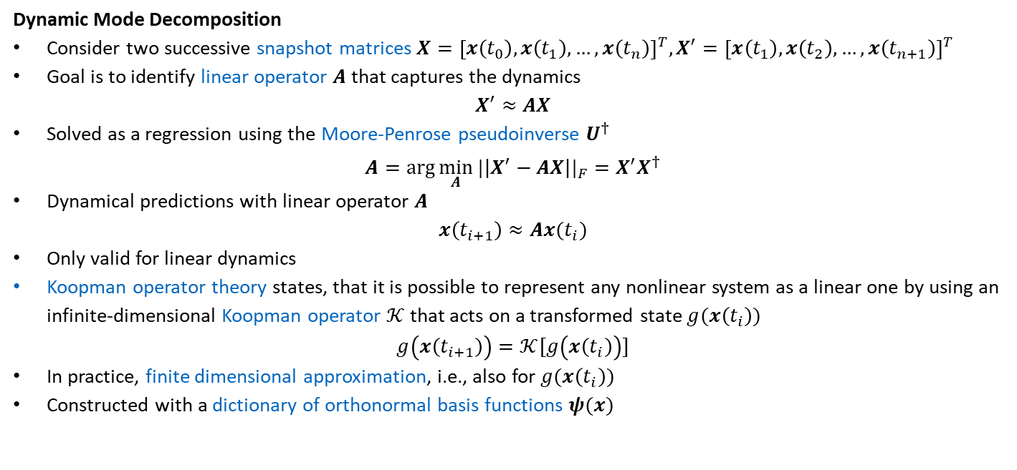
10.1.1.2 Time-Stepping Procedures
Dynamic Mode Decomposition
Consider two successive snapshot matrices $X={\left[x\left(t_{0}\right),x\left(t_{1}\right),…,x\left(t_{n}\right)\right]}^{T}, X^{′}={\left[x\left(t_{1}\right),x\left(t_{2}\right),…,x\left(t_{n+1}\right)\right]}^{T}$
Goal is to identify linear operator $A$ that captures the dynamics
$$X^{′}≈AX$$
Solved as a regression using the Moore-Penrose pseudoinverse $U^{†}$
$$A=\arg{\min_{A}{|\left|X^{′}−AX\right||_{F}=X^{′}X^{†}}}$$
Dynamical predictions with linear operator $A$
$$x\left(t_{i+1}\right)≈Ax(t_{i})$$
Only valid for linear dynamics
Koopman operator theory states, that it is possible to represent any nonlinear system as a linear one by using an infinite-dimensional Koopman operator $𝒦$ that acts on a transformed state $g(x\left(t_{i}\right))$
$$g\left(x\left(t_{i+1}\right)\right)=𝒦[g\left(x\left(t_{i}\right)\right)]$$
In practice, finite dimensional approximation, i.e., also for $g(x\left(t_{i}\right))$
Constructed with a dictionary of orthonormal basis functions $ψ(x)$

Slide 13

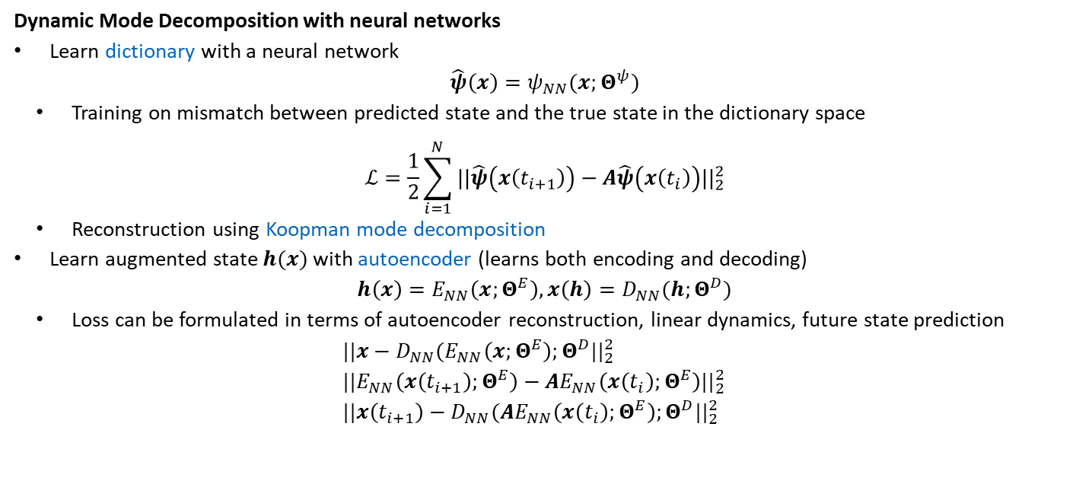
10.1.1.2 Time-Stepping Procedures
Dynamic Mode Decomposition with neural networks
Learn dictionary with a neural network
$$\hat{ψ}\left(x\right)=ψ_{NN}(x;Θ^{ψ})$$
Training on mismatch between predicted state and the true state in the dictionary space
$$ℒ=\frac{1}{2}\sum_{i=1}^{N}{||\hat{ψ}\left(x\left(t_{i+1}\right)\right)−A\hat{ψ}\left(x\left(t_{i}\right)\right)||_{2}^{2}}$$
Reconstruction using Koopman mode decomposition
Learn augmented state $h(x)$ with autoencoder (learns both encoding and decoding)
$$h\left(x\right)=E_{NN}\left(x;Θ^{E}\right), x\left(h\right)=D_{NN}(h;Θ^{D})$$
Loss can be formulated in terms of autoencoder reconstruction, linear dynamics, future state prediction
$$||x−D_{NN}(E_{NN}\left(x;Θ^{E}\right);Θ^{D}||_{2}^{2} \\ ||E_{NN}\left(x\left(t_{i+1}\right);Θ^{E}\right)−AE_{NN}\left(x\left(t_{i}\right);Θ^{E}\right)||_{2}^{2} \\ ||x\left(t_{i+1}\right)−D_{NN}(AE_{NN}\left(x\left(t_{i}\right);Θ^{E}\right);Θ^{D}||_{2}^{2}$$
$A$ is obtained with conventional DMD

Slide 14

10.1.2 Physics-Informed Learning
Incorporation of physical constraints
via penalty terms, which acts as regularization
$$\tilde{ℒ}=ℒ+λ{||⋅||}^{2}$$
For example physics-informed neural networks as seen in Chapters 4 & 5
by construction, which reduces the learnable space
$$\tilde{\hat{u}}=f(\hat{u})$$
For example physics augmented neural networks for material modeling as seen in Chapter 7

Slide 15
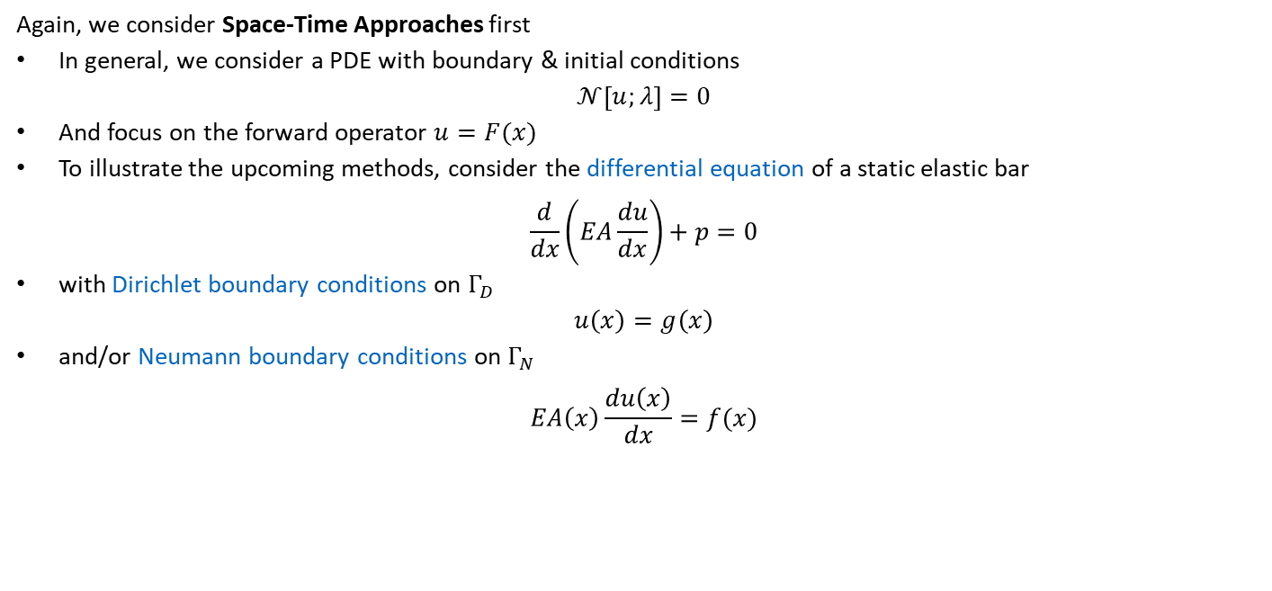
10.1.2 Physics-Informed Learning
Again, we consider Space-Time Approaches first
In general, we consider a PDE with boundary & initial conditions
$$𝒩\left[u;λ\right]=0$$
And focus on the forward operator $u=F(x)$
To illustrate the upcoming methods, consider the differential equation of a static elastic bar
$$\frac{d}{dx}\left(EA\frac{du}{dx}\right)+p=0$$
with Dirichlet boundary conditions on $Γ_{D}$
$$u\left(x\right)=g\left(x\right)$$
and/or Neumann boundary conditions on $Γ_{N}$
$$EA\left(x\right)\frac{du\left(x\right)}{dx}=f(x)$$

Slide 16
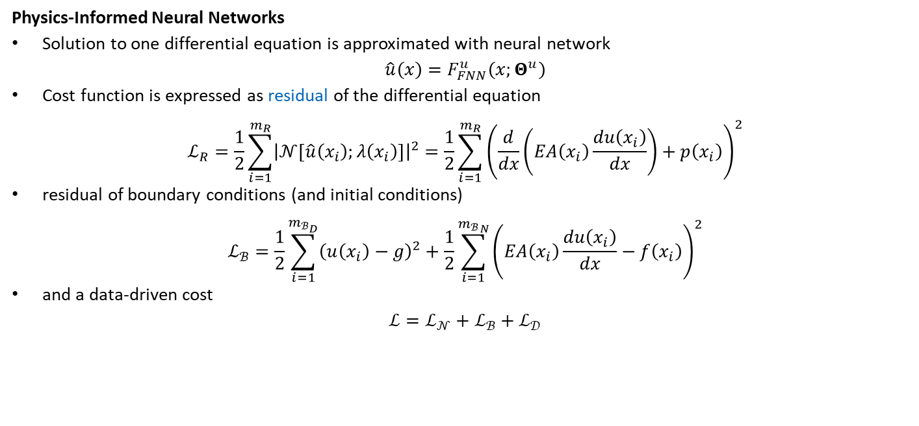
10.1.1.2.1 Differential Equation Solving
Covered in depth in Chapter 4
Physics-Informed Neural Networks
Solution to one differential equation is approximated with neural network
$$\hat{u}\left(x\right)=F_{FNN}^{u}\left(x;Θ^{u}\right)$$
Cost function is expressed as residual of the differential equation
$$ℒ_{R}=\frac{1}{2}\sum_{i=1}^{m_{R}}{{\left|𝒩\left[\hat{u}\left(x_{i}\right);λ\left(x_{i}\right)\right]\right|}^{2}}=\frac{1}{2}\sum_{i=1}^{m_{R}}{{\left(\frac{d}{dx}\left(EA\left(x_{i}\right)\frac{du\left(x_{i}\right)}{dx}\right)+p\left(x_{i}\right)\right)}^{2}}$$
residual of boundary conditions (and initial conditions)
$$ℒ_{ℬ}=\frac{1}{2}\sum_{i=1}^{m_{ℬ_{D}}}{{\left(u\left(x_{i}\right)−g\right)}^{2}+\frac{1}{2}\sum_{i=1}^{{m_{ℬ}}_{N}}{{\left(EA\left(x_{i}\right)\frac{du\left(x_{i}\right)}{dx}−f\left(x_{i}\right)\right)}^{2}}}$$
and a data-driven cost
$$ℒ=ℒ_{𝒩}+ℒ_{ℬ}+ℒ_{𝒟}$$

Slide 17
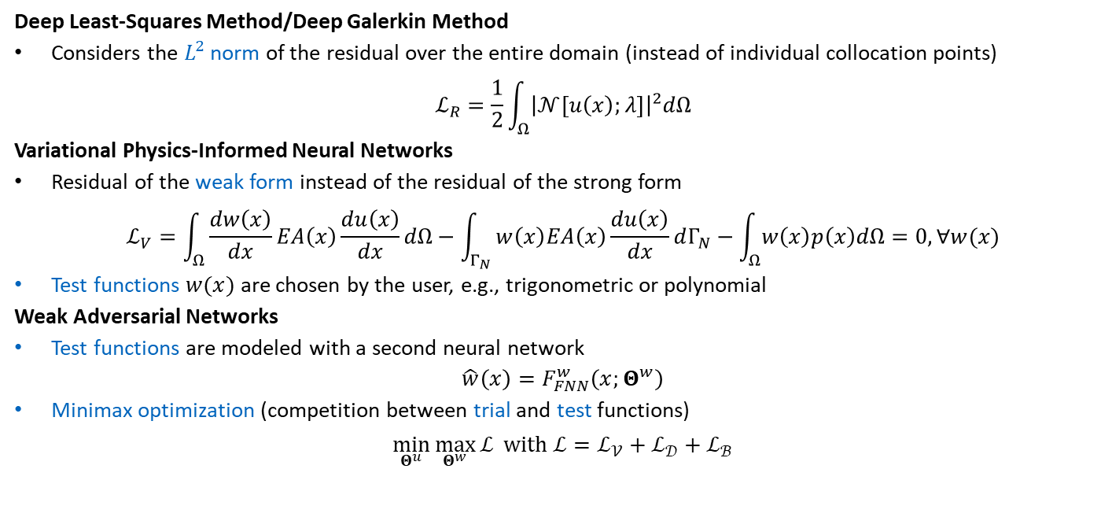
10.1.1.2.1 Differential Equation Solving
Covered in depth in Chapter 5
Deep Least-Squares Method/Deep Galerkin Method
Considers the $L^{2}$ norm of the residual over the entire domain (instead of individual collocation points)
$$ℒ_{R}=\frac{1}{2}\int_{Ω}^{ }{{\left|𝒩\left[u\left(x\right);λ\right]\right|}^{2}dΩ}$$
Variational Physics-Informed Neural Networks
Residual of the weak form instead of the residual of the strong form
$$ℒ_{V}=\int_{Ω}^{ }{\frac{dw\left(x\right)}{dx}EA\left(x\right)\frac{du\left(x\right)}{dx}dΩ−\int_{Γ_{N}}^{ }{w\left(x\right)EA\left(x\right)\frac{du\left(x\right)}{dx}dΓ_{N}−\int_{Ω}^{ }{w\left(x\right)p\left(x\right)dΩ=0, ∀w(x)}}}$$
Test functions $w(x)$ are chosen by the user, e.g., trigonometric or polynomial
Weak Adversarial Networks
Test functions are modeled with a second neural network
$$\hat{w}\left(x\right)=F_{FNN}^{w}\left(x;Θ^{w}\right)$$
Minimax optimization (competition between trial and test functions)
$$\min_{Θ^{u}}{\max_{Θ^{w}}{ℒ} with{ ℒ=ℒ}_{𝒱}+ℒ_{𝒟}+ℒ_{ℬ}}$$

Slide 18

10.1.1.2.1 Differential Equation Solving
Covered in depth in Chapter 5
Deep Energy Method/Deep Ritz Method
Minimization of the potential energy $Π_{tot}=Π_{i}+Π_{e}$
$$ℒ_{ℰ}=Π_{i}+Π_{e}=\frac{1}{2}\int_{Ω}^{ }{EA\left(x\right){\left(\frac{du\left(x\right)}{dx}\right)}^{2}dΩ−\int_{Γ}^{ }{u\left(x\right)EA\left(x\right)\frac{du\left(x\right)}{dx}dΓ−\int_{Ω}^{ }{u\left(x\right)p\left(x\right)dΩ}}}$$
Only applicable to conservative systems, i.e., systems that conserve energy
Not generally applicable to inverse problems
$EA(x)$ going towards $−∞$ in $Ω$ and towards $∞$ on $dΓ$ minimizes $ℒ_{ℰ}$ to an arbitrary level

Slide 19
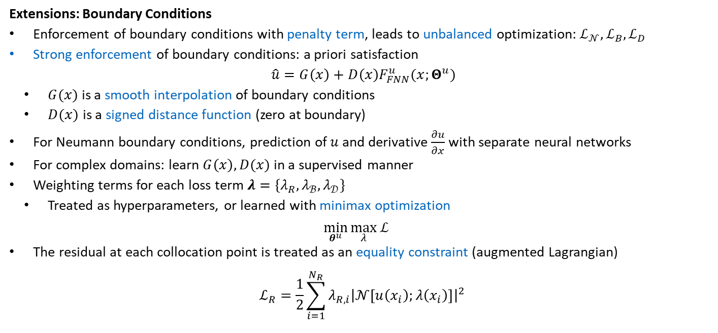
10.1.1.2.1 Differential Equation Solving
Extensions: Boundary Conditions
Enforcement of boundary conditions with penalty term, leads to unbalanced optimization: $ℒ_{𝒩},ℒ_{B},ℒ_{D}$
Strong enforcement of boundary conditions: a priori satisfaction
$$\hat{u}=G\left(x\right)+D\left(x\right)F_{FNN}^{u}(x;Θ^{u})$$
$G(x)$ is a smooth interpolation of boundary conditions
$D(x)$ is a signed distance function (zero at boundary)
For Neumann boundary conditions, prediction of $u$ and derivative $\frac{∂u}{∂x}$ with separate neural networks
For complex domains: learn $G\left(x\right), D(x)$ in a supervised manner
Weighting terms for each loss term $λ=\{λ_{R},λ_{ℬ},λ_{𝒟}\}$
Treated as hyperparameters, or learned with minimax optimization
$$\min_{θ^{u}}\max_{λ}{ℒ}$$
The residual at each collocation point is treated as an equality constraint (augmented Lagrangian)
$$ℒ_{R}=\frac{1}{2}\sum_{i=1}^{N_{R}}{λ_{R,i}{\left|𝒩\left[u\left(x_{i}\right);λ\left(x_{i}\right)\right]\right|}^{2} }$$

Slide 20
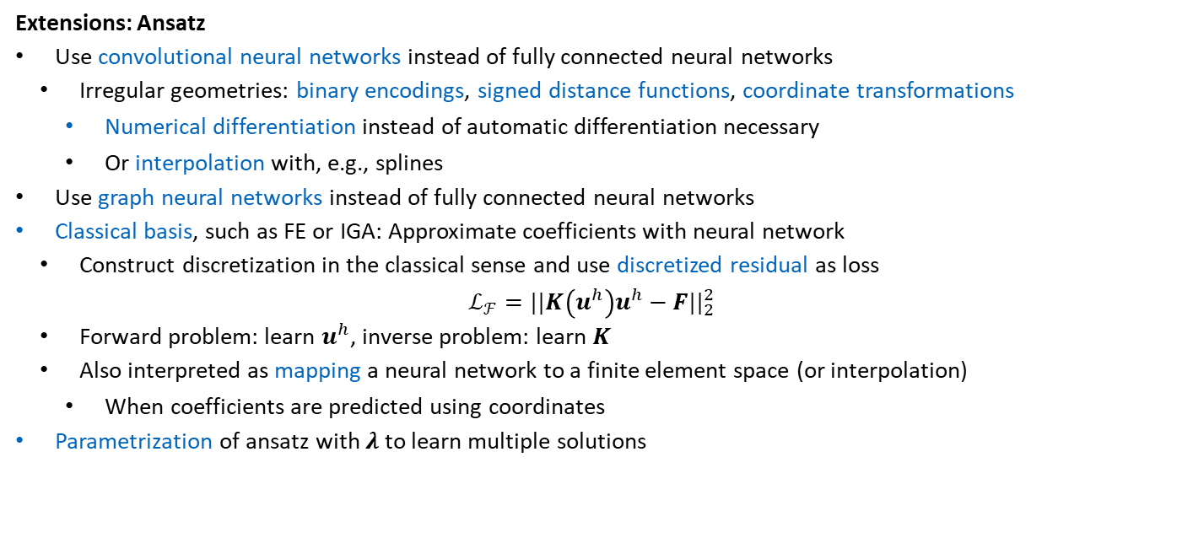
10.1.1.2.1 Differential Equation Solving
Extensions: Ansatz
Use convolutional neural networks instead of fully connected neural networks
Irregular geometries: binary encodings, signed distance functions, coordinate transformations
Numerical differentiation instead of automatic differentiation necessary
Or interpolation with, e.g., splines
Use graph neural networks instead of fully connected neural networks
Classical basis, such as FE or IGA: Approximate coefficients with neural network
Construct discretization in the classical sense and use discretized residual as loss
$$ℒ_{ℱ}=||K\left(u^{h}\right)u^{h}−F||_{2}^{2}$$
Forward problem: learn $u^{h}$, inverse problem: learn $K$
Also interpreted as mapping a neural network to a finite element space (or interpolation)
When coefficients are predicted using coordinates
Parametrization of ansatz with $λ$ to learn multiple solutions

Slide 21
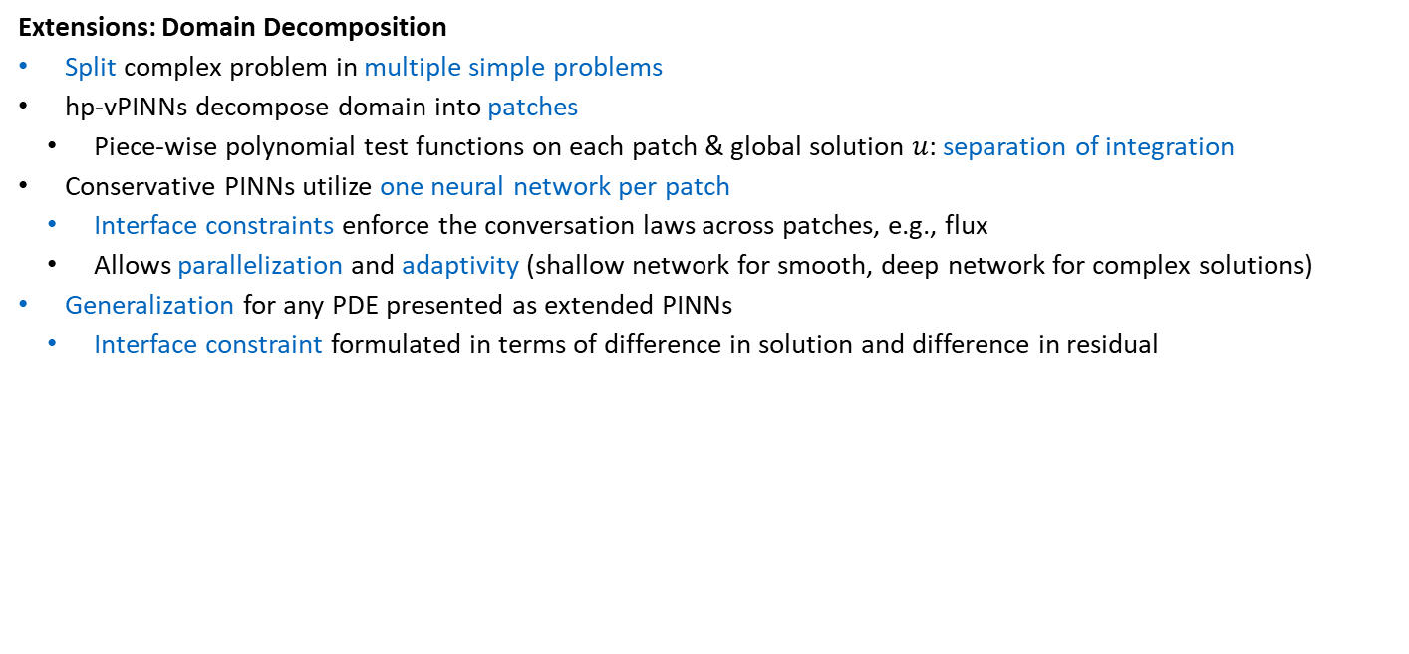
10.1.1.2.1 Differential Equation Solving
Extensions: Domain Decomposition
Split complex problem in multiple simple problems
hp-vPINNs decompose domain into patches
Piece-wise polynomial test functions on each patch & global solution $u$: separation of integration
Conservative PINNs utilize one neural network per patch
Interface constraints enforce the conversation laws across patches, e.g., flux
Allows parallelization and adaptivity (shallow network for smooth, deep network for complex solutions)
Generalization for any PDE presented as extended PINNs
Interface constraint formulated in terms of difference in solution and difference in residual

Slide 22
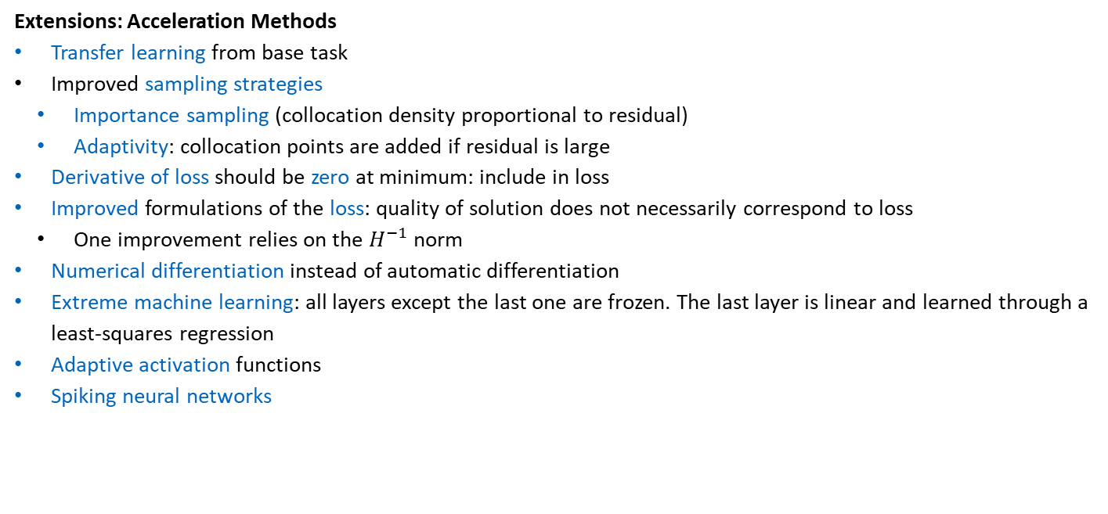
10.1.1.2.1 Differential Equation Solving
Extensions: Acceleration Methods
Transfer learning from base task
Improved sampling strategies
Importance sampling (collocation density proportional to residual)
Adaptivity: collocation points are added if residual is large
Derivative of loss should be zero at minimum: include in loss
Improved formulations of the loss: quality of solution does not necessarily correspond to loss
One improvement relies on the $H^{−1}$ norm
Numerical differentiation instead of automatic differentiation
Extreme machine learning: all layers except the last one are frozen. The last layer is linear and learned through a least-squares regression
Adaptive activation functions
Spiking neural networks
In particular for higher order derivatives, as seen in Chapter 5
Specialized hardware to improve efficiency of training neural networks

Slide 23

10.1.2.1.2 Inverse Problems
Discovery of Governing Equations
AI-Feynman is an automated framework for symbolic regression
Performs dimensional analysis, polynomial regression and brute force search algorithms sequentially
If an interpretable equation is not recovered
Neural networks as interpolation of the data
Test for symmetry, e.g., if $f\left(x_{1},x_{2},x_{3},…\right)=f(x_{1}+a,x_{2}+a, x_{3},…)$ then introduce variable $x_{1}^{′}=x_{2}−x_{1}$
Test for separability, i.e., $f\left(x_{1},x_{2}\right)=g\left(x_{1}\right)h\left(x_{2}\right)$, to split equation in simpler parts

Slide 24
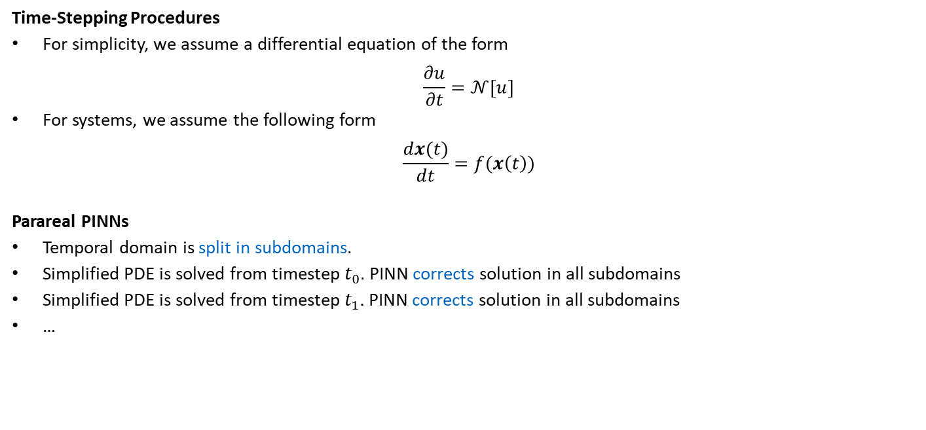
10.1.2.2 Time-Stepping Procedures
Time-Stepping Procedures
For simplicity, we assume a differential equation of the form
$$\frac{∂u}{∂t}=𝒩\left[u\right]$$
For systems, we assume the following form
$$\frac{dx(t)}{dt}=f(x\left(t\right))$$
Parareal PINNs
Temporal domain is split in subdomains.
Simplified PDE is solved from timestep $t_{0}$. PINN corrects solution in all subdomains
Simplified PDE is solved from timestep $t_{1}.$ PINN corrects solution in all subdomains
…

Slide 25
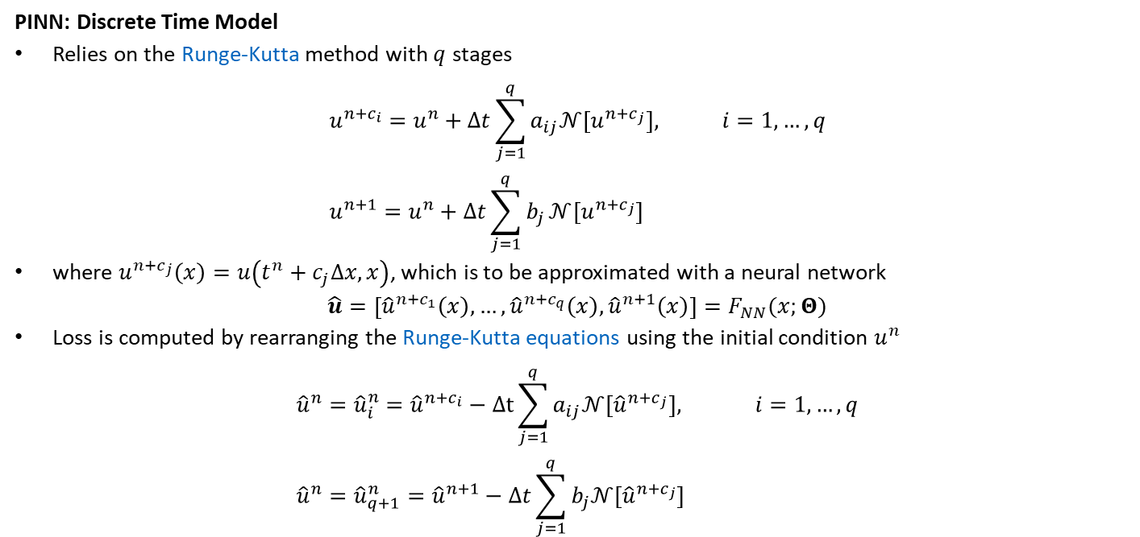
10.1.2.2 Time-Stepping Procedures
PINN: Discrete Time Model
Relies on the Runge-Kutta method with $q$ stages
$$u^{n+c_{i}}=u^{n}+Δt\sum_{j=1}^{q}{a_{ij}𝒩\left[u^{n+c_{j}}\right], i=1,…,q} \\ u^{n+1}=u^{n}+Δt\sum_{j=1}^{q}{b_{j}}𝒩[u^{n+c_{j}}]$$
where $u^{n+c_{j}}\left(x\right)=u\left(t^{n}+c_{j}Δx,x\right)$, which is to be approximated with a neural network
$$\hat{u}=\left[{\hat{u}}^{n+c_{1}}\left(x\right),…,{\hat{u}}^{n+c_{q}}\left(x\right),{\hat{u}}^{n+1}\left(x\right)\right]=F_{NN}(x;Θ)$$
Loss is computed by rearranging the Runge-Kutta equations using the initial condition $u^{n}$
$${\hat{u}}^{n}={\hat{u}}_{i}^{n}={\hat{u}}^{n+c_{i}}−Δt\sum_{j=1}^{q}{a_{ij}𝒩\left[{\hat{u}}^{n+c_{j}}\right], i=1,…, q} \\ {\hat{u}}^{n}={\hat{u}}_{q+1}^{n}={\hat{u}}^{n+1}−Δt\sum_{j=1}^{q}{b_{j}𝒩[{\hat{u}}^{n+c_{j}}]}$$

Slide 26
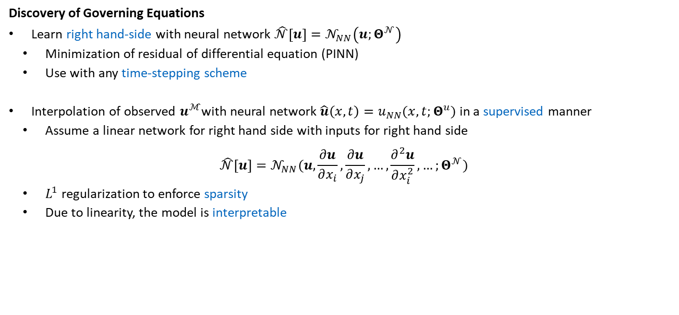
10.1.2.2.2 Inverse Problems
Discovery of Governing Equations
Learn right hand-side with neural network $\hat{𝒩}\left[u\right]=𝒩_{NN}\left(u;Θ^{𝒩}\right)$
Minimization of residual of differential equation (PINN)
Use with any time-stepping scheme
Interpolation of observed $u^{ℳ}$with neural network $\hat{u}\left(x,t\right)=u_{NN}(x,t;Θ^{u})$ in a supervised manner
Assume a linear network for right hand side with inputs for right hand side
$$\hat{𝒩}\left[u\right]=𝒩_{NN}(u,\frac{∂u}{∂x_{i}},\frac{∂u}{∂x_{j}},…,\frac{∂^{2}u}{∂x_{i}^{2}},…;Θ^{𝒩})$$
$L^{1}$ regularization to enforce sparsity
Due to linearity, the model is interpretable

Slide 27
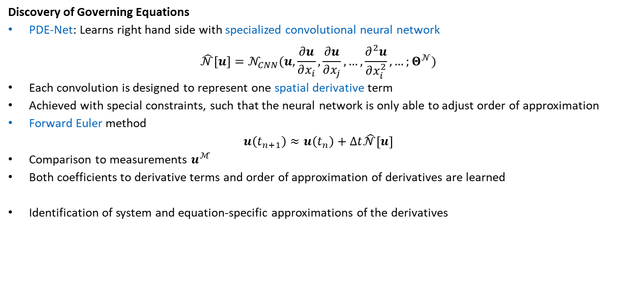
10.1.2.2.2 Inverse Problems
Discovery of Governing Equations
PDE-Net: Learns right hand side with specialized convolutional neural network
$$\hat{𝒩}\left[u\right]=𝒩_{CNN}(u,\frac{∂u}{∂x_{i}},\frac{∂u}{∂x_{j}},…,\frac{∂^{2}u}{∂x_{i}^{2}},…;Θ^{𝒩})$$
Each convolution is designed to represent one spatial derivative term
Achieved with special constraints, such that the neural network is only able to adjust order of approximation
Forward Euler method
$$u\left(t_{n+1}\right)≈u\left(t_{n}\right)+Δt\hat{𝒩}\left[u\right]$$
Comparison to measurements $u^{ℳ}$
Both coefficients to derivative terms and order of approximation of derivatives are learned
Identification of system and equation-specific approximations of the derivatives

Slide 28
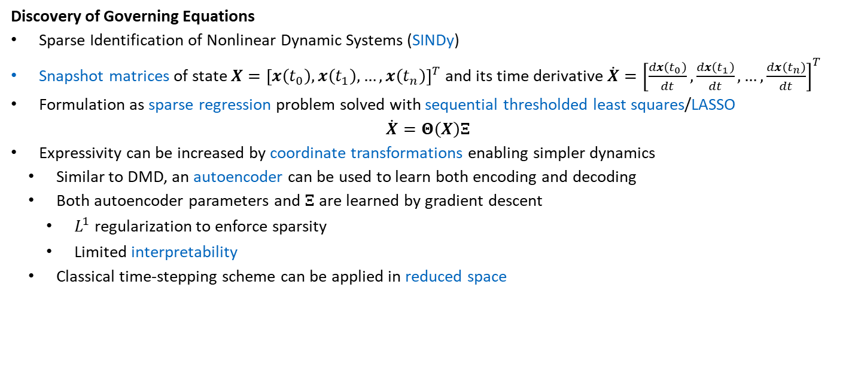
10.1.2.2.2 Inverse Problems
Covered in depth in Chapter 6
Discovery of Governing Equations
Sparse Identification of Nonlinear Dynamic Systems (SINDy)
Snapshot matrices of state $X={\left[x\left(t_{0}\right),x\left(t_{1}\right),…,x\left(t_{n}\right)\right]}^{T}$and its time derivative $\dot{X}={\left[\frac{dx\left(t_{0}\right)}{dt},\frac{dx\left(t_{1}\right)}{dt},…,\frac{dx\left(t_{n}\right)}{dt}\right]}^{T}$
Formulation as sparse regression problem solved with sequential thresholded least squares/LASSO
$$\dot{X}=Θ\left(X\right)Ξ$$
Expressivity can be increased by coordinate transformations enabling simpler dynamics
Similar to DMD, an autoencoder can be used to learn both encoding and decoding
Both autoencoder parameters and $Ξ$ are learned by gradient descent
$L^{1}$ regularization to enforce sparsity
Limited interpretability
Classical time-stepping scheme can be applied in reduced space

Slide 29
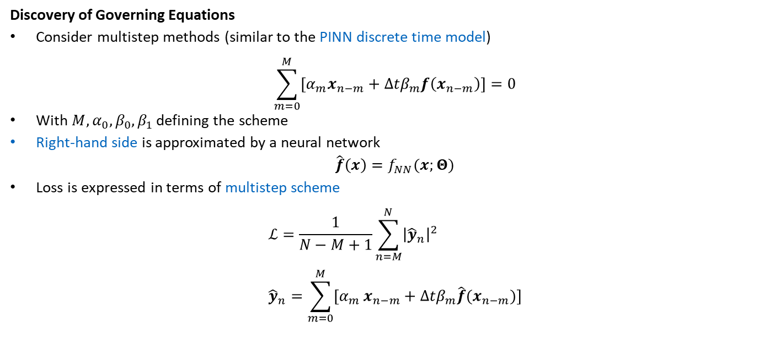
10.1.2.2.2 Inverse Problems
Discovery of Governing Equations
Consider multistep methods (similar to the PINN discrete time model)
$$\sum_{m=0}^{M}{\left[α_{m}x_{n−m}+Δtβ_{m}f\left(x_{n−m}\right)\right]=0}$$
With $M, α_{0}, β_{0},β_{1}$ defining the scheme
Right-hand side is approximated by a neural network
$$\hat{f}\left(x\right)=f_{NN}(x;Θ)$$
Loss is expressed in terms of multistep scheme
$$ℒ=\frac{1}{N−M+1}\sum_{n=M}^{N}{{\left|{\hat{y}}_{n}\right|}^{2}} \\ {\hat{y}}_{n}=\sum_{m=0}^{M}{[α_{m}}x_{n−m}+Δtβ_{m}\hat{f}(x_{n−m})]$$

Slide 30

10.2 Simulation Enhancement
Simulation Chain
Pre-Processing
Physical Modeling
Numerical Methods
Post-Processing
General Procedure
Replace a function $y=f\left(x\right)$ in the simulation chain by a neural network
$$\hat{y}=f_{NN}\left(x;Θ\right)$$
The remaining simulation chain remains unchanged

Slide 31
10.2.1 Pre-processing
Pre-Processing
Geometry extraction
Segmentation, e.g., visual crack detection in images
Mesh generation
Prediction of mesh density
Data preparation
Denoising of measurement data
Low-frequency extrapolation in seismic data
Preconditioning
Prediction of initial solution for classical solver
Transfer learning for neural networks

Slide 32
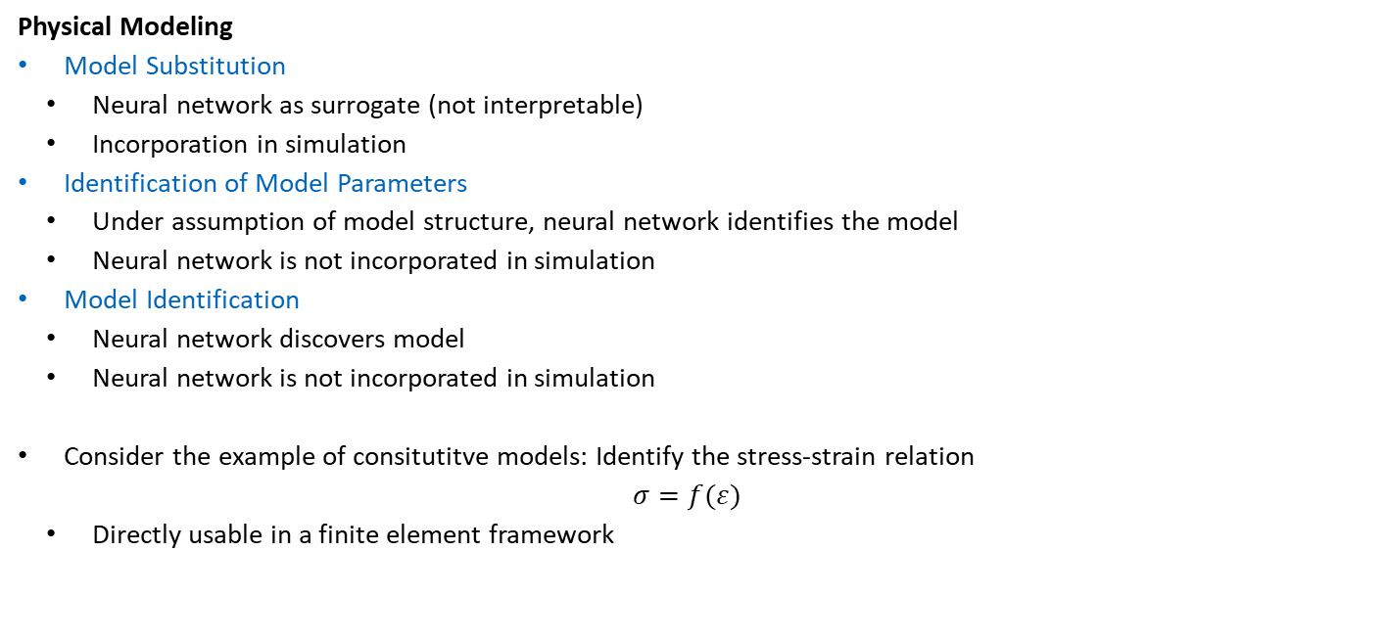
10.2.1 Physical Modeling
Physical Modeling
Model Substitution
Neural network as surrogate (not interpretable)
Incorporation in simulation
Identification of Model Parameters
Under assumption of model structure, neural network identifies the model
Neural network is not incorporated in simulation
Model Identification
Neural network discovers model
Neural network is not incorporated in simulation
Consider the example of consitutitve models: Identify the stress-strain relation
$$σ=f(ε)$$
Directly usable in a finite element framework
Covered in depth for material modeling in Chapter 7

Slide 33
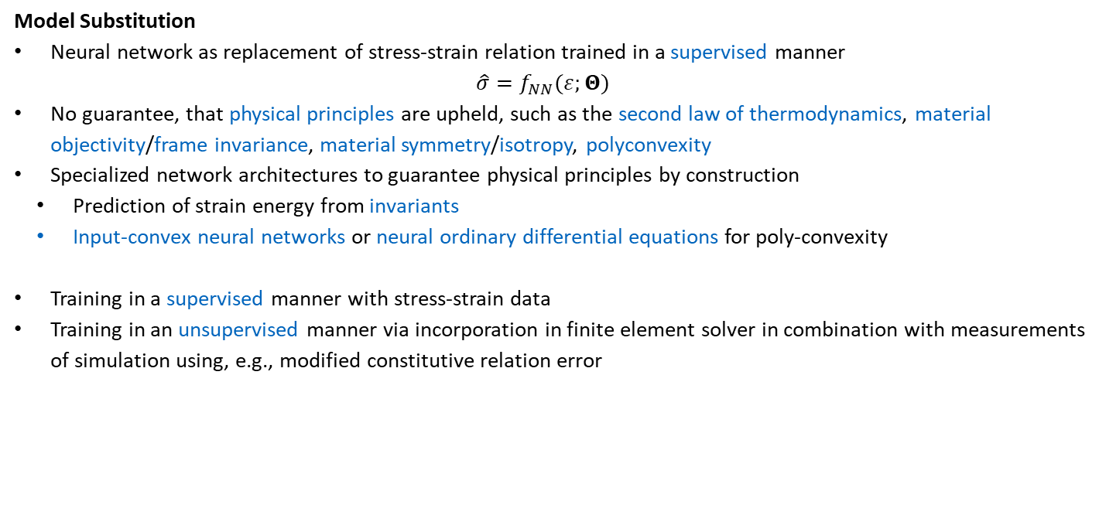
10.2.1 Physical Modeling
Model Substitution
Neural network as replacement of stress-strain relation trained in a supervised manner
$$\hat{σ}=f_{NN}(ε;Θ)$$
No guarantee, that physical principles are upheld, such as the second law of thermodynamics, material objectivity/frame invariance, material symmetry/isotropy, polyconvexity
Specialized network architectures to guarantee physical principles by construction
Prediction of strain energy from invariants
Input-convex neural networks or neural ordinary differential equations for poly-convexity
Training in a supervised manner with stress-strain data
Training in an unsupervised manner via incorporation in finite element solver in combination with measurements of simulation using, e.g., modified constitutive relation error

Slide 34

10.2.1 Physical Modeling
Identification of Model Parameters
Assumption of material model, e.g., linear elasticity $σ=Cε$
Prediction of model parameters $C$ from spatially varying Young‘s modulus $E$
$$\hat{C}=f_{NN}\left(E;Θ\right)$$
Can for example be used for homogenization

Slide 35
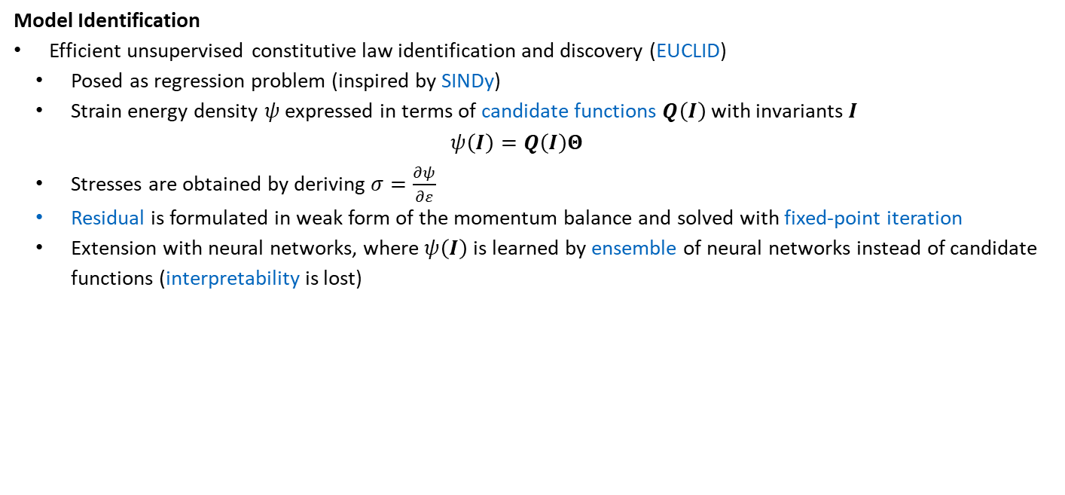
10.2.1 Physical Modeling
Model Identification
Efficient unsupervised constitutive law identification and discovery (EUCLID)
Posed as regression problem (inspired by SINDy)
Strain energy density $ψ$ expressed in terms of candidate functions $Q\left(I\right)$ with invariants $I$
$$ψ\left(I\right)=Q\left(I\right)Θ$$
Stresses are obtained by deriving $σ=\frac{∂ψ}{∂ε}$
Residual is formulated in weak form of the momentum balance and solved with fixed-point iteration
Extension with neural networks, where $ψ\left(I\right)$ is learned by ensemble of neural networks instead of candidate functions (interpretability is lost)

Slide 36
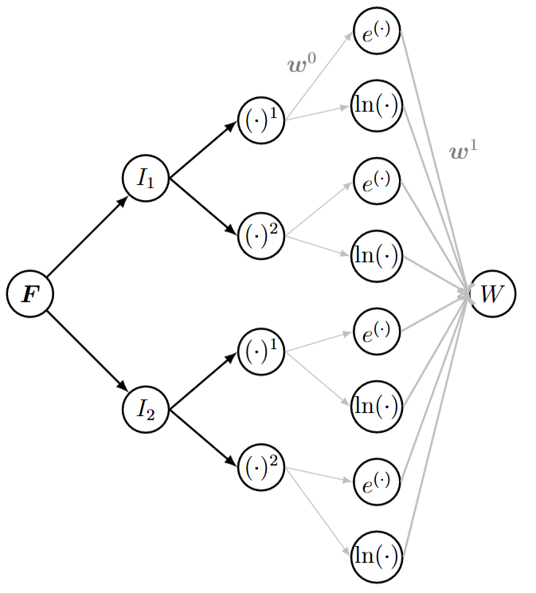

10.2.1 Physical Modeling
Model Identification
Automated discovery through interpretable neural networks
Strain energy density of example
$$\hat{ψ}=w_{0}^{1}e^{w_{0}^{0}I_{1}}+w_{1}^{1}\ln\left(w_{1}^{0}I_{1}\right)+w_{2}^{1}e^{w_{2}^{0}I_{1}^{2} }+w_{3}^{1}\ln\left(w_{3}^{0}I_{1}^{2}\right) \\ +w_{4}^{1}e^{w_{4}^{0}I_{2}}+w_{5}^{1}\ln\left(w_{5}^{0}I_{2}\right)+w_{6}^{1}e^{w_{6}^{0}I_{2}^{2}}+w_{7}^{1}\ln{(w_{7}^{0}I_{2}^{2})}$$

Slide 37
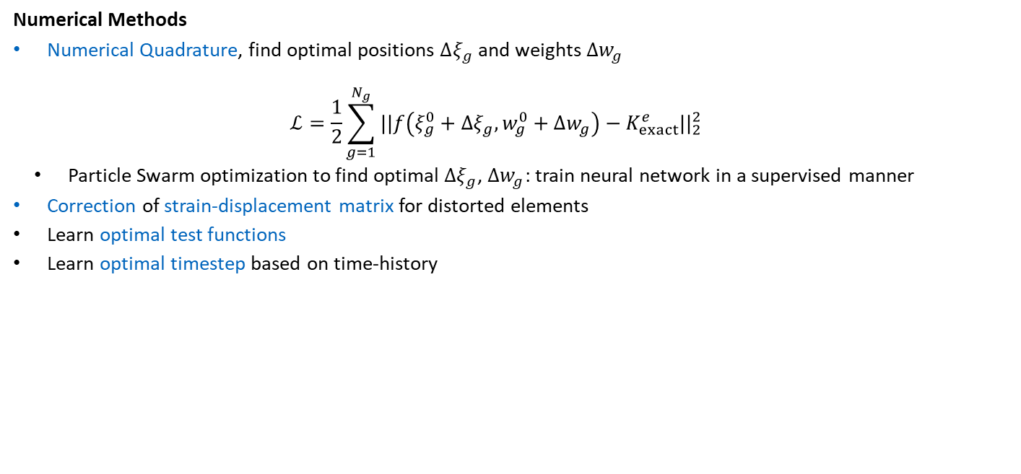
10.2.3 Numerical Methods
Numerical Methods
Numerical Quadrature, find optimal positions $Δξ_{g}$ and weights $Δw_{g}$
$$ℒ=\frac{1}{2}\sum_{g=1}^{N_{g}}{||f\left(ξ_{g}^{0}+Δξ_{g},w_{g}^{0}+Δw_{g}\right)−K_{exact}^{e}||_{2}^{2}}$$
Particle Swarm optimization to find optimal $Δξ_{g}$, $Δw_{g}$: train neural network in a supervised manner
Correction of strain-displacement matrix for distorted elements
Learn optimal test functions
Learn optimal timestep based on time-history

Slide 38
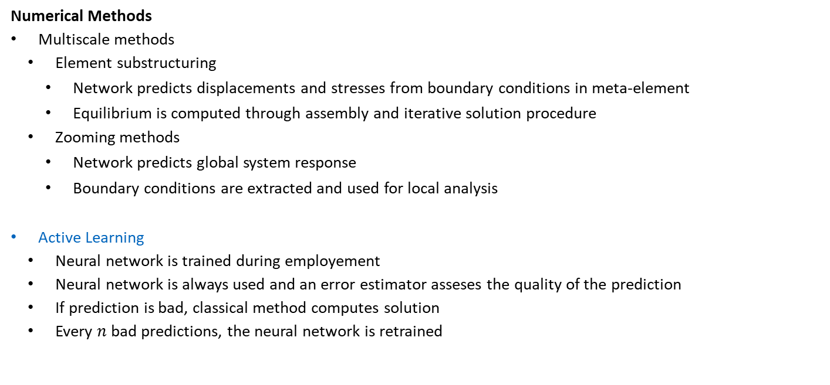
10.2.3 Numerical Methods
Numerical Methods
Multiscale methods
Element substructuring
Network predicts displacements and stresses from boundary conditions in meta-element
Equilibrium is computed through assembly and iterative solution procedure
Zooming methods
Network predicts global system response
Boundary conditions are extracted and used for local analysis
Active Learning
Neural network is trained during employement
Neural network is always used and an error estimator asseses the quality of the prediction
If prediction is bad, classical method computes solution
Every $n$ bad predictions, the neural network is retrained

Slide 39
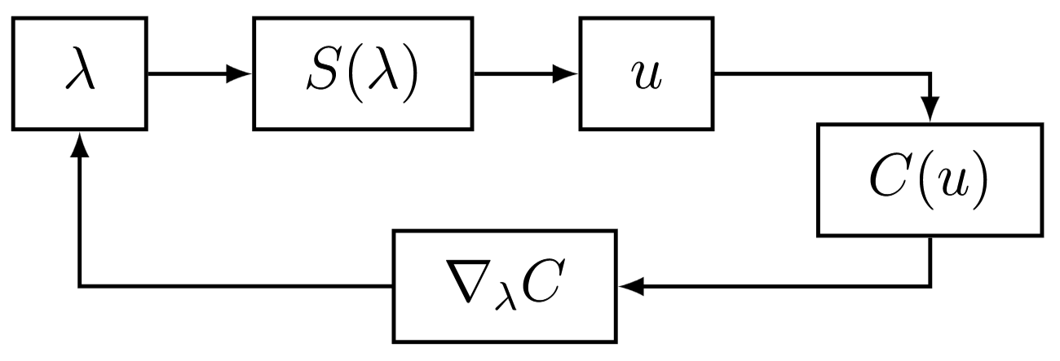

10.2.3 Numerical Methods
Covered in depth in Chapter 9
Numerical Methods
Optimization
Gradient-based optimization
Prediction of state $u$ from parameters $λ$ with forward operator $S\left(λ\right)$
Quality of prediction determined by cost function$C\left(u\right)$
Gradient of cost function $∇_{λ}C$ is used to update parameters $λ$

Slide 40
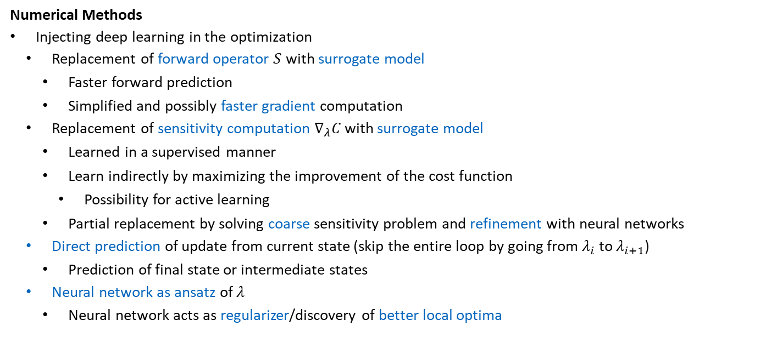
10.2.3 Numerical Methods
Numerical Methods
Injecting deep learning in the optimization
Replacement of forward operator $S$ with surrogate model
Faster forward prediction
Simplified and possibly faster gradient computation
Replacement of sensitivity computation $∇_{λ}C$ with surrogate model
Learned in a supervised manner
Learn indirectly by maximizing the improvement of the cost function
Possibility for active learning
Partial replacement by solving coarse sensitivity problem and refinement with neural networks
Direct prediction of update from current state (skip the entire loop by going from $λ_{i}$to $λ_{i+1}$)
Prediction of final state or intermediate states
Neural network as ansatz of $λ$
Neural network acts as regularizer/discovery of better local optima

Slide 41
10.2.4 Post-Processing
Post-Processing
Modification of results to ensure manufacturability
Feature extraction
Subsequent shape optimization
Solution enhancement: Coarse to fine to reduce numerical errors
Solve problem on coarse and fine grid, train neural network in a supervised manner
Forward problems
Inverse problems, e.g., increasing resolution of identified designs
Sensitivity computation, i.e., solving adjoint problem on coarse grid

Slide 42
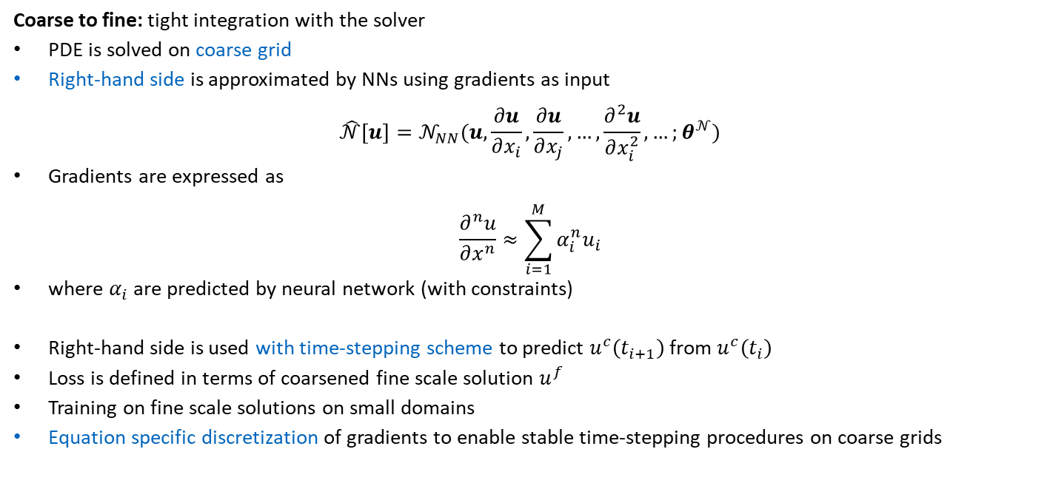
10.2.4 Post-Processing
Coarse to fine: tight integration with the solver
PDE is solved on coarse grid
Right-hand side is approximated by NNs using gradients as input
$$\hat{𝒩}\left[u\right]=𝒩_{NN}(u,\frac{∂u}{∂x_{i}},\frac{∂u}{∂x_{j}},…,\frac{∂^{2}u}{∂x_{i}^{2}},…;θ^{𝒩})$$
Gradients are expressed as
$$\frac{∂^{n}u}{∂x^{n}}≈\sum_{i=1}^{M}{α_{i}^{n}u_{i}}$$
where $α_{i}$ are predicted by neural network (with constraints)
Right-hand side is used with time-stepping scheme to predict $u^{c}\left(t_{i+1}\right)$ from $u^{c}\left(t_{i}\right)$
Loss is defined in terms of coarsened fine scale solution $u^{f}$
Training on fine scale solutions on small domains
Equation specific discretization of gradients to enable stable time-stepping procedures on coarse grids

Slide 43
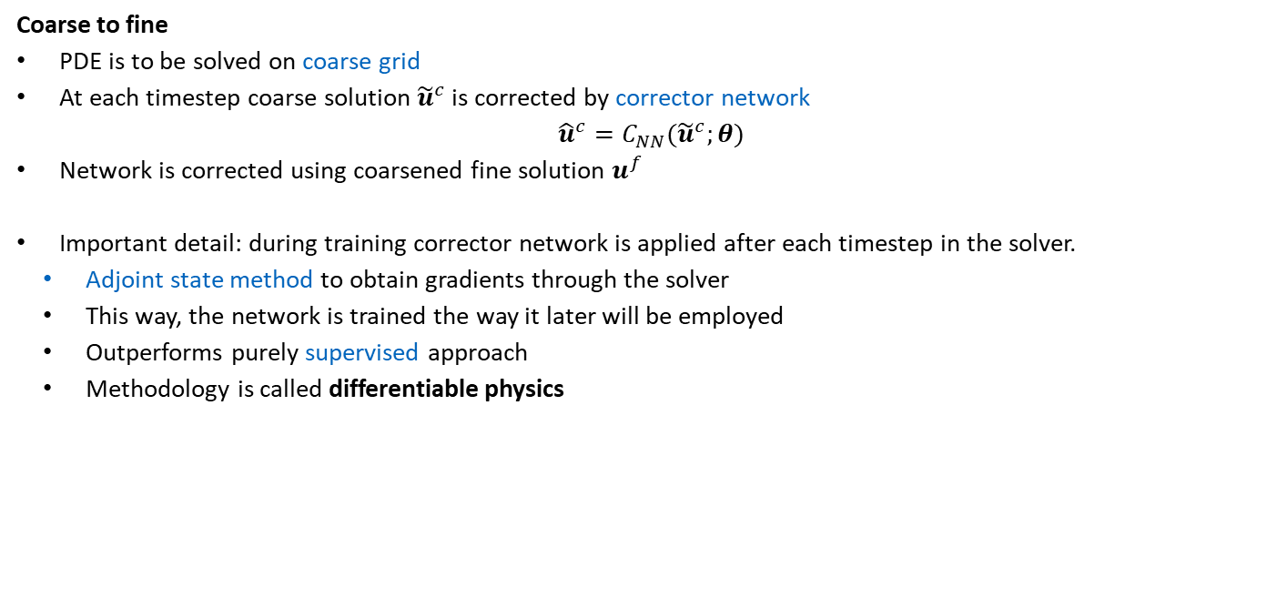
10.2.4 Post-Processing
Coarse to fine
PDE is to be solved on coarse grid
At each timestep coarse solution ${\tilde{u}}^{c}$ is corrected by corrector network
$${\hat{u}}^{c}=C_{NN}({\tilde{u}}^{c};θ)$$
Network is corrected using coarsened fine solution $u^{f}$
Important detail: during training corrector network is applied after each timestep in the solver.
Adjoint state method to obtain gradients through the solver
This way, the network is trained the way it later will be employed
Outperforms purely supervised approach
Methodology is called differentiable physics

Slide 44
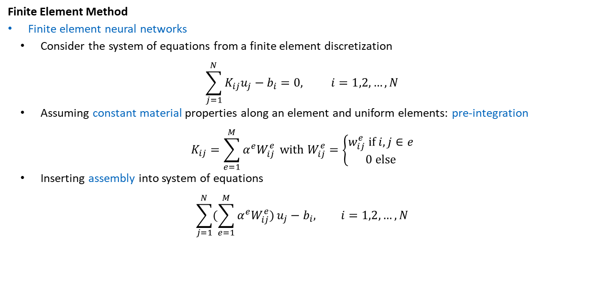
10.3 Discretizations as Neural Networks
Finite Element Method
Finite element neural networks
Consider the system of equations from a finite element discretization
$$\sum_{j=1}^{N}{K_{ij}u_{j}−b_{i}=0, i=1,2,…,N}$$
Assuming constant material properties along an element and uniform elements: pre-integration
$$K_{ij}=\sum_{e=1}^{M}{α^{e}W_{ij}^{e}} with W_{ij}^{e}=\left\{\begin{aligned}w_{ij}^{e} if i,j∈e \\ 0 else\end{aligned}\right.$$
Inserting assembly into system of equations
$$\sum_{j=1}^{N}{(\sum_{e=1}^{M}{α^{e}W_{ij}^{e})}u_{j}−b_{i}, i=1,2,}…,N$$

Slide 45
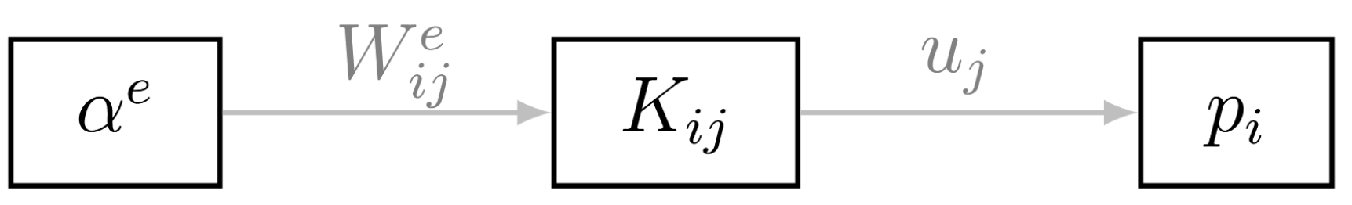
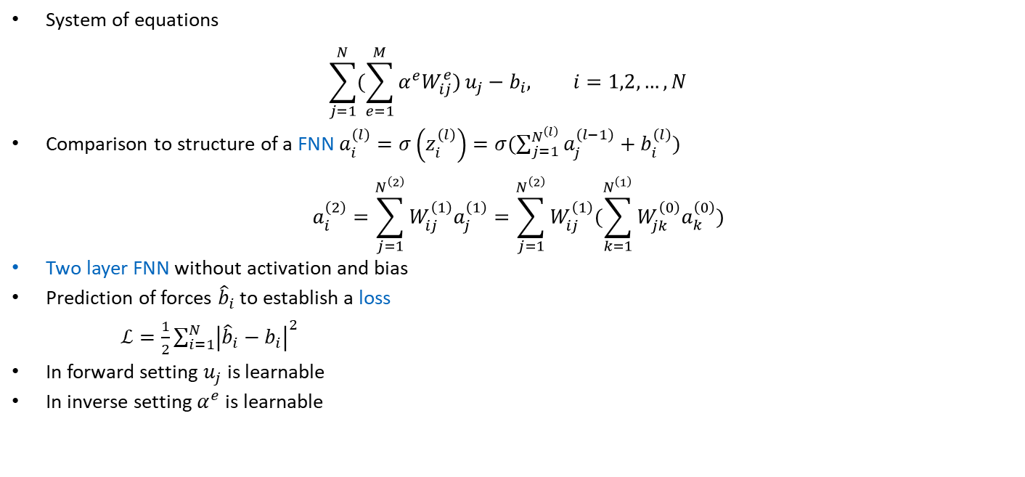
10.3 Discretizations as Neural Networks
System of equations
$$\sum_{j=1}^{N}{(\sum_{e=1}^{M}{α^{e}W_{ij}^{e})}u_{j}−b_{i}, i=1,2,}…,N$$
Comparison to structure of a FNN $a_{i}^{\left(l\right)}=σ\left(z_{i}^{\left(l\right)}\right)=σ(\sum_{j=1}^{N^{\left(l\right)}}{a_{j}^{\left(l−1\right)}+b_{i}^{\left(l\right)})}$
$$a_{i}^{\left(2\right)}=\sum_{j=1}^{N^{\left(2\right)}}{W_{ij}^{\left(1\right)}a_{j}^{\left(1\right)}=\sum_{j=1}^{N^{\left(2\right)}}{W_{ij}^{\left(1\right)}(\sum_{k=1}^{N^{\left(1\right)}}{W_{jk}^{\left(0\right)}a_{k}^{\left(0\right)})}}}$$
Two layer FNN without activation and bias
Prediction of forces ${\hat{b}}_{i}$ to establish a loss
$ℒ=\frac{1}{2}\sum_{i=1}^{N}{{\left|{\hat{b}}_{i}−b_{i}\right|}^{2}}$
In forward setting $u_{j}$ is learnable
In inverse setting $α^{e}$ is learnable

Slide 46
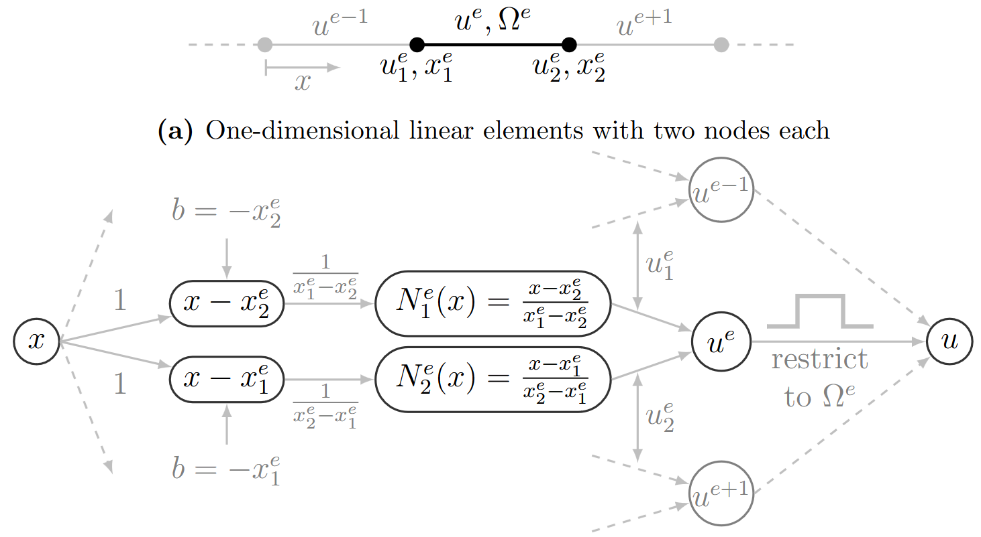

10.3 Discretizations as Neural Networks
Covered in depth in Chapter 5
Finite Element Method
Hierarchical deep-learning neural networks (HiDeNNs)
Shape functions are treated as neural networks constructed from basic building blocks
Consider one-dimensional linear shape functions
$$N_{1}\left(x\right)=\frac{x−x_{2}^{e}}{x_{1}^{e}−x_{2}^{e}} \\ N_{2}\left(x\right)=\frac{x−x_{1}^{e}}{x_{2}^{e}−x_{1}^{e}}$$
Elemental displacement from nodal displacements $u_{1}^{e},u_{2}^{e}$ treated as shared neural network weights
$$u^{e}=N_{1}^{e}\left(x\right)u_{1}^{e}+N_{2}^{e}\left(x\right)u_{2}^{e}$$
nodal positions $x_{1}^{e}, x_{2}^{e}$ and nodal displacements $u_{1}^{e},u_{2}^{e}$ are learnable weights
One-dimensional finite elements
Moving nodal positions during solving is equivalent to r-refinement in the finite element method
One-dimensional finite elements as NN

Slide 47
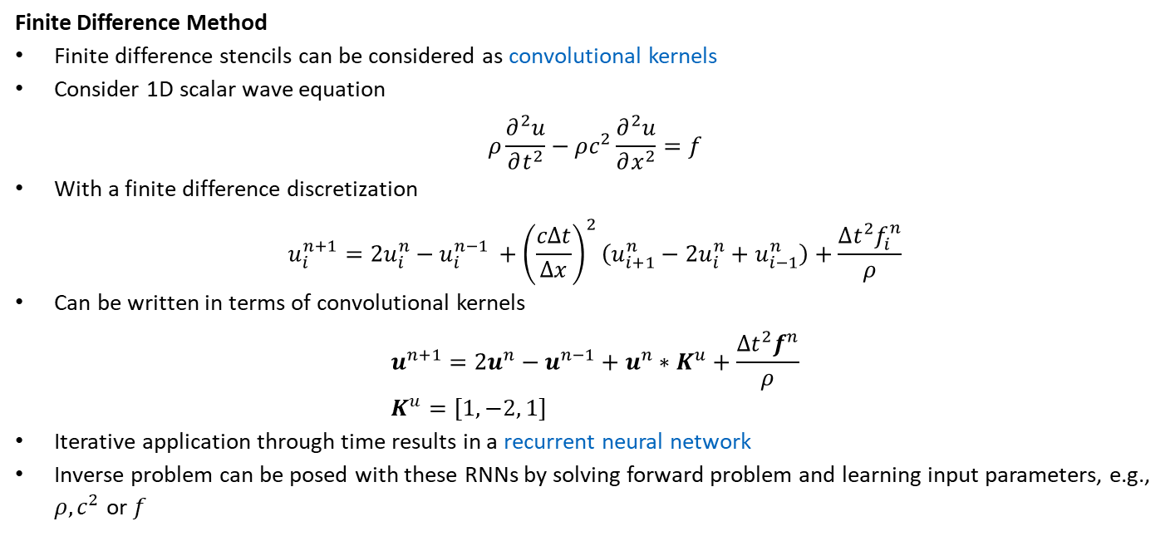
10.3 Discretizations as Neural Networks
Finite Difference Method
Finite difference stencils can be considered as convolutional kernels
Consider 1D scalar wave equation
$$ρ\frac{∂^{2}u}{∂t^{2}}−ρc^{2}\frac{∂^{2}u}{∂x^{2}}=f$$
With a finite difference discretization
$$u_{i}^{n+1}=2u_{i}^{n}−u_{i}^{n−1 }+{\left(\frac{cΔt}{Δx}\right)}^{2}\left(u_{i+1}^{n}−2u_{i}^{n}+u_{i−1}^{n}\right)+\frac{Δt^{2}f_{i}^{n}}{ρ}$$
Can be written in terms of convolutional kernels
$$u^{n+1}=2u^{n}−u^{n−1}+u^{n}∗K^{u}+\frac{Δt^{2}f^{n}}{ρ} \\ K^{u}=[1, −2, 1]$$
Iterative application through time results in a recurrent neural network
Inverse problem can be posed with these RNNs by solving forward problem and learning input parameters, e.g., $ρ, c^{2}$ or $f$
This is not truly a recurrent neural network due to the lack of a hidden state

Slide 48


10.3 Discretizations as Neural Networks
The discretized wave equation as analog recurrent neural networks
Input $x$ encoded as signal $x(t)$
Output $y_{i}$ measured $y_{i}\left(t\right)$ and integrated at probing locations
For example for classification of sounds
Trainable region could be 3D-printed as an analog neural network for classification

Slide 49


10.3 Discretizations as Neural Networks
Material Discretizations
Deep material networks construct neural networks from material distributions
Basic building blocks from analytical homogenization techniques
Output material tensor ${\overline{C}}_{r}$ is obtained by two input material tensors $C_{1}, C_{2}$, which are homogenized and rotated
Learnable parameters are the volume fractions $f_{1},f_{2}$ and the rotations $α,β,γ$
Application: from stress-strain data from multiple microstructure samples
Extraction of material properties of te phases, anisotropic characteristics, or volume fractions

Slide 50

10.3 Discretizations as Neural Networks
Neural Differential Equations
Evaluation of one recurrent unit in a recurrent neural network
$$a_{t+1}=a_{t}+f(a;θ)$$
Can be viewed as an Euler discretization of the following ODE
$$\frac{da\left(t\right)}{dt}=f\left(a\left(t\right),t;θ\right)$$
Instead of using the recurrent evaluations of an RNN, the ODE is considered as a network
Input is the initial condition $a(0)$
Output is the solution $a\left(T\right)$ at time $T$
Gradients are obtained through the adjoint state method in an ODE solver
Extension to partial differential equations, where convolutional neural networks act as spatial gradients

Slide 51


10.4 Generative Approaches
Covered in depth in Chapter 8
Variational autoencoder
Diffusion model
Generative adversarial network
Transformer
Flow-based model

Slide 52

10.4 Generative Approaches
Covered in depth in Chapter 8
Applications
Data Generation
Microstructures (specialized architectures relying on RNNs/transformers to go from 2D to 3D)
Designs
Optimization
Parametrization of design space with subsequent shape optimization
Variational autoencoder GANs are popular, due to well-behaving gradients
Incorporating vague constraints
Design diversity by increasing novelty/creativity
Similarity to old designs, due to aethetics or manufacturability
Pixel-wise $L^{1}$ distance to previous designs
Style transfer loss
Inverse problems
Generator predicts material distribution
Discriminator says, if it is correct based on a forward simulation

Slide 53
Generative Approaches
Covered in depth in Chapter 8
Applications
Conditional Generation
Rendered cars from sketches
Hierarchical shape generation (child shape considers ist parent shape)
Topology optimization from initial fields defined by boundary conditions
Generation from physical properties
Design with specific compliance
Material distribution resulting in a specific seismogram
Super-resolution GANs for coarse simulation data (tempoGAN)
cycleGANs for invertible functions without need for paired data
Anomaly Detection
Generative approach learns a distribution of structures
If the generative method is unable to reconstruct a structure, it must be an anomaly
In the case of GAN, a larger discriminator loss indicates an anomaly
In the case of an autoencoder, the latent space may also be considered

Slide 54


10.5 Deep Reinforcement Learning
Learning from interaction with environment
Agent performs actions $A_{t}$
Based on actions, environment returns state $S_{t}$ and reward $R_{t}$
Deep reinforcement learning uses a neural network for the agent
Value-based methods
Estimates value function
Take action that maximizes value function
Policy-based methods
Maps states to actions directly
Actor-critic methods
Combine value-based and policy-based methods
Actor chooses policy
Critic evaluates chosen action (the actor adjusts action according to the evaluations of the critic)

Slide 55
Contents
9 Inverse Problems & Deep Learning
10.1 Simulation Substitution
10.1.1 Data-Driven Modeling
10.1.2 Physics-Informed Learning
10.2 Simulation Enhancement
10.2.1 Pre-processing
10.2.2 Physical Modeling
10.2.3 Numerical Methods
10.2.4 Post-Processing
10.3 Discretizations as Neural Networks
10.4 Generative Approaches
10.5 Deep Reinforcement Learning
11 The Future of Deep Learning in Computational Mechanics

Slide 56
10 Methodological Overview
Leon Herrmann
Stefan Kollmannsberger
Chair of Data Engineering in Construction
Bauhaus-Universität Weimar
Deep Learning in Computational Mechanics – an introductory course, Herrmann et al. 2025
website
book
Notes:
generated with https://www.the-qrcode-generator.com/

