Slide 1


2 Fundamental Concepts of Machine Learning: Learning
Leon Herrmann
Stefan Kollmannsberger
Chair of Data Engineering in Construction
Bauhaus-Universität Weimar
Deep Learning in Computational Mechanics – an introductory course, Herrmann et al. 2025
website
book

Slide 2
Contents
2.1 Definition
2.2 Data Structure
2.3 Types of Learning
2.4 Machine Learning Tasks
2.5 Linear Regression
2.8.1 Gradient Descent
2.8.1 Stochastic Gradient Descent
2.8 Optimization Techniques
2.6 Overfitting versus Underfitting
2.7 Regularization
3 Neural Networks

Slide 3
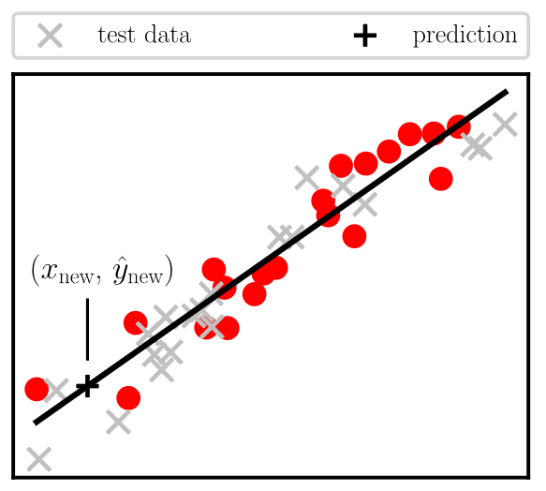
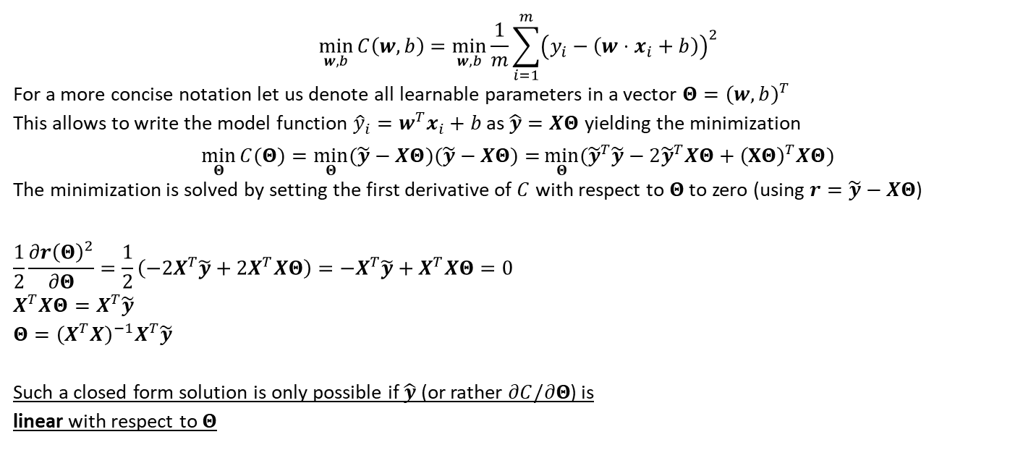


2.5 Linear Regression – Optimization
$$\min_{w, b}{C\left(w,b\right)=\min_{w,b}{\frac{1}{m}\sum_{i=1}^{m}{{\left(y_{i}−\left(w⋅x_{i}+b\right)\right)}^{2}}}}$$
For a more concise notation let us denote all learnable parameters in a vector $Θ={\left(w,b\right)}^{T}$
This allows to write the model function ${\hat{y}}_{i}=w^{T}x_{i}+b$ as $\hat{y}=XΘ$ yielding the minimization
$$\min_{Θ}{C(Θ)}=\min_{Θ}{(\tilde{y}−XΘ)(\tilde{y}−XΘ)=}\min_{Θ}{({\tilde{y}}^{T}\tilde{y}−2{\tilde{y}}^{T}XΘ+{\left(XΘ\right)}^{T}XΘ)}$$
The minimization is solved by setting the first derivative of $C$ with respect to $Θ$ to zero (using $r=\tilde{y}−XΘ$)
$$\frac{1}{2}\frac{∂r{\left(Θ\right)}^{2}}{∂Θ}=\frac{1}{2}\left(−2X^{T}\tilde{y}+2X^{T}XΘ\right)=−X^{T}\tilde{y}+X^{T}XΘ=0 \\ X^{T}XΘ=X^{T}\tilde{y} \\ Θ={\left(X^{T}X\right)}^{−1}X^{T}\tilde{y}$$
Such a closed form solution is only possible if $\hat{y}$ (or rather $∂C/∂Θ$) is linear with respect to $Θ$
Note that $X$ requires a column of ones for the bias $b$
All predictions ${\hat{y}}_{i}$ are collected in the vector $\hat{y}$.

Slide 4
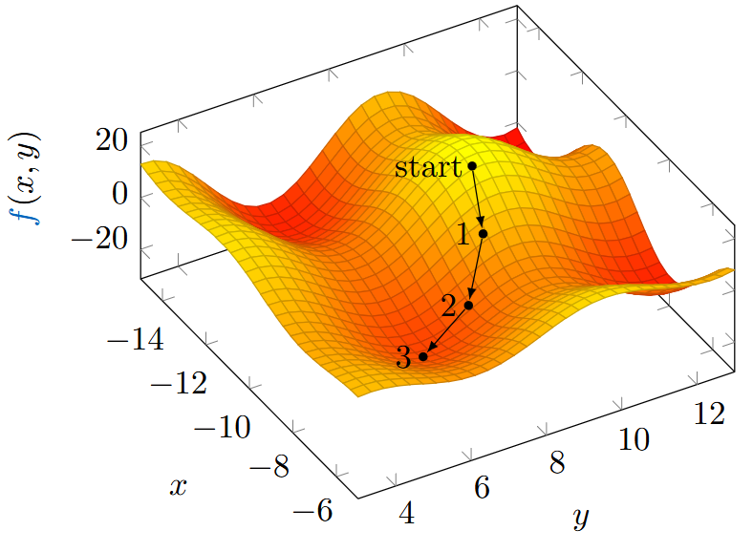
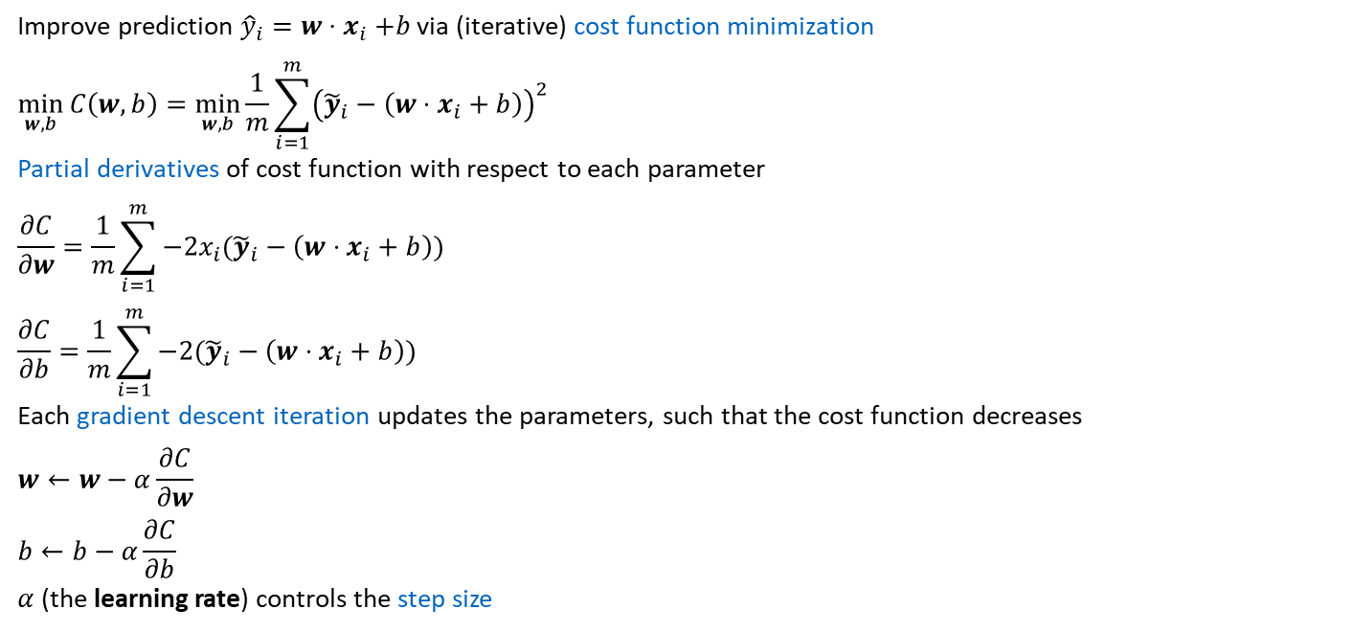
2.8.1 Gradient Descent
Improve prediction ${\hat{y}}_{i}=w{⋅x}_{i}+b$ via (iterative) cost function minimization
$$\min_{w, b}{C\left(w, b\right)=\min_{w, b}{\frac{1}{m}\sum_{i=1}^{m}{{\left({\tilde{y}}_{i}−\left(w⋅x_{i}+b\right)\right)}^{2}}}}$$
Partial derivatives of cost function with respect to each parameter
$$\frac{∂C}{∂w}=\frac{1}{m}\sum_{i=1}^{m}{−2x_{i}({\tilde{y}}_{i}−\left(w⋅x_{i}+b\right)) } \\ \frac{∂C}{∂b}=\frac{1}{m}\sum_{i=1}^{m}{−2({\tilde{y}}_{i}−\left(w⋅x_{i}+b\right))}$$
Each gradient descent iteration updates the parameters, such that the cost function decreases
$$w←w−α\frac{∂C}{∂w} \\ b←b−α\frac{∂C}{∂b}$$
$α$ (the learning rate) controls the step size

Slide 5
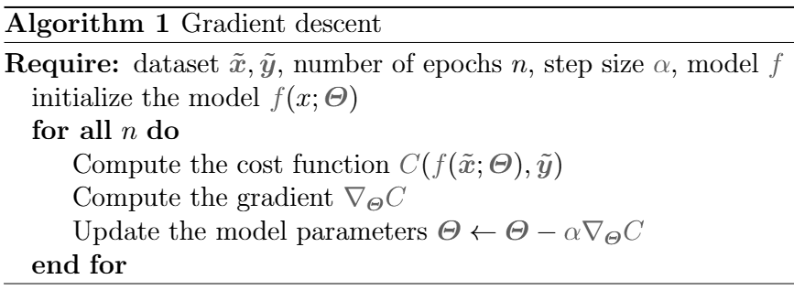
2.8.1 Gradient Descent
Generalized gradient descent algorithm
In machine learning:
Number of iterations is called number of epochs
Step size is called learning rate

Slide 6
Exercises
E.4 Linear Regression (P & C)
Perform a linear regression once by computing the weights directly and once using gradient descent. Do this by hand calculation and with a Python implementation.

Slide 7
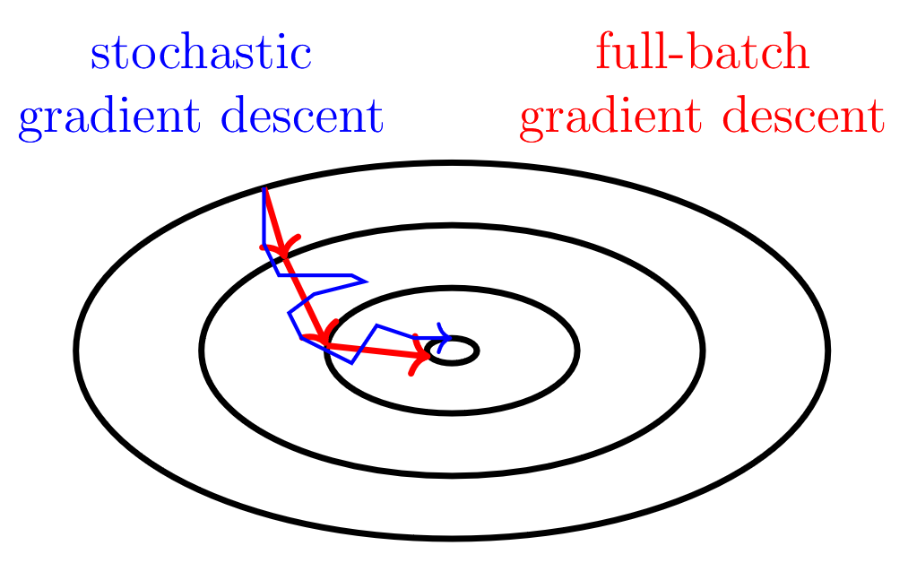
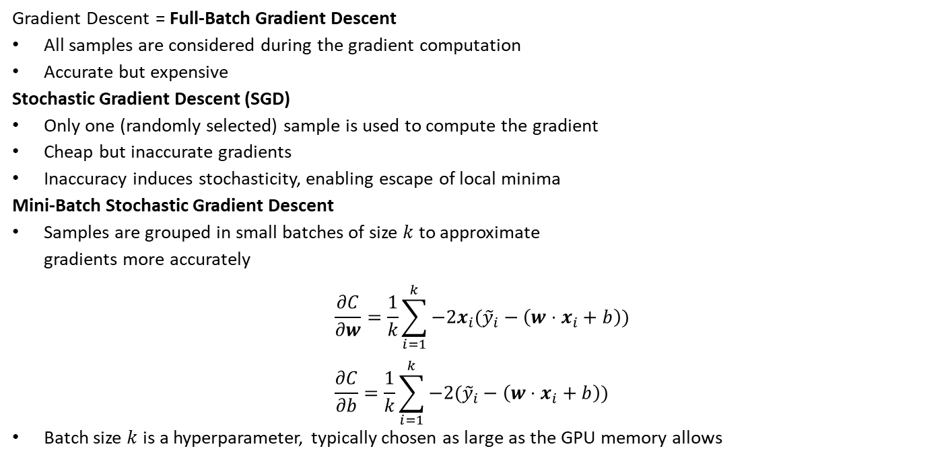
2.8.1 Gradient Descent – Stochastic Gradient Descent
Gradient Descent = Full-Batch Gradient Descent
All samples are considered during the gradient computation
Accurate but expensive
Stochastic Gradient Descent (SGD)
Only one (randomly selected) sample is used to compute the gradient
Cheap but inaccurate gradients
Inaccuracy induces stochasticity, enabling escape of local minima
Mini-Batch Stochastic Gradient Descent
Samples are grouped in small batches of size $k$ to approximate gradients more accurately
$$\frac{∂C}{∂w}=\frac{1}{k}\sum_{i=1}^{k}{−2x_{i}({\tilde{y}}_{i}−\left(w⋅x_{i}+b\right))} \\ \frac{∂C}{∂b}=\frac{1}{k}\sum_{i=1}^{k}{−2({\tilde{y}}_{i}−\left(w⋅x_{i}+b\right))}$$
Batch size $k$ is a hyperparameter, typically chosen as large as the GPU memory allows
Is it fair to compare the quality of a model after 100 iterations of Full-Batch, Mini-Batch, and Stochastic Gradient Descent?

Slide 8
2.8 Optimization Techniques
2.8.1 Gradient Descent
Stochastic Gradient Descent
Mini-Batch Stochastic Gradient Descent
2.8.2.1 Gradient Descent with Momentum
Uses a moving average of the gradient to improve the gradient estimation and avoid local minima
2.8.2.2 AdaGrad
Uses an accumulation of the squared gradients to normalize the updates and improve convergence
2.8.2.3 RMSprop
Extension of AdaGrad to avoid premature convergence by considering a moving average of the squared gradients
2.8.2.4 Adam
Combination of Gradient Descent with Momentum and RMSprop
2.8.3 L-BFGS
Leverages second order derivatives (Hessian) to improve convergence

Slide 9
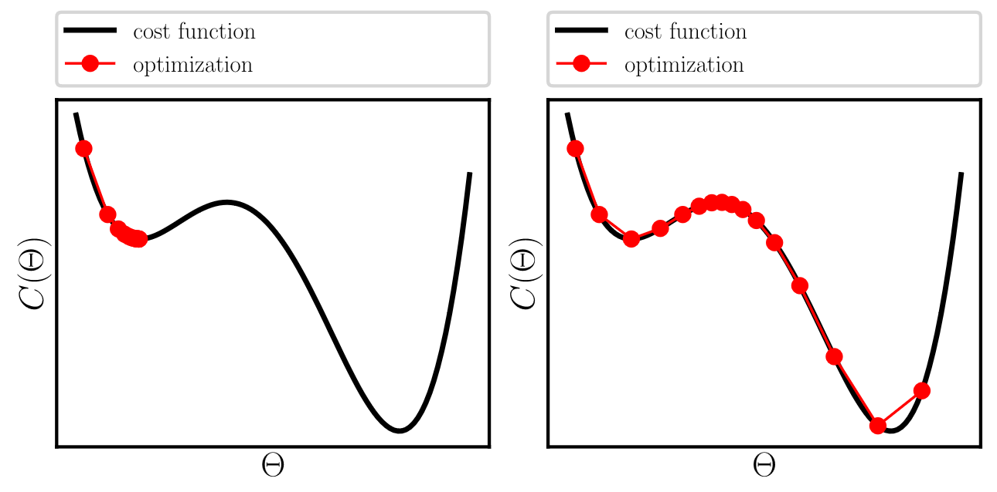

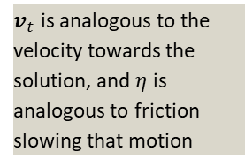
2.8 Optimization Techniques – GD with Momentum
Extension of update rule with momentum term $v_{t}$
$$v_{t+1}=ηv_{t}+∇_{Θ}C\left(Θ\right) \\ Θ_{t+1}=Θ_{t}−αv_{t+1}$$
$η$ is a hyperparameter, controlling the influence of previous gradients
$v_{t}$ is analogous to the velocity towards the solution, and $η$ is analogous to friction slowing that motion
Gradient descent
Gradient descent with momentum

Slide 10
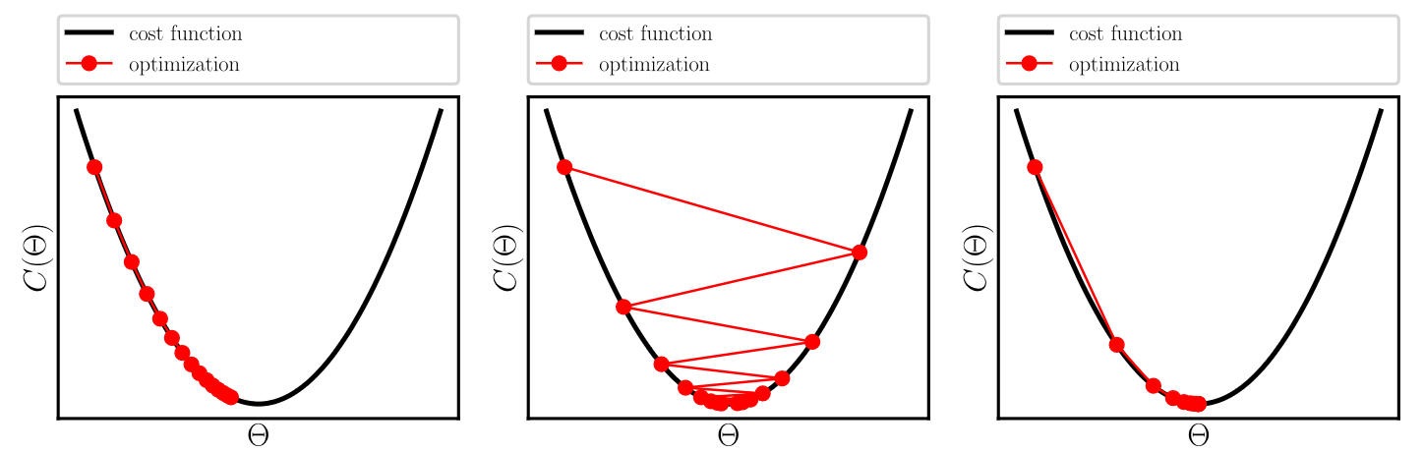



Optimization Techniques - AdaGrad
Adaptive Subgradient Methods for Online Learning and Stochastic Optimization, Duchi et al. 2011
AdaGrad introduces an adaptive learning rate to better reach optima
Achieved by tracking the accumulated squared gradients
$${\overline{g}}_{t}=\sum_{τ=1}^{t}{{\left[∇_{Θ_{τ}}C\left(Θ_{τ}\right)\right]}^{2}} \\ Θ_{t+1}=Θ_{t}−\frac{α}{\sqrt{{\overline{g}}_{t}^{2}+ε}}∇_{Θ_{t}}C(Θ_{t})$$
(Consistently) small gradients are amplified (indicates closeness to optimum)
(Consistently) large gradients are supressed (indicates distance to optimum, instability, overshooting)
Each parameter is scaled individually
$ε$ is small and prevents division by zero
Too small $α$
Too large $α$
AdaGrad

Slide 11

2.8 Optimization Techniques – RMSprop
AdaGrad can lead to a fast reduction in the learning rate $→$ can prevent convergence
RMSprop relies on a moving average of the squared gradients (via exponentially decaying average)
$${\tilde{g}}_{t}^{2}=ρ{\tilde{g}}_{t−1}^{2}+\left(1−ρ\right){\left[∇_{Θ_{t}}C\left(Θ_{t}\right)\right]}^{2} \\ Θ_{t+1}=Θ_{t}−\frac{α}{\sqrt{{\tilde{g}}_{t}^{2}+ε}}∇_{Θ_{t}}C\left(Θ_{t}\right)$$
$ρ$ is a hyperparameter controlling the decay rate
Again each parameter is scaled individually, effectively yielding an individual learning rate for each parameter
$ε$ is small and prevents division by zero

Slide 12
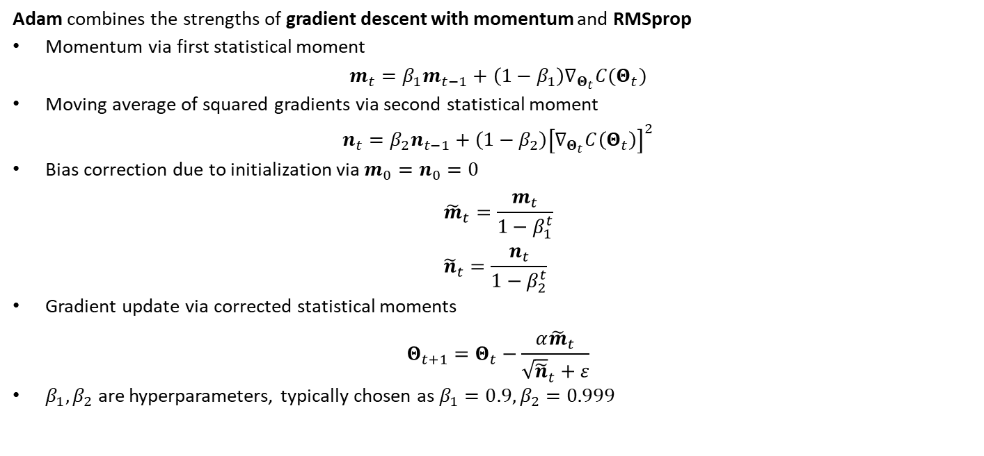
2.8 Optimization Techniques – Adam
Adam: A Method for Stochastic Optimization, Kingma et al. 2014
Adam combines the strengths of gradient descent with momentum and RMSprop
Momentum via first statistical moment
$$m_{t}=β_{1}m_{t−1}+\left(1−β_{1}\right)∇_{Θ_{t}}C(Θ_{t})$$
Moving average of squared gradients via second statistical moment
$$n_{t}=β_{2}n_{t−1}+\left(1−β_{2}\right){\left[∇_{Θ_{t}}C\left(Θ_{t}\right)\right]}^{2}$$
Bias correction due to initialization via $m_{0}=n_{0}=0$
$${\tilde{m}}_{t}=\frac{m_{t}}{1−β_{1}^{t}} \\ {\tilde{n}}_{t}=\frac{n_{t}}{1−β_{2}^{t}}$$
Gradient update via corrected statistical moments
$$Θ_{t+1}=Θ_{t}−\frac{α{\tilde{m}}_{t}}{{\sqrt{\tilde{n}}}_{t}+ε}$$
$β_{1}, β_{2}$ are hyperparameters, typically chosen as $β_{1}=0.9, β_{2}=0.999$

Slide 13
Exercises
E.6 Adam Optimizer (C)
Implement the Adam optimizer and find the optimum of the Rosenbrock function.

Slide 14
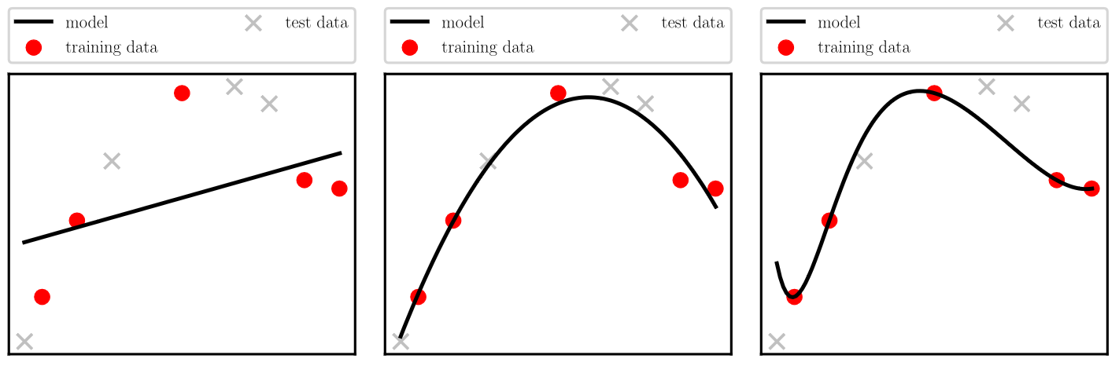
2.6 Overfitting Versus Underfitting
Underfitting: model capacity is too low
Unable to fit the data
Overfitting: model capacity is too high
Unable to generalize
Is monitored with the test data, that is not used during training (and tuning)
Underfitting
Ideal fitting
Overfitting

Slide 15
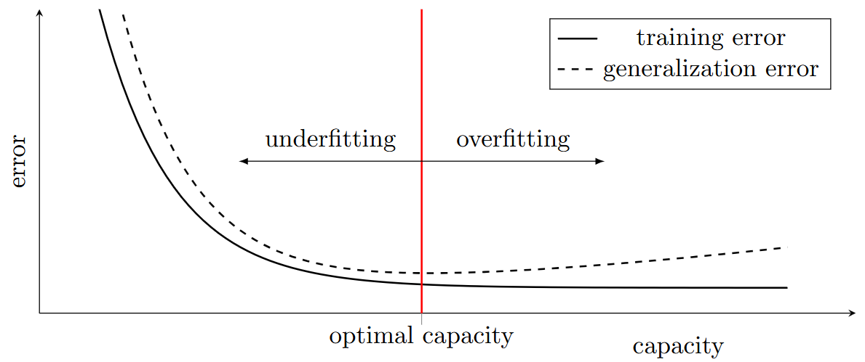
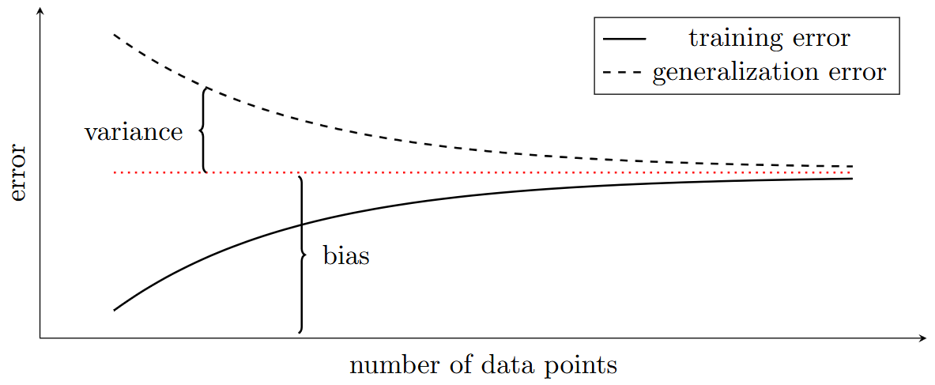
2.6 Overfitting Versus Underfitting
Underfitting: model capacity is too low
Overfitting: model capacity is too great
Remedies (see Chapter 3 for more)
Cross-validation
More data
Data augmentation
Regularization
Early stopping
Variance is related to the generalization error
Bias is related to the training error
What is preferable:
A high bias and low variance?
Or a high variance and a low bias?

Slide 16
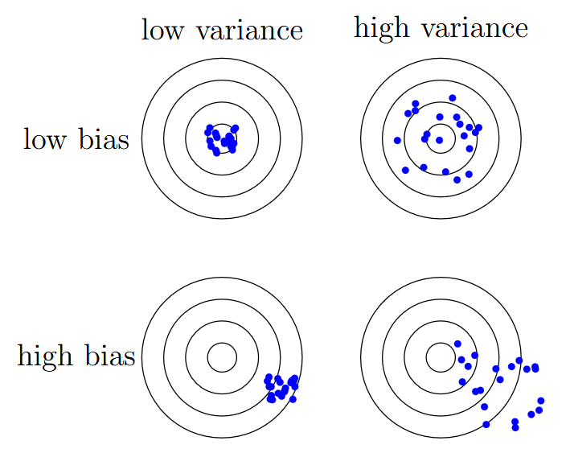
2.6 Overfitting Versus Underfitting
Low variance and high bias is preferable
A model/human should rather be consistently (but predictably) wrong, than inconsistent (and unpredictable).
This is even worse in a machine learning model, where the best predictions are on datapoints close to the training data.
Noise: a Flaw in Human Judgement, Kahneman et al. 2021

Slide 17
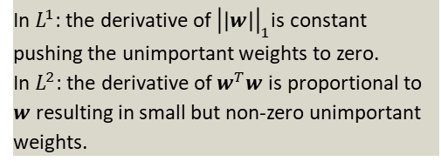
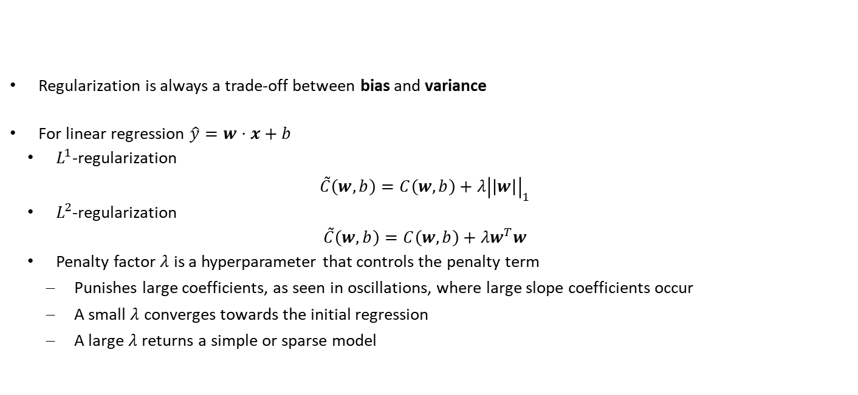
2.7 Regularization
Regularization is always a trade-off between bias and variance
For linear regression $\hat{y}=w⋅x+b$
$L^{1}$-regularization
$$\tilde{C}\left(w,b\right)=C\left(w,b\right)+λ{\left|\left|w\right|\right|}_{1}$$
$L^{2}$-regularization
$$\tilde{C}\left(w,b\right)=C\left(w,b\right)+λw^{T}w$$
Penalty factor $λ$ is a hyperparameter that controls the penalty term
Punishes large coefficients, as seen in oscillations, where large slope coefficients occur
A small $λ$ converges towards the initial regression
A large $λ$ returns a simple or sparse model
Regularization is any modification we make to a learning algorithm that is intended to reduce its generalization error (low variance) but ideally not its training error (low bias)
In $L^{1}$: the derivative of ${\left|\left|w\right|\right|}_{1}$is constant pushing the unimportant weights to zero. In $L^{2}$: the derivative of $w^{T}w$ is proportional to $w$ resulting in small but non-zero unimportant weights.

Slide 18
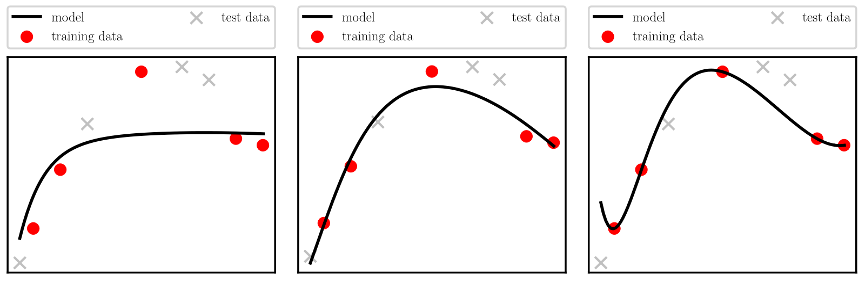

2.7 Regularization
$L^{2}$-regularization
Excessive regularization
Proper regularization
No regularization

Slide 19
Exercises
E.5 Higher-Order Regression (C)
Extend the linear regression Python implementation to higher-order regression. Experiment with underfitting, overfitting, and regularization.

Slide 20
Contents
2.1 Definition
2.2 Data Structure
2.3 Types of Learning
2.4 Machine Learning Tasks
2.5 Linear Regression
2.8.1 Gradient Descent
2.8.1 Stochastic Gradient Descent
2.8 Optimization Techniques
2.6 Overfitting versus Underfitting
2.7 Regularization
3 Neural Networks

Slide 21
2 Fundamental Concepts of Machine Learning: Learning
Leon Herrmann
Stefan Kollmannsberger
Chair of Data Engineering in Construction
Bauhaus-Universität Weimar
Deep Learning in Computational Mechanics – an introductory course, Herrmann et al. 2025
website
book

