Slide 1


5 Advanced Physics-Informed Neural Networks
Leon Herrmann
Stefan Kollmannsberger
Chair of Data Engineering in Construction
Bauhaus-Universität Weimar
Deep Learning in Computational Mechanics – an introductory course, Herrmann et al. 2025
website
book
Notes:
generated with https://www.the-qrcode-generator.com/

Slide 2
Contents
4 Introduction to Physics-Informed Neural Networks
5.1 Variations
5.1.1 Deep Energy Method
5.1.4 Variational Physics-Informed Neural Networks
5.1.5 Weak Adversarial Networks
5.2 Extensions
5.2.5 Ansatz (Finite Element Interpolated Neural Networks & Hierarchical Deep Learning Neural Networks)
6 Machine Learning in Computational Mechanics

Slide 3
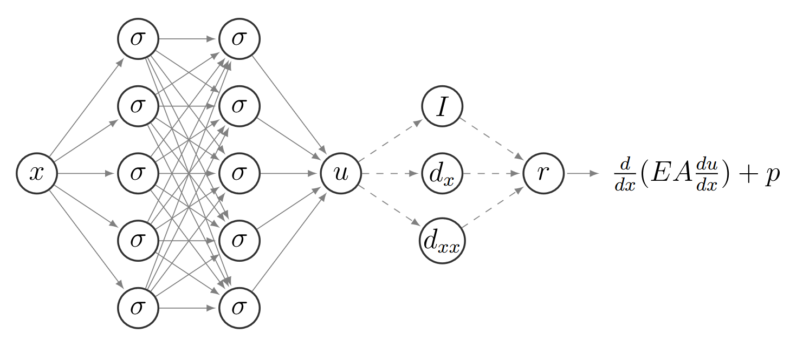
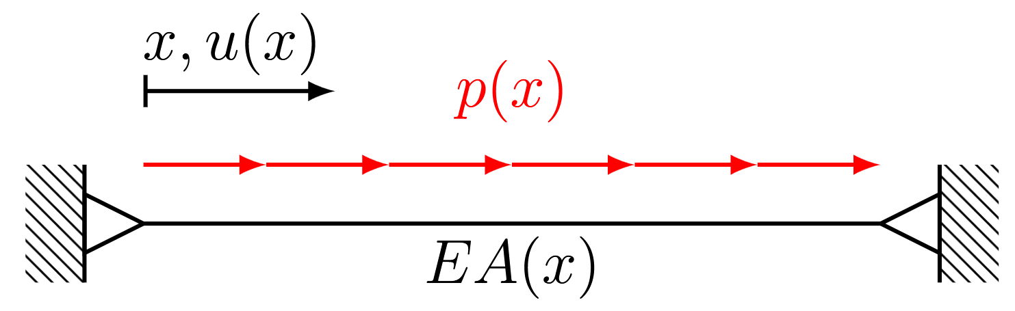

4 Introduction to Physics-Informed Neural Networks
Physics-informed neural networks make use of parametrized differential equations of the form
$$𝒩\left[u(x,t);λ(x,t)\right]=0, x∈Ω, t∈𝒯$$
In data-driven inference, a neural network approximates the solution (to solve the forward problem)
$$\hat{u}\left(x,t\right)=u_{NN}(x,t)$$
The physics are encoded via the cost function (composed of the residual $ℒ_{R}$ and boundary loss $ℒ_{B}$)
$$C=ℒ_{R}+ℒ_{B}$$
The derivatives in the loss terms $ℒ_{R},ℒ_{B}$ are computed with automatic differentiation with respect to the inputs $x, t$
One-dimensional static problem as example:

Slide 4
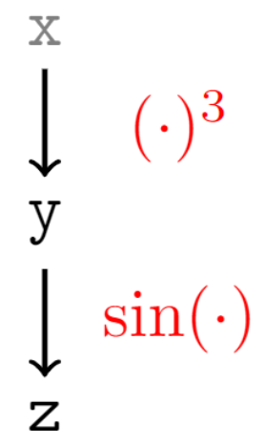
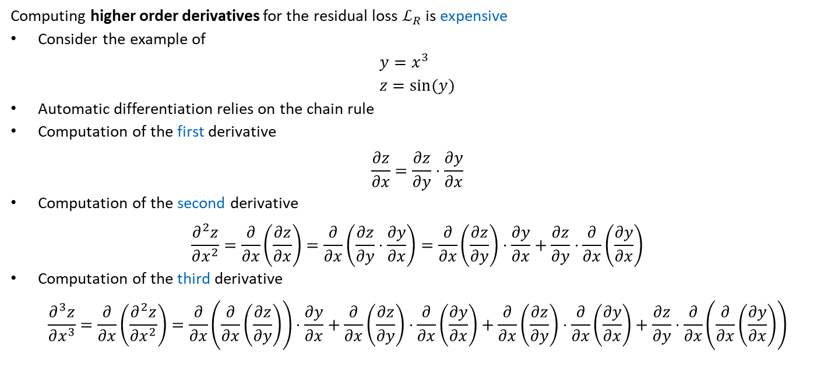
5.1 Variations
Computing higher order derivatives for the residual loss $ℒ_{R}$ is expensive
Consider the example of
$$y=x^{3} \\ z=sin(y)$$
Automatic differentiation relies on the chain rule
Computation of the first derivative
$$\frac{∂z}{∂x}=\frac{∂z}{∂y}⋅\frac{∂y}{∂x}$$
Computation of the second derivative
$$\frac{∂^{2}z}{∂x^{2}}=\frac{∂}{∂x}\left(\frac{∂z}{∂x}\right)=\frac{∂}{∂x}\left(\frac{∂z}{∂y}⋅\frac{∂y}{∂x}\right)=\frac{∂}{∂x}\left(\frac{∂z}{∂y}\right)⋅\frac{∂y}{∂x}+\frac{∂z}{∂y}⋅\frac{∂}{∂x}\left(\frac{∂y}{∂x}\right)$$
Computation of the third derivative
$$\frac{∂^{3}z}{∂x^{3}}=\frac{∂}{∂x}\left(\frac{∂^{2}z}{∂x^{2}}\right)=\frac{∂}{∂x}\left(\frac{∂}{∂x}\left(\frac{∂z}{∂y}\right)\right)⋅\frac{∂y}{∂x}+\frac{∂}{∂x}\left(\frac{∂z}{∂y}\right)⋅\frac{∂}{∂x}\left(\frac{∂y}{∂x}\right)+\frac{∂}{∂x}\left(\frac{∂z}{∂y}\right)⋅\frac{∂}{∂x}\left(\frac{∂y}{∂x}\right)+\frac{∂z}{∂y}⋅\frac{∂}{∂x}\left(\frac{∂}{∂x}\left(\frac{∂y}{∂x}\right)\right)$$

Slide 5
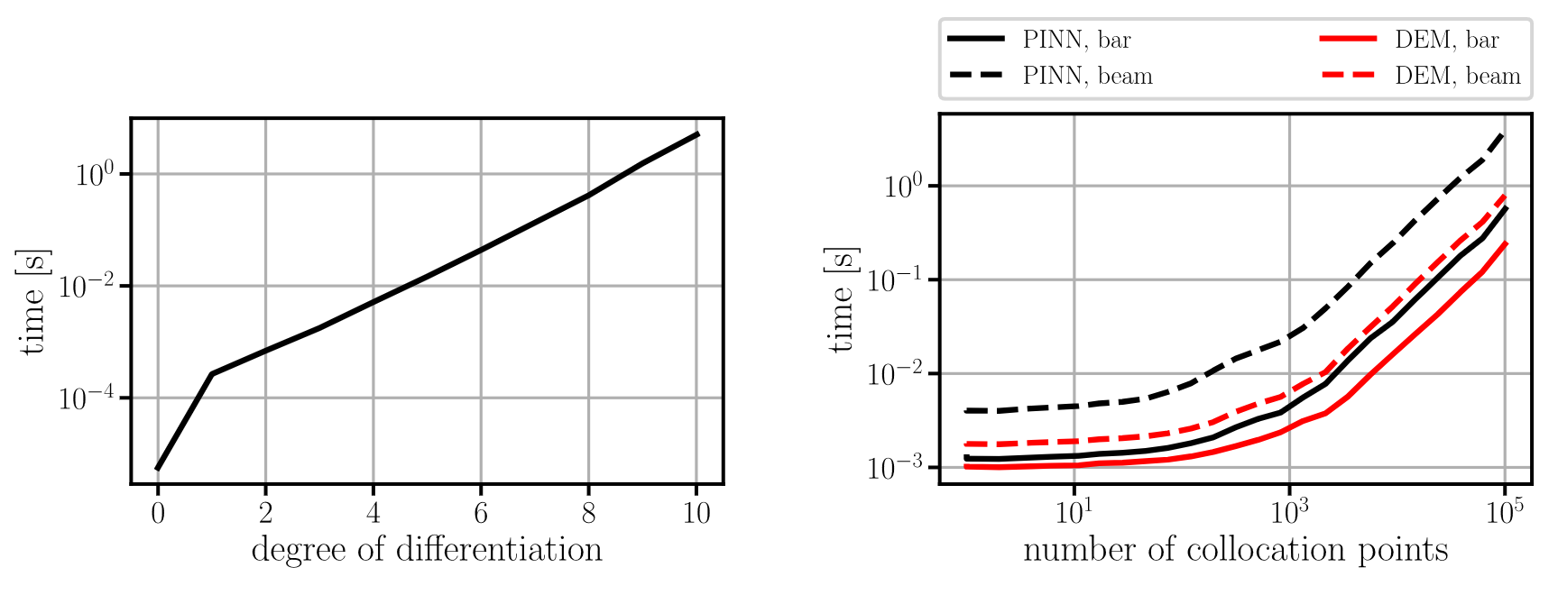
5.1 Variations
Computation times of higher-order derivatives with in autograd PyTorch
Deep energy method relies on weak form of the differential equation, i.e., requires lower order derivatives (1 and 2 for correspondingly the bar and beam equations)
Exponential growth

Slide 6
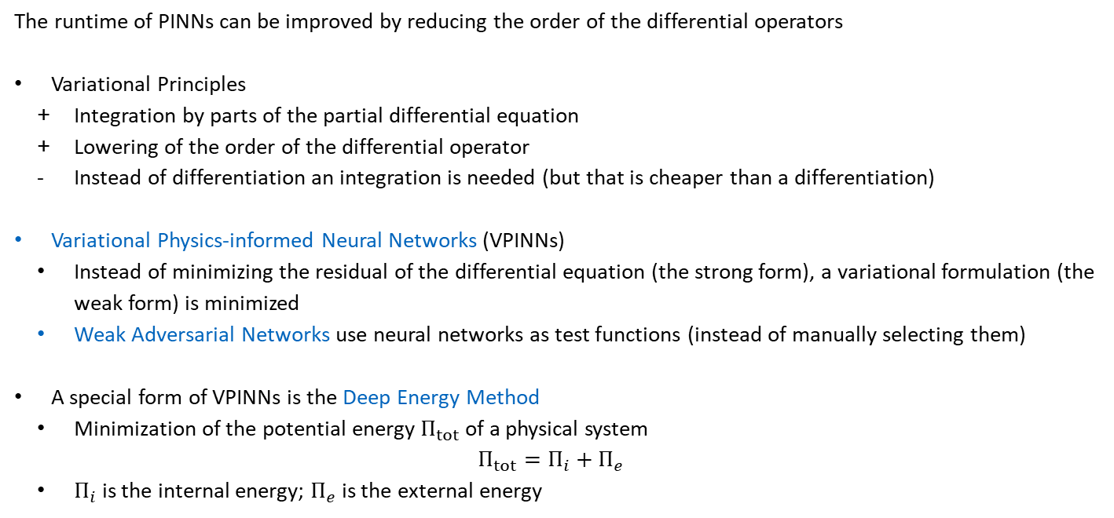
5.1 Variations
The runtime of PINNs can be improved by reducing the order of the differential operators
Variational Principles
Integration by parts of the partial differential equation
Lowering of the order of the differential operator
Instead of differentiation an integration is needed (but that is cheaper than a differentiation)
Variational Physics-informed Neural Networks (VPINNs)
Instead of minimizing the residual of the differential equation (the strong form), a variational formulation (the weak form) is minimized
Weak Adversarial Networks use neural networks as test functions (instead of manually selecting them)
A special form of VPINNs is the Deep Energy Method
Minimization of the potential energy $Π_{tot}$ of a physical system
$$Π_{tot}=Π_{i}+Π_{e}$$
$Π_{i}$ is the internal energy; $Π_{e}$ is the external energy
Equivalent to the summation over collocation points in standard PINNs

Slide 7
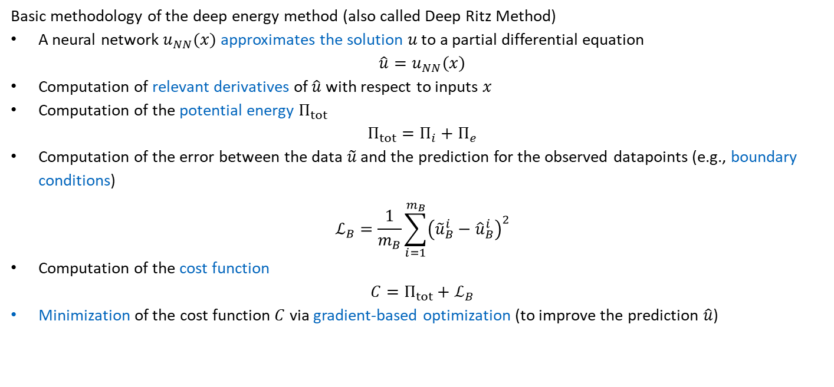
5.1.1 Deep Energy Method
A Deep Learning-Based Numerical Algorithm for Solving Variational Problems, Weinan et al. 2018
Basic methodology of the deep energy method (also called Deep Ritz Method)
A neural network $u_{NN}(x)$ approximates the solution $u$ to a partial differential equation
$$\hat{u}=u_{NN}\left(x\right)$$
Computation of relevant derivatives of $\hat{u}$ with respect to inputs $x$
Computation of the potential energy $Π_{tot}$
$$Π_{tot}=Π_{i}+Π_{e}$$
Computation of the error between the data $\tilde{u}$ and the prediction for the observed datapoints (e.g., boundary conditions)
$$ℒ_{B}=\frac{1}{m_{B}}\sum_{i=1}^{m_{B}}{{\left({\tilde{u}}_{B}^{i}−{\hat{u}}_{B}^{i}\right)}^{2}}$$
Computation of the cost function
$$C=Π_{tot}+ℒ_{B}$$
Minimization of the cost function $C$ via gradient-based optimization (to improve the prediction $\hat{u}$)

Slide 8
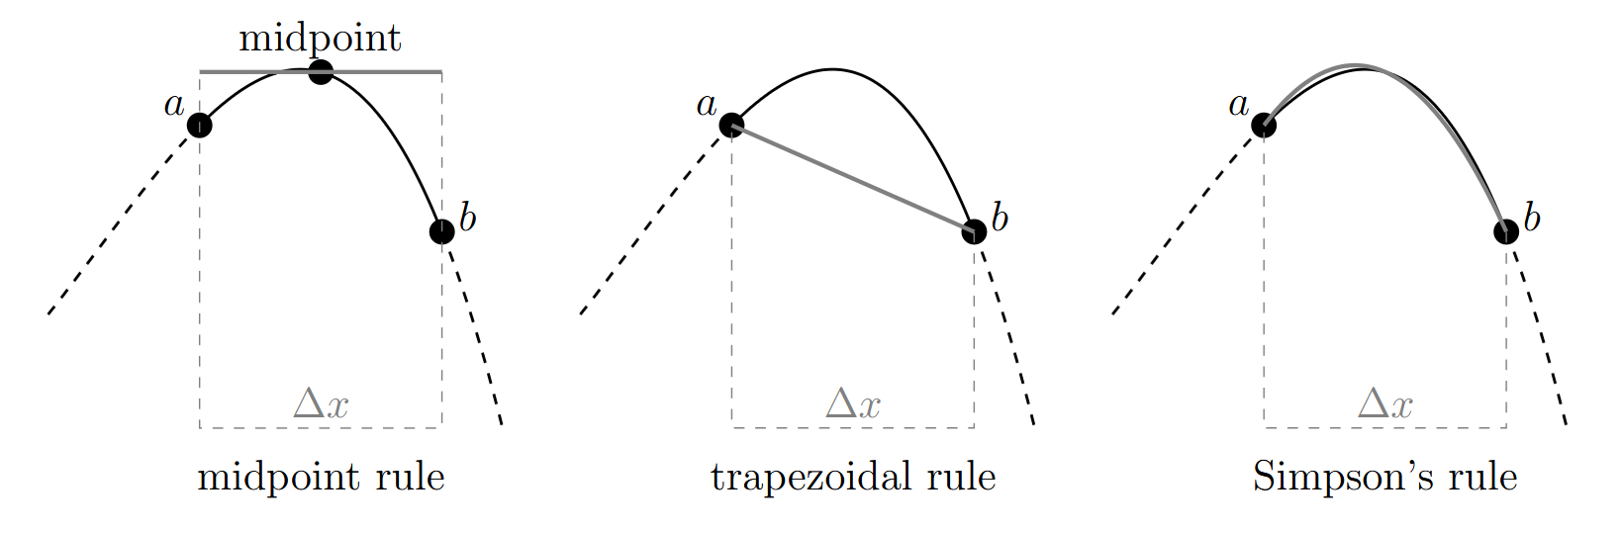

5.1.1 Deep Energy Method
The evaluation of the potential energy $Π_{tot}$ requires an integration
$$Π_{tot}=Π_{i}+Π_{e}$$
Solution can be evaluated at specific collocation points and integrated numerically by, e.g.,
Midpoint rule
Trapezoidal rule
Simpson’s rule
Gaussian quadrature

Slide 9
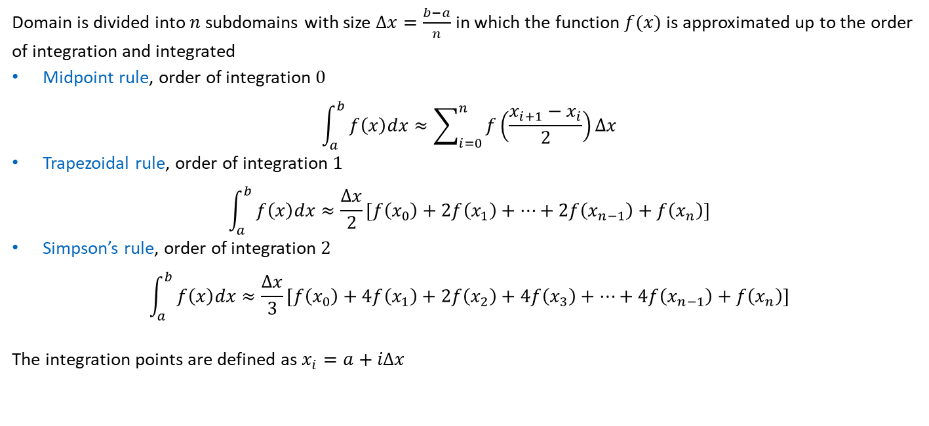
5.1.1 Deep Energy Method
Domain is divided into $n$subdomains with size $Δx=\frac{b−a}{n}$ in which the function $f(x)$ is approximated up to the order of integration and integrated
Midpoint rule, order of integration $0$
$$\int_{a}^{b}{f\left(x\right)dx≈\sum_{i=0}^{n}{f\left(\frac{x_{i+1}−x_{i}}{2}\right)Δx}}$$
Trapezoidal rule, order of integration $1$
$$\int_{a}^{b}{f\left(x\right)dx≈\frac{Δx}{2}[f\left(x_{0}\right)+2f\left(x_{1}\right)+…+2f\left(x_{n−1}\right)+f\left(x_{n}\right)]}$$
Simpson’s rule, order of integration $2$
$$\int_{a}^{b}{f\left(x\right)dx≈\frac{Δx}{3}[f\left(x_{0}\right)+4f\left(x_{1}\right)+2f\left(x_{2}\right)+4f\left(x_{3}\right)+…+4f\left(x_{n−1}\right)+f\left(x_{n}\right)]}$$
The integration points are defined as $x_{i}=a+iΔx$

Slide 10

5.1.2 One-Dimensional Static Model
The strong form of the linear elastic bar
$$\frac{d}{dx}\left(EA\frac{du}{dx}\right)+p=0, x∈ Ω \\ EA\frac{du}{dx}=F, x∈Γ_{N} \\ u=g, x∈Γ_{D}$$
A weak form of the linear elastic bar (expressed in terms of potentials)
$$Π_{tot}=Π_{i}+Π_{e}$$
The internal energy
$$Π_{i}=\frac{1}{2}\int_{Ω}^{ }{EA{\left(\frac{du}{dx}\right)}^{2}dx}$$
The external energy
$$Π_{e}=−\int_{Ω}^{ }{p\left(x\right)u\left(x\right)dx}−\sum_{i}^{ }{F_{i}u(x_{i})}$$

Slide 11
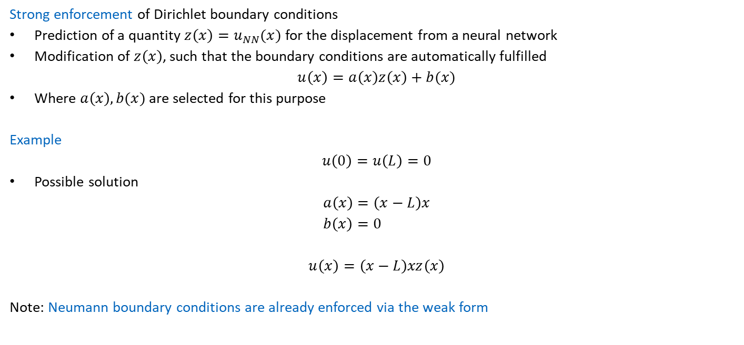
5.1.2 One-Dimensional Static Model
Strong enforcement of Dirichlet boundary conditions
Prediction of a quantity $z\left(x\right)=u_{NN}(x)$ for the displacement from a neural network
Modification of $z\left(x\right)$, such that the boundary conditions are automatically fulfilled
$$u\left(x\right)=a\left(x\right)z\left(x\right)+b(x)$$
Where $a\left(x\right), b(x)$ are selected for this purpose
Example
$$u\left(0\right)=u\left(L\right)=0$$
Possible solution
$$a\left(x\right)=\left(x−L\right)x \\ b\left(x\right)=0$$
$$u\left(x\right)=\left(x−L\right)xz\left(x\right)$$
Note: Neumann boundary conditions are already enforced via the weak form

Slide 12
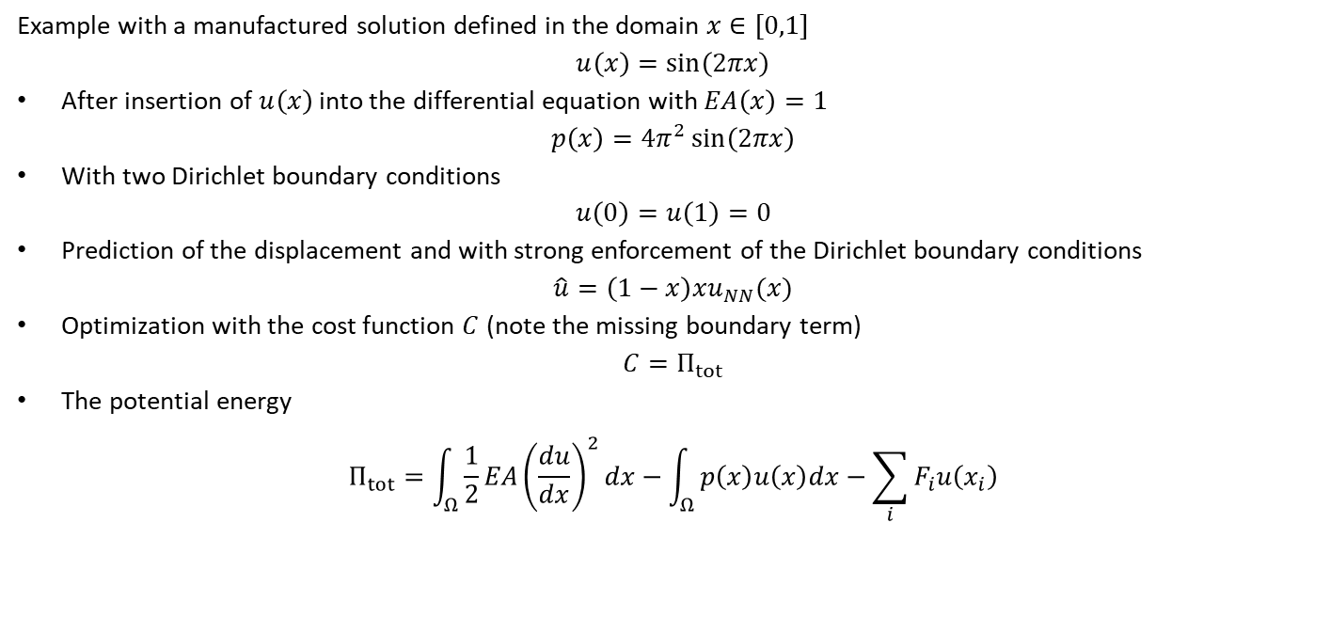
5.1.2 One-Dimensional Static Model
Example with a manufactured solution defined in the domain $x∈[0,1]$
$$u\left(x\right)=\sin\left(2πx\right)$$
After insertion of $u\left(x\right)$ into the differential equation with $EA\left(x\right)=1$
$$p\left(x\right)=4π^{2}\sin\left(2πx\right)$$
With two Dirichlet boundary conditions
$$u\left(0\right)=u\left(1\right)=0$$
Prediction of the displacement and with strong enforcement of the Dirichlet boundary conditions
$$\hat{u}=\left(1−x\right)xu_{NN}(x)$$
Optimization with the cost function $C$ (note the missing boundary term)
$$C=Π_{tot}$$
The potential energy
$$Π_{tot}=\int_{Ω}{\frac{1}{2}EA{\left(\frac{du}{dx}\right)}^{2}dx}−\int_{Ω}{p\left(x\right)u\left(x\right)dx−\sum_{i}{F_{i}u\left(x_{i}\right)}}$$

Slide 13
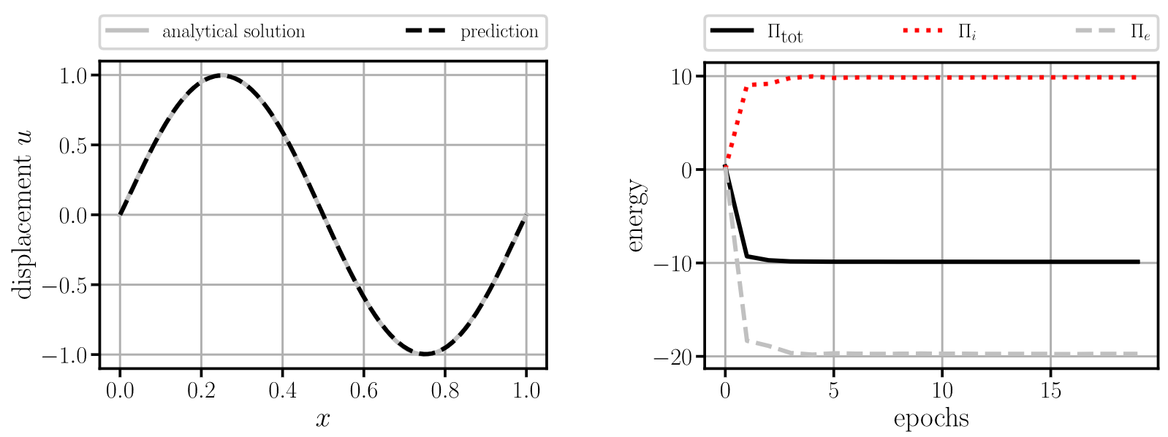

5.1.2 One-Dimensional Static Model
Results after 20 epochs
Faster predictions than with standard PINNs (fewer epochs & cheaper epochs)
Note, that the final potential energy $Π_{tot}$ is nonzero

Slide 14
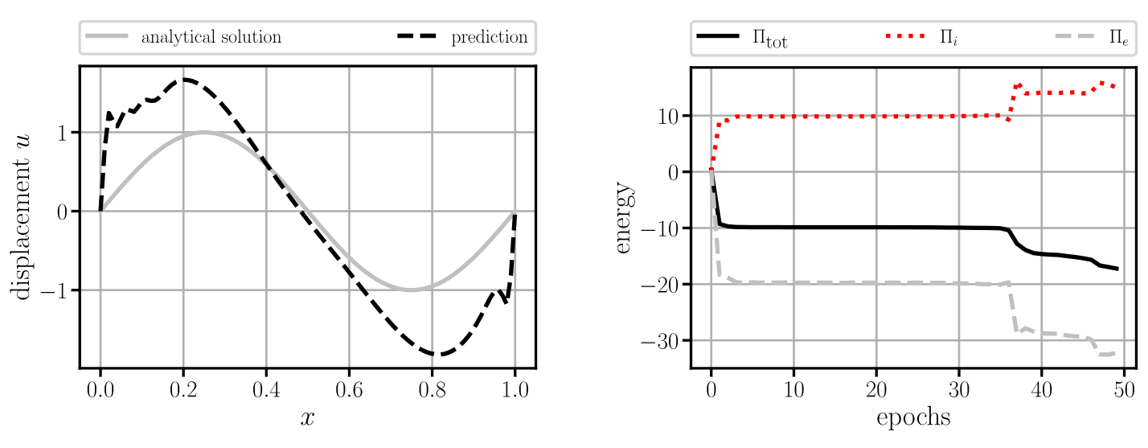
5.1.2 One-Dimensional Static Model
But: Overfitting after 35 iterations?
Can be avoided through regularization, such as early stopping (monitor the energies on a validation grid)

Slide 15
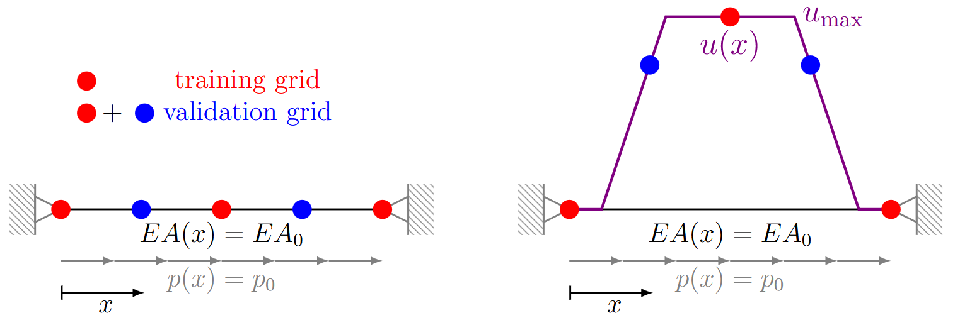


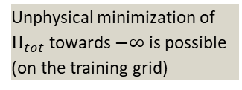
5.1.2 One-Dimensional Static Model
On quadrature rules for solving Partial Differential Equations using Neural Networks, Riviera et al. 2022
Why does the deep energy method overfit and PINNs do not?
Consider the following toy example
The proposed deformation leads to an external energy of $−∞$ for $u_{max}→∞$
$$Π_{e}=−\int_{Ω}^{ }{p\left(x\right)u\left(x\right)dx}→−∞$$
The internal energy of the system is zero on the training grid
$$Π_{i}=\frac{1}{2}\int_{Ω}^{ }{EA{\left(\frac{du}{dx}\right)}^{2}dx}=0$$
Toy example
One possibility of an “optimal“ deformation
Unphysical minimization of $Π_{tot}$ towards $−∞$ is possible (on the training grid)
$→$ use the validation grid!

Slide 16
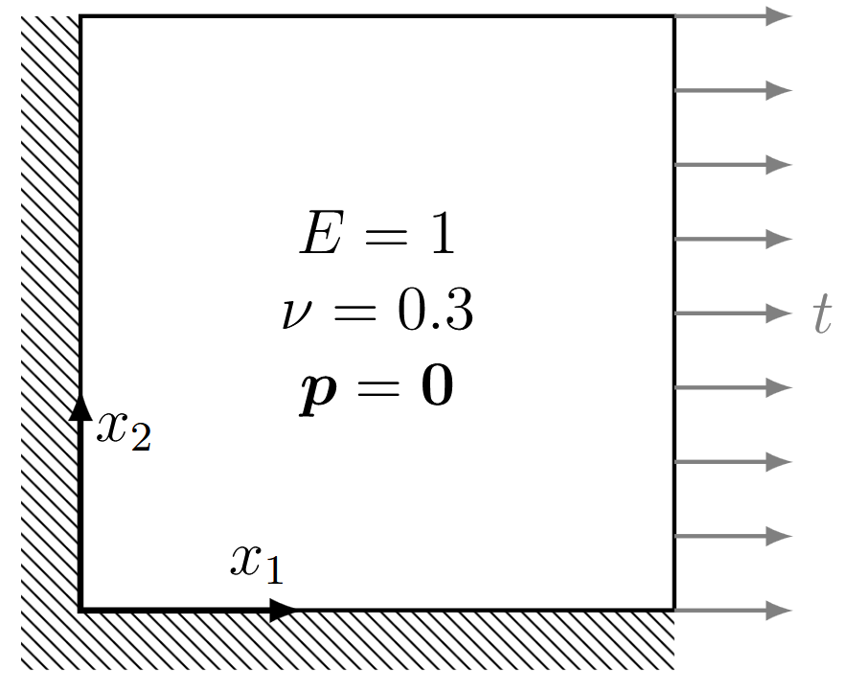
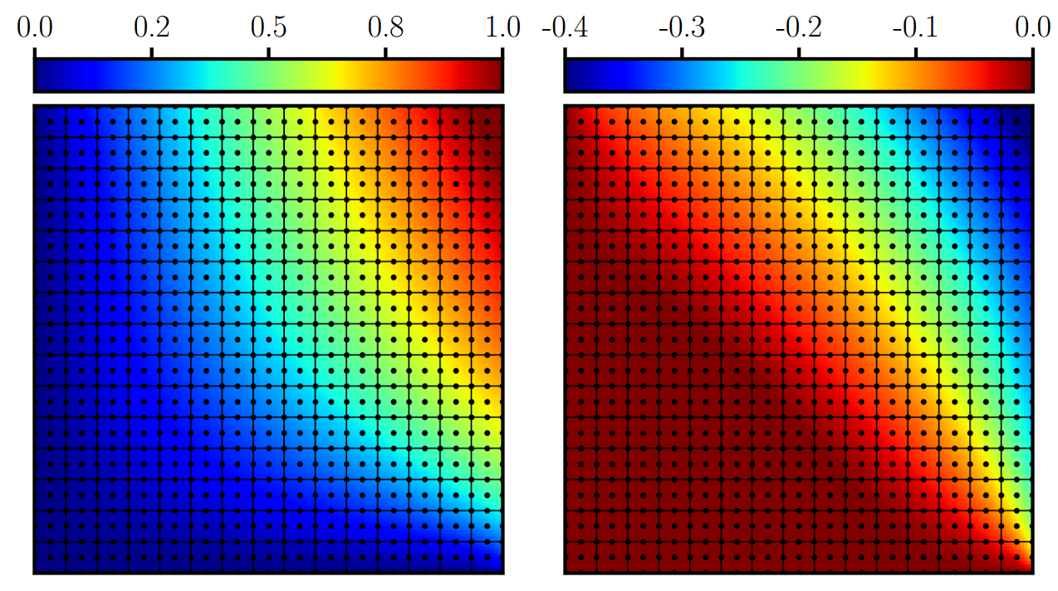
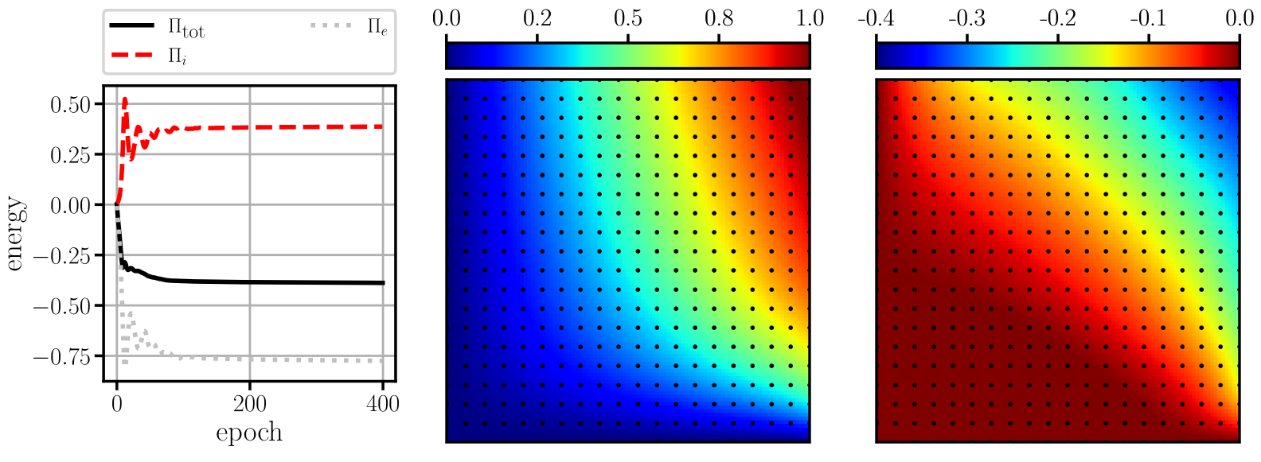





5.1.3 Two-Dimensional Static Model
Reconsider the plate in membrane action (with a stress singularity)
Prediction with deep energy method after 400 epochs with Adam (PINN took 5000)
Using $20×20$ collocation points
DEM: $400⋅∼4⋅{10}^{−3}$ s$=∼1.6$ s; PINN: $5000⋅∼2.3⋅{10}^{−2}$s$=∼1.2⋅{10}^{2}$ s: FEM: $∼9.1⋅{10}^{−2}$ s
$$u_{1}$$
$$u_{2}$$
$${\hat{u}}_{1}$$
$${\hat{u}}_{2}$$

Slide 17
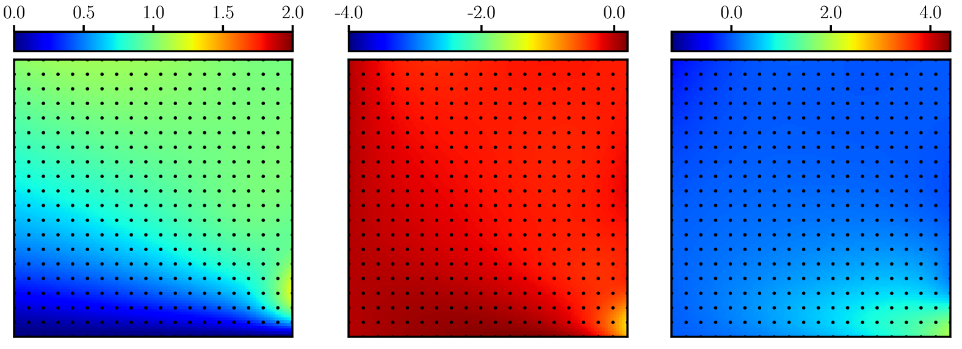
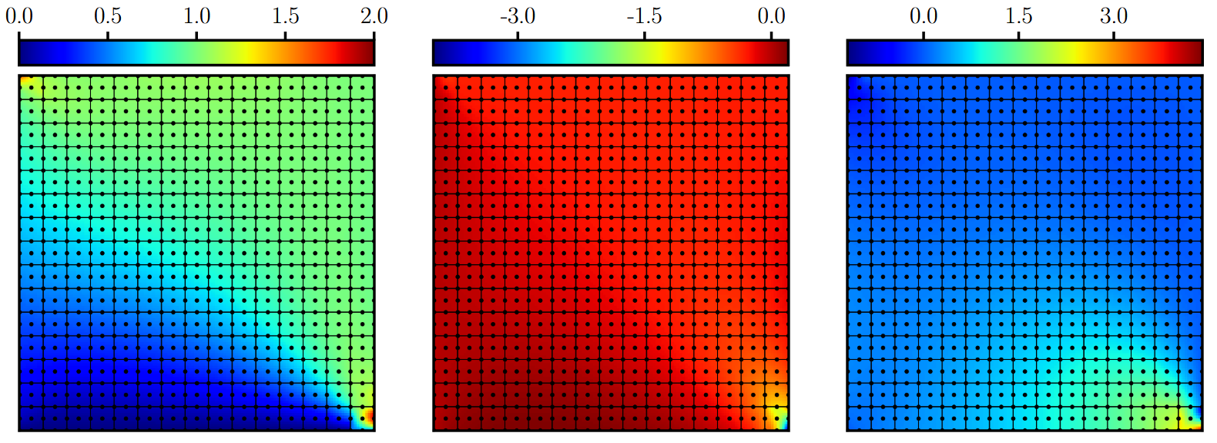




5.1.3 Two-Dimensional Static Model
Although displacement field $u$ has improved through deep energy method, the gradients remain inaccurate
Deep energy method
Finite element reference solution
$$ε_{11}$$
$$ε_{22}$$
$$ε_{12}$$

Slide 18
5.1.1 Deep Energy Method
Advantages
Lower order differential operators
(Possibility to work with singularities)
Disadvantages
Introduction of numerical errors through numerical integration
(More complex optimization task, if no strong enforcement of the boundary conditions is chosen)
No inbuilt regularization as empirically observed in PINNs
No direct inversion
Remedies
Finer grids or better integration schemes
Strong enforcement of the boundary conditions
Usage of a regularization technique

Slide 19
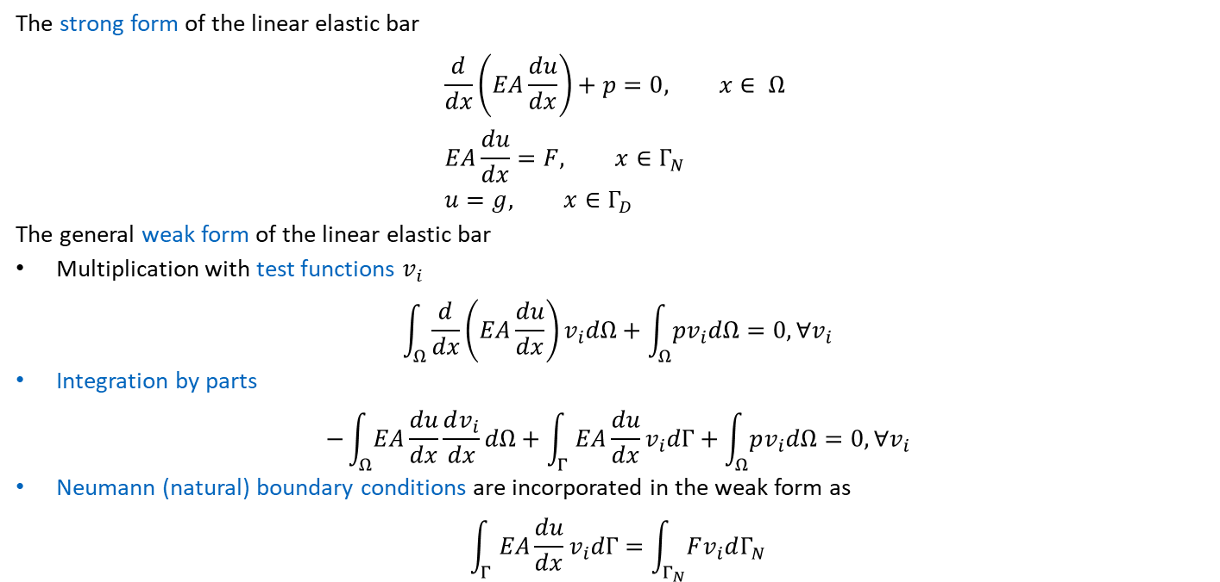
5.1.4 Variational Physics-Informed Neural Networks
Variational Physics-Informed Neural Networks For Solving Partial Differential Equations, Kharazmi et al. 2019
The strong form of the linear elastic bar
$$\frac{d}{dx}\left(EA\frac{du}{dx}\right)+p=0, x∈ Ω \\ EA\frac{du}{dx}=F, x∈Γ_{N} \\ u=g, x∈Γ_{D}$$
The general weak form of the linear elastic bar
Multiplication with test functions $v_{i}$
$$\int_{Ω}^{ }{\frac{d}{dx}\left(EA\frac{du}{dx}\right)v_{i}dΩ+\int_{Ω}^{ }{pv_{i}dΩ=0, ∀v_{i}}}$$
Integration by parts
$$−\int_{Ω}^{ }{EA}\frac{du}{dx}\frac{dv_{i}}{dx}dΩ+\int_{Γ}^{ }{EA\frac{du}{dx}v_{i}dΓ+\int_{Ω}^{ }{pv_{i}dΩ=0, ∀v_{i}}}$$
Neumann (natural) boundary conditions are incorporated in the weak form as
$$\int_{Γ}^{ }{EA\frac{du}{dx}v_{i}dΓ}=\int_{Γ_{N}}^{ }{Fv_{i}dΓ_{N}}$$

Slide 20
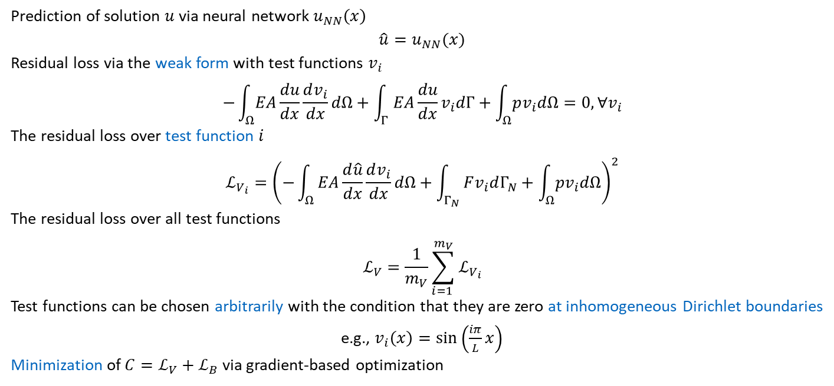
5.1.4 Variational Physics-Informed Neural Networks
Prediction of solution $u$ via neural network $u_{NN}\left(x\right)$
$$\hat{u}=u_{NN}(x)$$
Residual loss via the weak form with test functions $v_{i}$
$$−\int_{Ω}^{ }{EA}\frac{du}{dx}\frac{dv_{i}}{dx}dΩ+\int_{Γ}^{ }{EA\frac{du}{dx}v_{i}dΓ+\int_{Ω}^{ }{pv_{i}dΩ=0, ∀v_{i}}}$$
The residual loss over test function $i$
$$ℒ_{V_{i}}={\left(−\int_{Ω}^{ }{EA\frac{d\hat{u}}{dx}\frac{dv_{i}}{dx}dΩ+\int_{Γ_{N}}^{ }{Fv_{i}dΓ_{N}+\int_{Ω}^{ }{pv_{i}dΩ}}}\right)}^{2}$$
The residual loss over all test functions
$$ℒ_{V}=\frac{1}{m_{V}}\sum_{i=1 }^{m_{V}}{ℒ_{V_{i}}}$$
Test functions can be chosen arbitrarily with the condition that they are zero at inhomogeneous Dirichlet boundaries
e.g., $v_{i}\left(x\right)=sin\left(\frac{iπ}{L}x\right)$
Minimization of $C=ℒ_{V}+ℒ_{B}$ via gradient-based optimization

Slide 21
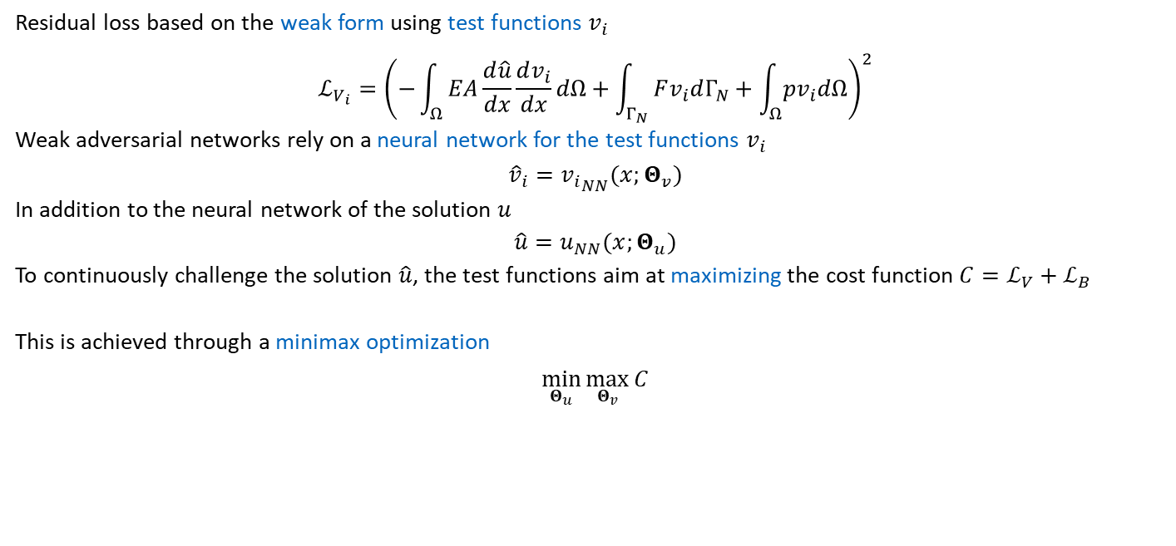
5.1.5 Weak Adversarial Networks
Weak adversarial networks for high-dimensional partial differential equations, Zang et al. 2020
Residual loss based on the weak form using test functions $v_{i}$
$$ℒ_{V_{i}}={\left(−\int_{Ω}^{ }{EA\frac{d\hat{u}}{dx}\frac{dv_{i}}{dx}dΩ+\int_{Γ_{N}}^{ }{Fv_{i}dΓ_{N}+\int_{Ω}^{ }{pv_{i}dΩ}}}\right)}^{2}$$
Weak adversarial networks rely on a neural network for the test functions $v_{i}$
$${\hat{v}}_{i}={v_{i}}_{NN}(x;Θ_{v})$$
In addition to the neural network of the solution $u$
$$\hat{u}=u_{NN}(x;Θ_{u})$$
To continuously challenge the solution $\hat{u}$, the test functions aim at maximizing the cost function $C=ℒ_{V}+ℒ_{B}$
This is achieved through a minimax optimization
$$\min_{Θ_{u}}{\max_{Θ_{v}}{C}}$$

Slide 22
Exercises
E.18 Variations of Physics-Informed Neural Networks (C)
Try the main variations of physics-informed neural networks on the one-dimensional static bar problem. Familiarize yourself with the implementational differences.
E.19 Deep Energy Method for a Plate in Membrane Action (C)
Use the deep energy method to obtain the solution of a plate in membrane action and compare the results with reference solutions obtained with the finite element method. Tune the neural network to improve convergence. Lastly compare the results with a standard physics-informed neural network using E.17

Slide 23
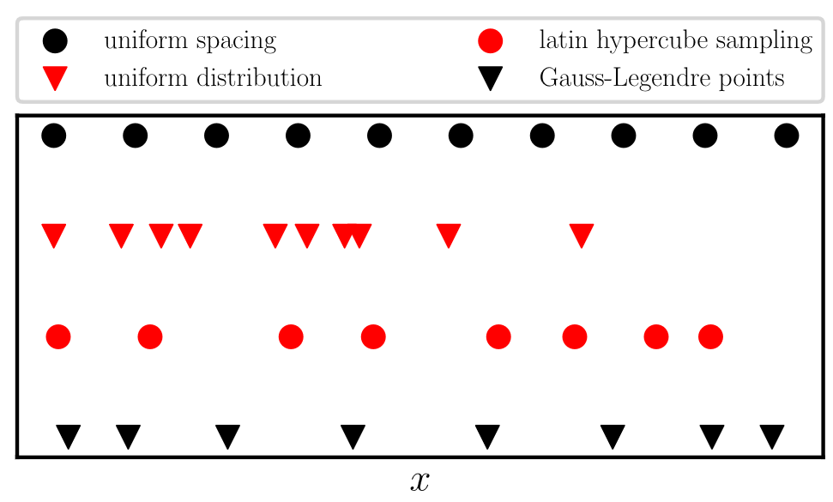
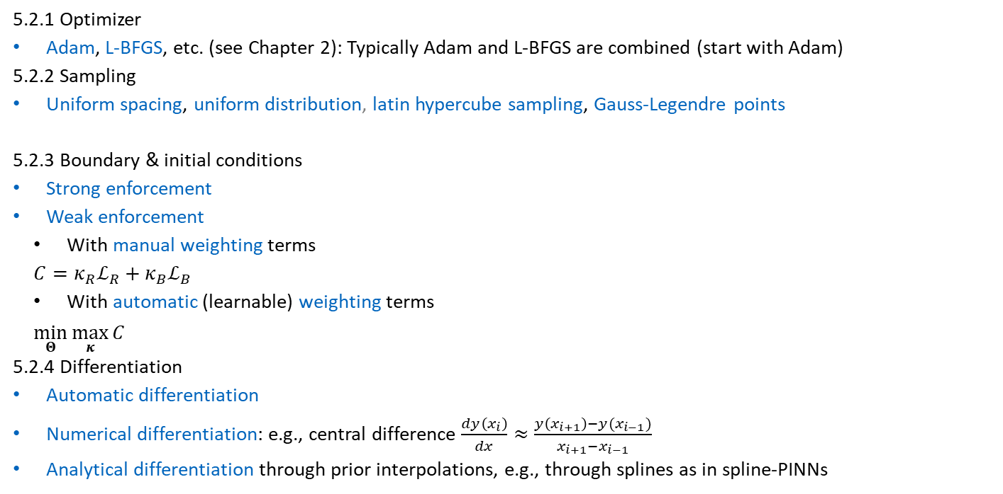
5.2 Extensions
5.2.1 Optimizer
Adam, L-BFGS, etc. (see Chapter 2): Typically Adam and L-BFGS are combined (start with Adam)
5.2.2 Sampling
Uniform spacing, uniform distribution, latin hypercube sampling, Gauss-Legendre points
5.2.3 Boundary & initial conditions
Strong enforcement
Weak enforcement
With manual weighting terms
$$C=κ_{R}ℒ_{R}+κ_{B}ℒ_{B}$$
With automatic (learnable) weighting terms
$$\min_{Θ}{\max_{κ}{C}}$$
5.2.4 Differentiation
Automatic differentiation
Numerical differentiation: e.g., central difference $\frac{dy\left(x_{i}\right)}{dx}≈\frac{y\left(x_{i+1}\right)−y(x_{i−1})}{x_{i+1}−x_{i−1}}$
Analytical differentiation through prior interpolations, e.g., through splines as in spline-PINNs

Slide 24
Exercises
E.20 Extensions for Physics-Informed Neural Networks (C)
Try the different extensions for physics-informed neural networks (optimizer, sampling, loss term weighting, strong enforcement, weighting per collocation point, learning rate scheduling, activation functions, numerical differentiation, convolutional neural networks, feature encoding layers). Understand when which extension is beneficial and familiarize yourself with the implementations.

Slide 25
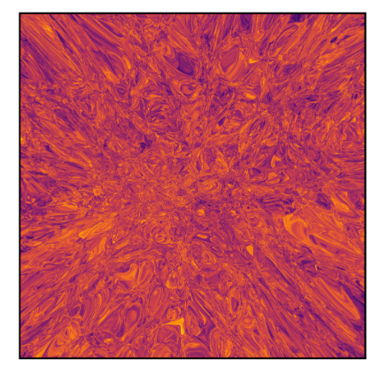
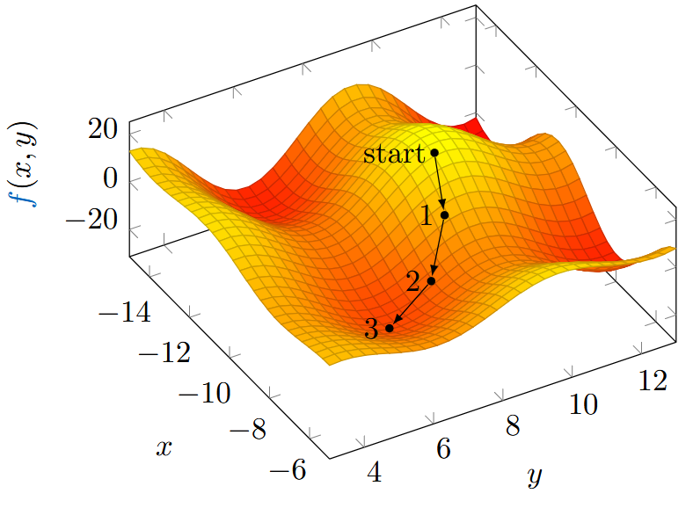


5.2.5 Ansatz
Neural network ansatz
$$f_{NN}=f_{3}\left(f_{2}\left(f_{1}\left(x\right)\right)\right)$$
High representational capacity
Nested nonlinearities requires iterative solution procedure
Finite element ansatz
$$f_{FEM}=\sum_{i=1}^{n}{N_{i}\left(x\right)u_{i}}$$
Lower representational capacity
Can be solved directly (one matrix inversion)
$$KU=F \\ U=K^{−1}F$$
Can the advantages of both Ansatz spaces be combined?
Finite element interpolated neural networks
Hierarchical deep learning neural networks (HiDeNN)

Slide 26
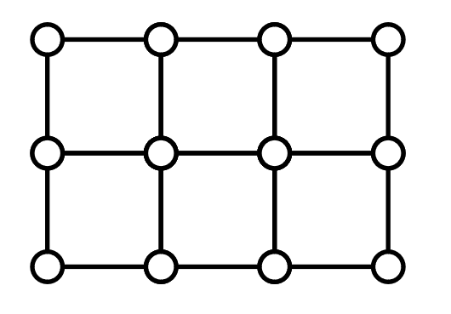
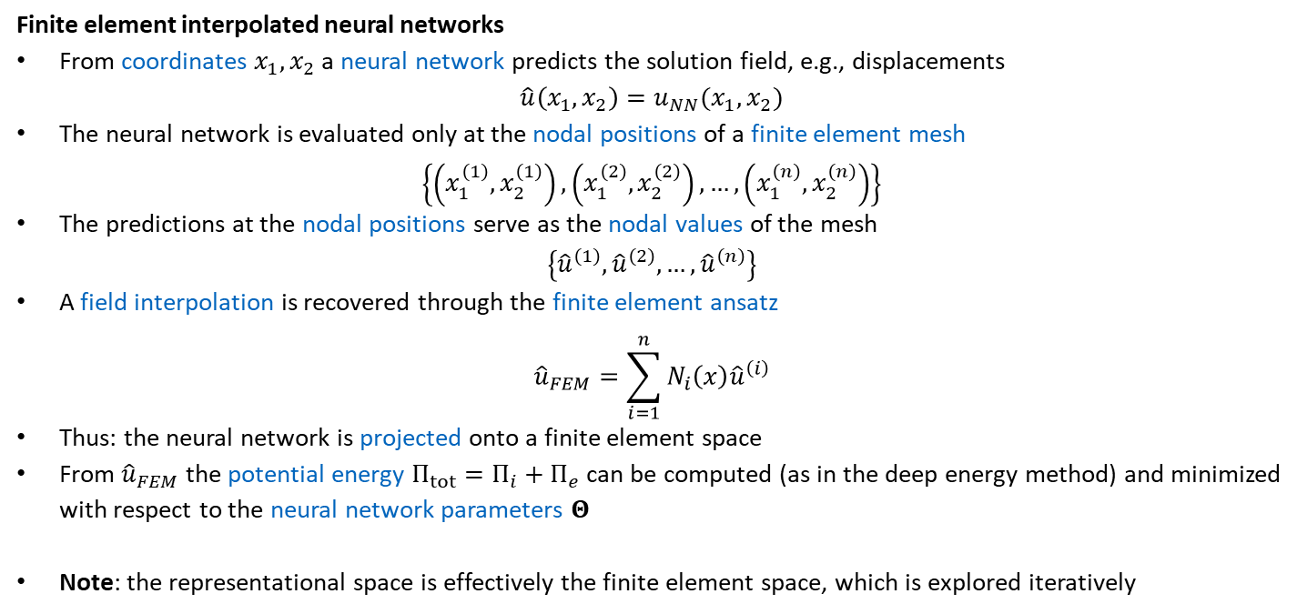
5.2.5.3 Finite Element Interpolated Neural Networks
Finite element interpolated neural networks for solving forward and inverse problems, Badia et al. 2024
Finite element interpolated neural networks
From coordinates $x_{1}, x_{2}$ a neural network predicts the solution field, e.g., displacements
$$\hat{u}\left(x_{1},x_{2}\right)=u_{NN}(x_{1},x_{2})$$
The neural network is evaluated only at the nodal positions of a finite element mesh
$$\left\{\left(x_{1}^{\left(1\right)},x_{2}^{\left(1\right)}\right),\left(x_{1}^{\left(2\right)},x_{2}^{\left(2\right)}\right),…,\left(x_{1}^{\left(n\right)},x_{2}^{\left(n\right)}\right)\right\}$$
The predictions at the nodal positions serve as the nodal values of the mesh
$$\left\{{\hat{u}}^{\left(1\right)},{\hat{u}}^{\left(2\right)},…,{\hat{u}}^{\left(n\right)}\right\}$$
A field interpolation is recovered through the finite element ansatz
$${\hat{u}}_{FEM}=\sum_{i=1}^{n}{N_{i}\left(x\right){\hat{u}}^{\left(i\right)}}$$
Thus: the neural network is projected onto a finite element space
From ${\hat{u}}_{FEM}$ the potential energy $Π_{tot}=Π_{i}+Π_{e}$ can be computed (as in the deep energy method) and minimized with respect to the neural network parameters $Θ$
Note: the representational space is effectively the finite element space, which is explored iteratively

Slide 27
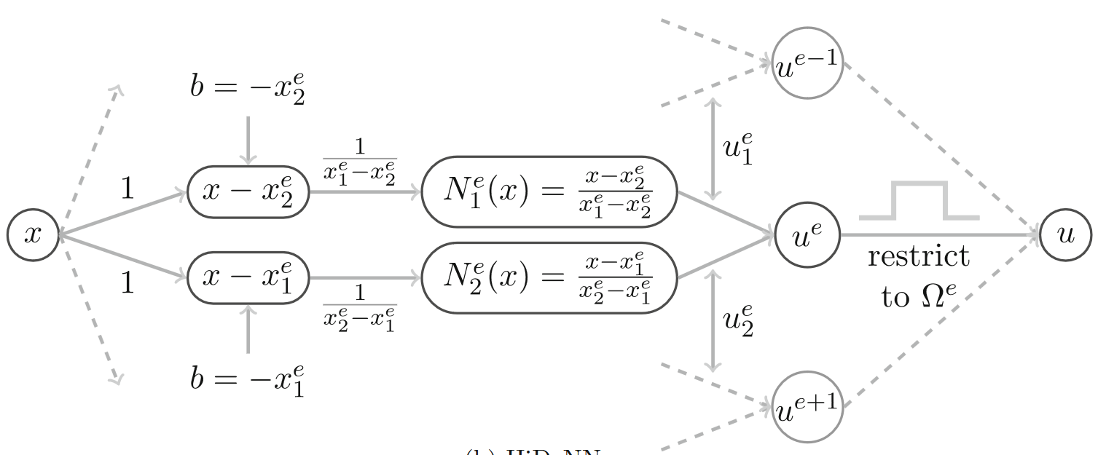


5.2.5.4 Hierarchical Deep Learning Neural Networks
Hierarchical deep-learning neural networks: finite elements and beyond, Zhang et al. 2021
HiDeNN also reduces the space to the finite element space
Finite elements and neural networks are both composed of linear transformations & nonlinearities
Assemble a neural network from finite elements (i.e., a neural network constrained to the finite element space)
From the predicted $\hat{u}$ the potential energy $Π_{tot}=Π_{i}+Π_{e}$ can be computed and minimized with respect to the standard nodal degrees of freedom of a finite element ansatz
The gradients are obtained with automatic differentiation (although they can be obtained analytically)
One-dimensional finite element
Hardcoding the shape functions is faster than treating them as a neural network.
Corresponding HiDeNN architecture
Using the analytical gradients is faster!
Deep learning in computational mechanics: a review, Herrmann et al. 2023

Slide 28
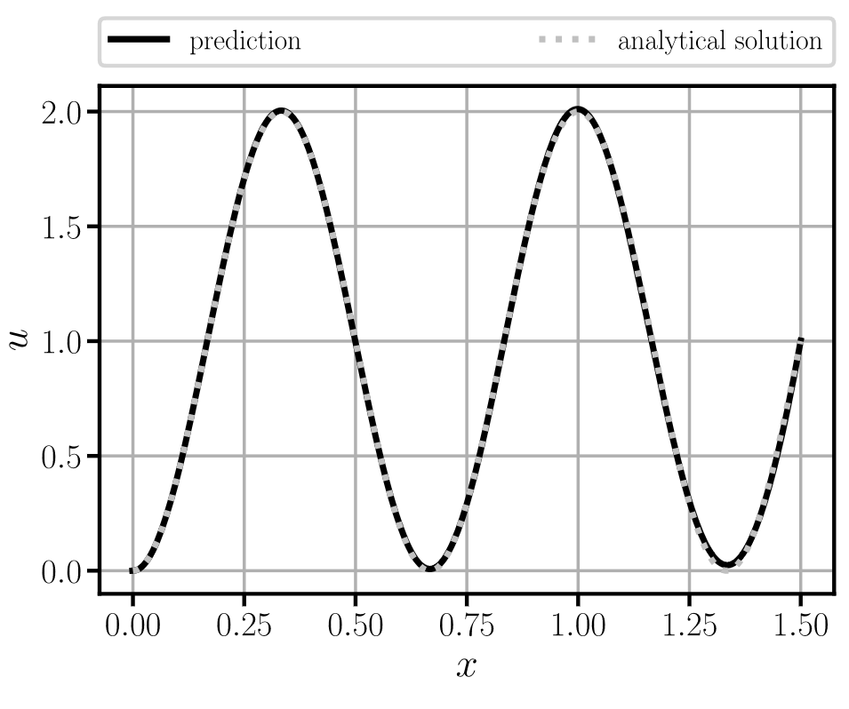
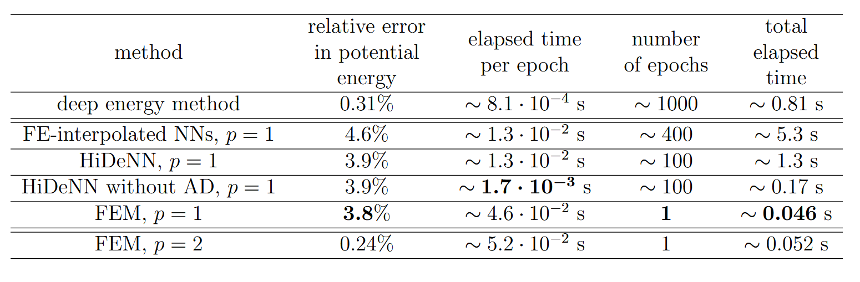
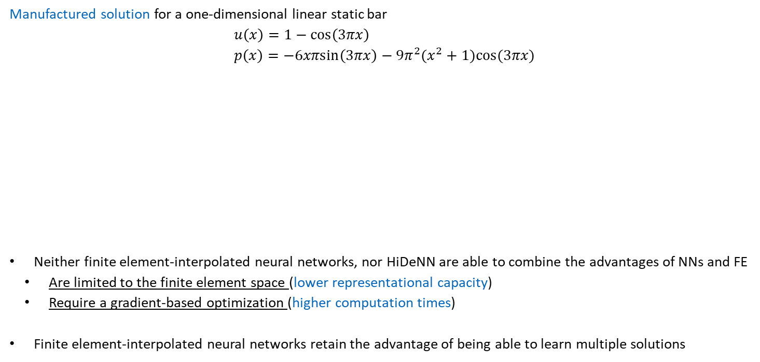
5.2.5.5 Comparison to the Finite Element Method
Manufactured solution for a one-dimensional linear static bar
$$u\left(x\right)=1−cos\left(3πx\right) \\ p\left(x\right)=−6xπsin\left(3πx\right)−9π^{2}(x^{2}+1)cos(3πx)$$
Neither finite element-interpolated neural networks, nor HiDeNN are able to combine the advantages of NNs and FE
Are limited to the finite element space (lower representational capacity)
Require a gradient-based optimization (higher computation times)
Finite element-interpolated neural networks retain the advantage of being able to learn multiple solutions

Slide 29
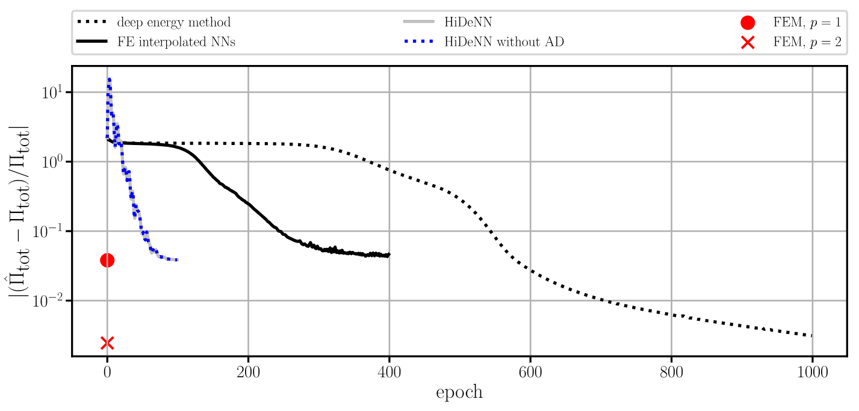
5.2.5.5 Comparison to the Finite Element Method
Visualization of convergence over the epochs

Slide 30
Exercises
E.21 Variations of the Ansatz Space (C)
Compare the different Ansatz spaces (i.e., neural network and finite element) on the one-dimensional static bar problem using the different solvers (gradient-based optimization and direct solving when possible). The considered methods are the deep energy method, FE-interpolated neural networks, HiDeNN (with and without automatic differentiation), and the finite element method.

Slide 31
Contents
4 Introduction to Physics-Informed Neural Networks
5.1 Variations
5.1.1 Deep Energy Method
5.1.4 Variational Physics-Informed Neural Networks
5.1.5 Weak Adversarial Networks
5.2 Extensions
5.2.5 Ansatz (Finite Element Interpolated Neural Networks & Hierarchical Deep Learning Neural Networks)
6 Machine Learning in Computational Mechanics

Slide 32
5 Advanced Physics-Informed Neural Networks
Leon Herrmann
Stefan Kollmannsberger
Chair of Data Engineering in Construction
Bauhaus-Universität Weimar
Deep Learning in Computational Mechanics – an introductory course, Herrmann et al. 2025
website
book
Notes:
generated with https://www.the-qrcode-generator.com/

