Slide 1


9 Inverse Problems & Deep Learning: Basic Methodology
Leon Herrmann
Stefan Kollmannsberger
Chair of Data Engineering in Construction
Bauhaus-Universität Weimar
Deep Learning in Computational Mechanics – an introductory course, Herrmann et al. 2025
website
book
Notes:
generated with https://www.the-qrcode-generator.com/

Slide 2
Contents
8 Generative Artificial Intelligence
9 Inverse Problems
9.1 Basic Methodology
9.1.1 Physics-Informed Neural Networks
9.1.2 Iterative Forward Solvers
9.1.3 Data-Driven Solvers
9.2 Ultrasonic Nondestructive Testing
9.2.1 Acoustic Wave Equation
9.2.3 Physics-Informed Neural Networks
9.2.4 Iterative Forward Solver with Neural Network Ansatz
9.2.5 Data-Driven Solver & Transfer Learning
9.3 Topology Optimization
9.3.3 Iterative Forward Solver with Neural Network Ansatz (Compliance & Acoustic Optimization)

Slide 3
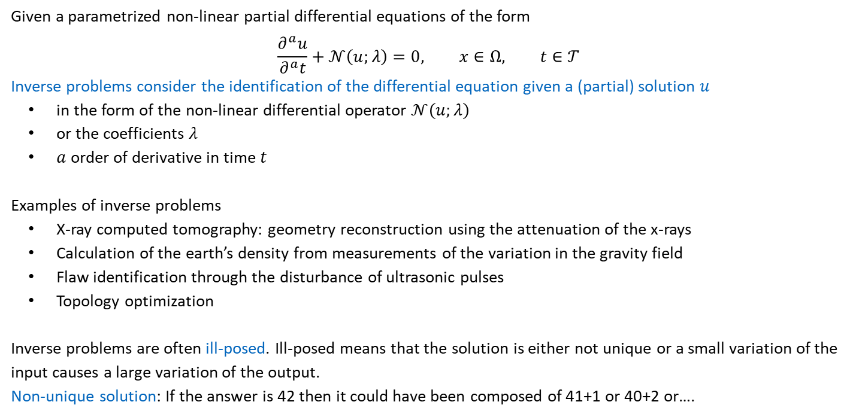
9 Inverse Problems
Given a parametrized non-linear partial differential equations of the form
$$\frac{∂^{a}u}{∂^{a}t}+𝒩\left(u;λ\right)=0, x∈Ω, t∈𝒯$$
Inverse problems consider the identification of the differential equation given a (partial) solution $u$
in the form of the non-linear differential operator $𝒩\left(u;λ\right)$
or the coefficients $λ$
$a$ order of derivative in time $t$
Examples of inverse problems
X-ray computed tomography: geometry reconstruction using the attenuation of the x-rays
Calculation of the earth’s density from measurements of the variation in the gravity field
Flaw identification through the disturbance of ultrasonic pulses
Topology optimization
Inverse problems are often ill-posed. Ill-posed means that the solution is either not unique or a small variation of the input causes a large variation of the output.
Non-unique solution: If the answer is 42 then it could have been composed of 41+1 or 40+2 or….

Slide 4
9.1 Basic Methodology
Three main methodologies in deep learning
Physics-Informed Neural Networks (e.g. the elastic bar discussed in Chapter 5)
Minimization of the residual of the partial differential equation
Sub-method of physics-informed learning (see Chapter 10)
Iterative Forward Solvers
Minimization of the residual between measurement data and the solution to the differential equation in an alternating fashion
Enforcement of physical laws by use of classical methods for the solution of differential equations
Data-driven solvers
Minimization of the residual between predictions and labelled data
Physics is ”learnt” by NN
Degree of enforcement of the underlying physics decreases from top to bottom

Slide 5
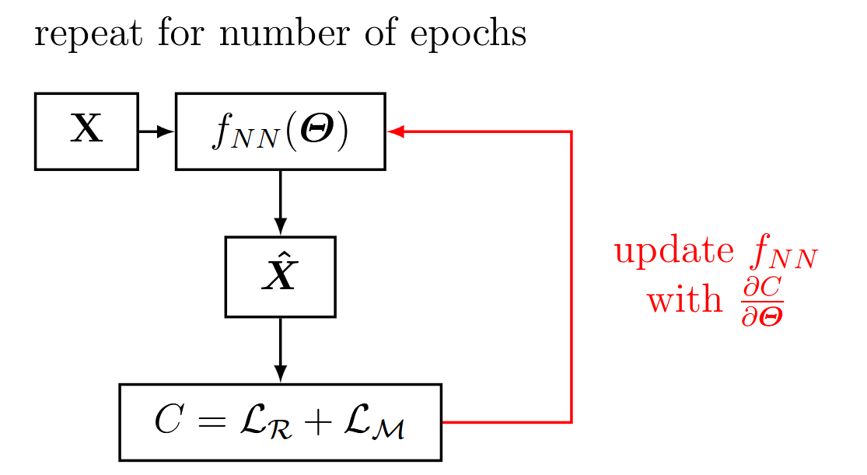
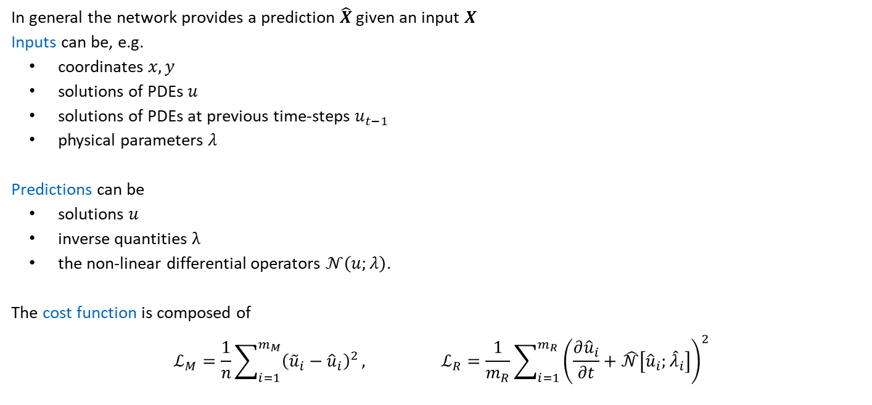
9.1.1 Physics-Informed Neural Networks
In general the network provides a prediction $\hat{X}$ given an input $X$
Inputs can be, e.g.
coordinates $x, y$
solutions of PDEs $u$
solutions of PDEs at previous time-steps $u_{t−1}$
physical parameters $λ$
Predictions can be
solutions $u$
inverse quantities $λ$
the non-linear differential operators $𝒩\left(u;λ\right)$.
The cost function is composed of
$$ℒ_{M}=\frac{1}{n}\sum_{i=1}^{m_{M}}{{\left({\tilde{u}}_{i}−{\hat{u}}_{i}\right)}^{2}}, ℒ_{R}=\frac{1}{m_{R}}\sum_{i=1}^{m_{R}}{{\left(\frac{∂{\hat{u}}_{i}}{∂t}+\hat{𝒩}\left[{\hat{u}}_{i};{\hat{λ}}_{i}\right]\right)}^{2}}$$

Slide 6
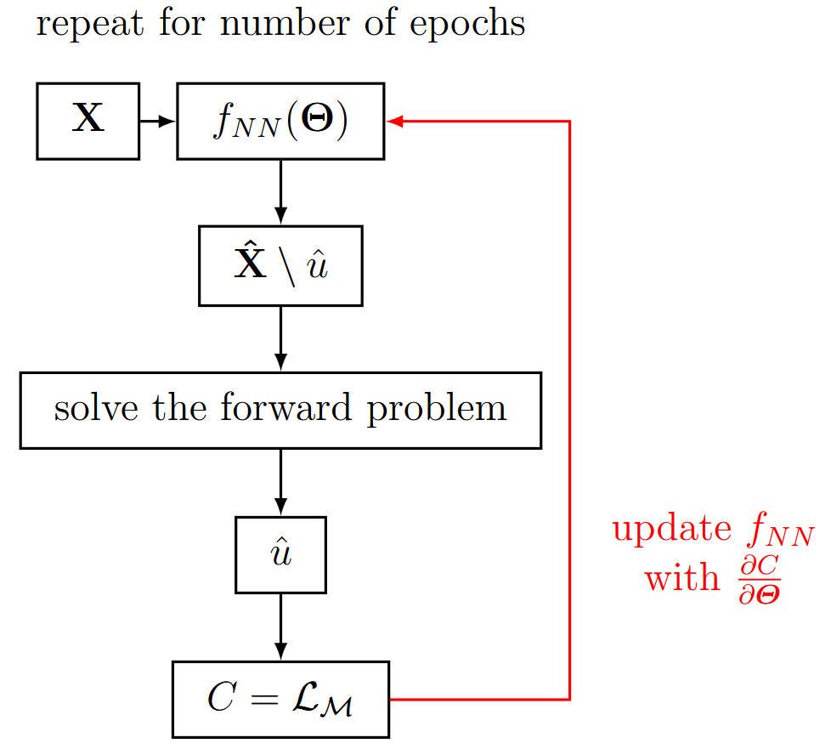
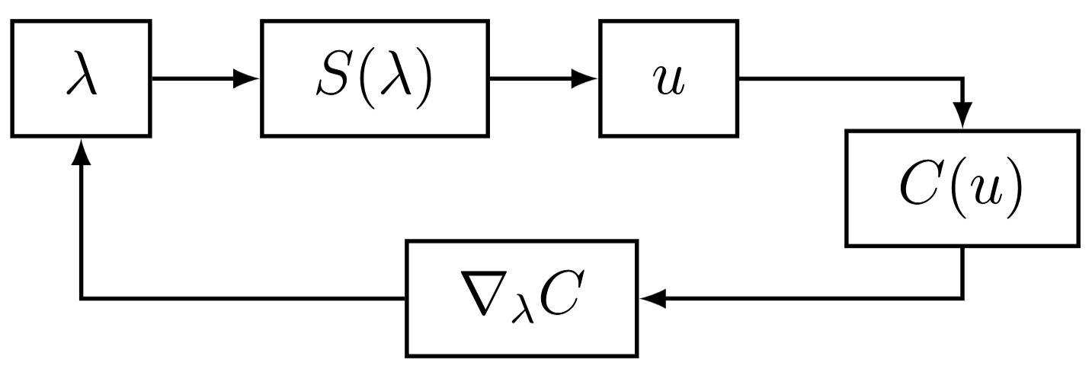

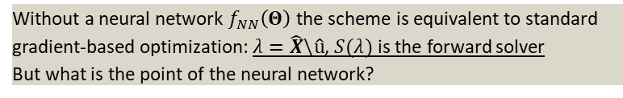
9.1.2 Iterative Forward Solvers
In general the network provides a prediction $\hat{X}\backslash \hat{u}$ without the solution to the PDE given an input $X$
The prediction $\hat{X}\backslash \hat{u}$ is the used to solve the forward problem with a conventional approach yielding $\hat{u}$
The predicted solution $\hat{u}$ is used to compute the measurement loss as cost function
${C=ℒ}_{M}=\frac{1}{n}\sum_{i=1}^{m_{M}}{{\left({\tilde{u}}_{i}−{\hat{u}}_{i}\right)}^{2}}$
The physics are indirectly enforced by the forward solver
Only finds a single solution
Without a neural network $f_{NN}\left(Θ\right)$ the scheme is equivalent to standard gradient-based optimization: $λ=\hat{X}\backslash \hat{u}$, $S(λ)$ is the forward solver
But what is the point of the neural network?

Slide 7
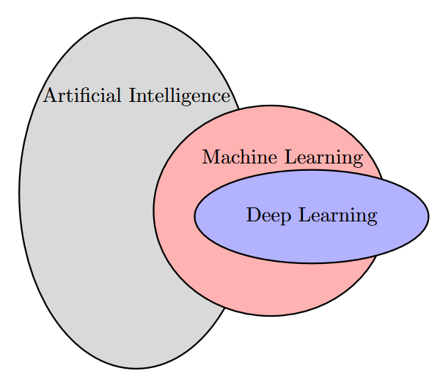
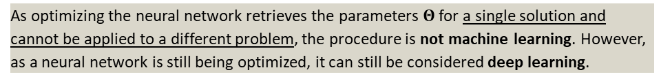

9.1.2.1 Neural Network Ansatz in Iterative Solvers
Standard gradient-based optimizer
Parametrization of $λ$ with classical ansatz functions (e.g., FEM)
$$\hat{λ}\left(x\right)≈\sum_{i}{λ_{i}N_{i}(x)}$$
Where $λ_{i}$ are the coefficients and $N_{i}\left(x\right)$ the shape functions
Given a set of coefficients $λ_{i}$ the forward solution $u$ is computed with the forward solver $S(λ)$
The quality of $λ_{i}$ is assessed by the cost function $C\left(u\right)$
The derivative $∇_{λ}C$ is used to update the set of coefficients $λ_{i}$
$$λ_{i}^{n+1}=λ_{i}^{n}−α∇_{λ}C$$
Iterative Forward Solver with Neural Network Ansatz
Instead of relying on a classical parametrization of $λ$, a neural network is employed
$$\hat{λ}\left(x\right)≈λ_{NN}\left(x;Θ\right)$$
The coefficients are thus the neural network parameters $Θ$
As optimizing the neural network retrieves the parameters $Θ$ for a single solution and cannot be applied to a different problem, the procedure is not machine learning. However, as a neural network is still being optimized, it can still be considered deep learning.
Notes:
Creating a PowerPoint macro with ChatGPT – Orr Editorial

Slide 8
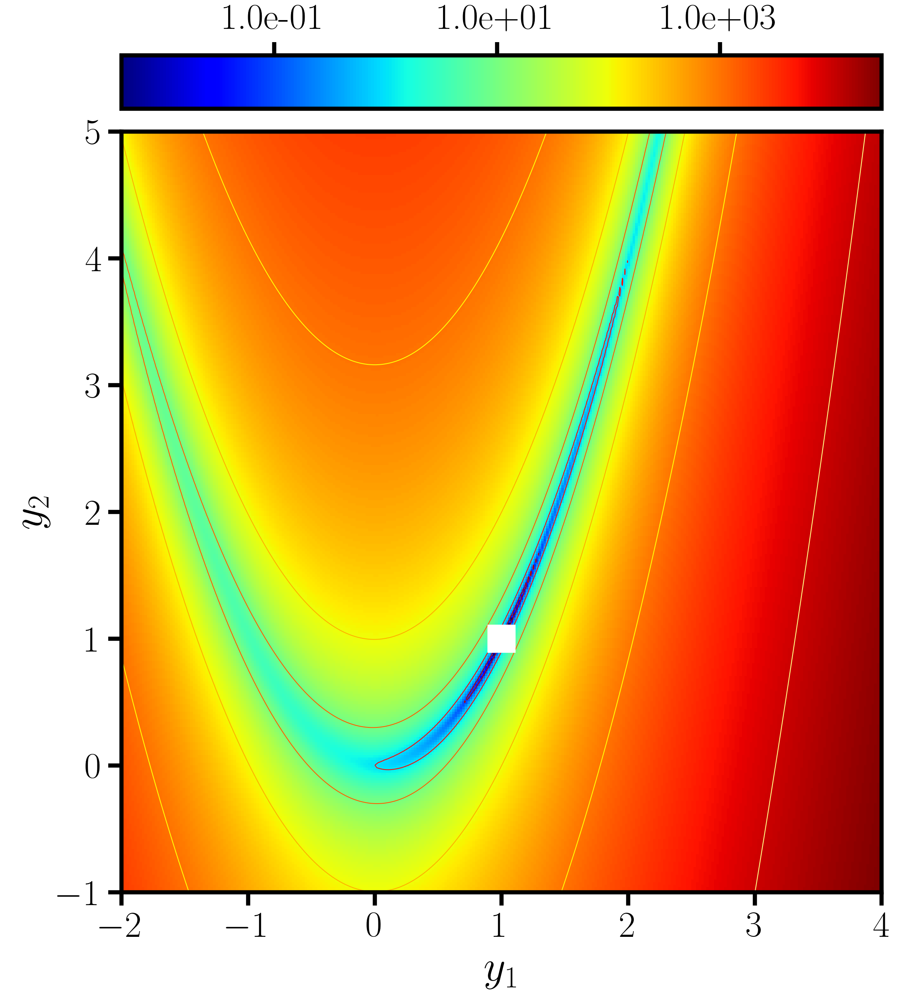

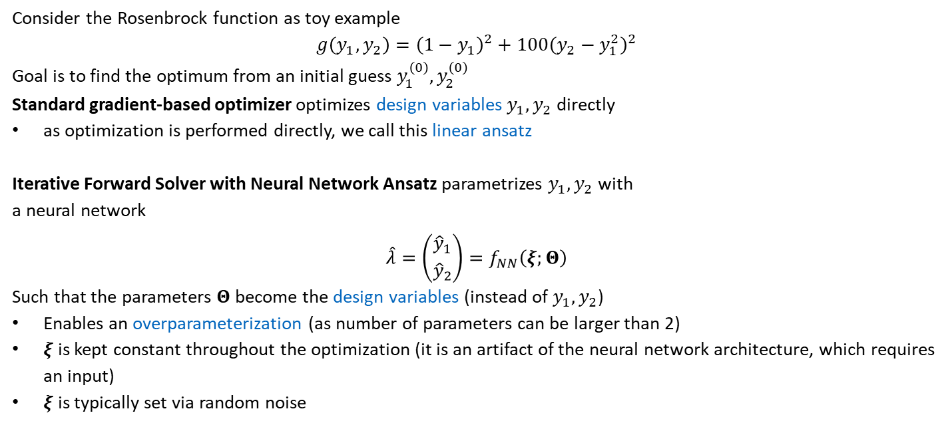
9.1.2.2 Motivation for a Neural Network Ansatz
On neural networks for generating better local optima in topology optimization, Herrmann et al. 2024
Consider the Rosenbrock function as toy example
$$g\left(y_{1},y_{2}\right)={\left(1−y_{1}\right)}^{2}+100{\left(y_{2}−y_{1}^{2}\right)}^{2}$$
Goal is to find the optimum from an initial guess $y_{1}^{\left(0\right)}, y_{2}^{\left(0\right)}$
Standard gradient-based optimizer optimizes design variables $y_{1}, y_{2}$ directly
as optimization is performed directly, we call this linear ansatz
Iterative Forward Solver with Neural Network Ansatz parametrizes $y_{1}, y_{2}$ with a neural network
$$\hat{λ}=\left({{\hat{y}}_{1} \atop {\hat{y}}_{2}}\right)=f_{NN}\left(ξ;Θ\right)$$
Such that the parameters $Θ$ become the design variables (instead of $y_{1}, y_{2}$)
Enables an overparameterization (as number of parameters can be larger than 2)
$ξ$ is kept constant throughout the optimization (it is an artifact of the neural network architecture, which requires an input)
$ξ$ is typically set via random noise
With optimum at $y_{1}=1, y_{2}=1$

Slide 9
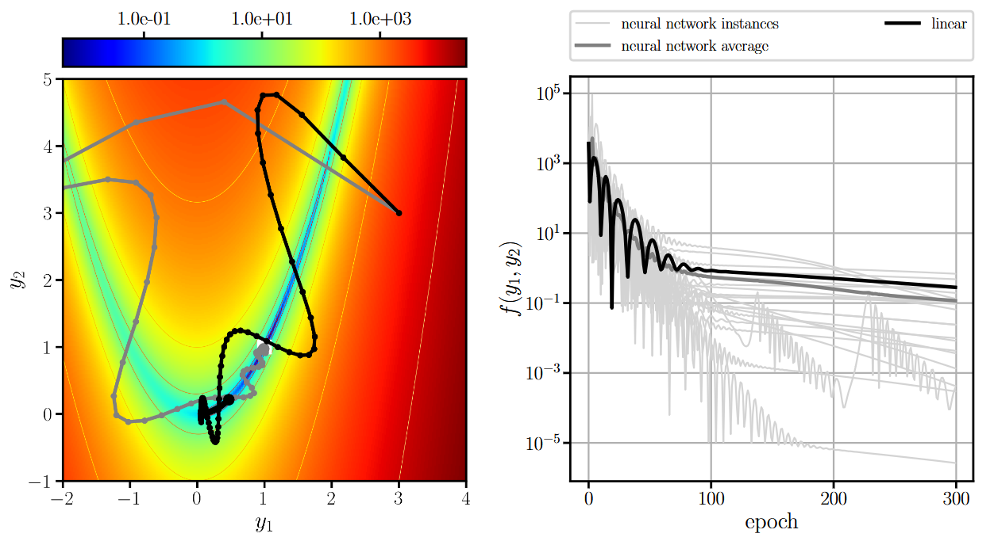
9.1.2.2 Motivation for a Neural Network Ansatz
Linear ansatz versus neural network ansatz on the Rosenbrock function (after 300 epochs)
Further improvements are possible by reintegrating machine learning via transfer learning (see 9.2.5.1)
For most initializations, the neural network is better
Advantage is only possible when using the Adam optimizer for both parametrizations

Slide 10
Exercises
E.31 Neural Network Ansatz on Optimization Benchmarks (C)
Compare a neural network ansatz with a linear ansatz on four basic optimization benchmarks (Rosenbrock, Rastrigrin, Ackley, Levy) using different optimizers (gradient descent with momentum, AdaGrad, RMSprop, Adam, and L-BFGS).

Slide 11
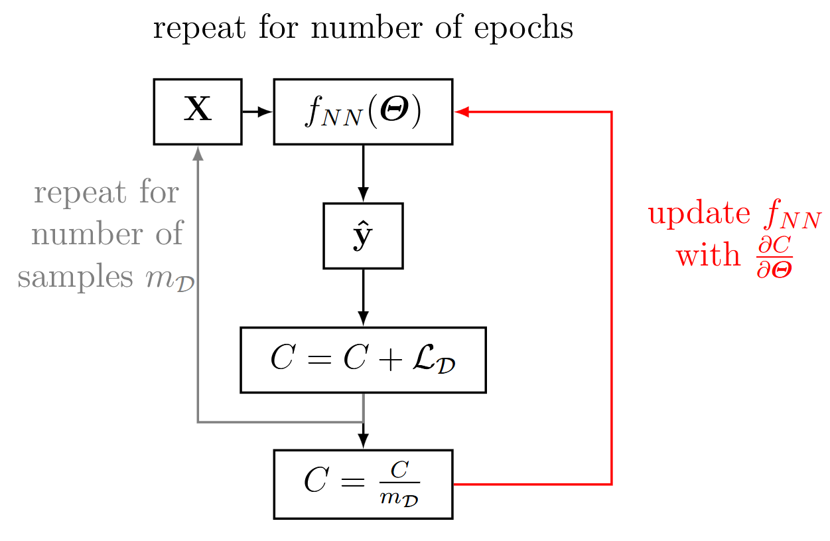

9.1.3 Data-Driven Solvers
In data-driven solvers, a labelled data-set of a physical problem is known as
$$(\tilde{X}, \tilde{y})$$
The neural network predicts the label $\hat{y}$ given an input $X$
This process is repeated over the whole dataset
The cost function is the error between the predictions and the labelled data
$C=\frac{1}{m_{D}}\sum_{i=1}^{m_{D}}{{\left({\tilde{y}}_{i}−{\hat{y}}_{i}\right)}^{2}}$
Data driven solvers…
require an off-line training phase (“expensive”)
learn multiple solutions
deliver fast predictions in the on-line phase (“cheap”)
require a very large amount of data
Do not enforce laws of physics. Physics is “observed and learnt”
Conceptually identical with the surrogate model for learning strain distributions in Chapter 3

Slide 12
Contents
8 Generative Artificial Intelligence
9 Inverse Problems
9.1 Basic Methodology
9.1.1 Physics-Informed Neural Networks
9.1.2 Iterative Forward Solvers
9.1.3 Data-Driven Solvers
9.2 Ultrasonic Nondestructive Testing
9.2.1 Acoustic Wave Equation
9.2.3 Physics-Informed Neural Networks
9.2.4 Iterative Forward Solver with Neural Network Ansaty
9.2.5 Data-Driven Solver & Transfer Learning
9.3 Topology Optimization
9.3.3 Iterative Forward Solver with Neural Network Ansatz (Compliance & Acoustic Optimization)

Slide 13
9 Inverse Problems & Deep Learning: Basic Methodology
Leon Herrmann
Stefan Kollmannsberger
Chair of Data Engineering in Construction
Bauhaus-Universität Weimar
Deep Learning in Computational Mechanics – an introductory course, Herrmann et al. 2025
website
book
Notes:
generated with https://www.the-qrcode-generator.com/

